Slide 1
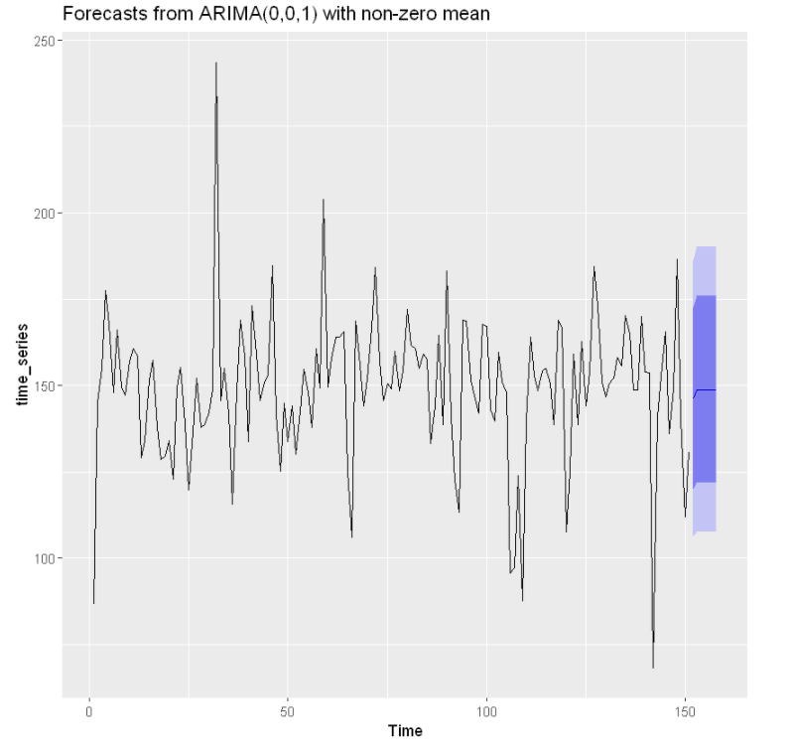
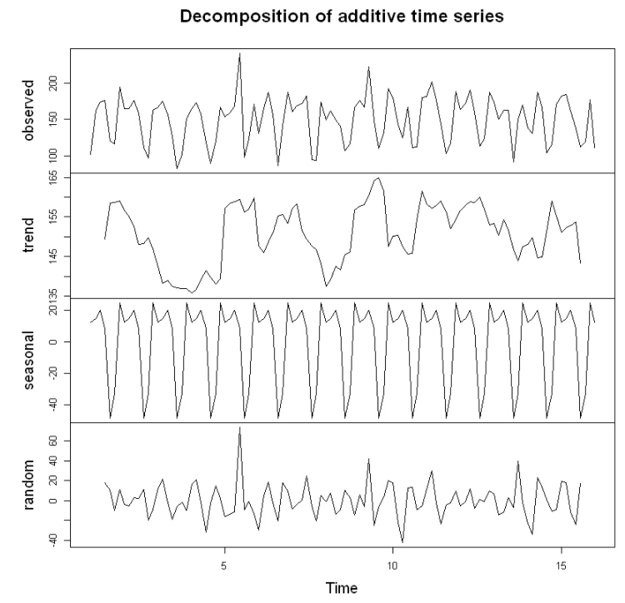
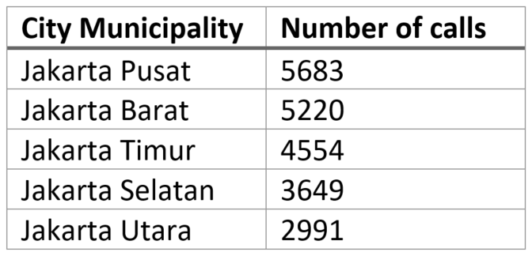
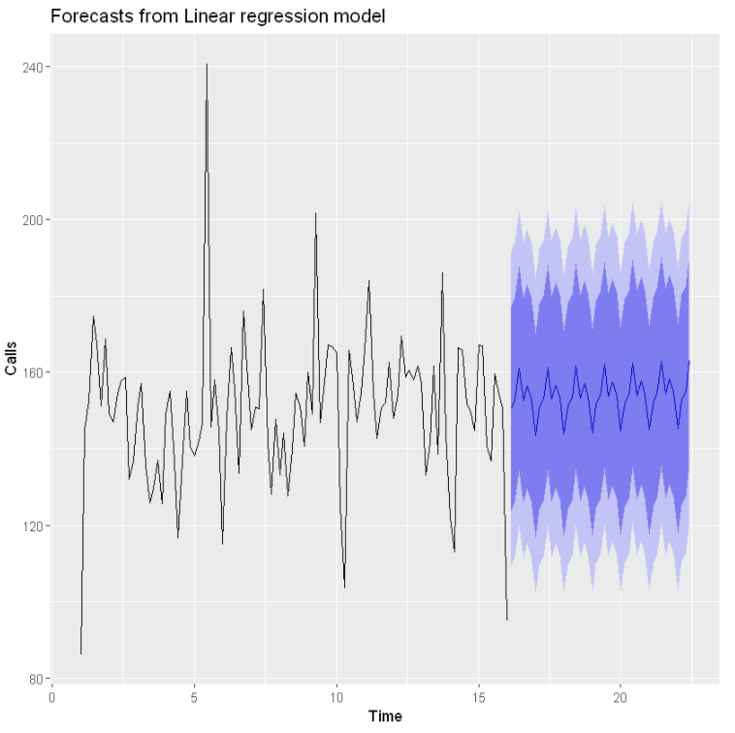
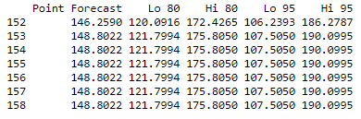
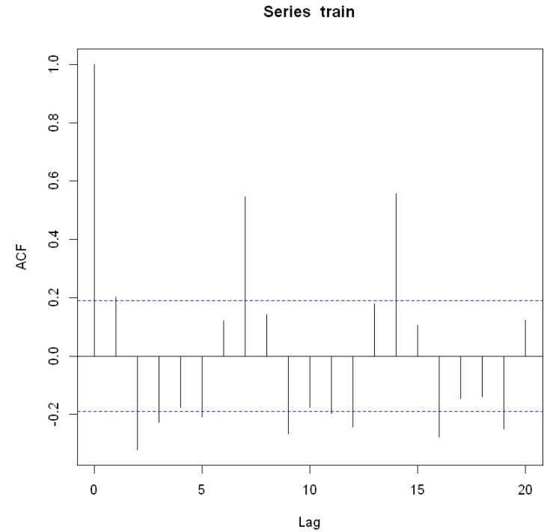
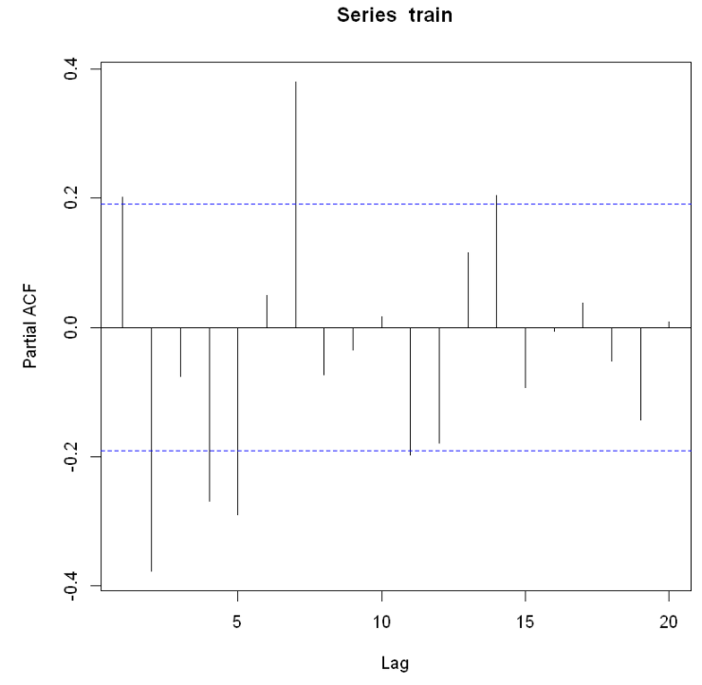
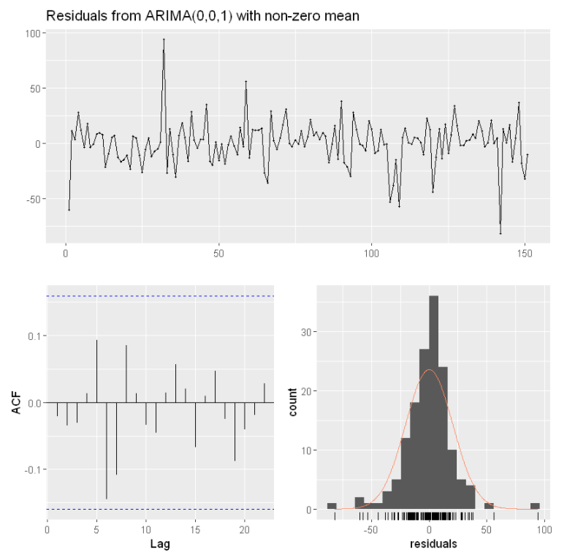
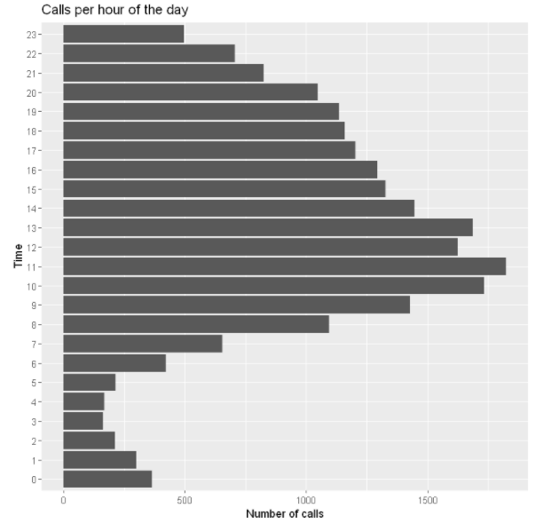
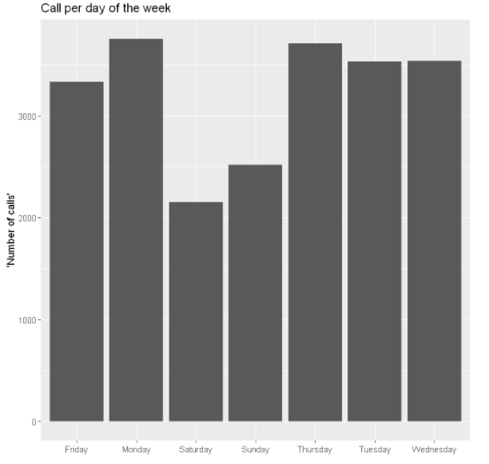
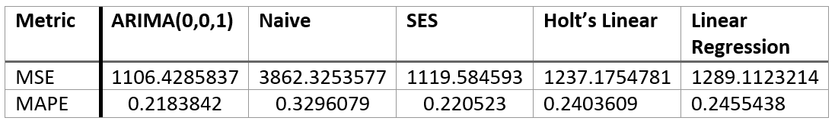
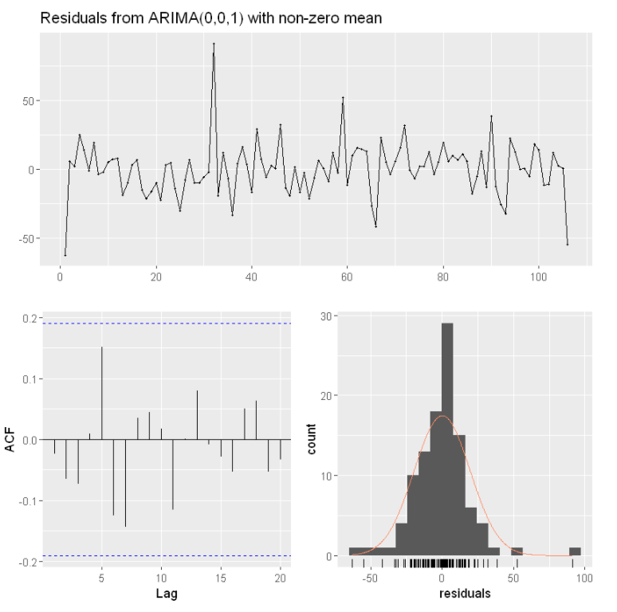
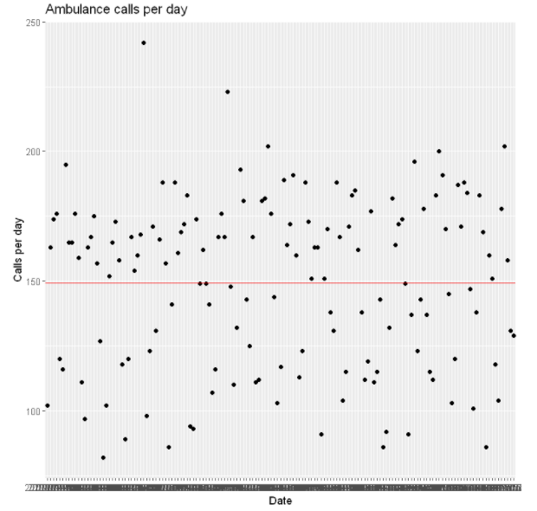
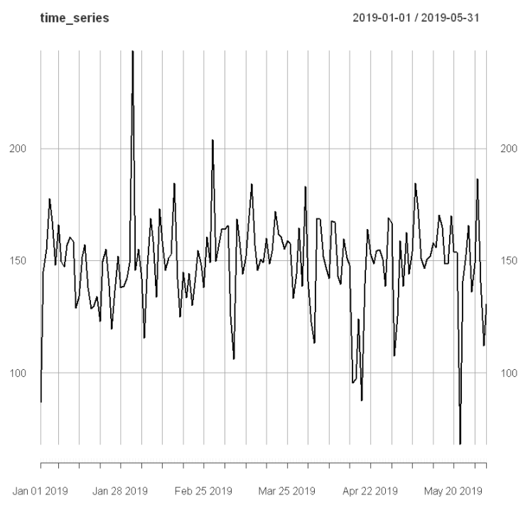
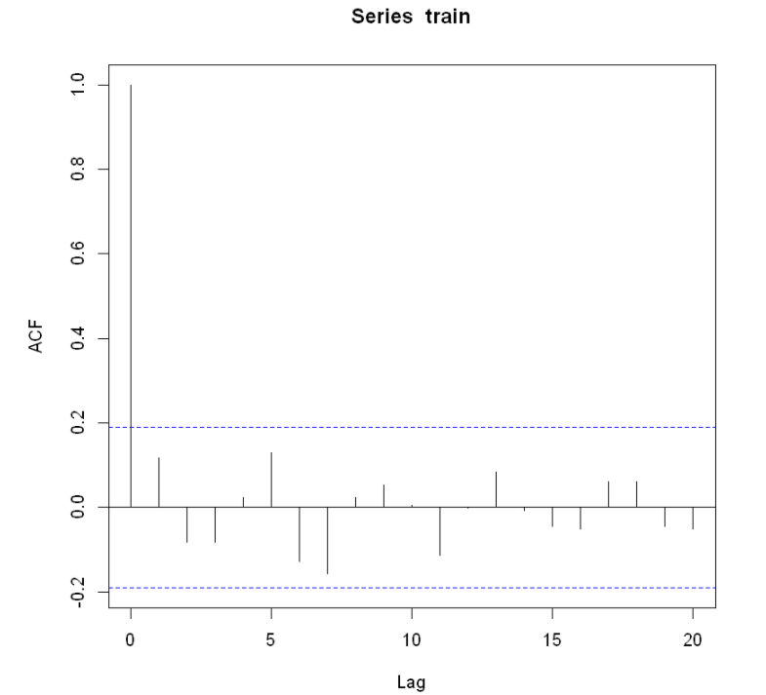
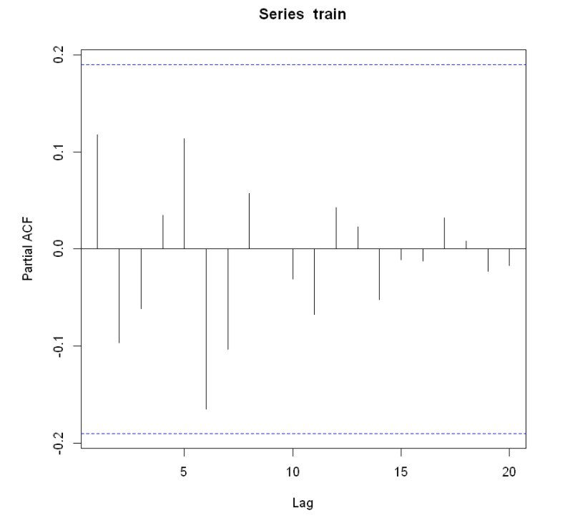
Introduction
Accurate forecasting is necessary for ambulance services to provide efficient medical treatment and transportation for patients. These services are time sensitive. If we can build an effective model to predict the number of ambulance calls, we could save time, money and potentially lives. The aim of this project was to predict the future demand of ambulance services in Jakarta.
MAT005: Forecasting the Demand for Ambulance Services in Jakarta
Forecast
A summary of the 7-day forecast with the ARIMA(0,0,1) model can be found below in figure 11 and table 3. The diagnostic criteria is found in figure 12.
The forecast results show a mean number of calls of 148.44 from June the 1st to June the 7th. The diagnostic criteria indicates the absence of autocorrelation, as seen in figure 12. The Shapiro-Wilk test on the residuals gives a p-value of 9.99e-07, which suggests the residuals are not normally distributed. Due to the central limit theorem the residuals will have approximately a normal distribution.
Bailey Millns: c2098580
Analysis
Decomposition, ACF and PACF plots, of the training data, were plotted to analyse trend, seasonality and whether the time series was stationary. A Dickey-Fuller test was also conducted to test whether the time series is stationary.
The plots shown above suggest we have strong weekly seasonality present, the significant lags 7 and 14 suggest this. The stl() and seasadj() functions in R were used to deseasonalize the full time series data. The data also appears non-stationary, as the lags in the ACF plot to not go to zero quickly. This hypothesis was tested with the Dickey-Fuller test. The data obtained a p-value of 0.01. The p-value is less than the significance level of alpha equals 0.05 so we reject the null hypothesis and conclude the Dickey-Fuller test suggests the time series is stationary. During the first run of the models, it was found that the residuals of the models were not normally distributed. A Box-Cox transformation was applied to the time series data, but the transformation did not assist with making the residuals normally distributed so it was not applied to the full data set.
We can see, in figure 7, that the significant lags 7 and 14 have been reduced and are no longer significant. All lags are within the threshold, which indicates absence of autocorrelation.
Models
For this project I will evaluate five different time series models, the best model will used to forecast the number of calls for 7 days in the future. The best model will be chosen based upon several factors. The models will be compared by calculating the MSE and MAPE on the test data to find the best model. The residuals of the best model will be analysed, the residuals should be normally distributed, the ACF plot of the residuals will be analysed to see if there is absence of auto-correlation. The Ljung-Box test, is also used to test for autocorrelation. A large p-value (>0.05) will indicate the residuals are not distinguishable from white noise. If these assumptions are met, the model will be used to forecast 7 days. The five different models evaluated are: Naïve, simple exponential smoothing, Holt’s linear model, linear regression and ARIMA. In figure 10 we can see an example forecast from the linear regression model.
A summary of the model evaluation, using MSE and MAPE, can be found in table 2.
A perfect model has an MSE and MAPE value of 0, so the closer to 0 for both metrics the better the model. We can see that the ARIMA(0,0,1) model performs the best. The residuals will now be analysed, this was completed using the checkresiduals() function in R.
The ACF plot of the residuals from the ARIMA(0,0,1) model in figure 10 indicates the absence of auto-correlation, demonstrating that the residuals are behaving like white noise. In addition, the Ljung-Box test returns a p -value of 0.4879, which is larger than the significance level of 0.05 also suggesting that the residuals are behaving like white noise. Testing the normality assumption of the residuals, with the Shapiro-Wilk test, we obtain a p-value of 3.689e-05 which suggests the residuals do not follow a normal distribution. All models evaluated had p-values which suggested that the residuals are not normally distributed. Due to the central limit theorem the residuals will have approximately a normal distribution. The ARIMA(0,0,1) will be the model used to forecast, as it is the best model evaluated with the considerations above.
Data
The data used in this project contained the date, time of call and the city municipality from which a call to the ambulance service was made. The dates run from January the 1st 2019 to May the 31st 2019, having 22540 total number of observations. A table containing the top five most called from city municipalities can be found in table 1.
We can see from figure 1 that there are more calls during the middle of the day (from 10:00 to 14:00) and we can see from figure 2 that there are more calls on weekdays than on weekends, with Monday being the day with the most calls.
The plot in Figure 3, which is a scatter plot of the dataset. We can see that the variance may be unstable, most of the observations are not close to mean which is 149.258.
The data will first need to be cleaned and pre-processed into time series data. Then the data will be split into training data and testing data. The training data contained dates from 01/01/2019 to 16/04/2019 and the testing data contained dates from 17/04/2019 to 31/05/2019 (a 70-30 split). The analysis will be conducted on the training set, then if transformations are needed, they will be applied to the full data set.
Table 1: Total calls made in the city municipality
Figure 11: ARIMA(0,0,1) 7 day forecast
Table 3: ARIMA(0,0,1) 7 day forecast, with 80% and 95% prediction intervals
Figure 3: Decomposition plot
Figure 9: Linear regression forecast
Figure 4: ACF plot of the original training data
Figure 5: PACF plot of the original training data
Table 2: Model evaluation
Figure 12: Diagnostic criteria of the ARIMA(0,0,1) residuals
Figure 1: Ambulance calls per hour
Figure 2: Ambulance calls per day
Conclusion and future work
We chose the ARIMA(0,0,1) as the best model to forecast, as this model obtained a MAPE value of 0.2184 and MSE value of 1106.429 on the testing data set, the best out of all models evaluated. ARIMA models allow both autoregressive (AR) components as well as moving average (MA) components and are more flexible than the other models tested. It was no surprise the ARIMA model performed the best. We cannot say that this is the accurate forecast, due to the size of the error statistics. In future work I would try more advanced models, such as Facebook Prophet or a neural network, to forecast this data. I would also try the technique of dynamic harmonic regression for deseasonalizing the data, as the method used in this project did not completely remove the seasonality. More data (longer dates and more features) would also be useful to further investigate the demand in ambulance services.
Figure 6: Time series plot after deseasonalizing
Figure 10: Diagnostic criteria of the ARIMA(0,0,1) residuals
Figure 3: Scatter plot of the calls per day
References
Rob J Hyndman and George Athanasopoulos 2018. Forecasting: Principles and Practice. Monash University. Available at: https://otexts.com/fpp2/.Steins, K. et al. 2019.
Forecasting the Demand for Emergency Medical Services. Linköping University. Available at: https://core.ac.uk/download/pdf/211327292.pdf.
Figure 7: ACF plot after deseasonalizing
Figure 8: PACF plot after deseasonalizing

