Slide 1
Project: 2018 Data Challenges Sponsored by Teradata University Network
Capstone Class Project for Jeff Mills
Summer 2018
Kansas State University

Slide 2
Overview
Problem:
The National Multiple Sclerosis Society (NMSS) Bike MS events are struggling to maintain fundraising and participation
Bike MS participation and revenue have steadily declined since peaking in 2012.
NMSS attributes this to increased competition for charity monies and time.
Bike MS currently loses past participants faster than it recruits new ones.
NMSS believes it must increase new cyclist participation to have future success.
NMSS believes it must also recruit new 10+ member corporate teams to maximize fundraising.
According to NMSS,
10+ members teams raise 3x money of smaller teams
over 41% of the 1,561 teams with 10+ members in 2017 were corporate teams
NMSS goals for 2018 Bike MS:
Increase from 74,000 riders to 80,572 riders (8.88%),
Increase from 6,150 teams to 6,489 teams (5.51%),
Recruit 40,000 new riders,
Increase number of corporate teams with 10 or more riders,
Successfully utilize digital marketing efforts to impact fundraising goals.

Slide 3
Research Priorities
FIRST PRIORITY: CORPORATE ACQUISITION
What are the greatest growth opportunities for new corporate teams?
Can we apply those opportunities to specific rides/markets, especially our biggest events?
What industries have had the strongest involvement in Bike MS in the last five years?
What occupations were responsible for most of our fundraising?
Can we tie together these industries and occupations to identify gaps/opportunities?
What is the common denominator for our top performing corporate teams? (Is it industry, culture, executive involvement, connection to MS, other?)
Can we quantify the effect competing events are having in our top markets?

Slide 4
Research Priorities
SECOND PRIORITY: DIGITAL/SOCIAL ACQUISITION
What are the greatest opportunities for digital marketing investments? Where have we seen the greatest ROI?
Once someone is registered, what tactics and behaviors drive fundraising, and at what times leading up to the event?
What behavioral data do you see about usage of our fundraising tools and how it may or may not relate to performance of top fundraisers?
Despite increasing our digital advertising spend, acquisition continues to trend downward overall. Why? Is it an issue of needing more traffic, better targeting, or a conversion rate issue that needs to be addressed through the registration process? What can we do to reverse the trend?
FINALLY:
As you studied this data, is there something else that came up as an insight into our operations that the questions above do not capture?

Slide 5
Data
Donations 2013-2017 Bike Donations.csv
Events 2013-2017 Bike Events.csv
Participants 2013-2017 Bike MS Participants.csv
Bike Teams 2013-2017 Bike Teams.csv
National Teams 2013-2017 National Team Activity.xlsx
Affiliates Contains Affiliate_Codes.xlsx
Bike MS Digital Advertising Reports Advertising reports for the 2015-2018 fiscal years.
Google Analytics Google Analytics report for the National MS Society website.

Slide 6
Data Cleaning
All data were found to contain some errors
Most common were misaligned columns due inaccurate characters dividing data (e.g. “2016(0001502456” instead of “2016,0001502456”
Additional errors resulted from typos and errors in data entry
E.g. multiple versions of Retired, Self employed, and company names (e.g. Alabama Power Company and Alabama Power Co);
Corrected obvious errors, left them as is if mistakes were not 100% certain
Standardized entries
E.g. for 'Donor Connection to MS’, deleted "Blank", changed "no connection" to "None", and standardized the relatives (“Wife/Husband has MS” changed to “Spouse has MS”
Dummy variables created for categorical data
Will drop one to avoid dummy trap

Slide 7
Cycling in America
According to Statista, approximately 12.4% of Americans regularly cycled in 2016.
Statista also reported:
U.S. cycling sizable increase 2012 to 2014, followed by plateau,
66.5 million U.S. cyclists in 2016,
U.S. cyclists 6 to 17 years old has decreased since 2013,
U.S. cyclists 18 to 24 years increased its peak of 5.7 million in 2013 and declined since.
Source: https://www.statista.com/topics/1686/cycling/

Slide 8
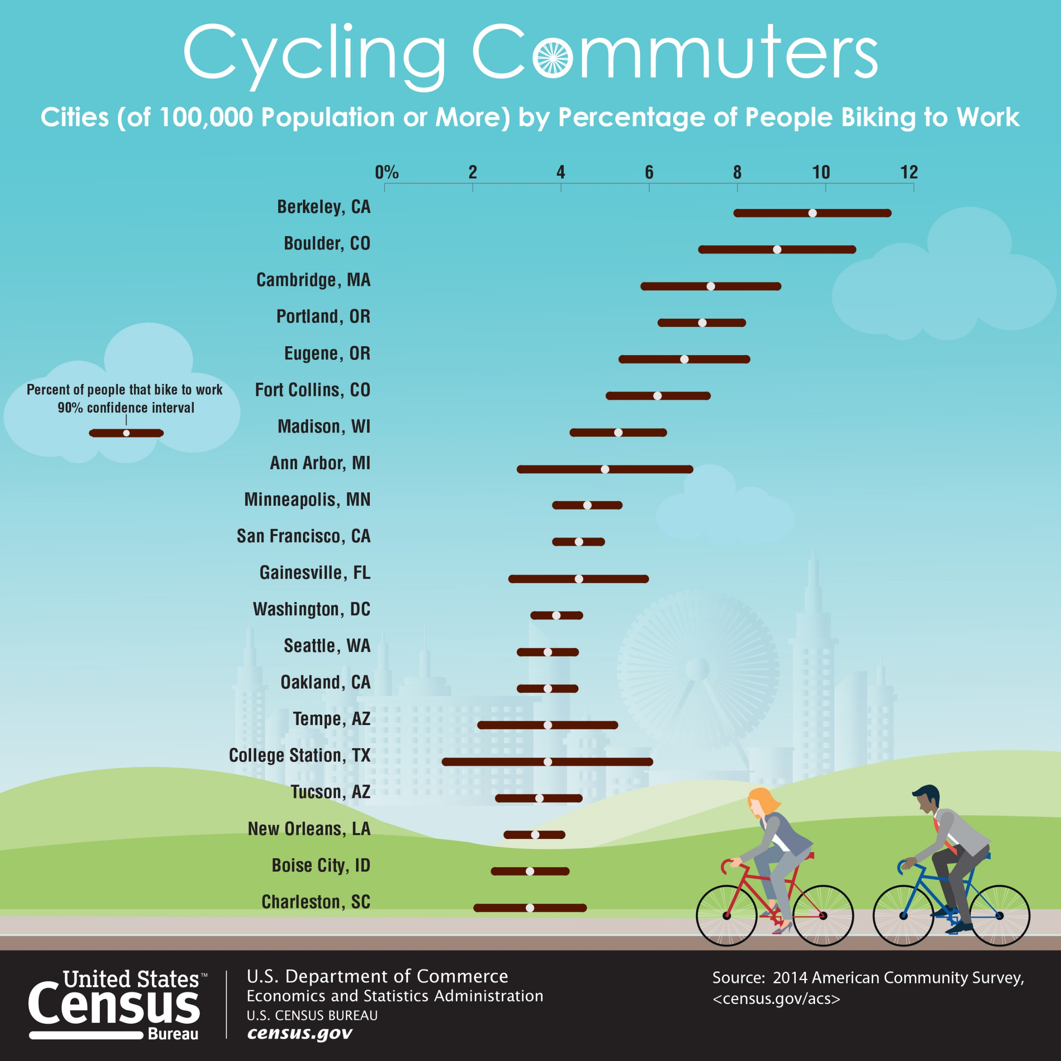
Cycling in America

Slide 9
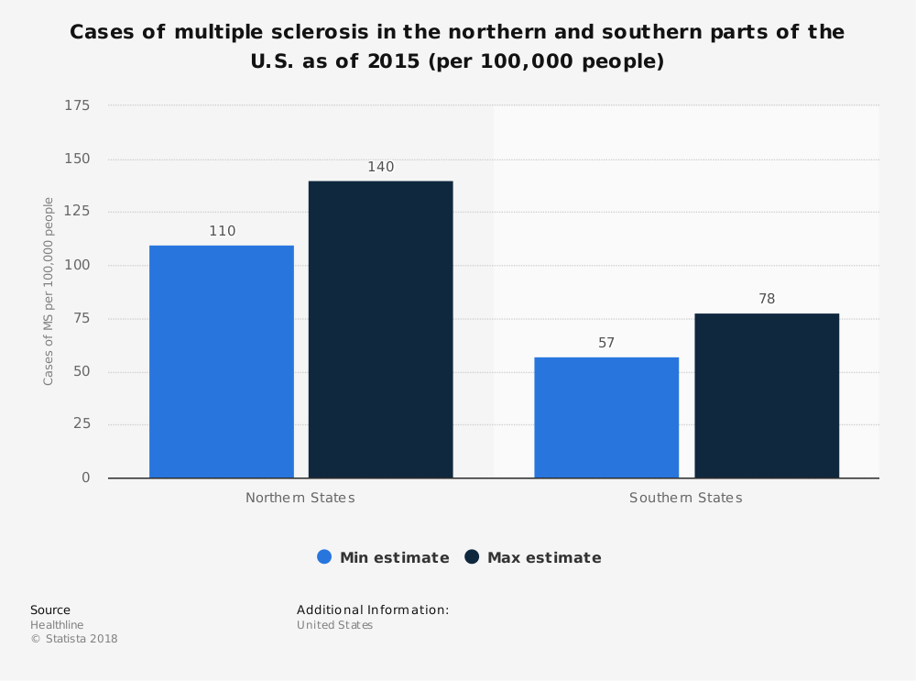

Slide 10
Confirmation: Bike MS fundraising struggled since 2014 and Bike Teams raising 87% of funds.

Slide 11
Bike Teams
2013-2017 Bike Teams Summary Statistics | Number of Participants | "Team Total Confirmed ($)"
count | 33,132 | 33,132
mean | 10.70 | $9,003.45
std | 21.69 | $28,457.23
min | 0.00 | $0.00
25% | 2.00 | $663.94
50% | 5.00 | $2,234.12
75% | 10.00 | $6,694.59
max | 725.00 | $1,249,482.00
11 members on average.
Largest team had 725 members.
Raised $9,003.45 on average.
Max raised $1,249,482.
 | Total Number of Bike Teams by Division, 2013-2017
Division |  | Count
Family and Friends |  | 21,641
Corporate |  | 7,686
Other |  | 628
Organization (Clubs; Civic Groups; Place of Worship; etc.) |  | 338
School |  | 101
Ohana |  | 23
Bike Shop |  | 16
Small Business |  | 9
Open |  | 9
Beer/Brewery |  | 7
School |  | 7
Bike Club |  | 4
Association |  | 1
‘Family and Friends’ and ‘Corporate comprise overwhelming majority of teams.
‘Friends and Family” has nearly 3 times as many teams as ‘Corporate.’

Slide 12
Bike Teams

Slide 13
Bike Teams - Participation Fatigue?
‘Friends and Family’
-2013, 2014, and 2015 peak later in year,
-2016 and 2017 decline in participation as the year progresses.
-Until 2016 September was peak, then June emerged with most participation.
‘Corporate”
-Peak each year in April.

Slide 14
Bike Teams - Fundraising Fatigue?
‘Friends and Family’
-2013, 2014, and 2015 peak later in year,
-2016 and 2017 decline in participation as the year progresses.
-Until 2016 September was peak, then June emerged with most participation.
‘Corporate”
-Peak each year in April.
Same pattern as participation (as expected)

Slide 15
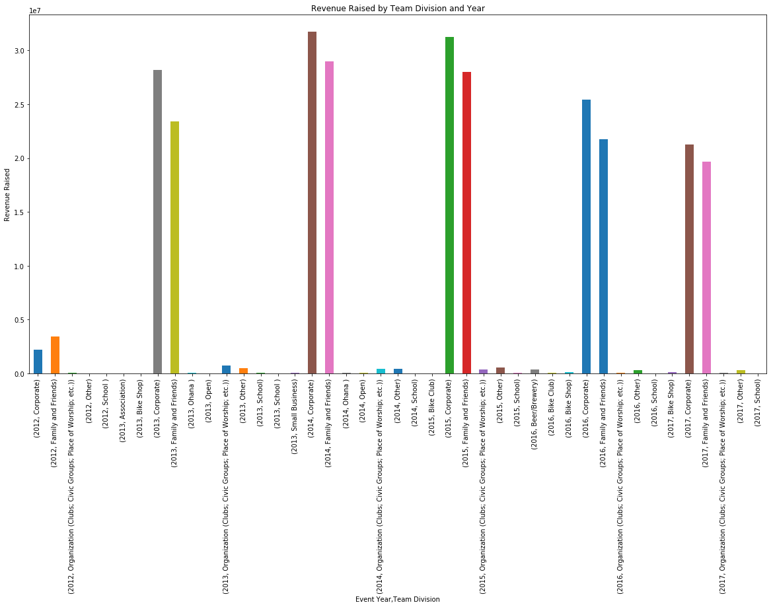
Bike Teams
‘Corporate’ division bike teams generate more revenue raised than ‘Family and Friends’
- The gap between them is converging

Slide 16
National Bike Teams
Revenues Raised by National Bike Team,
by Month, 2013-2017
Event Month | Revenue Raised
September | $1,963,260.90
June | $1,634,641.92
April | $1,534,043.70
October | $995,502.77
May | $467,148.64
August | $334,173.25
July | $151,520.86
March | $61,125.43
November | $505.00
Revenues Raised are strongest in April, June, and September.
Summary Statistics: National Bike Team
Revenue Raised and Members, 2013-2017
 | Revenue Raised | Number of Team Members (local)
count | 810 | 810
mean | $8,817.19 | 11.84
std | $22,295.01 | 19.10
min | $0.00 | 1
25% | $346.25 | 2
50% | $1,692.50 | 5
75% | $6,713.75 | 12
max | $230,589.24 | 172
12 members on average
Largest team had 172 members.
Raised $8,817.19 on average
Maximum raised $230,589.24.

Slide 17
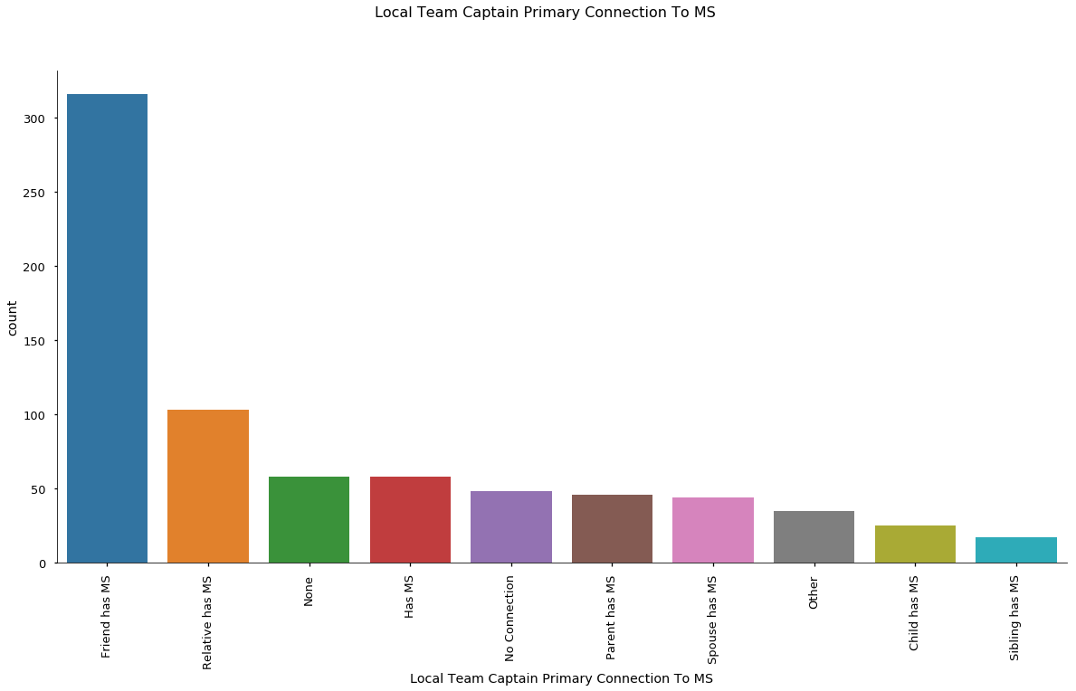
National Bike Teams

Slide 18
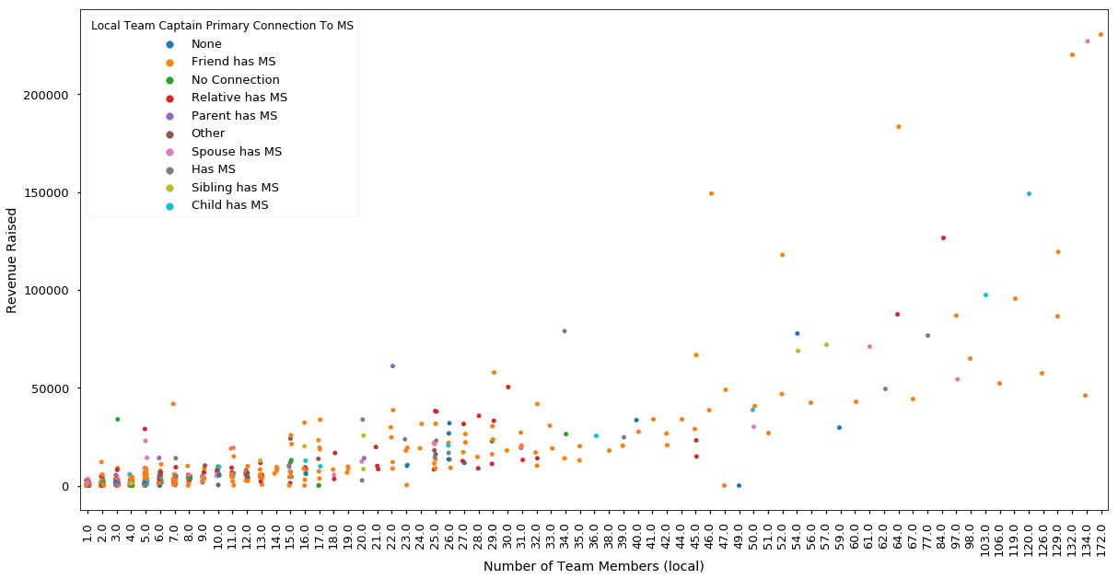
National Bike Teams

Slide 19
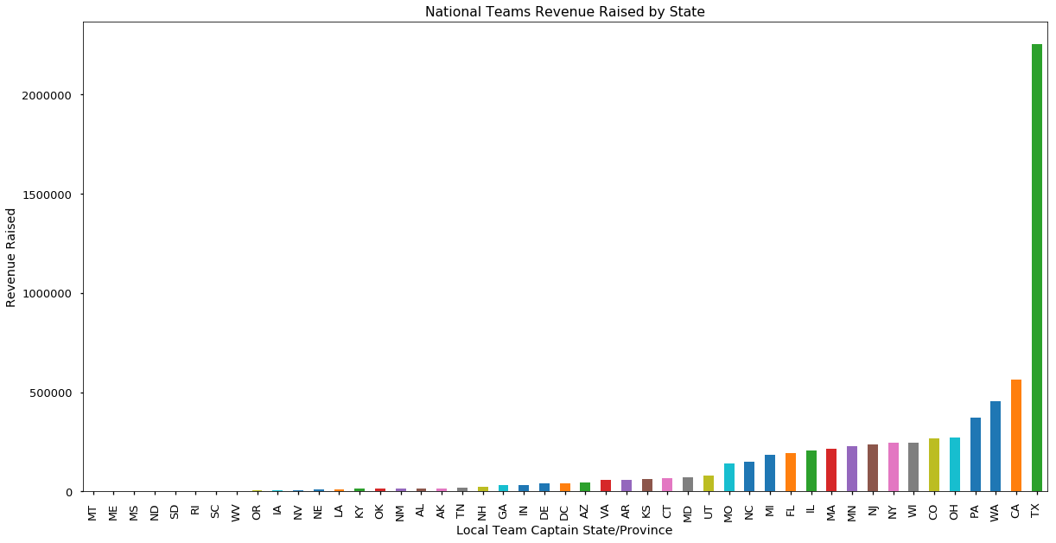
National Bike Teams
From 2013 to 2017 Top 5 Revenue Raising States:
1) Texas, 2) California, 3) Washington, 4) Pennsylvania, 5) Ohio
Texas raised $2,256,020.09
California raised $562,691.09

Slide 20
Events
Summary Statistics of Events, 2013 - 2017
 | Event Goal ($) | Total Fees Paid | Total of All Confirmed Gifts ($) | Active Registrations | Inactive Registrations
count | 524 | 524 | 524 | 524 | 524
mean | $859,198.30 | $35,211.03 | $664,506.00 | 904.79 | 34.22
std | $1,992,613.00 | $133,428.90 | $1,691,521.00 | 1,670.58 | 96.80
min | $0.00 | $0.00 | $0.00 | 0.00 | 0.00
25% | $115,000.00 | $3,139.48 | $58,311.93 | 162.50 | 1.00
50% | $295,000.00 | $7,843.75 | $184,144.60 | 378.50 | 5.50
75% | $936,125.00 | $27,180.72 | $681,904.40 | 1,065.00 | 21.25
max | $20,000,000.00 | $1,584,950.00 | $18,051,600.00 | 14,871.00 | 1,063.00

Slide 21
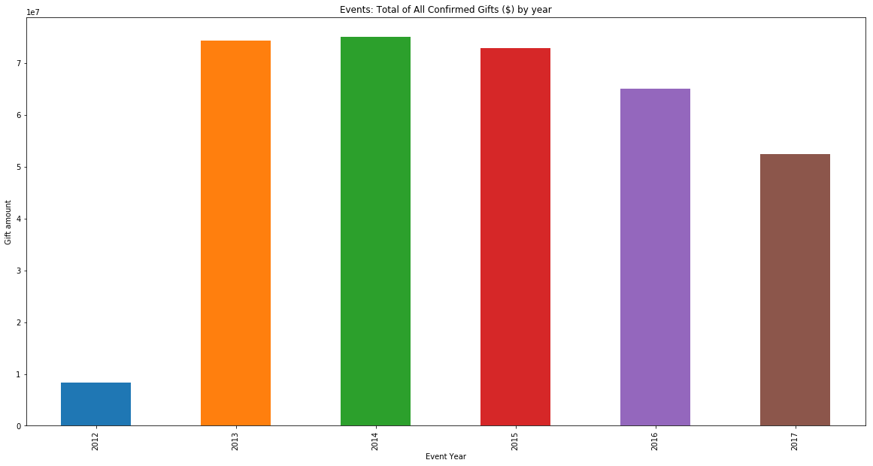
Events

Slide 22
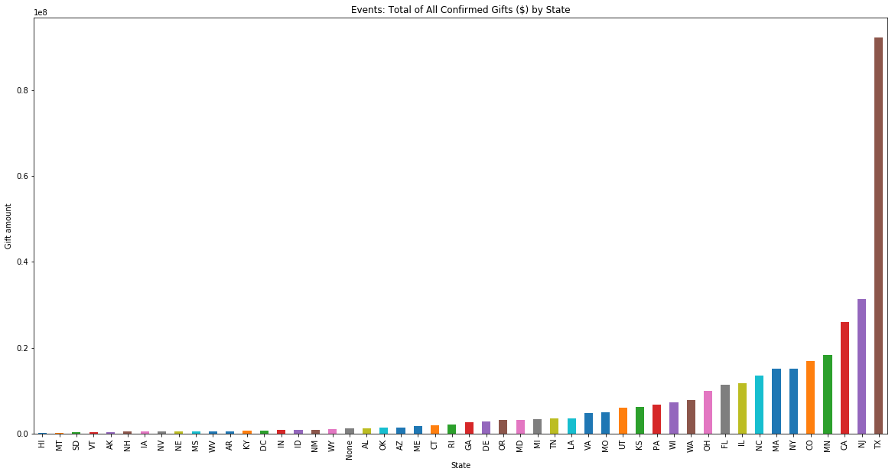
Events

Slide 23
Participants
Participants Summary Statistics, 2013 - 2017
 | Emails Sent | Total of All Confirmed Gifts ($) | Total From Participant ($) | Total Not From Participant ($) | Participant Goal ($) | Suggested Participant Goal ($)
count | 65,499 | 65,499 | 65,499 | 65,499 | 65,499 | 65,499
mean | 32.36 | $856.56 | $127.00 | $748.68 | $1,359.18 | $726.22
std | 269.05 | $2,490.75 | $492.65 | $2,403.30 | $84,475.20 | $391.79
min | 0.00 | $0.00 | $0.00 | $0.00 | $0.00 | $0.00
25% | 0.00 | $200.00 | $0.00 | $0.00 | $300.00 | $300.00
50% | 0.00 | $400.00 | $35.00 | $340.00 | $500.00 | $900.00
75% | 6.00 | $800.00 | $150.00 | $701.00 | $1,001.00 | $1,075.00
max | 27,354.00 | $203,791.00 | $50,093.00 | $203,791.00 | $21,474,836.47 | $5,000.00

Slide 24
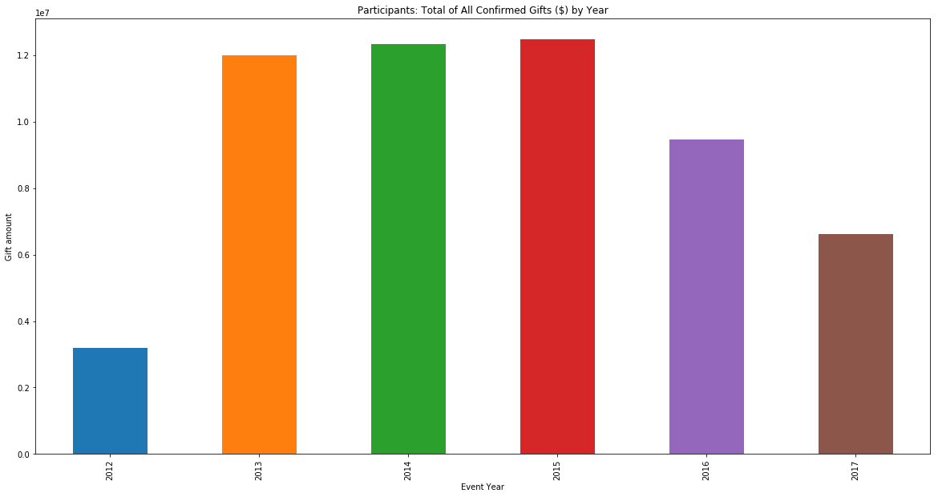
Participants

Slide 25
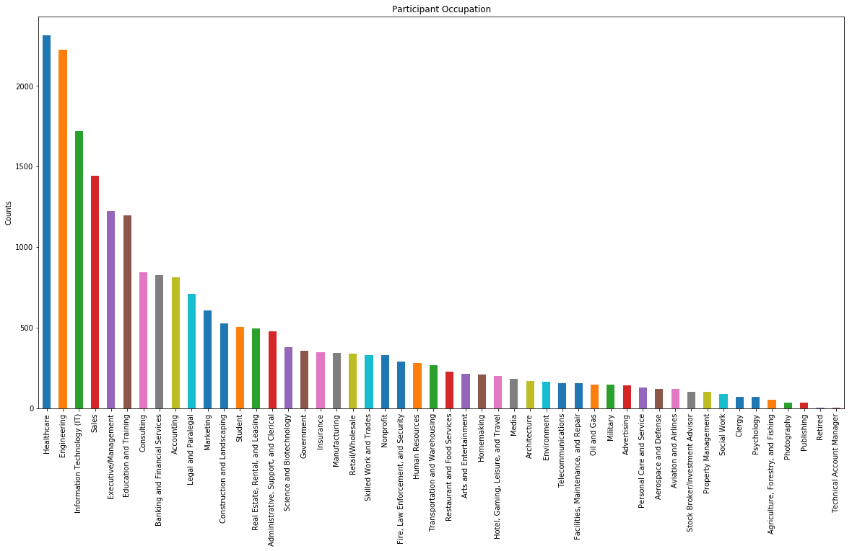
Participants

Slide 26
Participants
Participants Occupation by Year and Total of All Confirmed Gift ($)
Occupation | 2013 | 2014 | 2015 | 2016 | 2017 | Grand Total
Engineering | $456,374.71 | $537,343.27 | $478,919.37 | $449,985.70 | $398,437.34 | $2,321,060.39
Healthcare | $435,681.65 | $382,890.20 | $373,307.24 | $377,016.66 | $275,246.84 | $1,844,142.59
Executive/Management | $377,943.13 | $373,954.91 | $300,286.70 | $293,053.68 | $221,119.92 | $1,566,358.34
Sales | $328,339.00 | $323,374.85 | $309,457.82 | $303,443.44 | $267,385.18 | $1,532,000.29
Information Technology (IT) | $275,593.63 | $276,699.82 | $289,836.03 | $287,386.87 | $197,507.25 | $1,327,023.60
Consulting | $236,908.30 | $221,782.01 | $248,167.88 | $224,704.91 | $173,950.27 | $1,105,513.37
Education and Training | $236,958.57 | $212,514.05 | $214,377.45 | $179,963.52 | $150,621.02 | $994,434.61

Slide 27
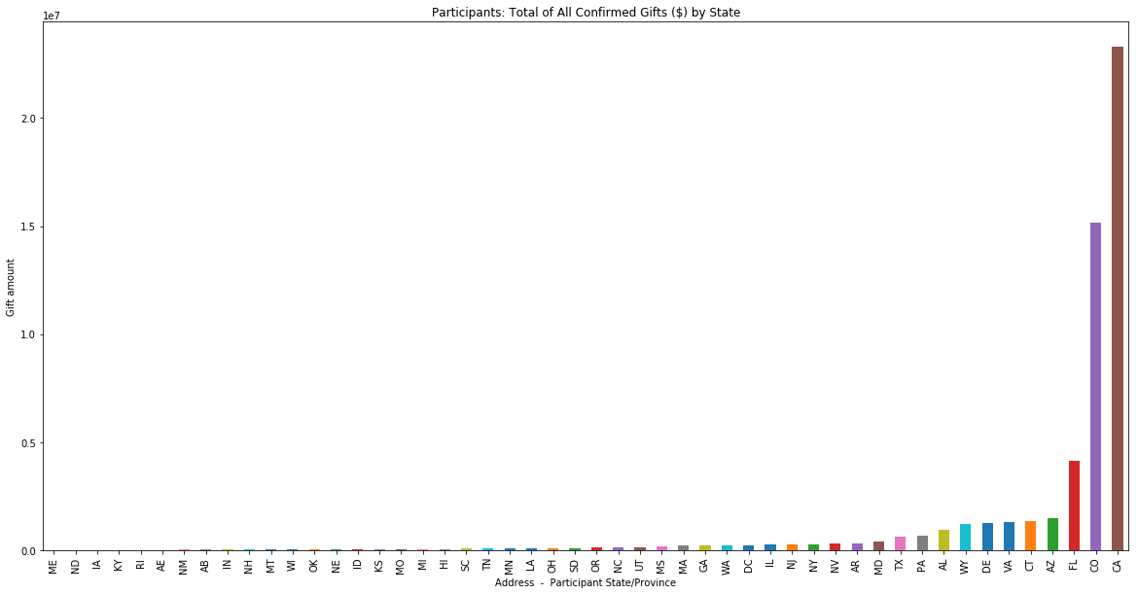
Participants

Slide 28
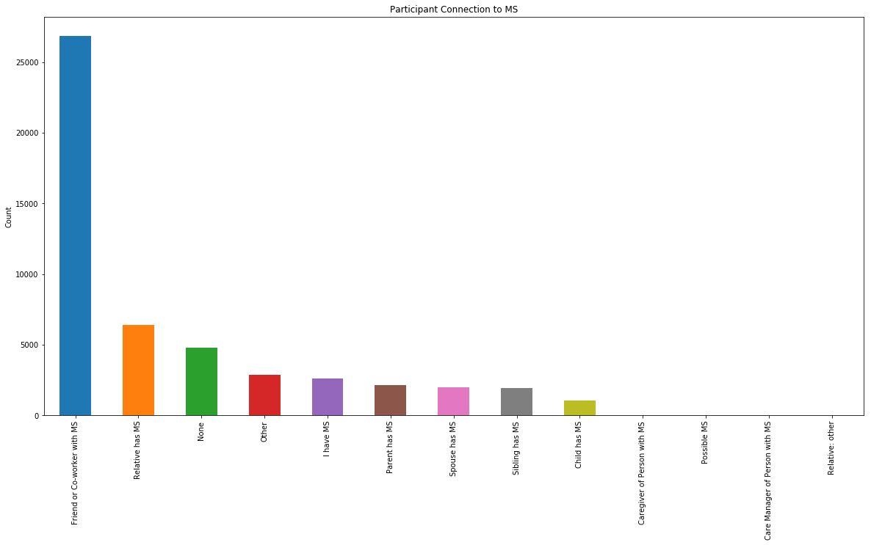
Participants

Slide 29
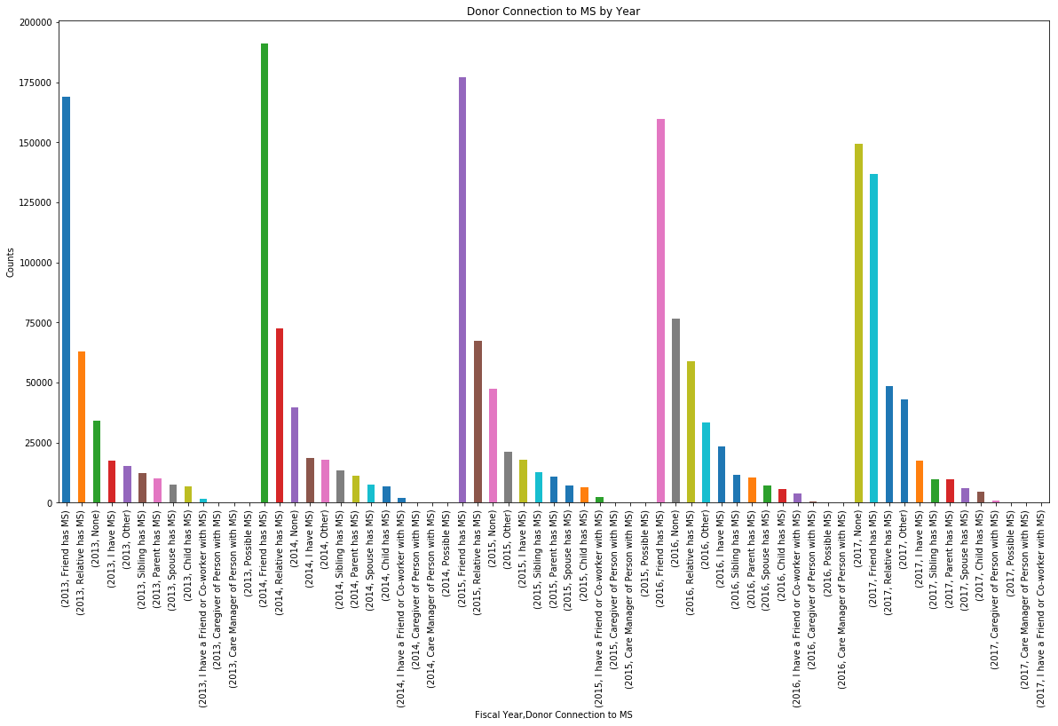
Donations
‘None’ > ‘Friend has MS’ in 2017

Slide 30
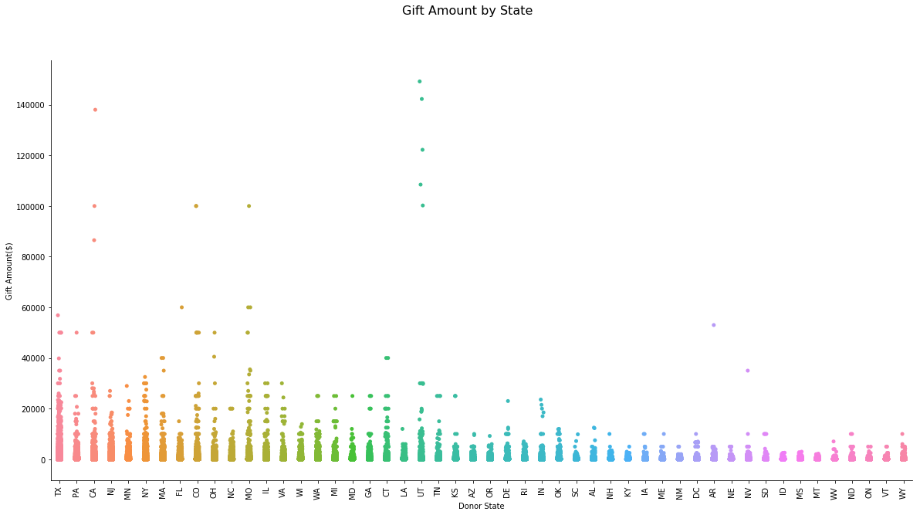
Donations

Slide 31
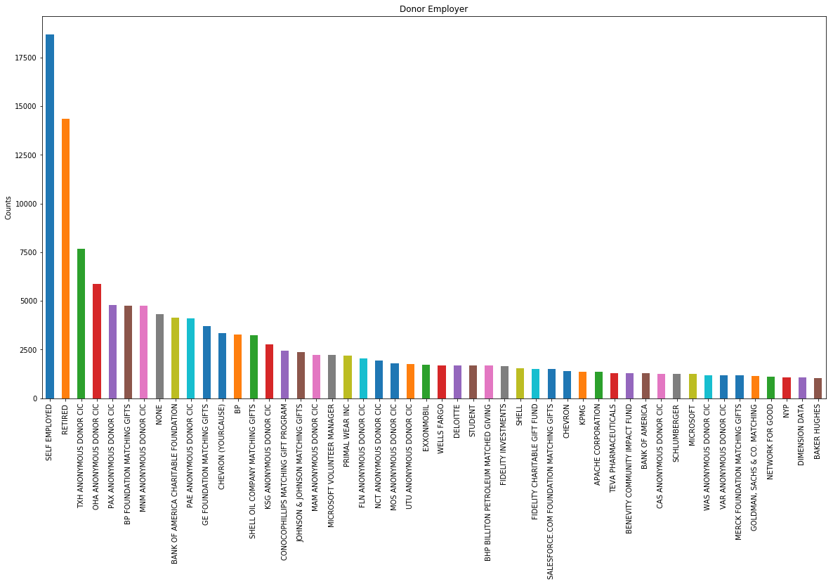
Donations

Slide 32
Donations
Patterns appear to exist independently of the included variables.
Little correlation exists in the dataset.
Few correlations above 0.75.
They are as follows: Event ID with Fiscal Year (0.97), Offline with Check (0.90), Online with Credit Card (0.97).
Given that Event ID is derived from the year and checks are very commonly used to donate in person and credit cards similarly are typically utilized to donate online, none of these are informative.
No variables are highly correlated to Gift Amount.
The largest correlation value is 0.07 for Check.
Indicates little or no relationship with the amount given by donors.
The volume of small gifts is extremely disproportionate to the volume of large gifts.

Slide 33
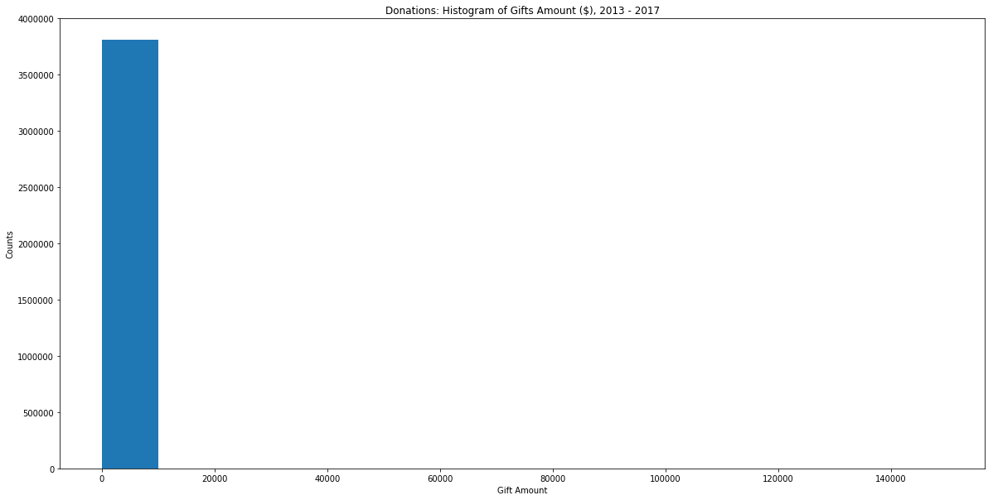
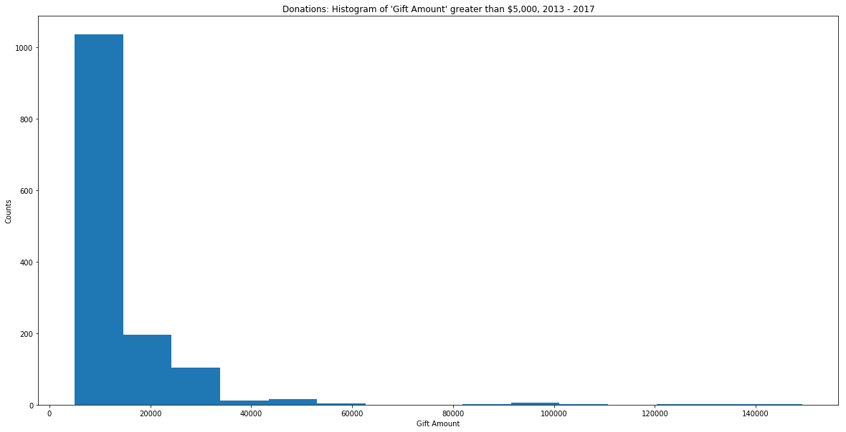
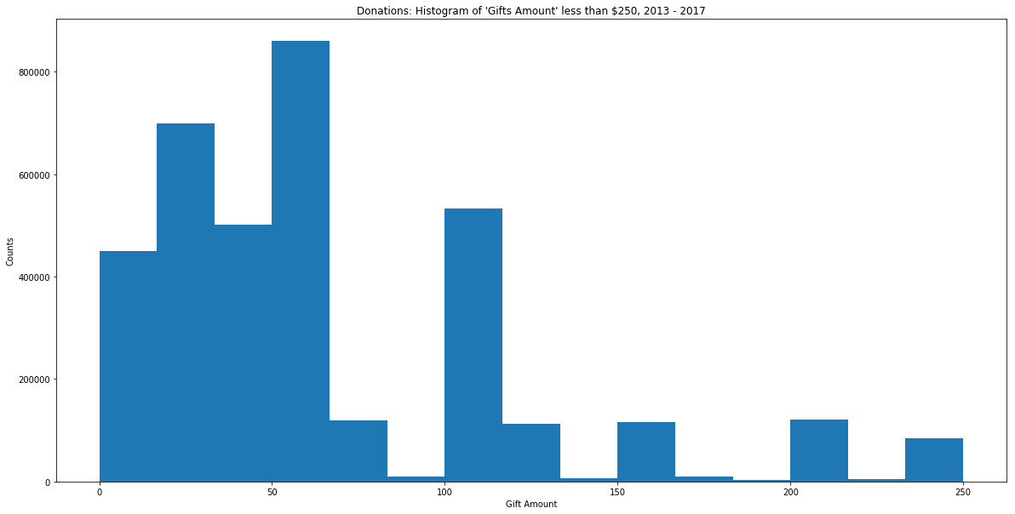
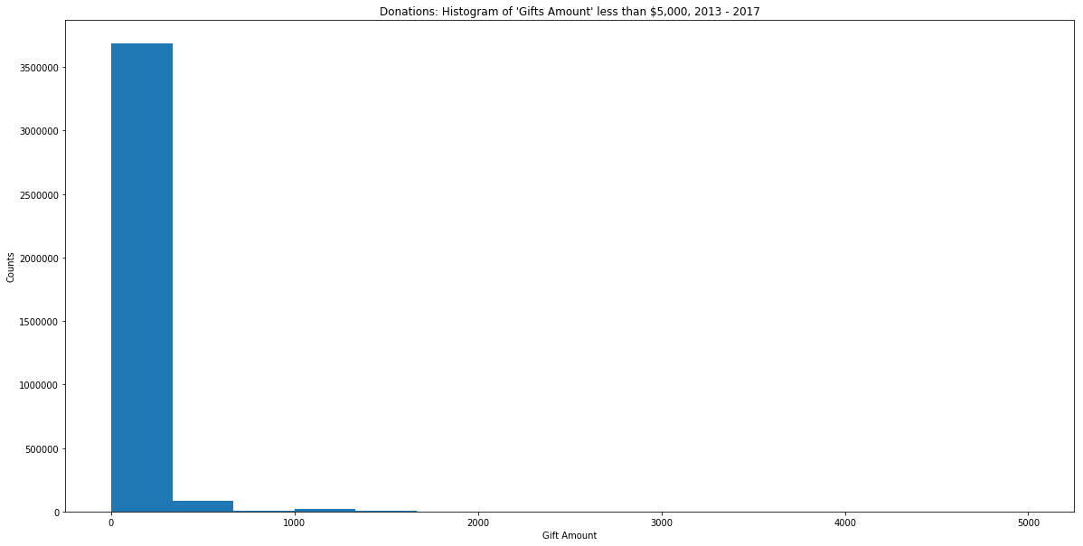
Donations
For Gifts <= $250:
Peaks at common $ values
Gift Amt % of All Gifts
$250 2.16%
$200 3.07%
$150 2.89%
$100 13.71%
$50 18.38%
$25 10.81%
51.02% of all gifts given
On average, 3,807,372 donors gave $91.77 with a maximum gift of $149,175.
1,377 gifts above 5,000, On average gifts above $5,000 were $12,900.46.
3,805,995 donations were equal to or below $5,000. On average gifts below $5,000 were $87.13.
3,630,004 donations less than or equal to $250. On average gifts less than or equal to $250 were $62.05.

Slide 34
Modeling
Bike Teams:
y = 'Team Total Confirmed ($)'
X = 'Number of Participants’, 'Total Fees Paid’, 'Total Online Gifts($)’, 'Total Offline Confirmed Gifts($)’, 'Team Goal($)’, 'Total Confirmed Gifts in Team History($)’, 'Previous Event Fiscal Year’, 'Fiscal Year’, 'Association’, 'Beer/Brewery’, 'Bike Club’, 'Bike Shop’, 'Corporate’, 'Family and Friends’, 'Open’, ’Org Groups’, 'Other’, 'School', 'Small Business’ plus a constant
Left out 'Ohana' for team division, 'Total Offline Confirmed Gifts($)’, and 'Total Offline Unconfirmed Gifts($)' to account for dummy trap
Adjusted R^2 of 0.954
OLS Regression results indicated the following variables were significant at the 95% level.
Variable | coef | std err | t | P>t | [0.025 | 0.975]
Number of Participants | 63.7908 | 3.192 | 19.982 | 0 | 57.534 | 70.048
Total Fees Paid | -0.8732 | 0.044 | -19.812 | 0 | -0.96 | -0.787
Total Online Gifts | 1.1929 | 0.005 | 251.979 | 0 | 1.184 | 1.202
Total Confirmed Gifts in Team History | 0.0899 | 0.001 | 63.649 | 0 | 0.087 | 0.093
Previous Event Fiscal Year | -0.2813 | 0.042 | -6.729 | 0 | -0.363 | -0.199
Previous Event Confirmed Gifts | -0.0392 | 0.003 | -13.425 | 0 | -0.045 | -0.033
Beer/Brewery | -7,886.078 | 2333.761 | -3.379 | 0.001 | -12500 | -3311.82
Corporate | -344.6836 | 140.408 | -2.455 | 0.014 | -619.888 | -69.479

Slide 35
Modeling
National Bike Teams:
All Revenues Raised more than 16,265 were eliminated from the forecast due to the 1.5(IQR) plus upper bound outlier identification method.
y = 'Revenue Raised'
F(x) = Number of Team Members (local)", 'Event Month’, 'Event Year’, 'Relative has MS’, 'None’, 'No Connection’, 'Has MS’, 'Parent has MS’, 'Spouse has MS’, 'Child has MS’, 'Sibling has MS','TX', 'PA', 'NJ’, 'CA', 'MN', 'NY', 'FL', 'MA', 'IL', 'MI', 'OH', 'NC', 'WA', 'CO', 'MO', 'UT', 'MD', 'VA', 'CT', 'AZ', 'GA', 'WI', 'KY', 'KS', 'TN', 'AL', 'AR', 'DE', 'NH', 'DC', 'IN', 'OK', 'IA', 'AK’, 'RI', 'RI', 'NM', 'NE’, 'NV', 'OR', 'MS', 'SD', 'WV', 'LA', 'ME', 'SC’, ‘MT’, and a constant
Left out 'Other' for connection to MS, and 'ND' for state to account for dummy trap
Adjusted R^2 of 0.406
OLS Regression results indicated the following variables were significant at the 95% level
Variable | coef | std err | t | P>t | [0.025 | 0.975]
Number of Team Members (local) | 318.3032 | 15.77 | 20.184 | 0 | 287.336 | 349.271
CA | 1,110.44 | 556.066 | 1.997 | 0.046 | 18.495 | 2202.384
MA | 1,234.746 | 593.198 | 2.082 | 0.038 | 69.886 | 2399.606
IL | 1,723.29 | 621.099 | 2.775 | 0.006 | 503.641 | 2942.939
CO | 2,504.49 | 820.546 | 3.052 | 0.002 | 893.188 | 4115.792
NH | 3,845.486 | 1263.075 | 3.045 | 0.002 | 1365.192 | 6325.779

Slide 36
Modeling
Events:
y = 'Total of All Confirmed Gifts($)'
X = 'Event Month', 'Event Year’, 'Active Registrations’, 'Teams’, 'Average Team Size', 'AK', 'AL’, 'AR', 'AZ', 'CA', 'CO', 'CT', 'DC', 'DE', 'FL', 'GA', 'HI', 'IA', 'ID', 'IL', 'IN', 'KS', 'KY', 'LA', 'MA', 'MD', 'ME', 'MI', 'MN', 'MO', 'MS', 'MT', 'NC', 'NE', 'NH', 'NJ', 'NM', 'NM’, ‘None', 'NY', 'OH', 'NV’, ‘MT’, ‘WY’, OK', 'OR', 'PA', 'RI', 'SD', 'TN', 'TX', 'UT’, ‘Emails Sent’ plus a constant
Left out 'ND' for state, 'Event Day', 'Fiscal Year', 'Inactive Registrations', "Event Goal($)", 'Total Fees Paid', and ’Total Online Gifts($)', to account for dummy trap
Adjusted R^2 of 0.982
OLS Regression results indicated the following variables were significant at the 95% level.
Variable | coef | std err | t | P>t | [0.025 | 0.975]
Event Month | 20,460 | 8124.398 | 2.519 | 0.012 | 4497.712 | 36400
Active Registrations | 507.8615 | 37.617 | 13.501 | 0 | 433.945 | 581.778
Teams | -5,283.18 | 324.45 | -16.283 | 0 | -5920.72 | -4645.64
Average Team Size | -5,874.94 | 1211.376 | -4.85 | 0 | -8255.28 | -3494.59
CO | 371,400 | 110000 | 3.39 | 0.001 | 156000 | 587000
DE | 224,700 | 104000 | 2.155 | 0.032 | 19800 | 430000
FL | -288,400 | 74200 | -3.885 | 0 | -434000 | -143000
GA | -479,800 | 128000 | -3.749 | 0 | -731000 | -228000
MA | 162,500 | 64000 | 2.537 | 0.011 | 36600 | 288000
UT | 403,500 | 114000 | 3.532 | 0 | 179000 | 628000
Emails Sent | 23.0523 | 0.855 | 26.961 | 0 | 21.372 | 24.732

Slide 37
Modeling
Participants:
Correlation with “Total of All Confirmed Gifts”
Total Not From Participant (0.975548993),
Number Not From Participant (0.580539693),
Total From Participant (0.362671763),
Yes (Is Team Captain, 0.140899282),
Number From Participant (0.134223094),
Emails Sent (0.102248768)
Only correlations above 0.10 with “Total of All Confirmed Gifts.”
Total of All Confirmed Gifts in excess of 1,700 were eliminated from the forecast due to 1.5(IQR) plus the upper quartile calculations.
Initial model results identified 2,706 observations were the Total Not From Participant exceeded the Total of All Confirmed Gifts in violation of their definitions and resulted in overestimation.
These occurrences were dropped.

Slide 38
Modeling
Participants:
y = 'Total of All Confirmed Gifts($)'
X = "Total Not From Participant($)",'Event Month’, ‘Event Year’, ‘Healthcare’, ‘Engineering’, ‘Information Technology (IT)’, ‘Sales', 'Executive/Management', 'Education and Training’, ‘Consulting’, ‘Banking and Financial Services’, ‘Accounting’, ‘Legal and Paralegal’, ‘Marketing’, ‘Construction and Landscaping’, ‘Real Estate, Rental, and Leasing’, ‘Administrative, Support, and Clerical’, ‘Science and Biotechnology’, ‘Government’, ‘Insurance’, ‘Manufacturing’, ‘Retail/Wholesale’, ‘Skilled Work and Trades’, ‘Nonprofit’, ‘Fire, Law Enforcement, and Security’, ‘Human Resources’, ‘Transportation and Warehousing’, ‘Restaurant and Food Services’, ‘Arts and Entertainment’, ‘Homemaking’, ‘Hotel, Gaming, Leisure, and Travel’, ‘Media’, ‘Architecture’, ‘Environment’, ‘Facilities, Maintenance, and Repair’, ‘Telecommunications’, ‘Oil and Gas’, ‘Military’, ‘Advertising’, ‘Personal Care and Service’, ‘Aviation and Airlines’, ‘Aerospace and Defense’, ‘Stock Broker/Investment Advisor’, ‘Property Management’, ‘Social Work’, ‘Clergy’, ‘Psychology’, ‘Agriculture, Forestry, and Fishing’, ‘Photography’, ‘Publishing’, ‘Technical Account Manager’, ‘Retired’, ‘Relative has MS’, ‘None’, ‘I have MS’, ‘Parent has MS’, ‘Spouse has MS’, ‘Child has MS’, ‘Sibling has MS’, ‘TX', 'PA', 'NJ', 'CA', 'MN', 'NY', 'FL', 'MA', 'IL', 'MI', 'OH', 'NC', 'WA', 'CO', 'MO', 'UT', 'MD', 'VA', 'CT', 'AZ', 'GA', 'WI', 'KY', 'KS', 'TN', 'AL', 'AR', 'DE', 'NH', 'DC', 'IN', 'OK', 'IA', 'AK', 'RI', 'RI', 'NM', 'NE', 'NV', 'OR', 'MS', 'SD', 'WV', 'LA', 'ME', 'SC’, ‘MT’, ‘Family and Friends’, ‘Corporate', 'Other’, ‘Organization (Clubs; Civic Groups; Place of Worship; etc.)’, ‘Female'' plus a constant
Left out 'Male' for gender, 'Student' for occupation, 'Other' for connection to MS, 'Other' for occupation, 'School' for team division, and 'ND' for state to account for dummy trap
Adjusted R^2 0.957

Slide 39
Modeling
OLS Regression results indicated the following variables were significant at the 95% level.
Variable | coef | std err | t | P>t | [0.025 | 0.975]
const | -7,923.917 | 2960.002 | -2.677 | 0.007 | -13700 | -2122.307
Total Not From Participant($) | 1.0402 | 0.001 | 1157.568 | 0 | 1.038 | 1.042
Event Year | 3.9525 | 1.468 | 2.692 | 0.007 | 1.075 | 6.83
Healthcare | 30.1557 | 10.599 | 2.845 | 0.004 | 9.382 | 50.93
Executive/Management | 40.3635 | 14.362 | 2.81 | 0.005 | 12.213 | 68.514
Consulting | 123.2248 | 17.148 | 7.186 | 0 | 89.615 | 156.835
Legal and Paralegal | 80.7371 | 18.671 | 4.324 | 0 | 44.141 | 117.333
Marketing | -41.1358 | 20.339 | -2.023 | 0.043 | -80.999 | -1.272
Real Estate, Rental, and Leasing | 50.0844 | 22.214 | 2.255 | 0.024 | 6.544 | 93.625
Hotel, Gaming, Leisure, and Travel | -82.6985 | 34.902 | -2.369 | 0.018 | -151.107 | -14.29
Relative has MS | 38.8319 | 6.676 | 5.817 | 0 | 25.747 | 51.916
None | 376.1461 | 183.727 | 2.047 | 0.041 | 16.041 | 736.251
I have MS | 47.7738 | 10.134 | 4.714 | 0 | 27.911 | 67.637
Spouse has MS | 53.0393 | 11.591 | 4.576 | 0 | 30.322 | 75.757
TX | 52.9261 | 23.346 | 2.267 | 0.023 | 7.169 | 98.684
CO | 58.2961 | 16.481 | 3.537 | 0 | 25.994 | 90.598
VA | 71.4748 | 20.784 | 3.439 | 0.001 | 30.739 | 112.211
CT | 65.2014 | 18.436 | 3.537 | 0 | 29.067 | 101.335
NH | 284.995 | 69.66 | 4.091 | 0 | 148.461 | 421.529
NE | 188.3212 | 68.572 | 2.746 | 0.006 | 53.92 | 322.723
Family and Friends | 23.6098 | 5.397 | 4.375 | 0 | 13.032 | 34.187
Other | 32.159 | 9.689 | 3.319 | 0.001 | 13.169 | 51.149
Female | -33.9082 | 4.177 | -8.118 | 0 | -42.095 | -25.721

Slide 40
Modeling
Participants: Results
Total of All Confirmed Gifts for Participants from New Hampshire are $285 higher
Nebraska ($188.32)
Virginia ($71.48)
Connecticut ($65.20)
Colorado ($58.30)
Texas ($52.93)
Total of All Confirmed Gifts for Participants without a connection to MS are $376.15 higher
Spouse has MS ($53.04)
I have MS ($47.77)
Relative has MS ($38.83)
Occupation w/ largest positive impact on a participant’s Total of All Confirmed Gifts is Consulting ($123.23)
Legal/Paralegal ($80.74)
Real Estate ($50.08)
Executive/Management ($40.36)
Healthcare ($30.16)

Slide 41
Modeling
Donations:
Gift amounts in excess of 212.50 were eliminated from the forecast using the 1.5(IQR) plus/minus the upper/lower quartile method.
Initial regression results yielded an adjusted R^2 of 0.037.
Both online and offline donations exhibited the fixed amounts pattern initially observed in preliminary results.
For both methods, the 25% quartile was $25, the 50% quartile was $50 and the 75% quartile was $100.
Gifts were then grouped amount buckets to identify those donors most associated with each bucket.
The following buckets index was developed for modeling as the new dependent variable.
Less than 25 (0+(gift amount/25))
25 to 50 (1+(gift amount/50))
51 to 100 (2+(gift amount/100))
Over 100 (3+(gift amount/150000))
Index calculation helped identify buckets and to create a weight to indicate if a donor is more likely to give 25 or 50 than a simple '1' would provide.
The gift bucket index isolated the lump sums preferred by donors, but only increased the Adjusted R^2 to 0.042.
Very little explained by the data regarding the amount of money donors give.
Model for donations was not pursued further.

Slide 42
Takeaways
Greatest growth opportunities for new corporate teams
Consulting,
Legal and Paralegal,
Real Estate, Rental, and Leasing,
Executive/Management,
Healthcare.
By scanning the local market for each event and undertaking efforts to recruit and solidify participation with key firms in each of these industries, it would be easy to pair these opportunities with specific markets and events.
New Hampshire, Nebraska, Virginia, Connecticut, Colorado, Texas
April, June, and September

Slide 43
Takeaways
Participants Occupation by Year and Total of All Confirmed Gift ($)
Occupation | 2013 | 2014 | 2015 | 2016 | 2017 | Grand Total
Engineering | $456,374.71 | $537,343.27 | $478,919.37 | $449,985.70 | $398,437.34 | $2,321,060.39
Healthcare | $435,681.65 | $382,890.20 | $373,307.24 | $377,016.66 | $275,246.84 | $1,844,142.59
Executive/Management | $377,943.13 | $373,954.91 | $300,286.70 | $293,053.68 | $221,119.92 | $1,566,358.34
Sales | $328,339.00 | $323,374.85 | $309,457.82 | $303,443.44 | $267,385.18 | $1,532,000.29
Information Technology (IT) | $275,593.63 | $276,699.82 | $289,836.03 | $287,386.87 | $197,507.25 | $1,327,023.60
Consulting | $236,908.30 | $221,782.01 | $248,167.88 | $224,704.91 | $173,950.27 | $1,105,513.37
Education and Training | $236,958.57 | $212,514.05 | $214,377.45 | $179,963.52 | $150,621.02 | $994,434.61
Top 20 Largest Contributing Occupations by Grand Total Raised
Participant Occupation | Total of All Confirmed Gifts($)
Engineering | $2,321,060.39
Healthcare | $1,844,142.59
Executive/Management | $1,566,358.34
Sales | $1,532,000.29
Information Technology (IT) | $1,327,023.60
Consulting | $1,105,513.37
Education and Training | $994,434.61
Real Estate, Rental, and Leasing | $862,481.49
Banking and Financial Services | $833,121.55
Legal and Paralegal | $792,718.61
Accounting | $649,308.95
Marketing | $623,237.58
Government | $602,098.09
Arts and Entertainment | $549,087.76
Construction and Landscaping | $369,074.49
Insurance | $347,820.69
Administrative, Support, and Clerical | $338,780.50
Science and Biotechnology | $307,457.41
Manufacturing | $305,952.97
Student | $281,723.64
Historically, Consulting, Legal and Paralegal, and Real Estate, Rental, and Leasing not top shelf fundraisers.
However, modeling revealed them to have a large positive impact on a participant’s confirmed gift total.
These three occupations represent a key opportunity for additional fundraising efforts.

Slide 44
Takeaways
Difficult to associate the specific impact of individual competitors on Bike MS events
Many reasons exist for Bike MS declining fundraising performance
The number of charitable competitors increased
The methods and way funds are raised has shifted
Participant resources have changed.

Slide 45
Digital/Social Acquisition
Digital Channels sorted by number of registrations
Three primary channels are direct, organic search, and social.
Direct traffic represents nearly 72% of registrations for both individuals and teams.
Channel Registration Performance for 4/01/2016 - 12/14/2017
Default Channel Grouping | Bike Registrations - Individuals | % of Total | Bike Registration -Teams | % of Total
Direct | 55,491 | 71.73% | 55,274 | 71.83%
Organic Search | 13,091 | 16.92% | 12,959 | 16.84%
Social | 1,718 | 2.22% | 1,709 | 2.22%
Total | 77,357 | 0.00% | 76,948 | 0.00%

Slide 46
Digital/Social Acquisition
Website registrant funnel results:
Bike Registrations - Individual with Payment:
Funnel started with 32,513 visitors to the registration page,
22,606 made it to the payment screen,
6,172 exited (27.3%) at payment page.
Bike Registration - Join Team from Team Page:
Funnel started with 76,545,
66,726 (87.27%) left at the Get started/Register page,
7,401 made it to the payment screen where 1,688 exited (22.81%).
Bike Registration - Join a Team:
Funnel started with 39,176
18,407 (53.13%) left after searching for a team,
Either didn’t find a specific team or any team to join.

Slide 47
Digital/Social Acquisition
Direct and Organic searches greatest sources of registrants
BUT>>>>
Potential registrants not finding or abandon the process when asked to pay.
Payment incentives/options should be explored to reduce abandonment at payment.
Efforts should be made to help align individuals with teams and encourage joining.
The loss of nearly 67,000 potential registrants from team pages should be a priority for improvement.

Slide 48
Digital/Social Acquisition
Facebook most effective for referring traffic.
Over 41% referral registrants for both team and individuals come arrive via Facebook channels.
couponfollow.com is a top 5 referral site
Discounts and financial incentives help increase registration.
Referral Traffic >=1% of Total Referral Registrations, 4/01/2016-12/14/2017
Source | Bike Registrations Individuals | % of Total | Rank | Bike Registrations Team | % of Total | Rank
Total | 3,932 |  |  | 3,900
facebook.com | 1,158 | 29.45% | 1 | 1,152 | 29.54% | 1
outlook.live.com | 562 | 14.29% | 2 | 562 | 14.41% | 2
l.facebook.com | 295 | 7.50% | 3 | 293 | 7.51% | 3
m.facebook.com | 162 | 4.12% | 4 | 161 | 4.13% | 4
couponfollow.com | 102 | 2.59% | 5 | 101 | 2.59% | 5
mg.mail.yahoo.com | 78 | 1.98% | 6 | 78 | 2.00% | 6
bfapps1.boundlessfundraising.com | 68 | 1.73% | 7 | 65 | 1.67% | 7
nmssdev.convio.net | 60 | 1.53% | 8 | 60 | 1.54% | 8
retailmenot.com | 52 | 1.32% | 9 | 52 | 1.33% | 9
matchinggifts.com | 39 | 0.99% | 10 | 39 | 1.00% | 10

Slide 49
Potential Insight
Changes in the Charitable Giving Landscape.
Cycling in America plateaued with the beginning of Bike MS fundraising troubles.
Time extremely scarce to Americans.
Bike MS events and fundraising take considerable amounts of time and resources.
Commitment reasonable a few years ago, people are giving up time demanding activities.
Appears to be a fatigue associated with the number of events held each year.
Bike Team data suggested this possibility
Reasonable to infer past participants may be leaving for similar reasons.

Slide 50
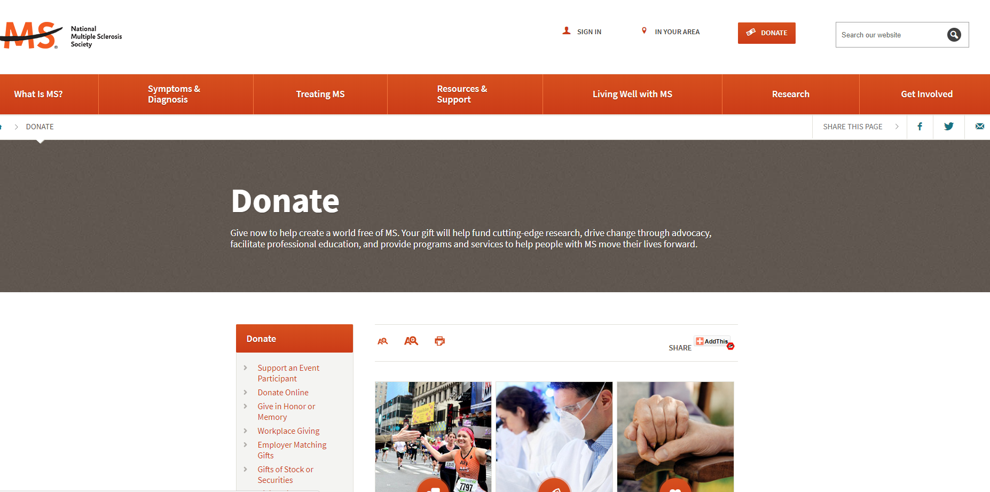
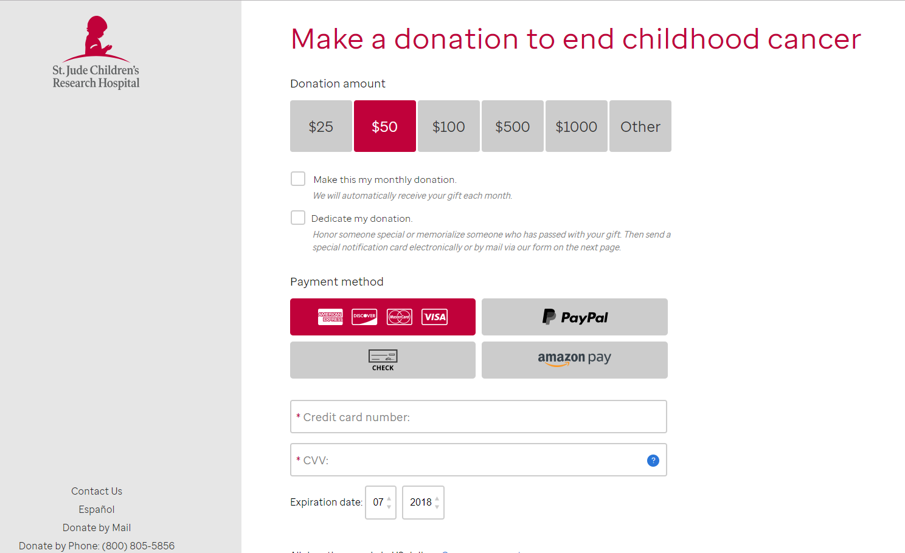
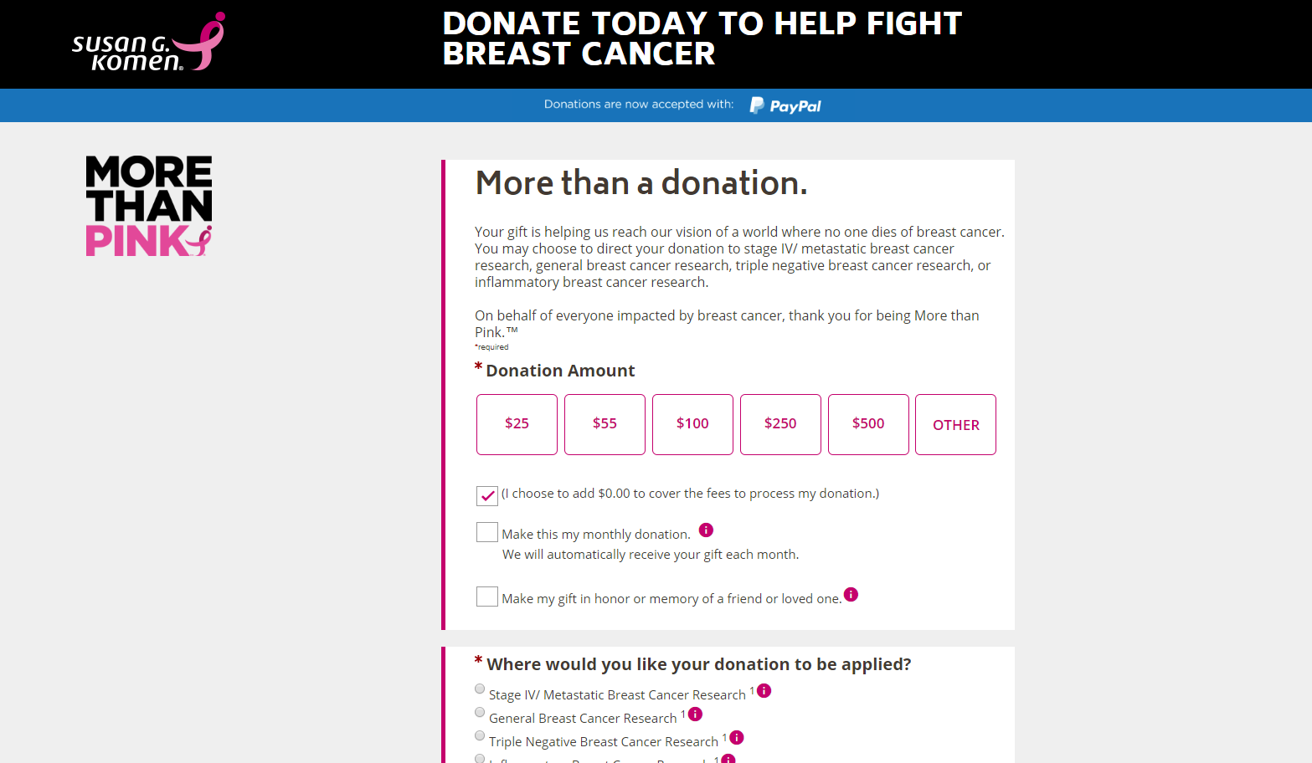
Potential Insight
Evolution of the Charitable Giving Landscape
ALS Ice Bucket Challenge
Susan G Komen partnerships with professional sports and utilize highly adaptive marketing techniques.
St. Jude, Susan G Komen, and the Ice Bucket Challenge all leverage personal connection as part of their fundraising efforts.
NMSS donation website reveals a bland and unappealing call to action.
Contrasted to Susan G Komen and St. Jude Children’s Research Hospital, there are dramatic differences.

Slide 51
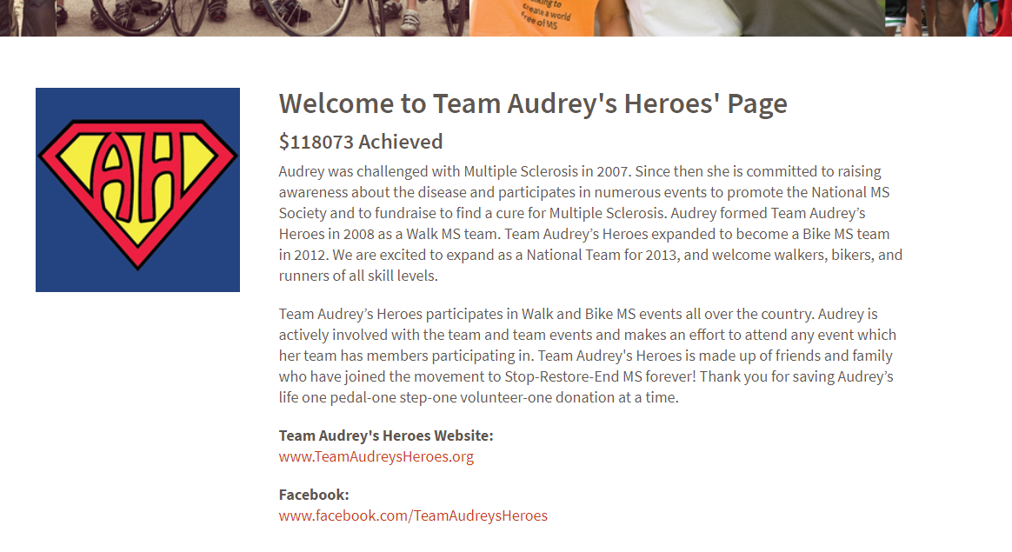
Potential Insight
Data show most common connection to MS is friend or co-worker followed by relative
Little of Bike MS fundraising efforts leverage this association.
Bike MS should build fundraising efforts around the individual with MS
Shift focus from disease to person and increase fundraising priority registrants life.
Potential Applications
Showcasing “Heroes with MS” who exhibit courage and perseverance in their struggle with the disease.
Select a person or team for each event for participants to rally around.
Such as Audrey’s Heroes.
Non-team individuals would have a team to join, a specific person to support, and a stronger connection for returning in the future.

Slide 52
Thank You
Jeff Mills
https://github.com/mills-jeffreyb/GENBA894

