Slide 1
Project: 2018 Data Challenges Sponsored by Teradata University Network
Capstone Class Project for Jeff Mills
Summer 2018
Kansas State University

Slide 2
Overview
Problem:
The National Multiple Sclerosis Society (NMSS) Bike MS events are struggling to maintain fundraising and participation
Bike MS participation and revenue have steadily declined since peaking in 2012.
NMSS attributes this to increased competition for charity monies and time.
Bike MS currently loses past participants faster than it recruits new ones.
NMSS believes it must increase new cyclist participation to have future success.
NMSS believes it must also recruit new 10+ member corporate teams to maximize fundraising.
According to NMSS,
10+ members teams raise 3x money of smaller teams
over 41% of the 1,561 teams with 10+ members in 2017 were corporate teams
NMSS goals for 2018 Bike MS:
Increase from 74,000 riders to 80,572 riders (8.88%),
Increase from 6,150 teams to 6,489 teams (5.51%),
Recruit 40,000 new riders,
Increase number of corporate teams with 10 or more riders,
Successfully utilize digital marketing efforts to impact fundraising goals.

Slide 3
Research Priorities
FIRST PRIORITY: CORPORATE ACQUISITION
What are the greatest growth opportunities for new corporate teams?
Can we apply those opportunities to specific rides/markets, especially our biggest events?
What industries have had the strongest involvement in Bike MS in the last five years?
What occupations were responsible for most of our fundraising?
Can we tie together these industries and occupations to identify gaps/opportunities?
What is the common denominator for our top performing corporate teams? (Is it industry, culture, executive involvement, connection to MS, other?)
Can we quantify the effect competing events are having in our top markets?

Slide 4
Research Priorities
SECOND PRIORITY: DIGITAL/SOCIAL ACQUISITION
What are the greatest opportunities for digital marketing investments? Where have we seen the greatest ROI?
Once someone is registered, what tactics and behaviors drive fundraising, and at what times leading up to the event?
What behavioral data do you see about usage of our fundraising tools and how it may or may not relate to performance of top fundraisers?
Despite increasing our digital advertising spend, acquisition continues to trend downward overall. Why? Is it an issue of needing more traffic, better targeting, or a conversion rate issue that needs to be addressed through the registration process? What can we do to reverse the trend?
FINALLY:
As you studied this data, is there something else that came up as an insight into our operations that the questions above do not capture?

Slide 5
Data
Donations 2013-2017 Bike Donations.csv
Events 2013-2017 Bike Events.csv
Participants 2013-2017 Bike MS Participants.csv
Bike Teams 2013-2017 Bike Teams.csv
National Teams 2013-2017 National Team Activity.xlsx
Affiliates Contains Affiliate_Codes.xlsx
Bike MS Digital Advertising Reports Advertising reports for the 2015-2018 fiscal years.
Google Analytics Google Analytics report for the National MS Society website.

Slide 6
Data Cleaning
All data were found to contain some errors
Most common were misaligned columns due inaccurate characters dividing data (e.g. “2016(0001502456” instead of “2016,0001502456”
Additional errors resulted from typos and errors in data entry
E.g. multiple versions of Retired, Self employed, and company names (e.g. Alabama Power Company and Alabama Power Co);
Corrected obvious errors, left them as is if mistakes were not 100% certain
Standardized entries
E.g. for 'Donor Connection to MS’, deleted "Blank", changed "no connection" to "None", and standardized the relatives (“Wife/Husband has MS” changed to “Spouse has MS”
Dummy variables created for categorical data
Will drop one to avoid dummy trap

Slide 7
Cycling in America
According to Statista, approximately 12.4% of Americans regularly cycled in 2016.
Statista also reported:
U.S. cycling sizable increase 2012 to 2014, followed by plateau,
66.5 million U.S. cyclists in 2016,
U.S. cyclists 6 to 17 years old has decreased since 2013,
U.S. cyclists 18 to 24 years increased its peak of 5.7 million in 2013 and declined since.
Source: https://www.statista.com/topics/1686/cycling/

Slide 8
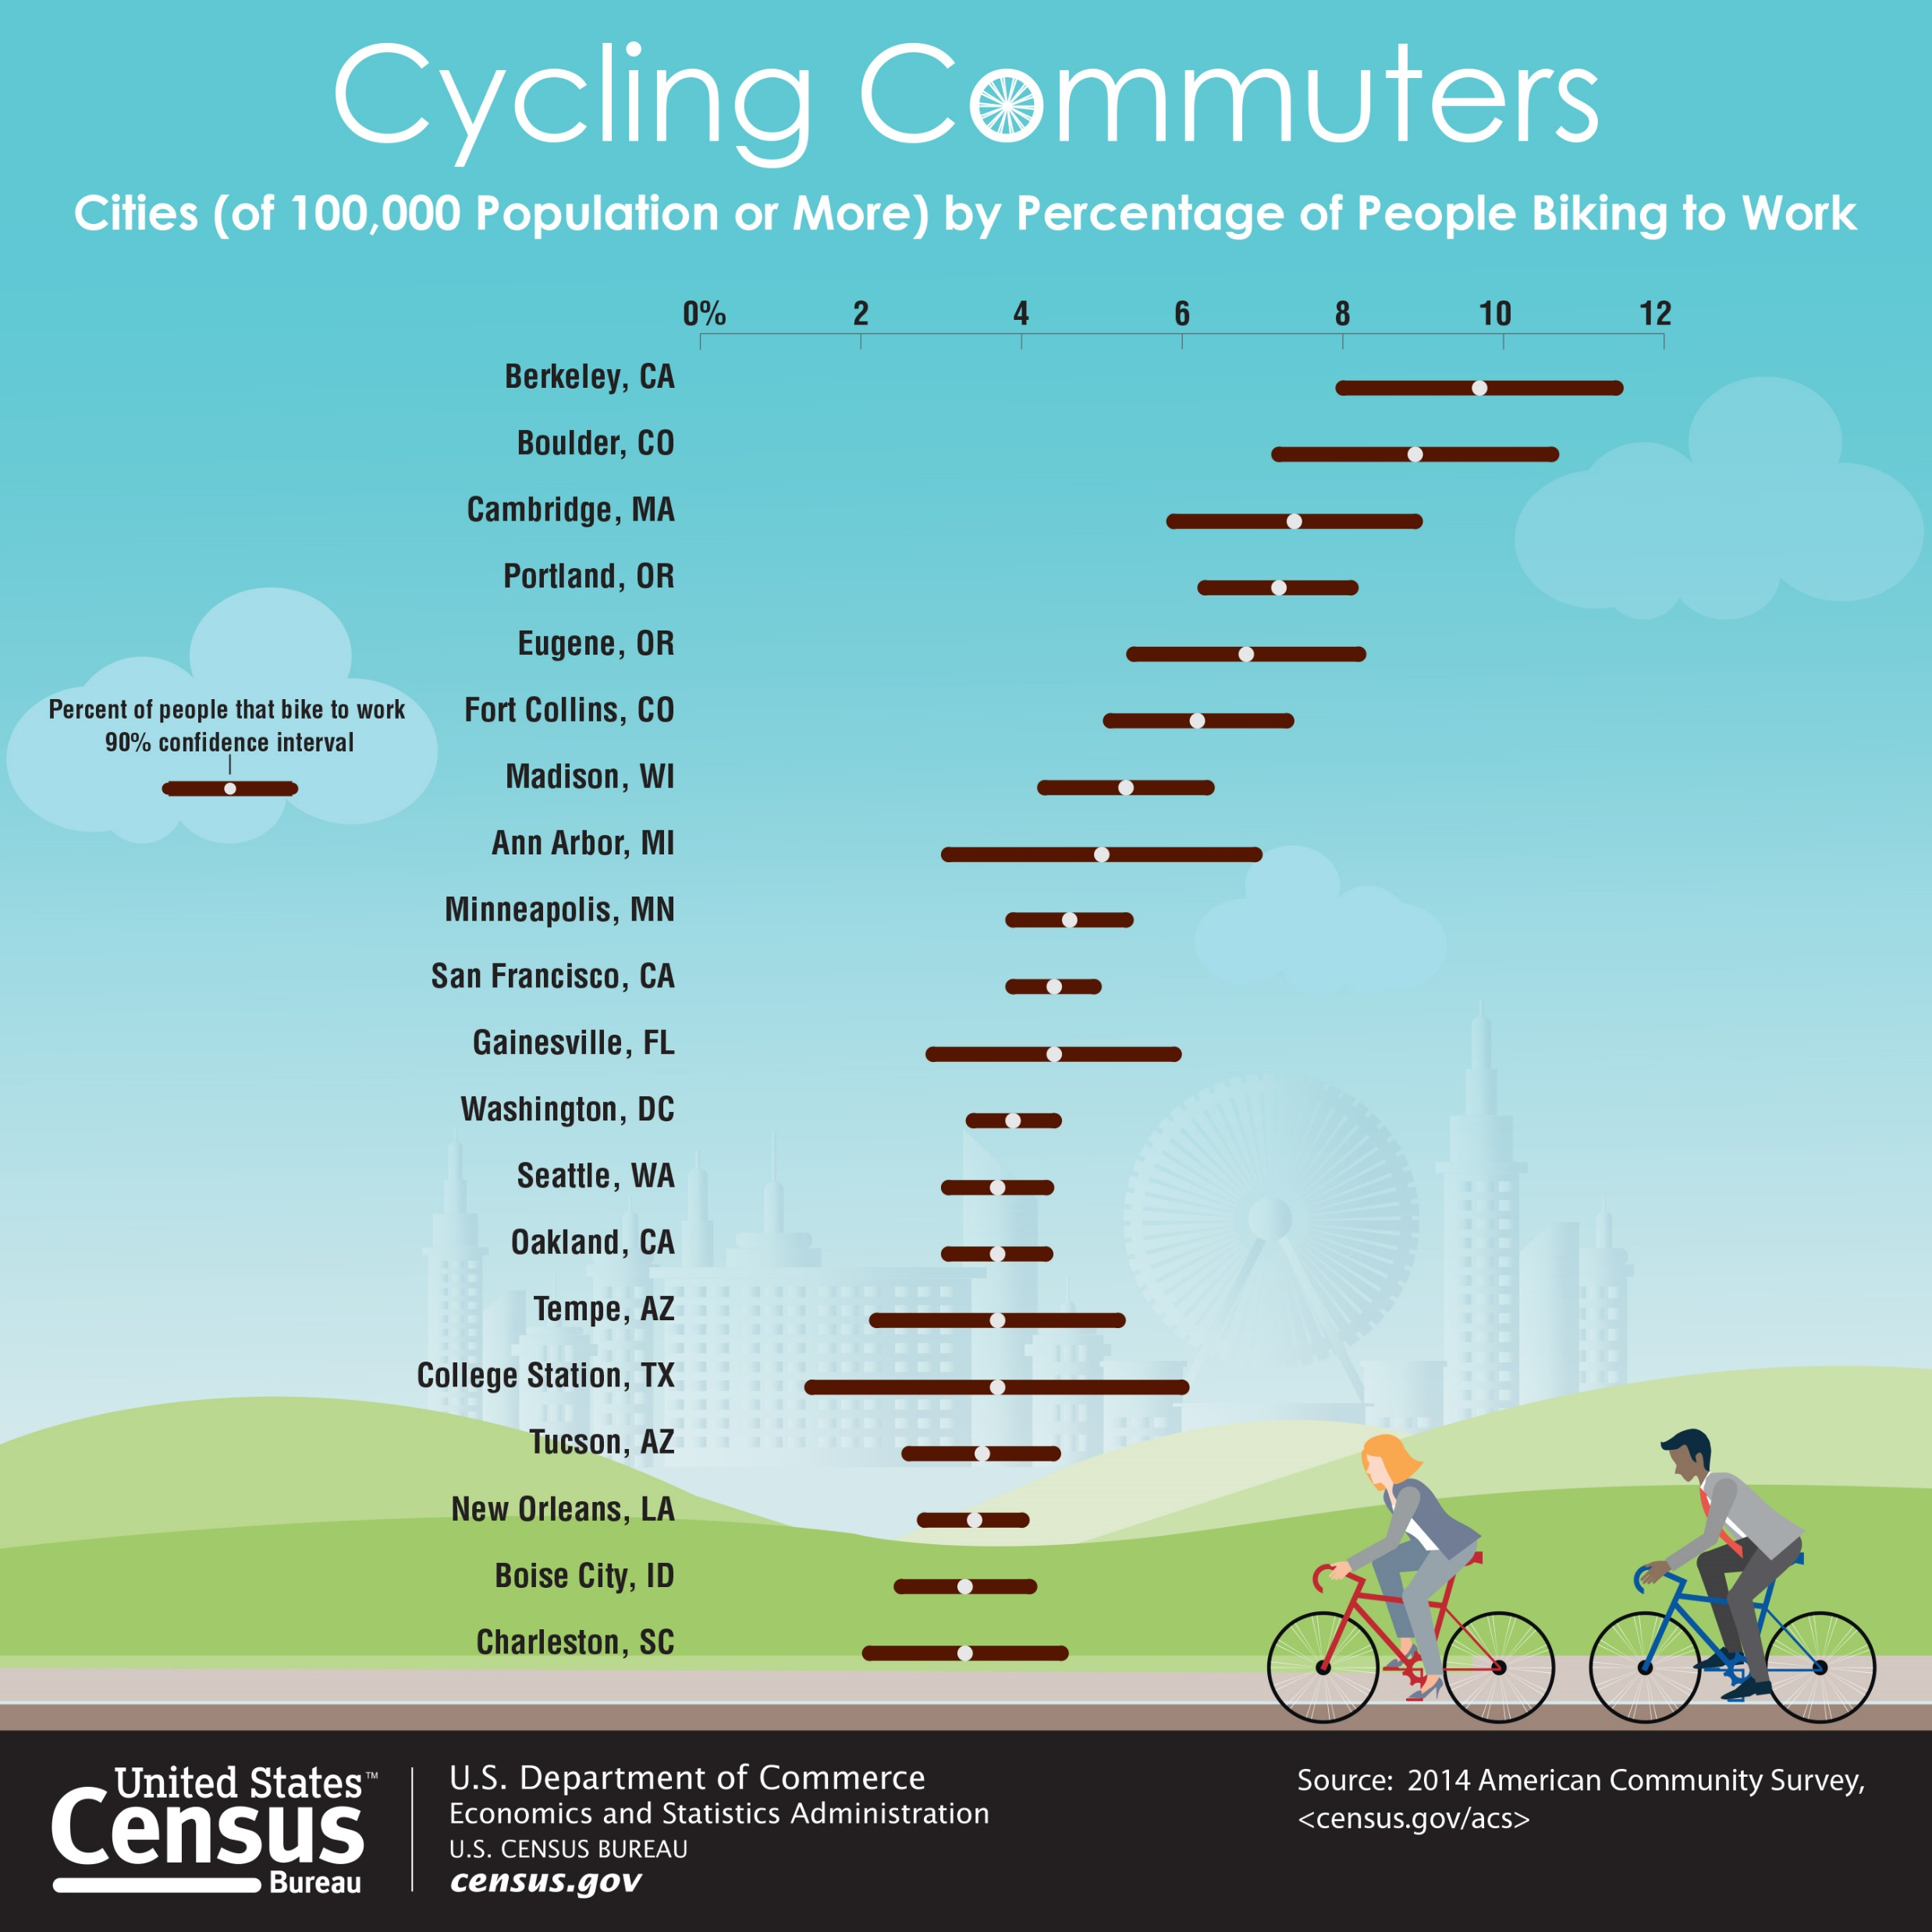
Cycling in America

Slide 9
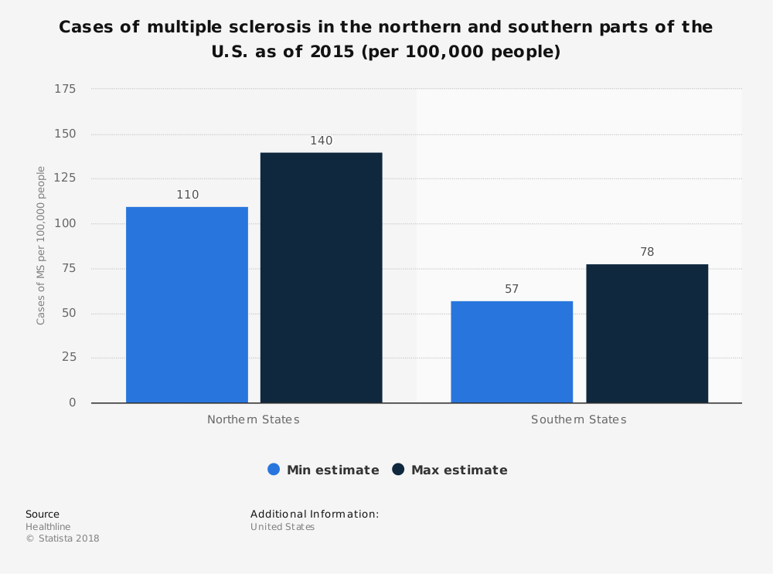

Slide 10
Fortune 500
http://fortune.com/fortune500/visualizations/?iid=recirc_f500landing-zone1

Slide 11
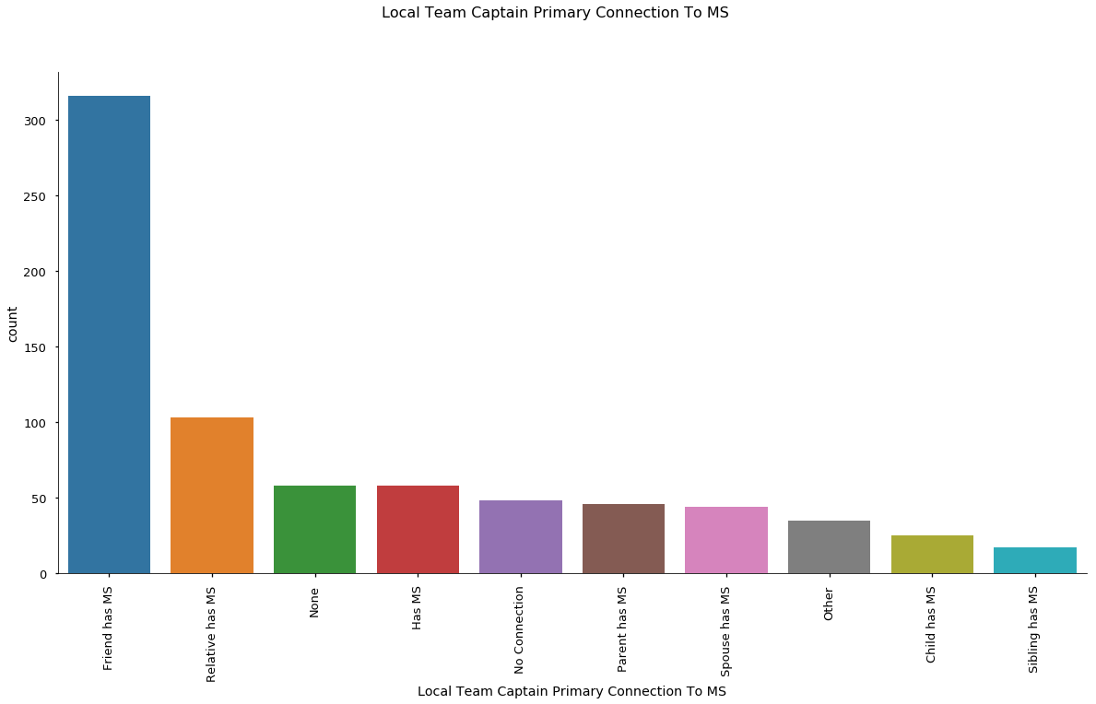
National Bike Teams

Slide 12
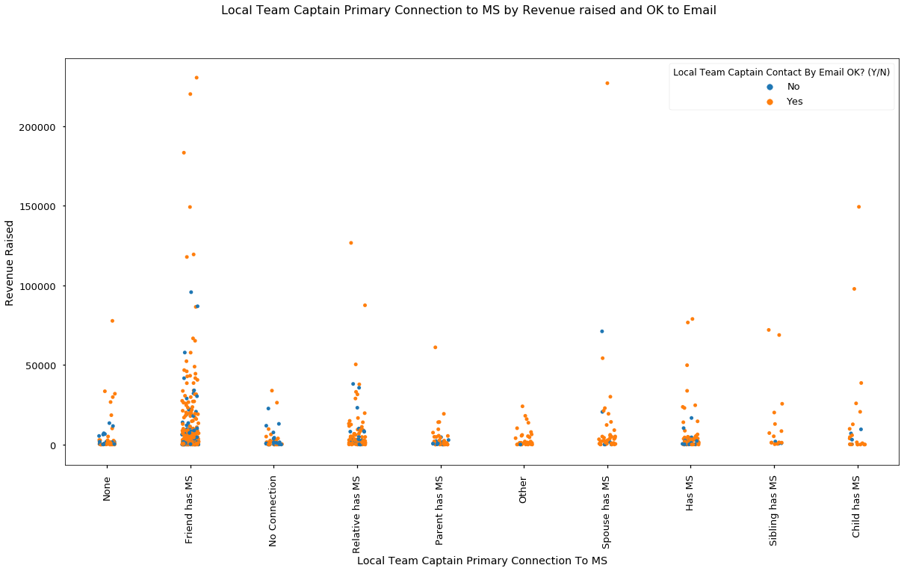
National Bike Teams

Slide 13
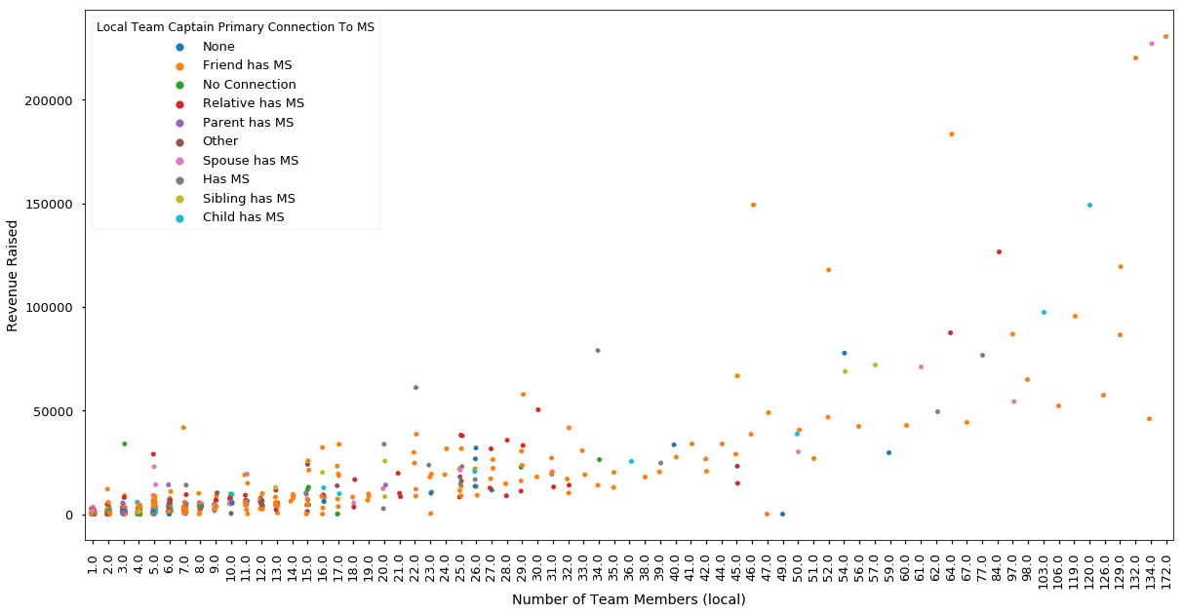
National Bike Teams

Slide 14
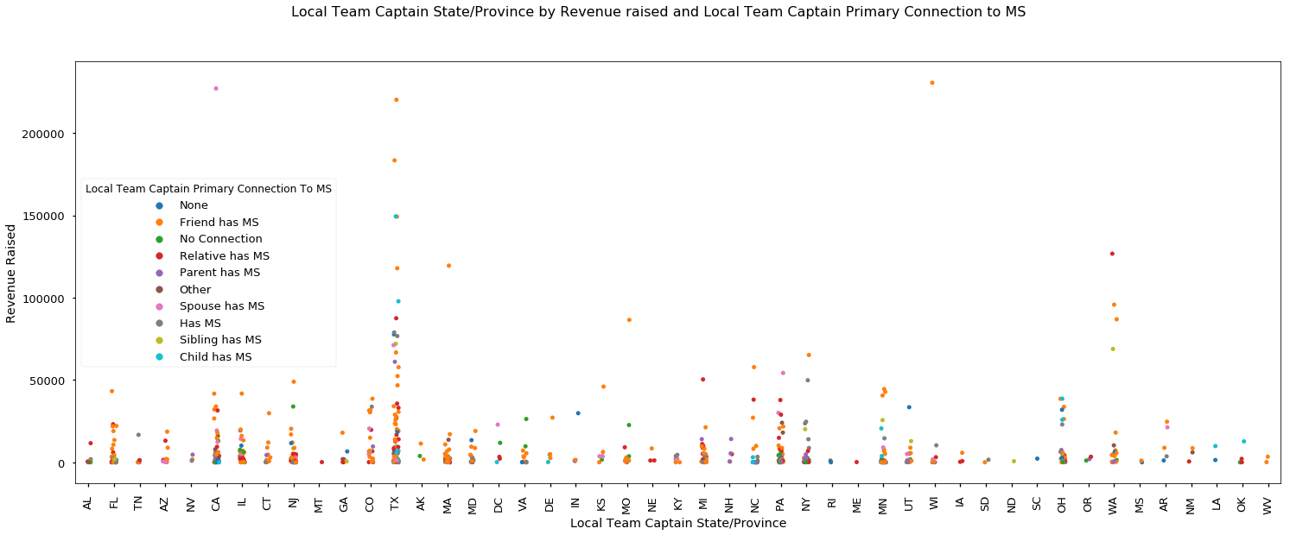
National Bike Teams

Slide 15
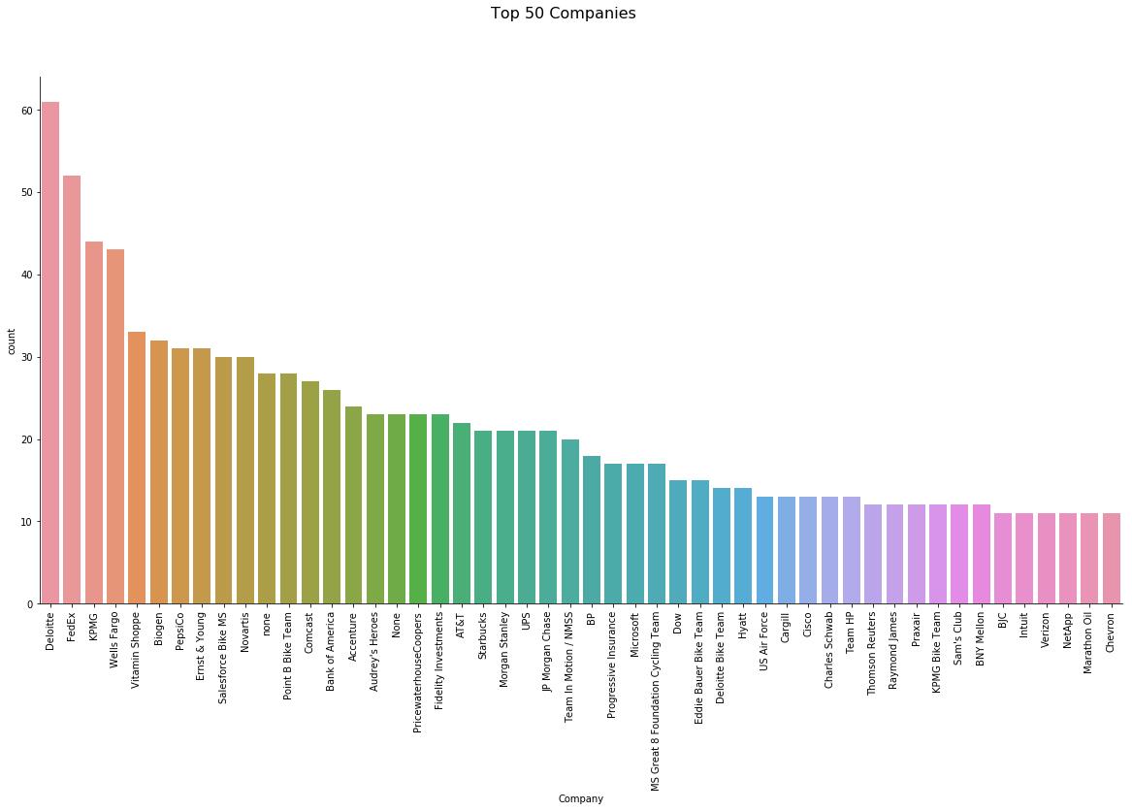
Bike Teams

Slide 16
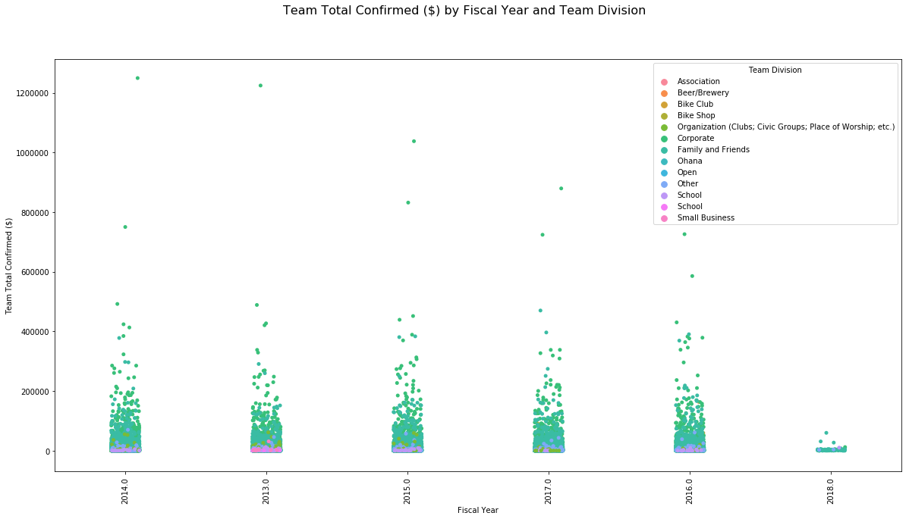
Bike Teams

Slide 17
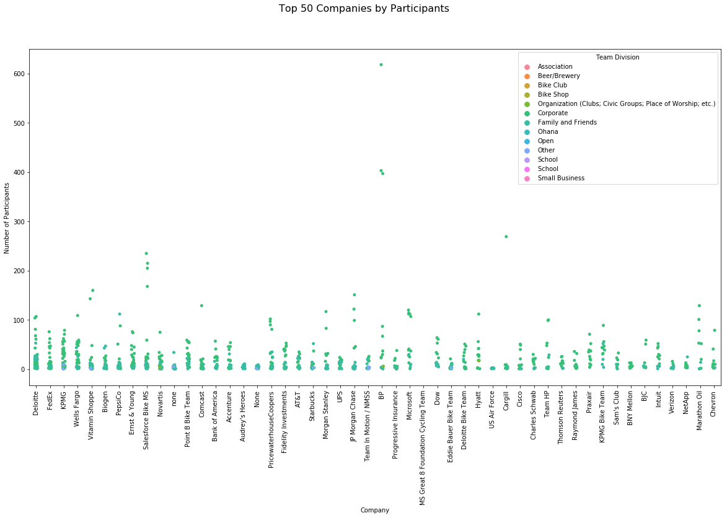
Bike Teams

Slide 18
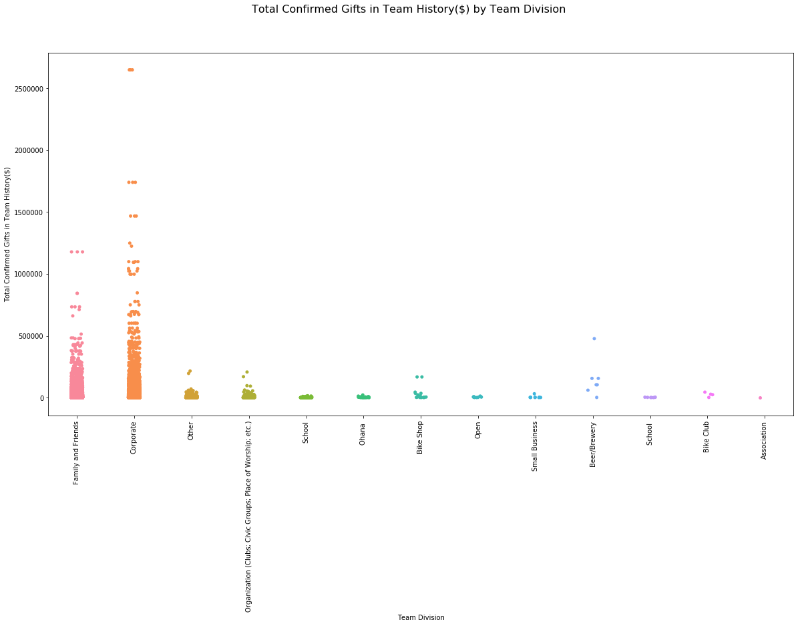
Bike Teams

Slide 19
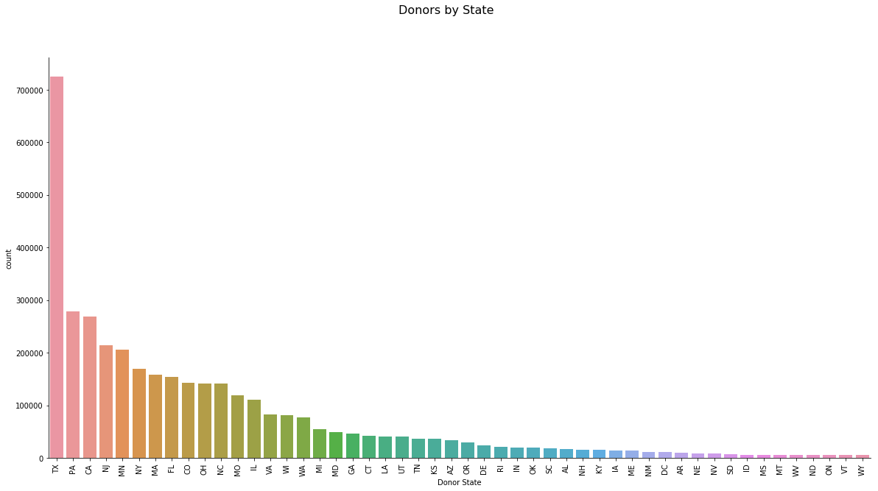
Donations

Slide 20
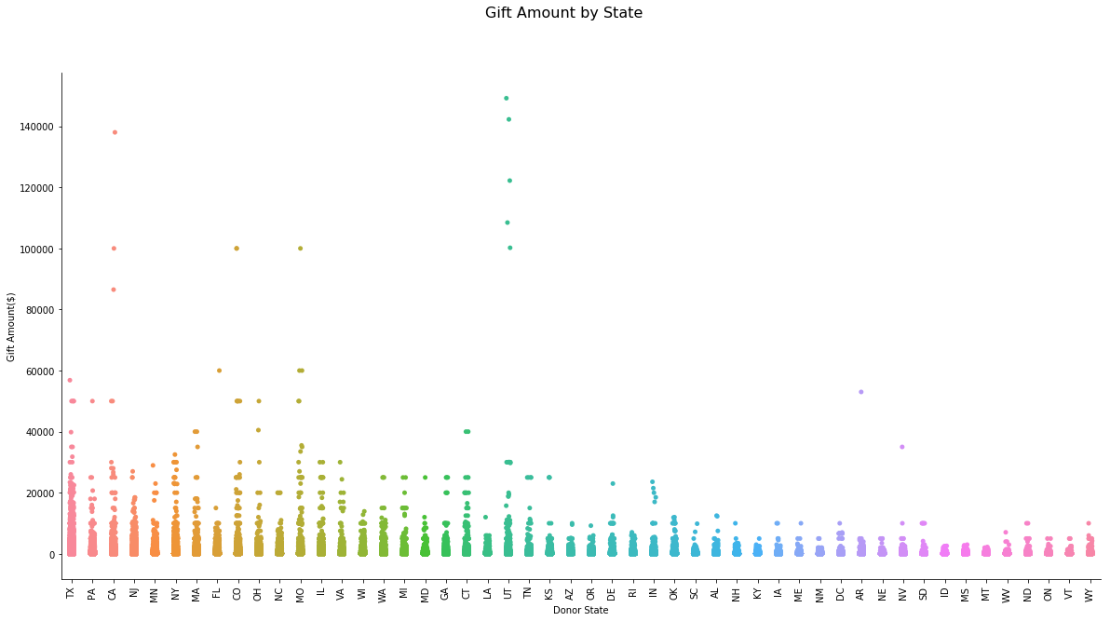
Donations

Slide 21
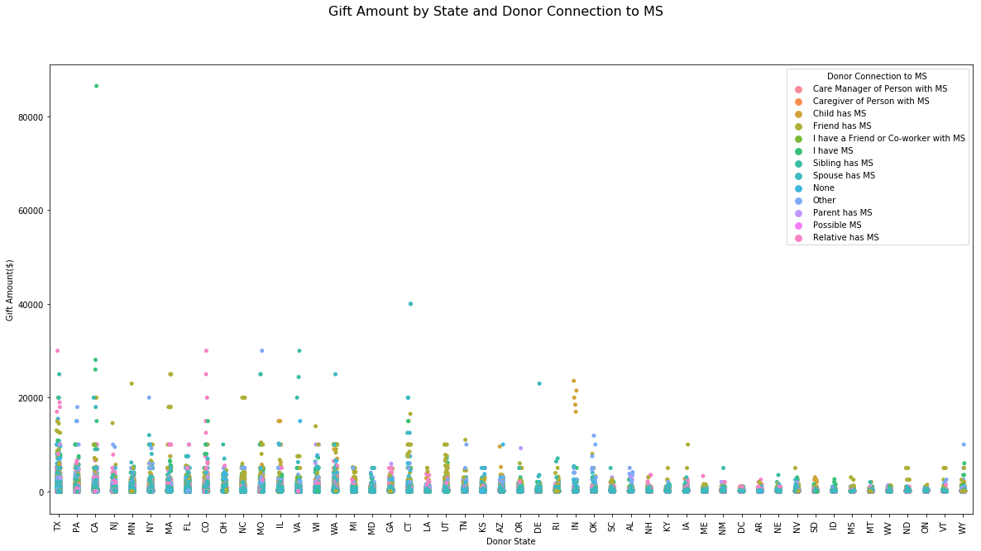
Donations

Slide 22
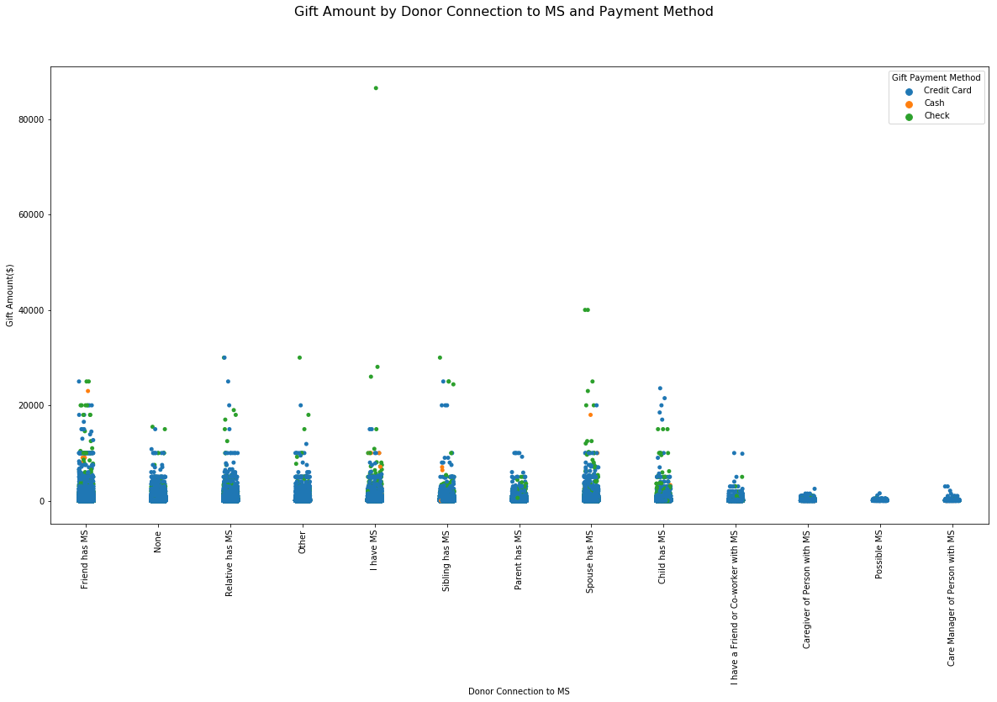
Donations

Slide 23
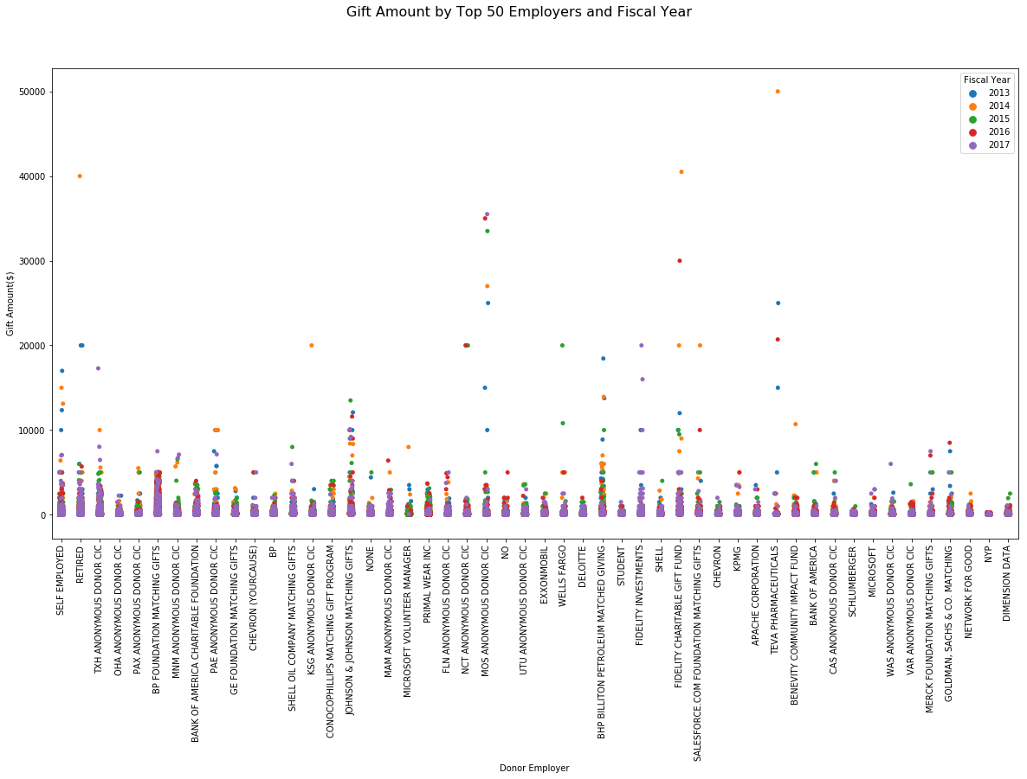
Donations

Slide 24
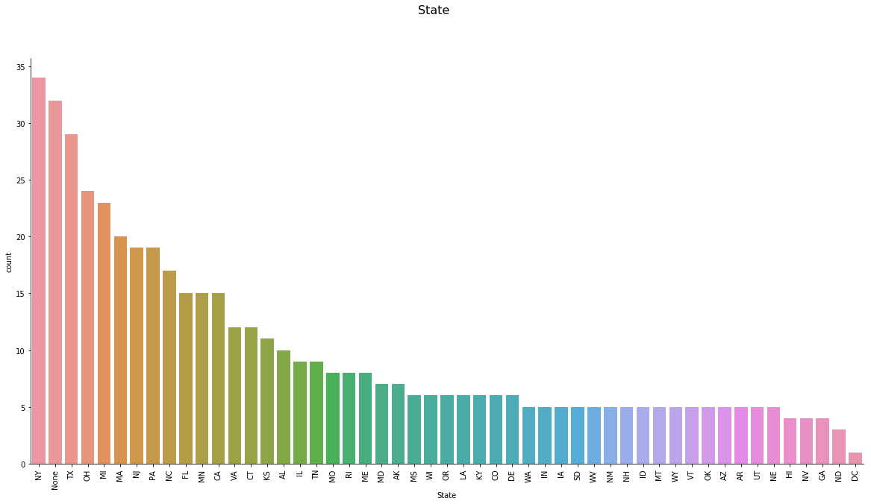
Events

Slide 25
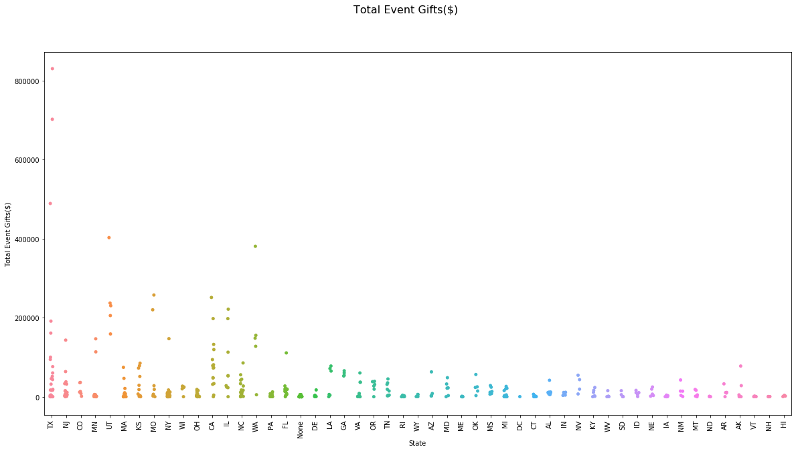
Events

Slide 26
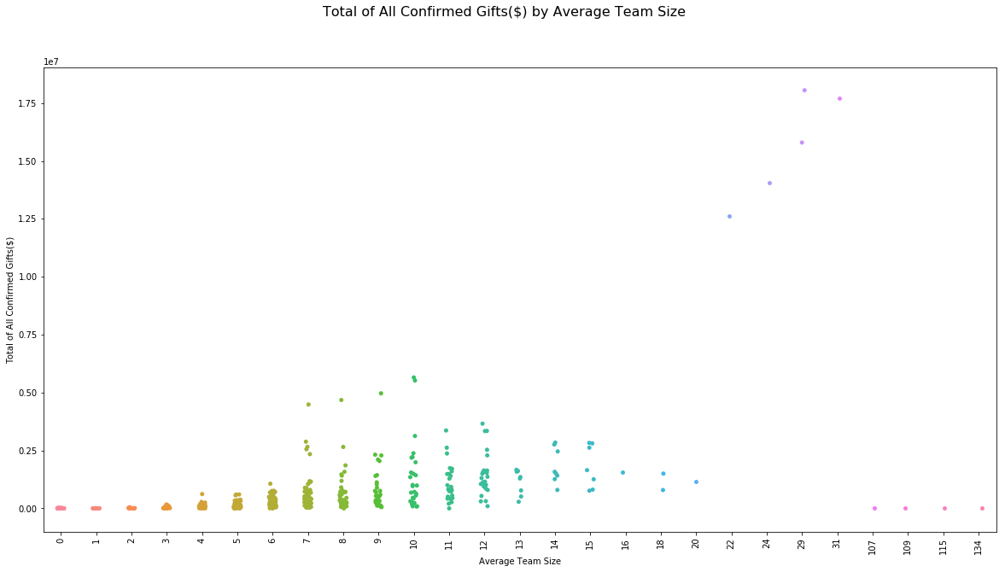
Events

Slide 27
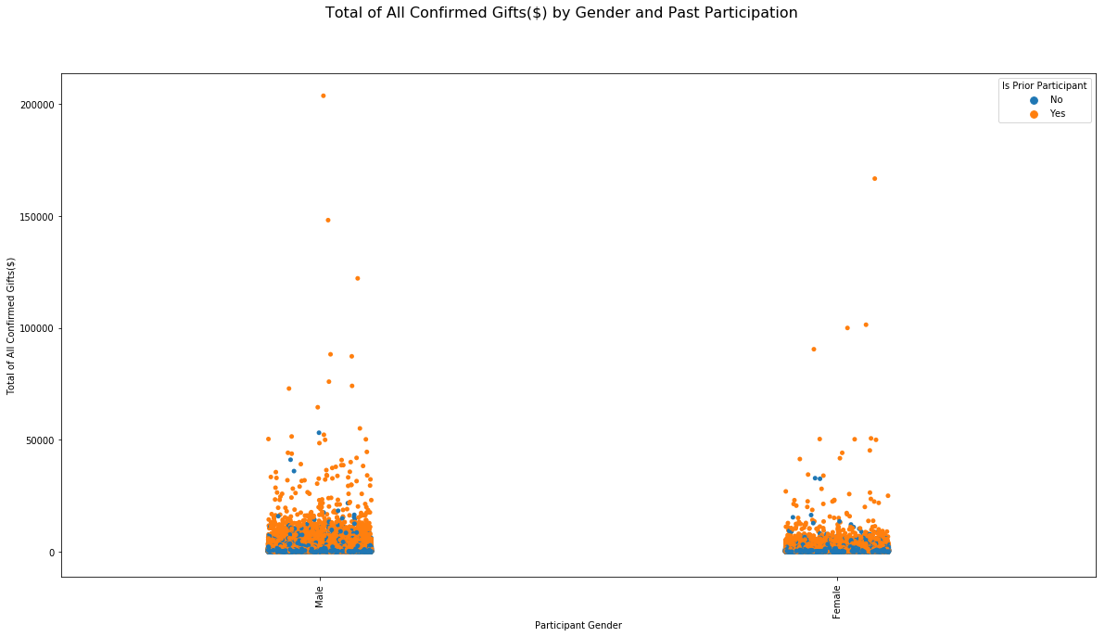
Participants

Slide 28
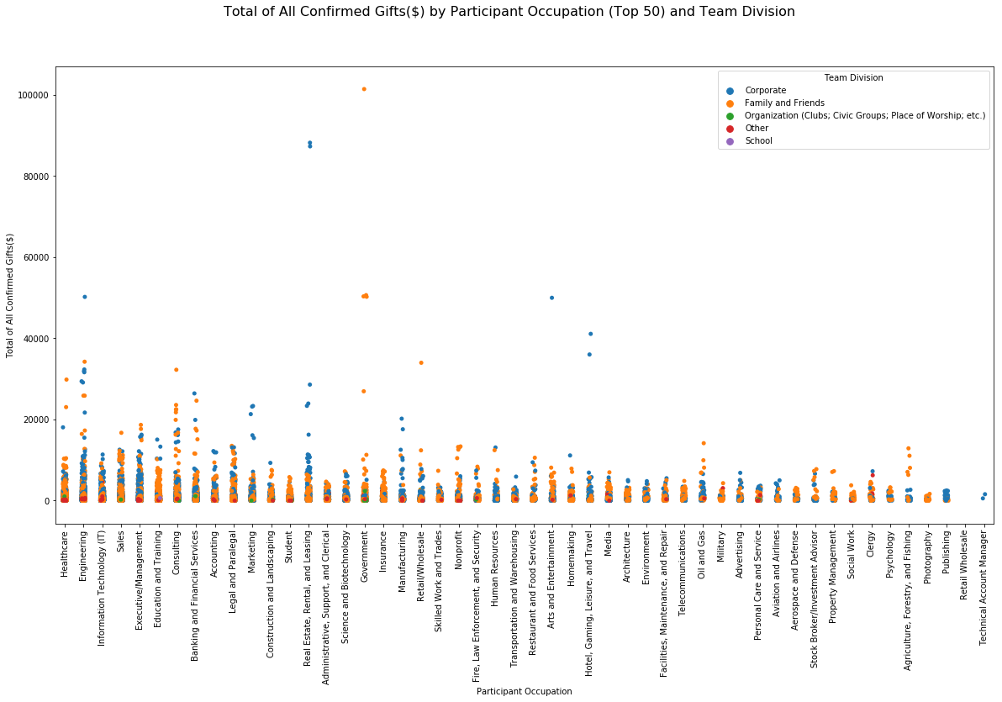
Participants

Slide 29
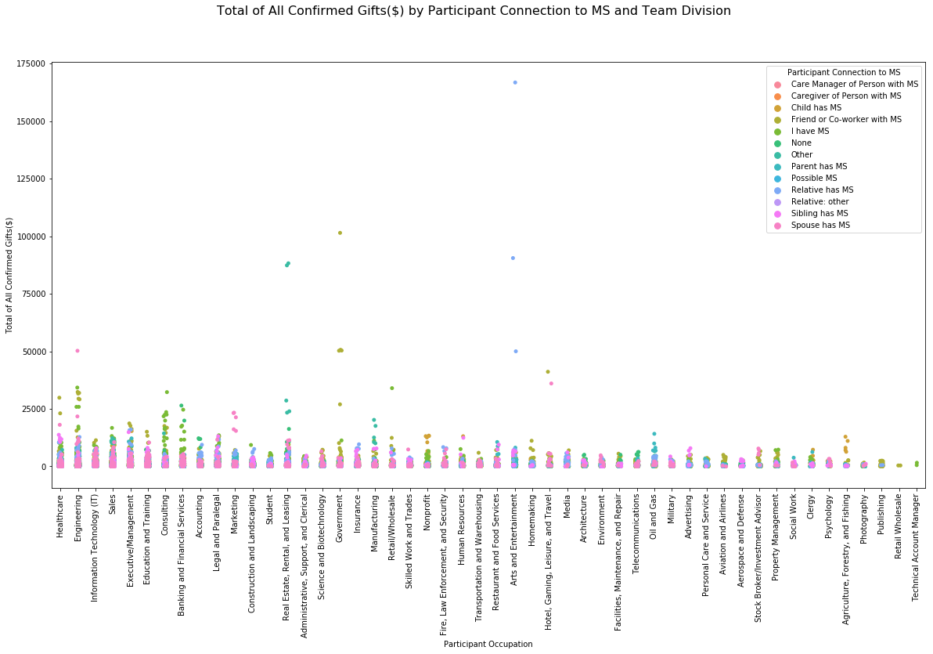
Participants

Slide 30
Google Analytics
Data Provided as follows:
Analytics Bike MS - Luminate Pages Acquisition Overview Goal 1 Indiv Reg 20160401-20171214
Analytics Bike MS - Luminate Pages Acquisition Overview Goal 2 Start New Team 20160401-20171214
Analytics Bike MS - Luminate Pages Acquisition Overview Goal 3 Join Team 20160401-20171214 (1)
Analytics Bike MS - Luminate Pages Acquisition Overview Goal 4 Join from Team Page 20160401-20171214
Analytics Bike MS - Luminate Pages Location 20160401-20171214
Analytics Bike MS - Luminate Pages Location City 20160401 - 20171214 (1)
Analytics Bike MS - Luminate Pages Location Metro 20160401-20171214 (2)
Analytics Bike MS - Luminate Pages Referral Traffic Goal 1 Indiv Reg 20160401-20171214
Analytics Bike MS - Luminate Pages Referral Traffic Goal 2 Start New Team 20160401-20171214
Analytics Bike MS - Luminate Pages Referral Traffic Goal 3 Join Team 20160401-20171214 (2)
Analytics Bike MS - Luminate Pages Referral Traffic Goal 4 Join from Team Page 20160401-20171214

Slide 31
Google Analytics
In general, correlations behaved as expected for all goals:
New Users were positively and strongly correlated with Sessions
Bounce rate was weakly and negatively associated with Sessions and New Users, but strongly negatively associated with Pages per Session and Avg. Session Duration
% New Sessions was positively and strongly associated with Bounce Rate and strongly, negatively associated with Pages per Session and Avg. Session Duration.

Slide 32
Google Analytics - Individuals
Direct positive correlation with Completions
Correlations | Bike Registrations - Individual with Payment (Goal 1 Conversion Rate) | Bike Registrations - Individual with Payment (Goal 1 Completions)
Sessions | 0.273725 | 0.940489
% New Sessions | -0.429735 | 0.157201
New Users | 0.291154 | 0.952012
Bounce Rate | -0.751216 | -0.327678
Pages / Session | 0.641821 | 0.281515
Bike Registrations - Individual with Payment (Goal 1 Conversion Rate) | 1 | 0.51048
Bike Registrations - Individual with Payment (Goal 1 Completions) | 0.51048 | 1
Direct | 0.64513 | 0.500105
Display | -0.531903 | -0.224058
Email | 0.344947 | -0.219618
Organic Search | -0.073729 | -0.053528
Other | -0.184323 | -0.174204
Paid Search | -0.034231 | -0.217242
Referral | 0.171157 | -0.195044
Social | -0.468707 | -0.20203
Total | 0.131659 | 0.785618

Slide 33
Google Analytics – New Team Starts
Direct positive correlation with Completions
Correlations | Bike Registrations - Start New Team Member (Goal 2 Conversion Rate) | Bike Registrations - Start New Team Member (Goal 2 Completions)
Sessions | 0.278235 | 0.940489
% New Sessions | -0.426235 | 0.157179
New Users | 0.295549 | 0.952012
Bounce Rate | -0.750735 | -0.32761
Pages / Session | 0.641132 | 0.279945
Avg. Session Duration | 0.716379 | 0.350046
Bike Registrations - Start New Team Member (Goal 2 Conversion Rate) | 1 | 0.515032
Bike Registrations - Start New Team Member (Goal 2 Completions) | 0.515032 | 1
Direct | 0.647752 | 0.500105
Display | -0.530807 | -0.224058
Email | 0.341729 | -0.219618
Organic Search | -0.07082 | -0.053528
Other | -0.183081 | -0.174204
Paid Search | -0.0373 | -0.217242
Referral | 0.167864 | -0.195044
Social | -0.469788 | -0.20203
Total | 0.134452 | 0.785618

Slide 34
Google Analytics – Join Team
Direct positive correlation with Completions
Correlations | Bike Registration - Join a Team (Goal 3 Conversion Rate) | Bike Registration - Join a Team (Goal 3 Completions)
Sessions | 0.278195 | 0.940215
% New Sessions | -0.424708 | 0.157601
New Users | 0.295764 | 0.951849
Bounce Rate | -0.748541 | -0.327365
Pages / Session | 0.638987 | 0.279549
Avg. Session Duration | 0.714508 | 0.349789
Bike Registration - Join a Team (Goal 3 Conversion Rate) | 1 | 0.515397
Bike Registration - Join a Team (Goal 3 Completions) | 0.515397 | 1
Direct | 0.648306 | 0.50085
Display | -0.529348 | -0.22394
Email | 0.345986 | -0.219479
Organic Search | -0.072698 | -0.054324
Other | -0.182591 | -0.174136
Paid Search | -0.0398 | -0.21717
Referral | 0.164248 | -0.195089
Social | -0.468536 | -0.201924
Total | 0.134432 | 0.785213

Slide 35
Google Analytics - Individuals
Direct positive correlation with Completions
Correlations | Bike Registration - Join Team from Team Page (Goal 4 Conversion Rate) | Bike Registration - Join Team from Team Page (Goal 4 Completions)
Sessions | 0.278195 | 0.940215
% New Sessions | -0.424708 | 0.157601
New Users | 0.295764 | 0.951849
Bounce Rate | -0.748541 | -0.327365
Pages / Session | 0.638987 | 0.279549
Avg. Session Duration | 0.714508 | 0.349789
Bike Registration - Join Team from Team Page (Goal 4 Conversion Rate) | 1 | 0.515397
Bike Registration - Join Team from Team Page (Goal 4 Completions) | 0.515397 | 1
Direct | 0.648306 | 0.50085
Display | -0.529348 | -0.22394
Email | 0.345986 | -0.219479
Organic Search | -0.072698 | -0.054324
Other | -0.182591 | -0.174136
Paid Search | -0.0398 | -0.21717
Referral | 0.164248 | -0.195089
Social | -0.468536 | -0.201924
Total | 0.134432 | 0.785213

Slide 36
Further Analysis
Why does Texas dominate National Teams?
Can it be repeated?
What opportunities are missed in the Northern States?
Colorado, Oregon, Washington
What opportunities are missed in the Southern States?
Georgia, Washington DC
What is the impact of “Connection to MS” type on revenue raised?
Optimal team size?
Does referral method impact conversion rates?
Plan to investigate with regression

Slide 37
Thank You
Jeff Mills
https://github.com/mills-jeffreyb/GENBA894

