Slide 1

Library Management System
Kevin Mills
Project 8
CSC785
Fall 2021

Slide 2
Purpose
Design a database back end for a Library Management System

Slide 3
Objectives
Two Librarian types for Student and Faculty will be needed.
Different number of books can be issued and the number of days a book can be lent out is dependent on the Librarian Type.
Each book will have a unique ID, but multiple copies of the same book (e.g., same title and author) will have a different ID.

Slide 4
Objectives (cont.)
When a book is checked out to a patron the librarian who checked out the book and the duration will also be identified.
If a book is not returned on time, then details of the fine should be recorded.
A patron should not be able to check out another book if a fine exists.

Slide 5
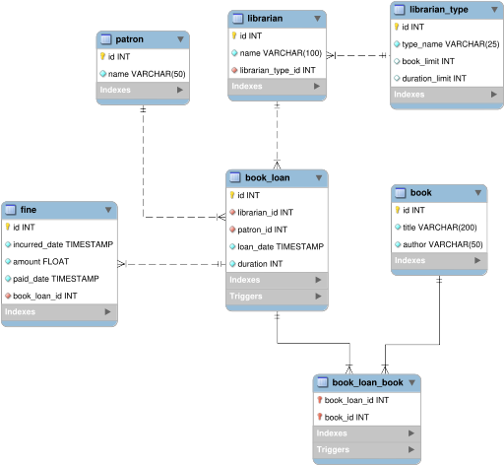
Data Model

Slide 6
Triggers
Prevent librarian from checking out books longer than allowed.
CREATE DEFINER = CURRENT_USER TRIGGER `book_loan_before_insert`
BEFORE INSERT ON `book_loan`
FOR EACH ROW
BEGIN
IF(NEW.duration > (SELECT lt.duration_limit
FROM librarian l, librarian_type lt
WHERE lt.id = l.librarian_type_id
AND l.id = NEW.librarian_id))
THEN
signal SQLSTATE '45000' SET message_text = "This librarian cannot check out a book for this duration.";
END IF;
END

Slide 7
Queries
Get the number of copies of each book
SELECT title, author, COUNT(*) copies
FROM book
GROUP BY title, author
ORDER BY 3 DESC,2,1;
Get the number of copies of each book that are not checked out
SELECT title, author, COUNT(*) copies
FROM book
WHERE id NOT IN (SELECT book_id FROM book_loan_book)
GROUP BY title, author
ORDER BY 3 DESC,2,1;

Slide 8
Queries
Get the details of the checked out books
SELECT l.name librarian_name, p.name patron_name,
b.title book_title, loan_date, duration,
DATE_ADD(loan_date, INTERVAL duration DAY) due_date
FROM book_loan bl,
librarian l,
patron p,
book_loan_book blb,
book b
WHERE bl.librarian_id = l.id
AND bl.patron_id = p.id
AND bl.id = blb.book_loan_id
AND blb.book_id = b.id;

Slide 9
Q&A

