Slide 1

eDNA and qPCR survey data
Milly Jones
mlj23@kent.ac.uk
Eleni Matechou, Diana Cole, Alex Diana, Jim Griffin,
Sara Peixoto, Lori Lawson Handley, Andrew Buxton

Slide 2
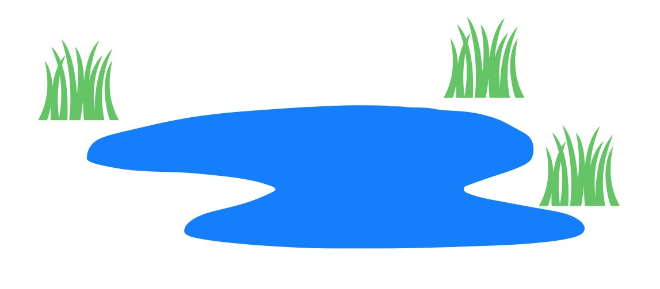

eDNA and qPCR survey data
Terminology:
eDNA: traces of DNA left by organisms in environmental samples such as water and soil
qPCR: Quantitative PCR is a technique used to amplify and quantify a target DNA molecule

Slide 3

eDNA and qPCR survey data
Spatial
Temporal
log(DNA)
qPCR survey pipeline
DNA availability:
Across sites $i=1,…,S$ and time-points $t=1,…,T.$
Environmental Covariates

Slide 4
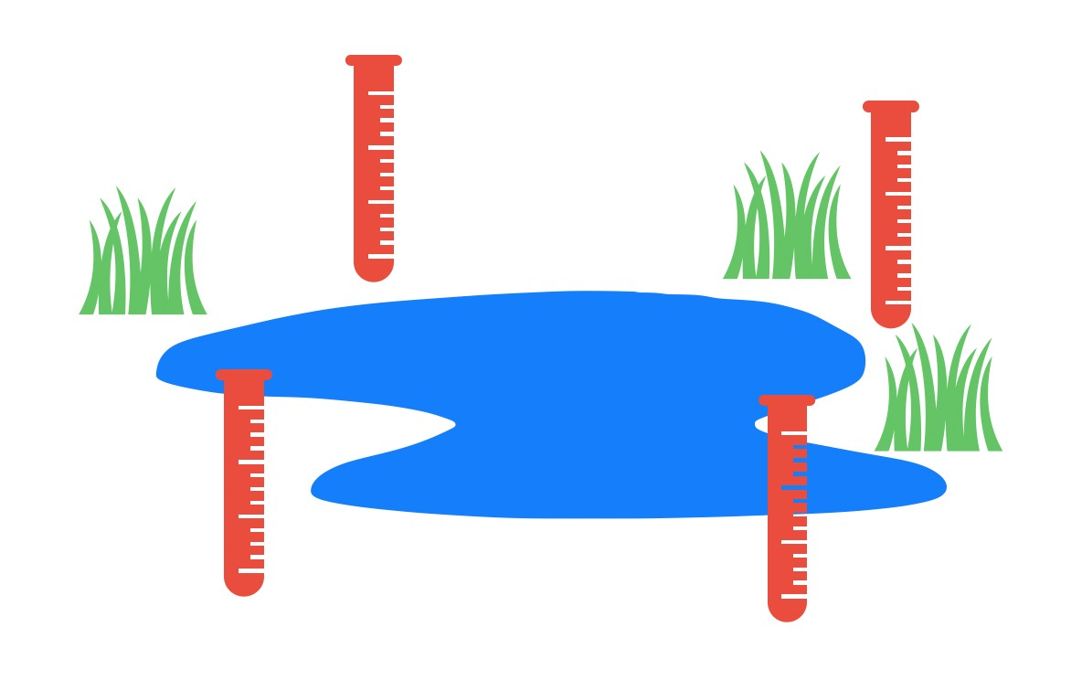

eDNA and qPCR survey data
Spatial
Temporal
log(DNA)
qPCR survey pipeline
DNA availability:
Across sites $i=1,…,S$ and time-points $t=1,…,T.$
DNA collection:
In samples $m=1, …, M.$
Environmental Covariates
log(DNA)
Technical Covariates
Environmental Covariates

Slide 5

eDNA and qPCR survey data
Spatial
Temporal
log(DNA)
qPCR survey pipeline
DNA availability:
Across sites $i=1,…,S$ and time-points $t=1,…,T.$
DNA collection:
In samples $m=1, …, M$
DNA analysis:
Model qPCR output on DNA concentration in the sample
Environmental Covariates
log(DNA)
Technical Covariates
Environmental Covariates
Laboratory

Slide 6
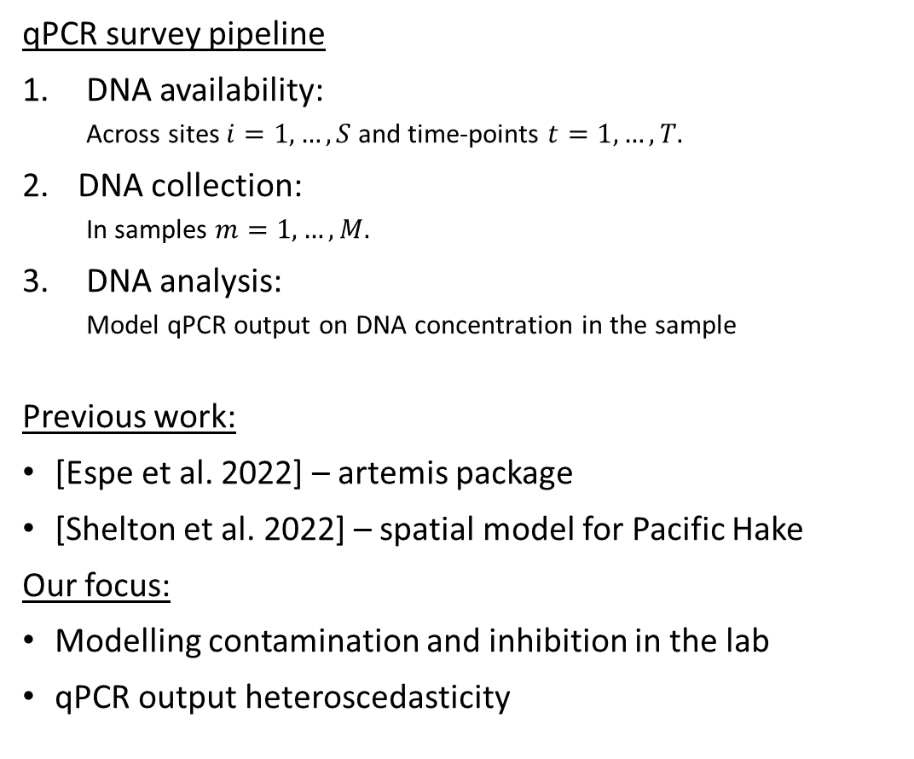
eDNA and qPCR survey data
Spatial
Temporal
log(DNA)
qPCR survey pipeline
DNA availability:
Across sites $i=1,…,S$ and time-points $t=1,…,T.$
DNA collection:
In samples $m=1, …, M.$
DNA analysis:
Model qPCR output on DNA concentration in the sample
Previous work:
[Espe et al. 2022] – artemis package
[Shelton et al. 2022] – spatial model for Pacific Hake
Our focus:
Modelling contamination and inhibition in the lab
qPCR output heteroscedasticity
Environmental Covariates
log(DNA)
Technical Covariates
Environmental Covariates
Laboratory

Slide 7
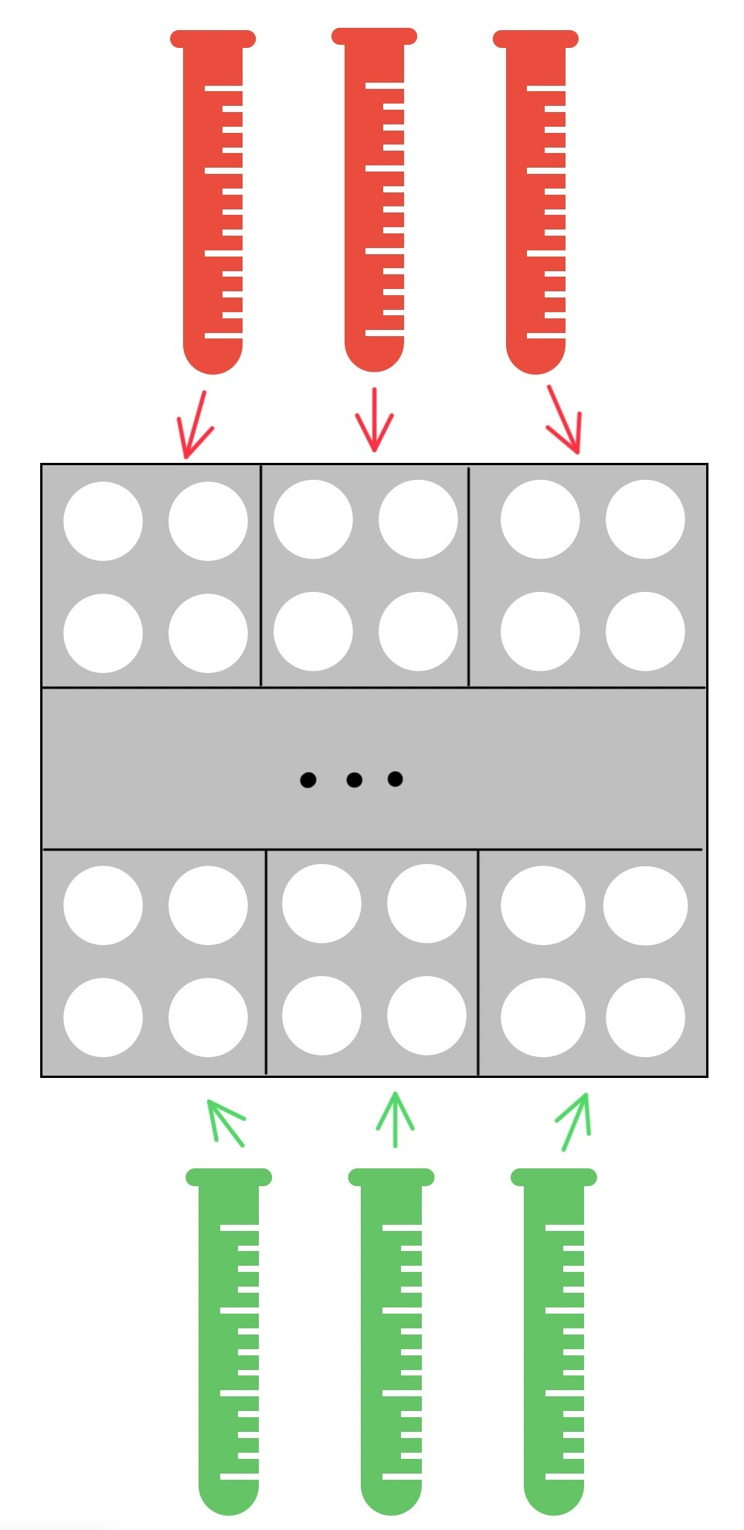
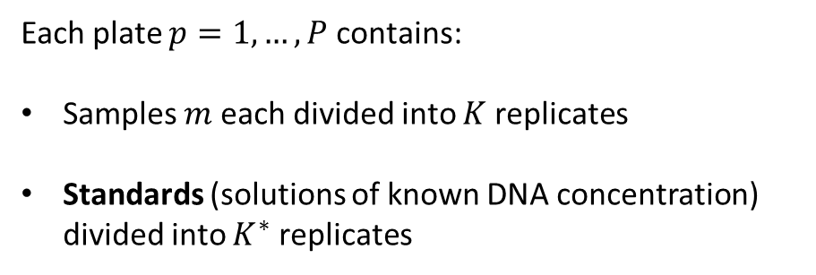
DNA analysis
Collected samples
Unknown Concentrations
Plate p
K replicates
per sample
Each plate $p=1,…,P$ contains:
Samples $m$ each divided into $K$ replicates
Standards (solutions of known DNA concentration) divided into $K^{∗}$ replicates
K* replicates
per standard
Standards
Known Concentrations

Slide 8
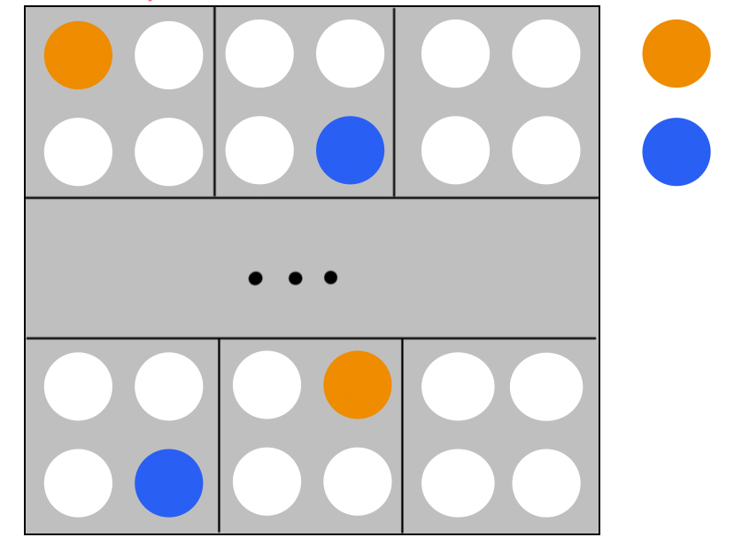
DNA analysis
M samples
Unknown Concentrations
Plate p
Contaminated
Contamination: presence of additional DNA in wells from lab through contaminated equipment or clothing
Inhibition: factors (substances or chemicals) interfering with the PCR process delaying DNA amplification
CT value – cycles to threshold, the (fractional) cycle number at which DNA is detected
Inhibited
Standards
Known Concentrations

Slide 9
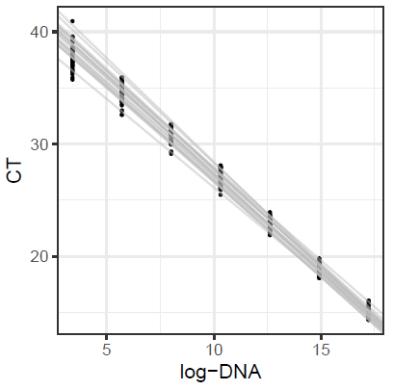
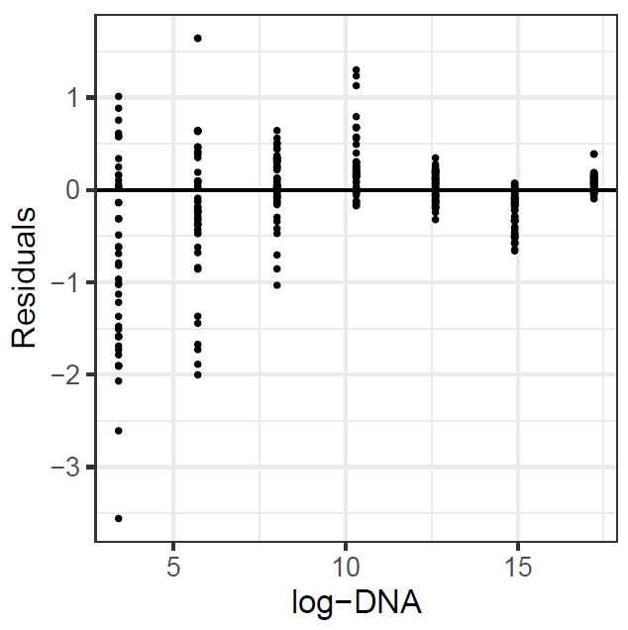
DNA analysis
CT.max
Heteroskedasticity: [Matz et al. 2013]

Slide 10

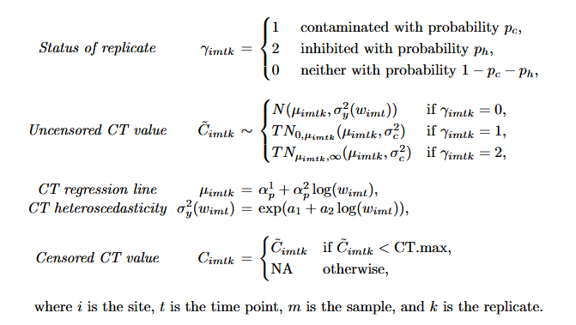


Slide 11
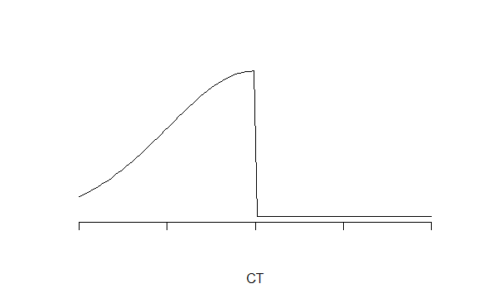
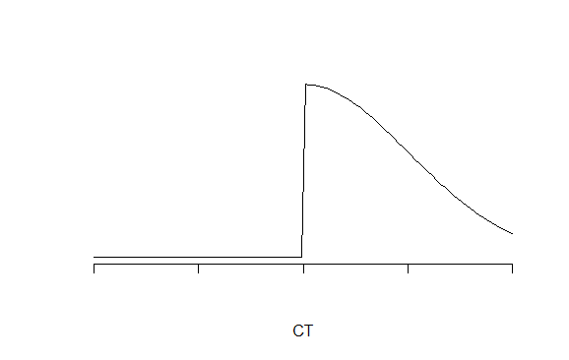
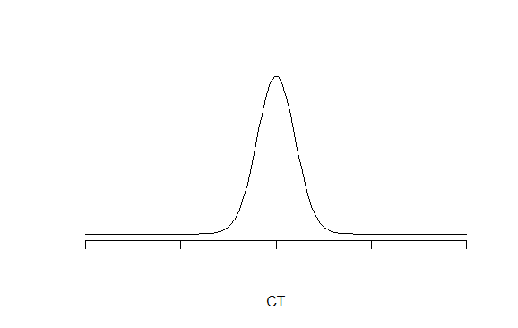



1
2
0
$$μ$$
$$μ$$
$$μ$$

Slide 12
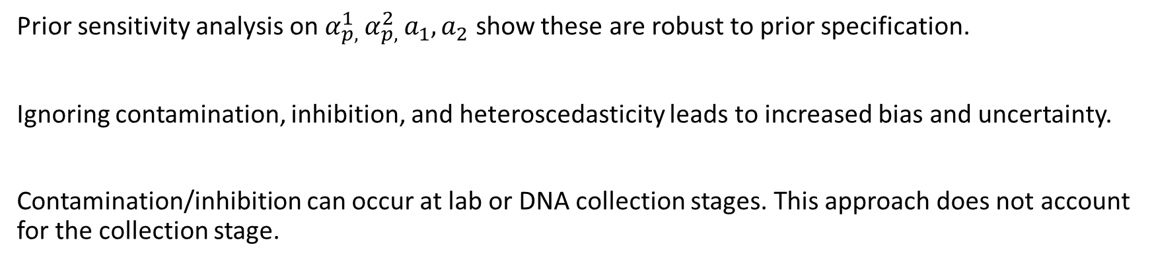
Final Comments
Prior sensitivity analysis on $α_{p, }^{1}α_{p, }^{2}a_{1}, a_{2}$ show these are robust to prior specification.
Ignoring contamination, inhibition, and heteroscedasticity leads to increased bias and uncertainty.
Contamination/inhibition can occur at lab or DNA collection stages. This approach does not account for the collection stage.

Slide 13
References
Espe, M.B., Johnston, M., Blankenship, S.M., Dean, C.A., Bowen, M.D., Schultz, A., Schumer, G.: The artemis package for environmental DNA analysis in R. Environmental DNA 4(3), 523–532 (2022) https://doi.org/10.1002/edn3.277
Shelton, A.O., Ramon-Laca, A., Wells, A., Clemons, J., Chu, D., Feist, B.E., Kelly, R.P., Parker-Stetter, S.L., Thomas, R., Nichols, K.M., Park, L.: Environmental DNA provides quantitative estimates of pacific hake abundance and distribution in the open ocean. Proceedings of the Royal Society B 289(1971), 20212613 (2022) https://doi.org/10.1098/rspb.2021.2613
Matz, M.V., Wright, R.M., Scott, J.G.: No control genes required: Bayesian analysis of qRT-PCR data. PLOS ONE 8(8), 71448 (2013) https://doi.org/10.1371/journal.pone.0071448

