Slide 1


Minimizing Network and Storage Costs for Consensus with Flexible Erasure Coding
Mi Zhang¹, Qihan Kang¹, Patrick P. C. Lee²
¹ICT, CAS ²CUHK
ICPP 2023
Notes:
The topic I will present is .

Slide 2
Introduction
Consensus protocols coordinate multiple servers to provide reliable services (e.g., Paxos and Raft)
Raft tolerates any F server failures in a group of N = 2F+1 servers
A Raft group normally has one leader and multiple followers
Leader handles client requests and replicates log entries (i.e., operations)
Raft divides time into terms, numbered with consecutive integers, and each term starts with a leader election
Leader
Follower
Follower
Follower
Follower
log
log
log
log
log
S₀
S₁
S₂
S₃
S₄
A Raft group of five servers (N=5, F=2)
Notes:
First let me introduce some background related to this talk.

Slide 3
Introduction
Log replication incurs high network and storage costs
Each server stores a full copy of log entries
N times network traffic and storage space in a group of N servers
Erasure coding provides low-redundancy fault tolerance
An RS(k, m) code encodes k data chunks to generate m parity chunks
Each server stores a coded chunk instead of the full copy
(k+m)/k times network and storage costs for a data object
Data
object
d₀
d₁
RS(4,2)
p₀
Network cost: 6/4
Storage cost: 6/4
d₂
p₁
d₃
encode
Data chunks
Parity chunks

Slide 4

Erasure-Coded Consensus Protocols
RS-Paxos first combines RS codes with Paxos
Reduce network and storage costs, but degrade liveness level (i.e., the number of tolerable failed servers that the system remains functional)
CRaft maintains the same liveness level as Raft
Use RS(k,m) for log replication when at least F+k servers run normally
Otherwise, switch to full-copy replication to keep the liveness level F
HRaft mitigates performance degradation in CRaft
Replicate some coded chunks to healthy servers
However, existing protocols fail to achieve the minimum network and storage costs

Slide 5

Motivating Example
Performance of CRaft and HRaft when N=5
No server failure (f=0)
Followers
S₁
k | Log Replication |  | Network Cost |  | Storage Cost
 | CRaft | HRaft | CRaft | HRaft | CRaft | HRaft
1 | full-copy | full-copy | 4 | 4 | 5 | 5
2 | RS(2,3) | RS(2,3) | 2 | 2 | 3 | 3
3 | RS(3,2) | RS(3,2) | 4/3 | 4/3 | 7/3 | 7/3
Coded chunk
Leader
S₂
S₀
log
S₃
A larger k indicates lower network and storage costs
RS(3,2) achieves the minimum network and storage costs
S₄
N=5, f=0

Slide 6
Motivating Example
Performance of CRaft and HRaft when N=5
One server failure (f=1)
Followers
S₁
k | Log Replication |  | Network Cost |  | Storage Cost
 | CRaft | HRaft | CRaft | HRaft | CRaft | HRaft
1 | full-copy | full-copy | 3 | 3 | 4 | 4
2 | RS(2,3) | RS(2,3) | 3/2 | 3/2 | 5/2 | 5/2
3 | full-copy | RS(3,2)+ | 3 | 5/3 | 4 | 8/3
Coded chunk
Leader
S₂
S₀
log
S₃
RS(3,2) fails to achieve the minimum costs
RS(2,3) achieves the minimum network and storage costs
S₄
N=5, f=1

Slide 7
Motivating Example
Performance of CRaft and HRaft when N=5
Two server failures (f=2)
Followers
S₁
k | Log Replication |  | Network Cost |  | Storage Cost
 | CRaft | HRaft | CRaft | HRaft | CRaft | HRaft
1 | full-copy | full-copy | 2 | 2 | 3 | 3
2 | full-copy | RS(2,3)+ | 2 | 2 | 3 | 3
3 | full-copy | RS(3,2)+ | 2 | 2 | 3 | 3
Coded chunk
Leader
S₂
S₀
log
S₃
The only method for log replication is full-copy replication
S₄
N=5, f=2

Slide 8
Summary
A fixed coding scheme cannot always achieve the minimum network and storage costs
Challenge: How to dynamically vary the coding scheme, while maintaining the liveness as Raft?
Table: Optimal coding scheme under different scenarios
f | k | Log Replication |  | Network Cost |  | Storage Cost
 |  | CRaft | HRaft | CRaft | HRaft | CRaft | HRaft
0 | 1 | RS(3,2) | RS(3,2) | 4/3 | 4/3 | 7/3 | 7/3
1 | 2 | RS(2,3) | RS(2,3) | 3/2 | 3/2 | 5/2 | 5/2
2 | 3 | full-copy | full-copy | 2 | 2 | 3 | 3

Slide 9
Our Contributions
Analyze optimal coding scheme under different scenarios
Given N’ healthy servers, the optimal coding scheme has k = N’ – F
Propose FlexRaft to dynamically vary the coding scheme
Guarantee the leader and its followers use the same coding scheme
Handle server failures recovery
Prove that FlexRaft guarantees Raft safety
Implement FlexRaft and evaluate on Alibaba Cloud

Slide 10
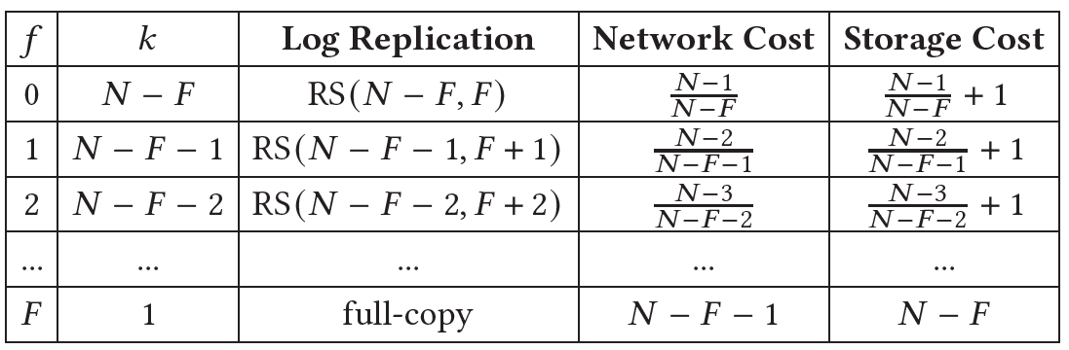
Choice of Coding Scheme
Given N servers, N’ healthy servers and f failed servers (i.e., N’ = N – f), the optimal coding scheme has k = N’ – F
Theorem: When there are 𝑁′ (𝐹 + 1 ≤ 𝑁′ ≤ 𝑁) healthy servers in a Raft group, FlexRaft always minimizes the network and storage costs for log replication
Coding scheme of FlexRaft

Slide 11
Design of FlexRaft
Vary coding scheme during log replication
Perform encoding using an initial coding scheme RS(k,m)
The value of k depends on the latest number of healthy servers N’
The leader distributes the coded chunks to the followers
Each follower appends the chunk to its log and returns a successful response
If the leader receives F+k-1 successful responses, commits the log entry
Otherwise, the leader varies the coding scheme
Update N’ based on the followers’ response
Switch to a new coding scheme RS(k’,m’) where k’ = N’ – F, m’ = N – k’
Re-encode the log entry and distribute the new chunks to the followers
Followers overwrite the old chunks with the new chunks

Slide 12
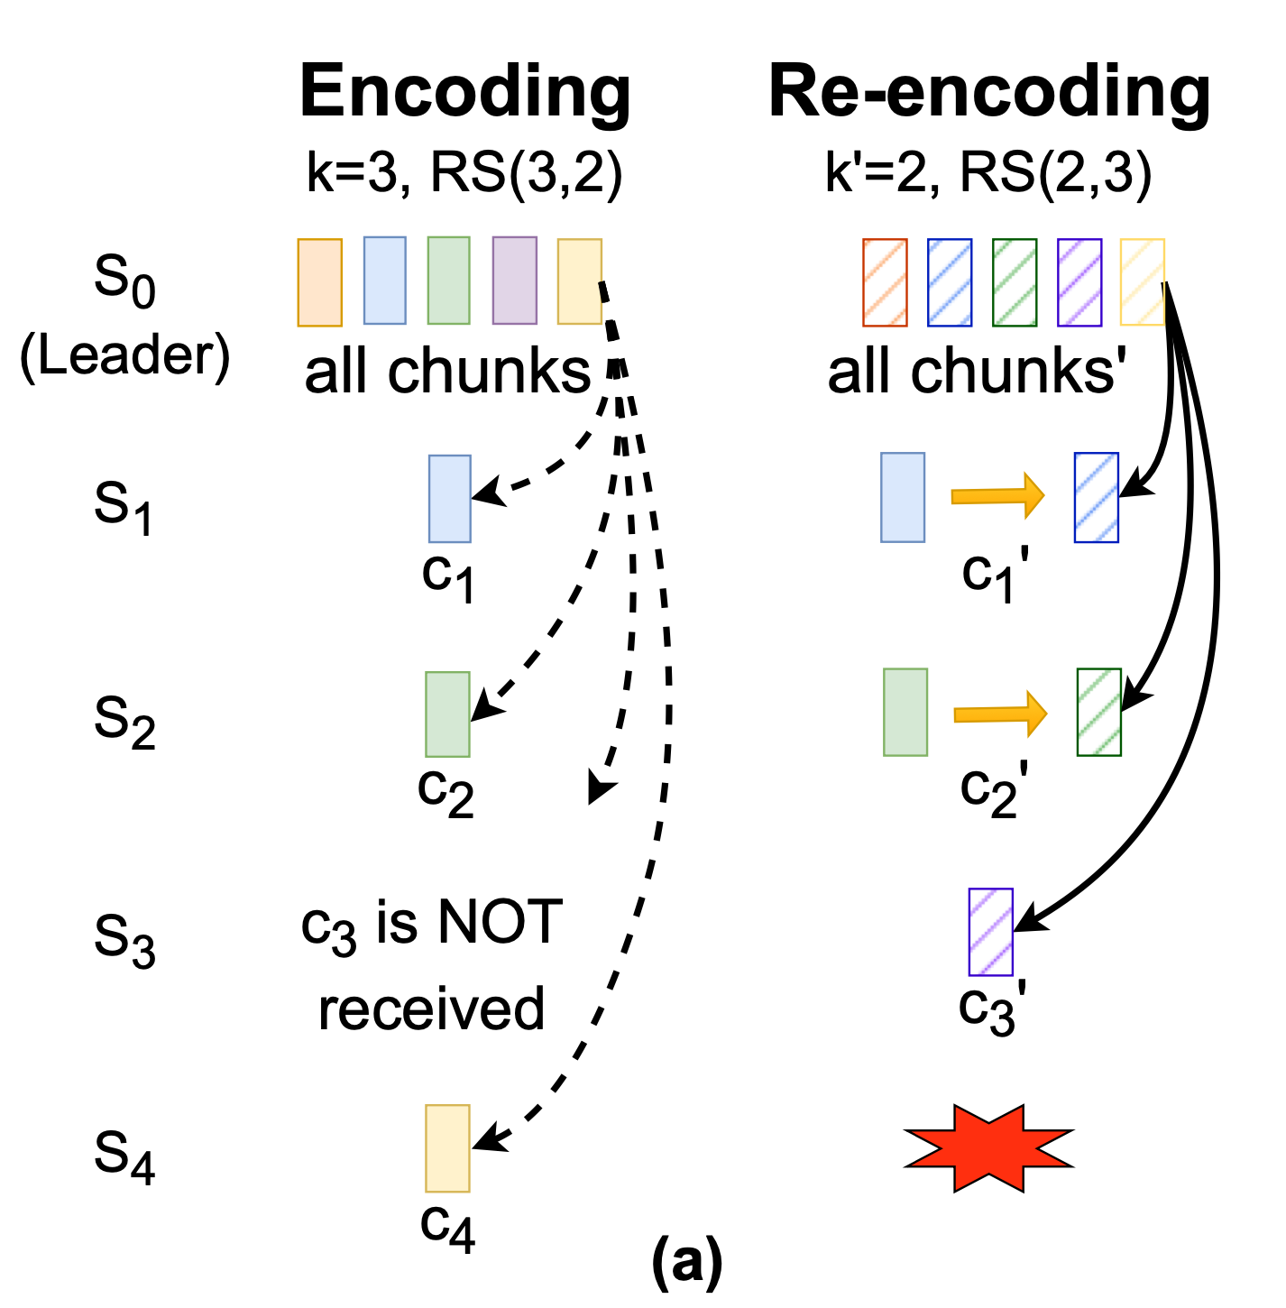
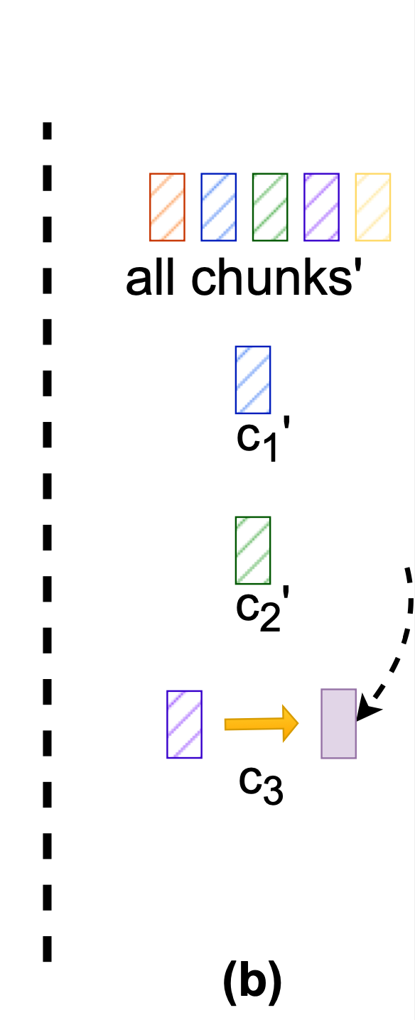
Challenges in Varying Coding Scheme
#1: the chunk in a follower can be mistakenly overwritten by an old chunk of the same log entry
(a) Coding scheme varies from
RS(3,2) to RS(2,3)
(b) Chunk c₃’ in S3 is mistakenly updated by old chunk c₃
Only allow a decrease of k for a log entry during writes
Check k before updating
The coding scheme varies during log replication

Slide 13
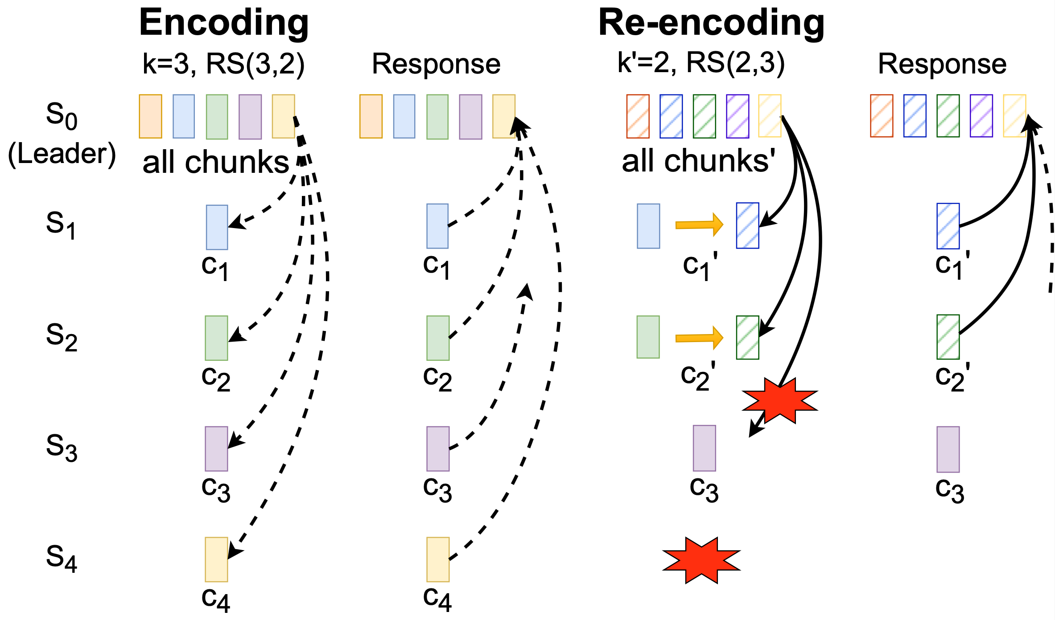
Challenges in Varying Coding Scheme
#2: some followers may not overwrite the old chunks successfully before the leader commits the log entry
S₀ switches to RS(2,3) as S₃’s
response does not reach S₀
S₀ mistakenly thinks enough chunks are stored to commit
Make log entries stay consistent
Update AppendEntries RPCs
Add prevK (k of prevLogIndex entry)
Add ChunkInfo (log index and value of k)
Responses of varied coding schemes
during log replication

Slide 14
Server Recovery
Handling leader failures
For committed log entries
The new leader can recover the entry by collecting k chunks
For unapplied entries
The new leader performs LeaderPre operation as Craft
Decide whether a log entry is recoverable based on the ChunkInfo in the log entry
Remove the unrecoverable log entries
Recovering a failed follower
Restore the committed log entries with the same coding scheme
The server should store all previous log entries before it can be counted as a healthy server, i.e., increasing N’ by one

Slide 15
Theorems
Log Matching Property: if two logs contain an entry with the same index and term, then the logs are identical (either a full copy or a coded chunk of the original proposed data) in all entries up through the given index.
Leader Completeness Property: if a log entry is committed in a given term, then that entry will be present in the logs of the leaders for all higher-numbered terms.
See proofs in the paper

Slide 16
Evaluation
We implement FlexRaft and a key-value store atop FlexRaft
Use RocksDB as a storage engine
ISA-L library for erasure coding
Run all experiments on Alibaba Cloud
Compare FlexRaft to CRaft and HRaft
Use N (e.g., 5, 7) servers to deploy a FlexRaft group
Each server: 8 vCPU, 32 GiB DRAM, 40 GiB ESSD cloud drive

Slide 17
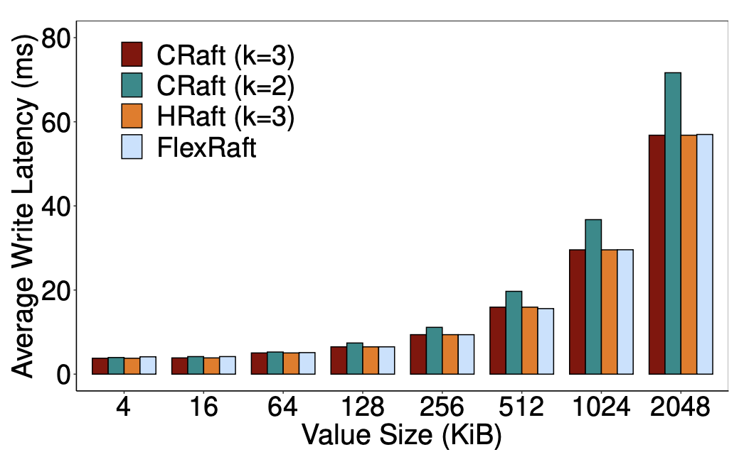
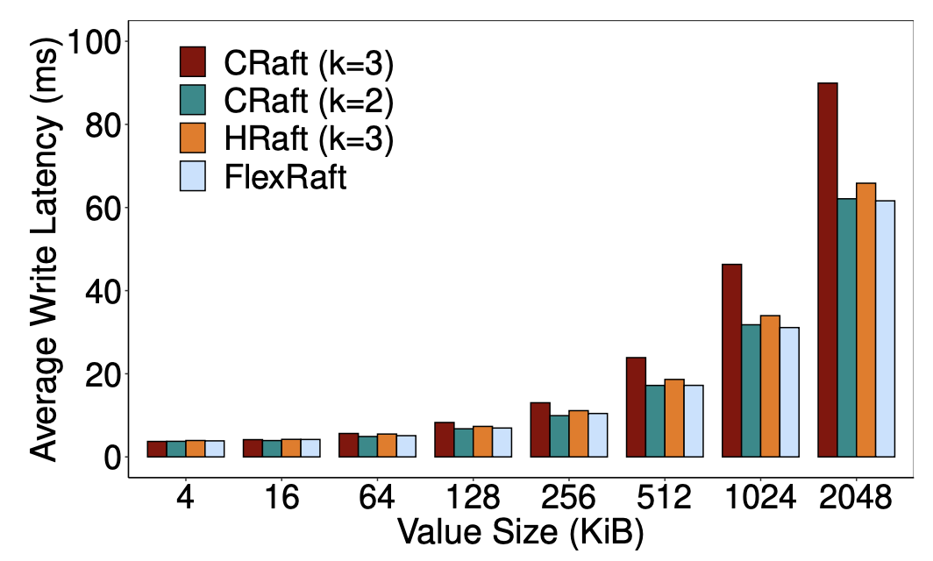
Evaluation
Write performance when N=5
FlexRaft achieves the lowest write latencies
When one server fails, FlexRaft varies the coding scheme to RS(2,3)
Reduce the latencies of CRaft (k=3) and HRaft by 32.82% and 8.43%
(a) In normal cases
(b) One server failure

Slide 18
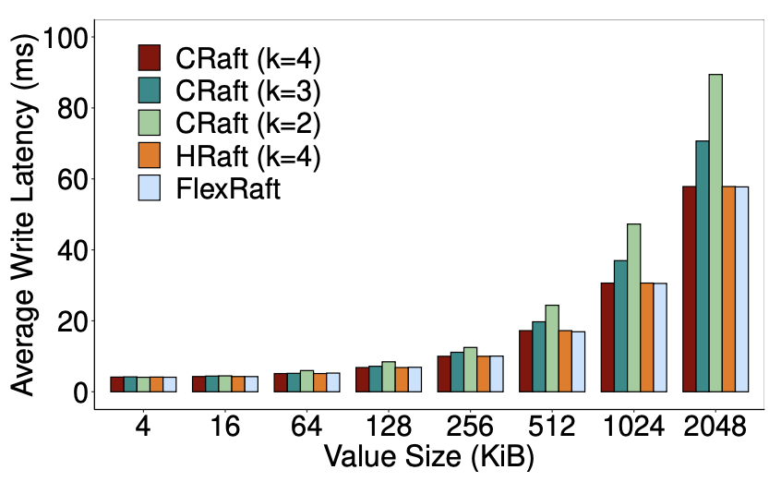
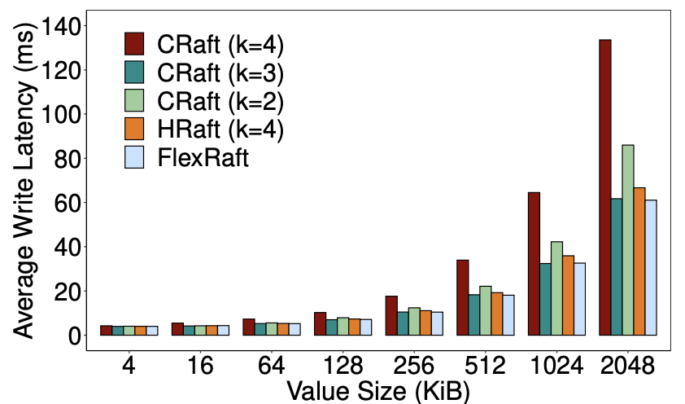
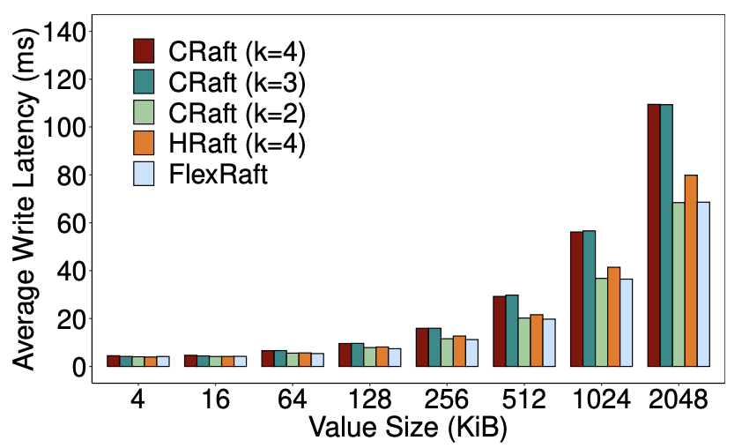
Evaluation
Write performance when N=7
FlexRaft also achieves the lowest write latencies
Under one server failure, FlexRaft varies to RS(3,4)
Under two server failures, FlexRaft varies to RS(2,5)
(a) In normal cases
(b) One server failure
(c) Two server failures

Slide 19
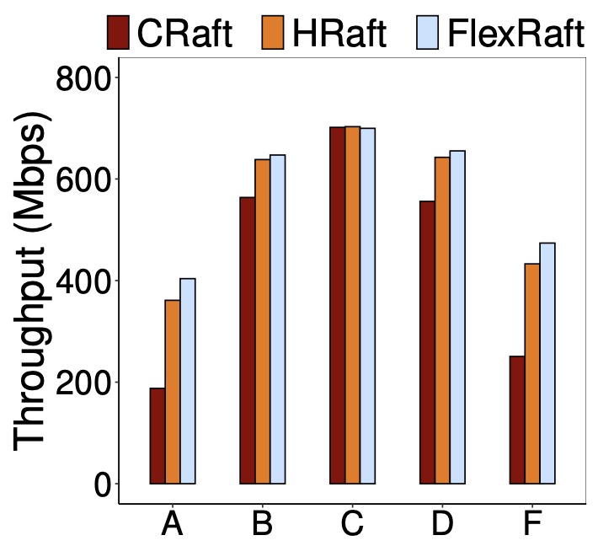
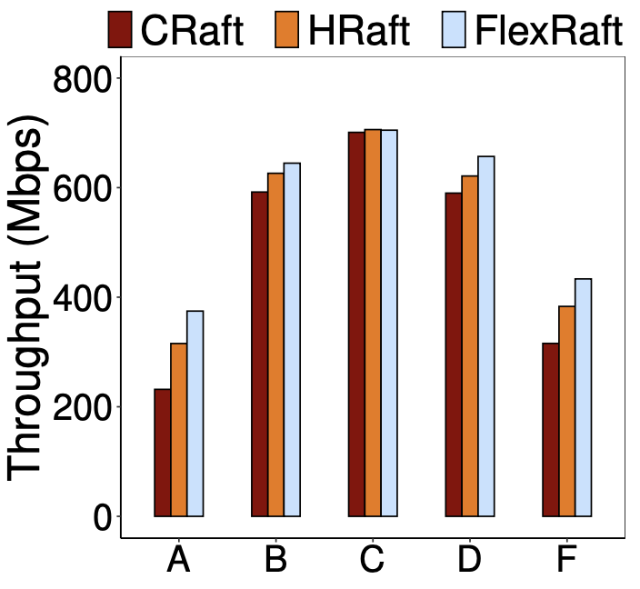
Evaluation
YCSB performance when N=7
Write-intensive: A, F
Read-intensive: B, D
Read-only: C
(a) One server failure
(b) Two server failures

Slide 20
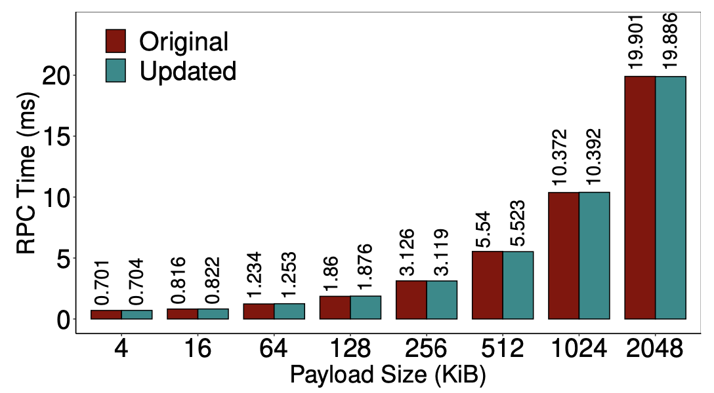
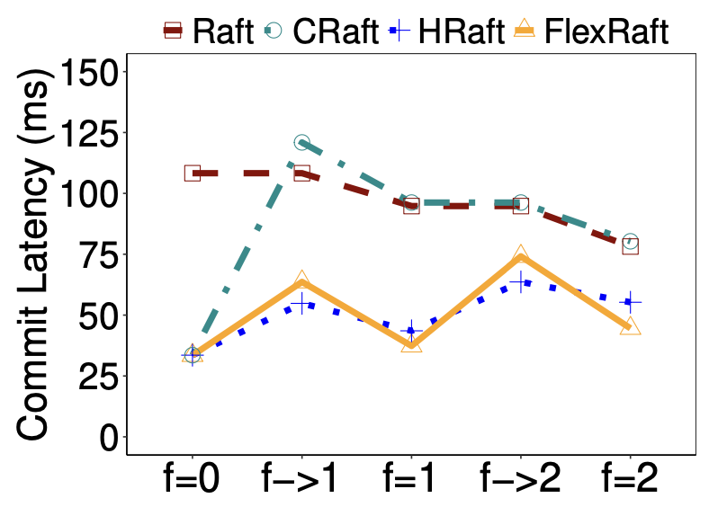
Evaluation
Overhead of FlexRaft
Nearly no overhead in RPC time
Little overhead when varying coding scheme during writes
RPC time of AppendEntries requests
Overhead of varying the coding scheme

Slide 21
Conclusions
FlexRaft dynamically adjusts the coding scheme used for log replication in Raft
Minimize both the network and storage costs
Use the optimal coding scheme based on the latest server status
When varying the coding scheme during writes
Restrict the overwriting of the coded chunks
Update AppendEntries RPCs to track the store chunks
Source code
https://github.com/ACS-Storage-Group/FlexRaft-Code

