Slide 1
A Shortest Path Algorithm
Dijkstra’s Algorithm
Demo
Summary
Intro
Algorithm
Presented by ZHANG, Mi
Aug. 28th, 2015

Slide 2
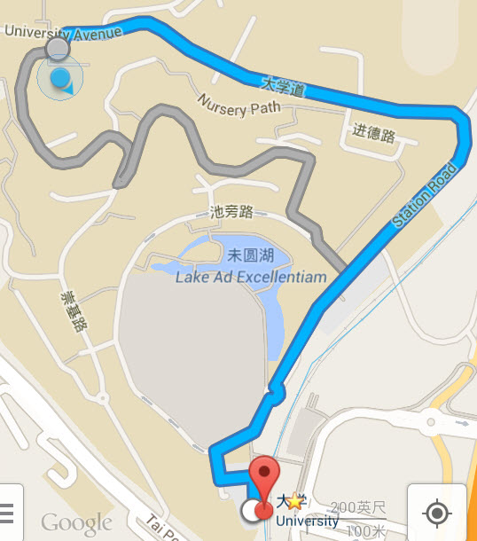
Introduction - Background
Path choosing on map:
How?
Notes:
How does google know the path? What is the algorithm behind?

Slide 3
Introduction - Concepts
Directed or Undirected Graph G(V, E)
Weighted Graph
Distance & Shortest Path
  A path of minimum total weight between s and t.
2
2
B
Path 1: s → B → t
9
s
2
1
Path 2: s → B → C → t
t
5
A
C
2
4

Slide 4
Introduction - Concepts
Directed or Undirected Graph G(V, E)
Weighted Graph
Distance & Shortest Path
  A path of minimum total weight between s and t.
2
2
B
Path 1: s → B → t
9
s
2
1
Path 2: s → B → C → t
t
5
A
C
2
  Shortest Path from s to t !
4

Slide 5
Demo – Finding shortest path from s
#1 Initialization
∞
B
0
2
9
∞
Q
s
A
B
C
t
s
2
1
t
0
∞
∞
∞
∞
5
A
C
2
4
d
∞
∞
s
A
B
C
t
pre
0
0
0
0
0

Slide 6
Demo – Finding shortest path from s
#2 Path finding – Find the min distance
∞
s ← mindistance(Q,d)
B
0
2
9
∞
Q
s
A
B
C
t
s
2
1
t
0
∞
∞
∞
∞
5
A
C
2
4
d
∞
∞
s
A
B
C
t
pre
0
0
0
0
0

Slide 7
Demo – Finding shortest path from s
#2 Path finding – update the shortest distance
2
d[v] ← d[u] + w(u, v)
B
0
2
9
∞
Q
s
A
B
C
t
s
2
1
t
0
∞
∞
∞
∞
5
A
C
2
4
d
5
2
∞
∞
5
∞
s
A
B
C
t
pre
0
0
0
0
0
s
s

Slide 8
Demo – Finding shortest path from s
#2 Path finding – Find the min-distance
2
B ← mindistance(Q,d)
B
0
2
9
∞
Q
s
A
B
C
t
s
2
1
t
0
∞
∞
∞
∞
5
A
C
2
4
d
5
2
∞
∞
5
∞
s
A
B
C
t
pre
0
0
0
0
0
s
s

Slide 9
Demo – Finding shortest path from s
#2 Path finding – update the shortest distance
2
d[v] ← d[u] + w(u, v)
B
0
2
9
11
Q
s
A
B
C
t
s
2
1
t
0
∞
∞
∞
∞
5
A
C
2
4
d
5
2
∞
∞
5
4
3
4
3
11
s
A
B
C
t
pre
0
0
0
0
0
s
s
B
B
B
B

Slide 10
Demo – Finding shortest path from s
#2 Path finding – Find the min distance
2
C ← mindistance(Q,d)
B
0
2
9
11
Q
s
A
B
C
t
s
2
1
t
0
∞
∞
∞
∞
5
A
C
2
4
d
5
2
∞
∞
5
4
3
4
3
11
s
A
B
C
t
pre
0
0
0
0
0
s
s
B
B
B
B

Slide 11
Demo – Finding shortest path from s
#2 Path finding – update the shortest distance
2
d[v] ← d[u] + w(u, v)
B
5
0
2
9
11
Q
s
A
B
C
t
s
2
1
t
0
∞
∞
∞
∞
5
A
C
2
4
d
5
2
∞
∞
5
4
3
4
3
11
s
A
B
C
t
4
5
pre
0
0
0
0
0
s
s
B
B
B
B
C

Slide 12
Demo – Finding shortest path from s
#2 Path finding – Find the min distance
2
A ← mindistance(Q,d)
B
5
0
2
9
11
Q
s
A
B
C
t
s
2
1
t
0
∞
∞
∞
∞
5
A
C
2
4
d
5
2
∞
∞
5
4
3
4
3
11
s
A
B
C
t
4
5
pre
0
0
0
0
0
s
s
B
B
B
B
C

Slide 13
Demo – Finding shortest path from s
#2 Path finding – update the shortest distance
2
d[v] ← d[u] + w(u, v)
B
5
0
2
9
11
Q
s
A
B
C
t
s
2
1
t
0
∞
∞
∞
∞
5
A
C
2
4
d
5
2
∞
∞
5
4
3
4
3
11
s
A
B
C
t
4
5
5
pre
0
0
0
0
0
s
s
B
B
B
B
C

Slide 14
Demo – Finding shortest path from s
#2 Path finding – Find the min distance
2
t ← mindistance(Q,d)
B
5
0
2
9
11
Q
s
A
B
C
t
s
2
1
t
0
∞
∞
∞
∞
5
A
C
2
4
d
5
2
∞
∞
5
4
3
4
3
11
s
A
B
C
t
4
5
5
pre
0
0
0
0
0
s
s
B
B
B
B
SP: t → C → B → s
C

Slide 15
Algorithm - Pseudo code
#1 Initialization
d[s] ← 0, s.pre = null
for all v in V–{s}
do d[v] ← ∞, v.pre = null
Q ← V
(distance to s is zero)
(set all other distances to infinity)
#2 Path finding
while Q ≠ ∅
do u ← mindistance(Q,d)
Q←Q - {u}
for all v in adj[u]
do if d[v] > d[u] + w(u, v)
then d[v] ←d[u] + w(u, v)
v.pre = u
return d
(select the vertex in Q with the min. distance)
(Remove u from Q)
(update the distances)
(Trace back!)

Slide 16
Remark
If not all of the weights are non-negative:
Dijkstra’s Path?
1
s
t
4
- 4
A
Notes:
Even a single edge with negative weight can make Dijkstra’s algorithm invalid.
The shortest path is reversed.

Slide 17
Remark
All the weights should be non-negative!
Solution:
  ? Add a positive value to all the weights.
s
1
t
4
A
- 4
Shortest Path: s→ A → t
Dijkstra’s Path: s → t
Notes:
Even a single edge with negative weight can make Dijkstra’s algorithm invalid.
The shortest path is reversed.

Slide 18
Remark
All the weights should be non-negative!
Solution:
  ? Add a positive value to all the weights.
  Other algorithms, e.g., Bellman Ford Algorithm
s
1
t
4
A
- 4
Shortest Path: s→ A → t
Dijkstra’s Path: s → t
√
Notes:
Even a single edge with negative weight can make Dijkstra’s algorithm invalid.
The shortest path is reversed.

Slide 19
Summary
Dijkstra’s algorithm
  Initialization
    Distances
    Predecessors
  Path finding
    Find the node v in Q with min-distance
    Update the distances of v’s neighbors
More…
  Section 24.3 of Introduction to Algorithms
    Time complexity
    Proof of correctness

Slide 20
Dijkstra’s algorithm
  Email: mzhang@cse.cuhk.edu.hk
  Office: Room 120, SHB, CUHK
Thank you!

