Slide 1

A Simulation Analysis of Reliability in Erasure-coded Data Centers
Mi Zhang, Shujie Han, Patrick P. C. Lee
The Chinese University of Hong Kong
IEEE SRDS 2017
Notes:
Good afternoon!
The topic I’ll present is …

Slide 2
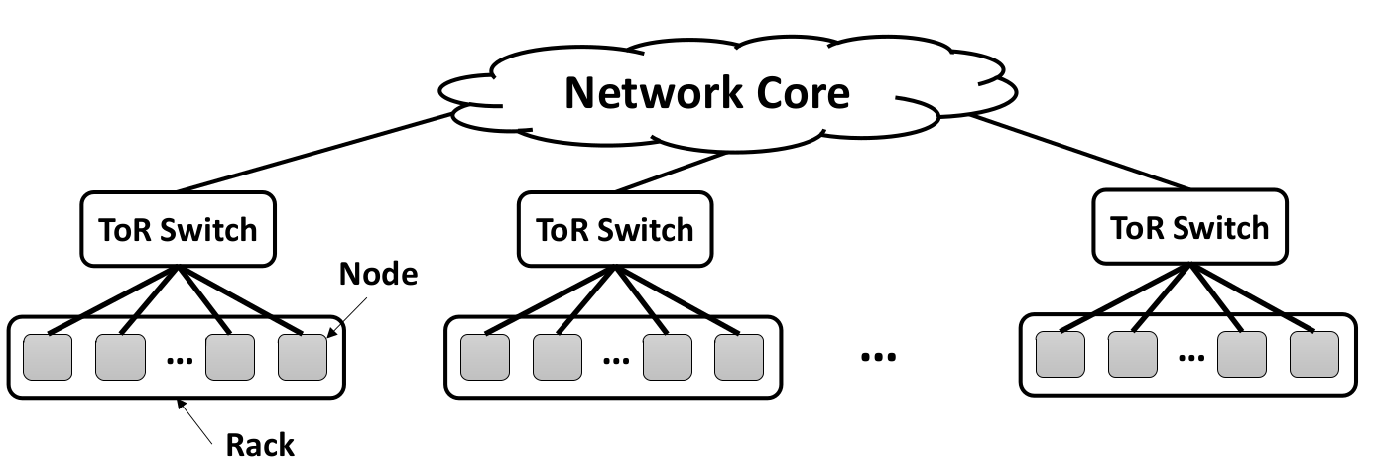
Background and Motivation
Modern data centers provide scalable storage by clustering physically independent machines (nodes)
Hierarchical nature:
Sufficient intra-rack bandwidth
Scarce cross-rack bandwidth
Notes:
Data centers cluster independent machines to provide large-scale storage.
This figure shows the architecture of a data center:
Nodes are grouped into racks
Nodes in one rack are connected to the same top-of-rack (ToR) switch
All racks are interconnected to a a network core
Such a data center has sufficient intra-rack bwth and scarce cross-rack bwth
We can call this as the hierarchical nature of the data center.

Slide 3
Background and Motivation
Failures are common
Classified by the cause
Independent failures and correlated failures
Classified by the effect
Permanent failures and transient failures
Failures degrade data reliability
Durability: no data loss under failures
Availability: data is accessible under failures
Two redundancy approaches:
Replication
Erasure Coding
Notes:
Failures are common in a data center:
We can classify the failures as independent failures and correlated failures by the cause:
Every storage device has a probability to fail;
And multiple devices can fail concurrently due to the same cause.
Furthermore, the failures can be classified by the effect:
Permanent failures damage the devices permanently
While transient failures make data unavailable temporarily.
Failures affect data reliability from 2 perspectives: durability and availability
We say data is durable if data persists in the face of failures.
Data is unavailable when we can’t access the data under failures.
Therefore, to guarantee storage reliability, modern data centers usually employ 2 redundancy techniques:
Replication
Erasure coding

Slide 4
Background and Motivation
(n,k) erasure coding
Encode k data chunks into n coded chunks (stripe) (where k < n)
Any k chunks in a same stripe can recover the original content
Erasure coding is a promising redundancy technique
Storage efficiency
Reduce storage overhead from 3x to 1.33x in Azure [Huang, ATC’12]
Higher reliability
MTTF of erasure coding is many orders of magnitude higher than that of replication
However, erasure coding has high repair traffic
Repair traffic: amount of data downloaded for recovery
Notes:
For (n,k) erasure coding, it encodes k data chunks into n coded chunks. These n chunks form a stripe.
When failure happens, any k chunks of a stripe can recover the original data.
Erasure coding is a promising technique to protect data against failures
1. It is storage-efficient. It can reduce storage overhead from 3x to 1.33x in Azure.
2. Erasure coding has higher reliability than replication. As pointed in previous work, the Mean Time to Failure of erasure coded system is many orders of magnitude higher than that of a system with replication.
However, erasure coding incurs high repair traffic.
Repair traffic is the amount of data retrieved in recovery.
Now let’s look at the repair traffic of different erasure codes.

Slide 5
Erasure Codes
Repair traffic of different codes
Assume chunk size is the same
Focus on single data chunk recovery
Erasure Codes | Parameter | Repair Traffic (chunks)
Reed-Solomon codes | (n,k) | k
Locally Reconstruction Codes | (n,k,l) | k/l
Regenerating Codes | (n,k) | (n-1)/(n-k)
Double Regenerating Codes | (n,k,r) | (r-1)/(r-Floor[kr/n]) *
* The minimum cross-rack repair traffic of DRC
Notes:
Here we use the number of chunks to denote the repair traffic of recovering a single data chunk.
And we assume the chunk size is the same.
Reed-Solomon code is a conventional approach, which requires to download k chunks.
To reduce the repair traffic, LRC divides k data chunks into l groups and adds 1 parity chunks to each group. Thus, it only needs to retrieve the chunks belonging to the same group.
Another approach to minimize the repair traffic is regenerating code, which takes advantage of all other surviving nodes of the same stripe. It reduces the repair traffic to n-1 over n-k.
DRC is an extension of RC, which considers the hierarchical nature of a data center. As the cross-rack bandwidth is a scarce resource, DRC decreases the cross-rack bandwidth cost by placing n chunks in r racks. Now let’s look at how different deployment works.

Slide 6
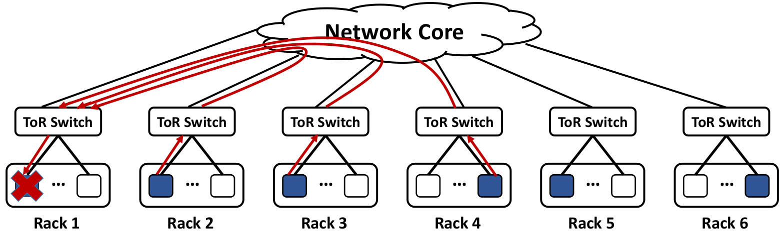
Different Deployment
Two redundancy placement schemes:
Flat placement
n chunks of a stripe are located in n distinct racks
Maximize the tolerance against rack/node failures
However, repairing any chunk incurs a significant amount of cross-rack traffic
RS(6,3) under flat placement
Notes:
Generally, there are 2 placement schemes:
One is flat placement, where n chunks of a stripe reside in n different racks.
It maximized failure tolerance both on rack level and node level.
However, repairing any chunk need to read from non-local racks. Thus, it incurs a significant amount of cross-rack bandwidth cost.

Slide 7
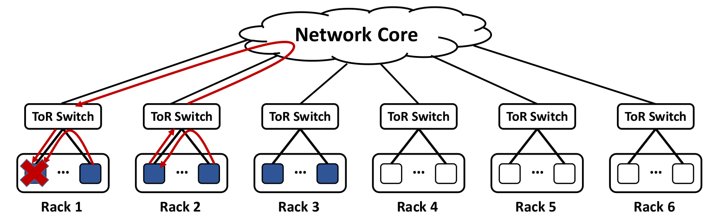
Different Deployment
Two redundancy placement schemes:
Hierarchical placement
n chunks of a stripe reside in n different nodes of r (r < n) distinct racks
Minimize cross-rack repair traffic
However, fewer rack failures can be tolerated than flat placement
DRC(6,3,3) under hierarchical placement
Notes:
We call another placement scheme as hierarchical placement.
It places n chunks of a stripe in r racks. Here r is less than n.
During recovery, it can reduce cross-rack traffic by leveraging the chunks in the same rack.
However, compared with flat placement, hierarchical placement tolerates fewer rack failures.

Slide 8
Problem
The choices of erasure codes and different deployments raise new reliability issues:
How much can the reduction of cross-rack repair traffic improve reliability?
What is the reliability trade-off between sacrificing rack-level fault-tolerance and reduced cross-rack repair traffic?
How does the reliability of an erasure-coded data center vary with different failure patterns?
Notes:
Therefore, the choices of erasure codes and different deployments raise new reliability issues:
1, as we know, the repair time increases with the cross-rack bandwidth cost in a data center. Thus, how much can the reduction of cross-rack traffic improve the reliability?
2, when sacrificing rack-level fault tolerance to reduce cross-rack traffic, what is the trade-off?
3, in the face of different failure patterns, what is the reliability of a data center with erasure coding?

Slide 9
Contributions
Build SimEDC
Simulate discrete events in an erasure-coded data center
Consider various factors
Data center topology
Erasure codes construction
Different redundancy placements (flat/hierarchical)
Failure/repair patterns of different subsystems
Capture both durability and availability
Reliability analysis of erasure-coded data center
Notes:
To answer the above questions, we build SimEDC, to simulate discrete events in an erasure-coded data center.
It is comprehensive and very general, by accounting for various factors, such as data center topology, different types of erasure codes, flat or hierarchical placement and different failure patterns of different subsystems.
Then we conduct extensive reliability analysis using SimEDC

Slide 10
SimEDC Architecture
Data Center Topology
Erasure Code
Chunk Placement
Models
/ Traces
Event Handler
Event Queue
Event
Generator
Reliability
Metrics
…
Time 0
Mission time
Failure Event
Repair Event
Notes:
This figure illustrates the architecture of SimEDC.
As I said just now, it takes various factors as input, then it performs simulation, and outputs reliability estimation at last.

Slide 11
Design of SimEDC
General workflow
SimEDC performs simulation over a number of iterations
It reports reliability metrics averaged over all iterations
Probability of data loss (PDL)
Likelihood that a data center experiences data loss
Normalized magnitude of data loss (NOMDL)
Expected amount of data loss normalized to storage capacity
Blocked ratio (BR)
Fraction of time that a chunk can not be directly accessed
Notes:
SimEDC performs simulation over a number of iterations and reports the reliability metrics averaged over all iterations.
We use 3 metrics, probability of data loss, normalized magnitude of data loss, and blocked ratio.
The first two metrics measures data durability while blocked ratio estimates data availability.

Slide 12
Design of SimEDC
General workflow
For each iteration:
Initialization
Data Center Topology
Erasure Code
Chunk Placement
Models
/ Traces
Event Handler
Event Queue
Event
Generator
…
Time 0
Mission time
Failure Event
Notes:
Now let’s look at how SimEDC works in each iteration:
1, event handler takes the data center topology, erasure codes and chunk placement as inputs for initialization
And event generator generates a sequence of failure events from failure models or practical traces.
These failure events are pushed into event queue and will be processed one by one later.

Slide 13
Design of SimEDC
General workflow
For each iteration:
Simulation
Event Handler
…
Time 0
Mission time
Failure Event
Repair Event
Notes:
During the simulation, event handler fetches event from event queue and process it.
Here the first event is a failure event.

Slide 14
Design of SimEDC
General workflow
For each iteration:
Simulation
Event Handler
…
Time 0
Mission time
Failure Event
Repair Event
Notes:
Event handler processes this failure event and generates a corresponding repair event.
I will talk about the detailed process later.

Slide 15
Design of SimEDC
General workflow
For each iteration:
Simulation
Event Handler
…
Time 0
Mission time
Failure Event
Repair Event
Notes:
Then this repair event is also pushed into event queue.

Slide 16
Design of SimEDC
General workflow
For each iteration:
Simulation
Event Handler
…
Time 0
Mission time
Failure Event
Repair Event
Notes:
Next, event handler processes the repair event and generate the next failure event accordingly.

Slide 17
Design of SimEDC
General workflow
For each iteration:
Termination
Event Handler
…
Time 0
Mission time
Data Loss
Failure Event
Repair Event
Notes:
The above process will repeat until data loss occurs or the mission time is reached.

Slide 18
Implementation
Events:
Each event is a tuple
(timestamp, event type, subsystem associated)
All events are stored in the event queue
We differentiate permanent failures and transient failures
Permanent failures damage data permanently
Transient failures make data unavailable temporarily
We consider independent failures and correlated failures
Every subsystem can fail independently
Multiple nodes fail simultaneously (e.g., power outage)
Notes:
Each event simulated is a tuple of timestamp, event type and subsystem associated.
As we see in previous slides, all events are in the event queue.
For the failure events, we differentiate permanent failures and transient failures.
Moreover, we consider correlated failures besides independent failures.

Slide 19
Implementation
Event handling
When failure happens
Check whether data loss occurs
If yes, return the reliability metrics for this simulation
Update the status of the subsystems (crashed or unavailable)
Trigger repair event
When repair occurs
Update the status of the subsystems (normal)
Generate the next failure event and push it to event queue
Notes:
Now I elaborate how we handle failure or repair event.
When failure happens, we first check whether data loss occurs.
If yes, simulation terminates and SimEDC returns reliability metrics.
If no data loss, we will update the status of the subsystems as crashed or unavailable based on the effect of the failures.
Then we trigger repair event.
When repair occurs, we will update the status of the subsystems as normal, and then generate the next failure event and add it to the event queue.

Slide 20
Experiments
Configuration
Data center
1024 nodes in total, which are located in 32 racks
Cross-rack bandwidth – 1 Gb/s
The storage capacity - 1 PiB
Mission time - 10 years
Erasure codes
Reed-Solomon (RS) codes
Locally Reconstruction Codes (LRC)
Double Regenerating Codes (DRC)
Chunk placement
r, the number of racks that each stripe resides on
Flat placement, r = n
Hierarchical placement, r < n with n/r chunks per rack
Notes:
Now I’ll introduce our experiments.
We simulate a data center with 1024 nodes in total, these nodes are divided into 32 racks.
The cross-rack bandwidth is 1 Gb/s.
The whole storage capacity is 1 PiB. The mission time is 10 years.
We analyze three types of erasure codes: RS, LRC, and DRC
For different deployment, we evaluate both flat placement and hierarchical placement.
Here we use r to denote the number of racks that each stripe resides on.

Slide 21
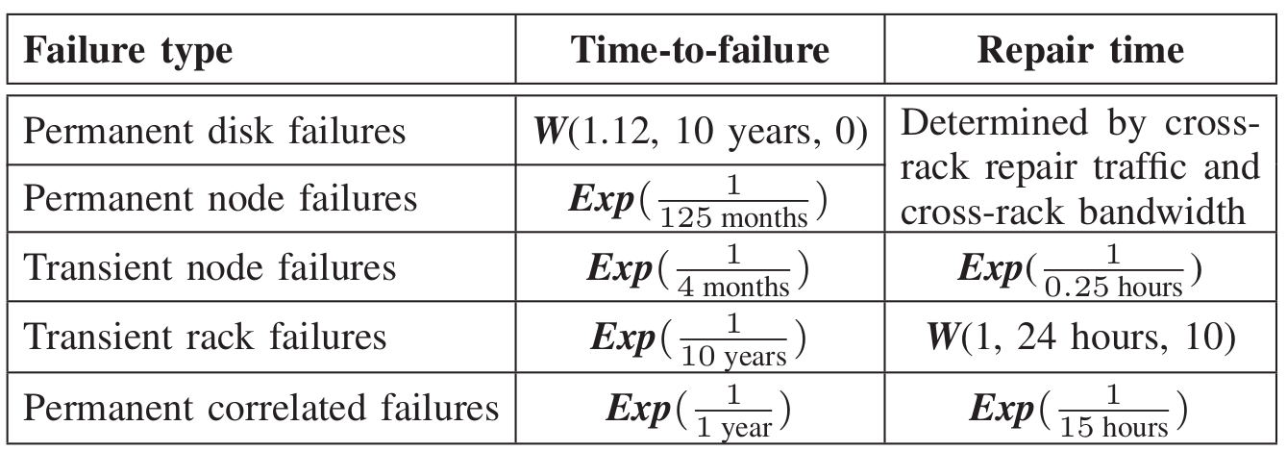
Failure and Repair Model
Notes:
For different failure patterns, we consider permanent disk failures, permanent node failures, transient node failures, transient rack failures, and permanent correlated failures.
This table illustrates the failure and repair model we use in our experiment.

Slide 22
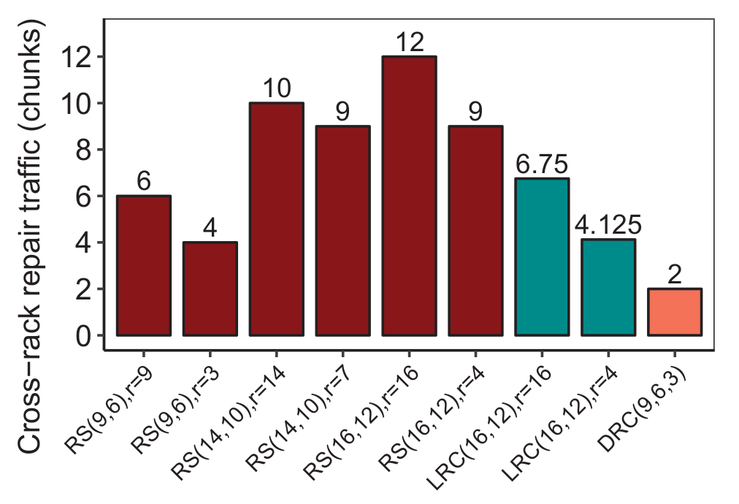
Numerical Results
Observations
Over 99.5% of repairs are single-chunk repair from our simulation
Repair time depends on cross-rack repair traffic
Notes:
In our evaluation, we observe that over 99.5% of repairs are single-chunk repair.
As we expected, repair time depends on the cross-rack repair traffic.
This figure shows the cross rack repair traffic for different erasure code settings.
The x axis is the different erasure code setting
While the y axis denotes the cross-rack repair traffic
We can see hierarchical placement has lower repair traffic than flat placement.

Slide 23
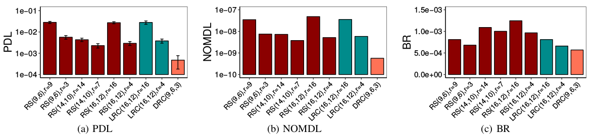
Evaluation Results
Reliability under independent failures only
RS(14,10) has lowest PDL and NOMDL among RS codes
Hierarchical placement has better reliability than flat placement
DRC achieves highest reliability
Notes:
First, we analyze the reliability under independent failures
Among all RS codes, RS(14,10) has best reliability.
Compare with flat placement, hierarchical placement has better reliability because it reduces cross-rack repair traffic
Moreover, we can see that BR of different erasure code setting matches the amount of cross-rack bwth cost.

Slide 24
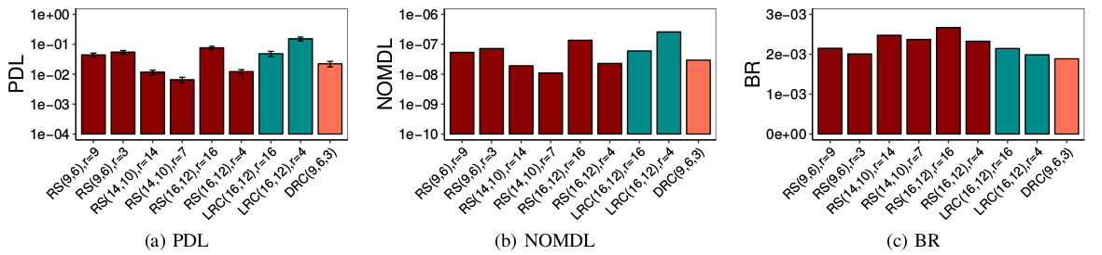
Evaluation Results
Reliability under independent and correlated failures
Hierarchical placement has higher PDL and NOMDL in some cases (e.g., RS(9,6))
For RS(14,10) and RS(16,12), hierarchical placement still achieves better reliability
Notes:
Here we analyze the reliability under independent and correlated failures.
In the face of correlated failures, hierarchical placement is more likely to experience data loss.
However, RS(14,10) and RS(16,12) with hierarchical placement can achieve better reliability as they can tolerate 4-chunk loss in each stripe.

Slide 25
Trace Analysis
Traces
Failure records about node failures
Span 22 HPC systems of 1 to 1024 nodes
Collected from Los Alamos National Laboratory
Our analysis
Select the systems containing no less than 128 nodes
Parse failure events from the records
Classify transient node failures and permanent node failures
Notes:
At last, we conduct analysis using practical traces that keeps record of the node failrues.
This trace spans 22 HPC systems of 1 to 1024 nodes, which is collected from Los Alamos National Laboratory.
In our analysis,
We select the systems containing no less than 128 nodes.
Then we parse failure events and classify them to transient node failure and permanent node failures.

Slide 26
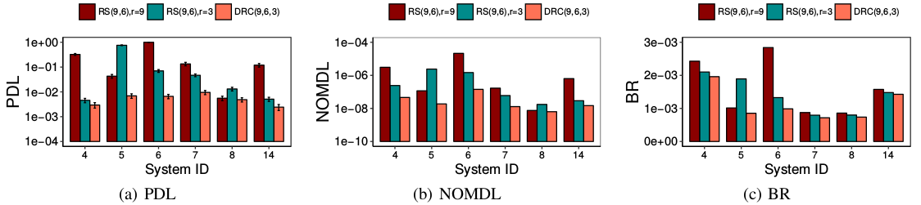
Evaluation Results
Reliability under trace-driven failures
Results are consistent with those under failure models
Notes:
The result under trace-driven failures match that under failure models.
For the systems whose ID is 5 and 8, hierarchical placement has worse reliability because some contiguous nodes fail within a short time in the trace.

Slide 27
Conclusion
Build SimEDC
Discrete-event simulator tailored for erasure-coded data centers
General to capture various factors
Capture durability and availability
Reliability analysis
Hierarchical placement achieves higher reliability than flat placement
In correlated failures, hierarchical placement decreases fault tolerance
Reduction of cross-rack bandwidth can improve reliability in general
Source code
http://adslab.cse.cuhk.edu.hk/software/simedc
Notes:
The source code is now available on this link. If you have any questions, please email to us.

Slide 28
Related Work
Reliability of Distributed Storage Systems
Modeling
Conduct Markov modeling by assuming the failure and repair pattern
Simulation
High-Fidelity Reliability Simulator (HFRS) performs simulation on disk arrays [Greenan, Tech. Rep. UCSC’09]
ds-sim simulates the system behavior to show the effectiveness of lazy repair [Silberstein, SYSTOR’14]
CQSim-R evaluates the reliability in data center environment [Hall, TOS’16]
Our work differs from above:
Consider the hierarchical nature of data centers
Consider the impact of cross-rack repair traffic with different erasure codes
Consider more complicated failure patterns which occur in data center

Slide 29
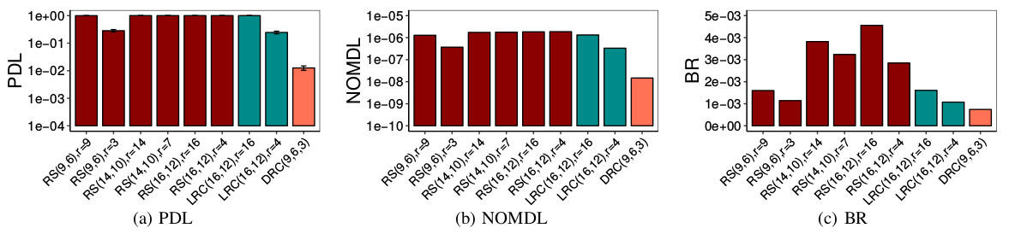
Evaluation Results
Reliability with the cross-rack bandwidth 400 Mb/s
All erasure code with flat placement have PDL = 1
DRC(9,6,3) has PDL = 1.26%
Notes:
Then we decrease the cross-rack bandwidth from 1 Gb/s to 400 Mb/s
We’d like to check the reliability under such extreme case.
We find that almost all erasure code with flat placement will experience data loss.
However, drc has lowest pdl because it incurs a very small amount of cross-rack repair bandwidth.

