Slide 1



Exploiting Hybrid Index Scheme for RDMA-based Key-Value Stores
SYSTOR 2023
2023/06/05
Shukai Han^{1,2}, Mi Zhang¹, Dejun Jiang^{1,2}, Jin Xiong^{1,2}
1. State Key Lab of Processors, Research Center for Advanced Computer Systems,
Institute of Computing Technology, CAS;
2. University of Chinese Academy of Sciences
Notes:
Hey everyone! I'm Shukai Han, from University of Chinese Academy of Sciences.
Today, I'm here to talk about our research topic, "Exploiting Hybrid Index Scheme for RDMA-based Key-Value Stores".

Slide 2
Outline
Background & Motivation
Design
Evaluation
Conclusion
Notes:
Next, I will explain our research using the following sections: background and motivation, design, evaluation and conclusion.

Slide 3
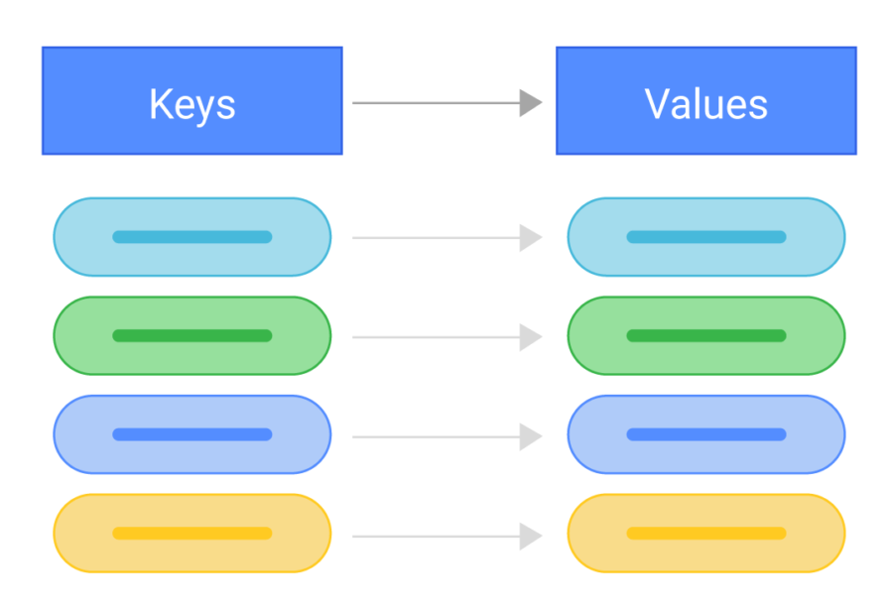





Background : Key-Value Store
A data storage system that stores and retrieves data in the form of key-value pairs.
API : Put (K,V), Update(K,V), Delete(K), Get(K), Scan(K1, K2)
Fig. Key-Value Data Model
Fig. Different Key-Value Stores
Notes:
The Key-value store is a data storage system that stores and retrieves data through key-value pairs.
The API of the key-value store includes Put, Update, Delete, Get and Scan.
Put, Update, and Delete can write, update, and delete the value of one key.
Get can retrieve the corresponding value according to a key.
Scan retrieves values for a range of consecutive keys.

Slide 4
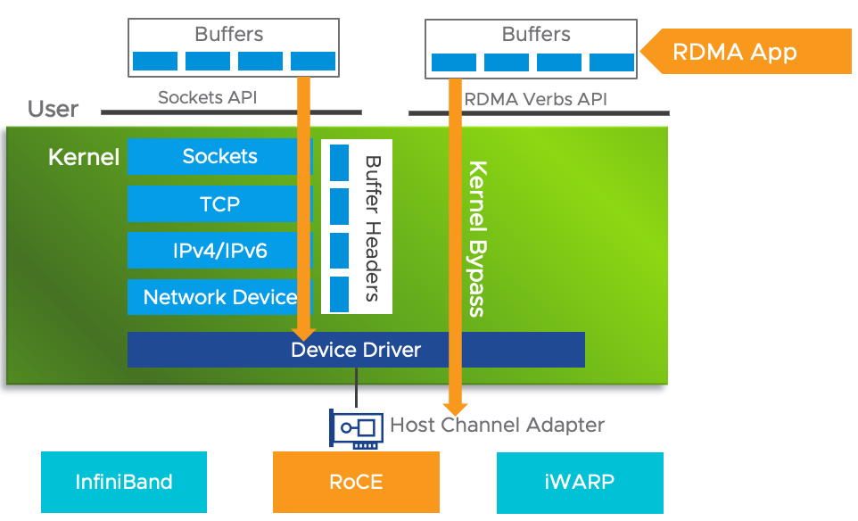
Background : RDMA (Remote Direct Memory Access)
Less data copying in user space;
Round Trip Time (RTT) latency: 3 ~ 5 microseconds.
Accessing remote host memory bypassing the remote host CPU;
Table. RTT Latency for
Different Network Technologies
Network Technology | RTT Latency
Ethernet | > 30 us
RDMA | 3 ~ 5 us
Table. RDMA Verbs
Type | Verb
One-sided | Read/Write/Atomic
Two-sided | Send/Recv
Fig. RDMA Software Stack
Notes:
Remote Direct Memory Access is a popular network technology.
With the help of a special RDMA network card, it can perform a small amount of data copying in user mode, achieving lower software costs.
Therefore, its latency is lower than traditional Ethernet (only 3 - 5 microseconds for one RTT).
RDMA provides two-sided verbs similar to send/write in sockets.
Moreover, it provides one-sided verbs that enable the sender to access remote host memory directly without involving the CPU of the remote host .

Slide 5
Background : RDMA-based Key-Value Store
Using different RDMA verbs perform key-value opertaions
Load,
Store
CPU
CPU
Key-Value Store
in Memory
Send, Recv
Read, Write, Atomic
RNIC
RNIC
Read, Write, Atomic
Client
Server
Notes:
There have been many research works on building remote key-value stores based on RDMA.
They can access remote key-value stores based on different verbs.

Slide 6
Background : Server-centric key-value stores
CPU might become the bottleneck
Less network RTTs
Server-centric
Load,
Store
CPU
CPU
Key-Value Store
in Memory
Send, Recv
Read, Write, Atomic
RNIC
RNIC
Read, Write, Atomic
Client
Server
Notes:
For example, some systems called the server-centric mode, can send all requests to the server for processing.
In this mode, all requests are processed by the CPU of the server.
Therefore, when the concurrency of client requests is high, the CPU on the server may become a bottleneck.

Slide 7
Background : Client-direct key-value store
CPU friendly
More network RTTs
Load,
Store
CPU
CPU
Key-Value Store
in Memory
Send, Recv
Read, Write, Atomic
RNIC
RNIC
Read, Write, Atomic
Client-direct
Client
Server
Notes:
Some systems only access remote key-value stores through one-sided verbs, which we call client-direct mode.
Although it is friendly to the CPU of the server , however, the one-sided verbs are memory semantic.
A key-value operation may require multiple verbs, resulting in more network costs.

Slide 8
Background : Hybrid-access key-value store
Balance between server-centric and client-direct mode.
Two-sided verbs for PUT, one-sided verbs for GET
Load,
Store
CPU
CPU
Key-Value Store
in Memory
Send, Recv
Read, Write, Atomic
RNIC
RNIC
Read, Write, Atomic
Hybrid Access
Client
Server
Notes:
Of course, there is also a hybrid-access mode.
Some balance has been made between the two modes mentioned above,
for example, they only use the CPU of the server to process PUT requests and
use one-sided verbs to direct access data in remote memory.

Slide 9
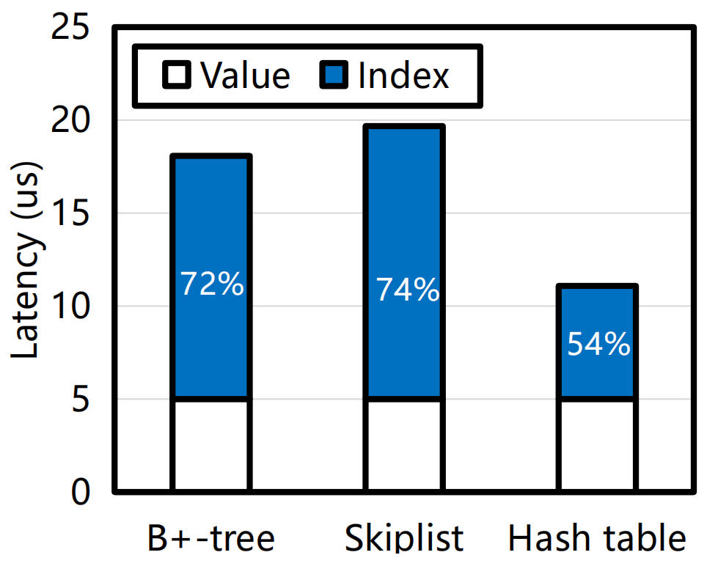
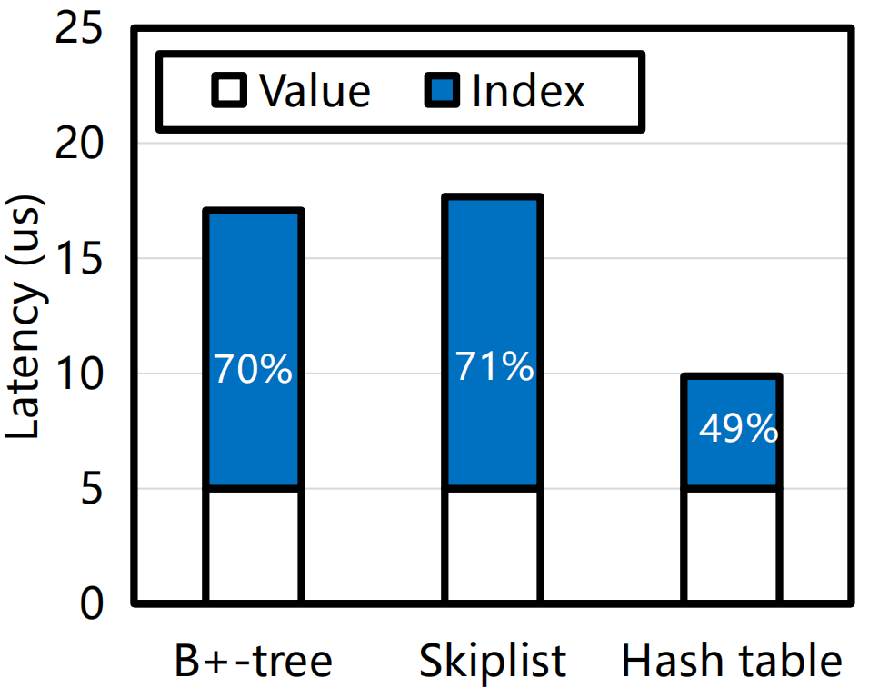
Motivation : RDMA-based index
When providing remote key-value services, the overhead of remote indexing is significant.
Fig. Put Latency
Fig. Get Latency
Notes:
We have observed that in current RDMA-based key-value stores, the cost of indexing accounts for the majority, ranging from 50% to 70%.
It is easy to understand because the index structure is complex, and a single-read operation may require multiple RTTs and more CPU resources.
Moreover, the performance of key-value stores using different indexes also varies greatly, for example, the performance of systems based on a hashing index is much better than those based on a sorted index.

Slide 10
Motivation : Limitations of the single index
Hashing index^{[1-6]}
Efficient access through less one-sided verbs
Cannot support range query
Slot
Client
Slot
2.Read
1.Hash (key)
Slot
Slot
[1] Kalia A, SIGCOMM 2014; [2] Zuo P, ATC 2021;
[3] Tsai S Y, ATC 2020; [4] Cassell B, TPDS 2017;
[5] Mitchell C, ATC 2013; [6] Wang Y, SoCC 2014.
Slot
HashTable
Notes:
Next, let us analyze the advantages and disadvantages of different RDMA-based indexes.
For hashing index, we can quickly locate the required index items through the hash function and
read the index entry from the remote through a few verbs.
However, the hash index cannot support range queries.

Slide 11
Motivation : Limitations of the single index
Sorted index^{[1-4]}
Not easy to achieve both scalability and high efficiency.
Support range query
many Reads !
Client
Node
Node
Node
Node
Node
Node
Node
Node
Node
Node
Node
Node
Node
Node
B⁺Tree
[1] Wang Q, SIGMOD 2022; [2] Huang C, DASFAA 2020;
[3] Mitchell C, ATC 2016; [4] Li P, Hua, FAST 2023
Notes:
For sorted indexes, although range queries can be supported, single-point queries are less efficient.
For example, when querying a B+tree, we need to traverse from the root node to the leaf node.
It requires more network cost compared to hashing index.

Slide 12
Hybrid index
Using hashing index to support single-point queries;
Hybrid index
Hashing index
Efficient single-point query
Cannot support range query
Notes:
Overall, the hashing index can provide efficient single-point queries but cannot support range queries.
---

Slide 13
Hybrid index
Using hashing index to support single-point queries;
Using sorted index to support range queries.
Hybrid index
Hashing index
Sorted index
Efficient single-point query
Inefficient single-point queries
Cannot support range query
Support range query
Notes:
The sorted index can support range queries, but cannot provide efficient single point queries.

Slide 14
Hybrid index
Using hashing index to support single-point queries;
Using sorted index to support range queries.
Hybrid index
Hashing index
Sorted index
? ? ?
Efficient single-point query
Inefficient single-point queries
Efficient single-point query
Cannot support range query
Support range query
Support range query
Notes:
Can efficient range queries and single-point queries be both supported ?

Slide 15
Hybrid index
Using hashing index to support single-point queries;
Using sorted index to support range queries.
Hybrid index
Hashing index
Sorted index
Hybrid index
Efficient single-point query
Inefficient single-point queries
Efficient single-point query
Cannot support range query
Support range query
Support range query
Notes:
Here, we propose combining the hashing and sorted index to construct the hybrid index to
support efficient single-point and range queries.

Slide 16
Challenge for hybrid index
Enhanced read performance is achievable through hybrid index.
Get
Put
Scan
Hashing index
Sorted index
index
index
Key-Value Data
Notes:
As shown in the figure, in our system, we use the hashing index to provide single-point
queries and the sorted index to support range queries.

Slide 17
Challenge for hybrid index
Enhanced read performance is achievable through hybrid index.
But both two indexes need to be updated simultaneously.
Get
Put
Scan
Hashing index
Sorted index
index
index
Key-Value Data
Notes:
But due to the use of two indexes, one issue that has to be considered
is that we need to update both two indexes.

Slide 18
Challenge for hybrid index
C1: How to ensure the synchronization of two indexes?
C2: How to efficiently update two indexes?
Hybrid index
Get
Put
Scan
Hashing index
Sorted index
index
index
Key-Value Data
Notes:
On one hand, we need to consider how to ensure synchronization between two indexes.
We need to avoid situations where one index updates successfully and the other fails, which can lead to inconsistent queries.
On the other hand, the need to update two indexes results in a loss of write performance.
How to reduce this cost is also something we need to consider.

Slide 19
Outline
Background & Motivation
Design
Evaluation
Conclusion
Notes:
Next, I will introduce our design

Slide 20


Synchronization of hybrid index
Some works assume that remote memory nodes lack computing resources^{[1, 2]}
Only one-sided verbs can be used for writing.
Software
Hardware
Client
CPUs
write
Hashing index
Sorted index
DRAM
Key-Value Data
[1] Zuo P, ATC 2021;
[2] Wang Q, SIGMOD 2022;
Notes:
The figure shows the hybrid index architecture we considered at the beginning, where computing and memory resources are separated.
Since the memory nodes that hold the index don't have any computing capabilities.
As a result, the client uses one-sided verbs to update the remote hybrid index.

Slide 21
Synchronization of hybrid index
Some works assume that remote memory nodes lack computing resources^{[1, 2]}
Only one-sided verbs can be used for writing.
Implementing index based on one-sided verbs achieve better scalability?
Software
Hardware
Client
CPUs
write
Hashing index
Sorted index
DRAM
Key-Value Data
[1] Zuo P, ATC 2021;
[2] Wang Q, SIGMOD 2022;
Notes:
Using one-sided verbs seems like a way to achieve good system scalability.
However, this method is not efficient.

Slide 22
Synchronization of hybrid index
Lack of computing resources in remote nodes makes synchronization difficult and inefficient.
Client
2
write
2
Hashing index
Sorted index
1
1
Notes:
We use an example to show the limitations of using only one-sided verbs to modify hybrid index.
For example, we want to change the value of data 1 to 2 in both the Hashing Index and Sorted Index.

Slide 23
Synchronization of hybrid index
Lack of computing resources in remote nodes makes synchronization difficult and inefficient.
Client
Client
2
write
2
OK
ERROR
Hashing index
Sorted index
Hashing index
Sorted index
1
1
2
1
Inconsistency
Notes:
Let's assume the data update in the Hashing Index is successful.
However, the update in the Sorted Index fails due to network issues. It leads to a mismatch in the hybrid index,
where the key-value pair can be found through the Hashing Index but not the Sorted Index.

Slide 24
Synchronization of hybrid index
Lack of computing resources in remote nodes makes synchronization difficult and inefficient.
Special scheme, like transactions, are required to ensure rollback in case of failures.
For more details, refer to Chapter 3.1 (An Intuitive Approach) of the paper.
Client
Client
2
write
2
OK
ERROR
Hashing index
Sorted index
Hashing index
Sorted index
1
1
2
1
Inconsistency
Notes:
Therefore, when update failures occur, we need special scheme to handle such inconsistency.
For example, we can use transaction tables to support rollback.
However, this approach is complex, and there may be performance implications in terms
of reading and writing the transaction tables.

Slide 25
Synchronization of hybrid index
Lack of computing resources in remote nodes makes synchronization difficult and inefficient.
Special mechanisms, like transactions, are required to ensure rollback in case of failures.
For more details, refer to Chapter 3.1 (An Intuitive Approach) of the paper.
Is it possible to achieve index synchronization
without introducing complex scheme?
Client
Client
2
write
2
OK
ERROR
Hashing index
Sorted index
Hashing index
Sorted index
1
1
2
1
Inconsistency
Notes:
All right, let's consider a question.
Is it possible to achieve index synchronization without introducing complex scheme?

Slide 26
Synchronization of hybrid index
Placing the indexes in memory nodes with sufficient computing resources can achieve a simple and efficient index synchronization.
Software
Hardware
Client
CPUs
Hashing index
Sorted index
CPUs + DRAM
Key-Value Data (in Memory Pool)
DRAM
Notes:
To simplify the synchronization process of the index, instead of placing the hybrid index
in a memory pool without computing resources as mention above,
here we need to place the hybrid index in a machine that has both computational and memory resources.

Slide 27
Synchronization of hybrid index
Placing the indexes in memory nodes with sufficient computing resources can achieve a simple and efficient index synchronization.
Send update operations to the memory node where the index is located for serialized synchronous processing.
Software
Hardware
Client
CPUs
Send
Sync
Hashing index
Sorted index
CPUs + DRAM
Key-Value Data (in Memory Pool)
DRAM
Notes:
In this architecture, the index node has sufficient computing resources to handle write requests.
The client sends the write request to the hash index node, which synchronizes the request with the node storing the sorted index.
This process is serialized, ensuring that any error at any step does not compromise the consistency of the hybrid index.

Slide 28
Synchronization of hybrid index
Implement
1. Client sends update reuqest to hashing index server
Client
Hashing Index Server
Sorted Index Server
1.Send
APP Thread
RPC Thread
RPC Thread
Log
Log
Worker Thread
Worker Thread
Hashing index
Sorted index
Notes:
Let's discuss the sequential process of index synchronization in detail.
First, the client sends the request to the Hashing Index Server.

Slide 29
Synchronization of hybrid index
Implement
2. RPC thread writes request to log.
Client
Hashing Index Server
Sorted Index Server
1.Send
APP Thread
RPC Thread
RPC Thread
2. Write log
Log
Log
Worker Thread
Worker Thread
Hashing index
Sorted index
Notes:
Afterwards, the RPC thread writes the request into a log, which serves as a request queue.

Slide 30
Synchronization of hybrid index
Implement
3. Worker thread reads reuquest from log.
Client
Hashing Index Server
Sorted Index Server
1.Send
APP Thread
RPC Thread
RPC Thread
2. Write log
Log
Log
3. Read log
Worker Thread
Worker Thread
Hashing index
Sorted index
Notes:
Then the worker thread reads update requests from the log and processes them.

Slide 31
Synchronization of hybrid index
Implement
4. Worker thread sends sync request to sorted index server
Client
Hashing Index Server
Sorted Index Server
1.Send
4.Send
APP Thread
RPC Thread
RPC Thread
2. Write log
Log
Log
3. Read log
Worker Thread
Worker Thread
Hashing index
Sorted index
Notes:
When processing update requests, the worker thread first synchronizes the requests with the Sorted Index Server.
Worker thread sends the update request to the RPC thread of the Sorted Index Server .

Slide 32
Synchronization of hybrid index
Implement
5. RPC thread writes sync request to log.
Client
Hashing Index Server
Sorted Index Server
1.Send
4.Send
APP Thread
RPC Thread
RPC Thread
2. Write log
5. Write log
Log
Log
3. Read log
Worker Thread
Worker Thread
Hashing index
Sorted index
Notes:
Then, the processing flow is the same as that of the Hashing Index Server.
The RPC thread writes the request into a log.

Slide 33
Synchronization of hybrid index
Implement
6. Worker thread reads sync request from log.
Client
Hashing Index Server
Sorted Index Server
1.Send
4.Send
APP Thread
RPC Thread
RPC Thread
2. Write log
5. Write log
Log
Log
3. Read log
6. Read log
Worker Thread
Worker Thread
Hashing index
Sorted index
Notes:
Then the worker thread reads update requests from the log and processes them.

Slide 34
Synchronization of hybrid index
Implement
7. Worker thread updates sorted index locally and return.
Client
Hashing Index Server
Sorted Index Server
1.Send
4.Send
APP Thread
RPC Thread
RPC Thread
2. Write log
5. Write log
Log
Log
3. Read log
return
6. Read log
Worker Thread
Worker Thread
7. Update index
Hashing index
Sorted index
Notes:
Finally, the worker thread updates the Sorted Index and returns the results to the worker thread of the Hashing Index Server.

Slide 35
Synchronization of hybrid index
Implement
8. Worker thread updates hashing index and return.
Client
Hashing Index Server
Sorted Index Server
1.Send
4.Send
APP Thread
RPC Thread
RPC Thread
return
2. Write log
5. Write log
Log
Log
return
3. Read log
6. Read log
Worker Thread
Worker Thread
8. Update index
7. Update index
Hashing index
Sorted index
Notes:
After receiving the successful feedback from Sorted Index Server, the worker thread in the
Hashing Index Server will update its local Hashing Index.
Finally, it sends the response of update request to the client.

Slide 36
Synchronization of hybrid index
The synchronization process is too long.
Client
Hashing Index Server
Sorted Index Server
1.Send
4.Send
APP Thread
RPC Thread
RPC Thread
return
2. Write log
5. Write log
Log
Log
return
3. Read log
6. Read log
Worker Thread
Worker Thread
8. Update index
7. Update index
Hashing index
Sorted index
Notes:
One issue is that the entire synchronization process is too long, which can result in a loss of write performance.

Slide 37
Asynchronous update
Asynchronous update of sorted indexes to reduce synchronization overhead
Client
Hashing Index Server
Sorted Index Server
1.Send
4.Send
APP Thread
RPC Thread
RPC Thread
return
2. Write log
return
5. Write log
Log
Log
Asynchronous
return
3. Read log
Read log
Worker Thread
Worker Thread
6. Update index
Update index
Hashing index
Sorted index
Notes:
To address the above issues, we introduce an asynchronous update scheme.
As shown in figure, the update to sorted index has become asynchronous.
This means that once the RPC thread successfully writes to the log, it can be returned.

Slide 38
HStore Design
Put
Client stores the key-value pair to memory pool, and get key-value address.
1. Send (key, value)
Client
2. Return (value_address)
Hash Table
Skiplist
Key-Value Data
Hash Table Server (HTS)
Skiplist Server (SLS)
in Memory Pool
Fig. HStore Architecture
Notes:
Based on the hybrid index scheme, we design our system HStore.
HStore consists of three parts: the Hash Table Server that stores the hash index, the Skiplist Server that stores the Skiplist, and the Memory pool that stores the key value data.
For write operations, the client first writes the key value data to the Memory Pool and obtains the address where the key value is located.

Slide 39
HStore Design
Put
Client stores the key-value pair to memory pool, and get key-value address.
Client sends the index update request to the hash table server (HTS).
1. Send (key, value)
Client
2. Return (value_address)
3. Send (key, value_address)
Hash Table
Skiplist
Key-Value Data
HTS
SLS
in Memory Pool
Fig. HStore Architecture
Notes:
It performs hybrid index updates.
As mentioned above, it sends the update request to the Hash Table Server.

Slide 40
HStore Design
Put
Client stores the key-value pair to memory pool, and get key-value address.
Client sends the index update request to the hash table server (HTS).
HTS syncs the request to skiplist server (SLS), updates hash table, return.
1. Send (key, value)
Client
2. Return (value_address)
3. Send (key, value_address)
4. Send (key, value_address)
Hash Table
Skiplist
Key-Value Data
HTS
SLS
in Memory Pool
Fig. HStore Architecture
Notes:
Hash Table Server will serialize and synchronize update requests to Skiplist Server.

Slide 41
HStore Design
Get
Client direct reads value address remote hash table using one-sided verbs.
Client reads value from memory pool.
2.Read (value_address)
Client
1. Read
Hash Table
Skiplist
Key-Value Data
HTS
SLS
in Memory Pool
Fig. HStore Architecture
Notes:
For GET operations, the client directly reads the Hashing Index in the Hash Table Server through the one-sided verb.

Slide 42
HStore Design
Scan
Client sends scan request to SLS, and return multiple value addresses.
Client reads values from memory pool
2.Read (value_address)
Client
1. Send
Hash Table
Skiplist
Key-Value Data
HTS
SLS
in Memory Pool
Fig. HStore Architecture
Notes:
Then, read the key-value pair in the Memory pool through the address.

Slide 43
HStore Design
Scan
Client sends scan request to SLS, and return multiple value addresses.
Client reads values from memory pool
2.Read (value_address)
Client
1. Send
Hash Table
Skiplist
Key-Value Data
HTS
SLS
in Memory Pool
Fig. HStore Architecture
Notes:
For the SCAN operation, the client sends the request to the Skiplist Server via RPC.
The Skiplist Server returns the addresses of the matching values to the client.
The client then retrieves the key-value pairs from the Memory Pool using the addresses.

Slide 44
Outline
Background & Motivation
Design
Evaluation
Conclusion
Notes:
Next, let's talk about the evaluation results.

Slide 45
Experiment Setup
Systems evaluated
Sherman^{[1]} : A key-value store based on the B⁺tree index.
Clover^{[2]} : A key-value store using the hashing index.
HStore-sync : HStore without asynchronous update optimization.
Testbed
100 Gbps Mellanox ConnectX-5 Infiniband NIC
db_bench for basic performance
YCSB for hybrid performance
[1] Wang Q, SIGMOD 2022;
[2] Tsai S Y, ATC 2020;
Notes:
Our evaluation targets are Sherman and Clover.
In addition, we also set up a control group, HStore sync.

Slide 46
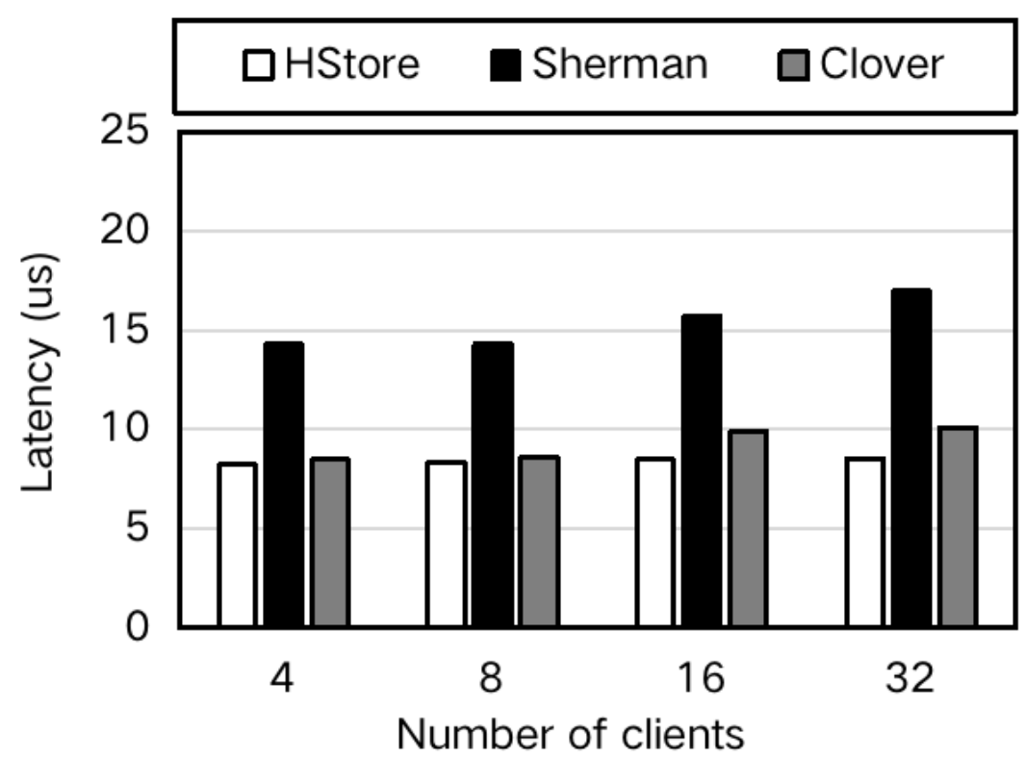
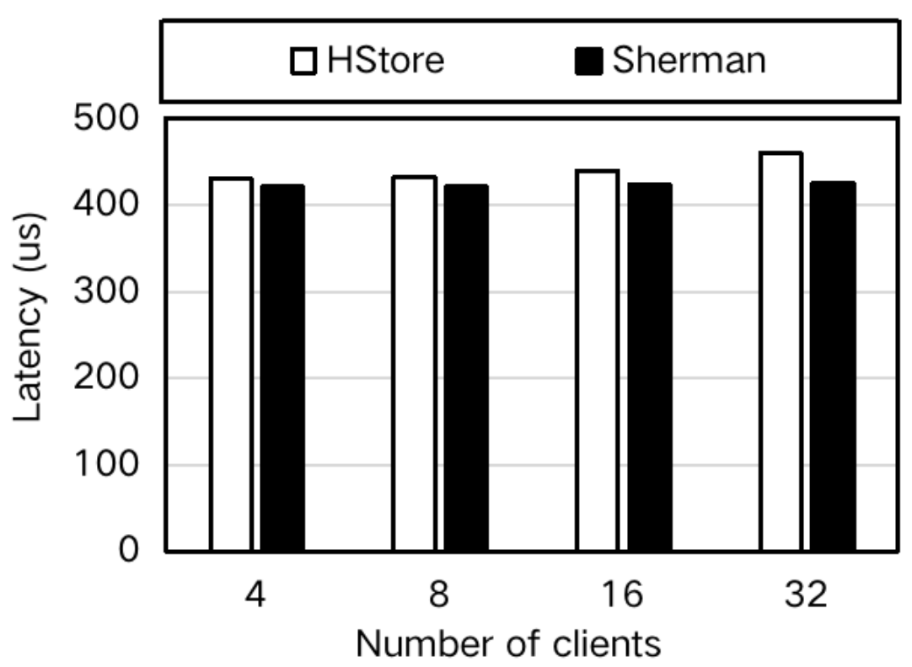
Read Latency
Get Latency
Scan Latency
The single point read performance of HStore is similar to that of systems based on hashing index, and the range query performance is similar to that of systems based on sorted index.
Notes:
These figures show the comparison of single-point and range queries latency.
The single point read performance of HStore is similar to that of systems based on hashing index,
and the range query performance is similar to that of systems based on sorted index.
This is easy to understand because we have introduced a hybrid index that handles single point reads through
hash indexing and range reads through skiplist.

Slide 47
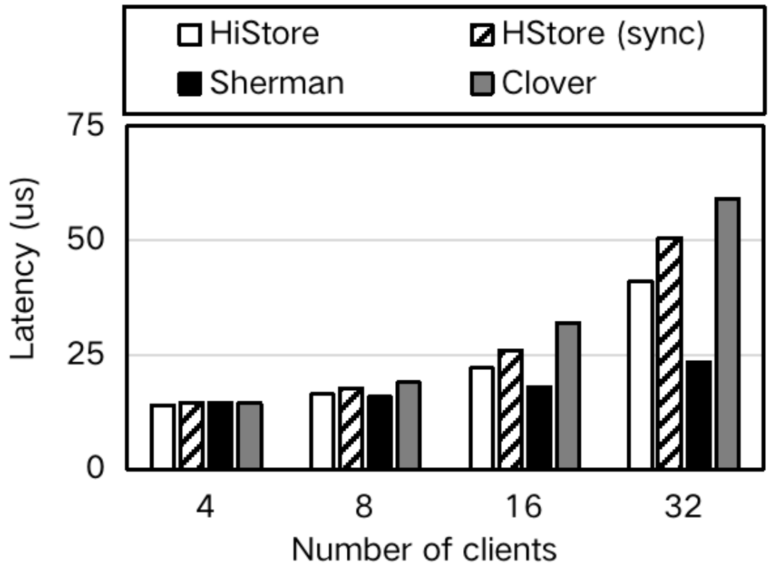

Put Latency
Put Latency
Asynchronous updates reduce the synchronization overhead of hybrid index
HStore relies on the CPU of the server for write processing, which limits its scalability.
Notes:
This figure shos the comparison of write latency.
HStore relies on the CPU of the server for write processing, which limits its scalability.
So in high concurrency with multiple clients, its performance is not as good as Sherman because
Sherman's write operations are all implemented through one-sided verbs.
However, Asynchronous updates reduce the synchronization overhead of hybrid index.
HStore based on asynchronous update optimization has lower write latency than HStore sync.

Slide 48
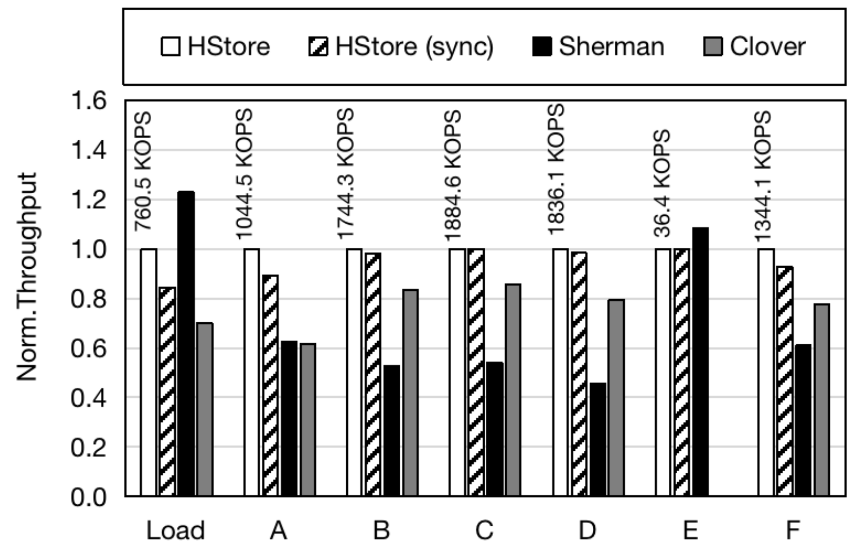
YCSB (Throughput, 16 clients)
Notes:
Under hybrid workloads, the performance of HStore can also achieve its best (except for workload load and E).

Slide 49
Outline
Background & Motivation
Design
Evaluation
Conclusion

Slide 50
Conclusion
HStore efficiently supports both single-point queries and range queries through its hybrid index scheme.
HStore leverages the CPU in memory nodes to simplify the synchronization of the hybrid index.
To reduce the synchronization cost of the hybrid index, HStore introduce an asynchronous update scheme.

Slide 51
THANK YOU ! Q & A

