Slide 1
Walden Huntington 924 Transcription Project: Learning Objectives:
To learn how to transcribe literary manuscripts from holograph sources
To apply your basic knowledge of XML encoding
To learn how to search the TEI Guidelines for elements and attributes and, deliberately making critical and creative choices, use those elements and attribute to create accurate, clear, illuminating markup of a digital edition
To tell the story of a literary’s work’s genesis and to recognize the many other possible stories that might arise from the same documentary evidence.
To explain these achievements of yours with accuracy and confidence, as you eventually may to potential and present employers.
To develop confidence and flexibility in experimenting with unfamiliar digital tools, languages, and methods; getting to the point where you can say to an employer, “I can figure out how to do that.”
Rebecca Nesvet University of Wisconsin, Green Bay nesvetr@uwgb.edu @R3b33cca

Slide 2
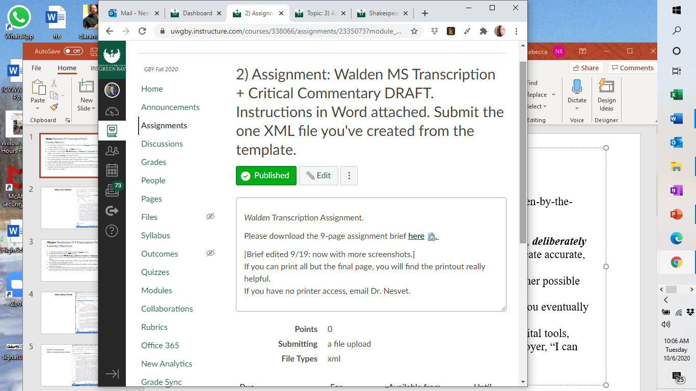
Rebecca Nesvet University of Wisconsin, Green Bay nesvetr@uwgb.edu @R3b33cca

Slide 3
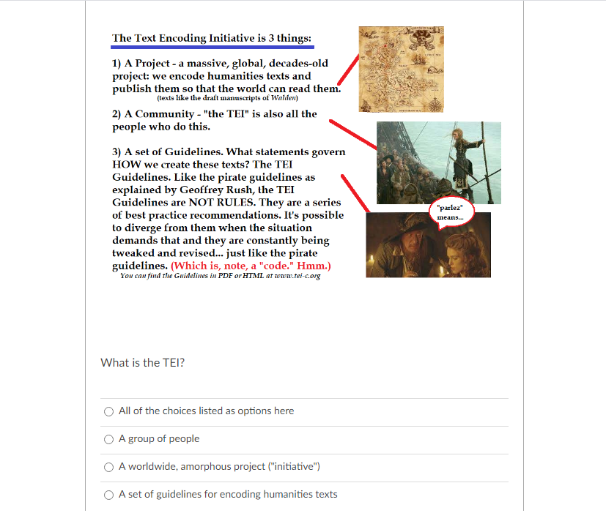
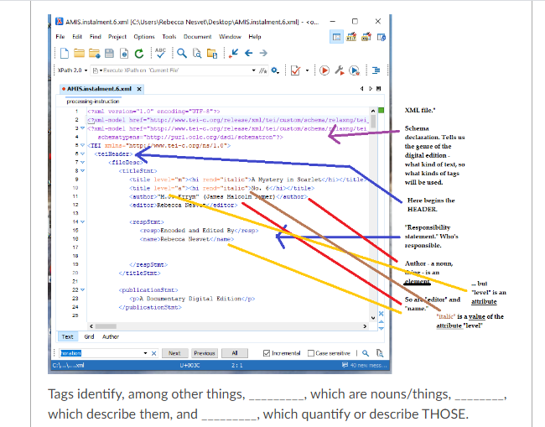
Rebecca Nesvet University of Wisconsin, Green Bay nesvetr@uwgb.edu @R3b33cca

Slide 4
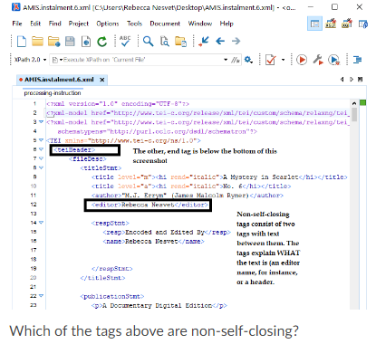
Rebecca Nesvet University of Wisconsin, Green Bay nesvetr@uwgb.edu @R3b33cca

Slide 5
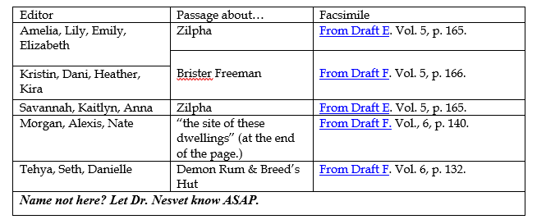
Rebecca Nesvet University of Wisconsin, Green Bay nesvetr@uwgb.edu @R3b33cca

Slide 6
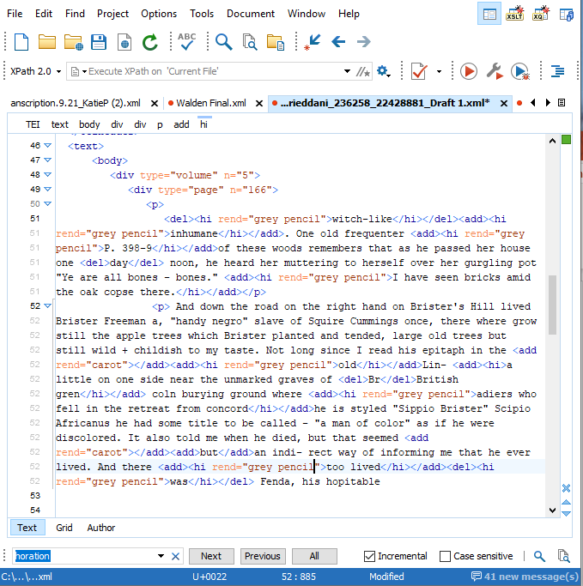
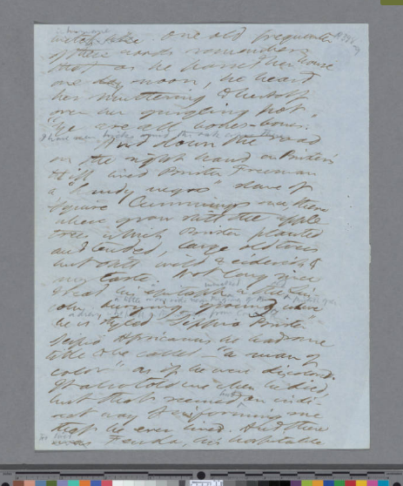
Editor: Dani Gottfried

Slide 7
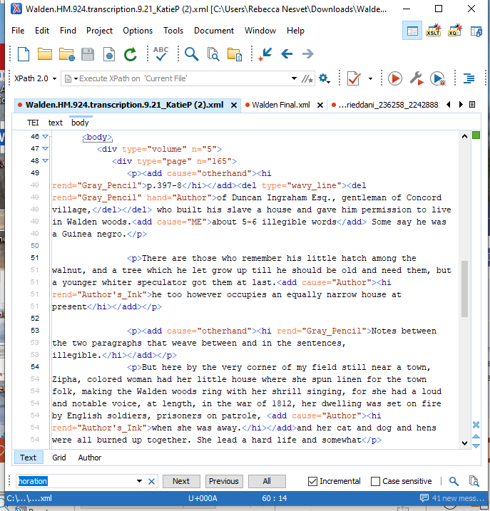
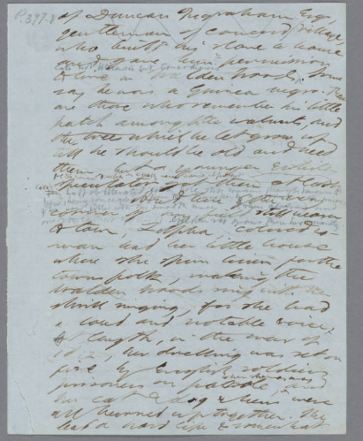
Editor: Kaitlyn Pichette

Slide 8
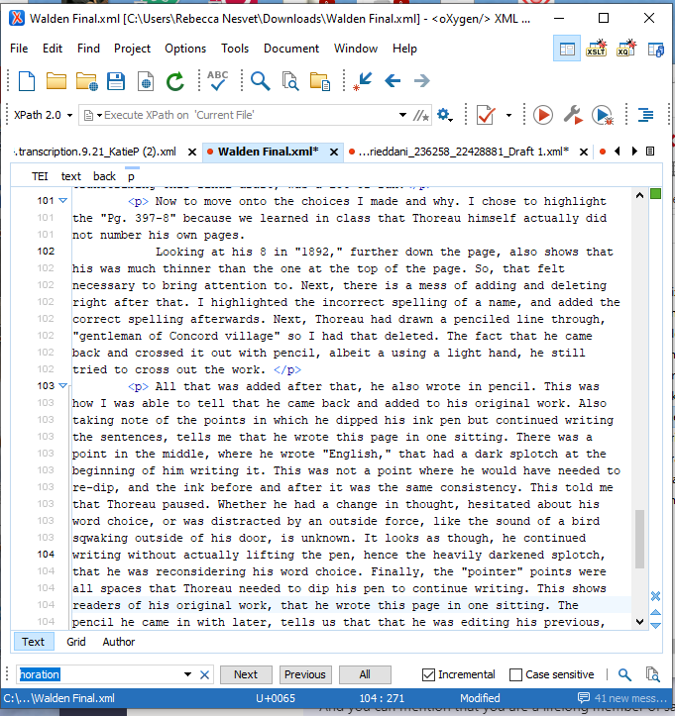
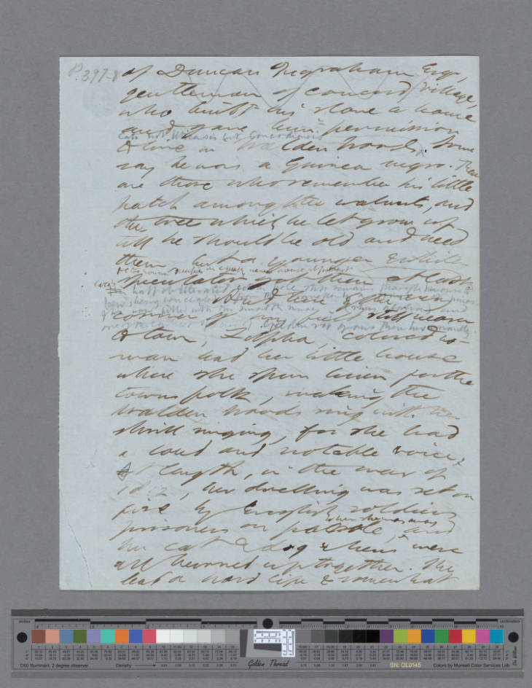
Critical Commentary Editor: Amelia Boylan-Knorr
Rebecca Nesvet University of Wisconsin, Green Bay nesvetr@uwgb.edu @R3b33cca

