Slide 1
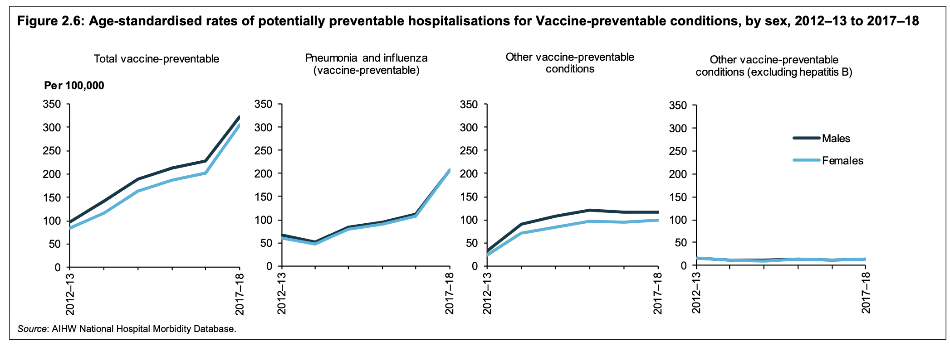
Taken from: Vaccine preventable disease in Australia AIHW factsheet

Slide 2
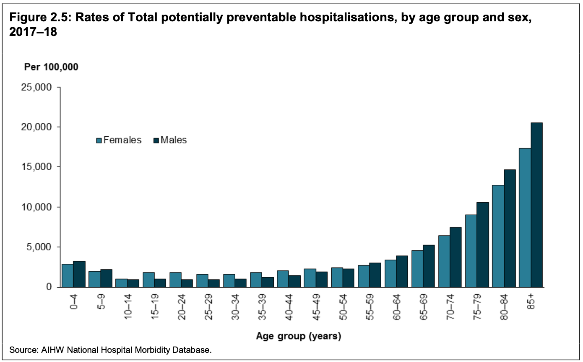
Taken from: Disparities in potentially preventable hospitalisations across Australia 2012–13 to 2017–18

Slide 3
Taken from: Disparities in potentially preventable hospitalisations across Australia 2012–13 to 2017–18

Slide 4
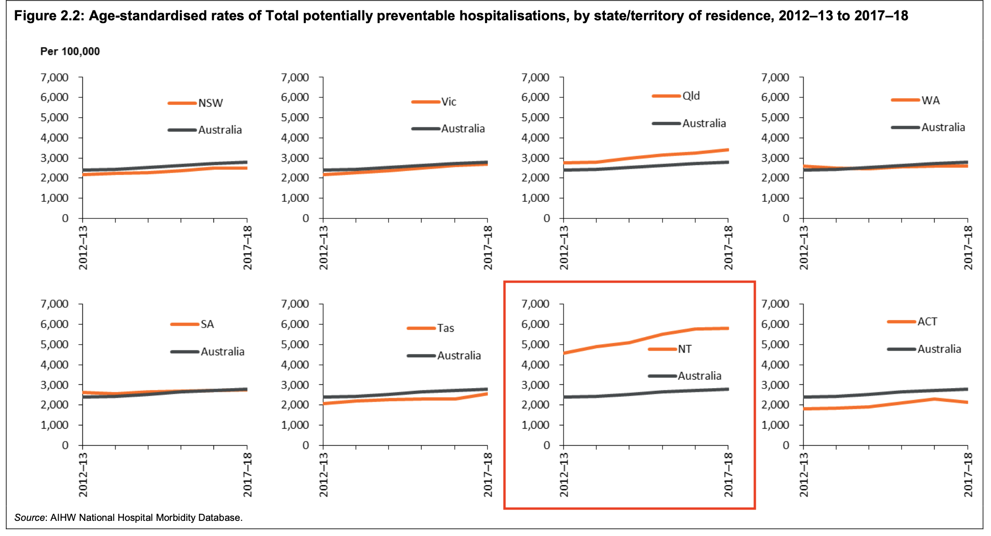
Taken from: Disparities in potentially preventable hospitalisations across Australia 2012–13 to 2017–18

Slide 5
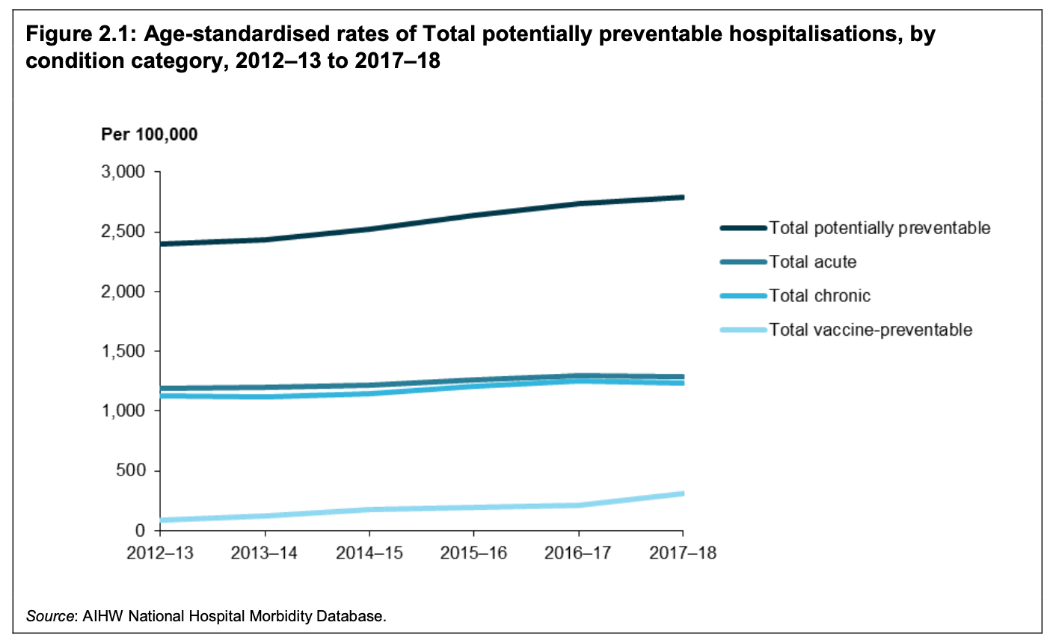
Taken from: Disparities in potentially preventable hospitalisations across Australia 2012–13 to 2017–18

Slide 6
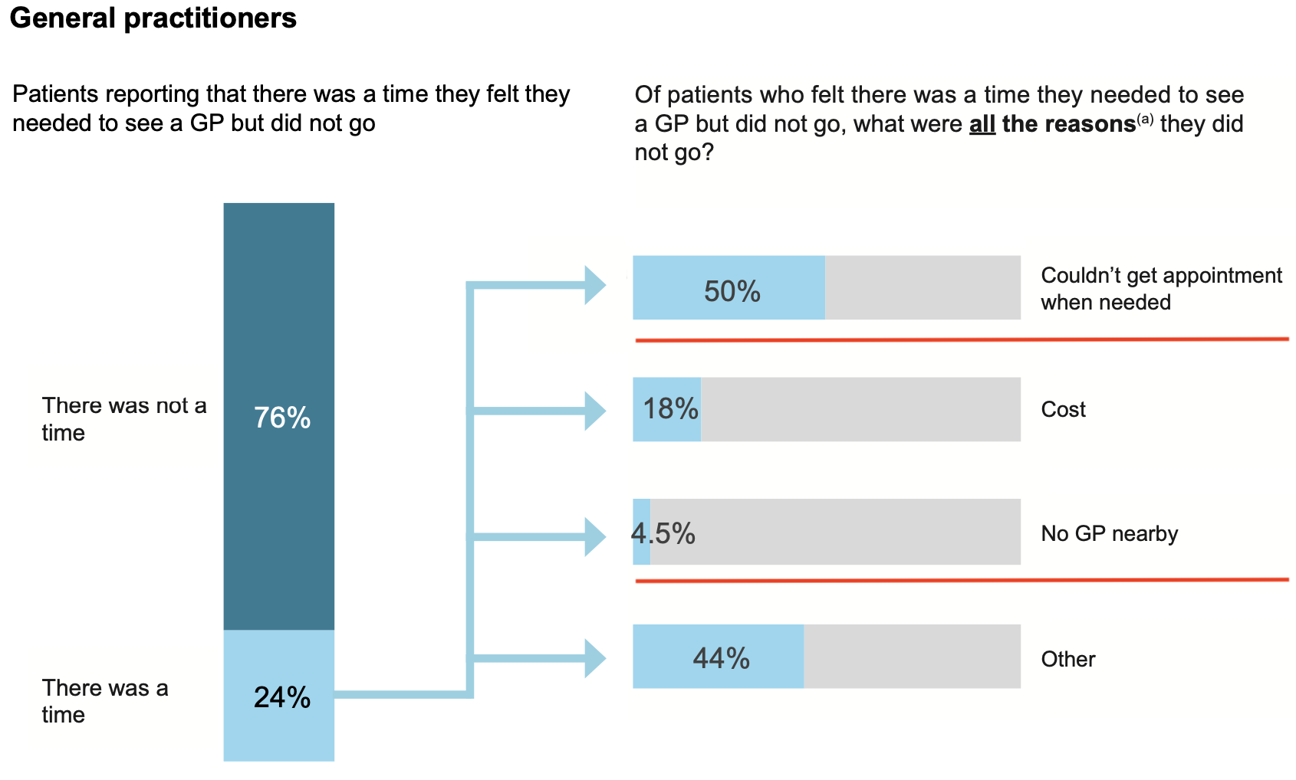
Taken from: AIHW - Coordination of health care: experiences of barriers to accessing health services among patients aged 45 and over (2016)

Slide 7
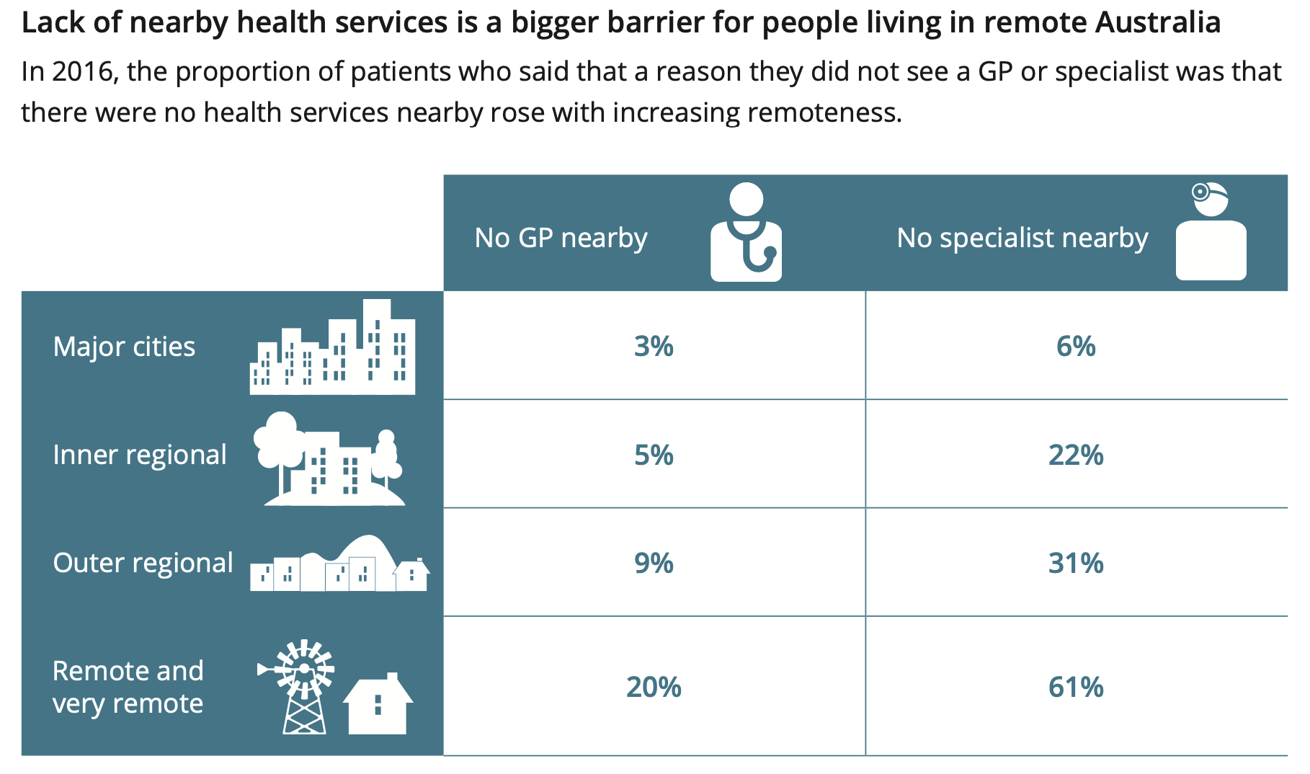
Taken from: AIHW - Coordination of health care: experiences of barriers to accessing health services among patients aged 45 and over (2016)

Slide 8
Taken from: AIHW - Coordination of health care: experiences of barriers to accessing health services among patients aged 45 and over (2016)

