Slide 1
Matrix Project – Supporting Data

Slide 2
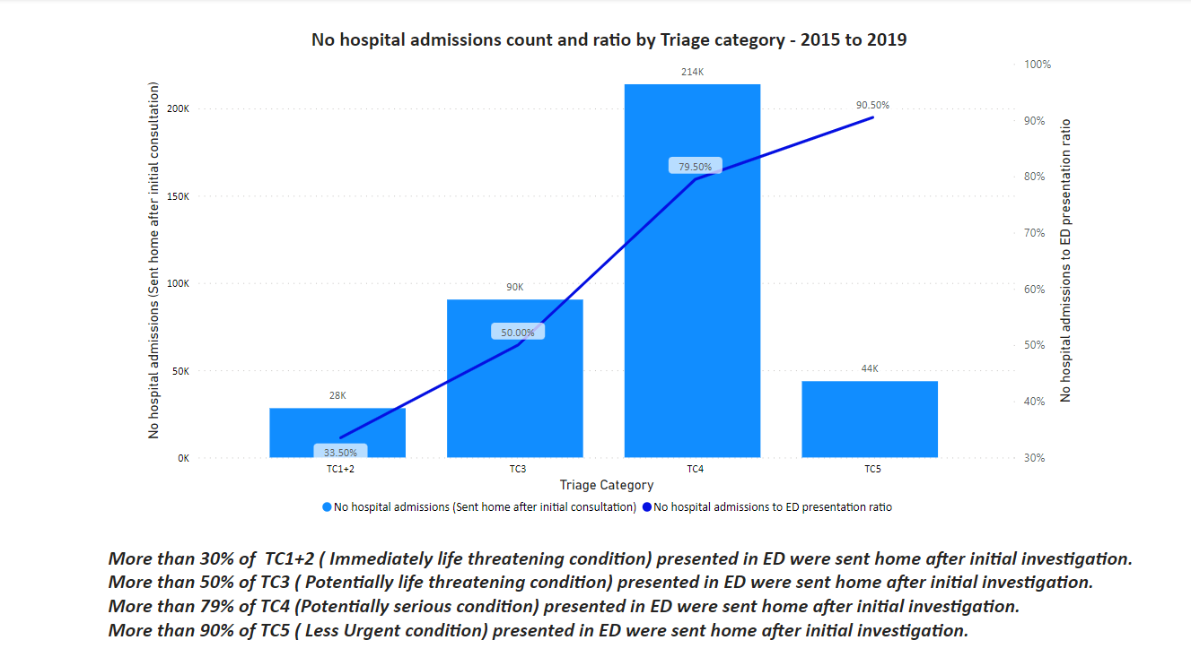
Presented in ED but not hospitalized – 2015 to 2019

Slide 3
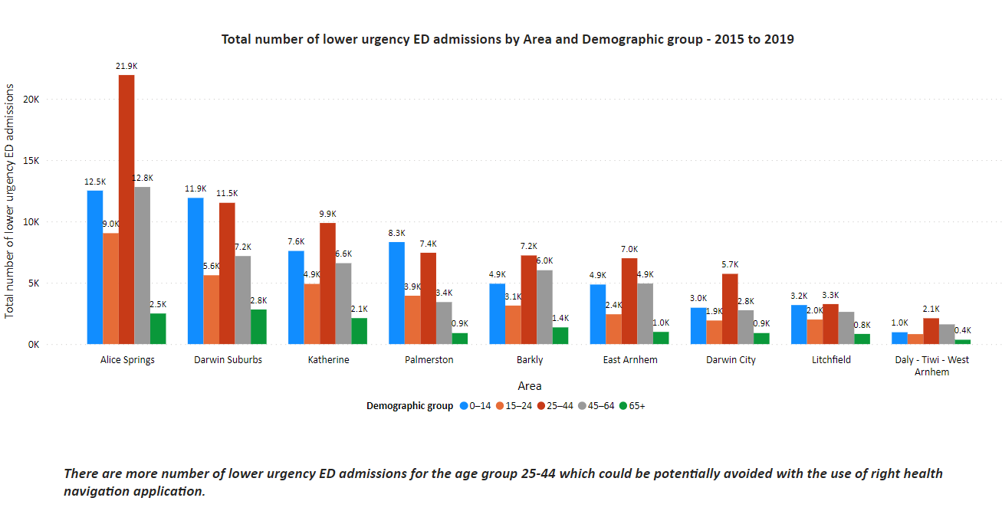
Lower Urgency ED admissions by age group and statistical area - 2015 to 2019

Slide 4
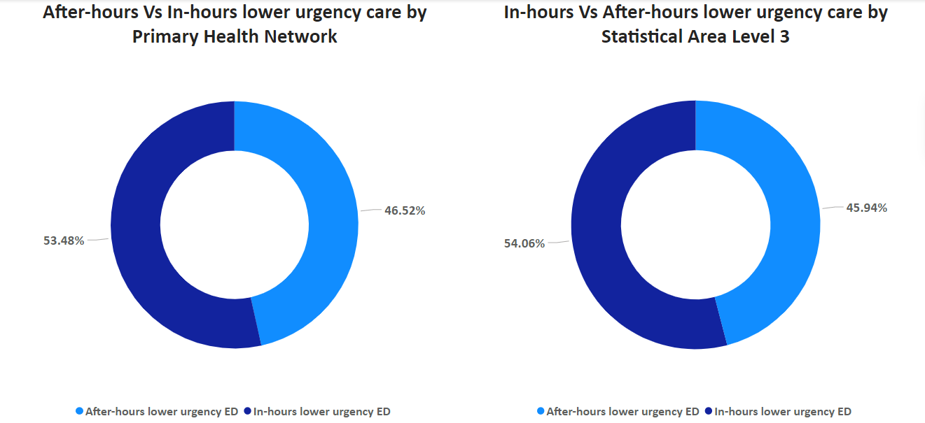
After – hours Vs In-hours lower urgency care admissions

Slide 5
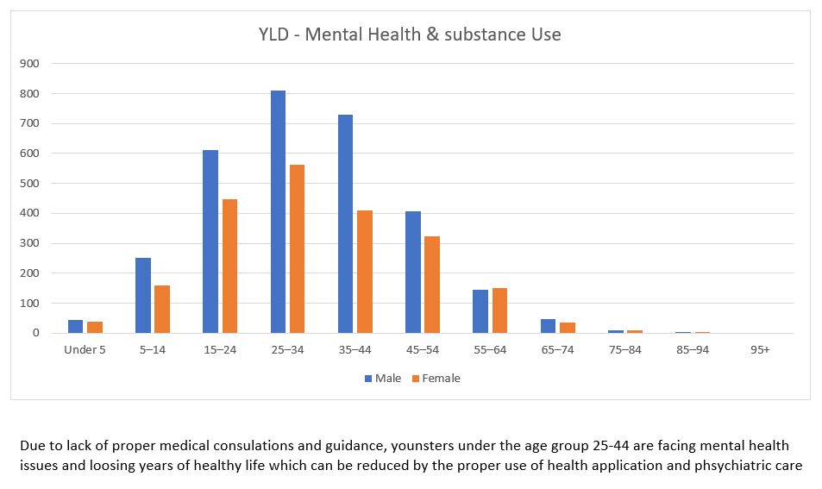
Year of Healthy Loss by Disability – Mental Health & Substance Use

