Slide 1
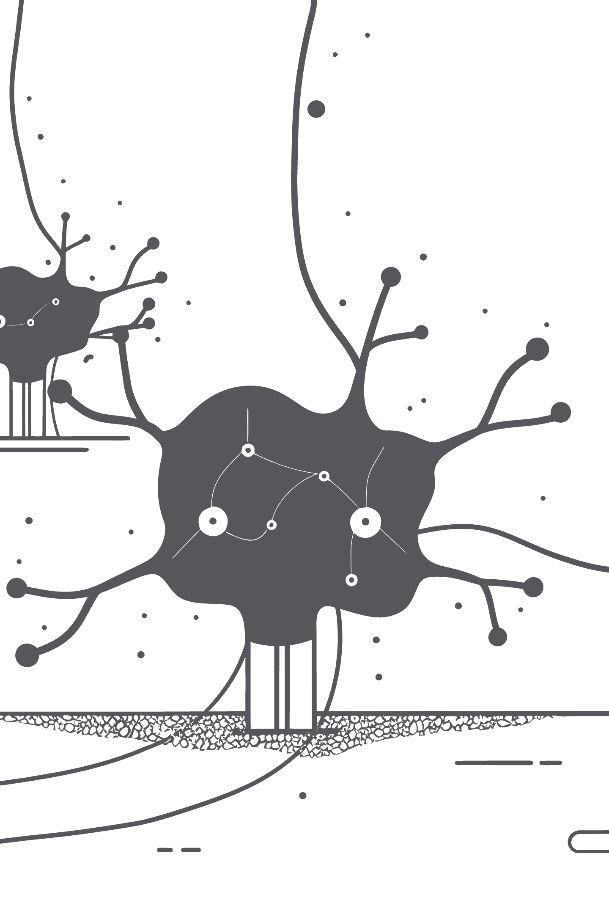
AAIPL Hackathon Submission: Optimized Logic Agents
Engineering a "Crash-Proof" System for High-Speed Inference
Team Alpha(Team 108)
February 15, 2026

Slide 2
The Challenge: Speed vs. Accuracy
The Constraint
Our Philosophy
Hackathon Death Lines: 13s for Questions, 9s for Answers
Predictability over Creativity. Time as a physics constraint.
Speed is non-negotiable
GPU throughput: ~40 tokens/sec. Mathematically impossible to timeout.
The Methodology
We engineered a system that treats time as a hard physics constraint. By calculating GPU throughput (~40 tokens/sec), we designed for zero timeouts, zero formatting errors, 100% compliance.

Slide 3
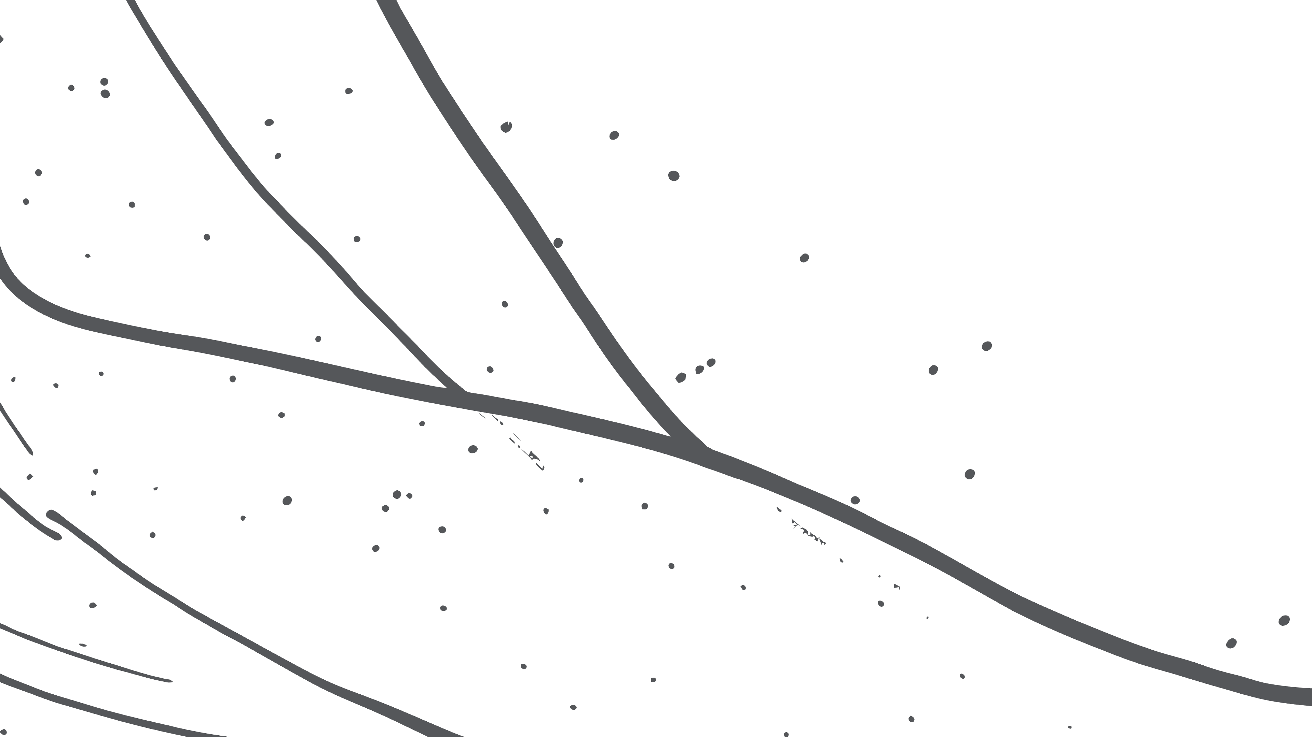

The Engineering Journey: Optimization Through Failure
Failed Experiments & Lessons Learned
The Pivot
Shifted focus from Hardware Optimization (compilers) to Prompt Constraints (forcing model conciseness).
The "Tensor Compiler" Trap (torch.compile)
Unbounded "Chain of Thought"
The "Big Batch" Gamble
Trade-off: Theoretical Speed → Real-World Reliability
Hypothesis: "Step-by-step reasoning increases accuracy"
Hypothesis: "Large batch sizes = better throughput"
Hypothesis: "Fusing kernels would maximize GPU throughput"
Failure Mode: "Straggler Effect—one slow question delayed entire batch of 10"
Failure Mode: "Model generated 400+ tokens of reasoning. Generation Time ≈ Token Count = 11s+ latency (Disqualification)"
Failure Mode: "Warmup overhead catastrophic for dynamic input shapes. First batch: ~15s (Timeout)"
Lesson: "Smaller, dynamic batches provide consistent latency"
Lesson: "Compiler startup latency too risky for short-lived sessions"
Lesson: "Cannot afford deep reasoning. Must enforce brevity"

Slide 4
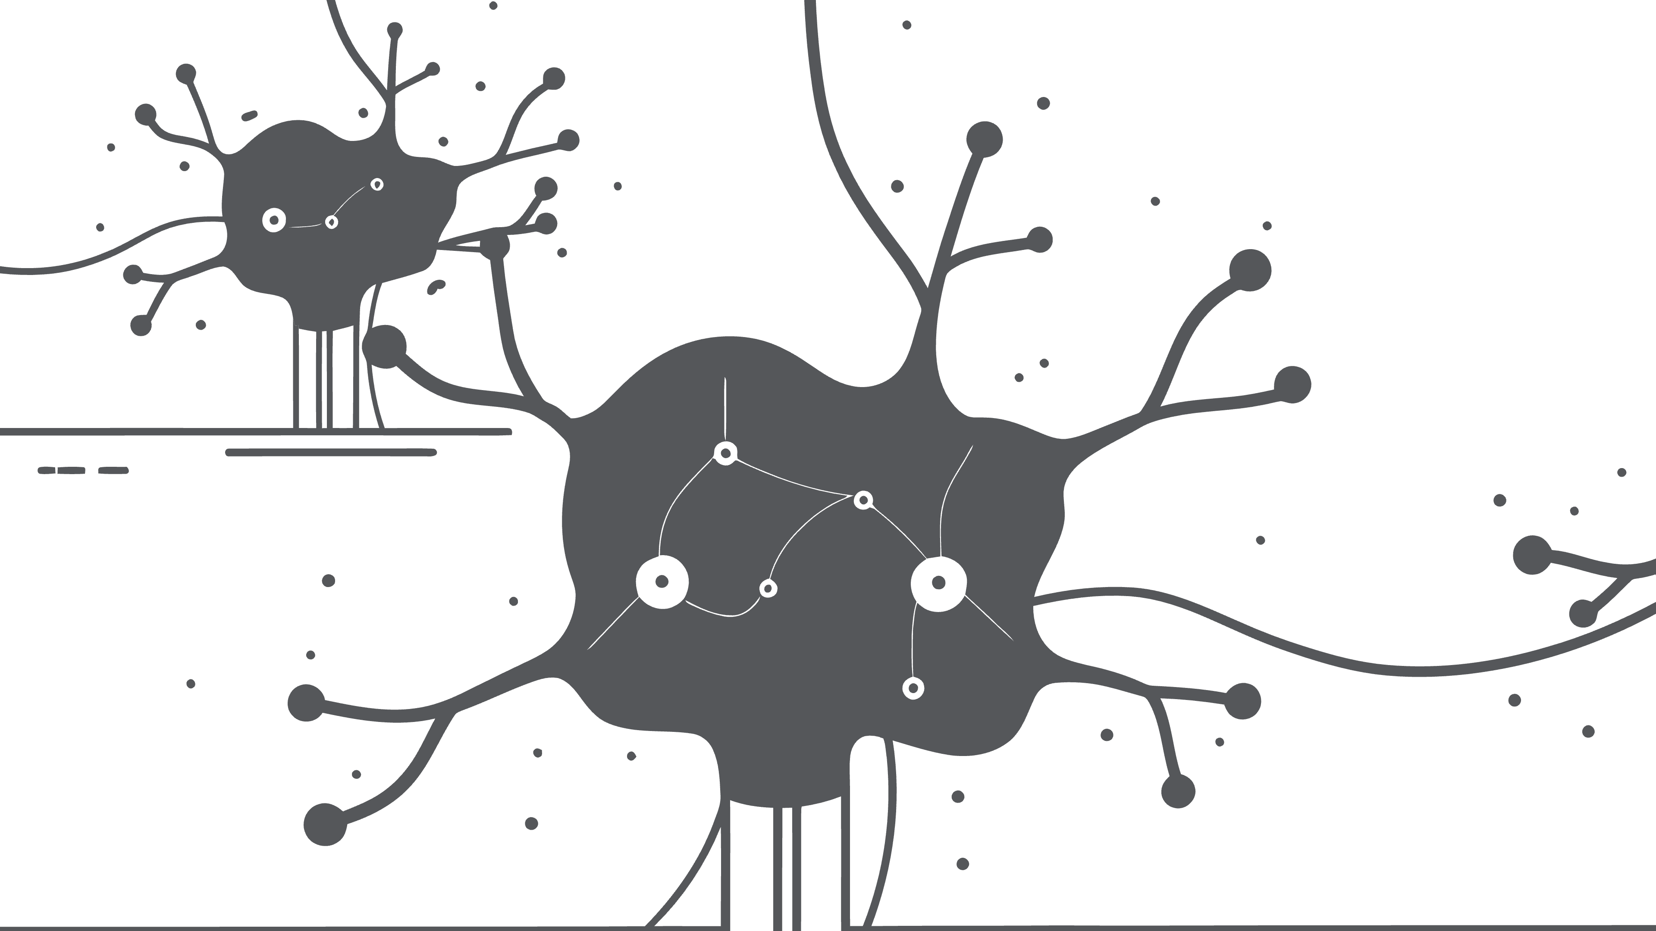




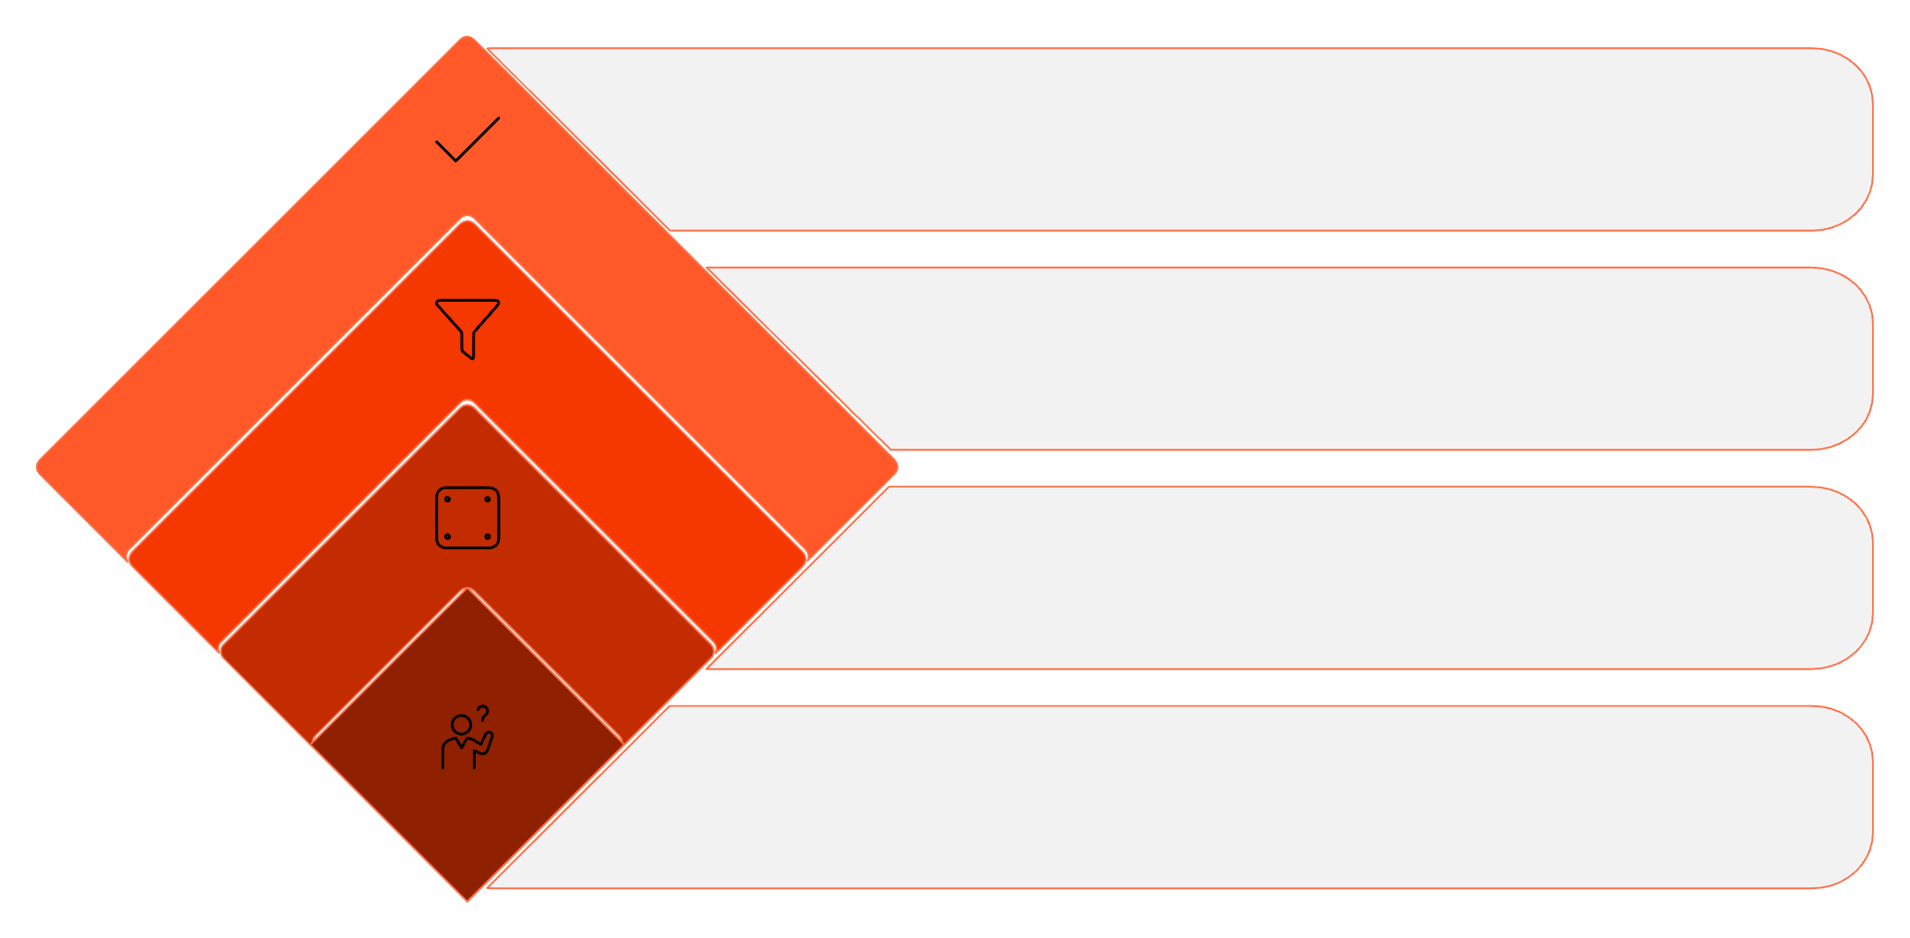
Q-Agent Strategy: The 'Negative Logic' Engine
The Objective
Core Technique: Negative Constraints
Generate high-complexity questions that force opponent to think longer, while keeping generation time short (< 4.5s)
Instead of simple queries ('Who sits next to A?'), generate negative logic ('Who is NOT sitting next to the person opposite A?'). Forces opponent to traverse entire logic tree to find answer.
Safety Mechanism: Rejection Sampling
Performance
Step 1: Generate Question. Step 2: Agent immediately solves it (Self-Check). Step 3: If (Solved Answer ≠ Generated Key) OR (Format Invalid) → DISCARD & RETRY. Result: 100% Valid JSON, Zero Ambiguity.
Avg Time: 4.47s (Safe Buffer: ~8.5s). Tactical precision. Zero failures.
This aggressive strategy ensures our Q-Agent maintains both speed and absolute accuracy.
Final Answer
Deliver constrained response
Apply Not B
Eliminate common patterns
Apply Not A
Exclude obvious answers
Initial Question
Pose the core query

Slide 5
A-Agent Strategy: The 'Strict Editor'
The Soft Brake: Prompt Engineering
The Hard Brake: Mathematical Safety
Objective: Survive the 9-second disqualification limit at all costs while maintaining accuracy.
The Math: GPU Throughput \approx 40 tokens/sec
The Limit: max_new_tokens = 300
Instruction: We explicitly prompt the model: 'Output reasoning in MAXIMUM 1 short sentence.'
Calculation: 300 / 40 = 7.5 seconds
Effect: Reduces average token count from \sim400 \rightarrow \sim200. Prevents 'yapping.'
Result: Mathematically guarantees the agent cannot time out, even if it hallucinates.
Performance & Reliability
This dual-layer safety approach ensures:
Avg Speed: 7.2s | Survival Rate: 100% | Zero Disqualifications

Slide 6
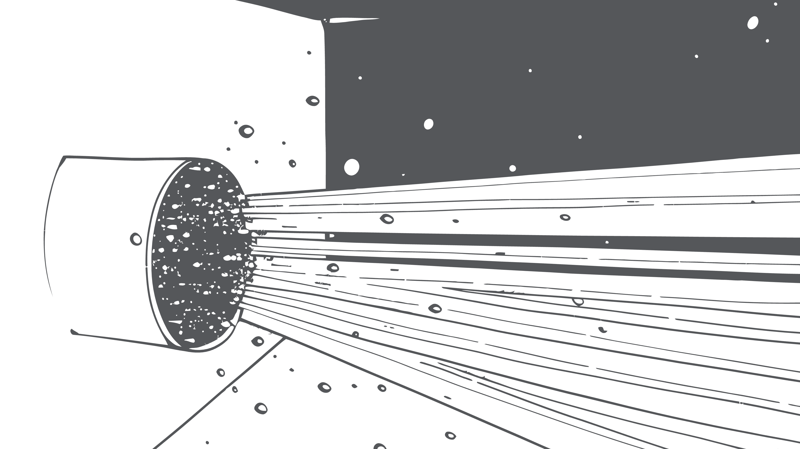
Final Performance: The 'Crash-Proof' Engine
A-Agent Speed
Q-Agent Speed
Reliability
7.27s
4.47s
100%
/ 9.0s Limit
/ 13.0s Limit
Valid JSON
SAFE - 1.73S BUFFER
SAFE - 8.5S BUFFER
0
Timeouts
UNBEATABLE
"In a high-stakes tournament, Survival is the First Requirement for Victory."
"We engineered a system that trades 'Theoretical Creativity' for 'Guaranteed Execution'."

