Slide 1
Source Control Fundamentals

Slide 2
Definition
A component of software configuration management, version control, also known as revision control or source control, is the management of changes to documents, computer programs, large web sites, and other collections of information.

Slide 3
Everyday Examples (non software)
Engineering revision control developed from formalized processes based on tracking revisions of early allowing returning to any earlier state of the design, for cases in which an engineering dead-end was reached.
Version control is widespread in business and law. Indeed, "contract redline" and "legal blackline" are some of the earliest forms of revision control.

Slide 4
What problem does it solve for software?
It’s a broad topic that can solve several problems depending on application, but for most cases today it solves the following problem:

Slide 5
What problem does it solve for software?
Allows multiple developers to collaborate on the same code base by
Providing a mechanism to centrally store code
Retrieve and modify the code
Providing a readable audit of how the code has changed
Providing a mechanism to deal with multiple parties changing the same files
Providing a way to return to a previous state
Different products tackle these in differing ways.

Slide 6
Quick History of Source Control Software
In the beginning…
Constraints and Conditions at that point in time
Storage was expensive
Software got distributed on floppy disks
Multiple versions are supported at the same time

Slide 7
Quick History of Source Control Software
1st Gen - SCCS (1972) RCS (1982)
Designed to solve a specific set of problems
Source code takes up too much space because it is repeated in every version.
Passing fixes from one version to other versions is difficult.
It is hard to acquire information about when and where changes occurred.
Finding the exact version which the client has problems with is difficult.

Slide 8
Quick History of Source Control Software
Typical implementations
Lock based -You lock a file while you are working on it
Deltas – stores files in a space efficient manner by only storing the parts that have changed using a method called Interleaved deltas

Slide 9


The next generation (86)
2nd Gen - CVS – Concurrent Versions System (1986),
A client–server architecture
a server stores the current version(s) of a project and its history
clients connect to the server in order to "check out" a complete copy of the project,
clients work on this copy and then later "check in" their changes.
developers may work concurrently, each having their own "working copy" of the project
To avoid conflicts, the server only accepts changes made to the most recent version of a file. Developers keep their working copy up-to-date by incorporating other people's changes on a regular basis.

Slide 10
CVS continued
CVS can also maintain different "branches" of a project.
For instance, a released version of the software project may form one branch, used for bug fixes,
another version under current development, with major changes and new features, can form a separate branch.
SVN (2000) CVS evolved with improvements

Slide 11

Branches?
Like as in a tree?
Or more like graph theory
Allows two (or more) parallel version of the files/software to exist at the same time
Usually changes need to be incorporated (merged) across branches

Slide 12
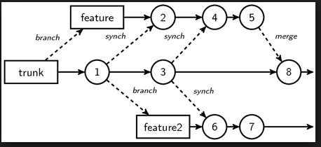
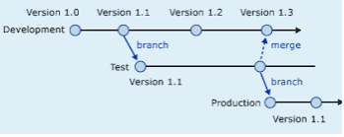
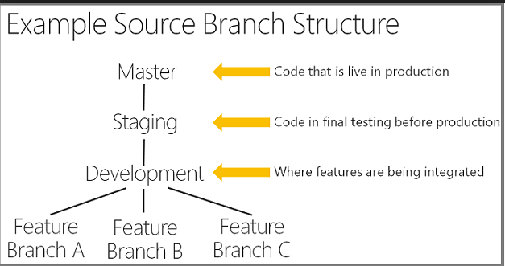
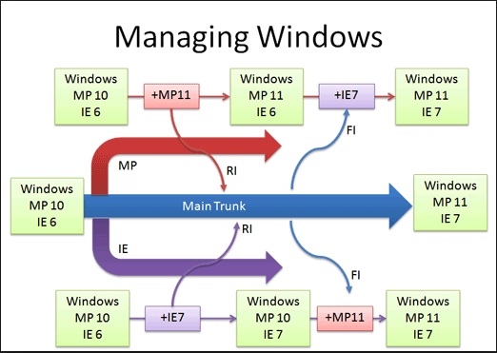
Branches?
Many different approaches and strategies
There should (and usually is) a specific reason for adopting a strategy and should always be justified
A topic to itself with plenty of differing opinions
Undeniable truths
They introduce complexity
The longer they exist and diverge, the harder the merge
(fondly referred to as merge parties)

Slide 13
Source Control Today – Rise of the DVCS
Distributed means no “real” central repository
Although, there is usually a repository that is treated like the main central repository
GIT
Linus’s replacement for BitKeeper
Mercurial
Say what? – this is GIT’s evil twin

Slide 14
Advantages
Also means you can work without needing to be connected to the central server,
and it’s a whole lot faster

Slide 15

Disadvantages
But does this mean it’s more complex, because every copy of a repository is kinda like a branch that needs to be merged back to the “shared repository”?

Slide 16

Microsoft’s Contributions
Source Safe (1995)
Lock based
No central server
Prone to corruption
TFS(2000ands)
Second foray into source control
Had a central serval
Was lock based (but changed)
Still exists today (even at ASOS!)
TFS Online supports hosting git repos

Slide 17
Git Fundamentals

Slide 18
In the beginning
There was git init
git-init - Create an empty Git repository or reinitialize an existing one

Slide 19
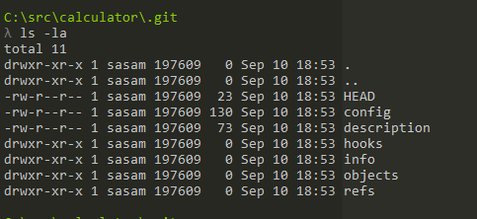
What did that do?
This command creates an empty Git repository
basically a .git directory with subdirectories for objects, refs/heads, refs/tags, and template files.
An initial HEAD file that references the HEAD of the master branch is also created.

Slide 20

What is HEAD?
Git refers to the current branch you are working on as HEAD
The file contains the details of the branch
A head is simply a reference to a commit object. Each head has a name (branch name or tag name, etc). By default, there is a head in every repository called master. A repository can contain any number of heads. At any given time, one head is selected as the “current head.” This head is aliased to HEAD, always in capitals".
Note this difference: a “head” (lowercase) refers to any one of the named heads in the repository; “HEAD” (uppercase) refers exclusively to the currently active head. This distinction is used frequently in Git documentation.

Slide 21
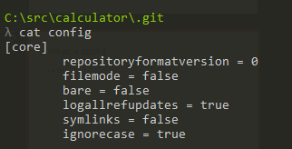
What is config
A file that contains configuration settings for the repo
There is also a global config
If you want to find where it is use
git config --list --show-origin

Slide 22
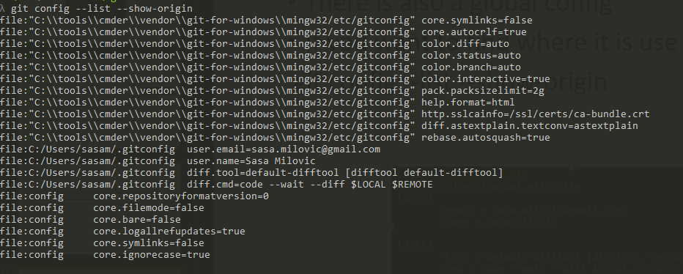
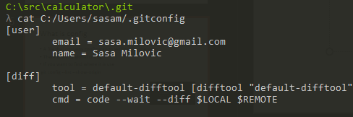

Slide 23
Git description file???
https://stackoverflow.com/questions/6866838/what-should-be-in-the-git-description-file

Slide 24
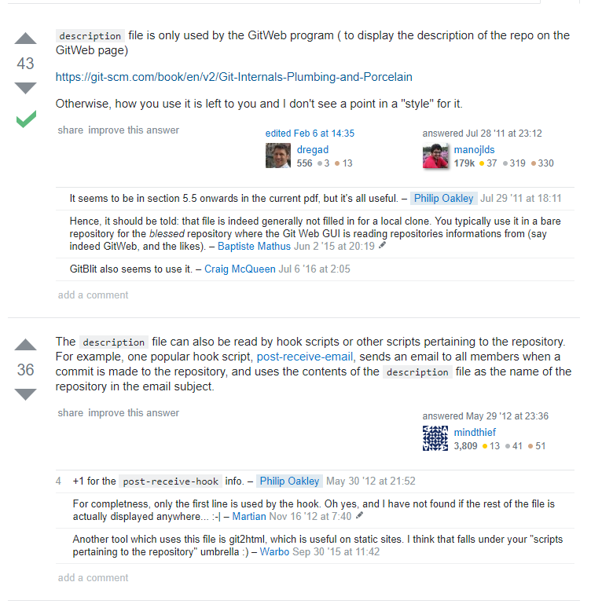

Slide 25
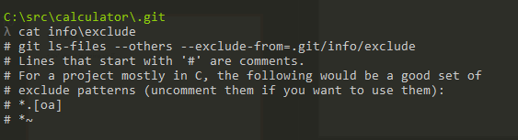
Info = Excludes?
Only one file in info - excludes
Its’ about ignoring stuff

Slide 26
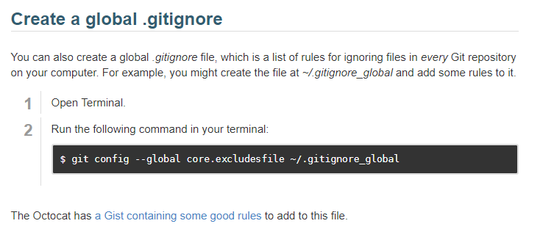
There are three ways to do that!
Excludes file (local to repo, doesn’t get shared with others)
Global .gitignore (global to all your local repos, doesn’t get shared)
Local .gitignore (local to repo, shared by everyone using the repo)

Slide 27
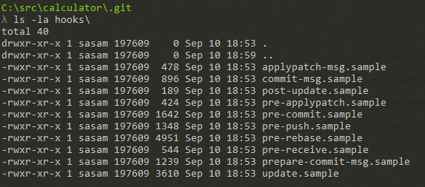
Hooks
Extension points for extending the behaviour of existing git commands by running your own code
Contains some samples for each hook (which you can enable by removing the .sample extension)
Read more here https://git-scm.com/book/gr/v2/Customizing-Git-Git-Hooks

Slide 28
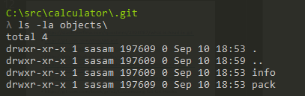
Objects?
There are two empty directories
Info
Pack
What could they be for?

Slide 29
Git object definition
Blob
File contents
Tree
Represents a directory and contents, has pointers to other trees and blobs
Trees are created using the index
Commit
A pointer to a tree (top level tree)
A pointer to previous commit
Some information about the commit (message, author, committer, timestamp)
git cat-file for the curious!
-p (prints contents)
-t describes the type

Slide 30
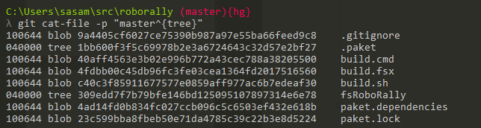
Lets look at the root of the tree
git cat-file -p "master^{tree}"

Slide 31
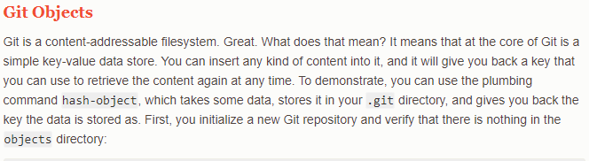
Git object definition

Slide 32
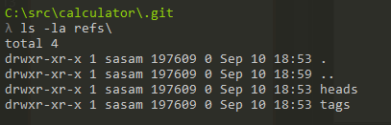
Refs?
Also has two empty directories
heads
tags

Slide 33
Types of References
Branch
Is a named reference to a commit
Can change which commit it points at
HEAD is the current reference to the current branch
Tag
Two types, annotated and lightweight
Similar to a commit, it contains a tagger, a date, a message, and a pointer, however points to a commit rather than a tree
Also like a branch, but it never moves
Remotes
Read only
HEAD will never point to it so you cant change it by committing

Slide 34
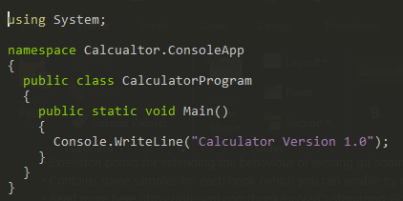
Worlds simplest example
Create a cs file called Calculator.cs

Slide 35

Worlds simplest build script
Create a file called build.cmd
You might want to add the csc.exe to your path
Set PATH=%PATH%;c:\Windows\Microsoft.NET\Framework\v4.0.30319

Slide 36
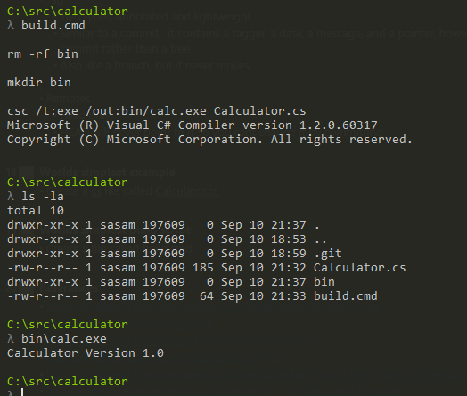
Run it

Slide 37
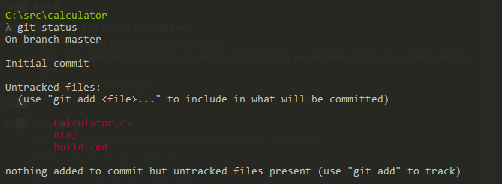
Cool, I want to source control now!
What stuff can I commit?
Git status
But I don’t want to check in that bin folder!
Why – it’s a transient thing that is the result of of compiling my program, so it’s gonna change all the time
Lets do that ignore thing!

Slide 38
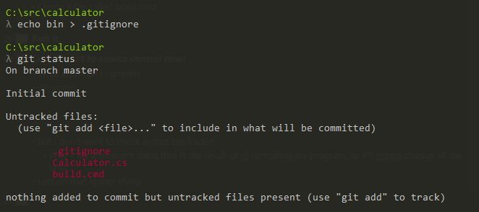
How?
Use .gitignore! And now you can forget about the bin folder

Slide 39
Ok so how do I create my commit/tree/blobs?
You first need to setup your index so the trees can be created
Although there are lower level commands we will skip to the simplest one, git add
In this case you just want to add everything to the index so use git add .
Check the status and green stuff means its staged in the index

Slide 40
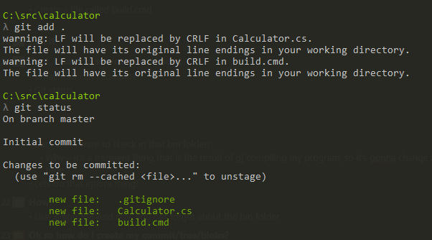
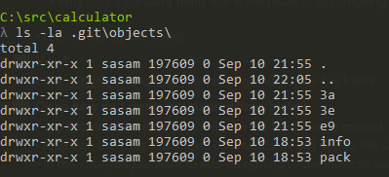
You don’t have a commit or tree yet.
Add does create some objects (blob in this case)
You can use cat-file to see the contents of the blobs

Slide 41
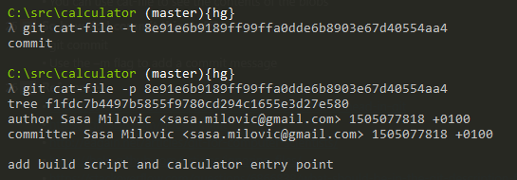
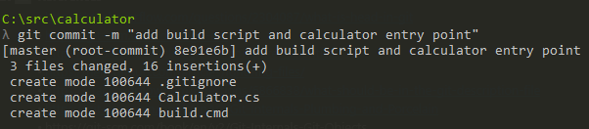

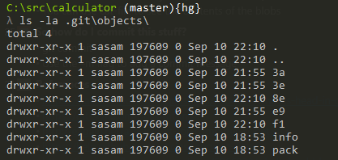
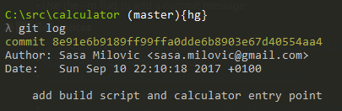
So how do I commit this stuff?
git commit
Use the –m flag to add a commit message

Slide 42
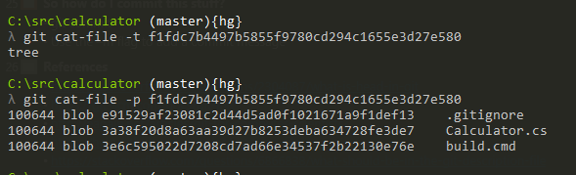

Slide 43
So how do I share this so other people can help?
Lets create a central repo that we all sync with
Lets use github for this! (at asos we would use TFS)

Slide 44
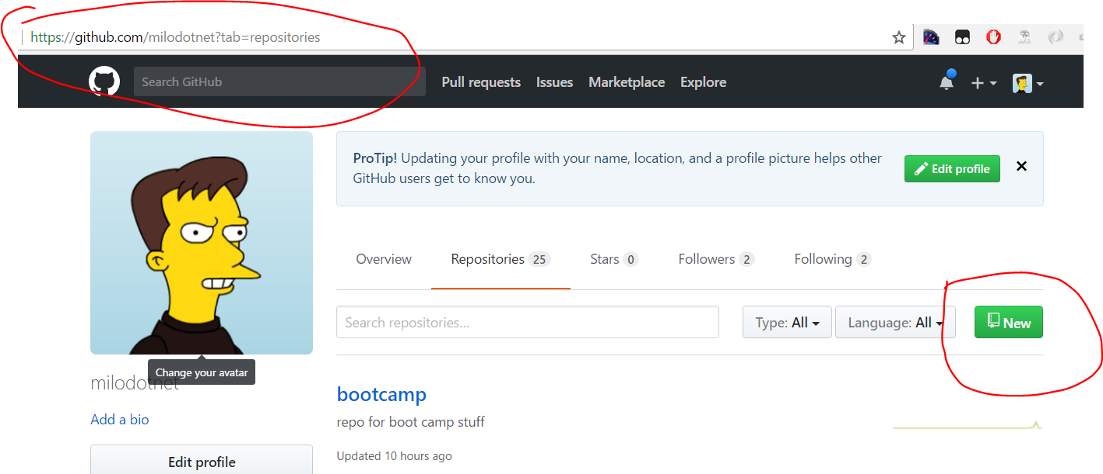

Slide 45
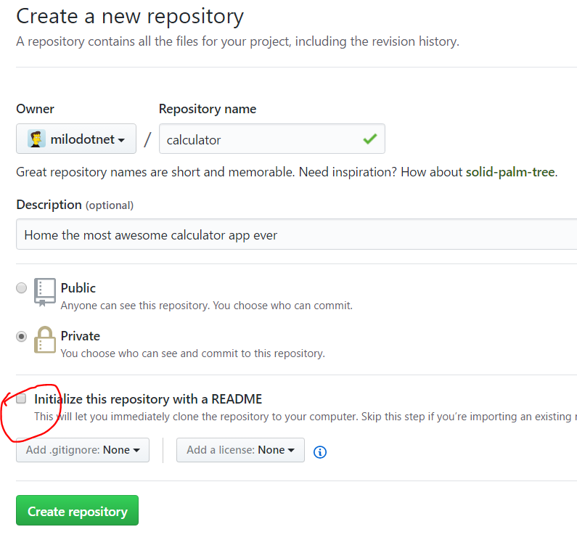

Slide 46
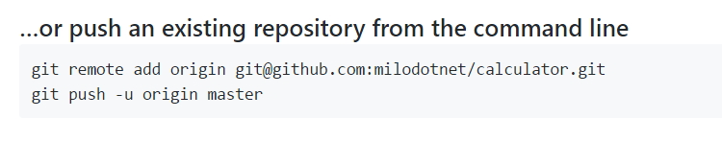
Add a remote!
Create a remote, called origin, that points to git@github.com:milodotnet/calculator.git
Push the commits from my local repo to the remote, and set it as the upstream (-u) – this sets this as the remote upstream for argumentless commands (e.g. git pull), origin gives the name of the remote, and master the name of the branch

Slide 47
Lets start collaborating
Split into groups of two
Your task is to add two operations to the calculator program, add and subtract
You each want to build one of these operations

Slide 48
References
https://en.wikipedia.org/wiki/Version_control
https://en.wikipedia.org/wiki/Source_Code_Control_System
https://en.wikipedia.org/wiki/Interleaved_deltas
http://docs.oracle.com/cd/E19504-01/802-5880/6i9k05dhp/index.html
https://en.wikipedia.org/wiki/Concurrent_Versions_System
https://simpleprogrammer.com/2017/01/16/software-developers-know-source-control/

Slide 49
References
https://stackoverflow.com/questions/2304087/what-is-head-in-git
https://git-scm.com/docs/git-init
http://eagain.net/articles/git-for-computer-scientists/
https://help.github.com/articles/ignoring-files/
https://stackoverflow.com/questions/6866838/what-should-be-in-the-git-description-file
https://git-scm.com/book/en/v2/Git-Internals-Plumbing-and-Porcelain
https://git-scm.com/book/en/v2/Git-Internals-Git-Objects
https://git-scm.com/book/gr/v2/Customizing-Git-Git-Hooks
https://git-scm.com/book/en/v2/Git-Internals-Git-References
https://git-scm.com/docs/git-push

