Slide 1
Source Control Fundamentals

Slide 2
Definition
A component of software configuration management, version control, also known as revision control or source control, is the management of changes to documents, computer programs, large web sites, and other collections of information.

Slide 3
Examples from history (non software)
Engineering revision control developed from formalized processes based on tracking revisions of early blueprints or bluelines. This system of control implicitly allowed returning to any earlier state of the design, for cases in which an engineering dead-end was reached in the development of the design. A revision table was used to keep track of the changes made. Additionally, the modified areas of the drawing were highlighted using revision clouds.
Version control is widespread in business and law. Indeed, "contract redline" and "legal blackline" are some of the earliest forms of revision control,^{[4]} and are still employed in business and law with varying degrees of sophistication. The most sophisticated techniques are beginning to be used for the electronic tracking of changes to CAD files (see product data management), supplanting the "manual" electronic implementation of traditional revision control.[

Slide 4
What problem does it solve for software?
Allows multiple developers to collaborate on the same code base by
Providing a mechanism to store and retrieve the code and changes
Providing a mechanism to deal with changes to the same files
Providing a readable history of how the code has changed
Providing a way to return to a previous state
Different products tackle these in differing ways.

Slide 5
Quick History
1st Gen - SCCS (1972) RCS (1982)
Designed to solve a specific set of problems
Source code takes up too much space because it is repeated in every version.
Passing optimization from one version to other versions is difficult.
It is hard to acquire information about when and where changes occurred.
Finding the exact version which the client has problems with is difficult.
Context
Storage was expensive
Software gets packaged and shipped to clients
Multiple versions are supported at the same time
Lock based -You lock a file while you are working on it
Deltas – stores files in a space efficient manner by only storing the parts that have changed using a method called Interleaved deltas

Slide 6
More History
2nd Gen - Centralized Source Control
CVS uses a client–server architecture: a server stores the current version(s) of a project and its history, and clients connect to the server in order to "check out" a complete copy of the project, work on this copy and then later "check in" their changes.
Several developers may work on the same project concurrently, each one editing files within their own "working copy" of the project, and sending (or checking in) their modifications to the server.
To avoid conflicts, the server only accepts changes made to the most recent version of a file. Developers keep their working copy up-to-date by incorporating other people's changes on a regular basis.
This task is mostly handled automatically by the CVS client, requiring manual intervention only when an edit conflict arises between a checked-in modification and the yet-unchecked local version of a file.
If the check in operation succeeds, then the version numbers of all files involved automatically increment, and the CVS-server writes a user-supplied description line, the date and the author's name to its log files.
Clients can also compare versions, request a complete history of changes, or check out a historical snapshot of the project as of a given date or as of a revision number.
CVS servers can allow "anonymous read access", check-in of changes requires a personal account and password
Clients use the "update" command to bring their local copies up-to-date with the newest version on the server. This eliminates the need for repeated downloading of the whole project.
CVS can also maintain different "branches" of a project. For instance, a released version of the software project may form one branch, used for bug fixes, while a version under current development, with major changes and new features, can form a separate branch.
CVS uses delta compression for efficient storage of different versions of the same file. This works well with large text files with few changes from one version to the next. This is usually the case for source code files. On the other hand, when CVS is told to store a file as binary, it will keep each individual version on the server. Storing files as binary is important in order to avoid corruption of binary files.
CVS (1986),
SVN (2000) CVS evolved with improvements

Slide 7

Branches?
Like as in a tree?
Or more like graph theory
Allows two (or more) parallel version of the files/software to exist at the same time
Usually changes need to be incorporated (merged) across branches

Slide 8
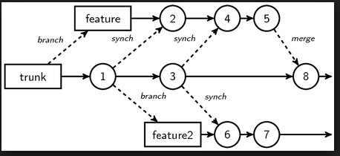
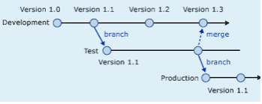
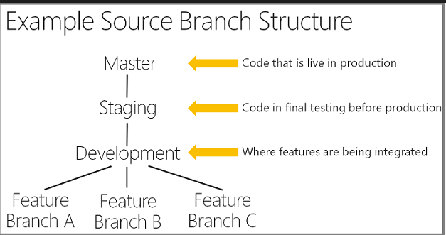
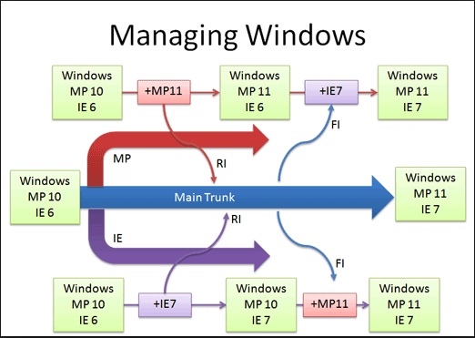
Branches?
Many different approaches and strategies
There should (and usually is) a specific reason for adopting a strategy and should always be justified
A topic to itself with plenty of differing opinions
Undeniable truths
They introduce complexity
The longer they exist and diverge, the harder the merge
(fondly referred to as merge parties)

Slide 9
Source Control Today – Rise of the DVCS
Distributed means no “real” central repository
Although, there is usually a repository that is treated like the main central repository
GIT
Linus’s replacement for BitKeeper
Mercurial
Say what? – this is GIT’s evil twin

Slide 10
Advantages
Also means you can work without needing to be connected to the central server,
and it’s a whole lot faster

Slide 11

Disadvantages
But does this mean it’s more complex, because every copy of a repository is kinda like a branch that needs to be merged back to the “shared repository”?

Slide 12

Microsoft’s Contributions
Source Safe (1995)
Lock based
No central server
Prone to corruption
TFS(2000ands)
Second foray into source control
Had a central serval
Was lock based (but changed)
Still exists today (even at ASOS!)
TFS Online supports hosting git repos

Slide 13
Git Fundamentals

Slide 14
In the beginning
There was git init
git-init - Create an empty Git repository or reinitialize an existing one

Slide 15
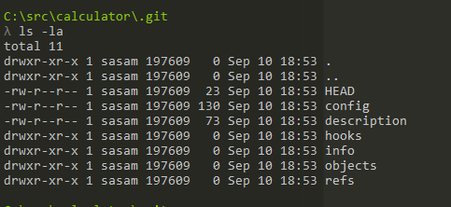
What did that do?
This command creates an empty Git repository
basically a .git directory with subdirectories for objects, refs/heads, refs/tags, and template files.
An initial HEAD file that references the HEAD of the master branch is also created.

Slide 16

What is HEAD?
Git refers to the current branch you are working on as HEAD
The file contains the details of the branch
A head is simply a reference to a commit object. Each head has a name (branch name or tag name, etc). By default, there is a head in every repository called master. A repository can contain any number of heads. At any given time, one head is selected as the “current head.” This head is aliased to HEAD, always in capitals".
Note this difference: a “head” (lowercase) refers to any one of the named heads in the repository; “HEAD” (uppercase) refers exclusively to the currently active head. This distinction is used frequently in Git documentation.

Slide 17
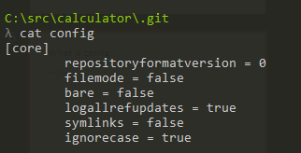
What is config
A file that contains configuration settings for the repo
There is also a global config
If you want to find where it is use
git config --list --show-origin

Slide 18
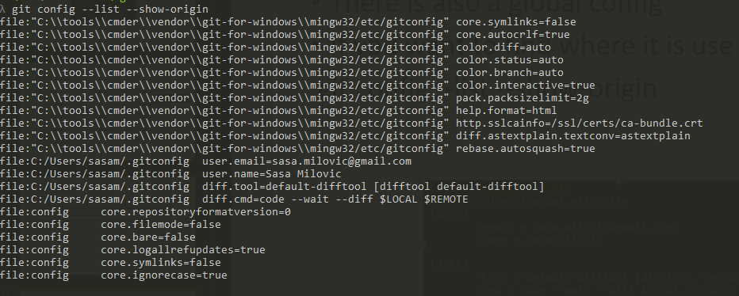
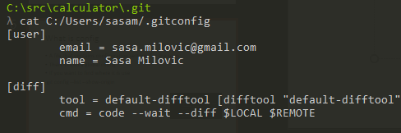

Slide 19
Git description file???
https://stackoverflow.com/questions/6866838/what-should-be-in-the-git-description-file

Slide 20
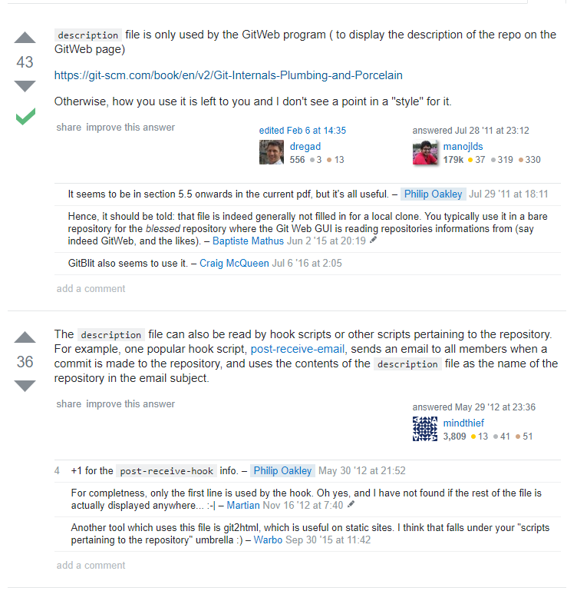

Slide 21
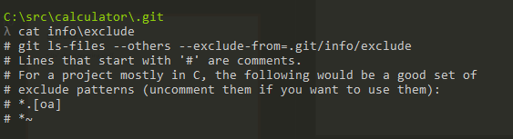
Info = Excludes?
Only one file in info - excludes
Its’ about ignoring stuff

Slide 22
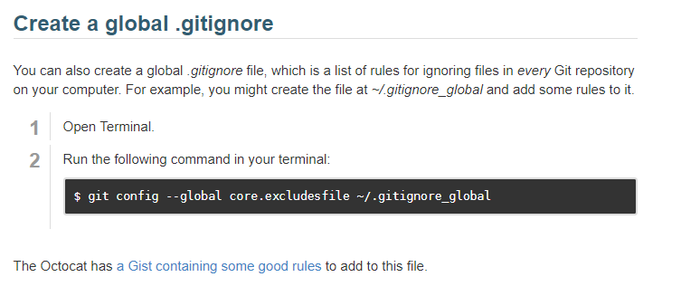
There are three ways to do that!
Excludes file (local to repo, doesn’t get shared with others)
Global .gitignore (global to all your local repos, doesn’t get shared)
Local .gitignore (local to repo, shared by everyone using the repo)

Slide 23
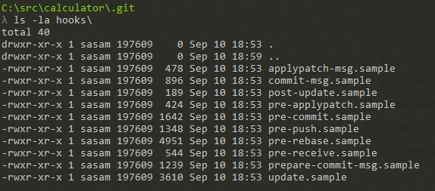
Hooks
Extension points for extending the behaviour of existing git commands by running your own code
Contains some samples for each hook (which you can enable by removing the .sample extension)
Read more here https://git-scm.com/book/gr/v2/Customizing-Git-Git-Hooks

Slide 24
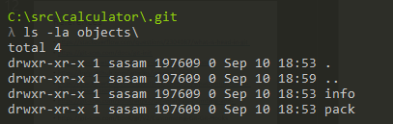
Objects?
There are two empty directories
Info
Pack
What could they be for?

Slide 25
Git object definition
Blob
File contents
Tree
Represents a directory and contents, has pointers to other trees and blobs
Trees are created using the index
Commit
A pointer to a tree (top level tree)
A pointer to previous commit
Some information about the commit (message, author, committer, timestamp)
git cat-file for the curious!
-p (prints contents)
-t describes the type

Slide 26
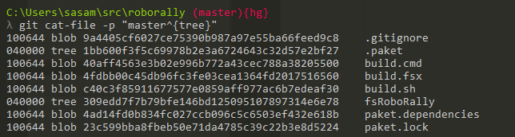
Lets look at the root of the tree
git cat-file -p "master^{tree}"

Slide 27
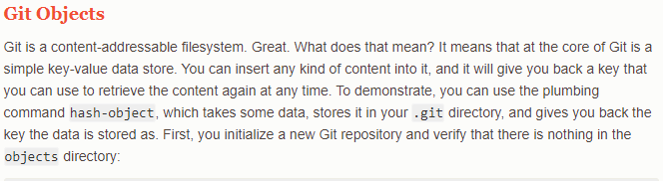
Git object definition

Slide 28
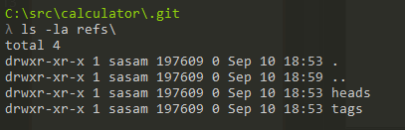
Refs?
Also has two empty directories
heads
tags

Slide 29
Types of References
Branch
Is a named reference to a commit
Can change which commit it points at
HEAD is the current reference to the current branch
Tag
Two types, annotated and lightweight
Similar to a commit, it contains a tagger, a date, a message, and a pointer, however points to a commit rather than a tree
Also like a branch, but it never moves
Remotes
Read only
HEAD will never point to it so you cant change it by committing

Slide 30
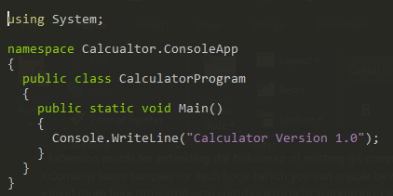
Worlds simplest example
Create a cs file called Calculator.cs

Slide 31

Worlds simplest build script
Create a file called build.cmd
You might want to add the csc.exe to your path
Set PATH=%PATH%;c:\Windows\Microsoft.NET\Framework\v4.0.30319

Slide 32
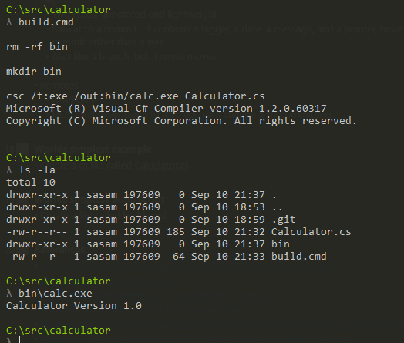
Run it

Slide 33
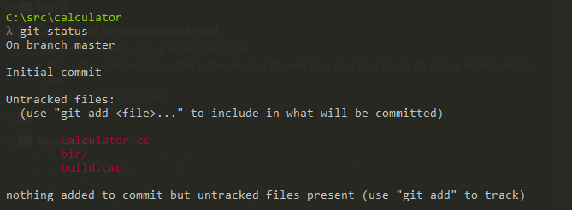
Cool, I want to source control now!
What stuff can I commit?
Git status
But I don’t want to check in that bin folder!
Why – it’s a transient thing that is the result of of compiling my program, so it’s gonna change all the time
Lets do that ignore thing!

Slide 34
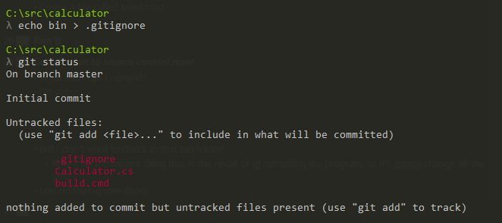
How?
Use .gitignore! And now you can forget about the bin folder

Slide 35
Ok so how do I create my commit/tree/blobs?
You first need to setup your index so the trees can be created
Although there are lower level commands we will skip to the simplest one, git add
In this case you just want to add everything to the index so use git add .
Check the status and green stuff means its staged in the index

Slide 36
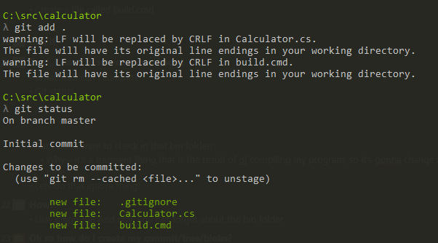
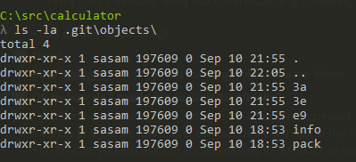
You don’t have a commit or tree yet.
Add does create some objects (blob in this case)
You can use cat-file to see the contents of the blobs

Slide 37
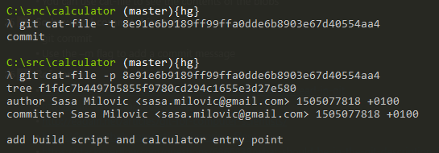
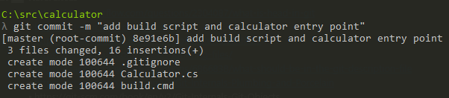

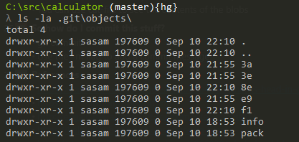
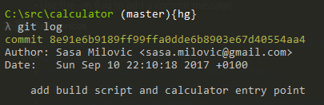
So how do I commit this stuff?
git commit
Use the –m flag to add a commit message

Slide 38
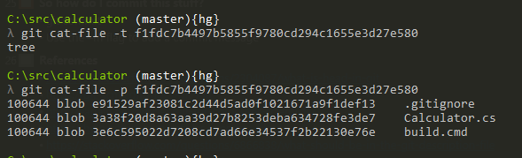

Slide 39
So how do I share this so other people can help?
Lets create a central repo that we all sync with
Lets use github for this! (at asos we would use TFS)

Slide 40
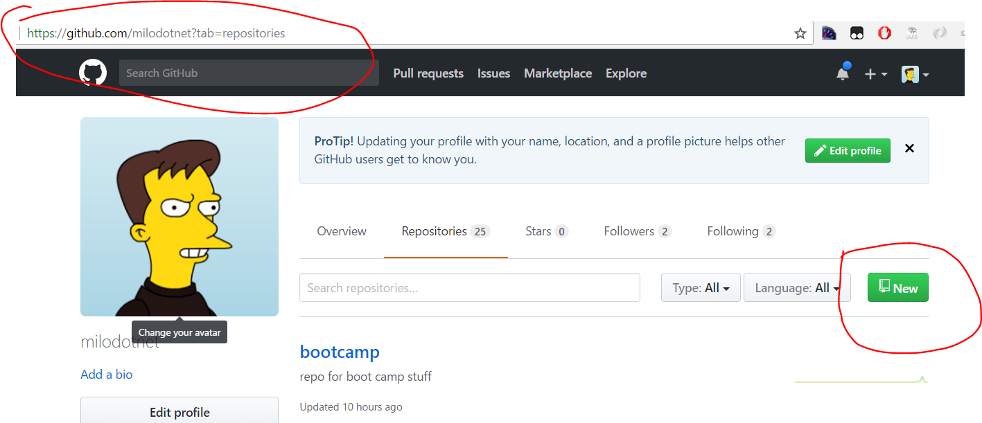

Slide 41
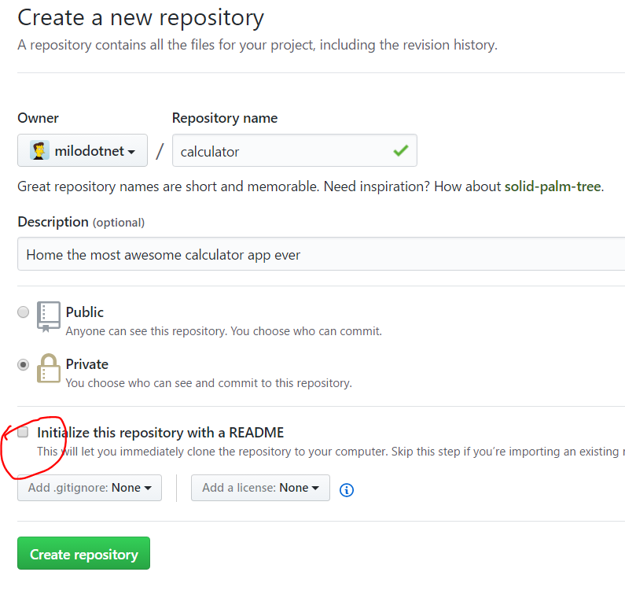

Slide 42
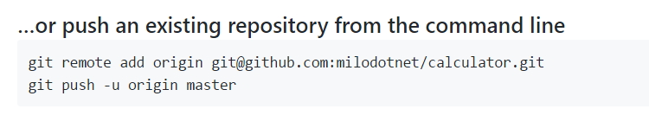
Add a remote!
Create a remote, called origin, that points to git@github.com:milodotnet/calculator.git
Push the commits from my local repo to the remote, and set it as the upstream (-u) – this sets this as the remote upstream for argumentless commands (e.g. git pull), origin gives the name of the remote, and master the name of the branch

Slide 43
Lets start collaborating
Split into groups of two
Your task is to add two operations to the calculator program, add and subtract
You each want to build one of these operations

Slide 44
References
https://en.wikipedia.org/wiki/Version_control
https://en.wikipedia.org/wiki/Source_Code_Control_System
https://en.wikipedia.org/wiki/Interleaved_deltas
http://docs.oracle.com/cd/E19504-01/802-5880/6i9k05dhp/index.html
https://en.wikipedia.org/wiki/Concurrent_Versions_System
https://simpleprogrammer.com/2017/01/16/software-developers-know-source-control/

Slide 45
References
https://stackoverflow.com/questions/2304087/what-is-head-in-git
https://git-scm.com/docs/git-init
http://eagain.net/articles/git-for-computer-scientists/
https://help.github.com/articles/ignoring-files/
https://stackoverflow.com/questions/6866838/what-should-be-in-the-git-description-file
https://git-scm.com/book/en/v2/Git-Internals-Plumbing-and-Porcelain
https://git-scm.com/book/en/v2/Git-Internals-Git-Objects
https://git-scm.com/book/gr/v2/Customizing-Git-Git-Hooks
https://git-scm.com/book/en/v2/Git-Internals-Git-References
https://git-scm.com/docs/git-push

