Slide 1
Continuous Delivery
Part I

Slide 2


Who we are
discounts
Orders Management
Pablo Rodriguez
Lewis Jackson
vouchers
stock
payments
…
Notes:
Platform orchestrating the lifecycle of an order
We are in charge of the microservices that conform this “monster”
Some numbers: num of people in the team, num of services, avg num of deployments per day (any env)

Slide 3
The problem of delivering software
The most important problem that we face as software professionals
If somebody thinks of a good idea, how do we deliver it to users as quickly as possible?
Notes:
Until now you’ve heard about:
Design patterns and architectures
Testing strategies
Agile methodologies and techniques
But…
What happens once requirements are identified, solutions designed, developed, and tested?
How do we join everything, and everybody (devs, QAs, ops) to work together effectively

Slide 4


Slide 5
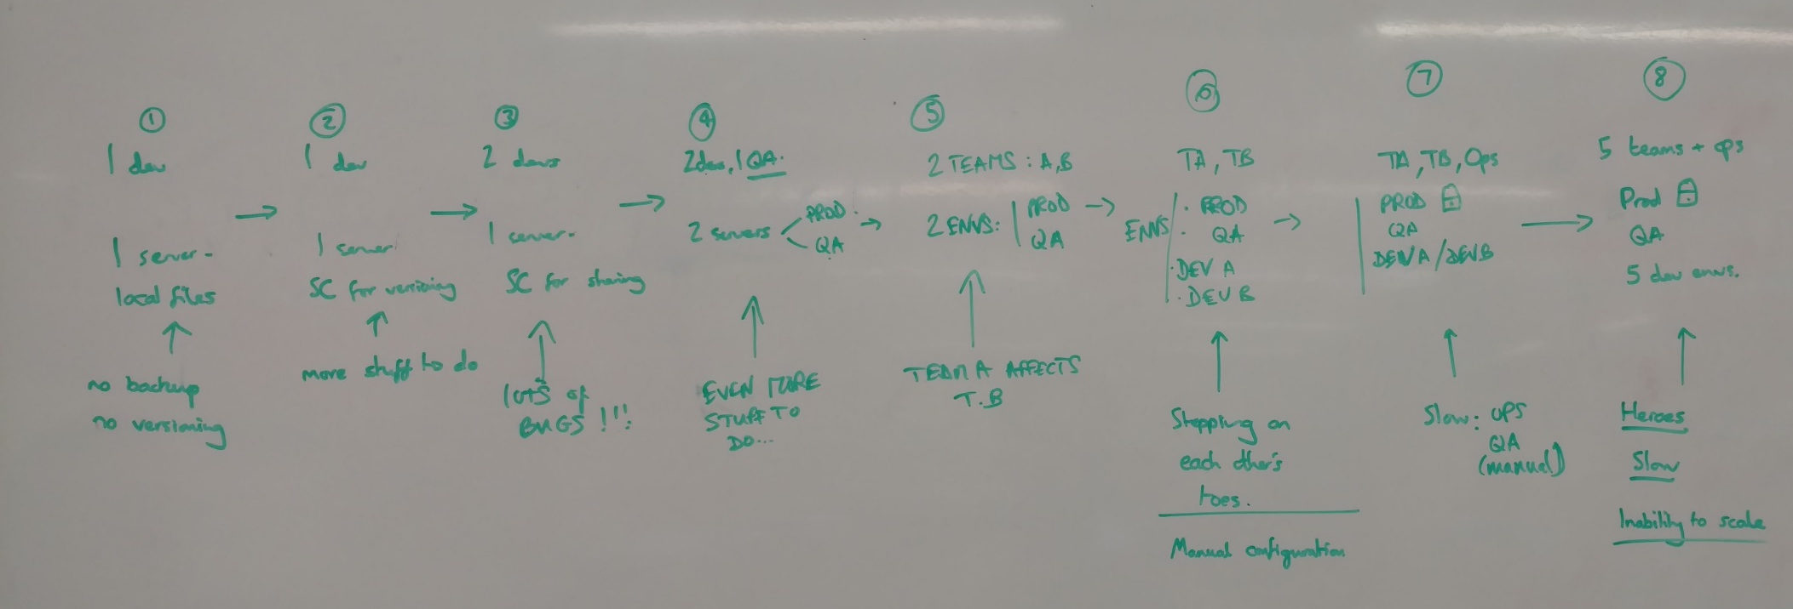
The story of a company… from Tim, with, a laptop and an idea to 100 teams…
(It could be ASOS, could be not…)
illusions
drama
Notes:
Introduce the concepts of
Manual deployments
Deploying to a Production-like Environment Only after Development Is Complete
Manual Configuration Management of Environments
Scatter the problems each of these present all along the story

Slide 6
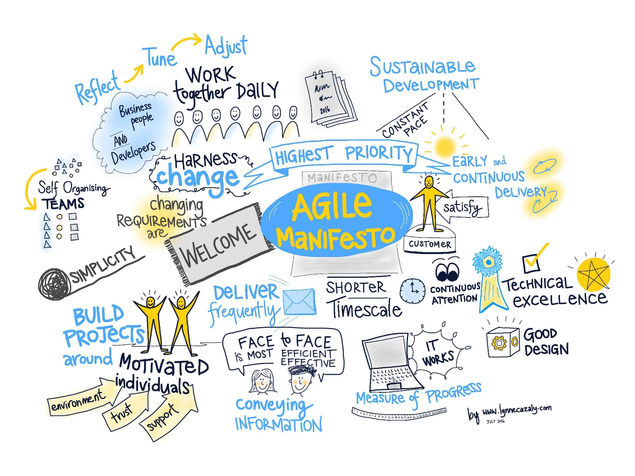
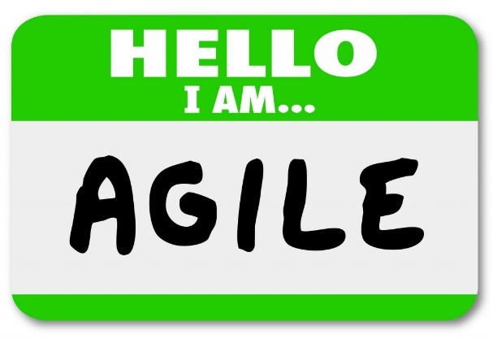
Notes:
Now, let’s talk about agile…

Slide 7
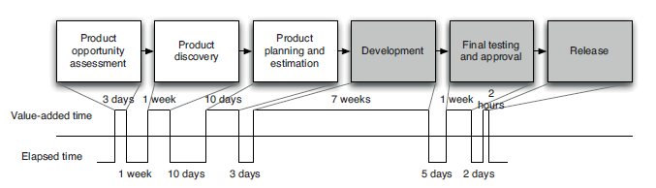
Traditional value stream map for a feature or product
Notes:
Traditional lifecycle of a feature/product

Slide 8
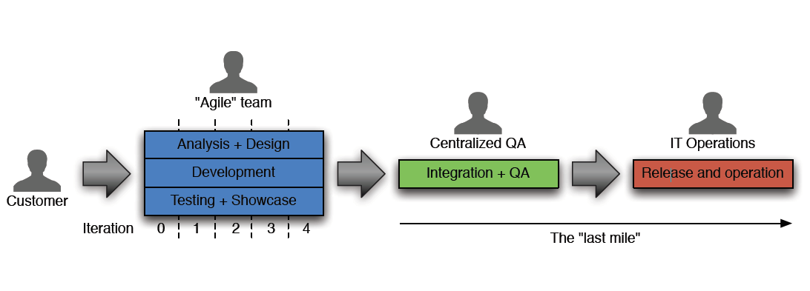
Traditional value stream map for a feature or product

Slide 9
Traditional value stream map for a feature or product
Notes:
Agile methodologies applied only to the development phase result in that we iterate, yes… to some extent

Slide 10
Traditional value stream map for a feature or product
10 weeks
Notes:
But problems usually arise here. Operations hasn’t developed the code, they struggle to support it
Until the code is deployed, we have provided NO value
It’s accessible to nobody, and we don’t know if it actually works where we want it to work: the Production environment
- Heavy load
- Restrictive conditions
- Real customers interacting with it
- 3rd party dependencies
The life of the product/feature starts at this point, it doesn’t end here

Slide 11
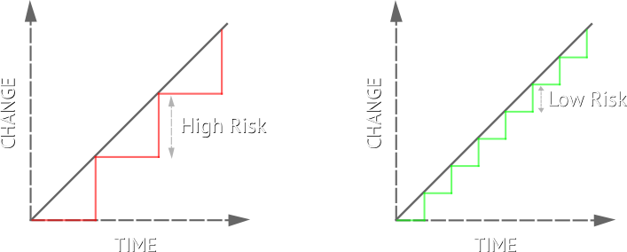

Risk
Deployment
Install a version of the software in an environment
Release
Make a version of the software available to the public
Traditional way: 1 deployment = 1 release
Notes:
What’s less risky?
A deployment every 2 months with 200 commits with code changes
A deployment every hour with 1 commit with code changes
In case there’s a problem: technical or operational, in which one we’ll be able to spot where the problem is and revert it or apply a solution

Slide 12
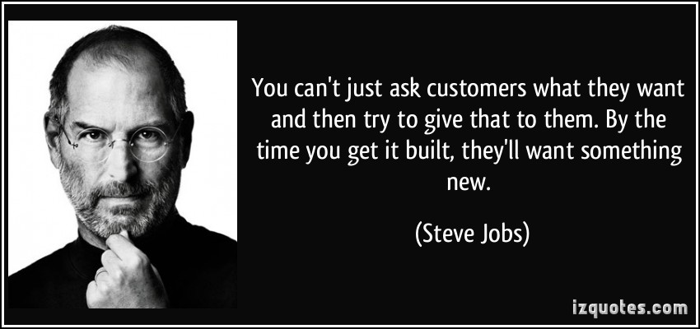
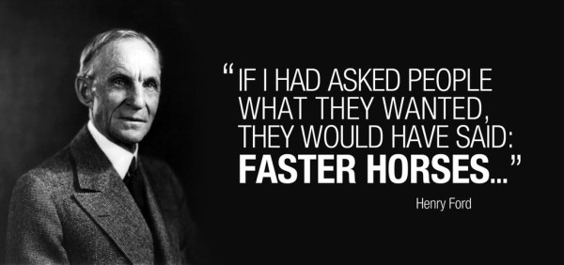
Problems are not only technical
How to build the right thing?
Agile manifesto
Responding to change over following a plan

Slide 13
Continuous delivery
Software always production ready
Releases tied to business needs, not
operational constraints
Work out what the smallest possible amount of work you can do to test your idea, get feedback, and... repeat
Notes:
Eternal business complaint: IT is slow
Customers not necessarily end-users: example of our client -> MyAccount team
MVP:
Work out what the smallest possible amount of work you can do to test your idea, prove your point, get feedback, and... repeat

Slide 14
Make the whole cycle an iteration: feedback loop
Build
Test
Release
Measure
Adapt
Notes:
We want to go round this loop:
Build
Test
Release
Measure: get real data from customer, by experimenting on them, not by asking them
And then with all that information, decide what’s next
We want to optimise our software delivery process to reduce the time on this loop: lead time

Slide 15
“How long would it take your organization to deploy a change that involved just one single line of code?

Slide 16
Production ready
We want…
Fast, automated feedback on the production readiness of the applications every time there is a change in:
Code
Infrastructure
Configuration
Deploy N times
Release by simply “enabling a flag”
Notes:
Continuous Delivery takes Agile to its logical conclusion, creating software that is always ready to release

Slide 17
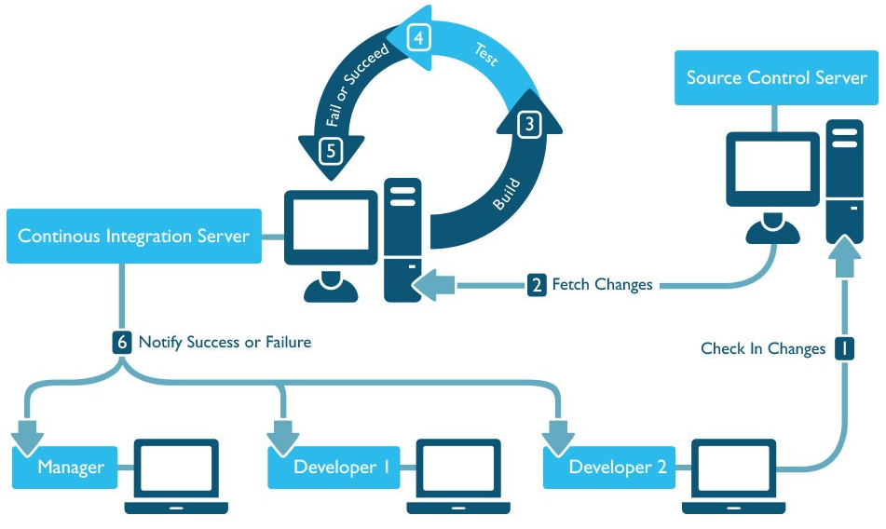
Practices Continuous Integration
Notes:
Continuous Integration (CI) is a development practice that requires developers to integrate code into a shared repository
several times a day.
Each check-in or commit is then verified by an automated process, called “build”, that confirms whether the commit is OK or not, allowing teams to detect problems early and react to them

Slide 18

& demo
Continuous Integration with Team City

