Slide 1
Continuous Delivery
Part I
Notes:
We are going to talk about continuous delivery
We are going to split the topic into 2 sessions: one today, and another one next Friday
- Today we’ll start with some theory now
Then a break and a hands-on session

Slide 2


Who we are
discounts
vouchers
Orders Management
Pablo Rodriguez
Lewis Jackson
payments
stock
…
Notes:
First of all, the introduction
We are in charge of the services that form part of the platform orchestrating the lifecycle of an order, from the moment an orders is “placed” from the checkout to the point where it’s dispatched to the warehouse systems.
Our team in numbers:
20 members in one single team, 20+ micro services, 30+ deployments per day (any env), several releases to Production per week
Why are we here telling you about continuous delivery?
Because If we weren’t following the continuous delivery principles, none of this would be possible

Slide 3
The problem of delivering software
The most important problem that we face as software professionals
If somebody thinks of a good idea, how do we deliver it to users as quickly as possible?
Notes:
First of all, let’s start with the problem
Until now you’ve heard about:
Design patterns and architectures
Testing strategies
Agile methodologies and techniques
But…
What happens once requirements are identified, solutions designed, developed, and tested?
How do we join everything, and everybody (devs, QAs, ops) to work together effectively

Slide 4

Notes:
To introduce you to the problem we are going to tell you a story first

Slide 5

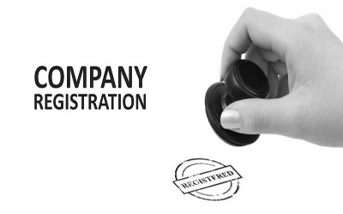
1 idea

Slide 6
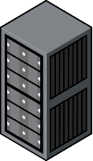

1 developer
1 server (for everything)
1 local folder
Notes:
PROBLEMS:
No backups
No versioning

Slide 7

1 developer
1 server (for everything)
1 source control
Notes:
PROBLEMS:
More stuff to do, need more hands

Slide 8
3 devs
1 server (for everything)
1 source control
Notes:
PROBLEMS:
They start having lot’s of bugs and they don’t know why…

Slide 9
3 devs
1 QA
1 prod server
(accessible to devs)
1 test server
1 source control
Notes:
So they get a QA to help them with the testing strategies
And the QA brings with him the idea of a test environment
So now we have the concept of “environments”. The server they were using all the time until now was “Production”, they just didn’t know
And the QA says that before going to Prod, the release has to go to the test environment, where he’ll run some regression tests
Now -> Number of bugs reduced
But… there’s more stuff to do, they need more hands

Slide 10
2 teams: red & green
1 prod server
(accessible to devs)
1 test server
1 source control
Notes:
Red and green team want to try out new things with the server (the only one) without affecting each other

Slide 11

2 teams: red & green
2 dev servers
2 test server
1 prod server
(still accessible to devs)
1 source control
Notes:
The red team makes their change and push it all the way up to Prod and it works
The green team does the same, and since the change doesn’t clash with the other team’s changes, it works fine as well
But both teams are making changes in the environments manually
The process is not easily reproducible, requires “experts”
Pressure to finish more features
So they are not keeping the environments in sync
The teams only test their changes in a production-like environment… when they get to production
“This ain’t gonna end well…”

Slide 12

2 teams: red & green
2 dev servers
2 test server
1 prod server
(still accessible to devs)
1 source control
Notes:
Read team introduce a change in the system that clashes with what the other team has
The earliest integration point between both teams is Production, so this is the environment that blows up

Slide 13

Notes:
Since the configuration and the deployment process has been handled manually all this time, reverting to a previous stable point is very costly and time consuming
Downtime for the application, and pain for both teams to fix the mess
So after a long weekend working until late in the night the company decides that the platform needs stability

Slide 14

2 feature teams
1 ops team
2 dev servers
2 test server
1 prod server
(only accessible to Ops)
1 source control
Notes:
So they hire “operations” people, to be in charge of the deployments and monitoring of production
And they block the access to Production to everybody but “Ops”
Stability is restored, but now the process is way slower than before

Slide 15
4 feature teams
1 ops team
4 dev servers
4 test server
1 prod server
(only accessible to Ops)
1 source control
Notes:
The solution the companies find is always the same… throw more people. Problem solved. Right?
Problem, the more people, the bigger and more complex the platform, the codebase and the deployment process.
Ops people have now deployment scripts with hundreds of steps
Remember that all these environments are still being manually configured, so the differences between what each team has are becoming nearly impossible to manually handle

Slide 16
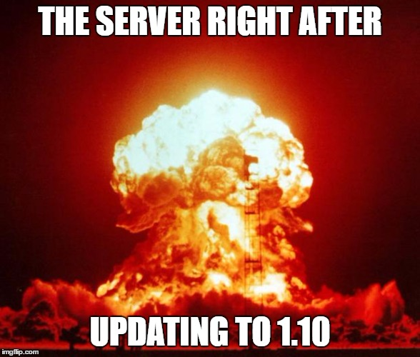
Notes:
Ops people miss one of the steps in the, now long, deployment process.
Or there were two changes from 2 teams, in the batch of 10 changes to release today, that clashed
Now the consequences and the downtime are even worse

Slide 17
4 feature teams
1 ops team
1 rel management team
4 dev servers
4 test server
1 prod server
(only accessible to Ops)
1 source control
Notes:
So the company hires Release Managers, to coordinate the releases and the dependencies between them
This makes the process slower again
So what does the company to go faster?
Again, throw more people at the problem
The result? The codebase is now huge, also the differences between environments, the deployment process has now many many steps that have to be done in rigorous order…
Release managers try to deal with the risk, but as dependencies get bigger, the slots to go to Prod with a release become more strict

Slide 18
4 feature teams
1 ops team
1 rel management team
4 dev servers
4 test server
1 prod server
(only accessible to Ops)
1 source control
Notes:
So the company hires Release Managers, to coordinate the releases and the dependencies between them
This makes the process slower again
So what does the company to go faster?
Again, throw more people at the problem
The result? The codebase is now huge, also the differences between environments, the deployment process has now many many steps that have to be done in rigorous order…
Release managers try to deal with the risk, but as dependencies get bigger, the slots to go to Prod with a release become more strict

Slide 19

50 feature teams
1 release = 3 months

Slide 20
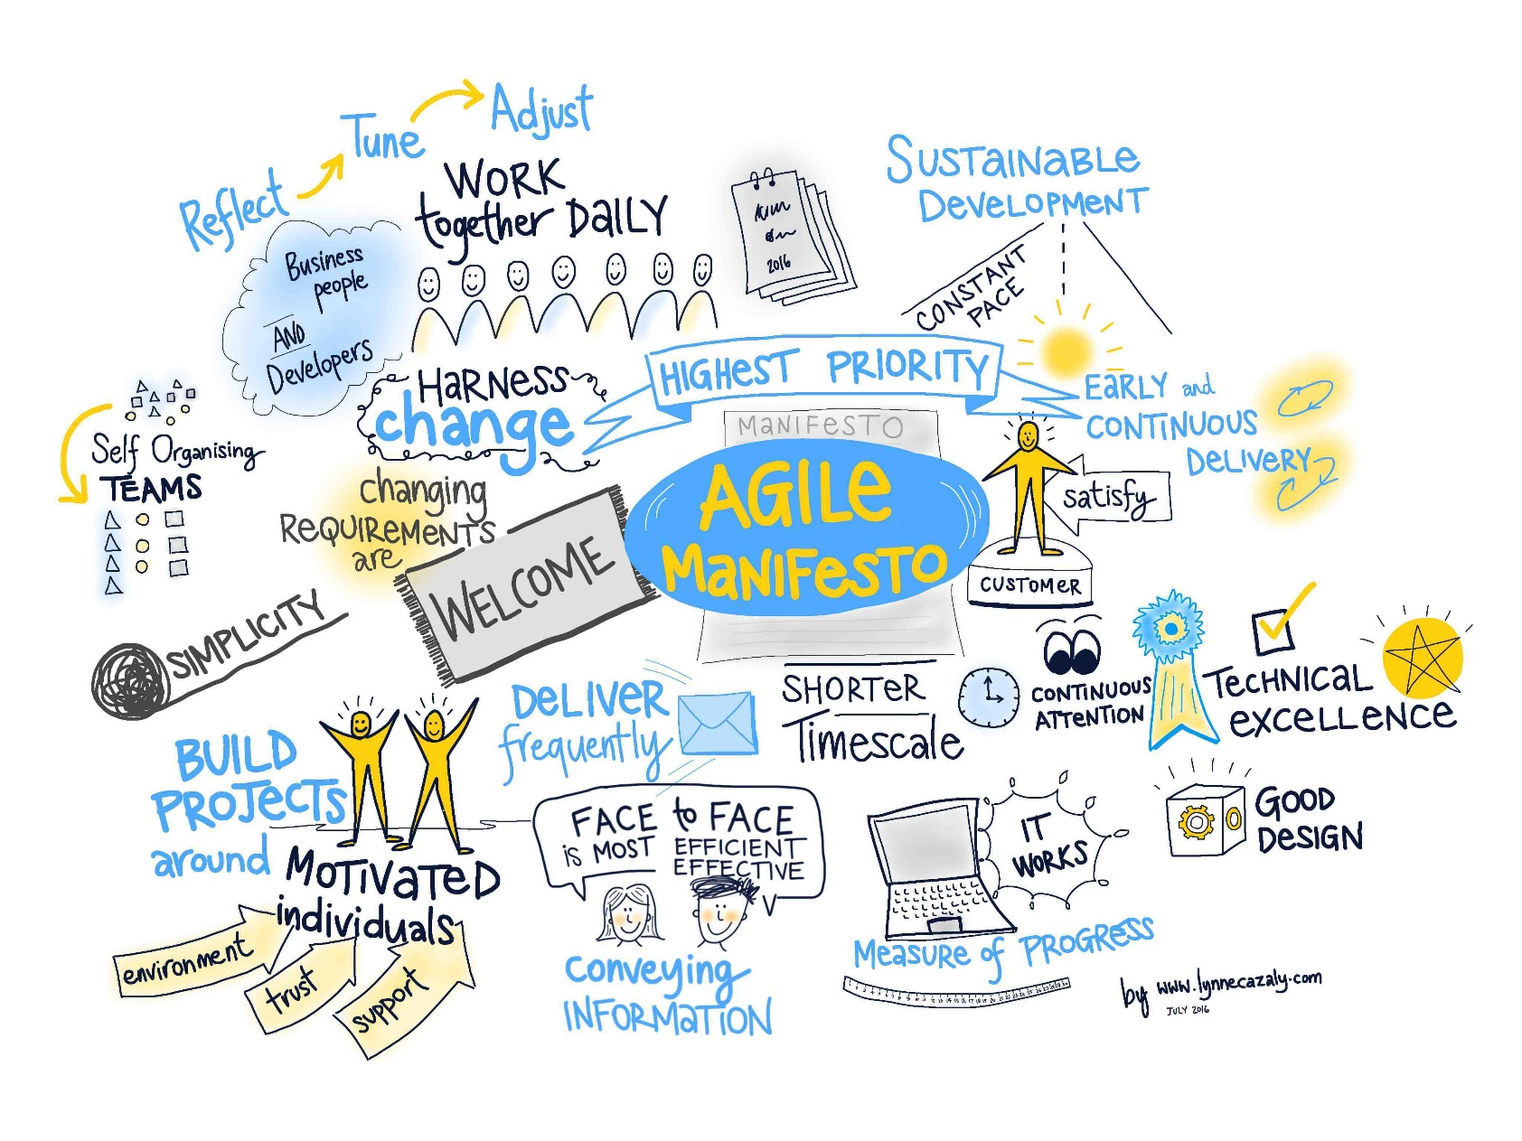
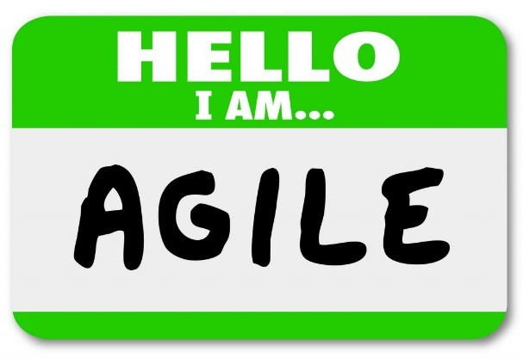
Notes:
Now, let’s talk about agile…
You’ve been taught many agile techniques these days: how to coordinate in teams, how to plan the work, how to build a healthy team culture…
But without the continuous delivery ideas and techniques, you are missing a piece of the puzzle.
The agile manifesto says:
Customer collaboration over contract negotiation
Responding to change over following a plan
To do that I need to be able to release my software in the shortest time possible, and very frequently.
How to “technically” do it is what we’ll see in these sessions

Slide 21
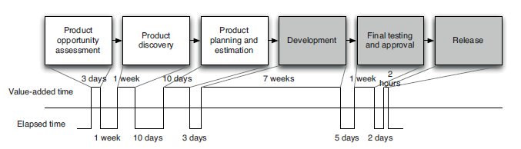
Traditional value stream map for a feature or product
Notes:
Traditional lifecycle of a feature/product

Slide 22
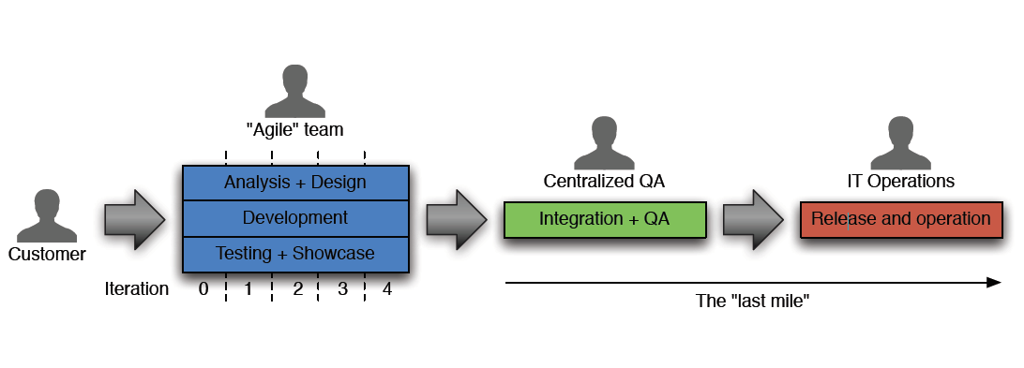
Traditional value stream map for a feature or product

Slide 23
Traditional value stream map for a feature or product
Notes:
Agile methodologies applied only to the development phase result in that we iterate, yes… to some extent

Slide 24
Traditional value stream map for a feature or product
Notes:
But problems usually arise here. Operations hasn’t developed the code, they struggle to support it
Until the code is deployed, we have provided NO value
It’s accessible to nobody, and we don’t know if it actually works where we want it to work: the Production environment
- Heavy load
- Restrictive conditions
- Real customers interacting with it
- 3rd party dependencies
The life of the product/feature starts at this point, it doesn’t end here

Slide 25
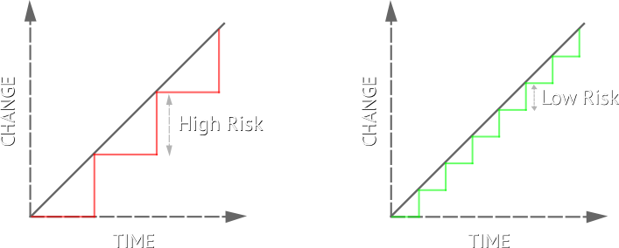

Risk
Deployment
Install a version of the software in an environment
Release
Make a version of the software available to the public
Traditional way: 1 deployment = 1 release
Notes:
What’s less risky?
A deployment every 2 months with 200 commits with code changes
A deployment every hour with 1 commit with code changes
In case there’s a problem: technical or operational, in which one we’ll be able to spot where the problem is and revert it or apply a solution

Slide 26
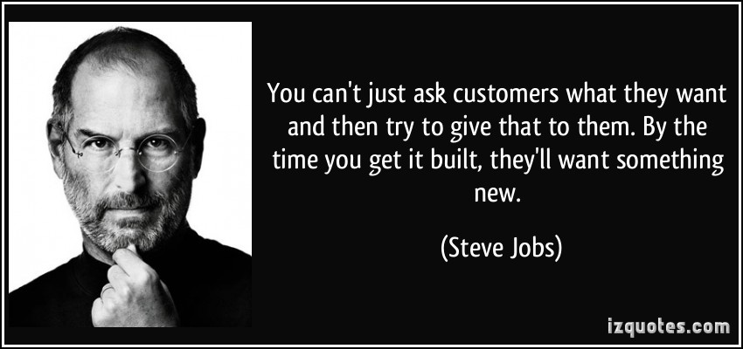
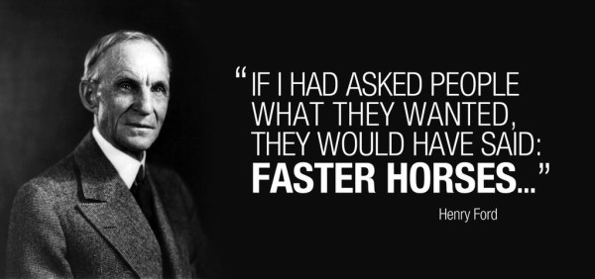
Problems are not only technical
How to build the right thing?
Agile manifesto
Responding to change over following a plan

Slide 27
Continuous delivery (i)
Shorten lead time
10 weeks
Notes:
Eternal business complaint: IT is slow
Customers not necessarily end-users: example of our client -> MyAccount team
Remember that until the code is deployed to the Production environement, we have provided NO value
The problem then is the lead time (“from concept to production”) is too big

Slide 28
Continuous delivery (i)
< 1 week
Shorten lead time
Make the whole cycle an iteration feedback loop
Build
Test
Release
Measure
Adapt
Notes:
What we have to do is taking this whole cycle, and making it an iteration, a loop
We want to go round this loop:
Build
Test
Release
Measure: get real data from customer, by experimenting on them, not by asking them
And then with all that information, decide what’s next
We want to optimise our software delivery process to reduce the time on this loop: lead time
The only way is to repeat it, over and over, iterating and improving it

Slide 29
Continuous delivery (ii)
We want…
Fast, automated feedback on the production readiness of the applications every time there is a change in:
Code
Infrastructure
Configuration
Deploy N times
Release by simply “enabling a flag”
Software always production ready
Releases tied to business needs, not
operational constraints
Notes:
Continuous Delivery takes Agile to its logical conclusion, creating software that is always ready to release

Slide 30
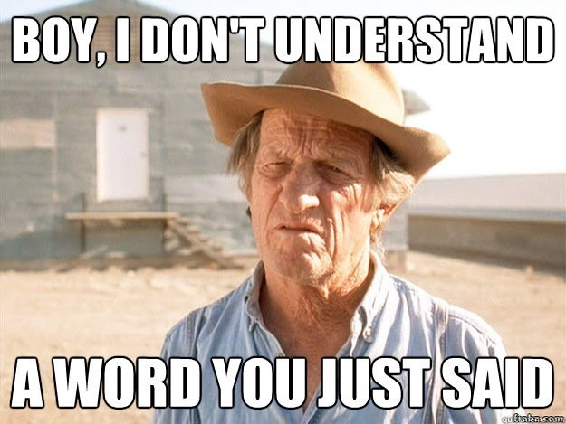
Notes:
So how do we do all this?

Slide 31
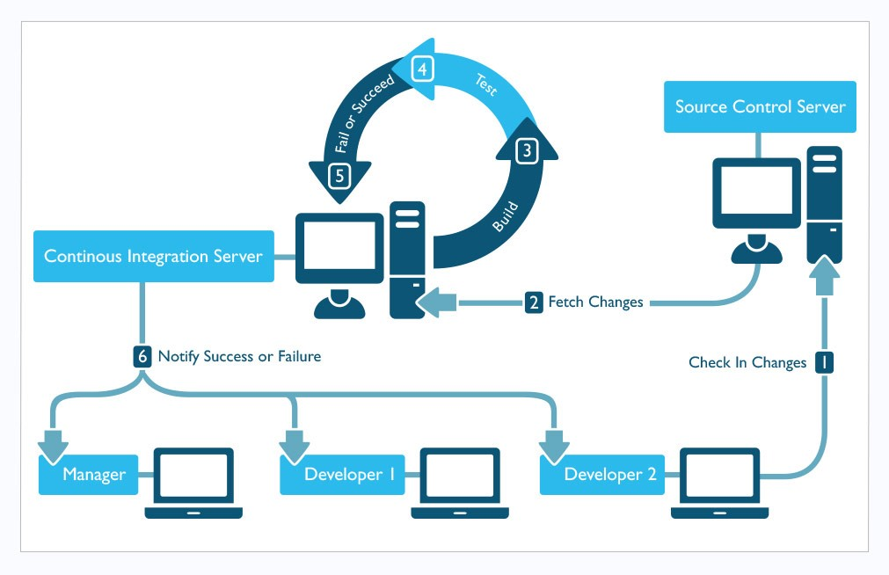
Practices (i) Continuous Integration
refs/heads/master
1a410e
Notes:
Continuous Integration (CI) is a development practice that requires developers to integrate code into a shared repository (like git -> the remote server, not the local one)
several times a day.

Slide 32
Practices (i) Continuous Integration
refs/heads/master
1a410e
refs/heads/master
1a410e
Notes:
Each check-in or commit is then captured by a CI server connected to the source control
In the case of ASOS, the CI server is Team City
The CI server fetches the contents of the commit

Slide 33
Practices (i) Continuous Integration
Unit Tests
Integration Tests
Acceptance Tests
#1.0.1
refs/heads/master
1a410e
refs/heads/master
1a410e
Notes:
That automatically triggers a process called “build” on the CI server
This process is associated to that particular commit and will define one version of our application, with a version number
In this process we define a series of steps, meant to confirm whether this version of the application (in this case, let’s say that for the commit 1a410e it’s the #1.0.1) is OK o not
These steps are commonly called CI pipeline
The steps that we’ll usually see are:
Compilation (restoring all the dependencies on 3rd party libraries that our application may have)
Automated execution of tests: in the order that gives us faster feedback in case of failure
UT -> quicker
IT -> slower
AT -> slowest
Package version of the application, minify the files (javascript)
Publish results

Slide 34
Practices (i) Continuous Integration
Unit Tests
Integration Tests
Acceptance Tests
#1.0.1
refs/heads/master
1a410e
fail
refs/heads/master
1a410e
Notes:
Let’s imagine that the Unit Tests pass, but the Integration Tests fail, because there’s something wrong with the way we communicate with the DB in the code
The Acceptance Tests won’t even execute, there’s no point in doing it
At this point all the team is notified that the build is “broken”, and what they need to do asap is fix it.
IMPORTANT: You don’t commit anything on a broken build (it only makes the problem harder to fix)

Slide 35
Practices (i) Continuous Integration
Unit Tests
Integration Tests
Acceptance Tests
#1.0.2
#1.0.1
refs/heads/master
fdf4fc
success
refs/heads/master
fdf4fc
Notes:
We fix the problem in the code
Make the tests pass locally and commit them
Push the code the git remote
A new version is created: #1.0.2
The tests pass on the build now, and the CI server confirm everybody that there’s a new version ready to deploy
And that’s is essentially what we mean by “continuous integration”

Slide 36
Practices (ii)
Deployment Pipeline
Build / Test / Package
Deploy to Dev
Deploy to Integration
Deploy to Perf
Deploy to Prod
Configuration Management
External dependencies
Application configuration
Environments
Secrets
Notes:
The next essential practices that you need to do to accomplish the goal of continuous delivery are:
Defining a deployment pipeline
Defining a configuration management strategy
We’ll see these 2 in detail in the next session (Friday), but as a summary…
A deployment pipeline is basically taking the continuous integration and extending it until the end.
It’s the whole automated process for getting software from the source control into the hands of your users
Configuration management is the process by which all artefacts relevant to your software are stored and handled:
External dependencies
Application configuration
Environments
Secrets (private information like passwords, connection strings, keys, etc.)
The goal is to answer “yes” to these questions:
• Could you completely re-create your production system from what you have in the source-control?
• Could you regress to an earlier state of your application?
• Can you be sure that each environment (production, staging, test) is set up in exactly the same way?

Slide 37

& demo
Continuous Integration with Team City

Slide 38
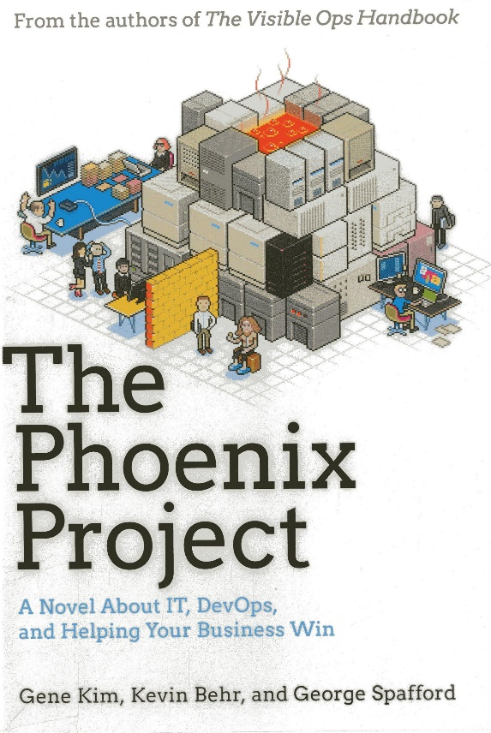
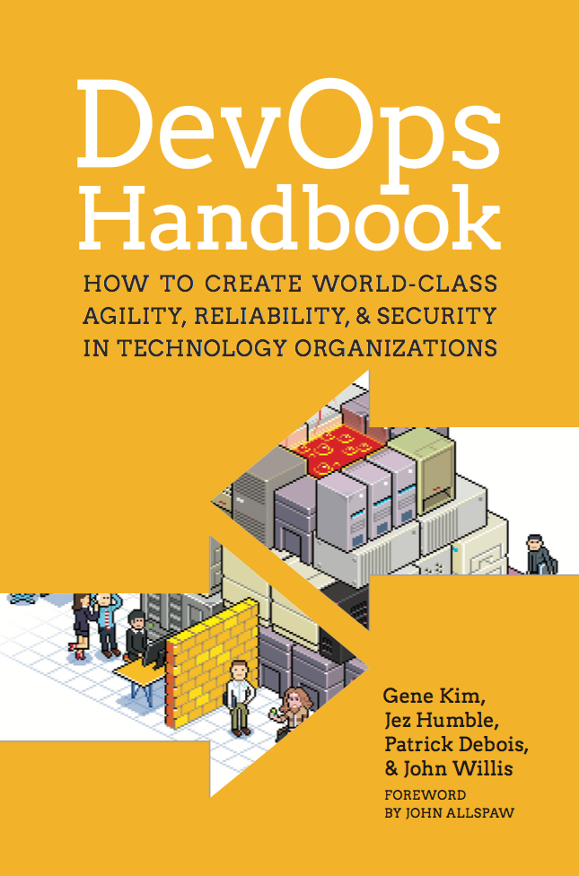
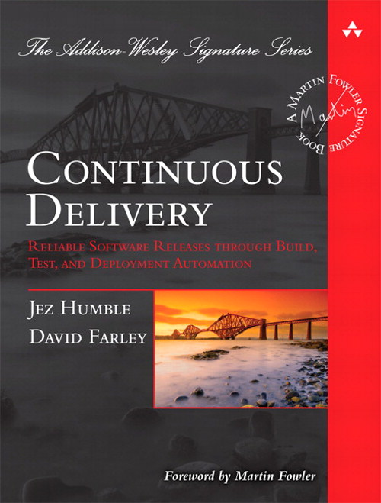
Further reading

