Slide 1
Source Control Fundamentals

Slide 2
Some code to use for context
We will use a hypothetical calculator app for the basis of discussing source control and what problems it solves.

Slide 3

Worlds simplest build script
Create a file called build.cmd
You might want to add the csc.exe to your path
Set PATH=%PATH%;c:\Windows\Microsoft.NET\Framework\v4.0.30319

Slide 4
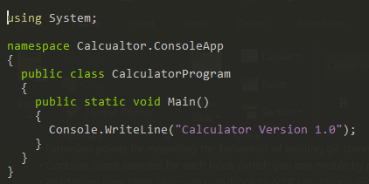
Worlds simplest example
Create a cs file called Calculator.cs

Slide 5
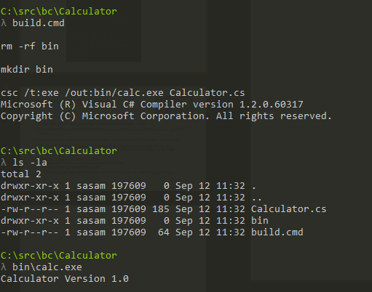
Run it

Slide 6

Imagine the following
It’s the 70s
Your calculator app is going to be sold on floppy disks
You might have several version of your software at clients at any point in time
You intend to support and maintain all versions for the next few years
You have a team of several people that might need to work on the calculator program at the same time

Slide 7
Problems to solver
Have a history of who did what
Be able to go back to an earlier version of the code in case things go wrong
Multiple Version with potentially
Conflicting changes
Promote common changes across all versions

Slide 8
Ideas?

Slide 9
Definition of Source Control / Version Control
A component of software configuration management, version control, also known as revision control or source control, is the management of changes to documents, computer programs, large web sites, and other collections of information.

Slide 10
Similar problems exist outside of software
Engineering revision control developed from formalized processes based on tracking revisions of early allowing returning to any earlier state of the design, for cases in which an engineering dead-end was reached.
Version control is widespread in business and law. Indeed, "contract redline" and "legal blackline" are some of the earliest forms of revision control.

Slide 11
What problem does VC solve for software?
Allows multiple developers to collaborate on the same code base by
Providing a mechanism to centrally store code
Retrieve and modify the code
Providing a readable audit of how the code has changed
Providing a mechanism to deal with multiple parties changing the same files
Providing a way to return to a previous state
Different products tackle these in differing ways.

Slide 12
Quick History of Source Control Software
In the beginning…
Constraints and Conditions at that point in time
Storage was expensive
Software got distributed on floppy disks
Multiple versions are supported at the same time

Slide 13
Quick History of Source Control Software
1st Gen - SCCS (1972) RCS (1982)
Designed to solve a specific set of problems
Source code takes up too much space because it is repeated in every version.
Passing fixes from one version to other versions is difficult.
It is hard to acquire information about when and where changes occurred.
Finding the exact version which the client has problems with is difficult.

Slide 14
Quick History of Source Control Software
Typical implementations
Lock based -You lock a file while you are working on it
Deltas – stores files in a space efficient manner by only storing the parts that have changed using a method called Interleaved deltas

Slide 15
Using git like it’s 1972
Lets create a local git repo to see how we could solve some of our 1970s problems
Install git for windows
Easy way is to download Cmder portable
https://github.com/cmderdev/cmder/releases

Slide 16

Lets create a repository
Open a console
Go to the calculator directory
Run git init

Slide 17
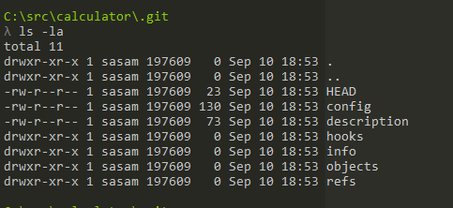
What did that do?
Creates an empty git repo in the directory
If you run ls –la you can see a .git directory was created
If you do the same in the git directory you see gits repos internal files

Slide 18
What do all these things mean?
For now we will focus on the most important git concepts related to versioning files and directories
In order to understand these we need to discuss git objects

Slide 19
Git objects
Git is known as a content addressable file system
This is means it’s just a key value store
A key value store, when asked to store some value or object, gives you a key (a lookup value/reference) to use to later retrieve that object.
Git stores certain types of objects as values and these are important to understand

Slide 20
Git objects
Blob
File contents
Tree
Represents a directory and contents, has pointers to other trees and blobs
Trees are created using the index
Commit
A pointer to a tree (top level tree)
A pointer to previous commit
Some information about the commit (message, author, committer, timestamp)
git cat-file for the curious!
Pass it key (SHA1) value
switches
-p (prints contents)
-t describes the type

Slide 21
Adding my app to the source control
First try to describe for the calculator app, which objects you think will be stored by git when I commit v1 of my app?

Slide 22
Adding my app to the source control
2 Blobs
1 Tree
1 Commit

Slide 23
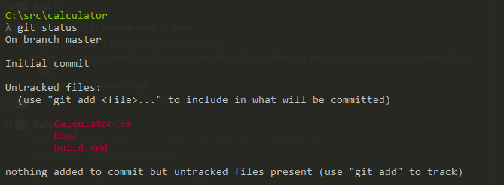
Adding my app to the source control
What stuff can I commit?
Git status – shows me the status of the current working copy
Should I commit the bin/ folder?

Slide 24
Checking in binaries
The answer is usually no
Why – it’s a transient thing that is the result of of compiling my program, so it’s gonna change all the time
Could manually add each file, but I’m way to lazy
How do I tell git to just ignore certain types of files or directories?
There are three ways!

Slide 25
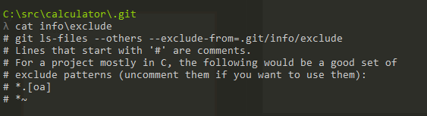
Excludes
If you remember earlier, in the .git dir there is an info directory
It contains a single file called excludes
Its’ about ignoring stuff
This does not get “checked in”

Slide 26
.gitignore file
A special file that tells git to ignore stuff
Global .gitignore
Not checked in
Setup by using gitconfig
git config –global core.excludesfile <path to ignore file>
Local .gitignore (local to repo, shared by everyone using the repo)

Slide 27
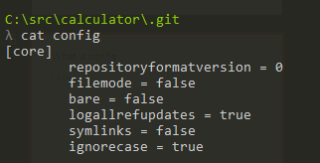
What is config
A file that contains configuration settings for the repo
There is also a global config

Slide 28
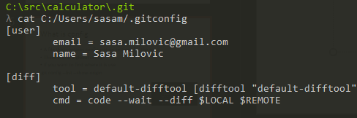
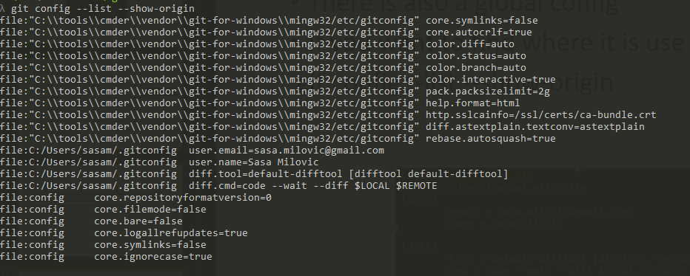
What is config
Git config –list shows all the config settings that are currently in scope
If you want to find where the different config values originate from you can use git config --list --show-origin

Slide 29
Which one?
Tell me which one and why?

Slide 30
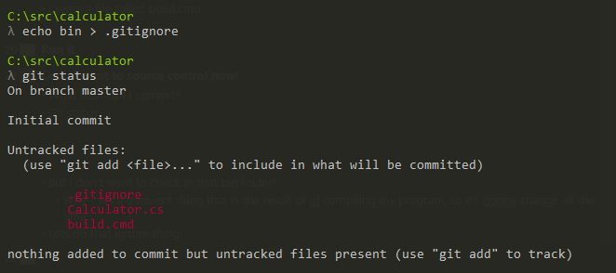
Which one?
Use a local .gitignore
Why – because it will always be relevant for this repo and I want it to exists even If restore a backup
Also when we leave the 70s it will make more sense

Slide 31
Ok so how do I create my commit/tree/blobs?
You first need to setup your index so the trees can be created
Although there are lower level commands we will skip to the simplest one, git add
In this case you just want to add everything to the index so use git add .
Check the status and green stuff means its staged in the index

Slide 32
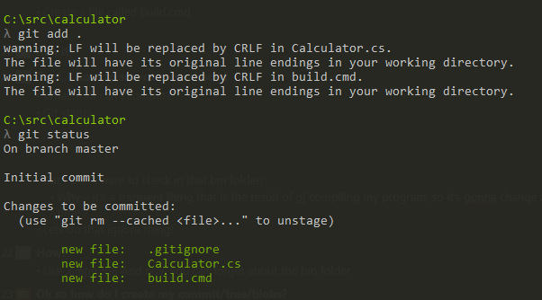
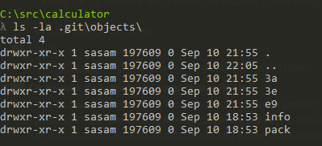
Staging the commit
You don’t have a commit or tree yet.
Add does create some objects (blob in this case)
You can use cat-file to see the contents of the blobs

Slide 33
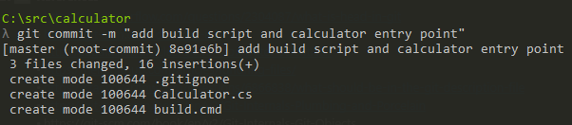
So how do I commit what I staged?
git commit
Use the –m flag to add a commit message

Slide 34

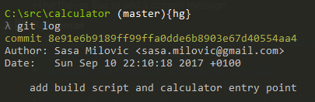
What now?
Git status
Git log – shows commits

Slide 35
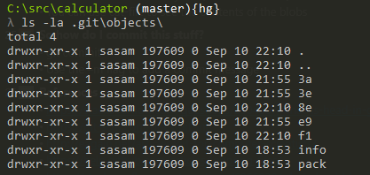


Digging deeper
Git cat-file
Figure out the key of the objects

Slide 36
Problems to solver
Have a history of who did what
Be able to go back to an earlier version of the code in case things go wrong
Multiple Version with potentially
Conflicting changes
Promote common changes across all versions

Slide 37
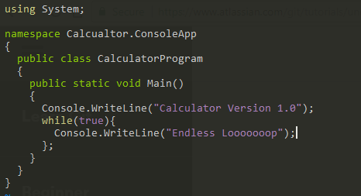
Going back when things go wrong

Slide 38

Commit your new feature
Commit this new feature, and when you view the log you should see two commits
To make the commits easier to read use --oneline

Slide 39

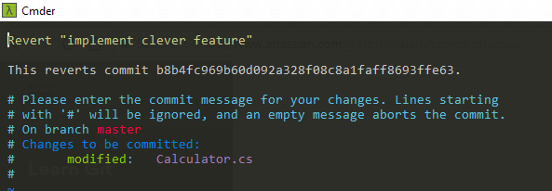


Lets fix this
Could edit the code and commit - or be lazy and let the VCS do it

Slide 40
Problems to solver
Have a history of who did what
Be able to go back to an earlier version of the code in case things go wrong
Multiple Version with potentially
Conflicting changes
Promote common changes across all versions

Slide 41
Branches?
Like as in a tree?
Or more like graph theory
Allows two (or more) parallel version of the files/software to exist at the same time
Usually changes need to be incorporated (merged) across branches

Slide 42
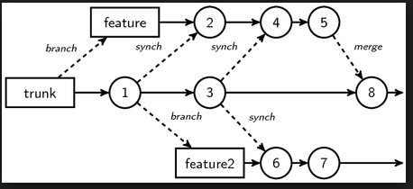
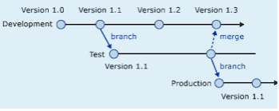
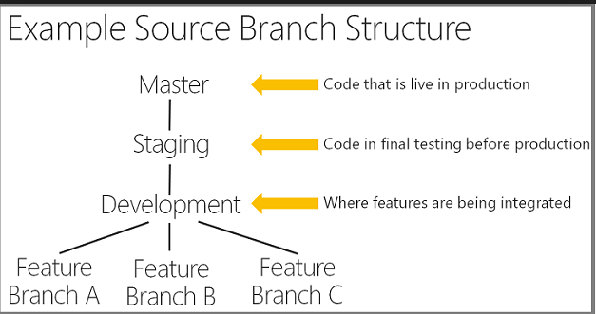
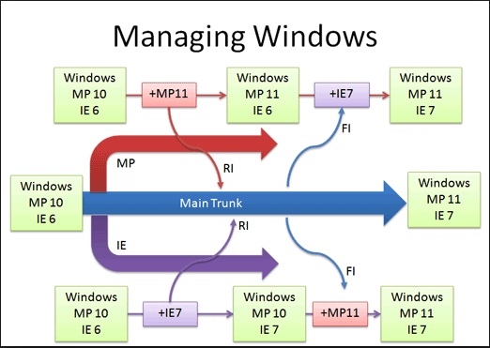
Branches?
Many different approaches and strategies
There should (and usually is) a specific reason for adopting a strategy and should always be justified
A topic to itself with plenty of differing opinions
Undeniable truths
They introduce complexity
The longer they exist and diverge, the harder the merge
(fondly referred to as merge parties)

Slide 43
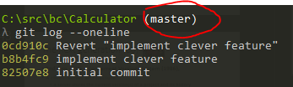
Git and Branches
You are already working on a branch called master
One of gits selling points is how it treats everything as branch which makes a little easier to work with them
This also helps explain some of the other things in the .git folder

Slide 44

What is HEAD - technical
Git refers to the current branch you are working on as HEAD
The file contains the details of the branch
A head is simply a reference to a commit object. Each head has a name (branch name or tag name, etc). By default, there is a head in every repository called master. A repository can contain any number of heads. At any given time, one head is selected as the “current head.” This head is aliased to HEAD, always in capitals".
Note this difference: a “head” (lowercase) refers to any one of the named heads in the repository; “HEAD” (uppercase) refers exclusively to the currently active head. This distinction is used frequently in Git documentation.

Slide 45
What is HEAD, simpler?
Its a file that contains
Simplified explanation – refs/heads/master
Something called a ref
Something called a head (which is a type of ref)
A head called master (heads have a name)
The head called master is currently HEAD (uppercase head represents a special head)
A head is also a branch

Slide 46
What is HEAD?
For now what really matter is to understand what master is
HEAD is currently referring to master which is the main branch of your repo.

Slide 47
A hypothetical branching model
Lets create a branch per version
Git branch <name>
(these are actually more correctly called forks)
Switch to the branch to update the version we print in Calculator.cs
Git checkout <name>
I’m lazy, there must be a faster way
git checkout –b <name>

Slide 48


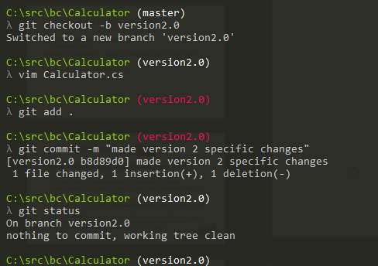
master
version1
version2

Slide 49
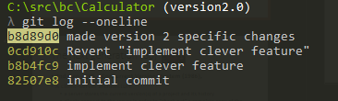
master
0cd910c
version1
b8d89d0
version2

Slide 50
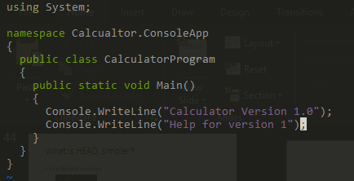
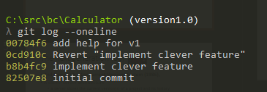
master
0cd910c
version2
b8d89d0
00784f6
version1

Slide 51
Problems to solver
Have a history of who did what
Be able to go back to an earlier version of the code in case things go wrong
Multiple Version with potentially
Conflicting changes
Promote common changes across all versions

Slide 52
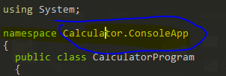
Lets fix that type in version 1 and 2
Fix in version 1, and merge to version 2?
Fix in master and merge to each version?
We will go with fix in master, then merge to specific versions

Slide 53
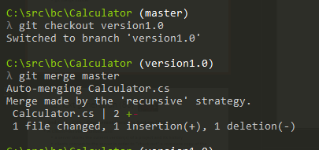
Merge to v1 and v2
Switch to each branch and do the following
git merge master

Slide 54
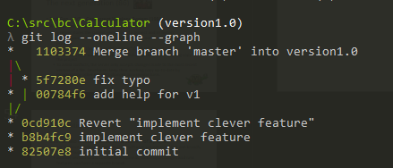
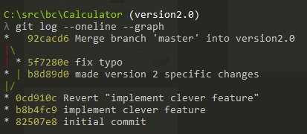
Merge to v1 and v2
Look at the log and add the –graph option

Slide 55
Problems to solver
Have a history of who did what
Be able to go back to an earlier version of the code in case things go wrong
Multiple Version with potentially
Conflicting changes
Promote common changes across all versions

Slide 56
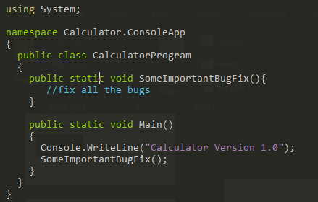
When conflict arises
In the master

Slide 57
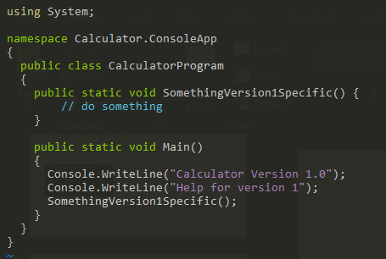
Meanwhile in version 1.0

Slide 58
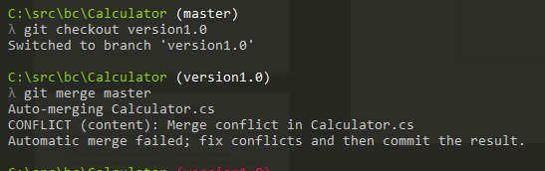
What happens when we merge?

Slide 59
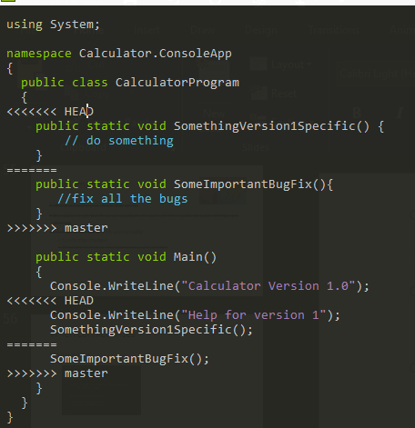
Lets open the file!

Slide 60


Merge party!
First thing you probably want a better diff tool
Since we are masochists we will use vimdiff
Configure it
Launch it

Slide 61
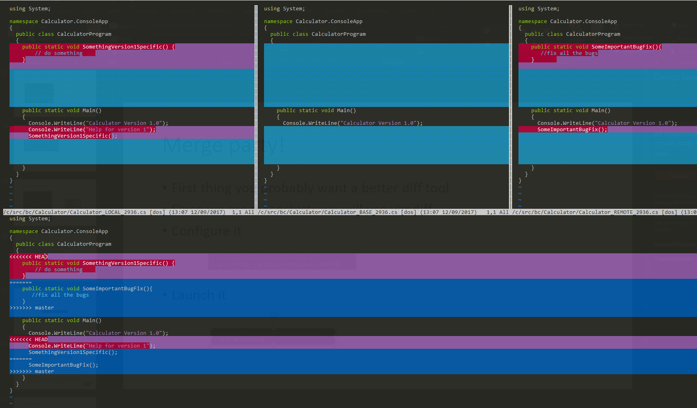
State before merge
(LOCAL)
State before either changed
(BASE)
State in master
(REMOTE)
Current state of the file

Slide 62
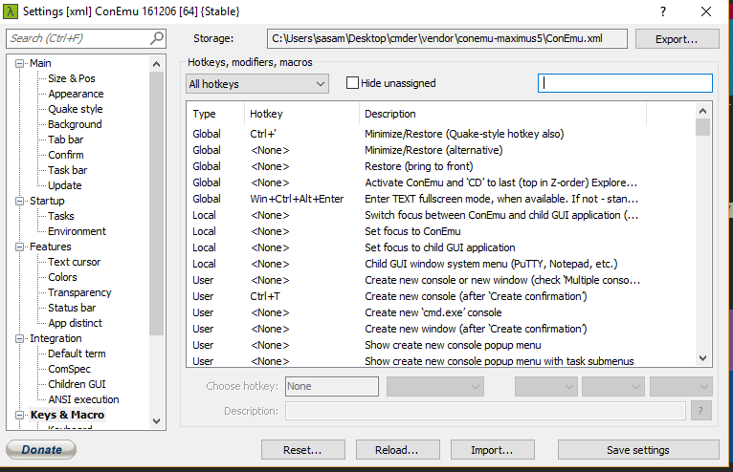
Lets play the merge game
Before we start, got to cmder settings and remove the short cut to ctrl+w

Slide 63
Lets play the merge game
]c move to next conflict
]c move backwards
:diffupdate refreshes the diff highlighting
CTRL+W+W move the cursor between buffers
diffget <bufferno/name> gets the contents of the diff from a specific buffer and uses to for the conflict in the current buffer
:y<lines> copies lines (known as yanking)
P pastes lines
:wqa to save and exit

Slide 64
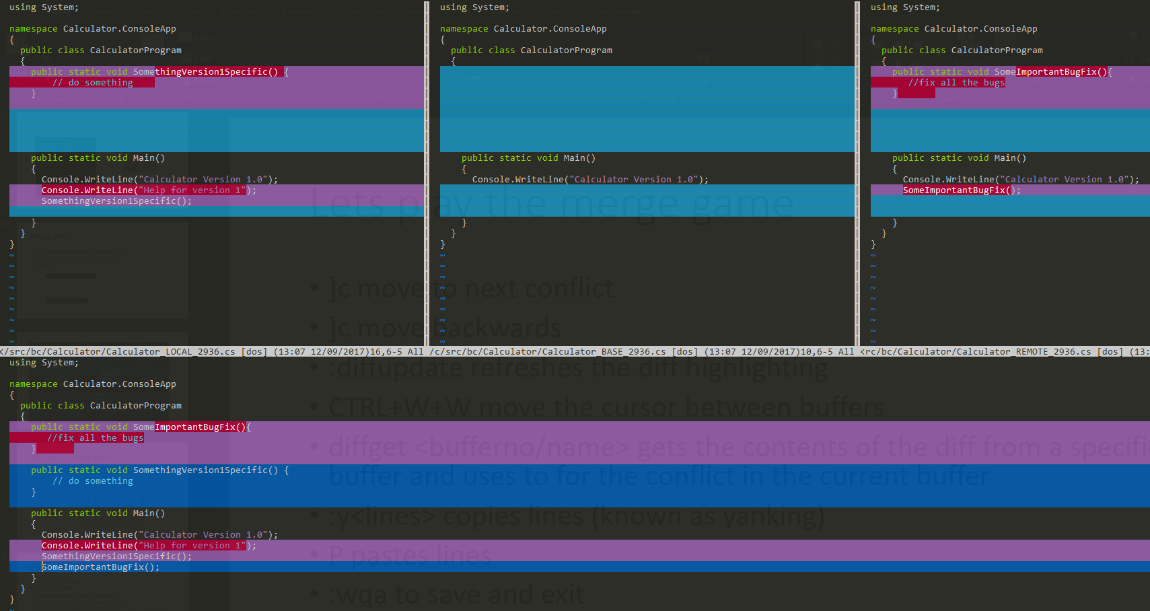

Slide 65
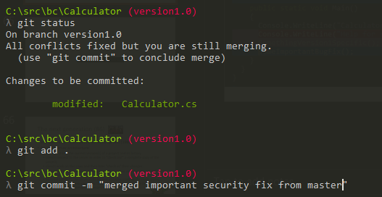
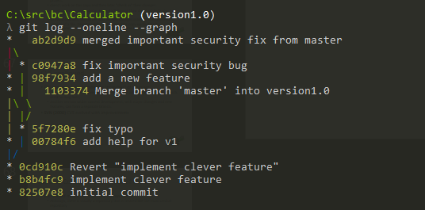
Commit the merge

Slide 66
Problems to solver
Have a history of who did what
Be able to go back to an earlier version of the code in case things go wrong
Multiple Version with potentially
Conflicting changes
Promote common changes across all versions

Slide 67


The next generation (86)
2nd Gen - CVS – Concurrent Versions System (1986),
A client–server architecture
a server stores the current version(s) of a project and its history
clients connect to the server in order to "check out" a complete copy of the project,
clients work on this copy and then later "check in" their changes.
developers may work concurrently, each having their own "working copy" of the project
To avoid conflicts, the server only accepts changes made to the most recent version of a file. Developers keep their working copy up-to-date by incorporating other people's changes on a regular basis.

Slide 68
CVS continued
CVS can also maintain different "branches" of a project.
For instance, a released version of the software project may form one branch, used for bug fixes,
another version under current development, with major changes and new features, can form a separate branch.
SVN (2000) CVS evolved with improvements

Slide 69
Source Control Today – Rise of the DVCS
Distributed means no “real” central repository
Although, there is usually a repository that is treated like the main central repository
GIT
Linus’s replacement for BitKeeper
Mercurial
Say what? – this is GIT’s evil twin

Slide 70
Advantages
Also means you can work without needing to be connected to the central server,
and it’s a whole lot faster

Slide 71

Disadvantages
But does this mean it’s more complex, because every copy of a repository is kinda like a branch that needs to be merged back to the “shared repository”?

Slide 72
So how do I share this so other people can help?
Lets create a central repo that we all sync with
Lets use github for this! (at asos we would use TFS)
This will introduce the concept of a remote
Remote repositories are versions of your project that are hosted on the Internet or network somewhere

Slide 73

How do I know which remotes I have?

Slide 74
Creating a remote
An easy free option is to use github to host your remote
If you don’t already have a github account set one up now
Once you are done we will got and create a remote repository and push our local changes to it

Slide 75
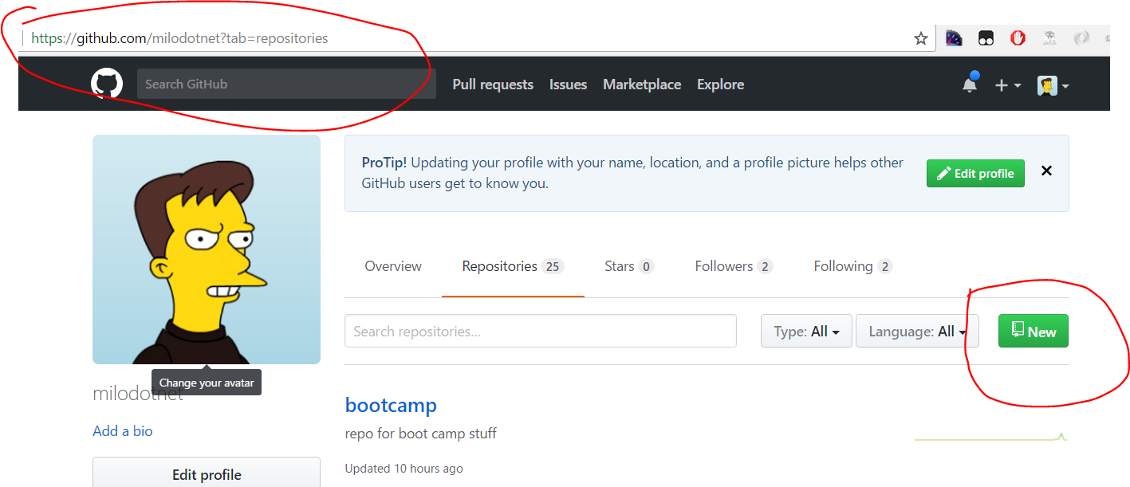

Slide 76
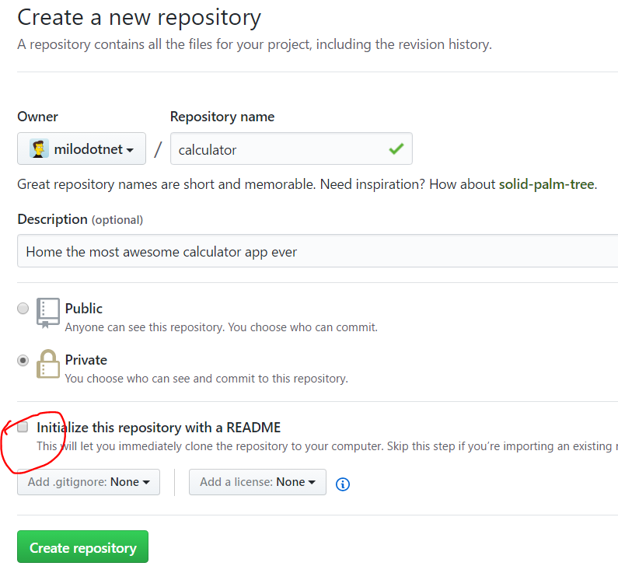

Slide 77
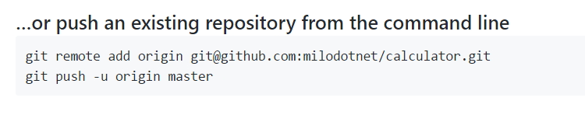
Add a remote!
Create a remote, called origin, that points to git@github.com:milodotnet/calculator.git
Push the commits from my local repo to the remote, and set it as the upstream (-u) – this sets this as the remote upstream for argumentless commands (e.g. git pull), origin gives the name of the remote, and master the name of the branch

Slide 78

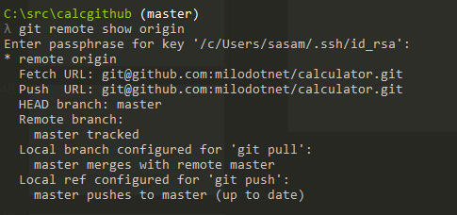
Lets see which remotes I have now

Slide 79
Types of References
Branch
Is a named reference to a commit
Can change which commit it points at
HEAD is the current reference to the current branch
Tag
Two types, annotated and lightweight
Similar to a commit, it contains a tagger, a date, a message, and a pointer, however points to a commit rather than a tree
Also like a branch, but it never moves
Remotes
Read only
HEAD will never point to it so you cant change it by committing

Slide 80

Git cloning
This creates a local repo based on a remote and include setting up the remote

Slide 81
Lets start collaborating
Split into groups of three
Your task is to add two operations to the calculator program, add and subtract, and a main input loop
You want to divide these task up amongst each of you
What’s the best way to do this?
Try this using feature branches, or not, up to you!

Slide 82
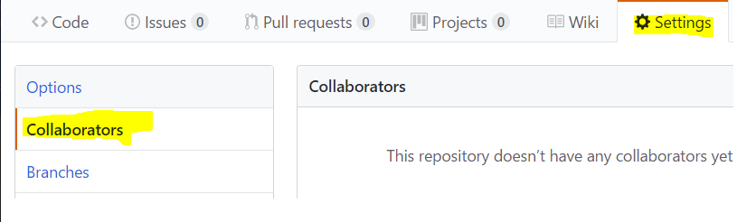

Slide 83

Microsoft’s Contributions
Source Safe (1995)
Lock based
No central server
Prone to corruption
TFS(2000ands)
Second foray into source control
Had a central serval
Was lock based (but changed)
Still exists today (even at ASOS!)
TFS Online supports hosting git repos

Slide 84
References
https://en.wikipedia.org/wiki/Version_control
https://en.wikipedia.org/wiki/Source_Code_Control_System
https://en.wikipedia.org/wiki/Interleaved_deltas
http://docs.oracle.com/cd/E19504-01/802-5880/6i9k05dhp/index.html
https://en.wikipedia.org/wiki/Concurrent_Versions_System
https://simpleprogrammer.com/2017/01/16/software-developers-know-source-control/

Slide 85
References
https://stackoverflow.com/questions/2304087/what-is-head-in-git
https://git-scm.com/docs/git-init
http://eagain.net/articles/git-for-computer-scientists/
https://help.github.com/articles/ignoring-files/
https://stackoverflow.com/questions/6866838/what-should-be-in-the-git-description-file
https://git-scm.com/book/en/v2/Git-Internals-Plumbing-and-Porcelain
https://git-scm.com/book/en/v2/Git-Internals-Git-Objects
https://git-scm.com/book/gr/v2/Customizing-Git-Git-Hooks
https://git-scm.com/book/en/v2/Git-Internals-Git-References
https://git-scm.com/docs/git-push
https://git-scm.com/book/en/v2/Git-Basics-Working-with-Remotes

Slide 86
Git description file???
https://stackoverflow.com/questions/6866838/what-should-be-in-the-git-description-file

Slide 87
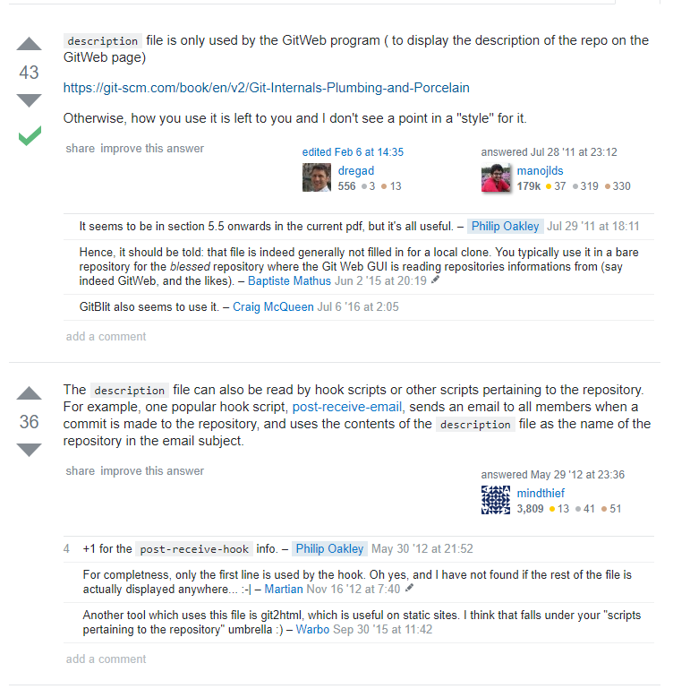

Slide 88
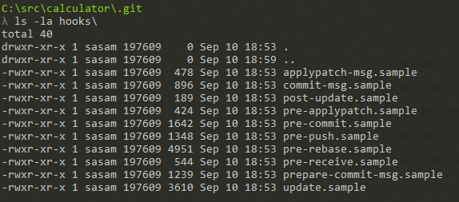
Hooks
Extension points for extending the behaviour of existing git commands by running your own code
Contains some samples for each hook (which you can enable by removing the .sample extension)
Read more here https://git-scm.com/book/gr/v2/Customizing-Git-Git-Hooks

Slide 89
Types of References
Branch
Is a named reference to a commit
Can change which commit it points at
HEAD is the current reference to the current branch
Tag
Two types, annotated and lightweight
Similar to a commit, it contains a tagger, a date, a message, and a pointer, however points to a commit rather than a tree
Also like a branch, but it never moves
Remotes
Read only
HEAD will never point to it so you cant change it by committing

Slide 90
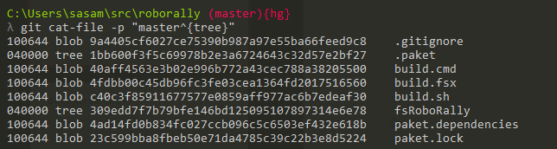
Lets look at the root of the tree
git cat-file -p "master^{tree}"

Slide 91
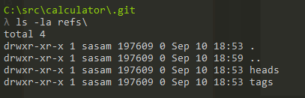
Refs?
Also has two empty directories
heads
Tags
We will get into these in more details just now

Slide 92
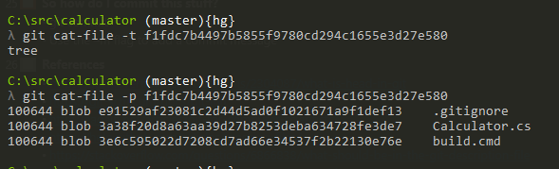

What was this for?

