Slide 1
Continuous Delivery
Part 2

Slide 2
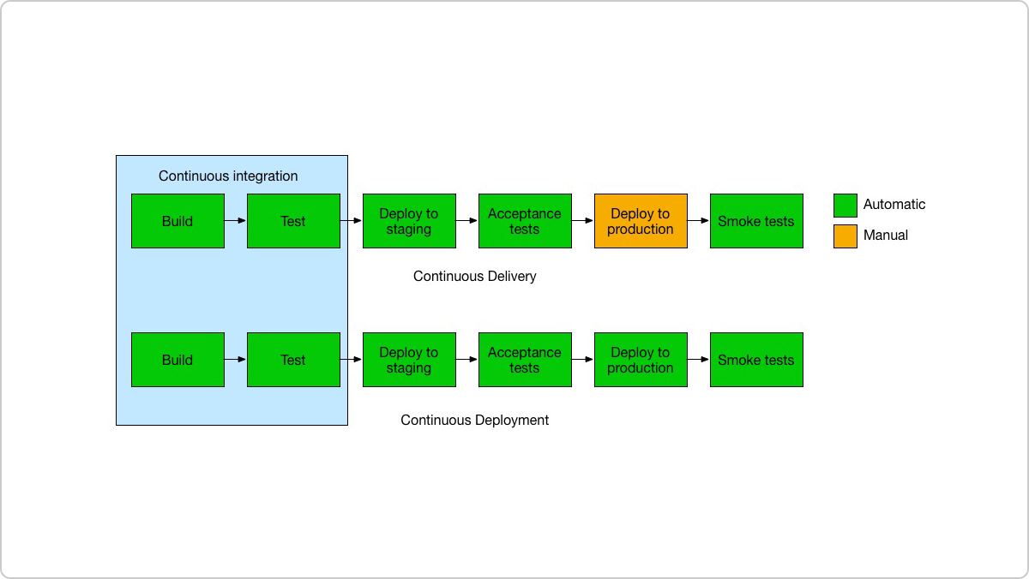
Continuous integration vs. continuous delivery vs. continuous deployment
Notes:
Continuous delivery is an extension of continuous integration to make sure that you can release new changes to your customers quickly in a sustainable way.
This means that on top of having automated your testing, you also have automated your release process and you can deploy your application at any point of time by clicking on a button.
If you truly want to get the benefits of continuous delivery, you should deploy to production as early as possible to make sure that you release small batches, that are easy to troubleshoot in case of a problem.
Continuous deployment goes one step further than continuous delivery. With this practice, every change that passes all stages of your production pipeline is released to your customers. There's no human intervention, and only a failed test will prevent a new change to be deployed to production.

Slide 3
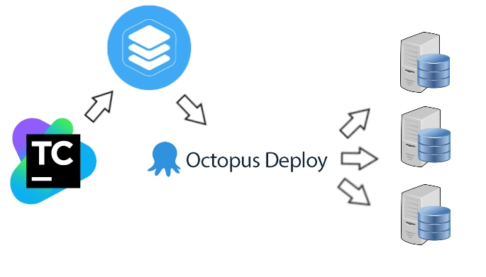
TeamCity & Octopus Deploy
Notes:
Last time we got as far as TeamCity building our artefacts for us
After building, we package the software and push it to ProGet.
ProGet is a package management system. It allows us to host and manage ASOS-wide package management feeds.
After packaging, TeamCity then orchestrates Octopus Deploy to create a release.

Slide 4
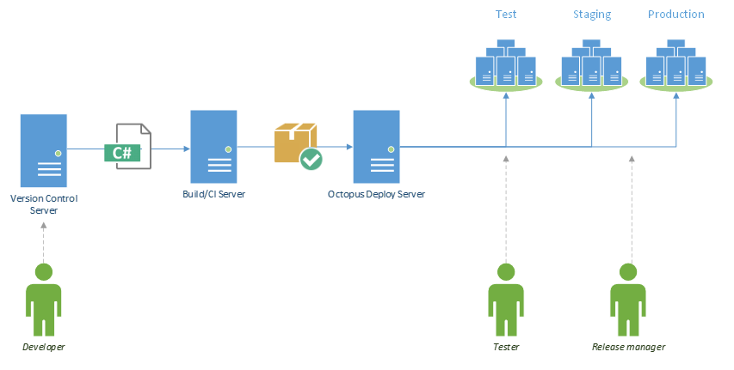
TeamCity & Octopus Deploy

Slide 5
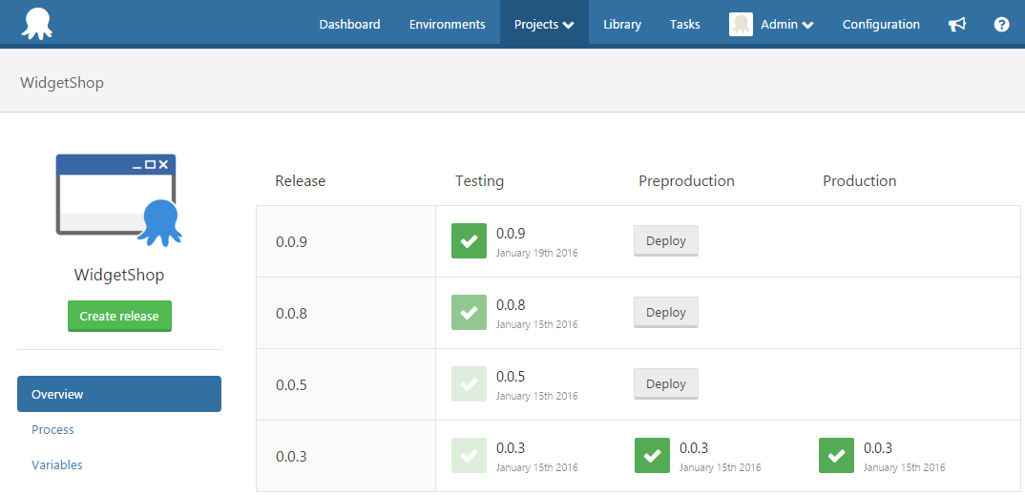
TeamCity & Octopus Deploy
Notes:
There are two important concepts involved in deploying your Octopus projects: releases and deployments.
A project within Octopus Deploy is like a recipe that describes the steps (instructions) and variables (ingredients) required to deploy your apps and services.
A release captures all the project and package details so it be deployed over and over in a safe and repeatable way. A deployment is the execution of the steps to deploy a release to an environment. An individual release can be deployed numerous times to different environments.

Slide 6
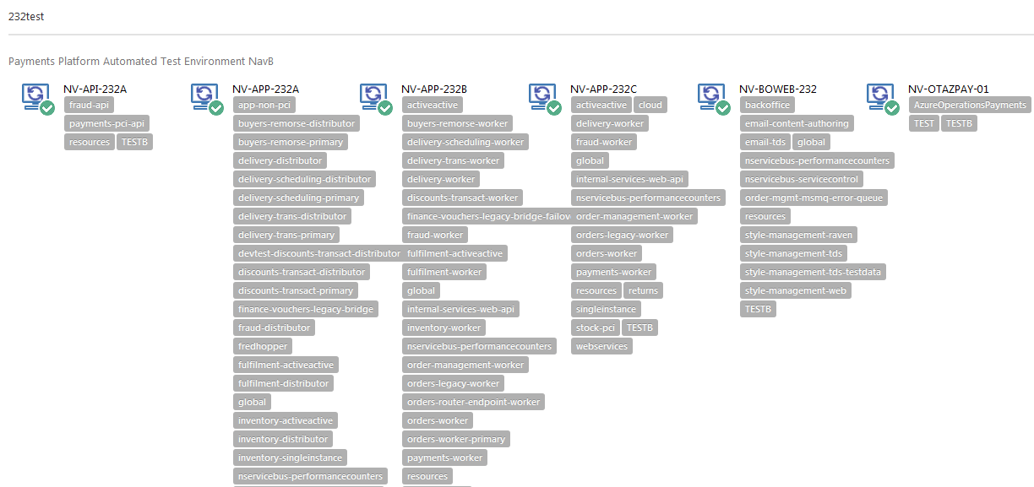
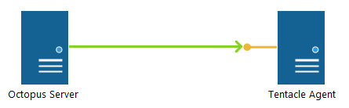
Environments & Roles
Notes:
Environments are groups of machines.
Each machine inside the environment runs an Octopus Deploy tentacle as a Windows Service.
Tentacle is a secure, lightweight agent service that Octopus uses to deploy software.
In essence, Tentacle is a job runner. It waits for Octopus to give it a job (deploy a package, run a script), and it executes it, reporting the progress and result back to the Octopus server.
Machine roles allow you to “tag” machines with a specific keyword which you can later on use to scope deployment steps and/or variables.

Slide 7
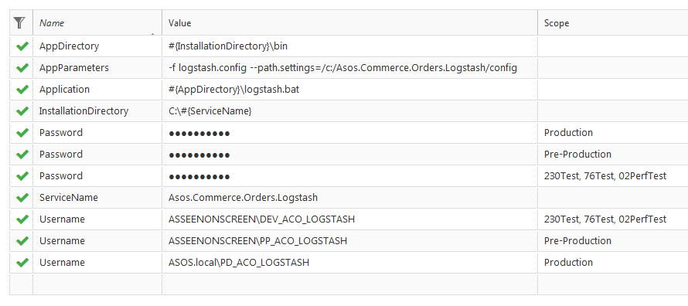
Configuration Management
Notes:
As you promote your application through testing, staging and production, there are going to be differences in database connection strings, application settings, web service URLs, and many other parameters.
To make it easy to support different environments without hard-coding these configuration values, you can define variables related to your project. These variables are used during your application deployment. For example, variables you define will be automatically substituted into XML configuration files, and made available to your PowerShell scripts. This allows you to create applications and deployment scripts that are agnostic of the target environment.
Variables are essentially name/value pairs with optional scope rules applied. You can edit the variables using the Variables tab within a project.
Library variable sets make it possible to share variables between projects.

Slide 8
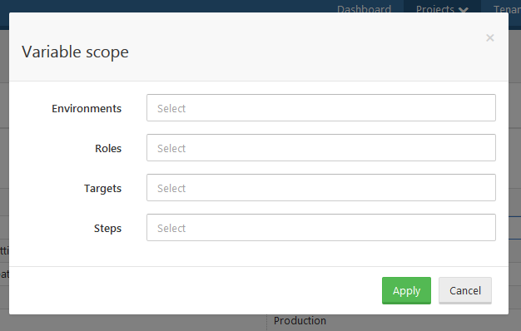
Scope
Notes:
To allow you to define different values for variables depending on where you are deploying, variables can be scoped.
Variables can be scoped by:
Environments (most common)
Specific machine roles
Specific machines (targets)
Specific deployment steps
Since variables can be scoped in many different ways, there needs to be a predictable, deterministic order in which they are resolved. The list below is the priority in which variable scopes take precedence - the top items are considered higher priority than the bottom ones:
The current step/action (most specific)
The current machine
Roles applied to the current machine and targeted by the current step
Roles applied to the current machine
The target tenant (if tenant-features are enabled)
The target tenant-tag (if tenant-features are enabled)
The target environment
The target channel (if channels are enabled)
No scope (least specific)

Slide 9
demo
Continuous Delivery with TeamCity & Octopus Deploy

Slide 10
Resources
https://octopus.com/blog/demo-server

