Slide 1
Short-beaked common dolphin (Delphinus delphis)
C.Saavedra

Slide 2
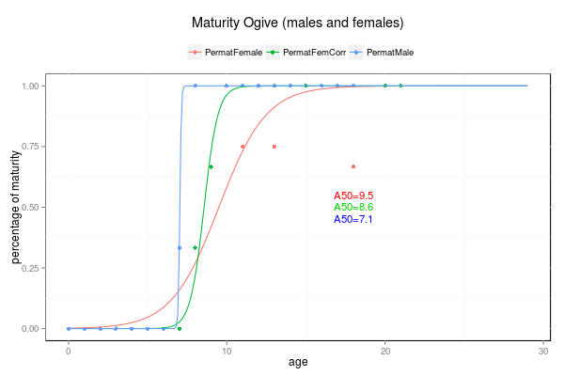
BIOLOGICAL DATA - GALICIA
Max. length 234 (240)
Max. age 29.5 (N=440)
Maturity (N=256)
  Males 7.1 (N=52)
  Females 8.6 (N=202)
Pregnancy rate ?

Slide 3
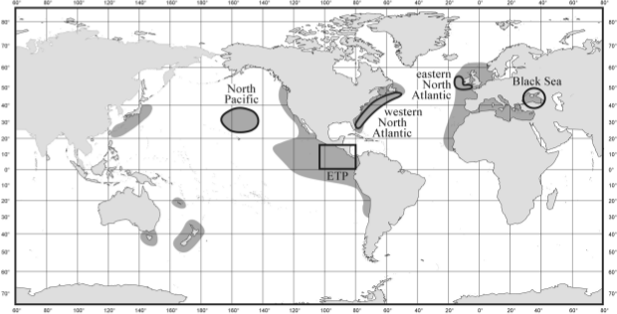
OTHER BIOLOGICAL DATA

Slide 4
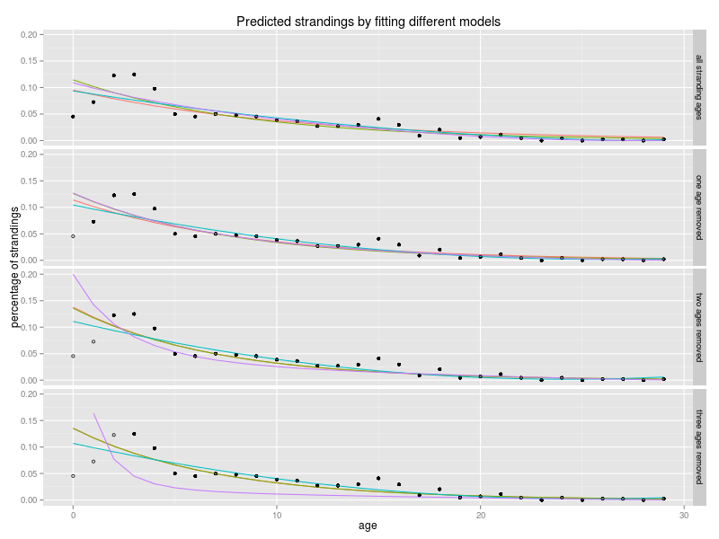
STRANDINGS MODELS
Predicted strandings applying different models: Exponential model (red), GLM family Poisson model (green), second-degree polynomial model (blue), and the Siler model (purple). Models fitted with all the available data and fitted after removing the younger age classes (none, one, two and three age classes). Total stranded dolphins used to fit the model (black dots) and stranded dolphins removed (circles).

Slide 5
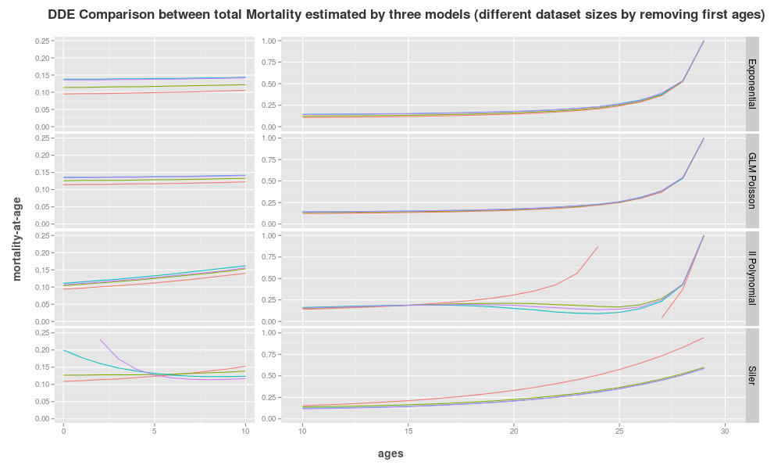
MORTALITY-AT-AGE
Predicted total mortality with four models and from four data sets of different sizes: Total mortality predicted from a life table constructed with an Exponential strandings model (Exponential), a GLM family Poisson (GLM Poisson), a second-degree polynomial model (II Polynomial) and a Siler model (Siler). model was fitted to the total number of stranded animals for which age was available (red line) and stranding numbers after removing the youngest age classes sequentially, 0 (green line), 0 to 1 (blue line) and 0 to 2 (purple line).

Slide 6
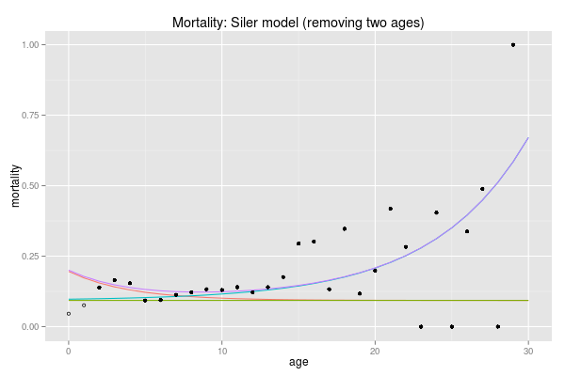
SILER MODEL
Mortality fitted with Siler competing-risk model. Siler mortality (Purple line), juvenile mortality (red line), constant mortality (green line), senescence mortality (blue line). Mortality-at-age from the raw data used to fit the model (dots), and mortality-at-age in the raw data do not used to fit the model (circles).

Slide 7
MORTALITY AND SURVIVORSHIP
Survivorship and mortality-at-age from the raw data and from the predicted data fitted with the data set with two ages removed: Survivorship (S) and mortality (M) both from the raw strandings data (lifeN) and from the strandings predicted with the Exponential model (lifeExp2), the GLM (lifeglmPois2), the Polynomial model (lifeIIPol2) and from the predicted mortality of the Siler model (lifeSiler2).

Slide 8
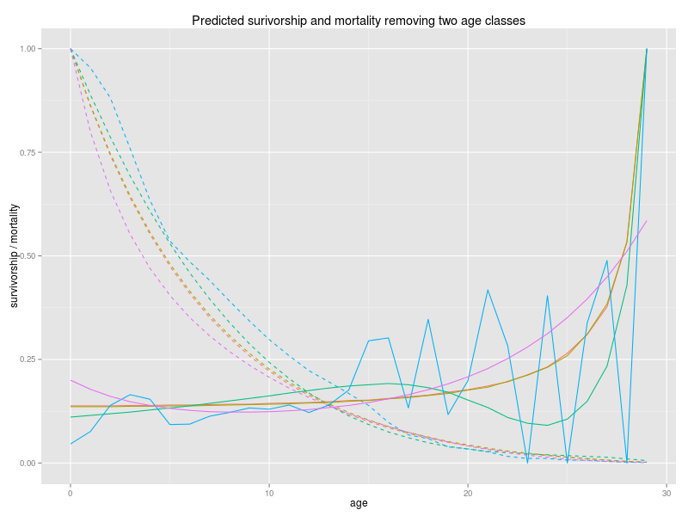
MORTALITY AND SURVIVORSHIP
Survivorship and mortality for the data set with the youngest two age classes removed: Raw data survivorship curve (blue dashed line), raw data mortality curve (blue line), predicted exponential survivorship curve (red dashed line), predicted exponential mortality curve (red line), predicted GLM survivorship curve (brown dashed line), predicted GLM mortality curve (brown line), predicted Siler survivorship curve (purple dashed line), predicted Siler mortality curve (purple line).

Slide 9
POPULATION STRUCTURE
ANNUAL BIRTHS
Population structure: Population structure with a total abundance of 15000 dolphins estimated from the total strandings data (lifeN), from the exponential model (lifeExp2), from the GLM (lifeglmPois2), from the polynomial (lifeIIPol2) and from the Siler model with the two first age classes removed (lifeSiler2).

Slide 10
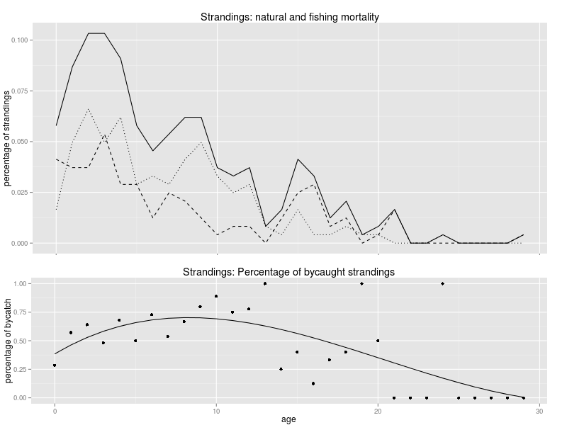
BYCATCH
No ByC = 104
ByC = 138
Natural and bycaught strandings: Percentage of total (solid line), unknown or non-bycaught (dashed line) and bycaught (dotted line) strandings by age [upper graph]. Percentage of bycaught dolphins in the total strandings (dots) and fitted model (solid line) [lower graph].

Slide 11
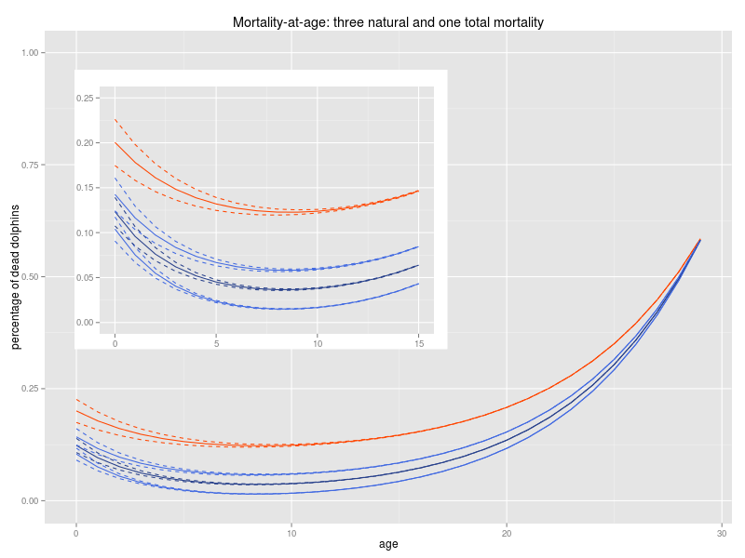
MORTALITY-AT-AGE
Three different vectors for total mortality and nine for natural mortality: Total mortality with an increment and reduction of 25% of its slope of the juvenile mortality (solid and dashed red lines). Natural mortality calculated by removing bycatch from the total mortality and 25% of variation in its slope (solid and dashed dark blue). Natural mortality calculated with an increment and reduction of 25% of the bycatch calculated for Galicia and 25% of variation in its slope (solid and dashed light blue)

Slide 12
TOTAL AND NATURAL MORTALITY

Slide 13
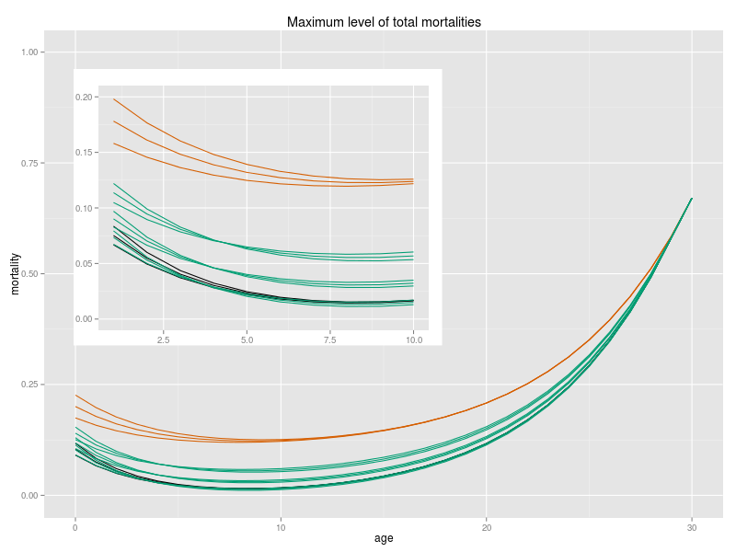
MAXIMUM MORTALITY LEVEL
Maximum level of total mortality: Total mortality from Galicia fitted with three different slopes of the mortality of the first ages (red lines). Natural mortality obtained by subtracting the bycath from Galicia, assuming that it is 25% higher than the originally calculated, and fitted with three different slopes of the mortality of the first ages (dark lines). Total mortality accepted for the population to keep the stability calculated with three different pregnancy rates and fitted with three different slopes of the mortality of the first ages. Pregnancy rate of 50% (three upper green lines), pregnancy rate of 33% (three green lines in the middle), pregnancy rate of 25% (three lower green lines)

Slide 14
MAXIMUM MORTALITY LEVEL

Slide 15
BYCATCH FOR THE WHOLE AREA
Nº MEDIO anual de barcos de cada métier en el período estudiado de varamientos
Nº MEDIO anual de lances por barco de cada métier -Distrib.prob-
Capturas anuales reconocidas en cada barco (por métier) (Sabine et al. 2013)
Calcular de dos formas: Usando solo aquellos que reconocen tener capturas accidentales y extrapolar a toda la flota. Usar todos incluyendo los que dicen no tener bycatch
Relación (lineal?) entre nº de lances y nº de delfines capturados reconocidos para cada flota. Si no se encuentra relación usar la media.
Extrapolar a otras áreas conociendo el nº de barcos y lances de cada métier
Calcular probabilidad de captura por lance para cada flota

Slide 16
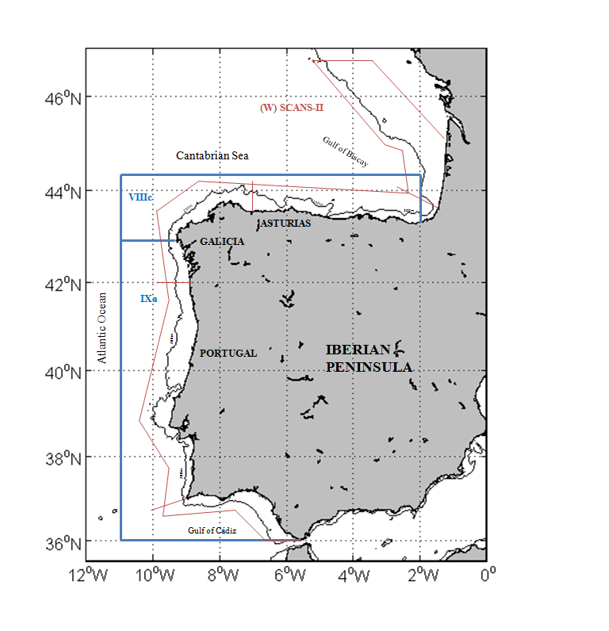
BYCATCH FOR THE WHOLE AREA
Relación (lineal) del número de lances frente al nº de barcos de cada año
Establecer un número medio de barcos y lances en el período 1990-2012
Porcentaje de muerte por bycatch en Galicia
Asumir relación lineal entre número de lances de cada métier y bycatch asignándole un porcentaje de las capturas a cada flota
Extrapolar a otras áreas conociendo el nº de lances de cada zona y métier
Calcular probabilidad de captura por lance para cada flota

Slide 17
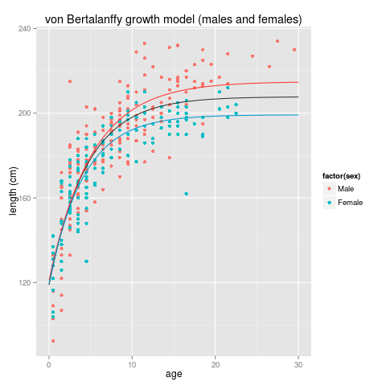
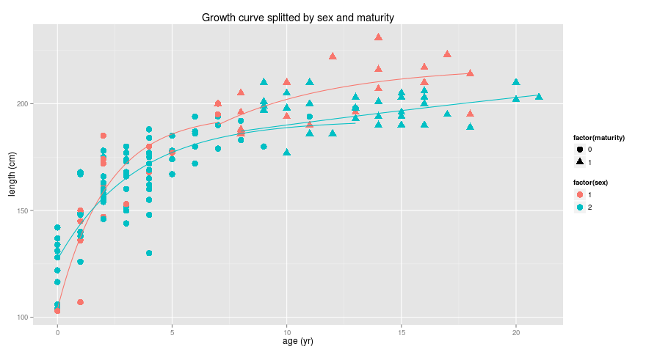
GROWTH

Slide 18
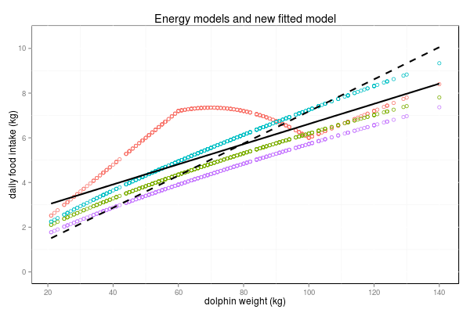
DIET
Daily food intake calculated with the Kastelein index (red dots), with the Innes index (green dots), with the Kleiber index for Galicia (blue dots) and for Portugal (purple dots). The regression model fitted to all these values is represented as a solid dark line, and the same regression but forcing the intercept to be zero is represented as a dashed dark line.

Slide 19
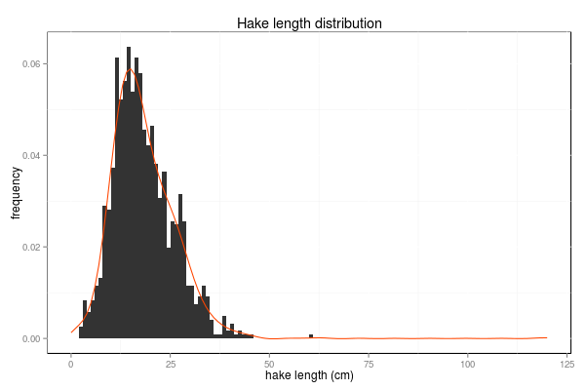
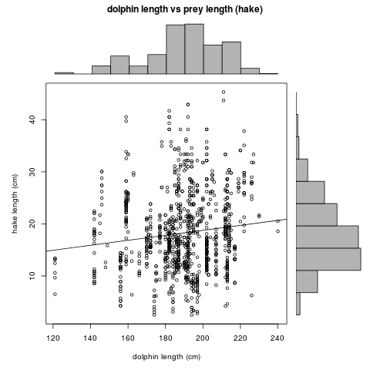
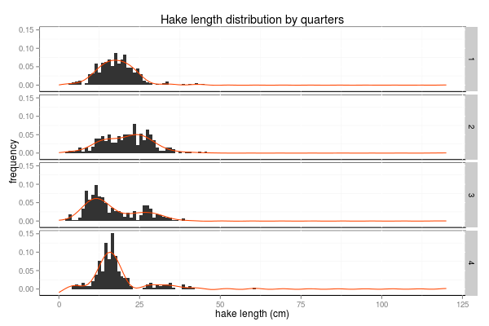
HAKE

Slide 20
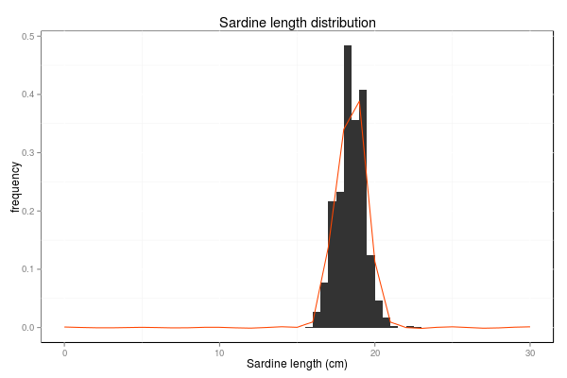
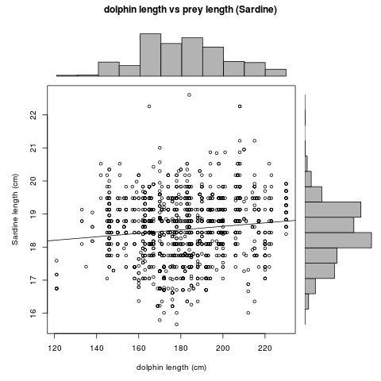
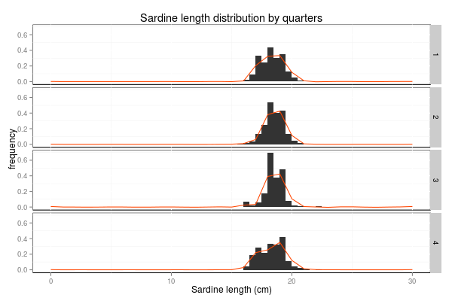
SARDINE

Slide 21
DIET

