Slide 1





Strategic Cost Management & New Technologies
Prof. Mario Milone MGT(P)495

Slide 2
Session 3 Cost-Volume Profit

Slide 3
Outline
Estimating Cost Functions
CVP Analysis
Breakeven Analysis
Sensitivity Analysis
Operating Leverage

Slide 4
Estimating Cost Functions

Slide 5
Cost Behavior
Pure fixed cost
Pure variable cost
Step-fixed cost
cost
cost
cost
volume
volume
volume
Semi-variable cost
Curvilinear cost
Learning curve
cost
cost
cost
volume
volume
volume

Slide 6

Estimating Cost Functions
Assume that costs are linear
$$Total Cost=Fixed Costs+Variable Costs ∗Activity Level$$
Standard Cost Method
Gather information and estimate
Analysis of individual cost items
Visual fit
scatter plot

Slide 7

Estimating Cost Functions
Regression Analysis
$$Y_{t}=β_{0}+β_{1}X_{1,t}+ε_{t}$$
$Y_{t}$: Dependent Variable (Cost)
$X_{1,t}$: Independent Variable
$β_{0}$: Fixed portion of the cost
$β_{1}$: Variable portion of $Y_{t}$
How much 1 unit of $X_{1,t}$ affects $Y_{t}$

Slide 8

Estimating Cost Functions
You can add more stuff: Multiple regression
$$Y_{t}=β_{0}+β_{1}X_{1,t}+β_{2}X_{2,t}+ε_{t}$$
$β_{1}$: Variable portion of $Y_{t}$
How much 1 unit of $X_{1,t}$ affects $Y_{t}$
$β_{2}$: Variable portion of $Y_{t}$
How much 1 unit of $X_{2,t}$ affects $Y_{t}$

Slide 9
Estimating Cost Functions
What do we use regression analysis for?
Classifying total costs into variable and fixed components
Separating total OH into FOH and VOH
Estimating manufacturing input costs
Estimating OH consumption patterns and selecting OH allocation bases
Using multiple bases to allocate OH costs

Slide 10
Estimating Cost Functions
But there is no such thing as a silver bullet
It requires a lot of data
Intuition and reasoning is very important
Relevant data?
How to interpret the results?
Extrapolation is not a given
External validity
Are the costs really linear (when using OLS)?
Should we think of using non-linear estimations?
If so, how do we interpret them?

Slide 11
Example
The company decided that as few C products as possible should be produced.
Increase production of product A
Start a promotional campaign to increase the sales of product A
 | A | B | C
Sales Price | $20.00 | $10.00 | $30.00
DM | $7.00 | $3.75 | $16.60
DL | $2.00 | $1.00 | $3.50
Factory OH | $5.00 | $2.50 | $8.75
Marketing | $3.00 | $1.50 | $4.50
Net Unit Profit | $3.00 | $1.25 | ($3.35)

Slide 12
Example
Before giving the green light, management asked the controller’s office to make sure the numbers are correct
The controller estimated that
20% of the factory OH was variable
50% of the marketing costs were also variable

Slide 13
Example
Contribution margins if the controller is correct
What should management do?
How can we check if the controller is correct?
 | A | B | C
Sales Price | $20.00 | $10.00 | $30.00
DM | $7.00 | $3.75 | $16.60
DL | $2.00 | $1.00 | $3.50
Variable Factory OH (20%) | $1.00 | $0.50 | $2.25
Variable Marketing (50%) | $1.50 | $0.75 | $2.25
Net Marginal Unit Profit | $8.50 | $4.00 | $5.90

Slide 14
Example
Let’s get some more data
2 production departments: Molding and Finishing
What data do we need to verify the controller’s information?
We want to predict the OH Cost as a function of (for example) DL$
We need OH cost and DL cost data
We analyze both the Manufacturing OH and Marketing
 | A | B | C
Molding | 2 per hour | 4 per hour | 3 per hour
Finishing | 4 per hour | 8 per hour | 1.33 per hour

Slide 15
Example
Direct Labor Costs (in thousands) |  |  |  | Overhead costs (in thousands)
Molding | Finishing | Total |  | Molding | Finishing | Total
140 | 170 | 310 |  | 341 | 434 | 775
135 | 150 | 285 |  | 340 | 421 | 761
140 | 160 | 300 |  | 342 | 428 | 770
130 | 150 | 280 |  | 339 | 422 | 761
130 | 155 | 285 |  | 338 | 425 | 763
125 | 140 | 265 |  | 337 | 414 | 751
120 | 150 | 270 |  | 335 | 420 | 755
115 | 140 | 255 |  | 334 | 413 | 747
120 | 140 | 260 |  | 336 | 414 | 750
115 | 135 | 250 |  | 335 | 410 | 745

Slide 16

Example
$$Y=618+0.506X$$
$$R^{2}=0.993$$

Slide 17
Example
Sales in Thousands
Product A | Product B | Product C | Total | Marketing Costs
2000 | 400 | 600 | 3000 | 450
1940 | 430 | 610 | 2980 | 445
1950 | 380 | 630 | 2960 | 445
1860 | 460 | 620 | 2940 | 438
1820 | 390 | 640 | 2850 | 433
1860 | 440 | 580 | 2880 | 437
1880 | 420 | 570 | 2870 | 438
1850 | 380 | 580 | 2810 | 434
1810 | 390 | 580 | 2780 | 430
1770 | 290 | 610 | 2670 | 425

Slide 18

Example
$$Y=235+0.0705X$$
$$R^{2}=0.9085$$

Slide 19
Example
What did we learn?
For Manufacturing Costs
Out of an average of 750 to 800 total manufacturing OH, around 620 seems to be fixed
Around 80% fixed costs, and 20% variable costs
For Marketing Costs
Out of an average of 430-450 total marketing cost, around 235 seems to be fixed
Roughly 50% fixed costs, and 50% variable costs
The company’s controller seems to be on track

Slide 20
Example
Can we do better?
What data can we use?
Can we be more precise?

Slide 21
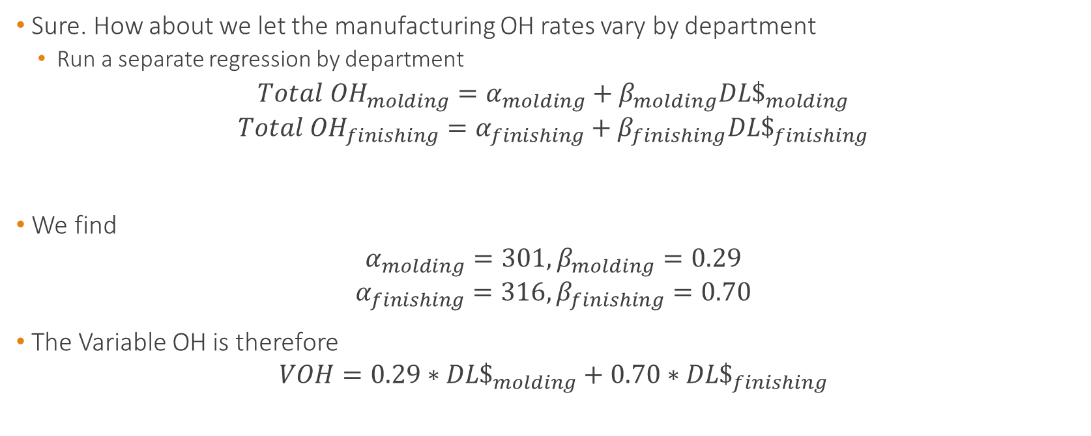
Example
Sure. How about we let the manufacturing OH rates vary by department
Run a separate regression by department
$$Total {OH}_{molding}=α_{molding}+β_{molding}{DL\$}_{molding}$$
$$Total {OH}_{finishing}=α_{finishing}+β_{finishing}{DL\$}_{finishing}$$
We find
$$α_{molding}=301,β_{molding}=0.29$$
$$α_{finishing}=316,β_{finishing}=0.70$$
The Variable OH is therefore
$$VOH=0.29∗{DL\$}_{molding}+0.70∗{DL\$}_{finishing}$$

Slide 22
Example
How would that impact the contribution margins of the products?
It would penalize products that consume more finishing
Product C would look less attractive if OH varies by department
 | A | B | C
Molding | 2 per hour | 4 per hour | 3 per hour
Finishing | 4 per hour | 8 per hour | 1.33 per hour

Slide 23
CVP Analysis

Slide 24
CVP Analysis
CVP uses fixed and variable cost patterns to asses the profitability of decisions
Product lines, investments, etc
Uses of CVP
Determine price floors
Simulation and sensitivity analysis
Breakeven analysis
Operating leverage
Budgeting

Slide 25
CVP Analysis - Outline
Breakeven Analysis
With and without uncertainty
Sensitivity Analysis
Operating Leverage

Slide 26
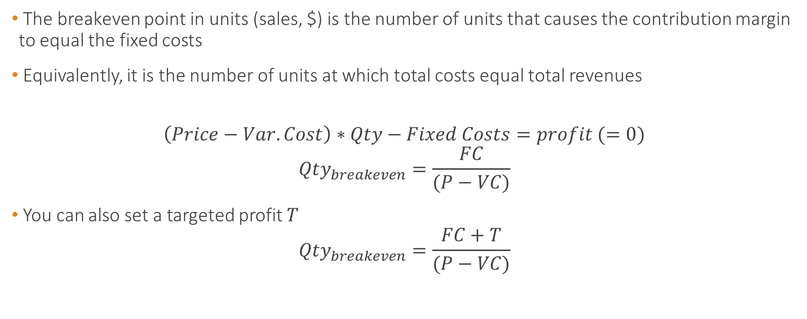
Breakeven Analysis
The breakeven point in units (sales, $) is the number of units that causes the contribution margin to equal the fixed costs
Equivalently, it is the number of units at which total costs equal total revenues
$$\left(Price−Var.Cost\right)∗Qty−Fixed Costs=profit (=0)$$
$${Qty}_{breakeven}=\frac{FC}{(P−VC)}$$
You can also set a targeted profit $T$
$${Qty}_{breakeven}=\frac{FC+T}{(P−VC)}$$

Slide 27
Example 1
A firm with 2 divisions sell 2 different products
How many boards does the first division need to break even?
How many discs does the second division need to sell to break even?
 | Division 1 | Division 2
Product | Boards | Discs
Price per unit | $12 | $8
Variable Cost per unit | $7 | $5
Total Fixed Costs | $250,000 | $120,000

Slide 28
Example 1
A firm with 2 divisions sell 2 different products
 | Division 1 | Division 2
Product | Boards | Discs
Price per unit | $12 | $8
Variable Cost per unit | $7 | $5
Total Fixed Costs | $250,000 | $120,000
Contribution Margin | $5 | $3
Quantity Breakeven | 250,000/5 = 50,000 | 120,000/3 = 40,000

Slide 29
Example 1
The firm’s HQ generated no revenue but costs $180,000.
Will the firm break even if the 2 divisions sell the breakeven amounts previously calculated?
Assume the following
What is the breakeven number of units for each division if corporate OH is allocated on the basis of direct labor hours?
Same question if OH allocated on the basis of machine hours?
 | Division 1 | Division 2 | Total
DL Hours | 20,000 | 10,000 | 30,000
Machine Hours | 35,000 | 35,000 | 70,000

Slide 30
Example 1
OH allocated on the basis of DL hours
 | Division 1 | Division 2 | Total
DL Hours | 20,000 | 10,000 | 30,000
Machine Hours | 35,000 | 35,000 | 70,000
Burden rate (DL$) | 2/3 | 1/3
Total FC | 250k+2/3*180k = 370,000 | 120k+1/3*180k= 180,000
Quantity Breakeven | 370k/5 = 74,000 | 180k/3 = 60,000

Slide 31
Example 1
OH allocated on the basis of Machine hours
 | Division 1 | Division 2 | Total
DL Hours | 20,000 | 10,000 | 30,000
Machine Hours | 35,000 | 35,000 | 70,000
Burden rate (Mhr) | 0.5 | 0.5
Total FC | 250k+0.5*180k = 340,000 | 120k+0.5*180k= 210,000
Quantity Breakeven | 340k/5 = 68,000 | 180k/3 = 70,000

Slide 32
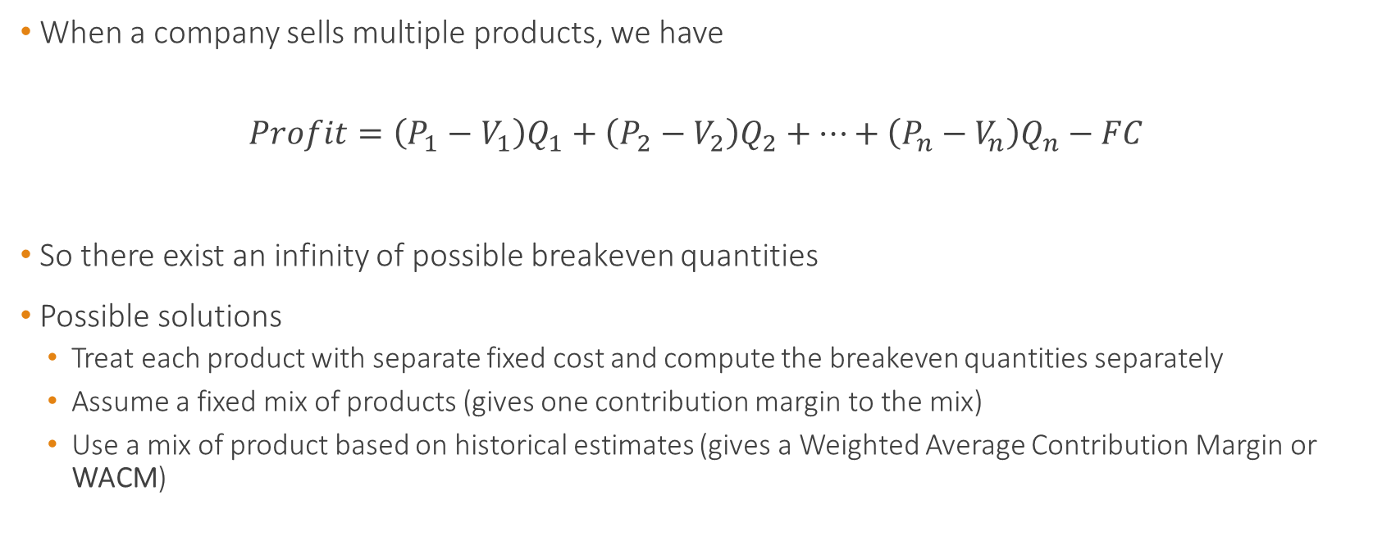
Breakeven Analysis – Multiple Products
When a company sells multiple products, we have
$$Profit=\left(P_{1}−V_{1}\right)Q_{1}+\left(P_{2}−V_{2}\right)Q_{2}+…+\left(P_{n}−V_{n}\right)Q_{n}−FC$$
So there exist an infinity of possible breakeven quantities
Possible solutions
Treat each product with separate fixed cost and compute the breakeven quantities separately
Assume a fixed mix of products (gives one contribution margin to the mix)
Use a mix of product based on historical estimates (gives a Weighted Average Contribution Margin or WACM)

Slide 33
Example 2 – Multiple Products
A company sells 3 products with fixed costs of $77,777
What is the Weighted Average Contribution Margin per unit (WACM/unit)?
Weighted average o the CM (weighted by the probability of being sold)
What is the breakeven in units and in Sales?
 | A | B | C
Selling Price | $10 | $10 | $20
Unit CM | $6 | $8 | $16
Units Sold | 100 | 200 | 300

Slide 34
Example 2 – Multiple Products
A company sells 3 products with fixed costs of $77,777
 | A | B | C
Selling Price | $10 | $10 | $20
Unit CM | $6 | $8 | $16
Units Sold | 100 | 200 | 300
Weight (proba/fraction sold) | 1/6 | 2/6 | 3/6
WACM | 1/6*$6 + 2/6*$8 + 3/6*$16 = $11.67
Breakeven Units | 77,777/11.67 = 6,666.7 units
Breakeven Units / product | 1,111 | 2,222 | 3,333
Breakeven in sales / product | $11,110 | $22,220 | $66,660
Breakeven in Sales | $100,000

Slide 35
Breakeven Under Uncertainty
So far, we have not incorporated the fact that the future is uncertain
How likely are we to break even?
We can try to estimate this probability
We need to have an idea of the distribution of the variable of interest
How are sales likely to be distributed?
Normal Distribution?
Uniform Distribution?

Slide 36
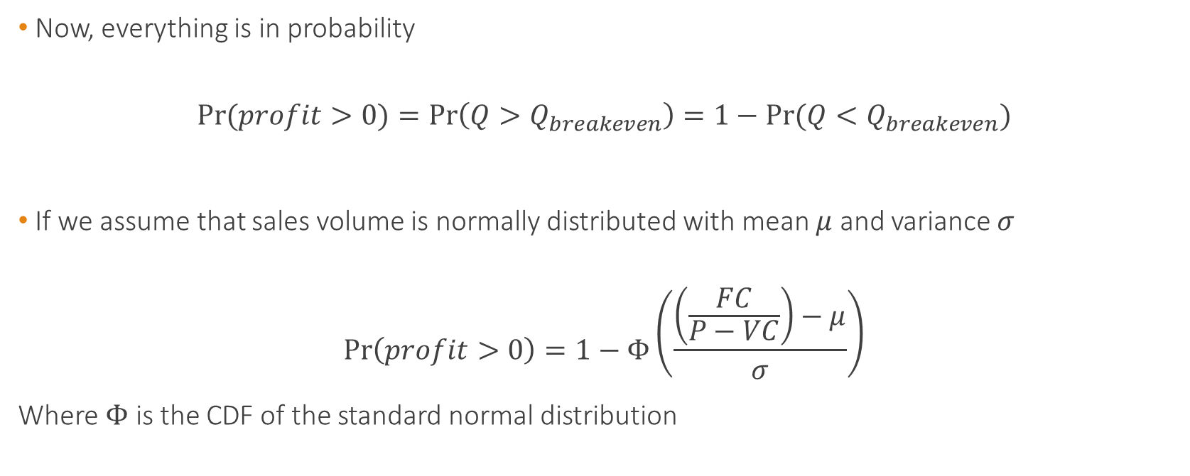
Breakeven Under Uncertainty
Now, everything is in probability
$$\operatorname{Pr}{(profit>0)}=Pr\left(Q>Q_{breakeven}\right)=1−Pr⁡(Q<Q_{breakeven})$$
If we assume that sales volume is normally distributed with mean $μ$ and variance $σ$
$$\operatorname{Pr}\left(profit>0\right)=1−Φ\left(\frac{\left(\frac{FC}{P−VC}\right)−μ}{σ}\right)$$
Where $Φ$ is the CDF of the standard normal distribution

Slide 37

Breakeven Under Uncertainty
Now, everything is in probability
$$\operatorname{Pr}{(profit>0)}=Pr\left(Q>Q_{breakeven}\right)=1−Pr⁡(Q<Q_{breakeven})$$
If we assume that sales volume is uniformly distributed over $[a,b]$
$$\operatorname{Pr}\left(profit>0\right)=1−\left(\frac{\left(\frac{FC}{P−VC}\right)−a}{b−a}\right)$$

Slide 38

Example
What is the Breakeven point?
What is the probability of breaking even if sales volume is normally distributed with a mean of 160 and a standard deviation of 25 units?
What is the probability of breaking even if sales volume is uniformly distributed over $\left[20,300\right]$
Selling Price per unit | $40
Variable Costs per unit | $12
Total Fixed Costs | $5,000

Slide 39
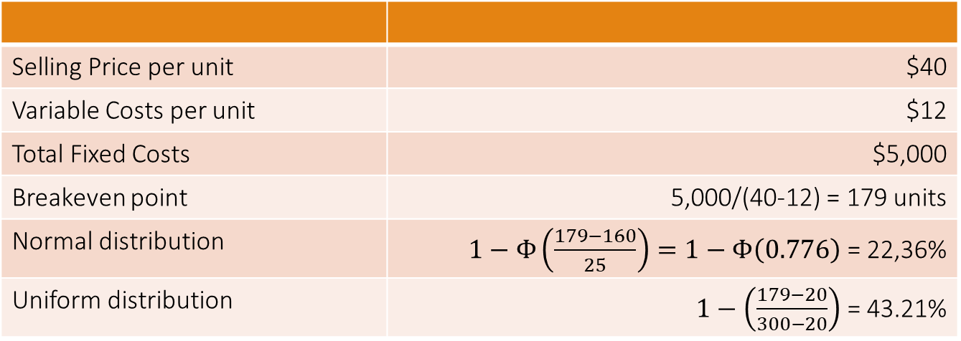
Example
Selling Price per unit | $40
Variable Costs per unit | $12
Total Fixed Costs | $5,000
Breakeven point | 5,000/(40-12) = 179 units
Normal distribution | $1−Φ\left(\frac{179−160}{25}\right)=1−Φ\left(0.776\right)$ = 22,36%
Uniform distribution | $1−\left(\frac{179−20}{300−20}\right)$ = 43.21%

Slide 40
Sensitivity Analysis
How sensitive is our analysis to our assumptions?
What will happen if
Quantity of unit sold decreases?
Prices changes?
etc

Slide 41
Example
Let us use the same example
What would happen if price decrease by 10%?
How would it change the breakeven point?
Selling Price per unit | $40
Variable Costs per unit | $12
Total Fixed Costs | $5,000
Breakeven point | 5,000/(40-12) = 179 units

Slide 42
Example
A 10% decrease in price increases the breakeven point by 16%
Original Selling Price | $40
New selling Price (10% decrease) | $36
Variable Costs per unit | $12
Total Fixed Costs | $5,000
Original Breakeven point | 5,000/(40-12) = 179 units
New Breakeven point | 5,000/(36-12) = 208 units
Percentage change | +16.2%

Slide 43
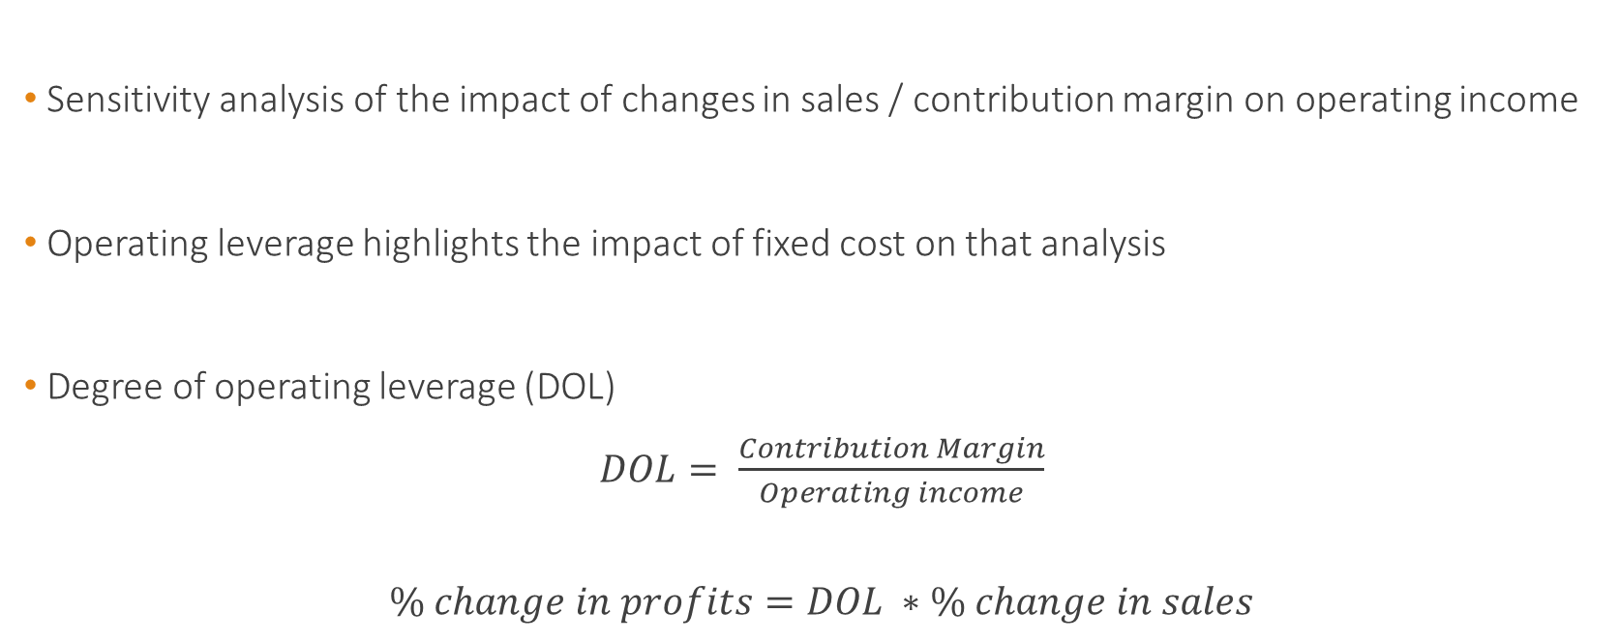
Operating Leverage
Sensitivity analysis of the impact of changes in sales / contribution margin on operating income
Operating leverage highlights the impact of fixed cost on that analysis
Degree of operating leverage (DOL)
$DOL= \frac{Contribution Margin}{Operating income}$
$$\% change in profits=DOL ∗\% change in sales$$

Slide 44
Example
What are the DOL and the effect on profit if sales increase by 100 units (10%)
 | Low Tech Firm | High Tech Firm
Selling Price per unit | $50 | $50
Unit CM | $25 | $40
Anticipated Sales (units) | 1000 | 1000
Fixed Costs | $15,000 | $30,000
Operating Profit | $10,000 | $10,000

Slide 45
Example
 | Low Tech Firm | High Tech Firm
Selling Price per unit | $50 | $50
Unit CM | $25 | $40
Anticipated Sales (units) | 1000 | 1000
Fixed Costs | $15,000 | $30,000
Operating Profit | $10,000 | $10,000
DOL | 2.5 | 4
Effect on profit if sales increase by 100 units | $2,500 | $4,000

Slide 46
Takeaways
We have tools to understand how costs behave.
Estimating cost functions can be done using quantitative methods
Regression analysis
Or other fancy prediction methods you like
But always need to interpret the results and use economic intuition
We have tools to understand how profits behave
Breakeven analysis gives important information for strategic decision
Uncertainty can be captured and sensitivity analysis allows to plan for different scenarios
Don’t forget about operating leverage!

