Slide 1





Strategic Cost Management & New Technologies
Prof. Mario Milone MGT(P)495

Slide 2
Session 5 Pricing Decisions

Slide 3
Outline
Pricing Decisions
Cost-Plus Pricing
Target Pricing
Customer Profitability

Slide 4
Pricing Decisions

Slide 5
What impacts pricing decisions?
Think of Porter's 5 forces (Competition)
Competition intensity
Threat of new entrants
Threat of Substitutes
Bargaining power of Customers
Bargaining power of Suppliers
And think of Costs

Slide 6
Cost-Plus Pricing
Not based on market but based on costs
Usually adds a markup to the cost given by the cost system
Usually used as a starting point
Apart from a few exceptions, the markup component will eventually be driven by the market

Slide 7
Cost-Plus Pricing
Different methods to determine the markup (a few examples)
Target a rate of return on investment
Choose a cost base to apply a markup to
Variable Manufacturing cost
Variable cost
Total manufacturing cost
Full Cost

Slide 8
Cost-Plus Pricing - Target ROI
Invested Capital | $10,000,000
Target ROI | 15%
Target Operating Income | $1,500,000
Number of units sold | 300,000
Target Operating Income per unit | $5
Full unit cost | $125
Prospective Selling Price | $130
Cost-Plus Markup (5/125) | 4%

Slide 9
Cost-Plus Pricing
Instead of targeting ROI, you can use a base to add the markup to
Most managers use Full Cost when doing cost-based pricing
Makes more sense when making a pricing decision in the long-run
Otherwise, runs the risk of not being profitable
Note that it relies on the accuracy of the costing system
Using variable costs as a base may be dangerous
Incentives to cut prices and not recover the fixed costs associated with production.

Slide 10
Target Pricing and Target Costing
Target pricing is market based
Prices are estimated using the customer's willingness to pay
Relies heavily on the understanding of customers and the competitive environment

Slide 11
Target Pricing and Target Costing - Steps
Develop the product using customer knowledge
Choose the Target Price
Decide on a Target Operating Income
Derives the Target Cost that satisfies the price and operating income
Analyze your costs and achieve Target Cost

Slide 12
Target Pricing and Target Costing
Target Price | $140
Target Operating Income (15%) | $21
Target Cost | $119
Current Full Cost | $130
Need to lower cost per unit by | $11

Slide 13
Cost-Plus VS Target Pricing
Cost-Plus pricing provides prospective prices
Does not take into account competitors' reaction to prices or customers' preferences
Target pricing tries to already incorporate information about competitors and customers
It reduces the amount of subsequent revisions that has to be done

Slide 14
Cost-Plus VS Target Pricing
Cost-Plus pricing is used more for
Commodity services with low barrier to entry and high competition
Target-Pricing is used more for
High value-added services
Examples: consulting, logistics, ...

Slide 15
Example: Sheridan Carpet Company

Slide 16
Sheridan - Background
Produced high-grade carpeting materials for use in automobiles and vans
Sold products to finishers
Largest company in its segment

Slide 17
Sheridan - Background
We focus on carpet 104
Difficult to produce (denser nap)
Late 1982: decision on the list price of carpet 104
Needed to bring 104's margin up to that of other carpets
Usually competitors have adhered to their announced prices within 6-months unless significant changes in costs
Sheridan is a price leader

Slide 18
Prices and Production
 | Production Volume (square yards) |  | Price (per square yard)
Season | Industry Total | Sheridan Carpet | Most Competitors | Sheridan Carpet
1980-1 | 549,000 | 192,000 | $5.20 | $5.20
1980-2 | 517,500 | 181,000 | $5.20 | $5.20
1981-1 | 387,000 | 135,500 | $3.90 | $3.90
1981-2 | 427,500 | 149,500 | $3.90 | $3.90
1982-1 | 450,000 | 135,000 | $3.90 | $5.20
1982-2 | 562,000 | 112,500 | $3.90 | $5.20

Slide 19
Prices and Production
Sheridan increased their prices but not the competitors
Loss of market share
Marketing Manager estimated that the industry would sell about 630,000 square yards of these carpets in the first half of 1983
His analysis was
Could sell 150,000 yards if drop the price back to $3.90
Could sell at least 65,000 yards at the $5.20 price

Slide 20
Pricing Decision - Concerns
Concerns of an erosion in Sheridan's share price if price held at $5.20
Would the competitors announce a further price decrease if Sheridan dropped the price back to $3.90?
Maybe not as Sheridan believes to be very efficient
Would the pricing decision have any impact on the sales of Sheridan's other carpets?
Maybe not as 104 is a specialized product

Slide 21
Estimated Costs per Volume
 | Volume (square yards)
Square Yards | 65,000 | 87,500 | 110,000 | 150,000 | 185,000 | 220,000
Raw Material | $0.520 | $0.520 | $0.520 | $0.520 | $0.520 | $0.520
Material Spoilage | $0.052 | $0.051 | $0.049 | $0.049 | $0.051 | $0.052
Direct Labor | $1.026 | $0.989 | $0.979 | $0.962 | $0.975 | $0.997
Departmental OH
Direct | $0.142 | $0.136 | $0.131 | $0.130 | $0.130 | $0.130
Indirect | $1.200 | $0.891 | $0.709 | $0.520 | $0.442 | $0.355
General OH | $0.308 | $0.297 | $0.294 | $0.289 | $0.293 | $0.299
Factory Cost | $3.248 | $2.884 | $2.682 | $2.479 | $2.391 | $2.353
Selling & Administrative | $2.111 | $1.875 | $1.743 | $1.606 | $1.554 | $1.529
Total Cost | $5.359 | $4.759 | $4.425 | $4.076 | $3.945 | $3.882

Slide 22
Pricing Decision
Should Sheridan lower the price to $3.90?
What information is relevant?
Forecast: Volume is 65,000 at $5.20
Forecast: Volume is 150,000 at $3.90
What is the underlying assumption?
Competitors stay at $3.90

Slide 23
Pricing Decision
How should we approach the problem?
Contribution analysis?
Look at variable costs
Full cost approach?
Competitor Analysis

Slide 24
Contribution Analysis
 | Volume (square yards)
Square Yards | 65,000 | 87,500 | 110,000 | 150,000 | 185,000 | 220,000
Raw Material | $0.520 | $0.520 | $0.520 | $0.520 | $0.520 | $0.520
Material Spoilage | $0.052 | $0.051 | $0.049 | $0.049 | $0.051 | $0.052
Direct Labor | $1.026 | $0.989 | $0.979 | $0.962 | $0.975 | $0.997
Departmental OH
Direct | $0.142 | $0.136 | $0.131 | $0.130 | $0.130 | $0.130
Indirect | $1.200 | $0.891 | $0.709 | $0.520 | $0.442 | $0.355
General OH | $0.308 | $0.297 | $0.294 | $0.289 | $0.293 | $0.299
Factory Cost | $3.248 | $2.884 | $2.682 | $2.479 | $2.391 | $2.353
Selling & Administrative | $2.111 | $1.875 | $1.743 | $1.606 | $1.554 | $1.529
Total Cost | $5.359 | $4.759 | $4.425 | $4.076 | $3.945 | $3.882

Slide 25
Contribution Analysis
Selling Price | $3.90 | $5.20
Volume | 150,000 | 65,000
Raw Material | $0.520 | $0.520
Material Spoilage | $0.049 | $0.052
Direct Labor | $0.962 | $1.026
Direct Dept. OH | $0.130 | $0.142
Contribution per unit | $2.239 | $3.46
Total Contribution | $335,850 | $224,900
Sheridan should price 104 at $3.90 to maximize total profits

Slide 26
Breakeven Analysis
If Sheridan keeps the price at $5.20, how much should it sell to be better off than selling 150,000 sq.yd. at $3.90?
$335,850 / $3.46 = 97,000 sq.yd

Slide 27
Full-Cost Analysis
Directly use the data on costs per volume
Full cost always greater than $3.90 up to 185,000 sq.yd.
Under the Full Cost view, $3.90 does not recover costs
Selling at $5.20 minimizes the loss
Selling Price | $3.90 | $5.20
Volume | 150,000 | 65,000
Full Cost | $4.076 | $5.359
Total Profit / Loss | $(26,400) | $(10,335)

Slide 28
What should we do?
Arguments supporting the contribution analysis
Fixed costs are irrelevant for short-term decisions
In a fixed-cost approach, some fixed costs are treated as if they were variable
Arguments supporting the full cost approach
Marginal cost pricing does not make profits
Fixed costs are relevant in the long-term
Fixed cost must be covered, so why not charge them in the pricing?
When does the short-term ends and the long-term begins?
Some decisions have more long-term rather than short-term implications

Slide 29
Competitor Analysis
Pricing decisions involve other players (competitors)
They are influenced by our pricing decisions
It is important to anticipate the competitor's actions
Pricing decisions are strategic decisions
How do we incorporate competitive reactions to our pricing decisions?

Slide 30
Competitor analysis
What is best for Sheridan?
Price the carpet at $5.20
Competitor move up the price to $5.20
What would be Sheridan's market share in that case?
Best case: 35% as it was before (sell 220,500 sq.yd)
Worst case: 24% if sells 150,000 (150,000/630,000)

Slide 31
Competitor Analysis
Market Share | 35% | 24%
Selling Price | $5.20 | $5.20
Volume | 220,500 | 150,000
Raw Material | $0.520 | $0.520
Spoilage | $0.052 | $0.049
Direct Labor | $0.997 | $0.962
Variable OH | $0.130 | $0.130
Contribution per unit | $3.501 | $3.539
Total Contribution | $771,970 | $530,850

Slide 32
Sheridan's Profits
Sheridan Competitor | $3.90 | $5.20
$3.90 | $335,850 | $224,900
$5.20 | Not Likely | $771,970 or $530,850

Slide 33
Competitors' Profits
Competitors seem to be better off at $5.20 as well
If they are rational, they should increase the price to $5.20
Competitors' Price | $3.90 | $5.20
Industry Volume | 630,000 | 630,000
Less Sheridan's share | 65,000 | 150,000
Competitors' Share | 565,000 | 480,000
Competitor's Var. Cost (assumed) | $1.74 | $1.74
Contribution per unit | $2.16 | $3.46
Total Contribution | $1.2 million | $1.7 million

Slide 34
Competitor Analysis
What should Sheridan do?
Stay at $5.20
Why?
Very likely that competitors increase the price to $5.20
Competitors are better off at $5.20
$3.90 does not cover Sheridan's full cost and is unlikely to cover competitors full cost as well
Market is growing and competitors may not be able to absorb enough demand

Slide 35
Competitor Analysis
Was it a good decision for Sheridan to cut the price in 1981?
Probably not
Competitors likely to meet the low price (they did)
Demand for 104 is linked to demand for cars (unlikely to change the demand by changing the price)
Price war induced by cut in price
No profit at $3.90

Slide 36
Customer Profitability

Slide 37
Customer Profitability Analysis
Process of allocating revenues and costs to customers
Can be customer segments or individual customer accounts
The profitability of those segments / accounts can then be calculated
It helps
Identify profitable and less profitable customers
Link products and customers

Slide 38
Customer Profitability Analysis
Captures the consequence of cross-selling
Captures profitability variations within each product line
Focuses on customer relationship management

Slide 39
Customer Profitability Analysis
Improve benefits both at the corporate and individual customer level
Provides insights in terms of
Costs
Revenues
Risk
Strategic positioning
Useful for marketing decision making as well

Slide 40
Example Infinity Bank

Slide 41
Infinity Bank
One of the top ten biggest banks in the UK
Offers 3 main products
Current Accounts (CA)
Credit Cards (CC)
Mortgages (M)

Slide 42
Infinity Bank
Failed to adapt to the changes in UK retail banking environment
Pre-tax profits declined compared to competitors
Current accounts were unprofitable
Under-performing branches
Branch managers did not know which customers and products were profitable

Slide 43
Infinity Bank
Infinity bank performed a product-profitability study for
Current Accounts
Credit Cards
Mortgages

Slide 44
Infinity Bank - Current Accounts
Current Accounts: | 2001 | 2002 | 2003
Revenue (£ millions) | 450 | 416 | 425
Service Costs (£ millions) | -707 | -701 | -716
Contribution Margin (£ millions) | -257 | -286 | -291
Overhead (£ millions) | -211 | -171 | -172
Profit pre-tax (£ millions) | -467 | -456 | -463
Number of Accounts (£ millions) | 8.32 | 8.41 | 8.60
Average Contribution Margin per account (£) | -31 | -34 | -34
Average profit per account (£) | -56 | -54 | -54

Slide 45
Infinity Bank - Credit Cards
Credit Card Accounts: | 2001 | 2002 | 2003
Revenue (£ millions) | 679 | 646 | 654
Service Costs (£ millions) | -232 | -223 | -220
Contribution Margin (£ millions) | 446 | 423 | 434
Overhead (£ millions) | -50 | -50 | -51
Profit pre-tax (£ millions) | 396 | 373 | 383
Number of Accounts (£ millions) | 4.98 | 5.00 | 5.06
Average Contribution Margin per account (£) | 90 | 85 | 86
Average profit per account (£) | 80 | 75 | 76

Slide 46
Infinity Bank - Mortgages
Mortgages: | 2001 | 2002 | 2003
Revenue (£ millions) | 392 | 360 | 355
Service Costs (£ millions) | -99 | -90 | -88
Contribution Margin (£ millions) | 294 | 270 | 266
Overhead (£ millions) | -9 | -9 | -9
Profit pre-tax (£ millions) | 284 | 261 | 257
Number of Accounts (£ millions) | 0.87 | 0.84 | 0.86
Average Contribution Margin per account (£) | 338 | 321 | 309
Average profit per account (£) | 327 | 311 | 299

Slide 47
Infinity Bank - Customer Profitability
Infinity bank decided to do a customer profitability study
Sampled 1,000 customers for each category of products cross-holdings
Customer Profitability in 2003 = Net Revenues - Service Costs
No corporate-level fixed OH allocations

Slide 48
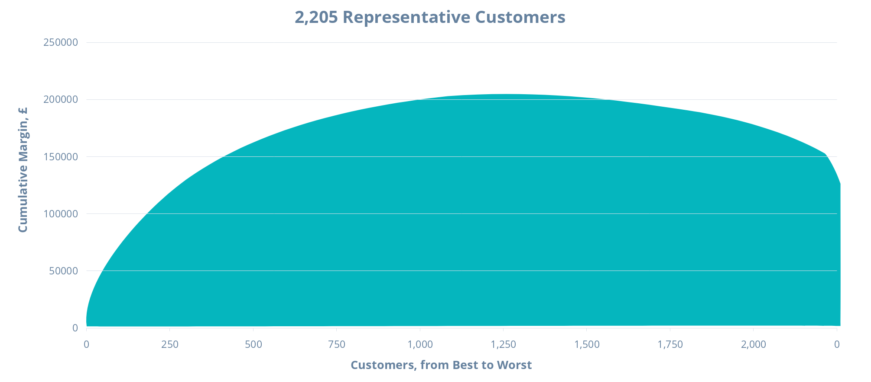
Infinity Bank - Customer Profitability

Slide 49
Infinity Bank - Customer Profitability
This is called the Whale Curve of Cumulative Profitability. Very Typical.

Slide 50
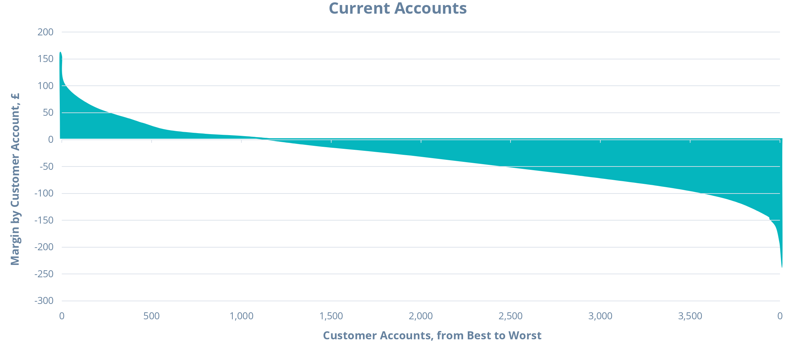
Infinity Bank - Customer Profitability

Slide 51
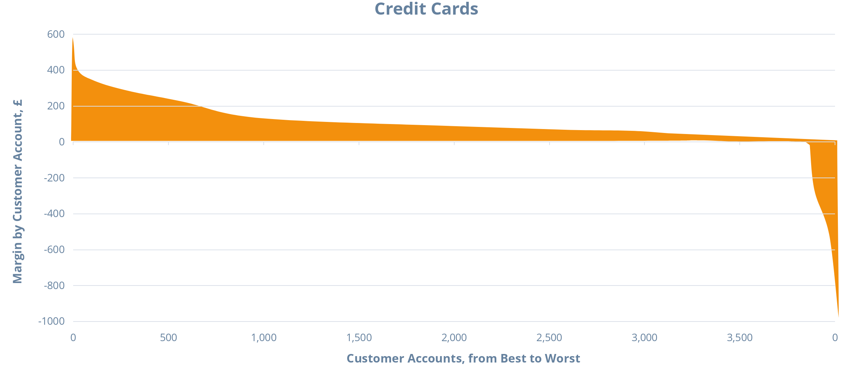
Infinity Bank - Customer Profitability

Slide 52
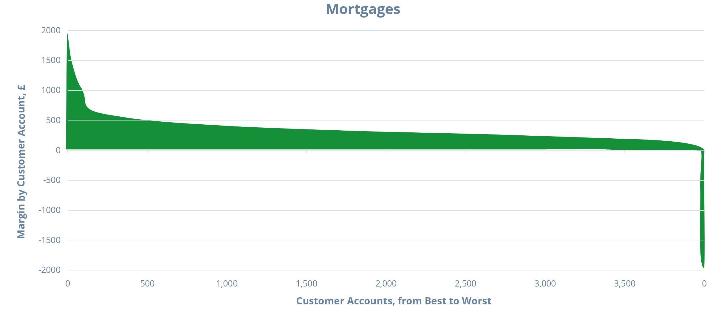
Infinity Bank - Customer Profitability

Slide 53
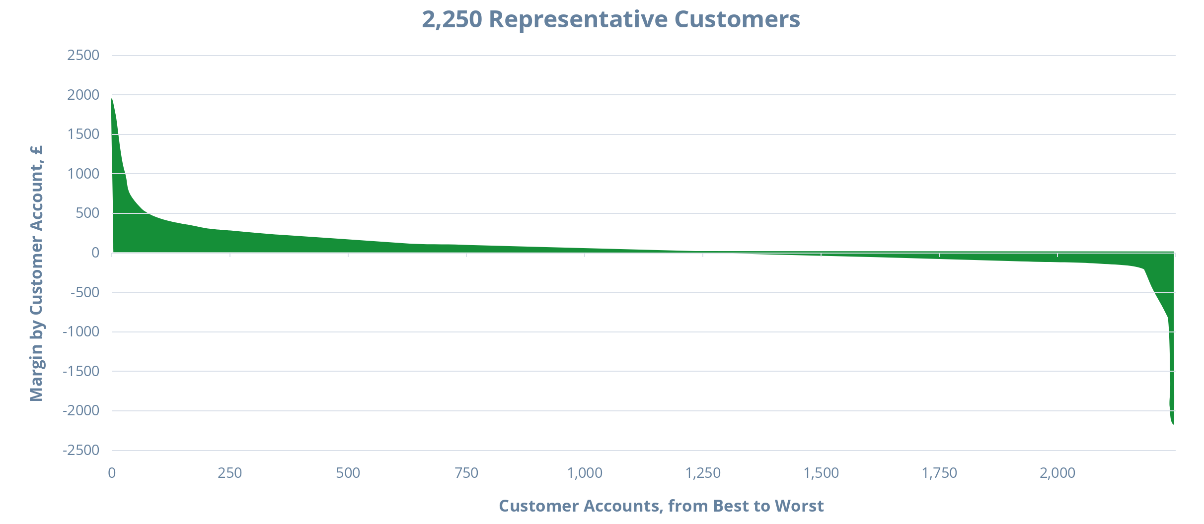
Infinity Bank - Customer Profitability

Slide 54
Credit-Card Account Averages
 | CC Only | CC + CA | CC + M | All 3
CC Balance | £543 | £943 | £704 | £951
CC rate margin | 9.63% | 10.19% | 10.13% | 10.33%
CC Rev Int | £52 | £96 | £71 | £98
CC Rev Other | 34 | 44 | 39 | 46
CC Rev | £87 | £140 | £110 | £144
CC Def Costs | £29 | £17 | £19 | £15
CC Serv Costs | 22 | 18 | 20 | 18
CC Costs | £51 | £35 | £39 | £33
CC Margin(£) | £36 | £106 | £71 | £111

Slide 55
Sources of Variation in Customer Prof.
Different revenue drivers and cost drivers
Some customers holding multiple products, mostly CA+CC, were still unprofitable
The majority of customers with a low profit / loss do not have a mortgage
At very high levels of profitability, all customers have a mortgage with large balance

Slide 56
How should we use this information?
Improve cost allocation
Devise appropriate marketing strategies. Examples are
Encourage CA holders to cross-holdings (promotional offers)
Promote the most profitable customers to attract new customers

Slide 57
Takeaways - Customer Profitability
Product or service profitability is not enough
Need to take into account the customer lifetime value
Go after competitors' high-profit customers
Analyze the benefit of expensive customers
Take actions to improve customer profitability

