Slide 1





Strategic Cost Management & New Technologies
Prof. Mario Milone MGT(P)495

Slide 2
Session 6 Profitability Analysis

Slide 3
Outline
Join product costing
Strategic Competition
The case of Ryanair initial launch strategy
Strategy and Balanced Scorecard: Introduction

Slide 4
Joint Product Costing

Slide 5
Joint Product Costing
Remember Death Spiral when cutting product lines
Increase in OH
leading to increase in cost
leading to cutting more product lines
Some similarity and differences when considering Joint Costs

Slide 6
Joint Costs
Join Cost: Cost incurred to produce two or more outputs from the same input
Consider a firm that produces fillets, drumstick and wings from chickens.
The chicken and the initial processing part costs $2.00

Slide 7
Joint Costs: Split-Off point
Split-off point: The point beyond which further processing has to take place for fillets, drumsticks and wings before they can be sold
Let us consider the following data
 | Price | Further Processing Cost | Net realizable Value
Fillets | $2.40 | ($0.80) | $1.60
Drumsticks | $0.80 | ($0.04) | $0.76
Wings | $0.30 | ($0.16) | $0.14

Slide 8
Joint Costs Decisions
Should a product be sold at the split-off point or processed further?
Is the joint cost incurred up to the split-off point relevant in deciding whether to process further?
How to allocate joint costs to products?

Slide 9
Joint Costs: How to Allocate?
We need to allocate the joint costs of $2.00
By weight seems appropriate (Weight in oz)
 | Total | Fillets | Drumsticks | Wings
Weight | 32 | 16 | 12 | 4
% Weight | 100% | 50% | 37.5% | 12.5%
Allocated Cost | $2.00 | $1.00 | $0.75 | $0.25

Slide 10
Net Profits with Join Cost Allocation
With weight-based allocation
If input/output prices are fixed, it appears optimal to drop the wings
 | Net Realizable Value | Joint Costs Allocated | Net Profit
Fillets | $1.60 | ($1.00) | $0.60
Drumsticks | $0.76 | ($0.75) | $0.01
Wings | $0.14 | ($0.25) | ($0.11)
 | $2.50 | ($2,00)

Slide 11
Joint Costs: How to Allocate:
Let's drop the wings
Redistribute the costs by weight again across fillets and drumsticks
 | Total | Fillets | Drumsticks
Weight | 32 | 16 | 12
% Weight | 100% | 57% | 43%
Allocated Cost | $2.00 | $1.40 | $0.86

Slide 12
Joint Cost Allocation: Death Spiral
Net Profits with weight-based allocation
Now, it seems optimal to drop the drumsticks
 | Net Realizable Value | Joint Costs Allocated | Net Profit
Fillets | $1.60 | ($1.14) | $0.46
Drumsticks | $0.76 | ($0.86) | ($0.10)
 | $2.36 | ($2,00)

Slide 13
Joint Cost Allocation: Death Spiral
Let’s drop the drumsticks
Net Profits with weight-based allocation
And then now we should drop the fillets!
 | Net Realizable Value | Joint Costs Allocated | Net Profit
Fillets | $1.60 | ($2.00) | ($0.40)
 | $1.60 | ($2,00)

Slide 14
Joint Costs & Net Realizable Value
Let us change the way we allocate the joint costs
We now allocate the costs by proportion of NRV
Joint Costs shift from Drumsticks and Wings towards Fillets
 | Total | Fillets | Drumsticks | Wings
NRV | $2.50 | $1.60 | $0.76 | $0.14
% NRV | 100% | 64% | 30.4% | 5.6%
Allocated Cost | $2.00 | $1.28 | $0.61 | $0.11

Slide 15
Joint Costs & Net Realizable Value
Profits with NRV-based allocation
 | Net Realizable Value | Joint Costs Allocated | Net Profit
Fillets | $1.60 | ($1.28) | $0.32
Drumsticks | $0.76 | ($0.61) | $0.15
Wings | $0.14 | ($0.11) | $0.03
 | $2.50 | ($2,00)

Slide 16
Joint Costs & Net Realizable Value
Proportion of Net Realizable Value (NRV) is the only correct way to allocate joint costs
Why?
Once the joint costs are incurred, the company is going to have fillets, drumstick and wings anyway
As long as the profit margins on each of those products are positive, the joint costs are essentially irrelevant in deciding the relative profitability of product lines

Slide 17
Takeaways
Death Spirals result not just from overhead allocation but also from cost-of-raw material allocations as well
In most or at least many cases, there are credible alternate allocation methods to avoid death spirals
e.g. Joint Costs should be allocated using Net Realizable Values.

Slide 18
Takeaways
Joint Product Costs incurred prior to the split-off point are sunk costs
Not affected by a decision to process further after the split-off point
A product should be processed beyond the split-off point only if the incremental revenue exceeds the incremental processing costs

Slide 19
Strategic Competition and Profitability

Slide 20
Profitability and Strategy
Profitability and Strategy are tightly intertwined
We cannot assess profitability correctly without an understanding of the competition and strategic interaction
Let’s have a look at Ryanair Initial Launch Strategy
Combines elements of pricing, competition and profitability.

Slide 21
The case of Ryanair
Since 1985, Ryanair had operated a 4-seat turboprop between Waterfront (Ireland) and Gatwick Airport (London)
In 1986, Ryanair announced that it would soon commence service between Dublin and London (Luton)
For the first time, Ryanair is going to face Aer Lingus (AL) and British Airways (BA) on a major route

Slide 22
Ryanair
The Dublin-London route was reputed to be quite lucrative
Only route for Aer Lingus that has a reasonable return on capital
Current least expensive fares on those routes from Aer Lingus and BA
I£208 (UK£189)
Discount fares as low as I£99 if booked one month in advance
Ryanair entended to run 4 roundtrips per day with 44-seat turboprop
Differentiation strategy: deliver first-rate customer service
Simple single fare of I£98 with no restrictions

Slide 23
Ryanair
Our Focus
Assess Ryanair's initial launch Strategy
Can Ryanar make money at a fare of 98?
Two important facts
US airlines seem to be more efficient than European airlines (in terms of costs and staff per passenger)
Ryanair estimates that Aer Lingus and BA have utilization rates of 60-70%

Slide 24
AL and BA Cost Structure (per passenger)
 | Aer Lingus / BA
Revenue | 166.5
 | Total Cost | Fixed Costs | Marg. Costs
Staff | 35.7 | 35.7
Depr. & Amort. | 8.6 | 8.6
Fuel & Oil | 31.8 | 31.8
Engineering | 9.8 | 9.8
Selling | 18 | 9.0 | 9.0
Aircraft Op. Leases | 3.4 | 3.4
Landing Fees | 11.7 |  | 11.7
Catering | 16.6 | 8.3 | 8.3
Subtotal | 155.1 | 126.1 | 29.0
Operating Profit | 11.4
Airline Industry is dominated by fixed costs

Slide 25
Efficiency U.S. VS European Airlines
Number of passengers per staff
U.S. Airlines (typical) | British Airways
708 passengers per staff | 483 passengers per staff

Slide 26
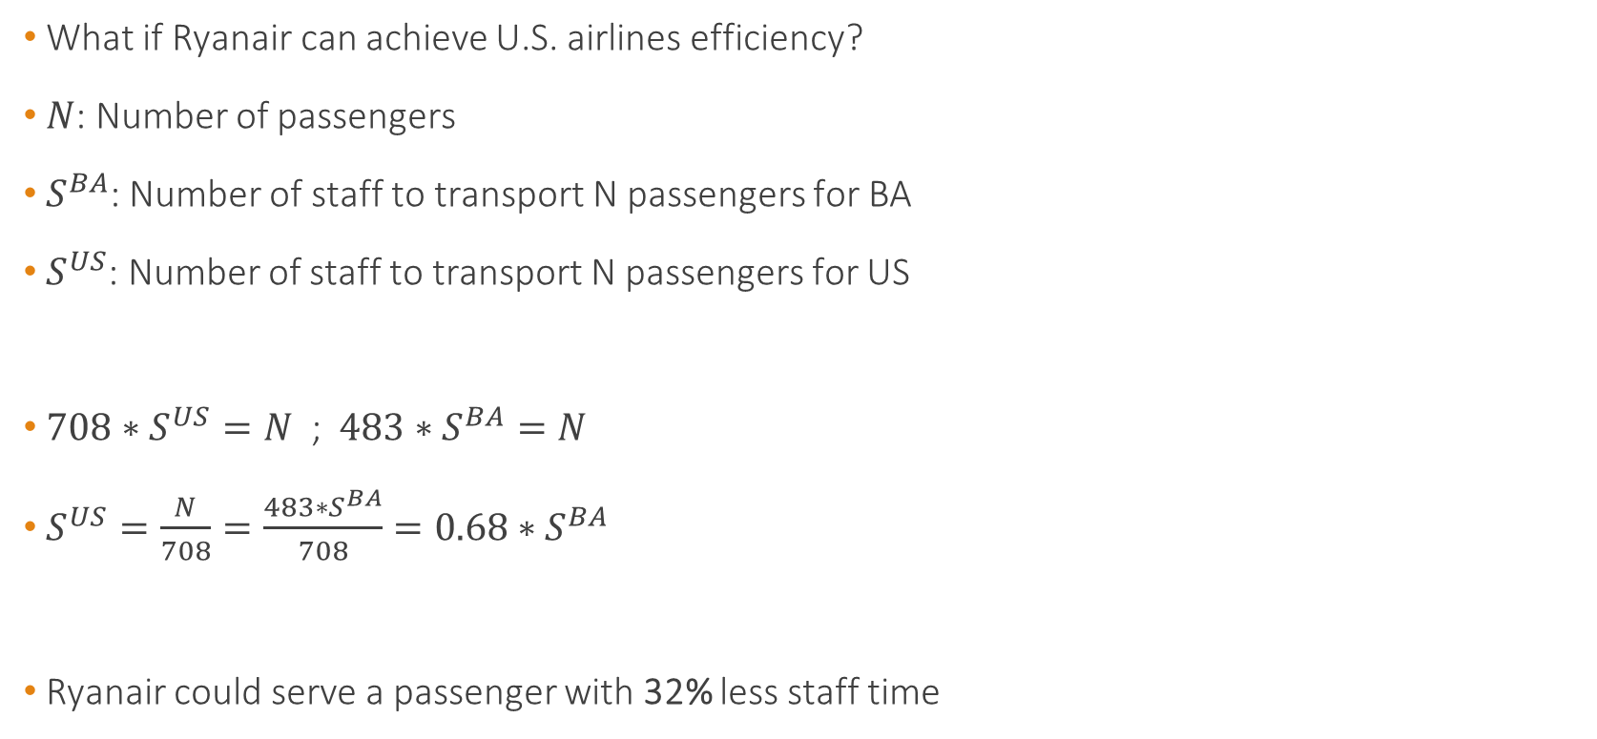
Ryanair's Cost Structure
What if Ryanair can achieve U.S. airlines efficiency?
$N$: Number of passengers
$S^{BA}$: Number of staff to transport N passengers for BA
$S^{US}$: Number of staff to transport N passengers for US
$708∗S^{US}=N$ ; $483∗S^{BA}=N$
$S^{US}=\frac{N}{708}=\frac{483∗S^{BA}}{708}=0.68∗S^{BA}$
Ryanair could serve a passenger with 32% less staff time

Slide 27
Ryanair's Cost Structure
 | Aer Lingus / BA |  |  | Greater Efficiency
Revenue | 166.5
 | Total Cost | Fixed Costs | Marg. Costs | Fixed Costs | Marg. Costs
Staff | 35.7 | 35.7 |  | 24.2
Depr. & Amort. | 8.6 | 8.6 |  | 8.6
Fuel & Oil | 31.8 | 31.8 |  | 31.8
Engineering | 9.8 | 9.8 |  | 9.8
Selling | 18 | 9.0 | 9.0 | 6.1 | 6.1
Aircraft Op. Leases | 3.4 | 3.4 |  | 3.4
Landing Fees | 11.7 |  | 11.7 |  | 11.7
Catering | 16.6 | 8.3 | 8.3 | 5.7 | 5.7
Subtotal | 155.1 | 126.1 | 29.0 | 109.1 | 23.5
Operating Profit | 11.4

Slide 28
Ryanair's Cost Structure
Can Ryanair do better?
AL and BA figures are based on their current utilisation rates (60-70%)
Ryanair could spread its fixed costs per flight over more passengers
How much should the costs per passenger be reduced?

Slide 29
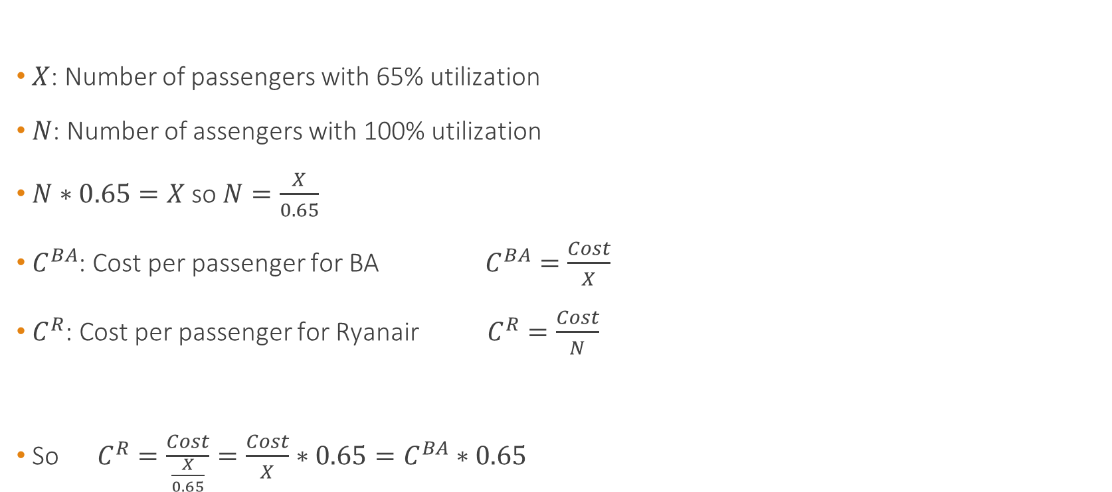
Ryanair's Cost Structure
$X$: Number of passengers with 65% utilization
$N$: Number of assengers with 100% utilization
$N∗0.65=X$ so $N=\frac{X}{0.65}$
$C^{BA}$: Cost per passenger for BA $C^{BA}=\frac{Cost}{X}$
$C^{R}$: Cost per passenger for Ryanair $C^{R}=\frac{Cost}{N}$
So $C^{R}=\frac{Cost}{\frac{X}{0.65}}=\frac{Cost}{X}∗0.65=C^{BA}∗0.65$

Slide 30
Ryanair's Cost Structure
 | Aer Lingus / BA |  |  | Greater Efficiency |  | Effic. + 100% Utilization
Revenue | 166.5
 | Total Cost | Fixed Costs | Marg. Costs | Fixed Costs | Marg. Costs | Fixed Costs | Total Costs
Staff | 35.7 | 35.7 |  | 24.2 |  | 15.8 | 15.8
Depr. & Amort. | 8.6 | 8.6 |  | 8.6 |  | 5.6 | 5.6
Fuel & Oil | 31.8 | 31.8 |  | 31.8 |  | 20.7 | 20.7
Engineering | 9.8 | 9.8 |  | 9.8 |  | 6.4 | 6.4
Selling | 18 | 9.0 | 9.0 | 6.1 | 6.1 | 4.0 | 10.1
Aircraft Op. Leases | 3.4 | 3.4 |  | 3.4 |  | 2.2 | 2.2
Landing Fees | 11.7 |  | 11.7 |  | 11.7 |  | 11.7
Catering | 16.6 | 8.3 | 8.3 | 5.7 | 5.7 | 3.7 | 9.3
Subtotal | 155.1 | 126.1 | 29.0 | 109.1 | 23.5 | 70.9 | 94.4
Operating Profit | 11.4

Slide 31
How about the Competitors' Response?
Ryanair seems to be able to pull it off but
Will fares remain at this level or drop further?
What response can we expect from competitors?
Competitors have 2 options (remember game theory again here)
Peace: Accommodation
Fight: Retaliation
Questions are
How expensive would it be to accomodate?
How expensive would it be to retaliate?

Slide 32

Competitors' Response
How big is Ryanair's intended business?
Ryanair intends to run 4 trips daily with a 44-seat turboprop
$4∗44∗365=64,240$ round trip seats of capacity per year
Note (important): AL and BA currently operate 500,000 round-trips per year

Slide 33
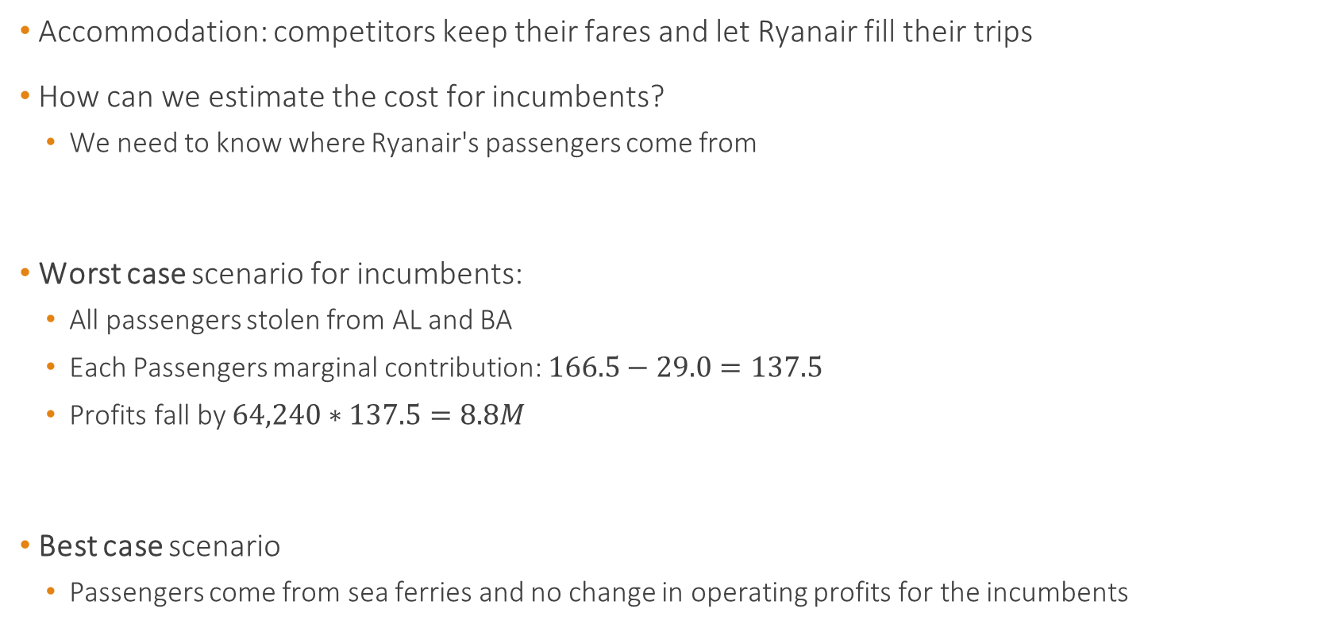
Cost of Accommodation
Accommodation: competitors keep their fares and let Ryanair fill their trips
How can we estimate the cost for incumbents?
We need to know where Ryanair's passengers come from
Worst case scenario for incumbents:
All passengers stolen from AL and BA
Each Passengers marginal contribution: $166.5−29.0=137.5$
Profits fall by $64,240∗137.5=8.8M$
Best case scenario
Passengers come from sea ferries and no change in operating profits for the incumbents

Slide 34
Cost of Retaliation
Retaliation: AL and BA cut fares to prevent Ryanair from getting any customers
Assume they reduce fares from 166.5 to 98
Impact of reduced fares
Prevent Ryanair from getting customers
Could attract new fliers from the sea ferries
But how many customers?

Slide 35
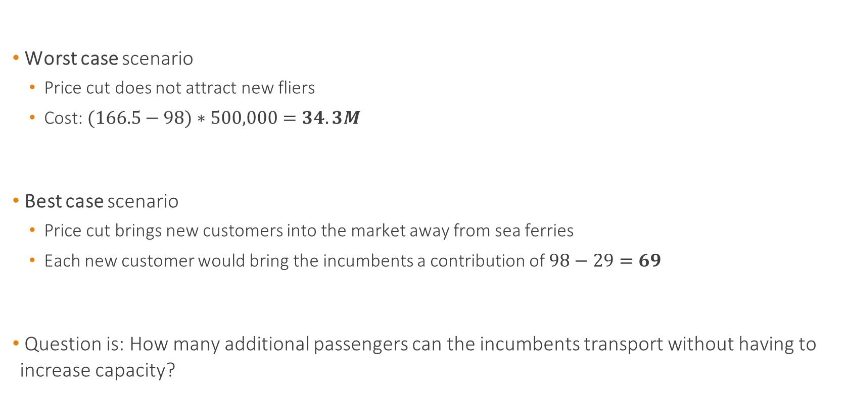
Cost of Retaliation
Worst case scenario
Price cut does not attract new fliers
Cost: $(166.5−98)∗500,000=34.3M$
Best case scenario
Price cut brings new customers into the market away from sea ferries
Each new customer would bring the incumbents a contribution of $98−29=69$
Question is: How many additional passengers can the incumbents transport without having to increase capacity?

Slide 36
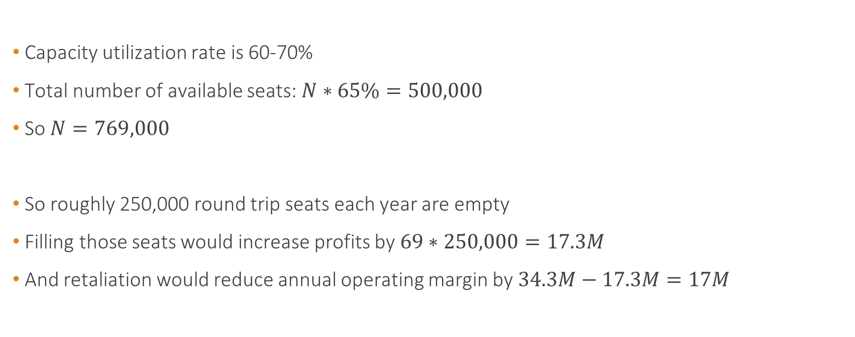
Cost of Retaliation
Capacity utilization rate is 60-70%
Total number of available seats: $N∗65\%=500,000$
So $N=769,000$
So roughly 250,000 round trip seats each year are empty
Filling those seats would increase profits by $69∗250,000=17.3M$
And retaliation would reduce annual operating margin by $34.3M−17.3M=17M$

Slide 37
Competitors' Response
Let's summarize
Why is the cost of accommodation so low?
Ryanair is currently relatively small
Analysis assumes that Ryanair does not expand beyond its current seat capacity
Scenario | Effect on operating profit of incumbents
Accommodation | Reduction by 0 - 8.8M
Retaliation | Reduction by 17 - 34.3M or worse if prices fall

Slide 38
Discussion
What if Ryanair increases capacity and expands?
Going after Ryanair's customers by decreasing prices becomes much more attractive
Retaliation (price war) becomes more likely
What happens if marginal costs are high?
AL and BA are less likely to drop prices to go after Ryanair's customers

Slide 39
Strategy and Balanced Scorecard

Slide 40
Strategy and Profitability
Strategy describes how an organization creates value
Most critical is the understanding of the industry.
Remember last week's Porter's 5 forces for this analysis
Strategy, profitability and performance and control are all linked
Today, we focus on how to organize our thoughts
In next sessions, we will talk more about Control and Performance Evaluation

Slide 41
Strategy and Profitability
What affects profitability and how to measure it?
Financial measures
Accounting-based measures (sales, profit, cash-flow ...)
Market-based measure (stock returns)
Limitations of financial measures
Impact of risky decisions (short-term vs long-term)
Financial measures are the outcome of decisions.
It is Historical.

Slide 42
Strategy and Profitability
Non-Financial measures
Productivity
Quality
Customer Satisfaction
Market Share
...
Contrary to financial measures, non-financial measures are difficult to estimate
How do we assess their impact for profitability?

Slide 43
Balanced Score Card
Provides a framework to understand and explicit the link between strategy and performance measures to improve profitability.
Uses multiple Financial and Non-Financial measures to
Clarify
Communicate
Implement
Evaluate business strategy

Slide 44
Balanced Score Card
What is my vision of the Future?
Statement of Vision
If my vision Succeeds, How will I differ?
To my Shareholders
To my Customers
With my Internal Mgt Process
With my Ability to Innovate and Grow
Financial
Perspective
Customer
Perspective
Internal
Perspective
Innovation
and Learning
What are the Critical Success Factors?
...
...
...
...
What are the Critical Measurements?
The Balanced Score Card
...
...
...
...

Slide 45
Balanced Score Card: Four Perspectives
Financial Perspective
Return-on-Capital-Employed
Cash Flow
Project Profitability
Profit Forecast Reliability
Customer Perspective
Customer Ranking Survey
Customer Satisfaction Index
Market Share
Internal Business Perspective
Safety Incident Index
Project Performance Index
Rework
Innovation and Learning Perspective
Rate of Improvement Index
Staff Attitude Survey

Slide 46
Balanced Score Card
Measures should be linked by cause-and-effect
Balanced Scorecard should
Articulate strategy
Communicate strategy via specific measures
Emphasize measures that are linked to results and goals
Learning & growth
Internal
Customer
Financial

Slide 47
Takeaways
Joint Product Cost should be though of differently
Strategic interaction is important in profitability analysis
Balanced Scorecard provides a framework to think of strategy, performances, and appropriate performances/profitability measurements
Let's see how this works for Store24 after the break

