Slide 1





Strategic Cost Management & New Technologies
Prof. Mario Milone MGT(P)495

Slide 2
Session 8 Control and Performance Evaluation

Slide 3
Outline
Performance Measures
Financial VS Non-Financial
Accounting-based Measures
Control and Accountability
Span of Control
Span of Accountability
Incentive Compensation

Slide 4
Performance Measures

Slide 5
Financial VS Non-Financial
Remember our class on the Balanced Scorecard
Non-financial measures lead financial measures
Allows to articulate the strategy and come up with appropriate measures
Non-financial measure allow to make improvements in the Learning-and-Growth perspective

Slide 6
Non-Financial Measure
Doing it right | Doing it wrong
Develop a causal model | Not linking measures to strategy
Gather data | Not validating the links
Turn data into information | Setting the wrong performance targets
Continually refine the model | Measuring incorrectly
Base actions on findings
Assess outcomes

Slide 7
Accounting-based Measures
Operating Profits / Income
Return on Investment (ROI)
Residual Income (RI)
Economic Value Added (EVA)

Slide 8
Operating Profits / Income
Pros
Very easy to calculate and comparable
Well understood
Cons
Not always representative of cash flows
Manipulable in the short-term
Macro factors are uncontrollable

Slide 9
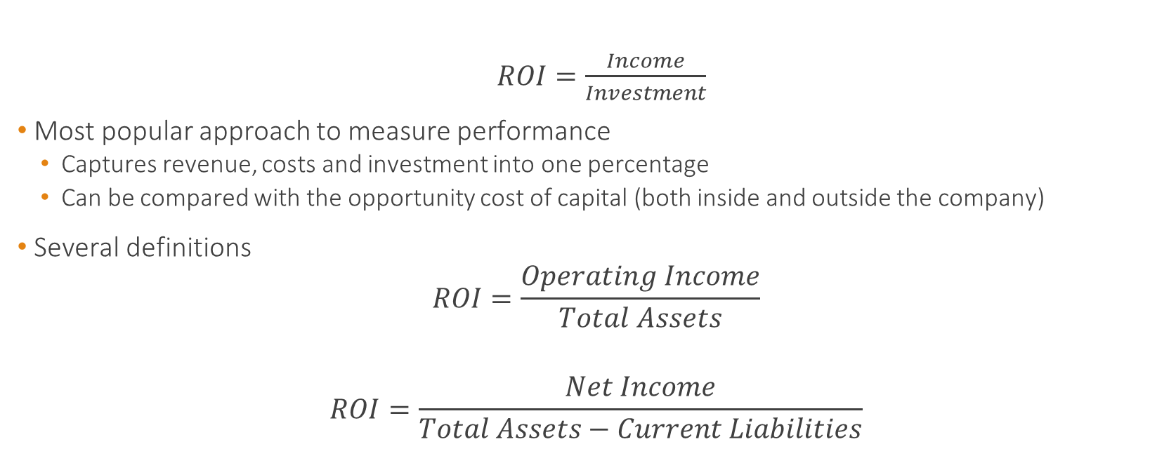
Return on Investment (ROI)
$ROI=\frac{Income}{Investment}$
Most popular approach to measure performance
Captures revenue, costs and investment into one percentage
Can be compared with the opportunity cost of capital (both inside and outside the company)
Several definitions
$$ROI=\frac{Operating Income}{Total Assets}$$
$$ROI=\frac{Net Income}{Total Assets−Current Liabilities}$$

Slide 10
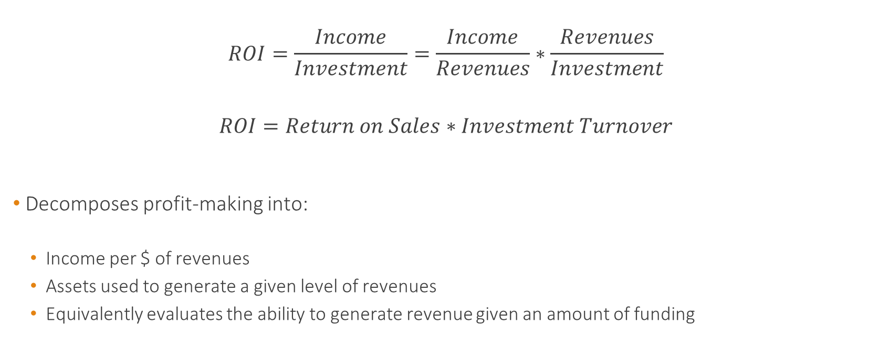
DuPont decomposition
$$ROI=\frac{Income}{Investment}=\frac{Income}{Revenues}∗\frac{Revenues}{Investment}$$
$$ROI=Return on Sales∗Investment Turnover$$
Decomposes profit-making into:
Income per $ of revenues
Assets used to generate a given level of revenues
Equivalently evaluates the ability to generate revenue given an amount of funding

Slide 11
DuPont decomposition
This decomposition helps understand how ROI can be increased
Decrease assets while keeping revenues and profits constant
Increase revenues (using the assets better) keeping income per revenue constant
Decrease costs while keeping revenues and assets constant

Slide 12
Return on Sales (ROS)
ROS is a component of ROI in the DuPont decomposition
Can be used as a separate performance measure
ROS measures how effectively companies manage costs

Slide 13
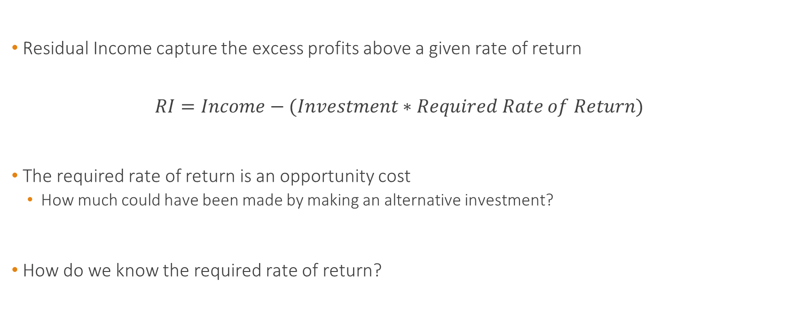
Residual Income (RI)
Residual Income capture the excess profits above a given rate of return
$$RI=Income−(Investment∗Required Rate of Return)$$
The required rate of return is an opportunity cost
How much could have been made by making an alternative investment?
How do we know the required rate of return?

Slide 14
Residual Income (RI)
Always think about risk!
What is the rate of return associated with a business which faces similar risk?
Can look at comparable companies
And use CAPM to compute the required rate of return
Don't forget to take into account leverage when you do that!
Linked to IRR when making investment choices

Slide 15
ROI vs RI
RI is a dollar amount instead of a ratio
Using ROI as a performance measure can lead to reject profitable projects
As it increases the denominator (Investment)
Particularly if the manager heads a profitable division

Slide 16
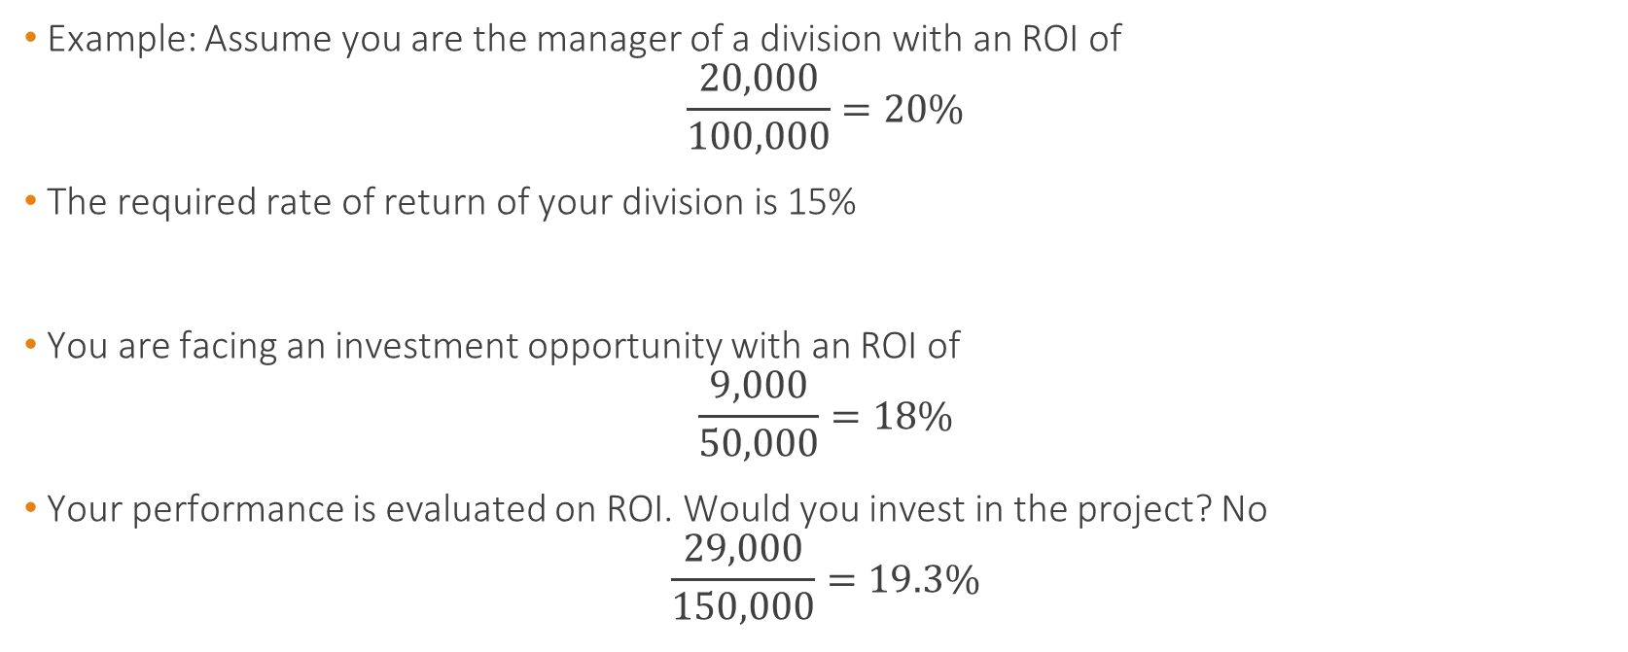
ROI vs RI
Example: Assume you are the manager of a division with an ROI of
$$\frac{20,000}{100,000}=20\%$$
The required rate of return of your division is 15%
You are facing an investment opportunity with an ROI of
$$\frac{9,000}{50,000}=18\%$$
Your performance is evaluated on ROI. Would you invest in the project? No
$$\frac{29,000}{150,000}=19.3\%$$

Slide 17

ROI vs RI
Your performance is evaluated on RI. Would you take the project? Yes
$${RI}_{No Project}=20,000−(100,000∗0.15)=5,000$$
$${RI}_{Project}=29,000−(150,000∗0.15)=6,500$$

Slide 18
ROI vs RI
These are general results
The new ROI is a weighted average of the current ROI and the ROI of the project
Any new project below the current ROI will be rejected by the manager
Even if it provides a return higher than the required rate of return
Being a dollar amount, RI aggregates linearly
Any new project's RI will add to the current RI

Slide 19
ROI vs RI
RI can be sensitivity to assumptions on the required rate of return
Consider 2 divisions
Division 1: Investment base of $1000 and Income of $200
Division 2: Investment base of $5,000 and Income of $750
 | Division 1 | Division 2
ROI | 200/1000 = 20% | 750/5000 = 15%
RI (@10%) | 200-(1000*0.1)=100 | 750-(5000*0.1) = 250
RI (@20%) | 200-(1000*0.2)=0 | 750-(5000*0.2) = -250

Slide 20
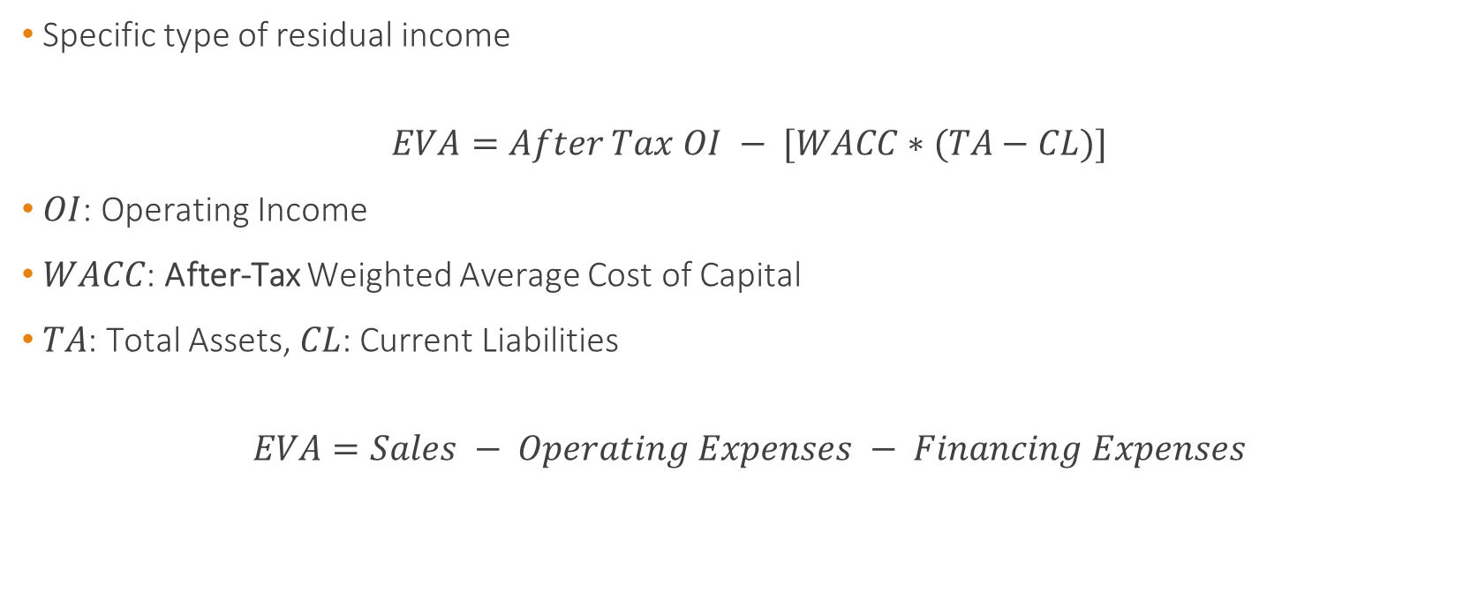
Economic Value Added (EVA)
Specific type of residual income
$$EVA=After Tax OI − [WACC∗(TA−CL)]$$
$OI$: Operating Income
$WACC$: After-Tax Weighted Average Cost of Capital
$TA$: Total Assets, $CL$: Current Liabilities
$$EVA=Sales − Operating Expenses − Financing Expenses$$

Slide 21
Economic Value Added (EVA)
Meant to capture the economic value creation
Allows the incorporation of the cost of capital at the company level
Charges managers for the cost of investment in Long-Term assets and Working Capital
Typical EVA compensation scheme:
Tied to both EVA and change in EVA
Often no cap on the upside potential
Bonus Bank (adjust for negative declines in the future)

Slide 22
Economic Value Added (EVA)
Example:
Income Tax Rate: 30%, Before Tax Operating income: $250,000
Compute the EVA
In million $ | Book Value | Market Value | Interest Rate at Issuance | Cost of Equity Capital
Debt | $2 | $2 | 13%
Equity | $0.5 | $1.5 |  | 20%
Total Assets | $2.5
Current Liabilities | $0.5

Slide 23

Economic Value Added (EVA)
WACC
After-Tax cost of debt = 13%*(1-30%)=9.1%
$$WACC=\frac{9.1\%∗2+20\%∗1.5}{2+1.5}=13.77\%$$
After Tax Operating Income = $250,000*(1-30%) = $175,000
$$EVA=0.175−[13,77\%∗(2−0.5)]=−0.0315$$
EVA = -$31,500

Slide 24
Control and Accountability

Slide 25
Span of Control
Resources the manager controls to accomplish the task she/he is responsible for.
Resources directly controlled by the manager
Headcounts
Budget allocations
Balance Sheet Assets
...

Slide 26
Span of Accountability
Range of performance measures used to evaluate the manager's achievements
Could be narrow (few trade-offs to consider) or very large
Responsible of operating expenses (narrow)
Market value of the firm (large)

Slide 27
Span of Accountability
Competitive Position
Market Value
Wide
Brand Equity
Residual Income
Market Share
Return on Capital Employed
Customer Satisfaction
P&L + Current Assets
Product Reliability
Profits & Loss
Outputs
Sales Revenue
Narrow
Process
Manufacturing Costs
Inputs
Operating Expenses

Slide 28
Controllability Principle
The controllability principle suggests that expected performance should depend on what can be controlled by the manager
That is, when someone is given authority (or control) over resources, they should be responsible (or accountable) for the performance of those resources
Let's look at what it means in terms of Span of Control and Span of Accountability

Slide 29
Line of Sight
When Span of Control = Span of Accountability, we call this "Line of Sight"
Managers are responsible only for what they can control
Few resources Span of Control Many Resources
Few Trade-Offs Span of Accountability Many Trade-Offs

Slide 30
Accountability > Control
Most jobs are not perfectly aligned
Often, Span of Accountability is wider than Span of Control
Few resources Span of Control Many Resources
Entrepreneurial Gap
Few Trade-Offs Span of Accountability Many Trade-Offs

Slide 31
Accountability > Control
Does this seem fair?
In these situations, employee is forced to find creative ways to meet her/his goal
Increases innovation

Slide 32
Incentive Compensation

Slide 33
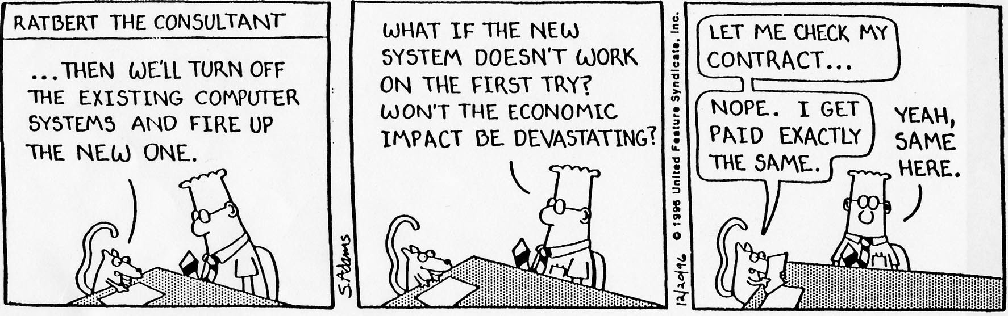
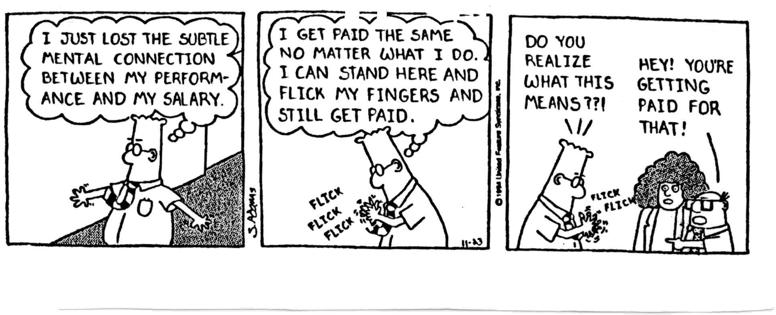
Incentive Compensation

Slide 34
Incentive Compensation - Outline
Performance Pay
Control
Stock VS Options
Severance Pay

Slide 35
Incentive Compensation
How to motivate effort?
How can we think of this problem using a theoretical framework?
Does the difference between the Span of Control and Span of Accountability matters for compensation?

Slide 36
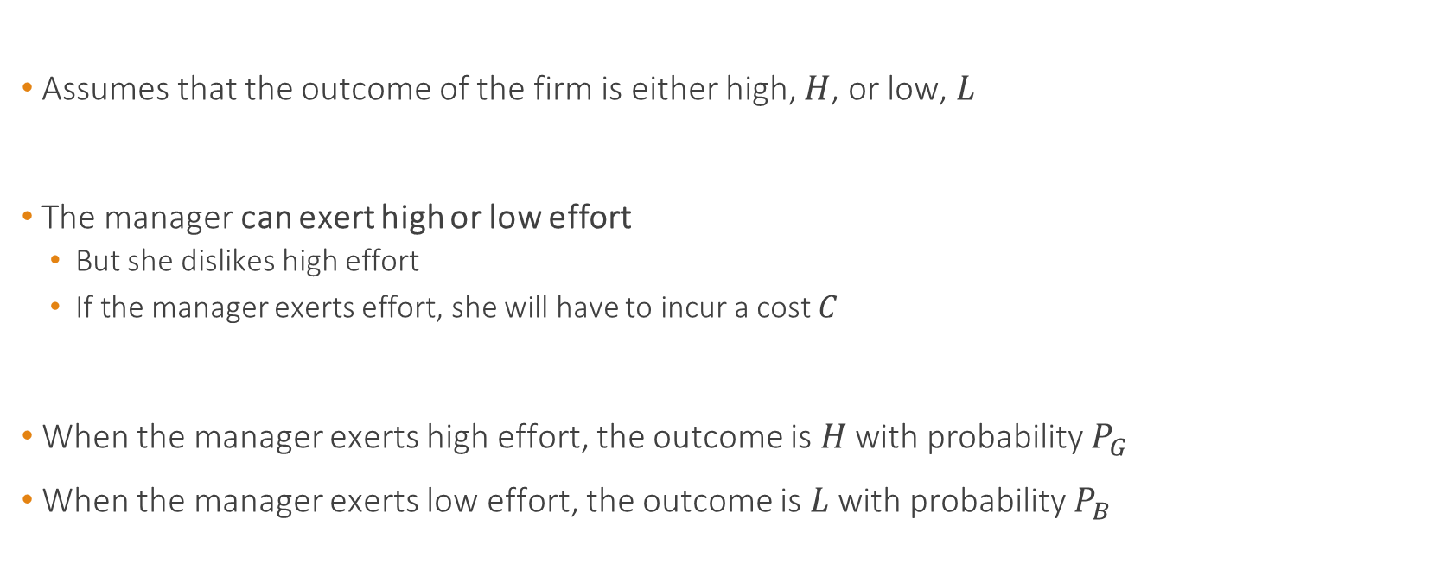
Performance Pay
Assumes that the outcome of the firm is either high, $H$, or low, $L$
The manager can exert high or low effort
But she dislikes high effort
If the manager exerts effort, she will have to incur a cost $C$
When the manager exerts high effort, the outcome is $H$ with probability $P_{G}$
When the manager exerts low effort, the outcome is $L$ with probability $P_{B}$

Slide 37









Performance Pay
High Effort
Low Effort
$$P_{G}$$
$$H$$
$$P_{B}$$
$$H$$
$${1−P}_{G}$$
$$L$$
$${1−P}_{B}$$
$$L$$
$$P_{G}>P_{B}$$

Slide 38



Performance Pay
How to motivate effort?
Assume the maximum punishment is to pay nothing
$$H$$
Pay a bonus $B$ in case of the high outcome
$$L$$
Punish the manager in case of the low outcome

Slide 39

Performance Pay
The manager will exert effort if
$$P_{G}B−C≥P_{B}B$$
$$B≥\frac{C}{P_{G} − P_{B}}$$
Cost of providing incentives (expected compensation cost)
$$P_{G}∗Bonus=P_{G}∗\frac{Effort Cost}{P_{G} − P_{B}}$$

Slide 40
Performance Pay
Bonus compensation increases with
The cost of effort
Bonus compensation decreases with
The impact the manager has on outcome by exerting effort

Slide 41
Span of Control and Accountability
For example, what happens when using stock compensation?
Problem: Managers may have little control over firm overall performance.
How can we understand the implications in terms of compensation?

Slide 42

Span of Control and Accountability
Remember,
$P_{G}$ is the probability of high outcome (bonus) if she works
$P_{B}$ is the probability of high outcome (bonus) if she shirks
What happens if $P_{G}−P_{B}$ decreases?
That means that the manager's action has a smaller impact on the expected outcome
That is, the manager has less control

Slide 43
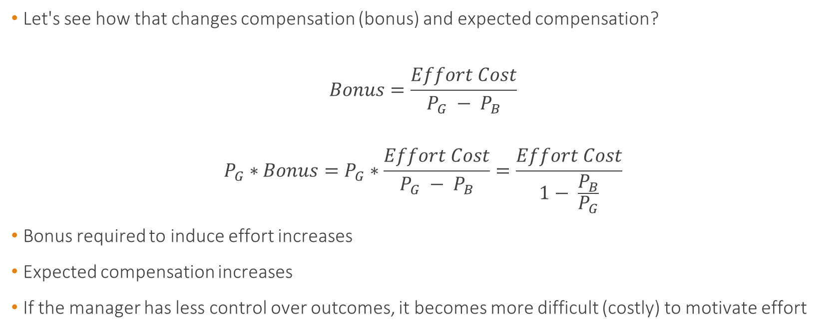
Span of Control and Accountability
Let's see how that changes compensation (bonus) and expected compensation?
$$Bonus=\frac{Effort Cost}{P_{G} − P_{B}}$$
$$P_{G}∗Bonus=P_{G}∗\frac{Effort Cost}{P_{G} − P_{B}}=\frac{Effort Cost}{1− \frac{P_{B}}{P_{G}}}$$
Bonus required to induce effort increases
Expected compensation increases
If the manager has less control over outcomes, it becomes more difficult (costly) to motivate effort

Slide 44





How about using stock as compensation?
Assumes that $H>L$ and that the manager obtains $N_{S}$ shares of stock
$$H$$
$H$ is the stock price in case of success
$$L$$
$L>0$ is the stock price in case of failure

Slide 45

How about using stock as compensation?
The manager will exert effort if
$$P_{G}N_{S}H+{(1−P}_{G})N_{S}L−C≥P_{B}N_{S}H+{(1−P}_{B})N_{S}L$$
$$N_{S}≥\frac{C}{{(H − L)(P}_{G} − P_{B})}$$

Slide 46
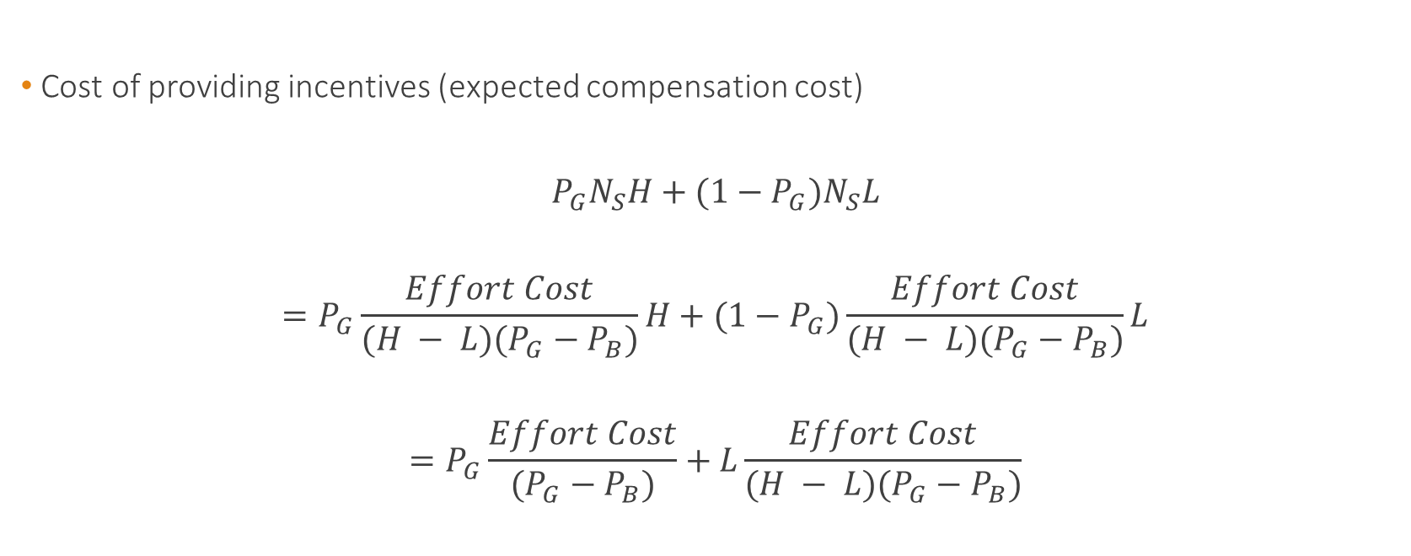
How about using stock as compensation?
Cost of providing incentives (expected compensation cost)
$$P_{G}N_{S}H+{(1−P}_{G})N_{S}L$$
$$=P_{G}\frac{Effort Cost}{{(H − L)(P}_{G} − P_{B})}H+{(1−P}_{G})\frac{Effort Cost}{{(H − L)(P}_{G} − P_{B})}L$$
$$=P_{G}\frac{Effort Cost}{{(P}_{G} − P_{B})}+L\frac{Effort Cost}{{(H − L)(P}_{G} − P_{B})}$$

Slide 47

How about using stock as compensation?
Cost of providing incentives (expected compensation cost)
$$=P_{G}\frac{Effort Cost}{{(P}_{G} − P_{B})}+L\frac{Effort Cost}{{(H − L)(P}_{G} − P_{B})}$$
What was it before?
$$P_{G}∗Bonus=P_{G}∗\frac{Effort Cost}{P_{G} − P_{B}}$$

Slide 48

How about using stock as compensation?
Why is it more expensive to compensate the manager using stock based compensation?
The manager still gets compensated for making no effort (gets $N_{S}L$)
Not optimal contract
Optimal contract has a zero compensation when no effort
How can we manage that?

Slide 49

How about using stock options?
Exercise Price (Strike Price): $K$
We assume that
$$L<K<H$$
The manager is given $N_{O}$ stock options

Slide 50





How about using stock options?
So we can replicate the first contract (the one that paid a bonus)
$$N_{O}(H−K)=bonus=\frac{Effort Cost}{P_{G} − P_{B}}$$
$$N_{O}=\frac{Effort Cost}{(H−K)(P_{G} − P_{B})}$$
$$H$$
Manager receives $N_{O}(H−K)$
$$L$$
Manager receives $0$

Slide 51
Stock Options and Risk-Taking
OK, so stock options encourage effort
But they also encourage risk-taking
payoff
payoff
0
0
X
Stock price
Stock price

Slide 52
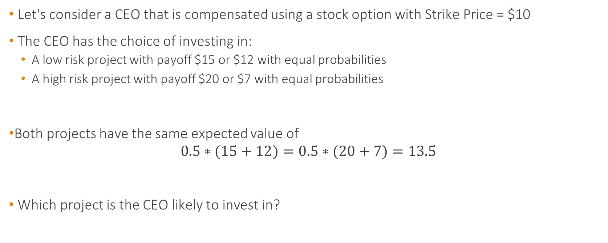
Stock Options and Risk-Taking
Let's consider a CEO that is compensated using a stock option with Strike Price = $10
The CEO has the choice of investing in:
A low risk project with payoff $15 or $12 with equal probabilities
A high risk project with payoff $20 or $7 with equal probabilities
Both projects have the same expected value of
$$0.5∗(15+12)=0.5∗(20+7)=13.5$$
Which project is the CEO likely to invest in?

Slide 53

Stock Options and Risk-Taking
Expected payoff of investing in the low risk project:
$$0.5∗(15−10)+0.5∗(12−10)=3.5$$
Expected payoff of investing in the high risk project:
$$0.5∗(20−10)=5$$
Using stock options as compensation increases the risk appetite.

Slide 54
Stock Options and Risk-Taking
Expected Profits of the high-risk investment
payoff
Expected Profits of the low-risk investment
0
$10
Stock price

Slide 55
Severance Pay
Is severance pay detrimental to shareholders?
If so, why?
If not, why not?
Potential disadvantages:
Pay for poor performance: may dilute incentives
Potential benefits:
May induce the revelation of bad news
Or induce risk-taking

Slide 56
Severance Pay
How do we model these effects?
Interpret the effort as an investment in firm specific human capital
The CEO is either a good fit or a bad fit for the firm
If the CEO works, she will be more likely a good fit
If she is bad, she should be replaced
Problem: Only the CEO observes whether she is a good or bad fit
How to induce effort and revelation of information?

Slide 57






Severance Pay
Bonus
$$P_{G}$$
Good Fit
$$z$$
$${1−P}_{G}$$
Zero Compensation
Works
$$P_{B}$$
Bonus
Announces "good"
$$1−z$$
$${1−P}_{B}$$
Shirks
Bad Fit
Announces "bad"
Replaced / Possible Severance Pay

Slide 58
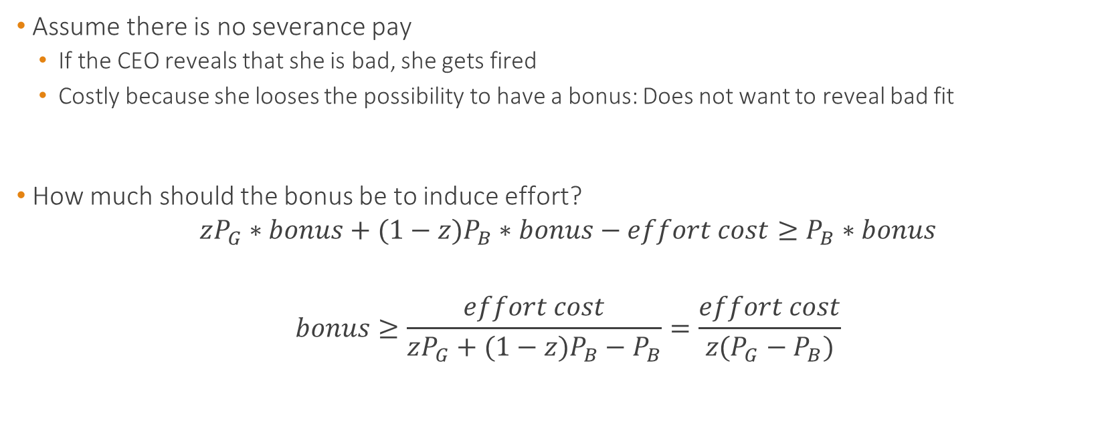
Severance Pay
Assume there is no severance pay
If the CEO reveals that she is bad, she gets fired
Costly because she looses the possibility to have a bonus: Does not want to reveal bad fit
How much should the bonus be to induce effort?
$$zP_{G}∗bonus+(1−z)P_{B}∗bonus−effort cost≥P_{B}∗bonus$$
$$bonus≥\frac{effort cost}{zP_{G}+(1−z)P_{B}−P_{B}}=\frac{effort cost}{z(P_{G}−P_{B})}$$

Slide 59

Severance Pay
Expected CEO compensation
$$zP_{G}∗bonus+(1−z)P_{B}∗bonus$$
$$=bonus∗(zP_{G}+(1−z)P_{B})$$
$$=\frac{effort cost}{z(P_{G}−P_{B})}(zP_{G}+(1−z)P_{B})$$

Slide 60
Severance Pay
Bonus
$$P_{G}$$
Good Fit
$$z$$
$${1−P}_{G}$$
Zero Compensation
Works
$$P_{B}$$
Bonus
Announces "good"
$$1−z$$
$${1−P}_{B}$$
Shirks
Bad Fit
Announces "bad"
Replaced + Severance Pay

Slide 61
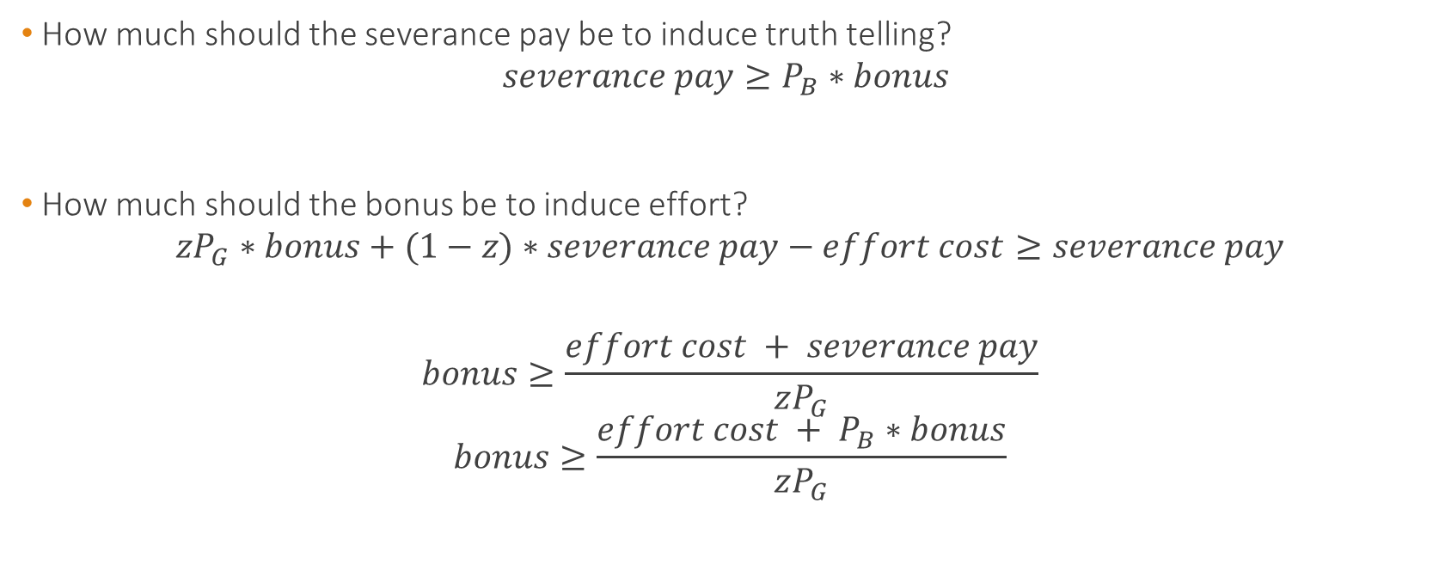
Severance Pay
How much should the severance pay be to induce truth telling?
$$severance pay≥P_{B}∗bonus$$
How much should the bonus be to induce effort?
$$zP_{G}∗bonus+(1−z)∗severance pay−effort cost≥severance pay$$
$$bonus≥\frac{effort cost + severance pay}{zP_{G}}$$
$$bonus≥\frac{effort cost + P_{B}∗bonus}{zP_{G}}$$

Slide 62

Severance Pay
How much should the bonus be to induce effort?
$$bonus≥\frac{effort cost + P_{B}∗bonus}{zP_{G}}$$
$$bonus≥\frac{effort cost}{z(P_{G}−P_{B})}$$
How much is the severance pay?
$$severance pay=P_{B}∗bonus=P_{B}\frac{effort cost}{z(P_{G}−P_{B})}$$

Slide 63

Severance Pay
Expected CEO compensation
$$zP_{G}∗bonus+(1−z)∗severance pay$$
$$=zP_{G}∗\frac{effort cost}{z(P_{G}−P_{B})}+(1−z)P_{B}\frac{effort cost}{z(P_{G}−P_{B})}$$
$$=\frac{effort cost}{z(P_{G}−P_{B})}(zP_{G}+(1−z)P_{B})$$

Slide 64
Severance Pay
In this setting, severance pay:
Induces the CEO to reveal bad news
Improves CEO turnover
Does not dilute effort incentives if chosen optimally
Cost of the incentive scheme remains unchanged

Slide 65
Takeaways
Multiple financial performance measures
Span of Control VS Span of Accountability
How to think about incentive compensation

