Slide 1



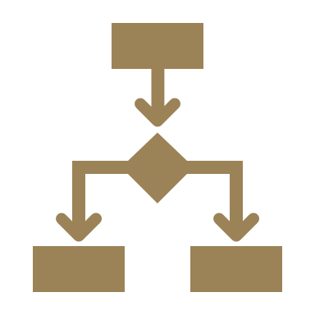

Strategic Cost Management & New Technologies
Prof. Mario Milone MGT(P)495

Slide 2
Session 9 Transfer Pricing
Part I

Slide 3
Outline
Vertical Integration
Transfer Pricing
Cost Based
Market Based
Minimum Transfer Price

Slide 4
Vertical Integration

Slide 5
Why do firms vertically integrate?
To gain control over scarce resources
Boeing tried to outsource 70% of its 787 and it was a disaster.
Parts came in late and did not fit together.
6,000 components, many failed to conform to Boeing's specified engineering tolerances, resulting in significant cost and delays.
Record number of orders but delivery date was pushed back four times.

Slide 6
Why do firms vertically integrate?
To avoid Holdup issues
Fisher Body had an exclusive contract wit GM to supply car body parts
Fisher Body was the only company to deliver the components according to GM's specifications
In 1920, a sharp increase in demand occurred (above expectations)
It is claimed that Fisher Body used the unforeseen situation to hold up GM by increasing the price for the additional parts produced
It has been said that this led GM to acquire Fisher Body in 1926
Note: This example is strongly disputed by Coase (2005).

Slide 7
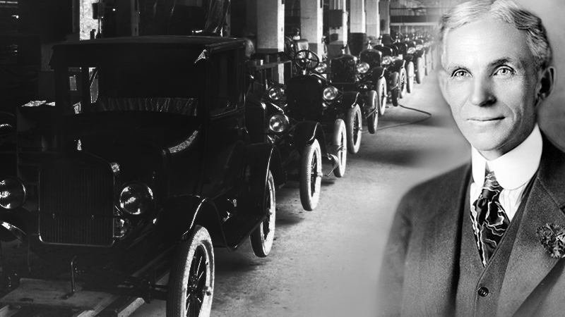

Vertical Integration
Vertical integration was very common a century ago
"If you want to do it right, do it yourself" - Henry Ford
Best vertical integration examples in the 1970-1980 are from the oil industry
BP and Shell cam to control every step involved in bringing a drop of oil
from Alaska to a vehicle's fuel tank

Slide 8


Dell's Virtual Integration
The idea of vertical integration was taken a step further by Dell Computer, one of the most successful companies of the 1990s. Michael Dell, its founder, said that he combined the traditional vertical integration of the supply chain with the special characteristics of the virtual organization to create something that he called “virtual integration”. Dell assembles computers from other firms’ parts, but it has relationships with those firms that are more binding than the traditional links between buyer and supplier. It does not own them in the way of the vertically integrated firm, but through exchanges of information and a variety of loose associations it achieves much the same aim – what Michael Dell calls “a tightly co-ordinated supply chain”.

Slide 9
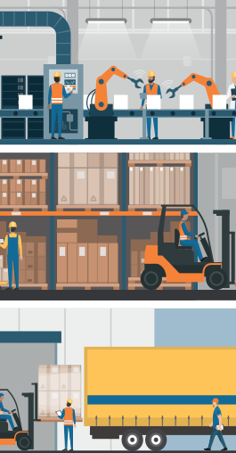
1990 - 2010: Lean Manufacturing
In the late 1990s, consultants McKinsey & Company wrote:
Whereas historically firms have vertically integrated in order to control access to scarce physical resources, modern firms are internally and externally disaggregated, participating in a variety of alliances and joint ventures and outsourcing even those activities normally regarded as core.
… for the past 30 years firms have been focusing on their core business and contracting out everything else to specialists. Steelmakers sold their mining operations and carmakers spun off their parts suppliers. Controlling it all made sense, the argument went, when markets were rudimentary: when supplies of vital materials were limited or contractors could cheat you. As markets became more sophisticated these justifications fell away. Thanks to globalization, companies could always find new resources and better suppliers.

Slide 10
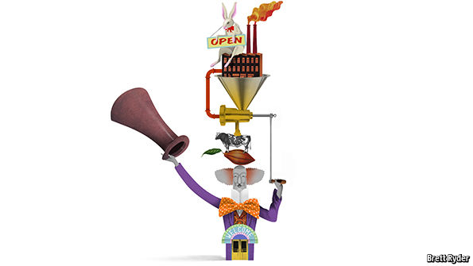
The latest trend: 2010 -
APPLE and Tesla are two of the world’s most talked-about companies. They are also two of the most vertically integrated. Apple not only writes much of its own software, but designs its own chips and runs its own shops. Tesla makes 80% of its electric cars and sells them directly to its customers. It is also constructing a network of service stations and building the world’s biggest battery factory, in the Nevada desert.
Elon Musk’s SpaceX believes the key to innovation and dramatically lower costs is to do as much as possible in-house and avoid the unwieldy multilayer supply chains and “cost-plus” billing used by its competitors. It builds everything from components to its rocket engines in-house at an integrated manufacturing facility in Los Angeles.

Slide 11
Simplicity and well integrated products command a premium
Reasons for the reversal abound, but five stand out. The most important is simplicity. Consumers are willing to pay a premium for well-integrated products that do not force them to deal with different suppliers or land them with components that do not talk to each other. They want to be able simply to press a button and let the machine to the rest. This is largely why Apple opted for integration, as did Nest, a maker of wireless thermostats.

Slide 12
If you are at the tech frontier, you may find no suppliers
A second reason is that firms operating on the technological frontier often find it more efficient to do things in-house. Companies that are inventing the future frequently have no choice but to pour money into new ventures rather than buy components off the shelf. This explains Tesla’s “gigafactory” for batteries: their availability is the biggest constraint on the firm’s growth.

Slide 13
Speed
Choice is reinforced by speed: fashion brands such as Spain’s Zara have resisted contracting out everything. Instead, they operate their own clothes factories, employ their own designers and run their own shops. This gives them a big advantage: they can turn the latest trend into new product, often in small batches, and have it in stores in a couple of weeks. Less vertically integrated brands such as Gap and American Apparel find they are stuck with yesterday’s creations because they cannot get supply chains to produce new wares quickly.

Slide 14
Decentralization
Vertical integration does not always imply centralization
(De)centralization requires a transfer pricing policy

Slide 15
Transfer Pricing

Slide 16
Objectives of Transfer Pricing
Transfer prices serve multiple purposes in vertically integrated companies with multiple divisions (Profit Centers)
Segment profitability measurement
Determine tax liabilities in different countries
Note: Transfer prices used for internal (managerial) purposes need not - and generally are not - the same ones used for tax purposes.
Multiple sets of Books

Slide 17
Transfer Pricing
Main points of transfer pricing:
Transfer prices split the overall corporate profit among business segments / division
Good transfer pricing rules incentivize divisional managers to make decisions in the overall corporate interest
Goal Congruence (division managers act in the best interest of the company)

Slide 18
Transfer Pricing
U
Upstream
Division
The transfer price (TP) becomes an expense in the income statement of the Downstream Division (D) and a revenue in the income statement of the Upstream Division (U)
Intermed. Product: q
D
Downstream
Division
Suppliers
Ext. Sales
Transfer Price: TP
Ext. Sales

Slide 19
Transfer Pricing Methods
Cost-Based transfer prices
Market-Based transfer prices
Minimum transfer price

Slide 20
Cost-Based Transfer Pricing
Transfer prices are derived from the cost incurred by the supplying division delivering the intermediate product.
Decision on quantity to be transferred typically made by the buying downstream division.
Pull System
Common cost-based transfer prices include:
Full cost
Variable cost
Full (or Variable) cost plus mark-up

Slide 21
Illustration: Megabuck
Megabuck Inc. has an Upstream Division that transfers an intermediate product to the Downstream Division, which then completes and sells the final product.
Each unit of the final product requires one unit of the intermediate product plus other inputs (sourced by the Downstream Division) resulting in a unit variable cost of $4 per unit
 | Upstream Division | Downstream Division
Fixed Cost | $4,000 | $3,000
Unit Variable Cost | $5 | $4
Capacity Constraint | 7,000 units

Slide 22

Illustration: Megabuck
U
Upstream
Division
D
Downstream
Division
Market demand for the final product is estimated to follow
$$P=18−0.001∗y$$
where $y$ denotes the number of units of the final product sold at price $P$
Intermed. Product: q
Suppliers
Ext. Sales
Transfer Price: TP
FC: 4,000
UVC: 5
P=18-0,.001y
Ext. Sales

Slide 23
Illustration: Megabuck
Suppose the buying division cannot obtain the intermediate product on the outside.
Assume the Transfer Price TP = $6
How much units would the downstream division demand ?
Would the full cost of the selling division be covered?

Slide 24
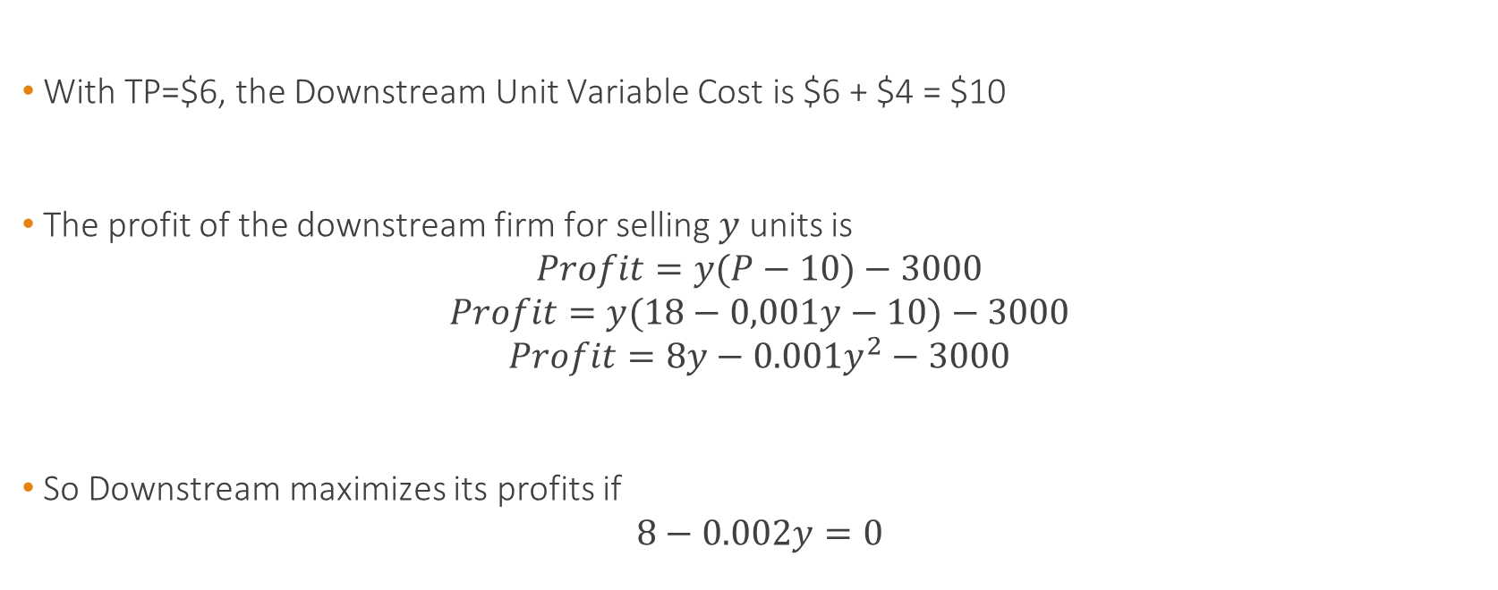
Illustration: Megabuck
With TP=$6, the Downstream Unit Variable Cost is $6 + $4 = $10
The profit of the downstream firm for selling $y$ units is
$$Profit=y(P−10)−3000$$
$$Profit=y(18−0,001y−10)−3000$$
$$Profit=8y−0.001y^{2}−3000$$
So Downstream maximizes its profits if
$$8−0.002y=0$$

Slide 25

Illustration: Megabuck
In order to maximize profits, Downstream will demand
$y=\frac{8}{0.002}=4,000$ units to Upstream
These units will be sold at a price
$$P=18−0.001∗4000=\$14$$

Slide 26
Illustration: Megabuck
TP=$6 | Downstream Division
Fixed Cost | $3,000
Unit Variable Cost | $4
Transfer Price | $6
Units Sold | 4,000
Total Cost | $43,000
Selling Price | $14
Revenues | $56,000
Profits | $13,000

Slide 27
Illustration: Megabuck
TP=$6 | Downstream Division
Fixed Cost | $3,000
Unit Variable Cost | $4
Transfer Price | $6
Units Sold | 4,000
Total Cost | $43,000
Selling Price | $14
Revenues | $56,000
Profits | $13,000
The full cost of the selling division (downstream) are covered.
Is this policy consistent with Full Cost Transfer Pricing?

Slide 28

Illustration: Megabuck
Is this policy consistent with Full Cost Transfer Pricing?
Yes
When TP=$6, Upstream covers both its full and variable costs
$$Profits Upstream=(6−5)∗4,000−4,000=0$$
Is this outcome efficient for the firm?

Slide 29
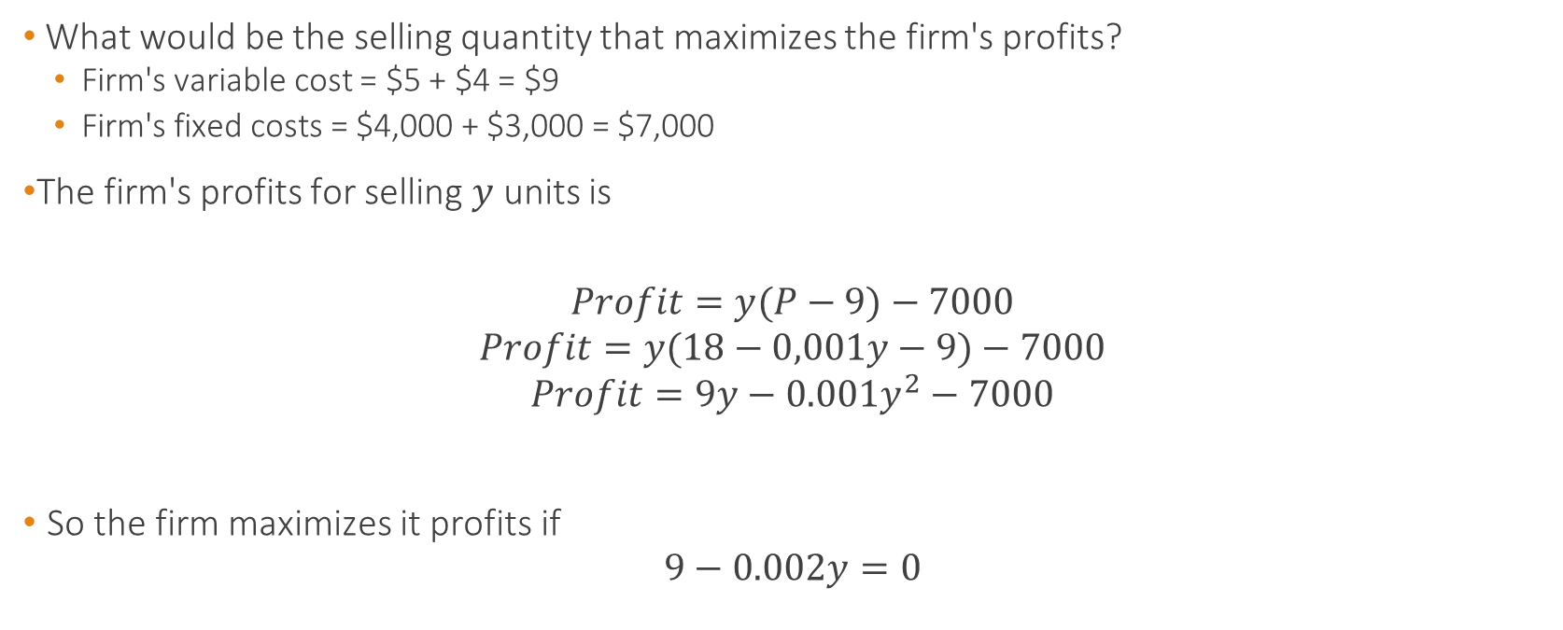
Illustration: Megabuck
What would be the selling quantity that maximizes the firm's profits?
Firm's variable cost = $5 + $4 = $9
Firm's fixed costs = $4,000 + $3,000 = $7,000
The firm's profits for selling $y$ units is
$$Profit=y(P−9)−7000$$
$$Profit=y(18−0,001y−9)−7000$$
$$Profit=9y−0.001y^{2}−7000$$
So the firm maximizes it profits if
$$9−0.002y=0$$

Slide 30
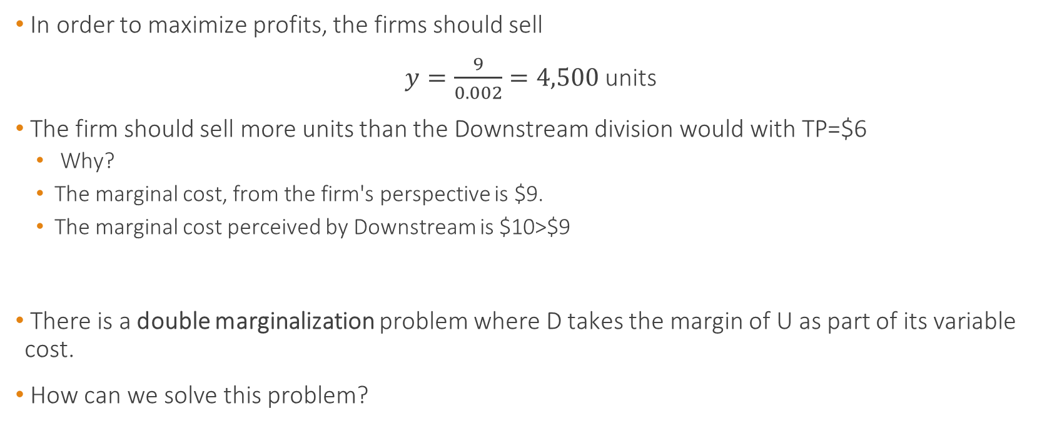
Illustration: Megabuck
In order to maximize profits, the firms should sell
$y=\frac{9}{0.002}=4,500$ units
The firm should sell more units than the Downstream division would with TP=$6
Why?
The marginal cost, from the firm's perspective is $9.
The marginal cost perceived by Downstream is $10>$9
There is a double marginalization problem where D takes the margin of U as part of its variable cost.
How can we solve this problem?

Slide 31
Illustration: Megabuck
What if we use Variable Cost Transfer Pricing?
Under variable cost, the transfer price is equal to the variable cost per unit of the upstream division ($5)
When TP=$5, Downstream chooses 4,500 units as its marginal cost is now $9
D internalizes the same marginal cost as the firm, so its incentives are aligned.

Slide 32
Cost-Based Transfer Pricing
Advantages of cost-based TP: It can be optimal when TP = Unit Variable Cost
Issues with cost-based transfer pricing
Weak incentives to cut cost
Incentives to over report costs
Induces double marginalization under Full Cost+

Slide 33

Transfer Pricing
"The economist's first instinct is to set the transfer price equal to marginal cost (Hirschleifer). But it may be difficult to find out marginal cost. As a practical matter, marginal cost information is rarely known to anybody in the firm, because it depends on opportunity costs that vary with capacity use. And even if marginal cost information were available, there is no guarantee that it would be revealed in a truthful fashion for the purpose of determining an optimal transfer price."
- Holmstrom and Tirole 1991

Slide 34
Market-Based Transfer Pricing
In the presence of "functioning" external markets, many firms take the external market price as a benchmark for their internal transfer price.
Generally, the external market price provides a ceiling not to be exceeded by the internal transfer price.
Decision on quantity to be transferred typically rests with the buying downstream division.
Pull System

Slide 35
Market-Based Transfer Pricing
Following our example, suppose the Upstream Division can sell any quantity, up to its capacity limit of 7,000 units, as a unit price of $7 to Outside Corp.
Will a policy of setting the internal transfer price at $7 achieve goal congruence?

Slide 36
Market-Based Transfer Pricing
Following our example, suppose the Upstream Division can sell any quantity, up to its capacity limit of 7,000 units, as a unit price of $7 to Outside Corp.
Will a policy of setting the internal transfer price at $7 achieve goal congruence?
Yes
The marginal cost of an internal transfer becomes $7 (opportunity cost)
TP=$7 aligns the incentives of D and those of the firm

Slide 37
Market-Based Transfer Pricing
Note: it assumes that the outside market is "functioning", in the sense of competitive market
If the market is imperfectly competitive, the external price may be too high and the downstream division may decide not to purchase the intermediate good.
In this situation, the transfer price must generally be set below the external market price
Companies frequently impose intra-company discounts

Slide 38
Market-Based Transfer Pricing
Advantages of market-based transfer pricing:
Objective and reliable
Provides incentives to cut cost
It may induce goal congruence if the market for the intermediate good is competitive
Issues with market-based transfer pricing:
Price may fluctuate over time
Sometimes there is no market for the intermediate product
The price of the intermediate product may not be competitive if U has market power

Slide 39
Minimum Transfer Price
Textbooks in managerial accounting frequently advocate a "Minimum Transfer Price" which calculates the transfer price as the sum of:
Incremental Cost of providing the intermediate product
Opportunity Costs for the selling division (e.g. contribution margin foregone on external sales)

Slide 40
Minimum Transfer Price
Let's continue our example
Suppose Upstream can sell a modified version of the intermediate product externally for $8 after incurring an additional variable cost of $1 per unit (beyond the initial $5)
What is the transfer price according to the minimum rule?

Slide 41
Minimum Transfer Price
What if there is no capacity limit?
MTP = 5 + (8-1-5) = $7
What if the maximum quantity the firm can sell externally is 4,000 units? (remember the maximum production capacity is 7000)
Then MTP is $5 for the first 3,000 units, and $7 for all units beyond 3,000.
If D sells 5,000 units to U, the average transfer price under MTP is 3/5*$5+2/5*$7
MTP helps combine Variable-Cost TP and Market-Based TP

Slide 42
Negotiated Transfer Pricing
Under this approach, the divisional managers are free to enter into any mutually agreeable arrangement.
They would typically report to the controller:
"We have agreed to transfer q widgets in exchange for an overall transfer payment of $X"

Slide 43
Takeaways
Full cost is a popular TP policy
But it can lead to double marginalization problem
MTP is optimal, but to know what the MTP is, we need to understand
Market Power in upstream and downstream markets
Capacity constraints
For example
If no upstream outside market: MTP=Variable Unit Cost
If not perfectly competitive market and no capacity constraints: MTP=Variable Cost
If upstream market is competitive and there are capacity constraints: MTP=Market Price

