Slide 1





Strategic Cost Management & New Technologies
Prof. Mario Milone MGT(P)495

Slide 2
Session 10 Transfer Pricing
Part II

Slide 3
Outline
International Taxation
Shifting Income via Transfer Prices
Transfer Pricing Methods for Tax Purposes

Slide 4
Transfer Pricing for Tax Purposes
Why does it matter?
Transfer pricing not only determine how the pie (total profit) is divided among responsibility centers, it also changes the size of the pie.
Over a third of all global trade takes place within firms.

Slide 5
International Taxation
OECD Rules for Taxing Multinational Firms:
Entity Principle: Income taxed in a particular country based on taxable income of local entity
No consolidation
Common approach: Territorial Taxation (UK, Germany, Japan, ... and most OECD countries)
A few countries: Taxation of Worldwide Income (Mexico, South Korea ...)

Slide 6
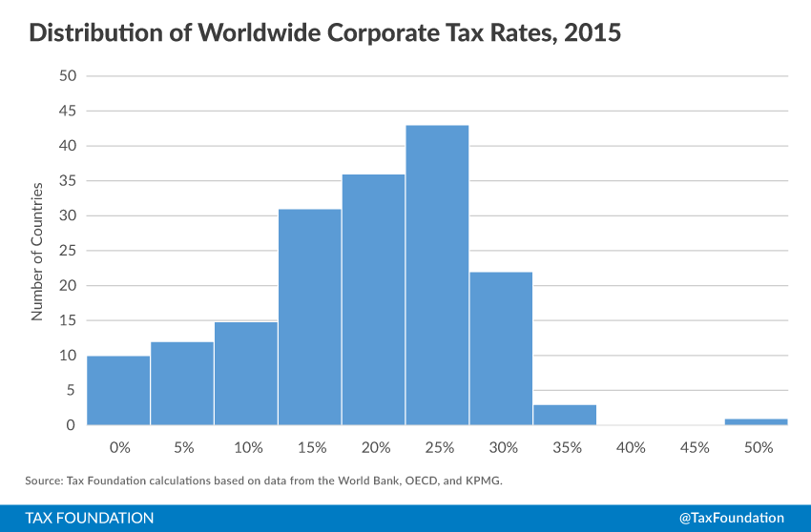
Worldwide Corporate Tax Rates

Slide 7
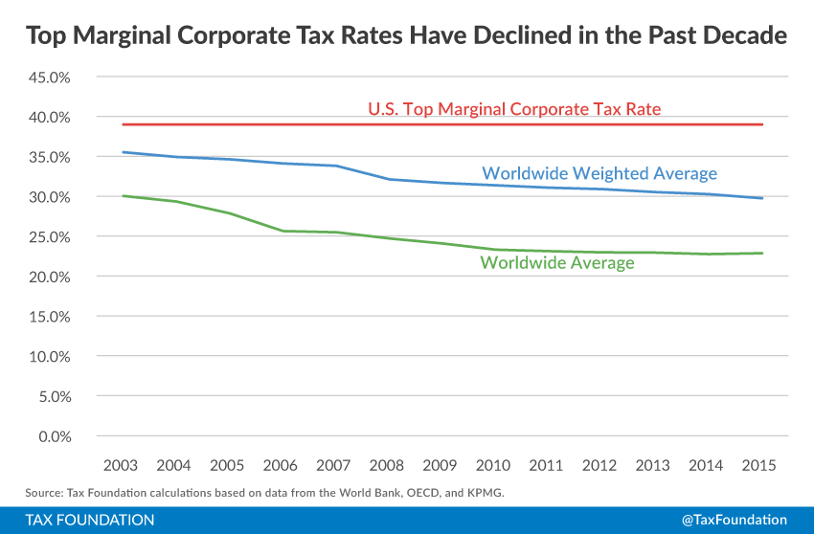
Worldwide Corporate Tax Rates

Slide 8




How about the US?
Old US tax system
Consider a U.S. multinational firm with operations in Ireland
Income is taxed when repatriated to the U.S.

Slide 9
How about the US?
Old US tax system
If dividend
Total Tax Paid = $35
2015 U.S. Tax Due |  | 2015 Irish Tax Due
Income | $100 | Income | $100
Tax Rate | 35% | Tax Rate | 15%
US tax w/o credit | $35 | Tax Due | $15
(Foreign Tax) | ($15)
Tax Due | $20

Slide 10
How about the US?
Old US tax system (Deferral)
If no dividend
Total Tax Paid Today = $15
2015 U.S. Tax Due |  | 2015 Irish Tax Due
Tax Due in 2015 | $0 | Income | $100
 |  | Tax Rate | 15%
Tax Due When Repatriated ... Maybe | $20 | Tax Due | $15

Slide 11
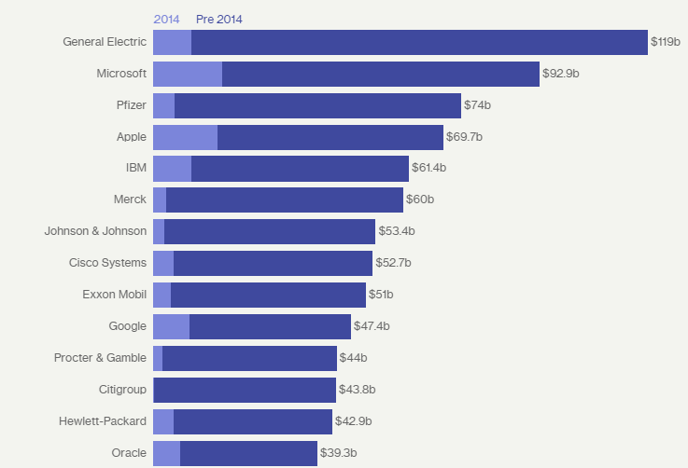
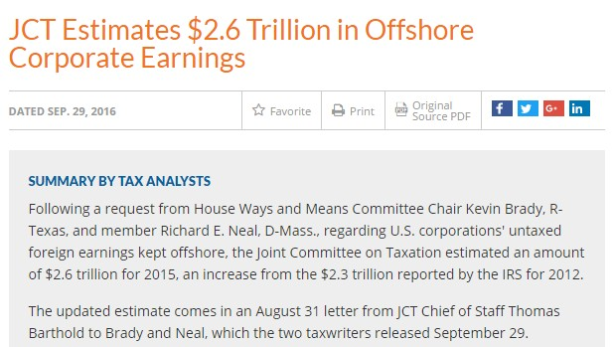
Offshore Corporate Earnings

Slide 12
Offshore Corporate Earnings
Example of Apple
Corporate profits based on software developed in the U.S.
The software was shifted to Bermuda using a technique called cost-sharing, approved by the IRS.
Once a product is developed, Apple could share the profits with the Bermuda subsidiary.
Apple then set up 2 Irish companies, one of which employed actual people.
In between the 2 companies, Apple set up a Dutch Company.
The profits from the sales of Apple products outside the U.S. were attributed to the operating Irish company, but then shifted via the Dutch company to Bermuda, which does not tax those profits.
Apple accumulated $128 billion in Bermuda with an effective overall tax rate below 5%.

Slide 13
Tax Cuts and Job Act of 2018
New U.S. corporate tax rate of 21%
No tax on dividend repatriations
Tax Act supporters point out 2 provisions designed to counter the incentives to shift:
Global Intangible Low-Taxed Income (GILTI)
Profits in excess of 10% return on offshore tangible investments are taxed at 10.5%
Trying to target return on intangibles (like IP)
Foreign Derived Intangible Income (FDII)
Very similar than GILTI

Slide 14
How about the US?
New US tax system
Consider a U.S. multinational firm with operations in Ireland
Income is not taxed when repatriated

Slide 15
How about the US?
Old US tax system
If dividend
Total Tax Paid = $15
2015 U.S. Tax Due |  | 2015 Irish Tax Due
Income | $100 | Income | $100
Tax Rate | 21% | Tax Rate | 15%
Tax Due | $0 | Tax Due | $15

Slide 16
Shifting Income via Transfer Prices
Foreign Subsidiary
Interm. Product q
Domestic Parent
Final Product
Market
Transfer Price TP
Revenue(q)
tf: low tax rate
cf: unit costs
td: high tax rate

Slide 17
Example
Let us consider the manufacturing of a mini-computer
South Korean plant assembles the computer
U.S. plant packages and distributes the computer
 | South Korean Plant | U.S. Plant
Variable Cost | $400 | $100
Fixed Cost | $600 | $200
Market Price | $1,500 | $2,200
Tax Rate | 20% | 30%

Slide 18
Example
Assume 2 possible transfer prices for the computer
Market Price
Or 300% of Variable Costs
South Korea | 300% VC | Market
Revenue | $1,200 | $1,500
Variable Cost | $400 | $400
Fixed Cost | $600 | $600
Profit | $200 | $500
After Tax | $160 | $400
United States | 300% VC | Market
Revenue | $2,200 | $2,200
Variable Cost | $1,300 | $1,600
Fixed Cost | $200 | $200
Profit | $700 | $400
After Tax | $490 | $280

Slide 19
Example
For the whole firm, we have
Using a TP of 300% of VC would reduce overall profits
Whole Firm | 300% VC | Market
Revenue | $2,200 | $2,200
Variable Cost | $500 | $500
Fixed Cost | $800 | $800
Profit | $900 | $900
Tax | $250 | $220
After Tax | $650 | $680

Slide 20
What is Admissible for Tax Reporting?
Section 482 of the IRS code states the "Arm's Length Principle"
"Section 482 places a controlled taxpayer on a tax parity with an uncontrolled taxpayer by determining the true taxable income of the controlled taxpayer in a manner that reasonably reflects the relative economic activity undertaken by each taxpayer"
That says it all, right?

Slide 21
What is Admissible for Tax Reporting?
For tangible property, the allowable methods in the U.S. include:
Comparable Uncontrolled Price (CUP)
Cost-Plus
Comparable Profit Method (CPM)

Slide 22
Comparable Uncontrolled Price (CUP)
Find Comparable Transactions with or between uncontrollable parties.
Difficult!
Need to asses the functions performed and the risks assumed by the different parties.
No adjustment to TP if the prices are within a range established by 2 uncontrolled transactions.

Slide 23
Comparable Uncontrolled Price (CUP)
CUP is the method of choice
Usually the first question from tax authorities: Did you use CUPs?
Problem: Very hard to find true comparable transactions
Cost-Plus has become the default after CUP

Slide 24
Comparable Profit Method (CPM)
This method uses profits indicators, such as operating margin, as a test to determine if cost-plus meets arms-length criteria
Identify some comparables (e.g. 10 companies)
Rank order them from lowest to highest (by operating margin for instance)
Exclude the outliers (e.g. the top 2 and the bottom 2)
The middle 6 is know as the "arm's length range"
If your operating margin is within this range, you are almost certainly OK

Slide 25
How many books?
Some MNEs want to retain flexibility in using internal transfer prices to improve operating performances
Arguments for "two sets of books"
Internal transfer prices should reflect the economics of intra-company transfers rather than statutory tax requirements
Transfer prices acceptable for tax purposes frequently reflect past rather than current data

Slide 26

E&Y Survey in 2000
“Part of the problem is that each operating group is compensated in accordance with their respective country’s profit and this may conflict with transfer pricing prescriptions in the jurisdictions.”
“We’ve overcome the difficulties (in incentives and performance measurement) by the accounting methods used for management incentives, i.e. bonuses. We run two sets of books; one for statutory accounting and one for management reporting.”
“It is difficult to measure the role of sales and manufacturing units while optimizing tax issues…. We have, for almost a year, been applying one system for operating measurement and dealing with ( tax) transfer pricing issues after.”

Slide 27

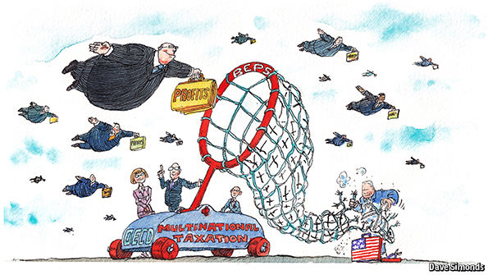
How about Intellectual Property?
Business today is increasingly digital, services-based and driven by intangible assets, including rights to exploit intellectual property (IP), from patents to logos. These are easier than physical assets to shuffle from subsidiaries in high-tax countries to those in low-tax ones. In short, they make the old rules easier to game.

Slide 28
Transfer of Intangible Property
Increasingly important for many MNEs, in particular technology and pharmaceutical companies, is the transfer of intangible assets
Example of Intangible Property transferred to foreign subsidiaries
Patents, processes and designs
Methods, programs, systems, procedures, surveys, forecasts, estimates, customer list, or technical data
Copyrights
Franchises, licenses, or contracts
Trademarks, trade names, or brand names

Slide 29
Where to locate the IP?
Intellectual property (IP) can be developed anywhere
Cost sharing agreements allocate ownership of IP to specific corporate entities
The corporate entity that owns the IP collects royalties from other corporate entities that use [sell] the IP
Tax on profits from the IP are taxed at the prevailing rates in the jurisdiction that owns the IP

Slide 30
The "IP buy-in"
Companies can initially incorporate in those jurisdictions that provide beneficial tax benefits
Usually expensive and not done until the company has proven technology
At some point, the company will "sell" its IP to a subsidiary to transfer ownership to a tax-favorable location - known as the "IP buy-in"
This creates a taxable event for the selling company, but moves the IP to a tax-favorable location for future profits
Since the value of IP generally increases over time, the earlier this is done, the better

Slide 31
Takeaways
Transfer Pricing is Contentious
At the firm level: transfer prices affect performance evaluation and, hence, the rewards managers receive. Disputes between divisions are inevitable.
At the country level: every country believes it is being cheated by multinational companies through their transfer pricing policies.

Slide 32
Takeaways
Example: GlaxoSmithKline (GSK)
In January 2004, the IRS files a $5.2 billion claim (including $2.5 billion in interest) over the transfer prices attributed to Zantac (ulcers), Zofran (nausea), Ceftin (antibiotic), etc.
The R&D had been undertaken in the U.K. The products were produces in the U.K. and shipped to the U.S. The drugs were then marketed and sold by the U.S. subsidiary.
The price charged by GSK in the U.K. fr drugs exported to the U.S. included a charge for services related to the costs of R&D
The IRS claimed that
The charges were excessive
GSK ignored the contribution that heavy marketing and sales efforts in the U.S. made to the drugs' success

