Slide 1

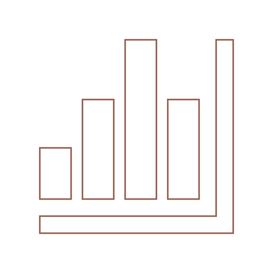

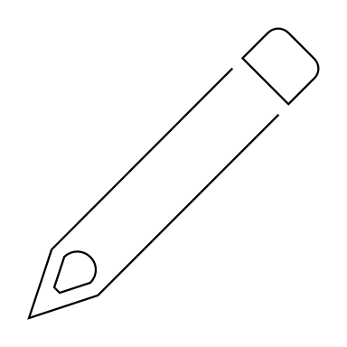

Precision Worldwide
Prof. Mario Milone

Slide 2
Background: Precision Worldwide
Manufacturer of industrial machines and equipment for sale in numerous countries
Models priced between $18,900 and $28,900
Repair and replacement parts accounted for a substantial part of the company’s business
In particular PWI manufactured a steel ring that can be found in PWI’s and similar competitor’s machines
Back of the envelope calculations:
2-6 rings per machine – normal life of about 2 months
Each ring cost $13.50, meaning revenue of $162-$486 per machine per year

Slide 3
Background: Precision Worldwide
Company’s success factors
Customer relationship / satisfaction
Quality
Market share
Servicing machines …

Slide 4
Background: Precision Worldwide
Competition is increasing
Japanese firms with lower-priced machines
Other companies with lower-quality and lower-priced machines

Slide 5
Background: Precision Worldwide
French competitor Henri Poulenc just introduced a plastic ring substitute
Much longer life than the steel ring (lasts 4 times as long)
Much lower manufacturing cost
Henri Poulenc is the main competitor in France

Slide 6
Thorborg’s Problem
PWI had a large quantity of steel rings on hand and a substantial inventory of special steel that had been purchase for their manufacture
The special steel could not be sold, even for scrap
The total book value of these inventories exceeded $390,000

Slide 7
Main issue / decision?
Should we forecast whether the future is steel vs plastic rings?
No – The future is plastic: lasts longer and cheaper to produce
Only costs $7,500 to acquire the tools and equipment
The issue is what to do with the existing inventory and raw material on hand
Write off / Scrap?
Keep using?
If we write off the inventory, the income statement is hit immediately
Reduction in income/earnings of $390,000

Slide 8
The alternatives
Stay out of plastic rings altogether
Stay out of plastic rings until all steel rings and all raw steel inventory is sold
Manufacture steel rings with excess labor
Manufacture steel rings with normal labor
Stay out of plastic rings until all steel rings are sold, but dispose of raw steel inventory
Sell both plastic rings and steel rings until all steel has been converted and sold
Sell plastic rings only in France
Sell plastic rings in all markets
Sell plastic rings only, as soon as possible

Slide 9
Players and tensions
Player | Position | Incentives | Cares about $390,000 write off?
Hans Thorborg | General Manager of German plant | Profit / ROI at the German plant | Yes
Patrick Corrigan | From Ohia parent company | Profit / ROI at HQ | Yes
Gerhard Henk | Sales Manager | Relationship, Satisfaction, Sales | No
Bodo Eisenbach | Development Engineer | Quality, Efficiency | No

Slide 10
What should Thorborg decide?
Roadmap
Relevant Costs
Opportunity Costs
Price relationship
Other considerations
Conclusion

Slide 11
What do we know?
Total costs
Variable cost represents 40% of the departmental amounts
 | 100 Plastic Rings | 100 Steel Rings
Material | $18 | $322
Direct Labor | $66 | $197
Departmental OH | $131 | $393
Administrative OH | $66 | $197
Total cost | $280 | $1,108

Slide 12
Financial Accounting
Assume that we can sell the rings at the same price (what HP is charging for the plastic ring)
Plastic seems to be more profitable (much cheaper to produce)
Is there more to it than meets the eyes?
 | Plastic | Steel
Sales Price | $1,350 | $1,350
Total Costs | $280 | $1,108
Gross Margin | $1,070 | $242
Replacement Factor | x1 | x4
Adjusted Gross Margin | $1,070 | $968

Slide 13
Relevant Costs
What should matter to compare the cost of plastic and steel rings?
Variable costs and contribution margin of course!
 | Plastic | Steel
Material | $18 | $322
Direct Labor | $66 | $197
Variable OH (40% of departmental OH) | $131*40% = $52 | $393*40% = $157
Fixed OH (departmental) | $79 | $236
Administrative OH (fixed) | $66 | $197
Relevant cost | $136 | $676

Slide 14
Relevant Costs
Assume (still) that we can sell the rings at the same price
Steel looks much more profitable now
 | Plastic | Steel
Sales Price | $1,350 | $1,350
Relevant Costs | $136 | $676
Contribution Margin | $1,214 | $674
Replacement Factor | x1 | x4
Adjusted Contribution Margin | $1,214 | $2,696

Slide 15
Financial VS Managerial accounting
If we rely on full costs (included in COGS), plastic seems more profitable
But looking more closely at the data, the story changes
The story depends on the assumptions!
Sales price stays the same
Arguments for and against?

Slide 16
Is that all?
So far, we only looked at plastic vs steel rings
But the decision faced by Thorborg involves more than that
What should we do about the existing inventory?

Slide 17
Relevant Costs for inventories
For existing steel rings
No extra cost, pure profit
How about converting the steel?
We know that during the next 2-3 months the plant would not operate at capacity (the time to prepare production for the plastic ring, from May to September)
PWI policy is to still pay workers 70% of their salary instead of laying off
We could decide to have them produce steel ring instead
What is the opportunity cost of not producing more steel rings?

Slide 18
Relevant Costs for inventories
 | Finished goods on hand | Convert steel | Convert steel w/ extra labor
Material | $0 | $0 | $0
Direct labor | $0 | $197 | $59
Variable OH | $0 | $157 | $47
Relevant costs | $0 | $354 | $106
Sales price | $1,350 | $1,350 | $1,350
Contribution margin | $1,350 | $996 | $1,244
Adjusted CM (x4) | $5,400 | $3,984 | $4,976
Only need to pay workers an additional 30% for the next 3 months
Remember: Financial Accounting costs of $1,108

Slide 19
Price relationships
Assumptions are important!
We assumed that
Price would stay the same
Demand would not change
No impact on customer satisfaction
We cannot predict future prices with the given data
But we can compute what the prices should be to produce identical contribution margins.
What price should the steel ring be sold at to have the same CM as the plastic ring?

Slide 20
Price relationships
Assume plastic ring sells for $1,350
Remember: Contribution margin of the plastic ring is $1,214
To have the same CM, steel ring must generate $1,214 / 4 = $304 in CM
 | Regular production | Finished goods on hand | Convert steel | Convert steel w/ extra labor
Relevant costs (from previous analysis) | $676 | $0 | $354 | $106
Target CM | $304 | $304 | $304 | $304
Target price | $979 | $304 | $658 | $410

Slide 21
Price relationships
Again, we assume that the price of plastic ring being charged by HP stays the same
Assume you are a customer and know that the plastic ring has 4x the durability of the steel ring?
How much would you be willing to pay for the steel ring? Probably $1,350 / 4 = $338
If this happens, it would only be profitable to sell the existing stock of rings, but not produce any additional ones using the steel.
Is that likely to happen?
What are the assumptions necessary for such a price drop to occur?
What if we believe customers would not know about the extra durability?

Slide 22
Other considerations
Would customers be angry if PWI sells plastic rings to some and steel rings to others?
What are the reputation consequences of not moving to plastic quickly enough?
Should we be concerned of plastic rings quality issues?
What about the competition? (HP may want to expand outside France)
How will that decision affect the sales of other PWI products (mainly machines)?

Slide 23
What should Hans Thorborg decide?

Slide 24
A possible solution – One amongst many
Convert the steel inventory into rings during the summer
Use the excess labor at an incremental cost of 30% to do so
Introduce plastic rings throughout the entire market in September
Set the price of the plastic rings to match or slightly undercut HP
Announce the more desirable properties of the plastic rings
Start a pricing policy for the steel rings
Maybe start to reduce price by about 30%
Drop the price further as market dictates

Slide 25
Takeaways
The same product can have different costs depending on
Decision-making context
Time horizon
Relevant Costs = Expected Costs that differ among alternatives
Sunk Costs are often irrelevant for decision-making
As a decision maker, it is your job to appreciate these tensions

