Slide 1
ISQS 3358: Business Intelligence Lecture 1.1 – Data Parsing
Part 1 – HTML
David J. Lucus, Ph.D.
Assistant Professor of Practice

Slide 2
Agenda
What is HTML
Basics of HTML
Tags & Attributes
Hierarchical Structure

Slide 3
What is HTML
Simply put: Language that structures a webpage
Note, it is the “structure” of a webpage….not..
What makes dynamic actions happen on a page
What makes content dynamically load on a page
What styles the webpage
i.e. Sets fonts, styles, etc
For our purposes: It is the web page structure to parse to extract data

Slide 4
Basics of HTML
HTML Attributes
Node based (referred to as tags)
Hierarchical in nature – i.e. Nodes, nested within nodes
Tags contain information in two locations
As an attribute of a tag
Within the open and close of the tag
Anchor Tag Example
Display:
Code: <a href=“http://isqs.ba.ttu.edu”>Department of ISQS</a>

Slide 5
Tags & Attributes
Example: <a href=“http://isqs.ba.ttu.edu”>Department of ISQS</a>
<a – Represents the opening of the tag. In this case an anchor tag (web hyperlink)
href – Represents an attribute of the tag
“http://isqs.ba.ttu.edu” – Represents the value held within the href attribute. In this case where the browser will go when the user clicks on the link.
Department of ISQS – Text that will display within the link to the user. Sometimes referred to as the Inner HTML.
</a> - Closing tag of the link

Slide 6
Tags & Attributes
Some of the most common tags you will encounter, Not Exhaustive
<a> - Anchor tag. Used to represent hyperlinks. Not uncommon to have images embedded within the tag so the “image” is clickable. i.e. <a href=“”><img….></img></a>
<img> - Image tag. Used for displaying images
<div> or <span> - division areas that contain other tags or text.
<p> - Paragraph. Typically used for large areas of text
<table> - Defines that a table of information is about to appear. Does not appear without the following:
<tr> - Defines a row in a table
<td> - Defines a cell in a row
<th> - Denotes a cell in the “header” row of a table
<ul> - Represents a list (bullets). Does not appear without:
<li> - List item. Denotes each item for a bulleted list

Slide 7
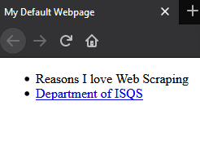
Hierarchical Structure
HTML defines tags within tags.
Represented as a kind of tree
Basic Sample Webpage

Slide 8
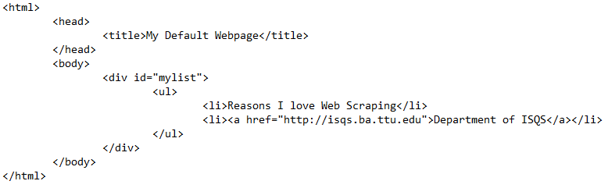
Hierarchical Structure
Example from Code

Slide 9
CSS Differences from HTML
HTML defines the structure of the web page
Hyperlinks (anchors)
Blocks of text (div, span, p, etc.)
CSS affects the “look” of the tag
i.e. How it renders in the browser
Note, not all browsers handle CSS the same (issue with request headers)
Styles might be remote
Typically CSS code is held in another file that is referenced within the HTML

Slide 10
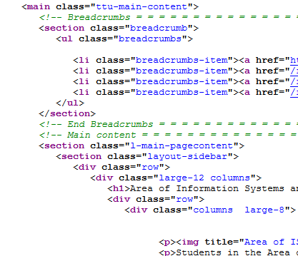
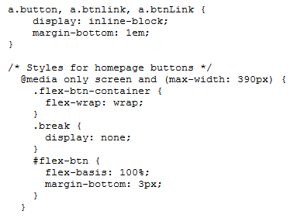
CSS Examples

Slide 11
CSS Application
Styles are applied to HTML tags via the “class” attribute
Note, HTML can be modified through the “style” attribute, but that is not using CSS
Example: <a href=“http://isqs.ba.ttu.edu” class=“linkstyle”>Department of ISQS</a>
This would apply the “linkstyle” CSS class to this anchor tag
Multiple classes can be applied as well
Ex: <a href=“http://isqs.ba.ttu.edu” class=“linkstyle style2”>Department of ISQS</a>
This would apply both “linkstyle” and “style2” to this anchor

Slide 12
Recap
HTML is the language that defines the structure of a web page
Web pages are made up of Tags that define the HTML object
Tags have attributes and inner HTML
Tags can be nested due to the hierarchical nature of HTML
Note all data is visible in the browsers default view

Slide 13
ISQS 3358: Business Intelligence Lecture 1.1 – Data Parsing
Part 3 – Parsing an HTML Page
David J. Lucus, Ph.D.
Assistant Professor of Practice

Slide 14
Agenda
Identifying tags and class styles in documents
BeautifulSoup
Extracting attributes from a tag

Slide 15
How to Parse a HTML page (Code)
Example in Firefox developer
Site: drd.ba.ttu.edu/imbadproducts
Element Identification
Path to node
CSS class selectors

Slide 16
BeautifulSoup
Allows Parsing of HTML via Python
Can extract based on:
HTML Tags
Attributes of Tags
CSS Class designations
Can extract:
Attribute Values
InnerHTML
Collections of HTML Tags

Slide 17
BeautifulSoup Example (Code)
Finding Items
By HTML node
By ID
By CSS Selector
Extracting
innerHTML Value
Attribute Value
Tag Collection with Iteration

Slide 18
Framework to Scrape
Visit page in browser & find path locations needed
Libraries, variable settings, etc
Request page
Create the Soup!
*important* Subset the page. i.e. find the parent node for the data you want
Extract data
If calling subpage, then think loops and what variable hold what values.

Slide 19
WalkThrough Example
Let’s extract all products from the imbadproducts website.
Example #2

Slide 20
In-Class Example
Let’s extract all player info from
http://drd.ba.ttu.edu/isqs6339/ex/l1.1/gamers
Extract and print the data for only “Molbrew”
Extensions #1
Extract and print the data for all 4 players
Make sure your code would work if another player was added
Extension #2
Extract and print all data for “Kalea” and the data from her child page.

Slide 21
In-Class Example Extension
Let’s add Throttling to the search:
Remember to use variables
Lastly, let’s output to a csv file.
Additional Practice:
http://drd.ba.ttu.edu/sites/extracker/
http://drd.ba.ttu.edu/sites/wowmobs/

