Slide 1
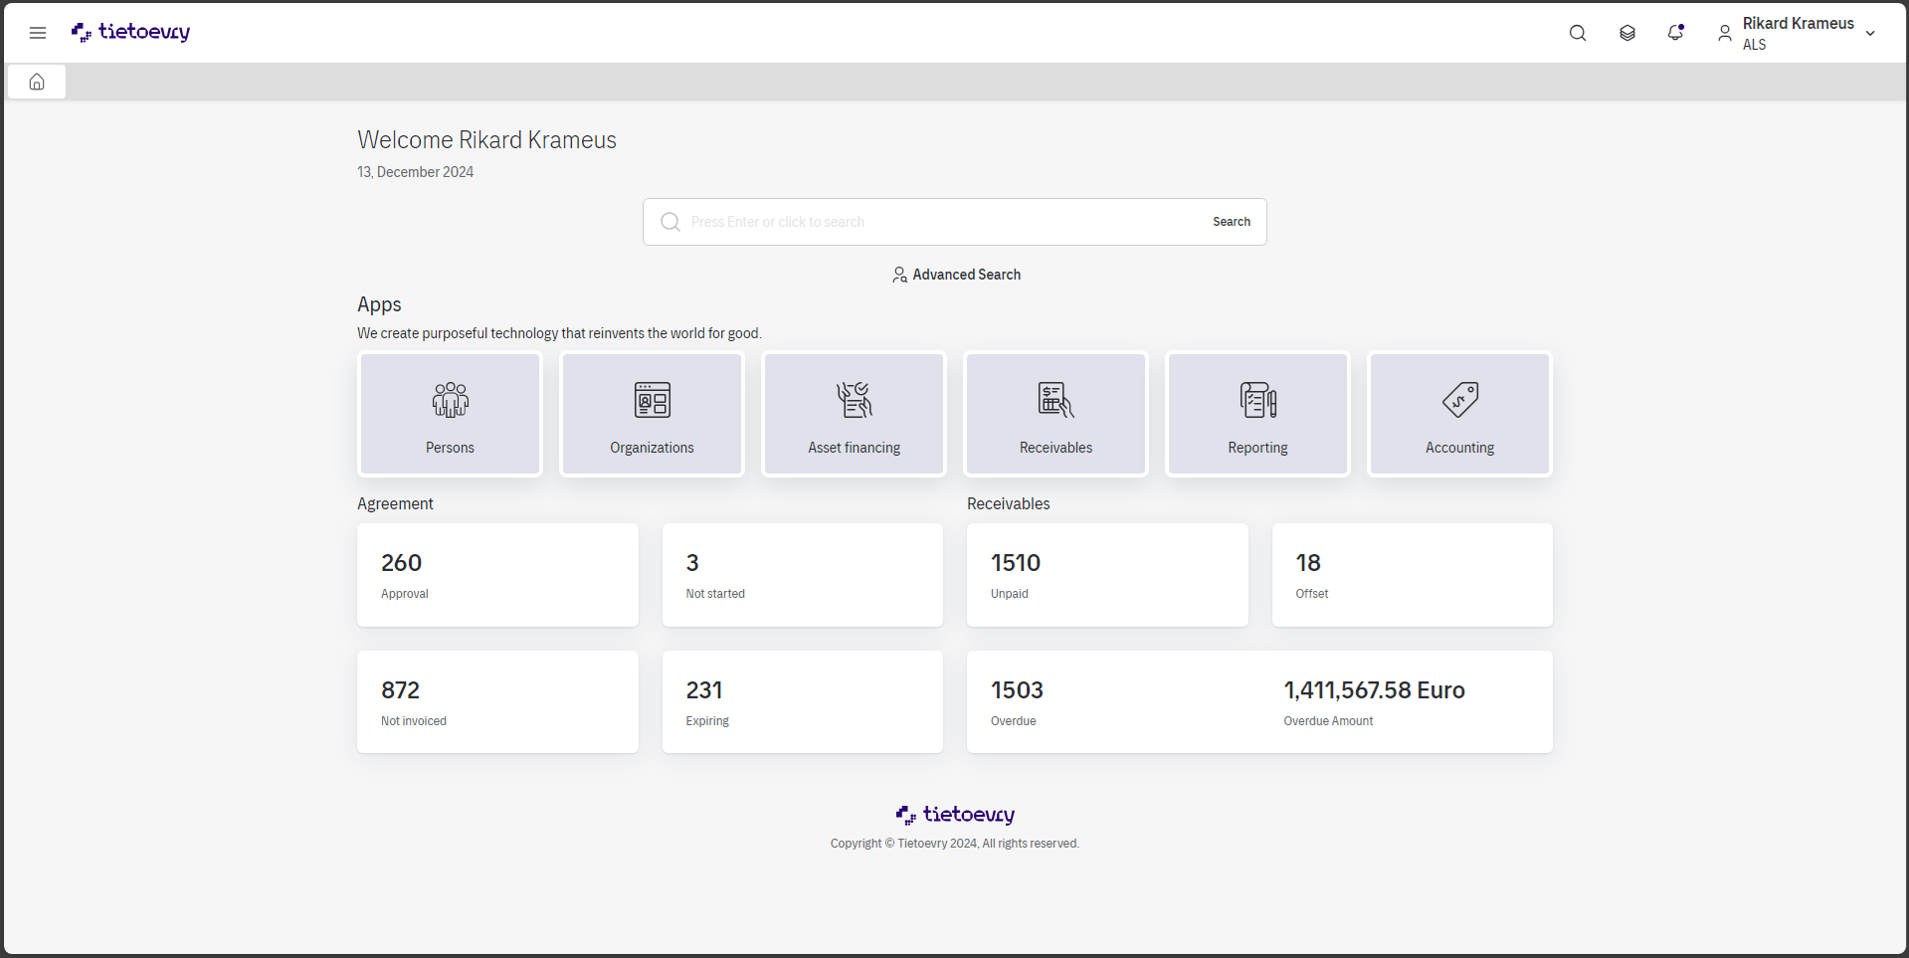
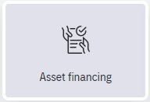
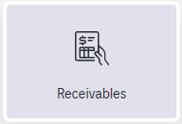


Slide 2
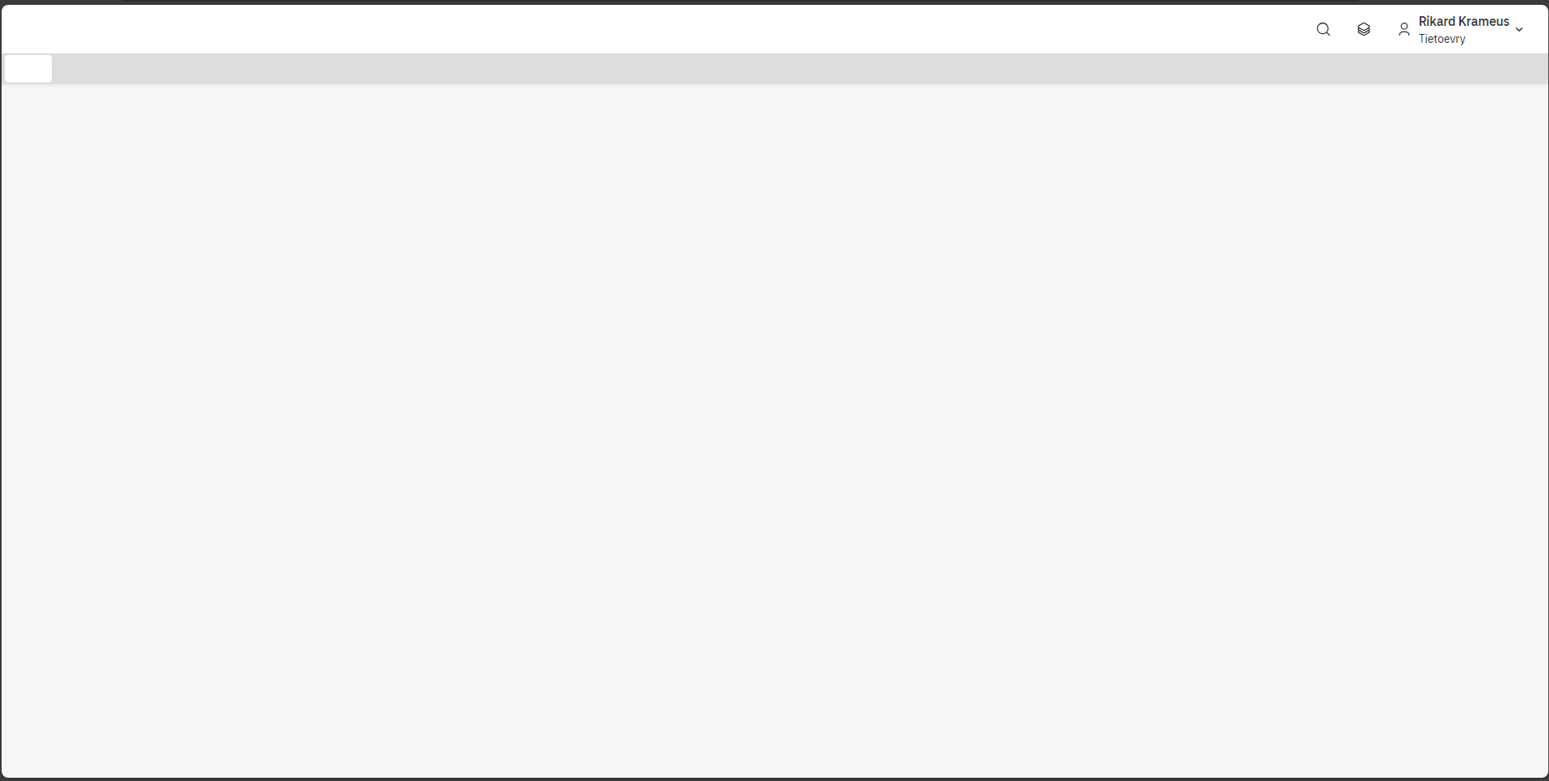


Legal entity
Journals
Reports
Settings
ALS SFB
ALS ITA
ALS NLD
End of month
End of month
End of month
202409
202409
202409
GL-interface
GL-interface
GL-interface
2024-09-30
2024-09-30
2024-09-30
Open period
Open period
Open period
202410
202410
202410
9
Journal
Differences
9
Journal
Differences
9
Journal
Differences

Slide 3
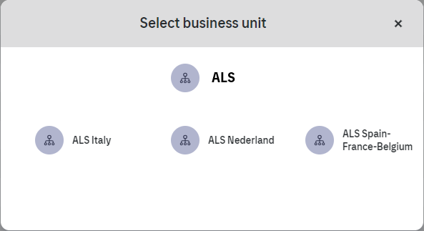
Legal entity
Journals
Reports
Settings
ALS SFB
ALS ITA
ALS NLD
End of month
End of month
End of month
202409
202409
202409
GL-interface
GL-interface
GL-interface
2024-09-30
2024-09-30
2024-09-30
Open period
Open period
Open period
202410
202410
202410
9
Journal
Differences
9
Journal
Differences
9
Journal
Differences

Slide 4
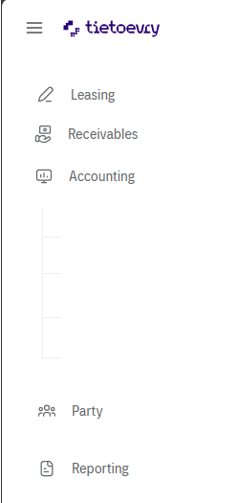
Legal entity
Journals
Reports
Settings
ALS SFB
ALS ITA
ALS NLD
Legal entity
Journals
End of month
End of month
End of month
Reports
202409
202409
202409
Settings
GL-interface
GL-interface
GL-interface
2024-09-30
2024-09-30
2024-09-30
Open period
Open period
Open period
202410
202410
202410
9
Journal
Differences
9
Journal
Differences
9
Journal
Differences

Slide 5
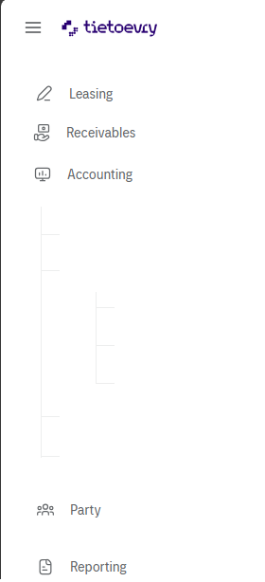
Legal entity
Journals
Reports
Settings
ALS SFB
ALS ITA
ALS NLD
Legal entity
Journals
End of month
End of month
End of month
Journal search
202409
202409
202409
Transaction search
Manual journal
GL-interface
GL-interface
GL-interface
Reports
2024-09-30
2024-09-30
2024-09-30
Settings
Open period
Open period
Open period
202410
202410
202410
9
Journal
Differences
9
Journal
Differences
9
Journal
Differences

Slide 6

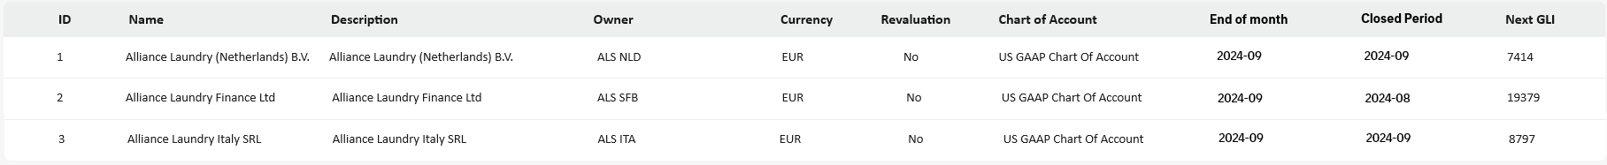
Legal entity
Journals
Reports
Settings
Legal entity

Slide 7
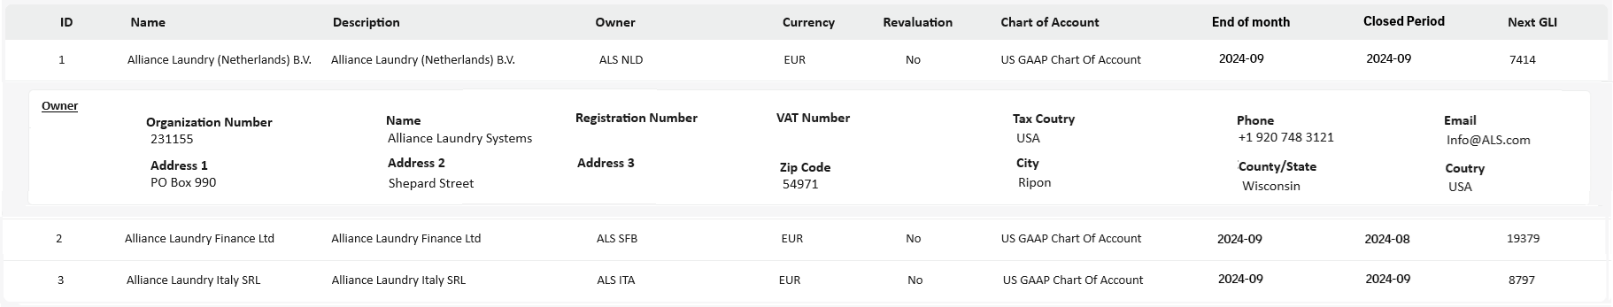
Legal entity
Journals
Reports
Settings
Legal entity

Slide 8


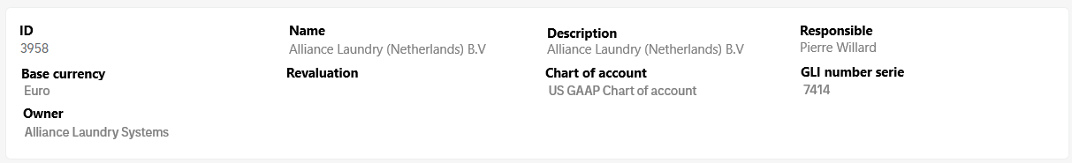
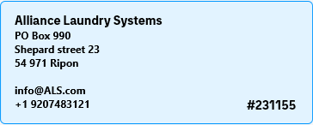
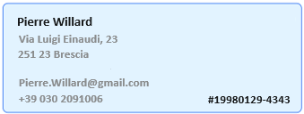







Legal entity
Journals
Reports
Settings
Legal entity /
1 – Alliance Laundry (Netherland) B.V
Last journal transaction
Legal entity: Tietoevry standard
Journal number: 23153
Accounting event: Invoicing
No of transactions : 2 452
Created 2024-10-17
Created by Rikard Krameus
Owner
Legal entity menu
Controller
Legal entity
Integration
Chart of account
Pseudo account
Ext. account parts
Formulas
Accounting rules

Slide 9
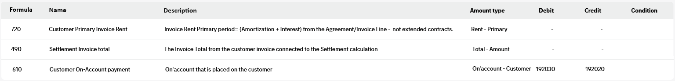

Legal entity
Journals
Reports
Settings
Legal entity /
1 – Alliance Laundry (Netherland) B.V
Last journal transaction
Legal entity: Tietoevry standard
Journal number: 23153
Accounting event: Invoicing
No of transactions : 2 452
Created 2024-10-17
Created by Rikard Krameus
Legal entity menu
Legal entity
Integration
Chart of account
Pseudo account
Ext. account parts
Formulas
Accounting rules

Slide 10
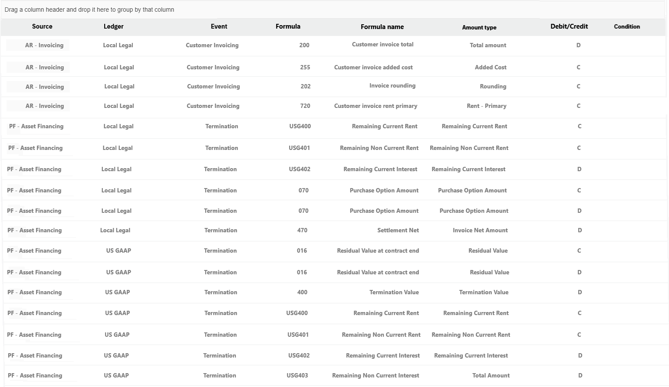

Legal entity
Journals
Reports
Settings
Legal entity /
1 – Alliance Laundry (Netherland) B.V
Last journal transaction
Legal entity: Tietoevry standard
Journal number: 23153
Accounting event: Invoicing
No of transactions : 2 452
Created 2024-10-17
Created by Rikard Krameus
Group-Example
Legal entity menu
Legal entity
Integration
Chart of account
Pseudo account
Ext. account parts
Formulas
Accounting rules
Blazor DataGrid Demos - Overview | Telerik UI for Blazor

Slide 11
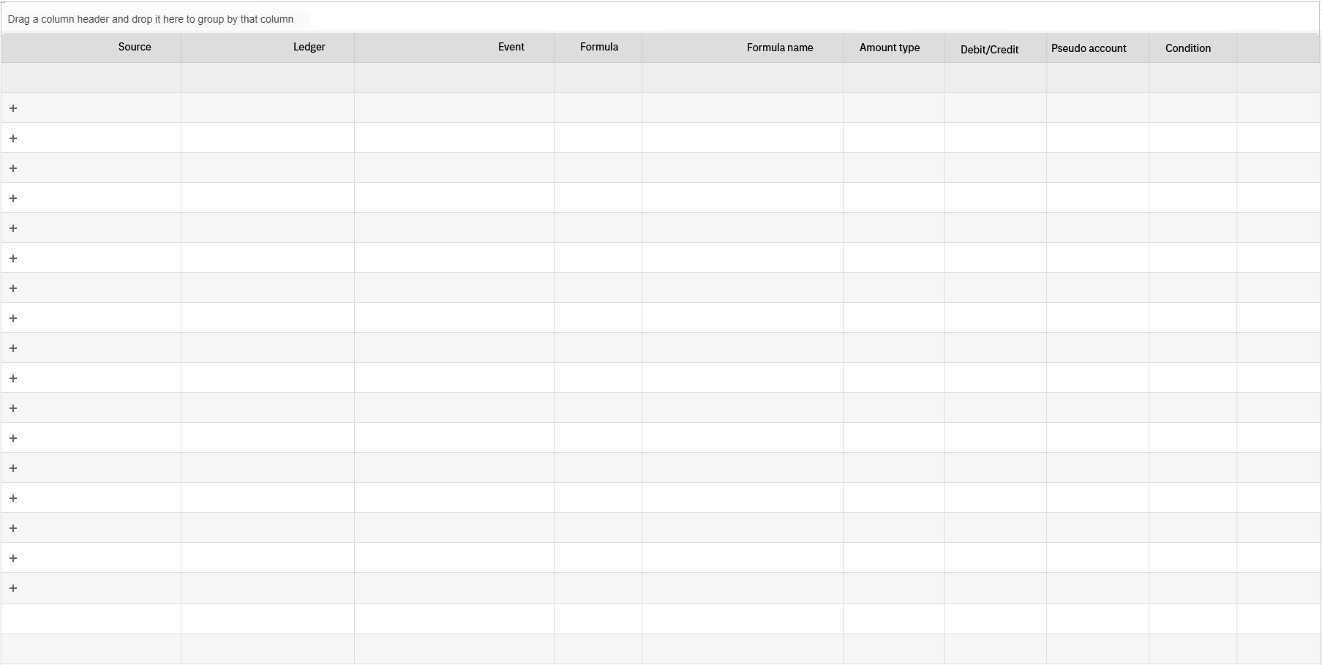



Legal entity
Journals
Reports
Settings
Legal entity /
1 – Alliance Laundry (Netherland) B.V
Group-Example
Last journal transaction
Legal entity: Tietoevry standard
Journal number: 23153
Accounting event: Invoicing
No of transactions : 2 452
Created 2024-10-17
Created by Rikard Krameus
Ar Invoicing Local legal Customer invoicing 200 Customer invoice total Total amount D 192500
Ar Invoicing Local legal Customer invoicing 255 Customer invoice added cost Total amount C 191202
Ar Invoicing Local legal Customer invoicing 202 Invoice rounding Total amount C 420100
Ar Invoicing Local legal Customer invoicing 720 Customer invoice rent primary Total amount C 192500
Legal entity menu
PF Asset Financing Local legal Termination 200 Customer invoice total Total amount C 192500
PF Asset Financing Local legal Termination USG400 Remaining current remt Remaining rent C 192107
Legal entity
PF Asset Financing Local legal Termination USG401 Remaining non current remt Non rent C 192107
PF Asset Financing Local legal Termination USG402 Remaining current interest Remaining int D 192407
Integration
PF Asset Financing Local legal Termination 070 Purchase option amount Purchase price C 192200
PF Asset Financing Local legal Termination 070 Purchase option amount Purchase price D 420420
PF Asset Financing US GAAP Termination 470 Settlement net amount Net amount D 192030
Chart of account
PF Asset Financing US GAAP Termination 016 Residual value at contract end Remaining rent C 192200
PF Asset Financing US GAAP Termination 016 Residual value at contract end Remaining rent D 192107
Pseudo account
PF Asset Financing US GAAP Termination 400 Termination value Term. value D 192102
PF Asset Financing US GAAP Termination USG400 Remaining current remt Remaining rent C 192107
Ext. account parts
PF Asset Financing US GAAP Termination USG401 Remaining non current remt Non rent C 192107
PF Asset Financing US GAAP Termination USG402 Remaining current interest Current Int D 192407
Formulas
Accounting rules
Blazor DataGrid Demos - Overview | Telerik UI for Blazor

Slide 12
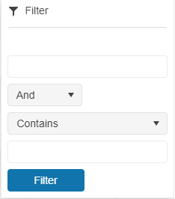


Legal entity
Journals
Reports
Settings
Legal entity /
1 – Alliance Laundry (Netherland) B.V
Group-Example
Last journal transaction
Legal entity: Tietoevry standard
Journal number: 23153
Accounting event: Invoicing
No of transactions : 2 452
Created 2024-10-17
Created by Rikard Krameus
Ar Invoicing Local legal Customer invoicing 200 Customer invoice total Total amount D 192500
Ar Invoicing Local legal Customer invoicing 255 Customer invoice added cost Total amount C 191202
Ar Invoicing Local legal Customer invoicing 202 Invoice rounding Total amount C 420100
Ar Invoicing Local legal Customer invoicing 720 Customer invoice rent primary Total amount C 192500
Legal entity menu
PF Asset Financing Local legal Termination 200 Customer invoice total Total amount C 192500
PF Asset Financing Local legal Termination USG400 Remaining current remt Remaining rent C 192107
Legal entity
PF Asset Financing Local legal Termination USG401 Remaining non current remt Non rent C 192107
PF Asset Financing Local legal Termination USG402 Remaining current interest Remaining int D 192407
Integration
PF Asset Financing Local legal Termination 070 Purchase option amount Purchase price C 192200
PF Asset Financing Local legal Termination 070 Purchase option amount Purchase price D 420420
PF Asset Financing US GAAP Termination 470 Settlement net amount Net amount D 192030
Chart of account
PF Asset Financing US GAAP Termination 016 Residual value at contract end Remaining rent C 192200
PF Asset Financing US GAAP Termination 016 Residual value at contract end Remaining rent D 192107
Pseudo account
PF Asset Financing US GAAP Termination 400 Termination value Term. value D 192102
PF Asset Financing US GAAP Termination USG400 Remaining current remt Remaining rent C 192107
Ext. account parts
PF Asset Financing US GAAP Termination USG401 Remaining non current remt Non rent C 192107
PF Asset Financing US GAAP Termination USG402 Remaining current interest Current Int D 192407
Formulas
Accounting rules
Blazor DataGrid Demos - Overview | Telerik UI for Blazor

Slide 13
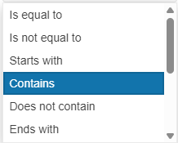
Legal entity
Journals
Reports
Settings
Legal entity /
1 – Alliance Laundry (Netherland) B.V
Group-Example
Last journal transaction
Legal entity: Tietoevry standard
Journal number: 23153
Accounting event: Invoicing
No of transactions : 2 452
Created 2024-10-17
Created by Rikard Krameus
Ar Invoicing Local legal Customer invoicing 200 Customer invoice total Total amount D 192500
Ar Invoicing Local legal Customer invoicing 255 Customer invoice added cost Total amount C 191202
Ar Invoicing Local legal Customer invoicing 202 Invoice rounding Total amount C 420100
Ar Invoicing Local legal Customer invoicing 720 Customer invoice rent primary Total amount C 192500
Legal entity menu
PF Asset Financing Local legal Termination 200 Customer invoice total Total amount C 192500
PF Asset Financing Local legal Termination USG400 Remaining current remt Remaining rent C 192107
Legal entity
PF Asset Financing Local legal Termination USG401 Remaining non current remt Non rent C 192107
PF Asset Financing Local legal Termination USG402 Remaining current interest Remaining int D 192407
Integration
PF Asset Financing Local legal Termination 070 Purchase option amount Purchase price C 192200
PF Asset Financing Local legal Termination 070 Purchase option amount Purchase price D 420420
PF Asset Financing US GAAP Termination 470 Settlement net amount Net amount D 192030
Chart of account
PF Asset Financing US GAAP Termination 016 Residual value at contract end Remaining rent C 192200
PF Asset Financing US GAAP Termination 016 Residual value at contract end Remaining rent D 192107
Pseudo account
PF Asset Financing US GAAP Termination 400 Termination value Term. value D 192102
PF Asset Financing US GAAP Termination USG400 Remaining current remt Remaining rent C 192107
Ext. account parts
PF Asset Financing US GAAP Termination USG401 Remaining non current remt Non rent C 192107
PF Asset Financing US GAAP Termination USG402 Remaining current interest Current Int D 192407
Formulas
Accounting rules
Blazor DataGrid Demos - Overview | Telerik UI for Blazor

Slide 14
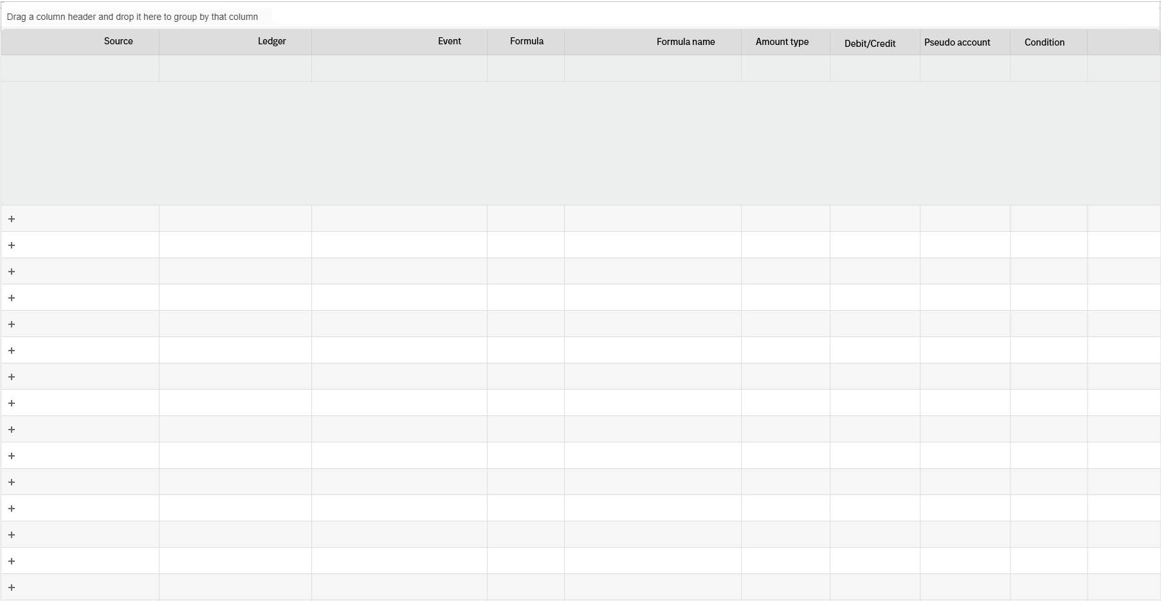

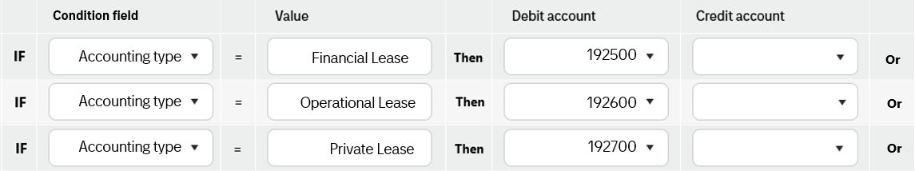
Legal entity
Journals
Reports
Settings
Legal entity /
1 – Alliance Laundry (Netherland) B.V
Group-Example
Last journal transaction
Legal entity: Tietoevry standard
Journal number: 23153
Accounting event: Invoicing
No of transactions : 2 452
Created 2024-10-17
Created by Rikard Krameus
Ar Invoicing Local legal Customer invoicing 200 Customer invoice total Total amount D 192500
Legal entity menu
Legal entity
Ar Invoicing Local legal Customer invoicing 255 Customer invoice added cost Total amount C 191202
Ar Invoicing Local legal Customer invoicing 202 Invoice rounding Total amount C 420100
Ar Invoicing Local legal Customer invoicing 720 Customer invoice rent primary Total amount C 192500
Integration
PF Asset Financing Local legal Termination 200 Customer invoice total Total amount C 192500
PF Asset Financing Local legal Termination USG400 Remaining current remt Remaining rent C 192107
Chart of account
PF Asset Financing Local legal Termination USG401 Remaining non current remt Non rent C 192107
PF Asset Financing Local legal Termination USG402 Remaining current interest Remaining int D 192407
Pseudo account
PF Asset Financing Local legal Termination 070 Purchase option amount Purchase price C 192200
PF Asset Financing Local legal Termination 070 Purchase option amount Purchase price D 420420
Ext. account parts
PF Asset Financing US GAAP Termination 470 Settlement net amount Net amount D 192030
PF Asset Financing US GAAP Termination 016 Residual value at contract end Remaining rent C 192200
Formulas
PF Asset Financing US GAAP Termination 016 Residual value at contract end Remaining rent D 192107
PF Asset Financing US GAAP Termination 400 Termination value Term. value D 192102
Accounting rules
PF Asset Financing US GAAP Termination USG400 Remaining current remt Remaining rent C 192107
PF Asset Financing US GAAP Termination USG401 Remaining non current remt Non rent C 192107
Blazor DataGrid Demos - Overview | Telerik UI for Blazor

Slide 15
Legal entity
Journals
Reports
Settings
Legal entity /
1 – Alliance Laundry (Netherland) B.V
Group-Example
Last journal transaction
Legal entity: Tietoevry standard
Journal number: 23153
Accounting event: Invoicing
No of transactions : 2 452
Created 2024-10-17
Created by Rikard Krameus
Ar Invoicing Local legal Customer invoicing 200 Customer invoice total Total amount D 192500
Ar Invoicing Local legal Customer invoicing 255 Customer invoice added cost Total amount C 191202
Ar Invoicing Local legal Customer invoicing 202 Invoice rounding Total amount C 420100
Ar Invoicing Local legal Customer invoicing 720 Customer invoice rent primary Total amount C 192500
Legal entity menu
PF Asset Financing Local legal Termination 200 Customer invoice total Total amount C 192500
PF Asset Financing Local legal Termination USG400 Remaining current remt Remaining rent C 192107
Legal entity
PF Asset Financing Local legal Termination USG401 Remaining non current remt Non rent C 192107
PF Asset Financing Local legal Termination USG402 Remaining current interest Remaining int D 192407
Integration
PF Asset Financing Local legal Termination 070 Purchase option amount Purchase price C 192200
PF Asset Financing Local legal Termination 070 Purchase option amount Purchase price D 420420
PF Asset Financing US GAAP Termination 470 Settlement net amount Net amount D 192030
Chart of account
PF Asset Financing US GAAP Termination 016 Residual value at contract end Remaining rent C 192200
PF Asset Financing US GAAP Termination 016 Residual value at contract end Remaining rent D 192107
Pseudo account
PF Asset Financing US GAAP Termination 400 Termination value Term. value D 192102
PF Asset Financing US GAAP Termination USG400 Remaining current remt Remaining rent C 192107
Ext. account parts
PF Asset Financing US GAAP Termination USG401 Remaining non current remt Non rent C 192107
PF Asset Financing US GAAP Termination USG402 Remaining current interest Current Int D 192407
Formulas
Accounting rules
Blazor DataGrid Demos - Overview | Telerik UI for Blazor

Slide 16
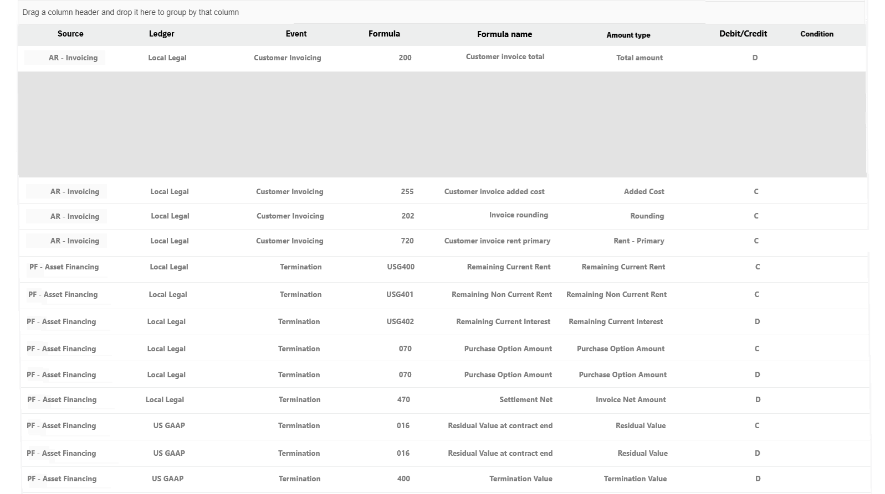
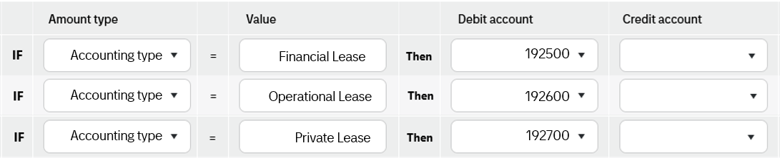
Legal entity
Journals
Reports
Settings
Legal entity /
1 – Alliance Laundry (Netherland) B.V
Last journal transaction
Legal entity: Tietoevry standard
Journal number: 23153
Accounting event: Invoicing
No of transactions : 2 452
Created 2024-10-17
Created by Rikard Krameus
Group
Legal entity menu
Legal entity
Integration
Chart of account
Pseudo account
Ext. account parts
Formulas
Accounting rules
Blazor DataGrid Demos - Overview | Telerik UI for Blazor

Slide 17
Legal entity
Journals
Reports
Settings
Legal entity /
1 – Alliance Laundry (Netherland) B.V
Last journal transaction
Legal entity: Tietoevry standard
Journal number: 23153
Accounting event: Invoicing
No of transactions : 2 452
Created 2024-10-17
Created by Rikard Krameus
Legal entity menu
Legal entity
Integration
Chart of account
Pseudo account
Ext. account parts
Formulas
Accounting rules
Blazor DataGrid Demos - Overview | Telerik UI for Blazor

Slide 18
Legal entity
Journals
Reports
Settings
Legal entity /
1 – Alliance Laundry (Netherland) B.V
Last journal transaction
Legal entity: Tietoevry standard
Journal number: 23153
Accounting event: Invoicing
No of transactions : 2 452
Created 2024-10-17
Created by Rikard Krameus
Legal entity menu
Legal entity
Integration
Chart of account
Pseudo account
Ext. account parts
Formulas
Accounting rules
Blazor DataGrid Demos - Overview | Telerik UI for Blazor

Slide 19
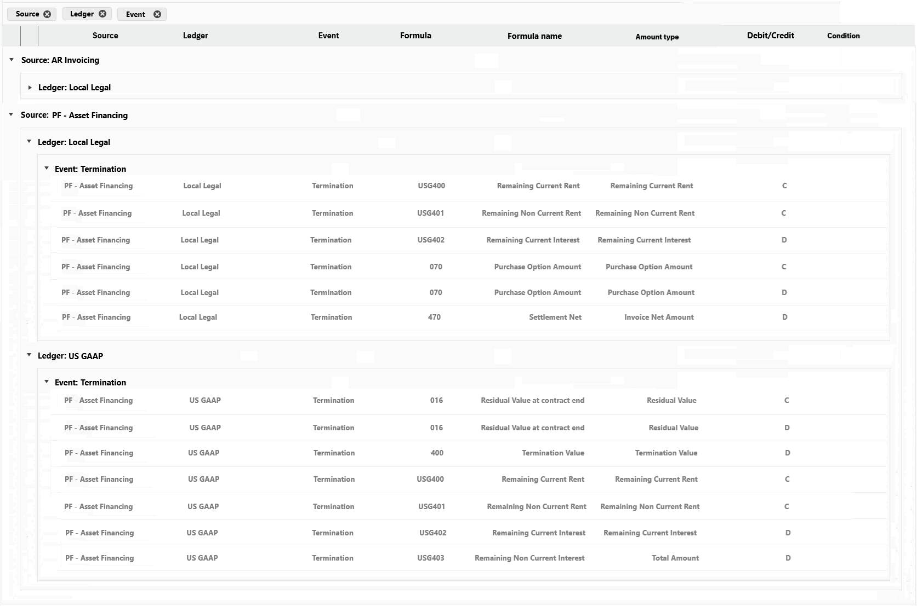
Legal entity
Journals
Reports
Settings
Legal entity /
1 – Alliance Laundry (Netherland) B.V
Last journal transaction
Legal entity: Tietoevry standard
Journal number: 23153
Accounting event: Invoicing
No of transactions : 2 452
Created 2024-10-17
Created by Rikard Krameus
>
Legal entity menu
Legal entity
Integration
Chart of account
Pseudo account
Ext. account parts
Formulas
Accounting rules
Blazor DataGrid Demos - Overview | Telerik UI for Blazor

Slide 20
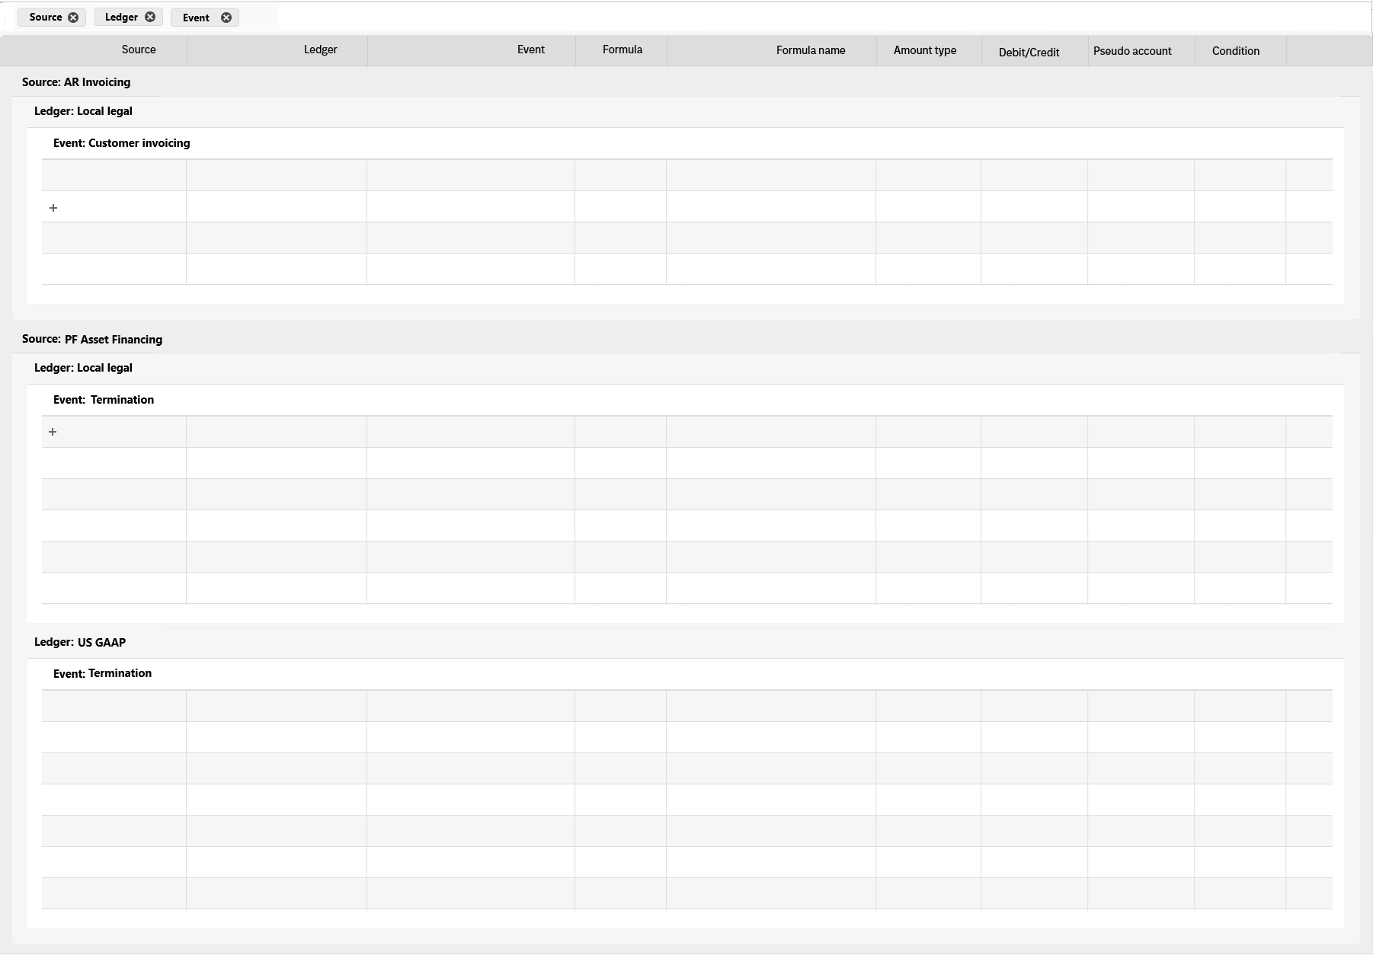
Legal entity
Journals
Reports
Settings
Legal entity /
1 – Alliance Laundry (Netherland) B.V
Last journal transaction
Legal entity: Tietoevry standard
Journal number: 23153
Accounting event: Invoicing
No of transactions : 2 452
Created 2024-10-17
Created by Rikard Krameus
>
Ar Invoicing Local legal Customer invoicing 200 Customer invoice total Total amount D 192500
Ar Invoicing Local legal Customer invoicing 255 Customer invoice added cost Total amount C 191202
Ar Invoicing Local legal Customer invoicing 202 Invoice rounding Total amount C 420100
Legal entity menu
Ar Invoicing Local legal Customer invoicing 720 Customer invoice rent primary Total amount C 192500
Legal entity
Integration
PF Asset Financing Local legal Termination 200 Customer invoice total Total amount C 192500
Chart of account
PF Asset Financing Local legal Termination USG400 Remaining current remt Remaining rent C 192107
PF Asset Financing Local legal Termination USG401 Remaining non current remt Non rent C 192107
PF Asset Financing Local legal Termination USG402 Remaining current interest Remaining int D 192407
Pseudo account
PF Asset Financing Local legal Termination 070 Purchase option amount Purchase price C 192200
PF Asset Financing Local legal Termination 070 Purchase option amount Purchase price D 420420
Ext. account parts
Formulas
PF Asset Financing US GAAP Termination 470 Settlement net amount Net amount D 192030
Accounting rules
PF Asset Financing US GAAP Termination 016 Residual value at contract end Remaining rent C 192200
PF Asset Financing US GAAP Termination 016 Residual value at contract end Remaining rent D 192107
PF Asset Financing US GAAP Termination 400 Termination value Term. value D 192102
PF Asset Financing US GAAP Termination USG400 Remaining current remt Remaining rent C 192107
PF Asset Financing US GAAP Termination USG401 Remaining non current remt Non rent C 192107
PF Asset Financing US GAAP Termination USG402 Remaining current interest Current Int D 192407
Blazor DataGrid Demos - Overview | Telerik UI for Blazor

Slide 21
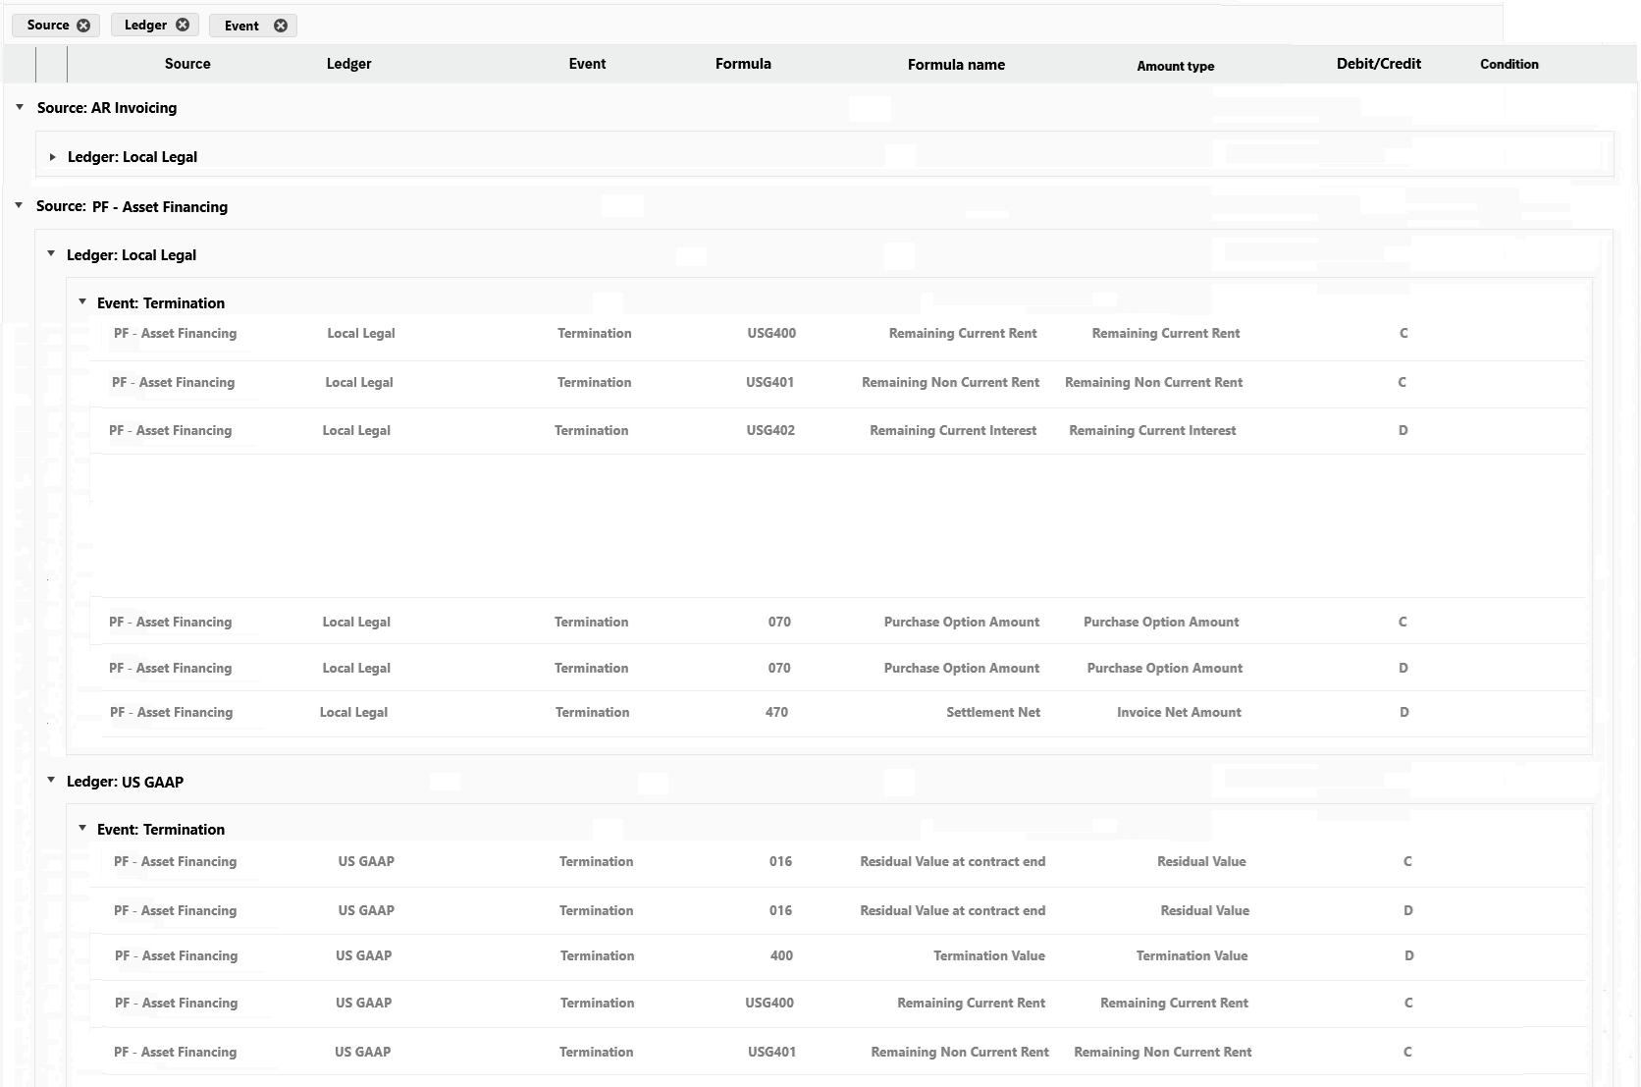
Legal entity
Journals
Reports
Settings
Legal entity /
1 – Alliance Laundry (Netherland) B.V
Last journal transaction
Legal entity: Tietoevry standard
Journal number: 23153
Accounting event: Invoicing
No of transactions : 2 452
Created 2024-10-17
Created by Rikard Krameus
Legal entity menu
Legal entity
Integration
Chart of account
Pseudo account
Ext. account parts
Formulas
Accounting rules
Blazor DataGrid Demos - Overview | Telerik UI for Blazor

Slide 22
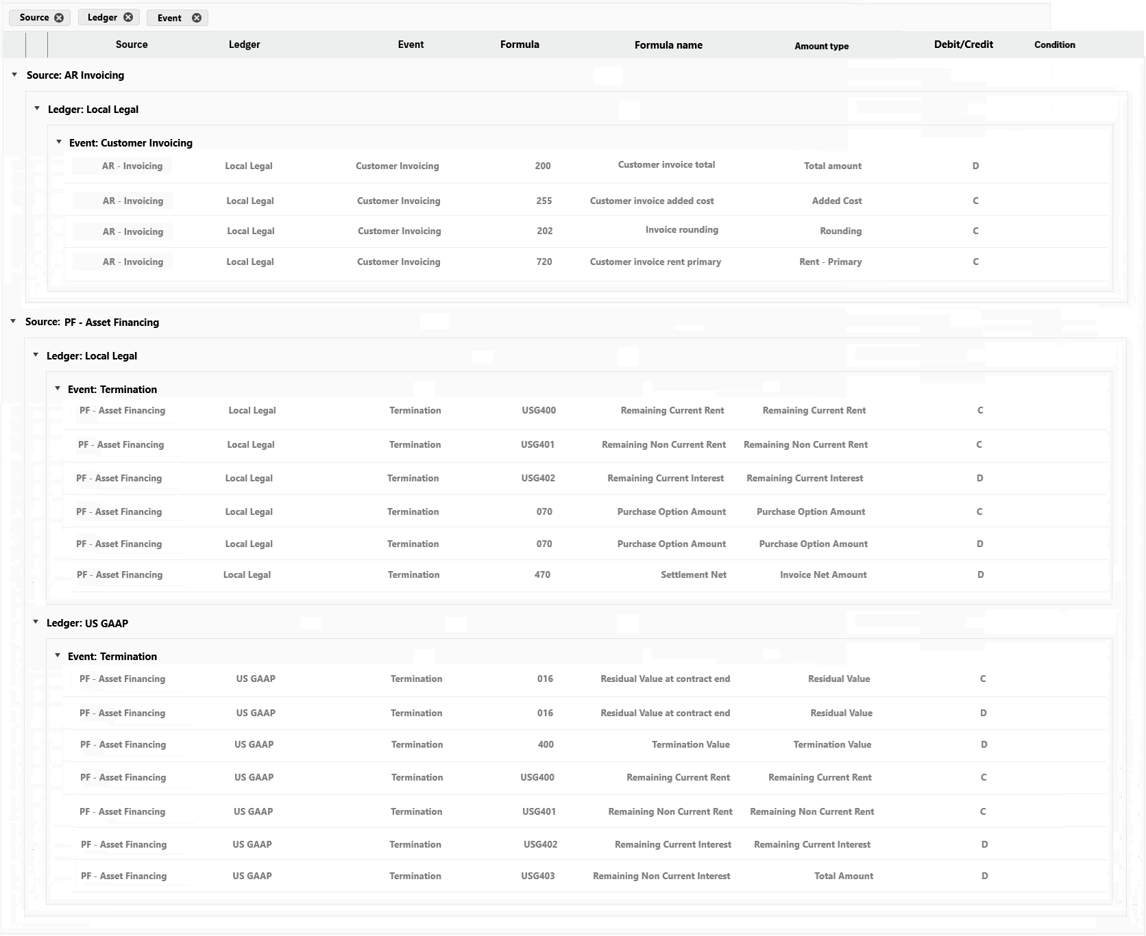
Legal entity
Journals
Reports
Settings
Legal entity /
1 – Alliance Laundry (Netherland) B.V
Last journal transaction
Legal entity: Tietoevry standard
Journal number: 23153
Accounting event: Invoicing
No of transactions : 2 452
Created 2024-10-17
Created by Rikard Krameus
Legal entity menu
Legal entity
Integration
Chart of account
Pseudo account
Ext. account parts
Formulas
Accounting rules
Blazor DataGrid Demos - Overview | Telerik UI for Blazor

Slide 23

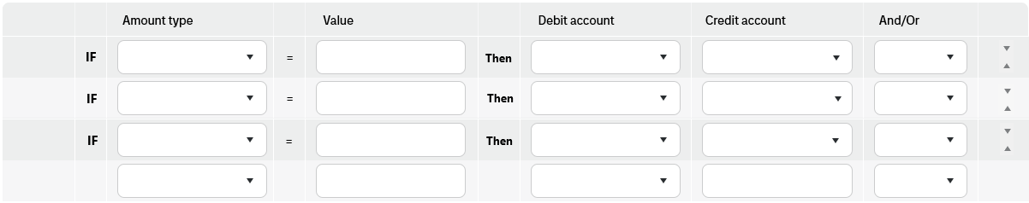
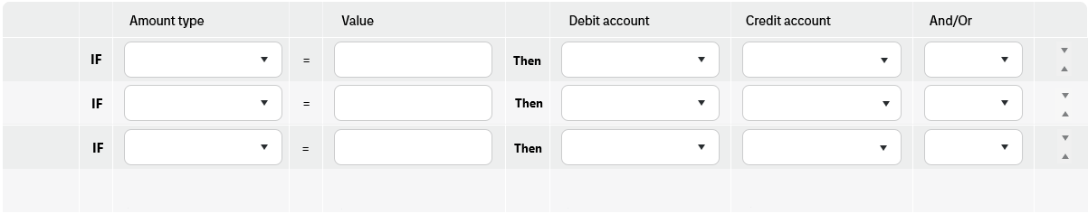


Legal entity
Journals
Reports
Settings
Legal entity /
/ Formula 490– Settlement invoice total
1 – Alliance Laundry (Netherland) B.V
Formula
Amount type
Name
Debit account
Credit account
490 Total – Amount Settlement invoice total - -
Description
The invoice total from the customer invoice connected to the settlement calculation -
Accounting type
Financial Lease
192500
Or
Accounting type
Operational Lease
192600
Or
Accounting type
Private Lease
192700

Slide 24
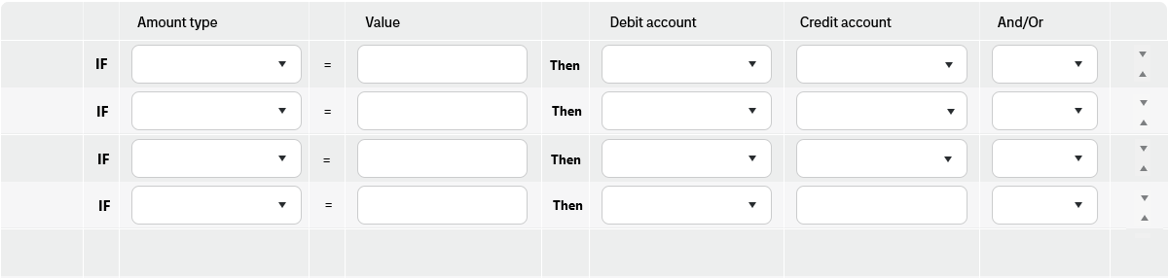
Legal entity
Journals
Reports
Settings
Legal entity /
/ Formula 490– Settlement invoice total
1 – Alliance Laundry (Netherland) B.V
Formula
Amount type
Name
Debit account
Credit account
490 Total – Amount Settlement invoice total - -
Description
The invoice total from the customer invoice connected to the settlement calculation -
Accounting type
Financial Lease
192500
Or
Accounting type
Operational Lease
192600
Or
Accounting type
Private Lease
192700

Slide 25
Legal entity
Journals
Reports
Settings
Legal entity /
/ Formula 490– Settlement invoice total
1 – Alliance Laundry (Netherland) B.V
Formula
Amount type
Name
Debit account
Credit account
490 Total – Amount Settlement invoice total - -
Description
The invoice total from the customer invoice connected to the settlement calculation -
Accounting type
Financial Lease
192500
Or
Accounting type
Operational Lease
192600
Or
Accounting type
Private Lease
And
Termination reason
911
193000

Slide 26
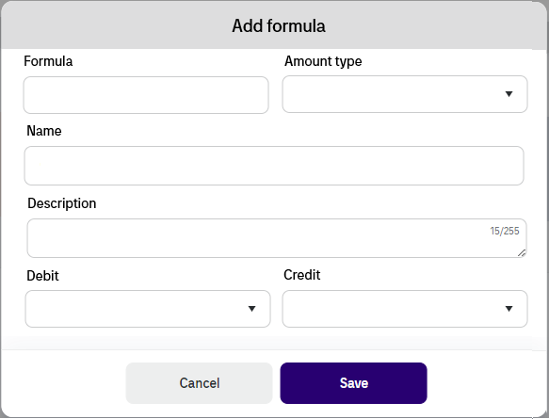

Legal entity
Journals
Reports
Settings
Legal entity /
1 – Alliance Laundry (Netherland) B.V
Last journal transaction
Legal entity: Tietoevry standard
Journal number: 23153
Accounting event: Invoicing
No of transactions : 2 452
Created 2024-10-17
Created by Rikard Krameus
Legal entity menu
Legal entity
Integration
Chart of account
Pseudo account
Ext. account parts
Formulas
Accounting rules

Slide 27
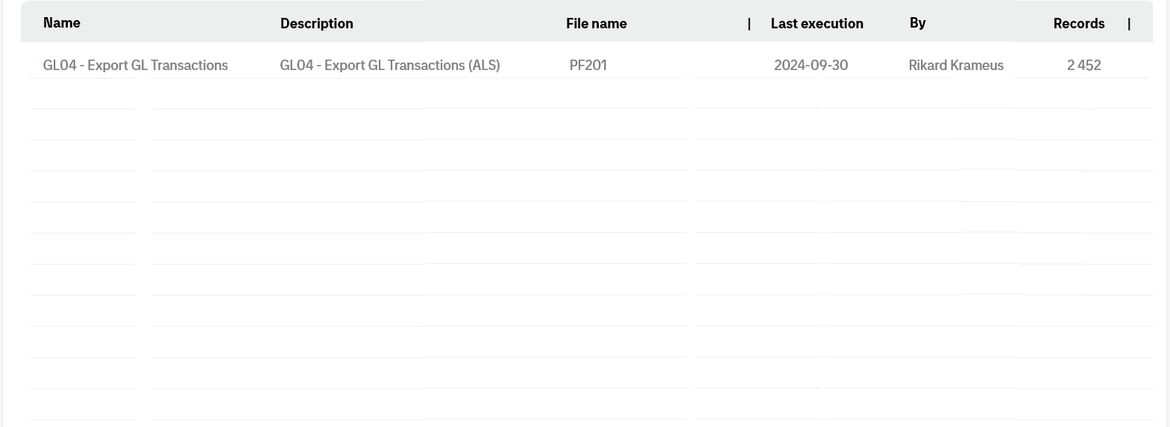
Legal entity
Journals
Reports
Settings
Legal entity /
1 – Alliance Laundry (Netherland) B.V
Last journal transaction
Legal entity: Tietoevry standard
Journal number: 23153
Accounting event: Invoicing
No of transactions : 2 452
Created 2024-10-17
Created by Rikard Krameus
Legal entity menu
Legal entity
Integration
Chart of account
Pseudo account
Ext. account parts
Formulas
Accounting rules

Slide 28
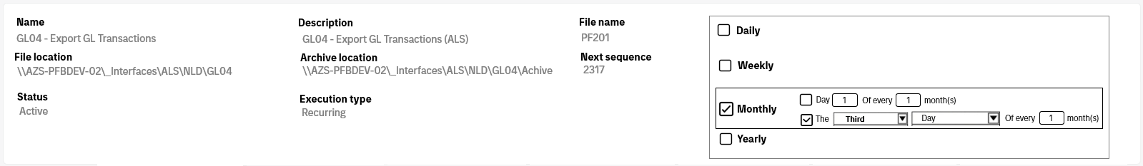
Legal entity
Journals
Reports
Settings
Legal entity /
Integration GL04 – Export GL transactions
1 – Alliance Laundry (Netherland) B.V /
Last journal transaction
Legal entity: Tietoevry standard
Journal number: 23153
Accounting event: Invoicing
No of transactions : 2 452
Created 2024-10-17
Created by Rikard Krameus
Integration menu
Integration data
Executions
Settings

Slide 29
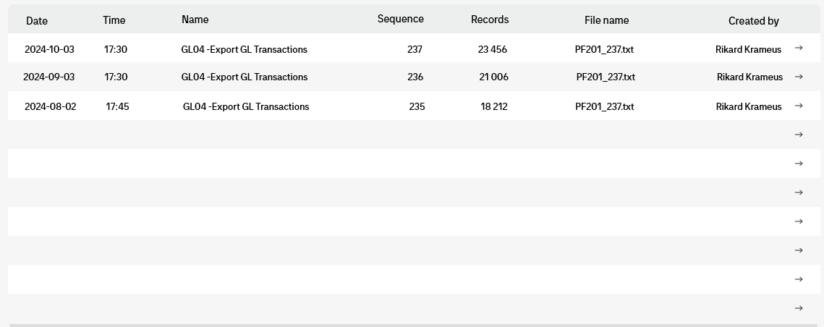
Legal entity
Journals
Reports
Settings
Legal entity /
Integration GL04 – Export GL transactions
1 – Alliance Laundry (Netherland) B.V /
Last journal transaction
Legal entity: Tietoevry standard
Journal number: 23153
Accounting event: Invoicing
No of transactions : 2 452
Created 2024-10-17
Created by Rikard Krameus
Integration menu
Integration data
Executions
Settings

Slide 30
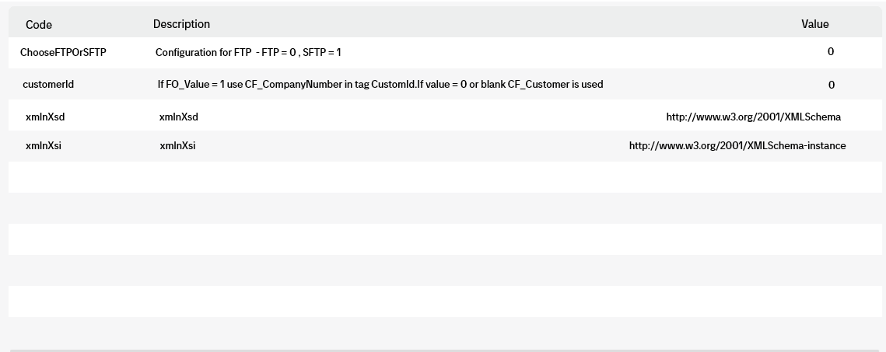

Legal entity
Journals
Reports
Settings
Legal entity /
Integration GL04 – Export GL transactions
1 – Alliance Laundry (Netherland) B.V /
Last journal transaction
Legal entity: Tietoevry standard
Journal number: 23153
Accounting event: Invoicing
No of transactions : 2 452
Created 2024-10-17
Created by Rikard Krameus
Integration menu
Integration data
Executions
Settings

Slide 31
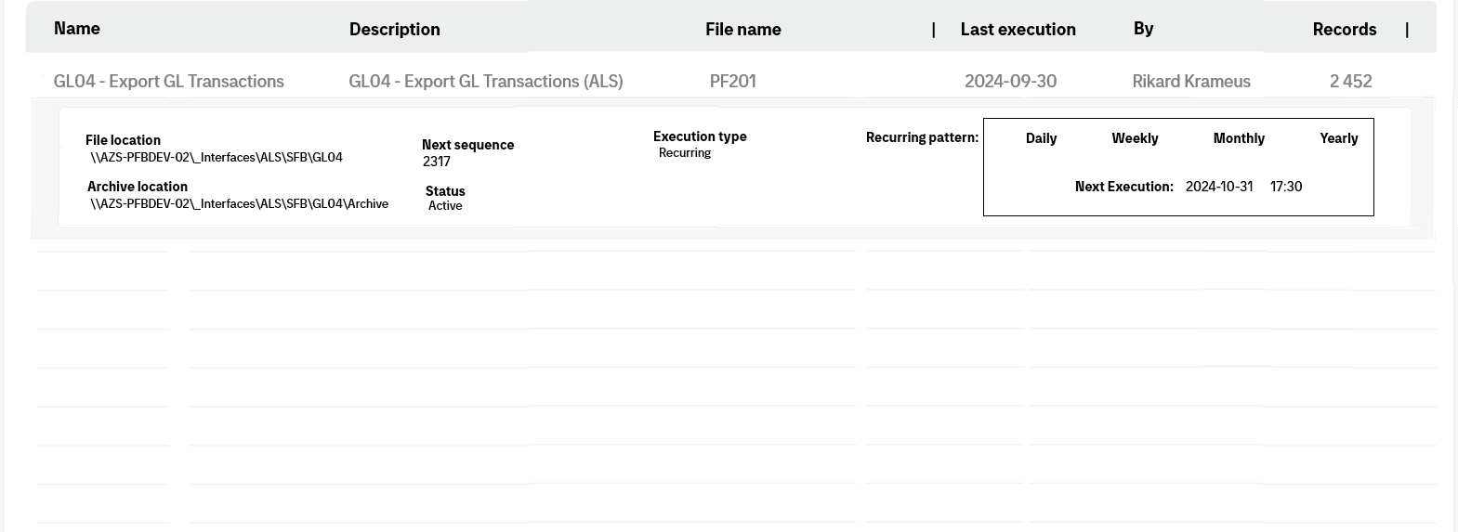

Legal entity
Journals
Reports
Settings
Legal entity /
1 – Alliance Laundry (Netherland) B.V
Last journal transaction
Legal entity: Tietoevry standard
Journal number: 23153
Accounting event: Invoicing
No of transactions : 2 452
Created 2024-10-17
Created by Rikard Krameus
Legal entity menu
Legal entity
Integration
Chart of account
Pseudo account
Ext. account parts
Formulas
Accounting rules

Slide 32

Legal entity
Journals
Reports
Settings
Legal entity /
1 – Alliance Laundry (Netherland) B.V
Last journal transaction
Legal entity: Tietoevry standard
Journal number: 23153
Accounting event: Invoicing
No of transactions : 2 452
Created 2024-10-17
Created by Rikard Krameus
Owner
End of month
Close period
Legal entity menu
Responsible
Legal entity
Integration
Chart of account
Pseudo account
Ext. account parts
Formulas
Accounting rules

Slide 33
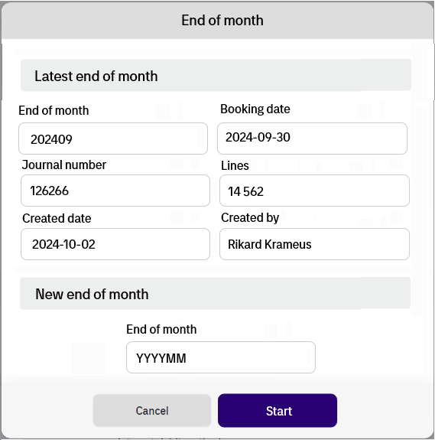
Legal entity
Journals
Reports
Settings
Legal entity /
1 – Alliance Laundry (Netherland) B.V
Last journal transaction
Legal entity: Tietoevry standard
Journal number: 23153
Accounting event: Invoicing
No of transactions : 2 452
Created 2024-10-17
Created by Rikard Krameus
Owner
Legal entity menu
Responsible
Legal entity
Integration
Chart of account
Pseudo account
Formulas
Accounting rules
Ext. account parts

Slide 34
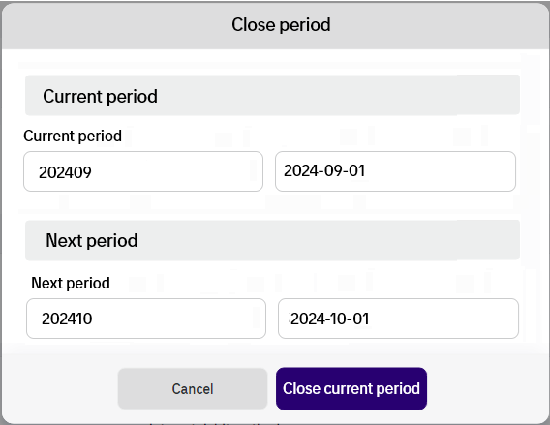
Legal entity
Journals
Reports
Settings
Legal entity /
1 – Alliance Laundry (Netherland) B.V
Last journal transaction
Legal entity: Tietoevry standard
Journal number: 23153
Accounting event: Invoicing
No of transactions : 2 452
Created 2024-10-17
Created by Rikard Krameus
Owner
Legal entity menu
Responsible
Legal entity
Integration
Chart of account
Pseudo account
Formulas
Accounting rules
Ext. account parts

Slide 35
Legal entity
Journals
Reports
Settings
Legal entity /
1 – Alliance Laundry (Netherland) B.V
Last journal transaction
Legal entity: Tietoevry standard
Journal number: 23153
Accounting event: Invoicing
No of transactions : 2 452
Created 2024-10-17
Created by Rikard Krameus
Owner
Legal entity menu
Responsible
Legal entity
Integration
Chart of account
Pseudo account
Formulas
Accounting rules
Ext. account parts

Slide 36
Legal entity
Journals
Reports
Settings
Legal entity /
1 – Alliance Laundry (Netherland) B.V
Last journal transaction
Legal entity: Tietoevry standard
Journal number: 23153
Accounting event: Invoicing
No of transactions : 2 452
Created 2024-10-17
Created by Rikard Krameus
Owner
Legal entity menu
Responsible
Legal entity
Integration
Chart of account
Pseudo account
Formulas
Accounting rules
Ext. account parts

Slide 37

Legal entity
Journals
Reports
Settings
Setting
Last journal transaction
Legal entity: Tietoevry standard
Journal number: 23153
Accounting event: Invoicing
No of transactions : 2 452
Created 2024-10-17
Created by Rikard Krameus
Setting menu
Accounting Class
Amount types
Ledgers
Chart of account
Ext. account values

Slide 38
Legal entity
Journals
Reports
Settings
Setting
Last journal transaction
Legal entity: Tietoevry standard
Journal number: 23153
Accounting event: Invoicing
No of transactions : 2 452
Created 2024-10-17
Created by Rikard Krameus
Report menu
Transaction List
Total reconciliation

Slide 39
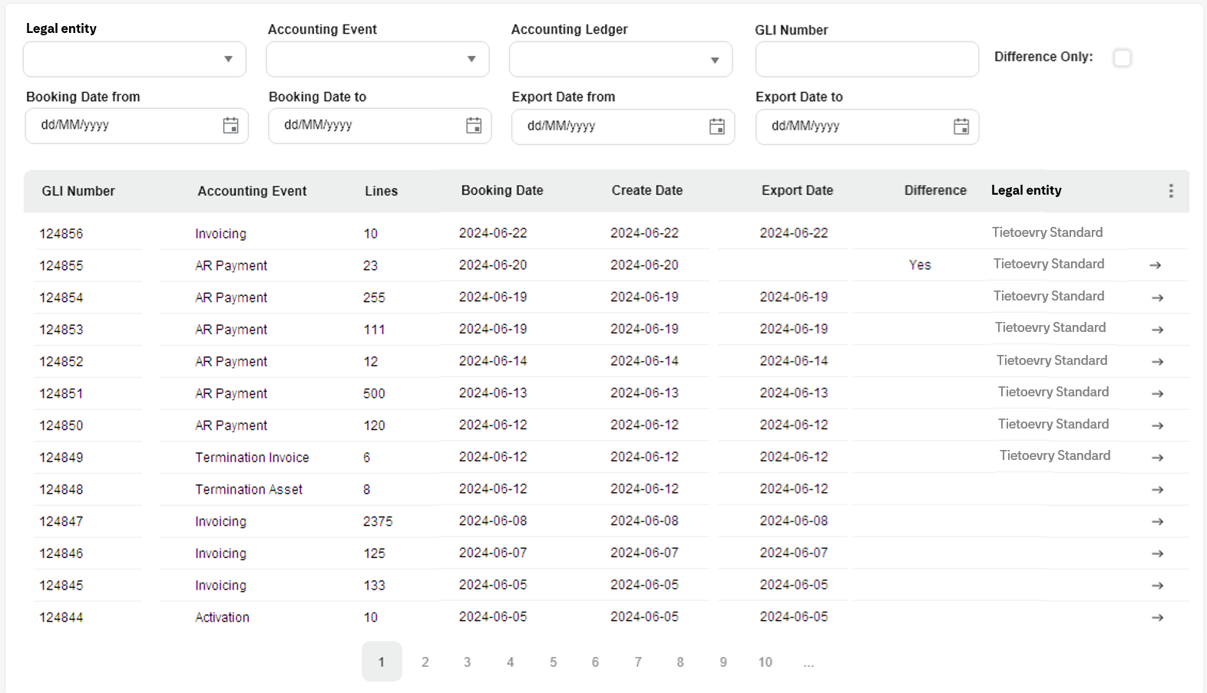

Legal entity
Journals
Reports
Settings
Journal search
Last GLI transaction
Legal entity: Tietoevry standard
GLI number: 23153
Accounting event: Invoicing
No of transactions : 2 452
Created 2024-10-17
Created by Rikard Krameus
Journal menu
Journal - search
Transaction search
Manual journal

Slide 40
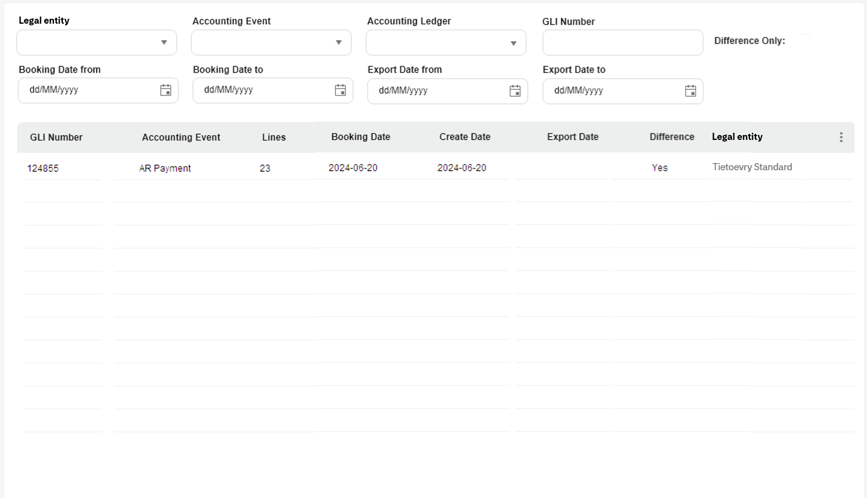
Legal entity
Journals
Reports
Settings
Journal search
Last GLI transaction
Legal entity: Tietoevry standard
GLI number: 23153
Accounting event: Invoicing
No of transactions : 2 452
Created 2024-10-17
Created by Rikard Krameus
GLI menu
GLI - search
Transaction search
Manual transaction
Accounting rules

Slide 41
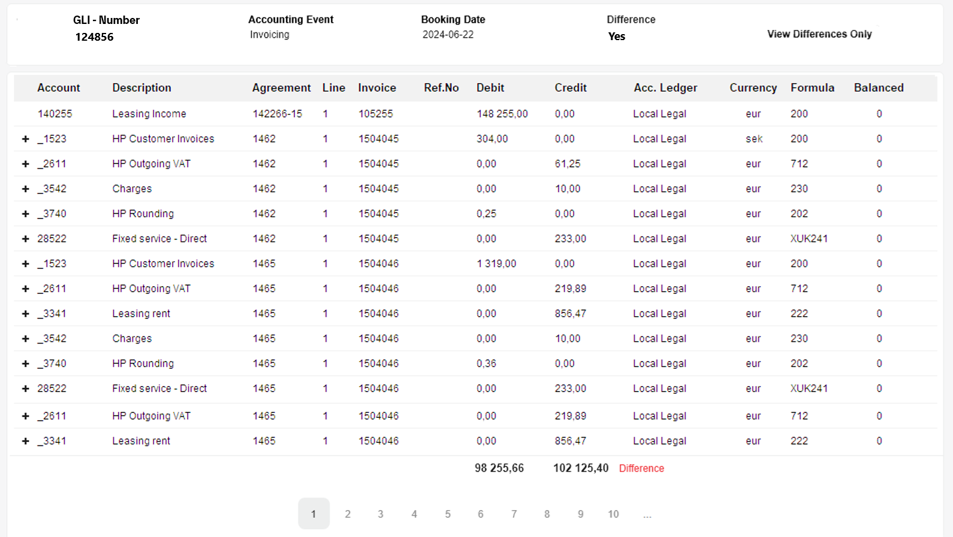

Legal entity
Journals
Reports
Settings
Journal search
/ GLI - 124856

Slide 42
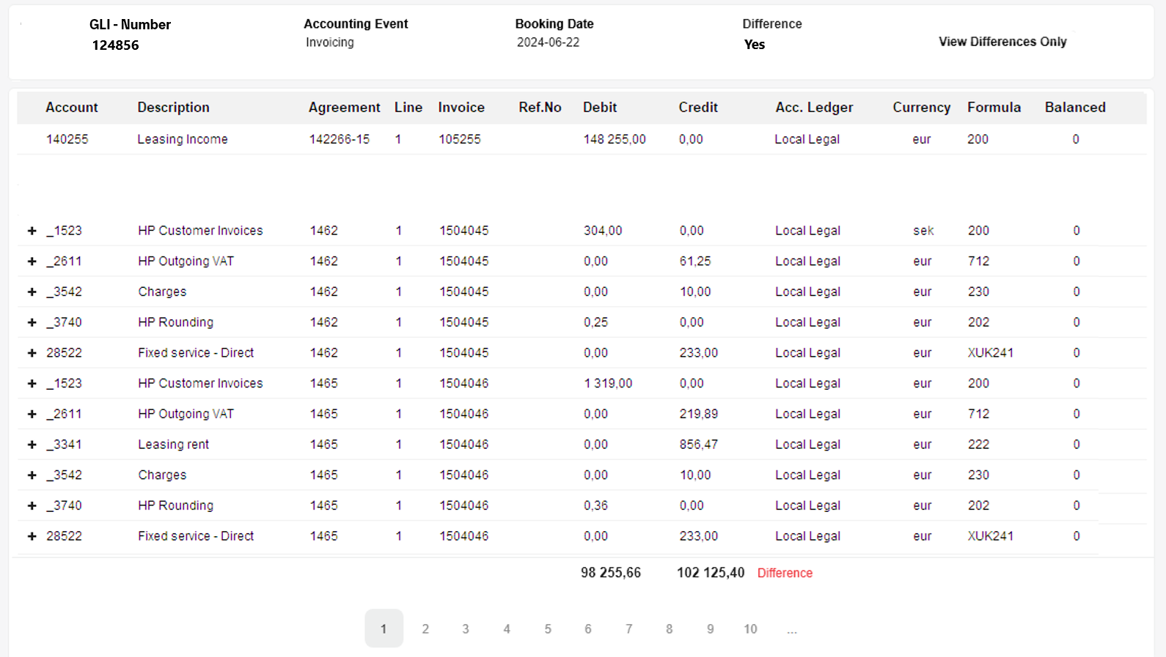
Legal entity
Journals
Reports
Settings
Journal search
/ GLI - 124856

Slide 43
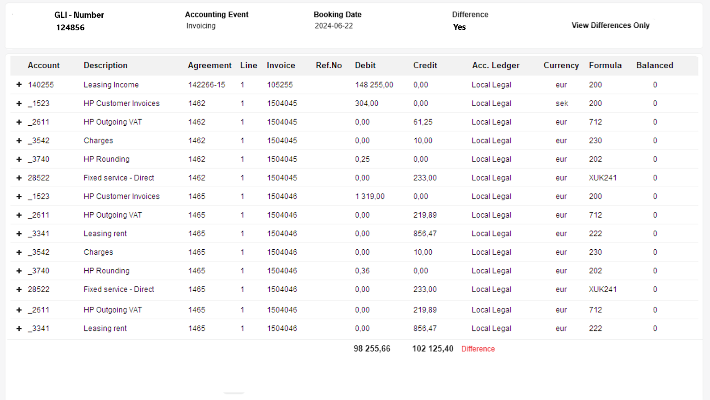
Legal entity
Journals
Reports
Settings
Journal search
/ GLI - 124856

Slide 44
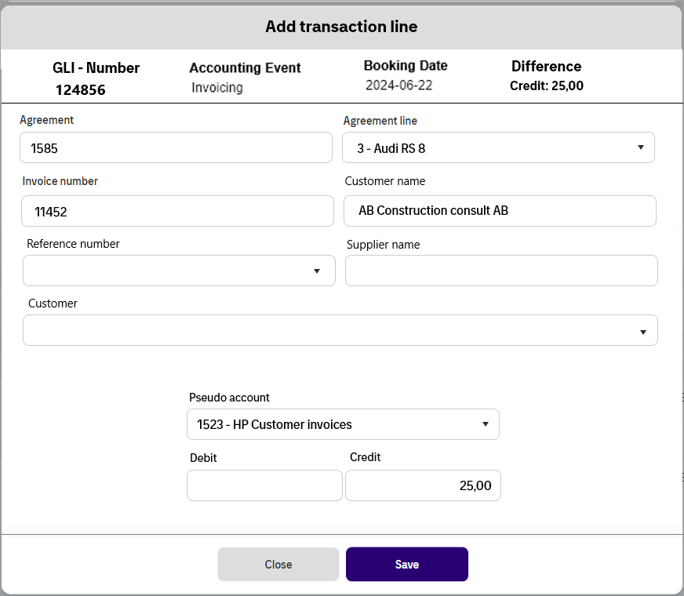
Legal entity
Journals
Reports
Settings
Journal search
/ GLI - 124856

Slide 45
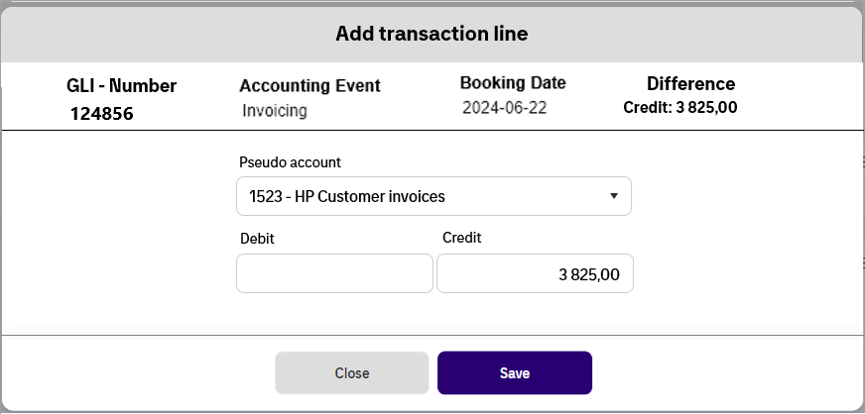
Legal entity
Journals
Reports
Settings
Journal search
/ GLI - 124856

Slide 46
Legal Entity = ALS = ID 21
Amount Group
Condition Values
Accounting Class
Accounting Event
ID Name
23 Message
231 Accrual
232 Monthly
ID Name
66 Accounting Product
67 Invoice type
Payment Method
Amount Code
ID Name Legal Entity: ID
2323 PF-Contract 21
2324 AR-Invoicing 21
ID Name Calculation Date Event Date
77 Activation No Yes
Accounting Ledger
Amount Type
ID Name Accounting Class: ID
Local Legal 21
US GAAP 21
Conditions
Formula Condition
ID Name Amount Group:ID
Purchase Price 23
Fixed Asset Value 23
Total Amortization 23
Total Rent 23
Total Interest 23
ID Name
34 Check What accounting product
ID Level Formula Condition ID ConditionValues:ID PseudoAccountCOA:ID Value Operator
1 34 66 50 Direct Lease
1 34 66 51 OP Lease
ChartOfAccount
Accounting Rules
ID Accounting Formulas:ID Accounting Ledger:ID AccountingEvent ID Debit/Credit
672 43 531 77 D
ID Name Description Order Depth ParentID
8 Accounts, Notes and Loan receivables Account 1300 - 1399 1.2.1 2 7
PseudoAccountCOA
Formula
ID ChartOfAccount:ID PseudoAccount:ID
8 341
8 342
8 343
PseudoAccount
ID Name Description AmountTypeID FormulaCondition:ID PseudoAccountCOA:ID
PF-014 Fixed Asset Value from the Line. 1011 34 49
PF-061 Sum of all Period amortizations 1012
PF-062 Sum of all Period rents 1013
PF-062 Sum of all Period interests 1014
ID PseudoAccount Name
140000 Equipment Purchases
140001 Equipment Purchases– Direct Lease
140002 Equipment Purchases– OP Lease
140000 Equipment Purchases
192101 Lease Rec - Curr Year Volume
192401 Unearn Inc- Curr Year Volume

Slide 47
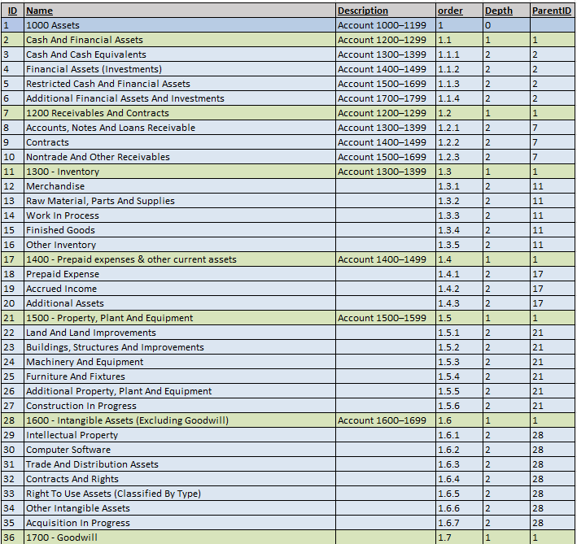
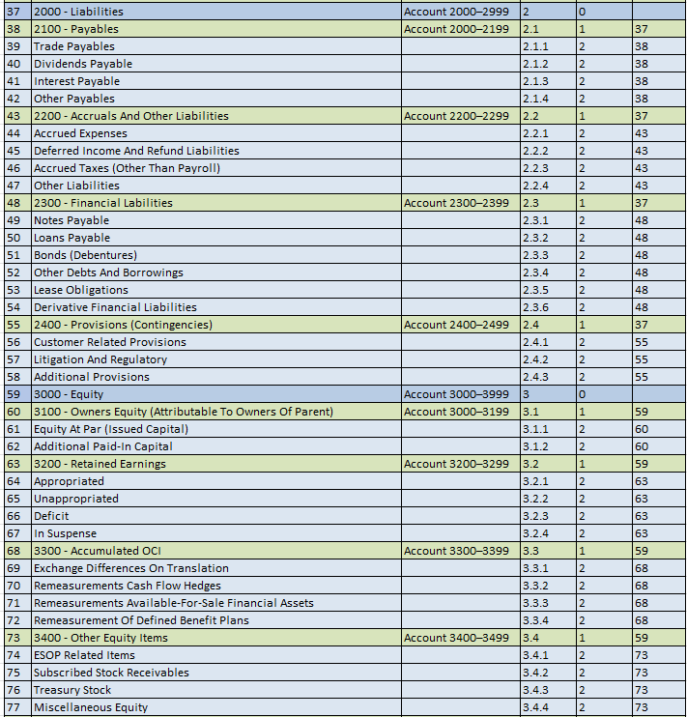
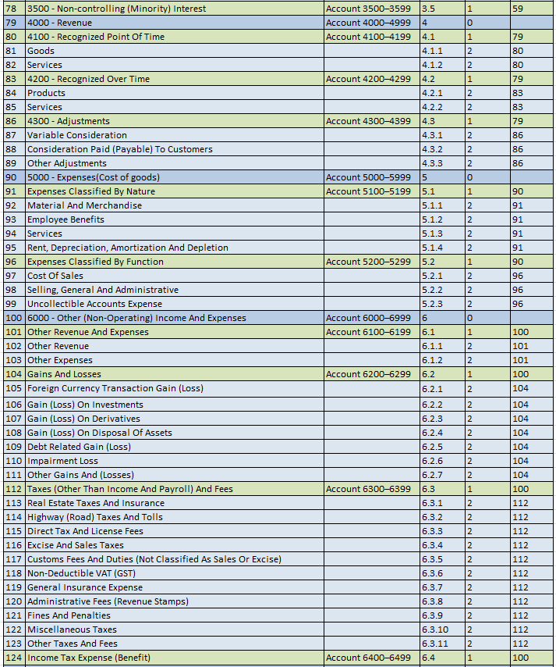
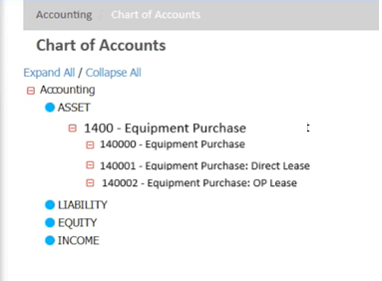
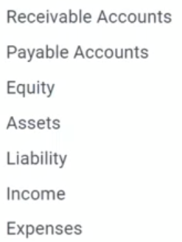
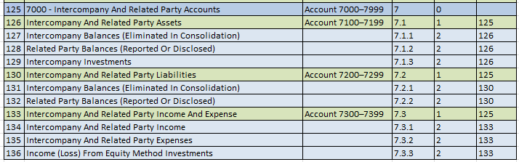
ChartOfAccount
PseudoAccountCOA
ID ChartOfAccount:ID PseudoAccount:ID
17 341
17 342
17 343
PseudoAccount
ID PseudoAccount Name
140000 Equipment Purchases
140001 Equipment Purchases– Direct Lease
140002 Equipment Purchases– OP Lease

Slide 48
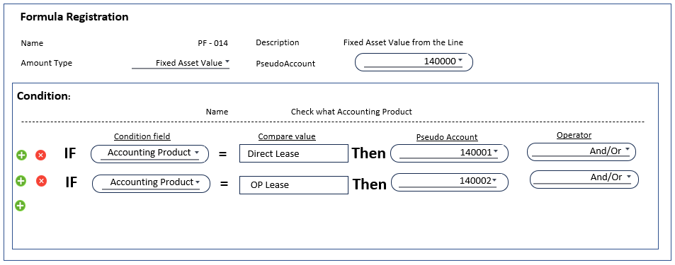
Condition Values
Amount Group
ID Name
66 Accounting Product
67 Invoice type
Payment Method
Amount Code
Portfolio
ID Name
23 Message
231 Accrual
232 Monthly
Conditions
Formula Condition
Amount Type
ID Level Formula Condition ID ConditionValues:ID PseudoAccountCOA:ID Value Operator
1 34 66 50 Direct Lease
1 34 66 51 OP Lease
ID Name
34 Check What accounting product
ID Name Amount Group:ID
Purchase Price 23
Fixed Asset Value 23
Total Amortization 23
Total Rent 23
Total Interest 23
Formula
ID Name Description AmountTypeID FormulaCondition:ID PseudoAccountCOA:ID
PF-014 Fixed Asset Value from the Line. 1011 34 49
PF-061 Sum of all Period amortizations 1012
PF-062 Sum of all Period rents 1013
PF-062 Sum of all Period interests 1014

Slide 49

Legal Entity = ALS = ID 21
Accounting Event
Accounting Class
ID Name Calculation Date Event Date
77 Activation No Yes
ID Name Legal Entity: ID
2323 PF-Contract 21
2324 AR-Invoicing 21
Accounting Rules
Accounting Ledger
ID Accounting Formulas:ID Accounting Ledger:ID AccountingEvent ID Debit/Credit
672 43 531 77 D
ID Name Accounting Class: ID
Local Legal 21
US GAAP 21
Formula
ID Name Description AmountTypeID FormulaCondition:ID PseudoAccountCOA:ID
PF-014 Fixed Asset Value from the Line. 1011 34 49
PF-061 Sum of all Period amortizations 1012
PF-062 Sum of all Period rents 1013
PF-062 Sum of all Period interests 1014

Slide 50

Formula Registration
Name PF - 014
Description Fixed Asset Value from the Line
Amount Type Fixed Asset Value
PseudoAccount
140000
Condition:
Name Check what Accounting Product
Condition Value
Compare value
Pseudo Account
Operator
IF
Accounting Product
=
Direct Lease
Then
140001
And/Or
And/Or
IF
Accounting Product
=
OP Lease
Then
140002
And/Or

Slide 51



Accounting Rule - Registration
PF- Contract
Local Legal
Accounting Event Activation
Accounting Class
Ledger
Formula
PF- 014
Debit/Credit
Debit
Pseudo Account
140000
PF- Contract
Local Legal
Accounting Event
Activation
Accounting Class
Ledger

Slide 52


Accounting Rule - Registration
PF- Contract
Local Legal
Accounting Event Activation
Accounting Class
Ledger
Formula
PF- 014
Debit/Credit
Debit
Pseudo Account
140000
PF- Contract
Local Legal
Accounting Event
Activation
Accounting Class
Ledger

Slide 53

Message Header
Activation
Event Data
Message Header
Invoicing
Event Data

Slide 54
Legal Entity = ALS = ID 21
Amount Group
Condition Values
Accounting Class
Accounting Event
ID Name
23 Message
231 Accrual
232 Monthly
ID Name
66 Accounting Product
67 Invoice type
Payment Method
Amount Code
ID Name Legal Entity: ID
2323 PF-Contract 21
2324 AR-Invoicing 21
ID Name Calculation Date Event Date
77 Activation No Yes
Accounting Ledger
Amount Type
ID Name Accounting Class: ID
Local Legal 21
US GAAP 21
Conditions
Formula Condition
ID Name Amount Group:ID
Purchase Price 23
Fixed Asset Value 23
Total Amortization 23
Total Rent 23
Total Interest 23
ID Name
34 Check What accounting product
ID Level Formula Condition ID ConditionValues:ID PseudoAccountCOA:ID Value Operator
1 34 66 50 Direct Lease
1 34 66 51 OP Lease
ChartOfAccount
Accounting Rules
ID Accounting Formulas:ID Accounting Ledger:ID AccountingEvent ID Debit/Credit
672 43 531 77 D
ID Name Description Order Depth ParentID
8 Accounts, Notes and Loan receivables Account 1300 - 1399 1.2.1 2 7
PseudoAccountCOA
Formula
ID ChartOfAccount:ID PseudoAccount:ID
8 341
8 342
8 343
PseudoAccount
ID Name Description AmountTypeID FormulaCondition:ID PseudoAccountCOA:ID
PF-014 Fixed Asset Value from the Line. 1011 34 49
PF-061 Sum of all Period amortizations 1012
PF-062 Sum of all Period rents 1013
PF-062 Sum of all Period interests 1014
ID PseudoAccount Name
140000 Equipment Purchases
140001 Equipment Purchases– Direct Lease
140002 Equipment Purchases– OP Lease
140000 Equipment Purchases
192101 Lease Rec - Curr Year Volume
192401 Unearn Inc- Curr Year Volume

Slide 55

Message Header
Activation
Event Data
Message Header
Invoicing
Event Data

Slide 56
In accounting domain user should be able to:
Create a new ledger entity
Maintain ledger entities
Create Calendar
Maintain Calendar
Create new ledger
Maintain ledgers
Create External account Part usage
Maintain External account parts
Create new Pseudo accounts
Maintain pseudo accounts
Create pseudo account configuration of External account part
Select what chart of account to use
Connect pseudo accounts to the selected chart of account
Change Name and description in the chart of account
Create new amount types connected to the group name ‘message’
Maintain amount types
Create new Formulas
Maintain formulas
Add conditions to formulas
Maintain conditions
Create new accounting Rule
Maintain accounting rules
Create manual GLI transactions
Search GLI Transaction
Maintain GLI transactions
Create manual GLI Transactions
Start Monthly Accounting
Close period
Export To General Ledger
Generate Reports

