Slide 2

About us
Miloš Naňo
  Java developer
Matúš Bartko
  Java developer
SPEED
  Liferay
  Spring
  Angular 4

Slide 3
Media Api
Online onboarding
  https://www.csob.sk/bezny-ucet-online/zriadenie?account_type=POHODA
Video call - we are dealing with two problems
  How to get media stream from camera/microphone
  Hot to establish p2p connection (exchanging media streams) between peers

Slide 4
MediaStream API
partial interface NavigatorUserMedia {
void getUserMedia(MediaStreamConstraints constraints,
NavigatorUserMediaSuccessCallback successCallback,
NavigatorUserMediaErrorCallback errorCallback);
};
Prompts the user for permission to use their Web cam or other video or audio input
The constraints argument is a dictionary of type MediaStreamConstraints
The successCallback will be invoked with a suitable MediaStream object as its argument
The errorCallback will be invoked if there is a failure in finding valid tracks or if the user denies permission
https

Slide 5
WebRTC
WebRTC is a free, open project that provides browsers and mobile applications with Real-Time Communications (RTC) capabilities via simple APIs.
      webrtc.org

Slide 6
WebRTC
https://www.w3.org/TR/webrtc/
Currently W3C Working Draft
This specification is being developed in conjunction with an API specification to get access to local media devices developed by the Media Capture Task Force
Browser support: http://iswebrtcreadyyet.com/

Slide 7
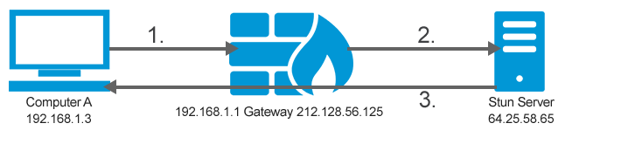
WebRTC
WebRTC provides p2p communication
BUT WebRTC web application still needs servers:
  For signaling: process of exchange of informations to coordinate browser`s communication
  To handle NAT (network address translation)

Slide 8
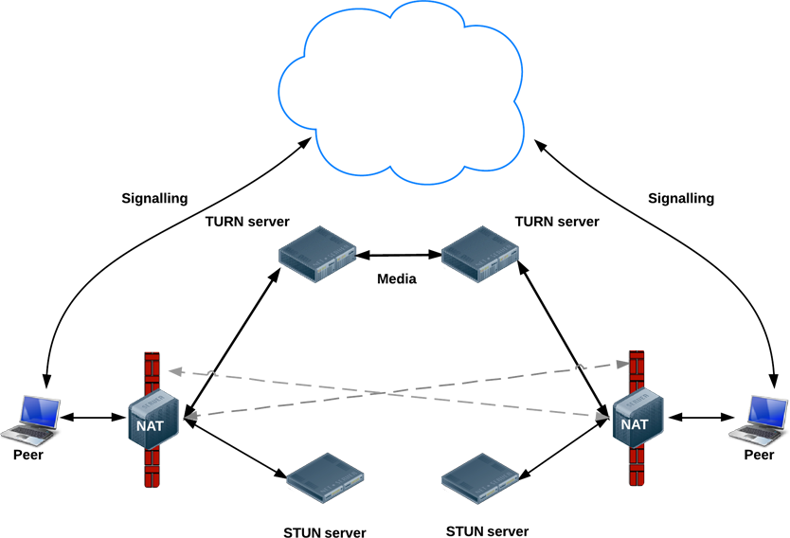
Signaling
STUN
  Session Traversal of User Datagram Protocol [UDP] Through Network Address Translators [NATs]
  STUN server allows clients to find out their public address, the type of NAT they are behind and the Internet side port
TURN
  TURN servers are used to relay traffic if direct (peer to peer) connection fails
  It is a STUN server with added functionality
I stole this from html5rocks.com

Slide 9
WebRTC
SDP
  Session Description Protocol
  SDPs are not aware of an external NATs IP address
  SDPs are not aware of how to handle any port restrictions
  SDPs are not aware of handling non-port preserved connections
ICE
  Interactive Connectivity Establishment
  The ICE protocol is used to generate media traversal candidates, which can be successfully sent and received through NATs.

Slide 10
What is part of WebRTC
Acquiring of local sdp
Communication with between client and STUN/TURN server
Sending/receiving p2p data (media stream in our case)
ICE candidates gathering

Slide 11
What is part of WebRTC
RTCPeerConnection interface
  Promise<RTCSessionDescriptionInit> createOffer(optional RTCOfferOptions options);
  Promise<RTCSessionDescriptionInit> createAnswer(optional RTCAnswerOptions options);
  Promise<void> setLocalDescription(RTCSessionDescriptionInit description);
  Promise<void> setRemoteDescription(RTCSessionDescriptionInit description);
  Promise<void> addIceCandidate((RTCIceCandidateInit or RTCIceCandidate) candidate);
  attribute EventHandler onicecandidate;
  attribute EventHandler onaddstream (deprecated)
    attribute EventHandler ontrack;

Slide 12
What is not part of WebRTC
Implementation of exchange mechanism between clients
This is exclusively architect's choice
  Our solution consists of http server, which communicates with browsers through websockets

Slide 13
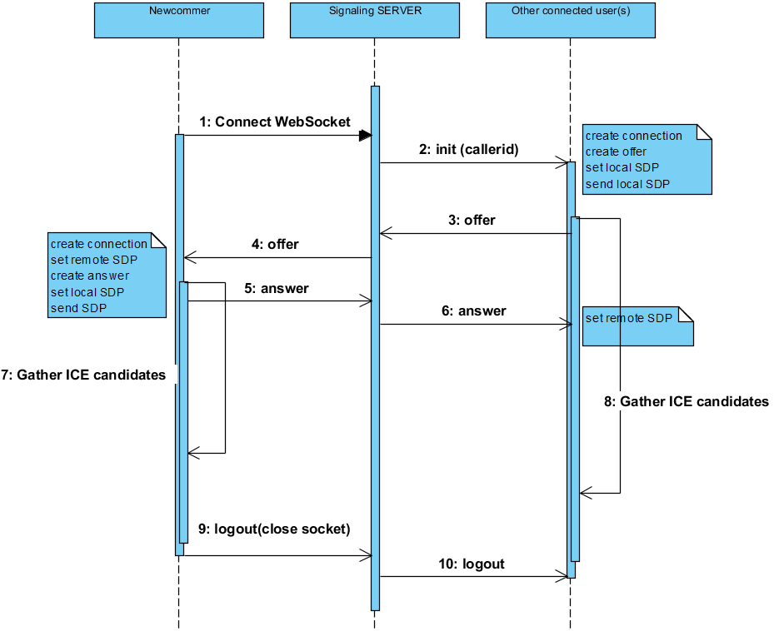

Slide 14
Signal message
{
“type”: “init|logout|offer|answer|ice”,
“data”: whateverObject,
“sender”: uuid,
“reciever”: uuid
}

Slide 15
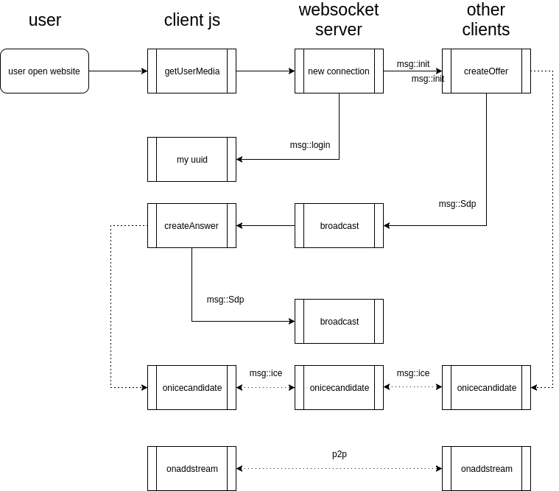

Slide 16
git
https://github.com/milosnano/spring-boot-webrtc
https://github.com/Matusko/openslava-webrtc

Slide 17
Any questions?
Feel free to ask us anything you like!

Slide 18
And don't forget to be very careful, what you are doing in front of your camera!

