Slide 1
Introduction to Networking
Chapter 1

Slide 2
Module Objectives
By the end of this module, you should be able to:
1. Distinguish between peer-to-peer and client-server networks
2. Identify types of applications and protocols used on a network
3. Describe various networking hardware devices and the most common physical topologies
4. Describe the seven layers of the OSI model
5. Explain best practices for safety when working with networks and computers
6. Describe the seven-step troubleshooting model for troubleshooting network problems

Slide 3
Network Models
Topology describes how parts of a whole work together
Physical topology mostly refers to a network’s hardware and how computers, other devices, and cables work together to form the physical network
Logical topology refers to how software controls access to network resources
  It includes how users and software initially gain access to the network
A network operating system (NOS) controls access to the entire network
  A NOS is required by client-server models

Slide 4
Peer-to-Peer Network Model (1 of 2)
In a peer-to-peer (P2P) network model the OS of each computer on the network is responsible for controlling access to its resources
  There is no centralized control
Computers, called nodes or hosts, form a logical group of computers and users
  Each computer controls its own administration, resources, and security
Advantages
  Simple configuration
  Less expensive compared to other network models
Disadvantages
  Not scalable
  Not necessarily secure
  Not practical for large installations

Slide 5
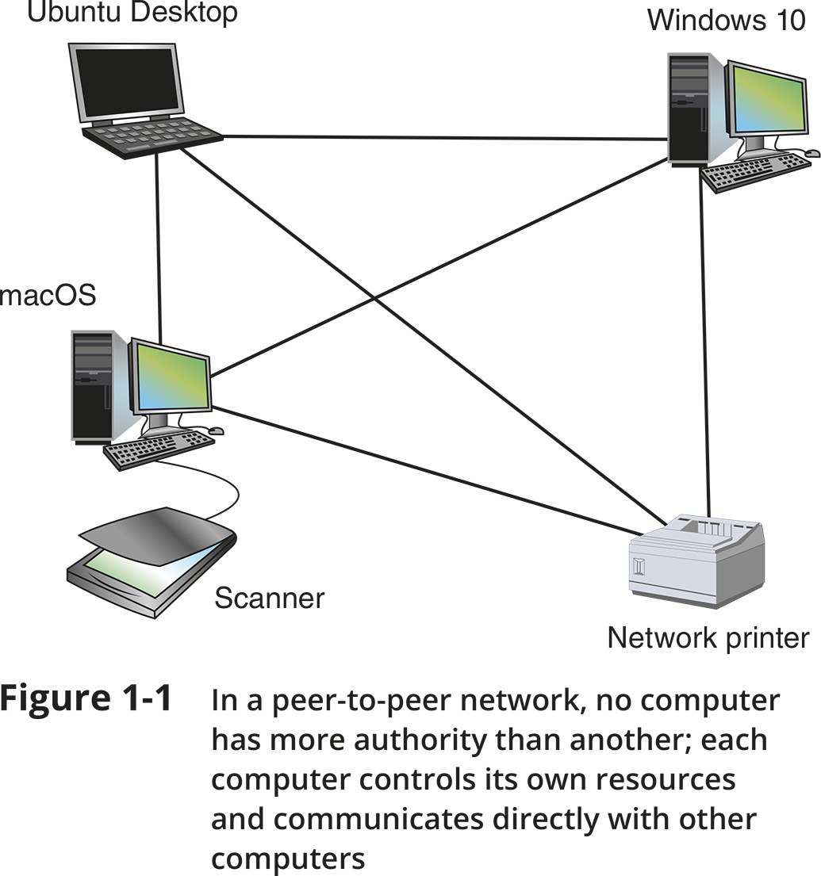
Peer-to-Peer Network Model (2 of 2)
Figure 1-1 In a peer-to-peer network, no computer has more authority than another; each computer controls its own resources and communicates directly with other computers

Slide 6
Client-Server Network Model (1 of 3)
Resources are managed by the NOS via a centralized directory database
A Windows domain is a logical group of computers that a Windows Server can control
Active Directory (AD) is the centralized directory database that contains user account information and security for the entire group of computers
A user can sign on to the network from any computer on the network and gain access to the resources that AD allows
  This process is managed by Active Directory Domain Services (AD DS)
A computer making a request from another is called the client

Slide 7
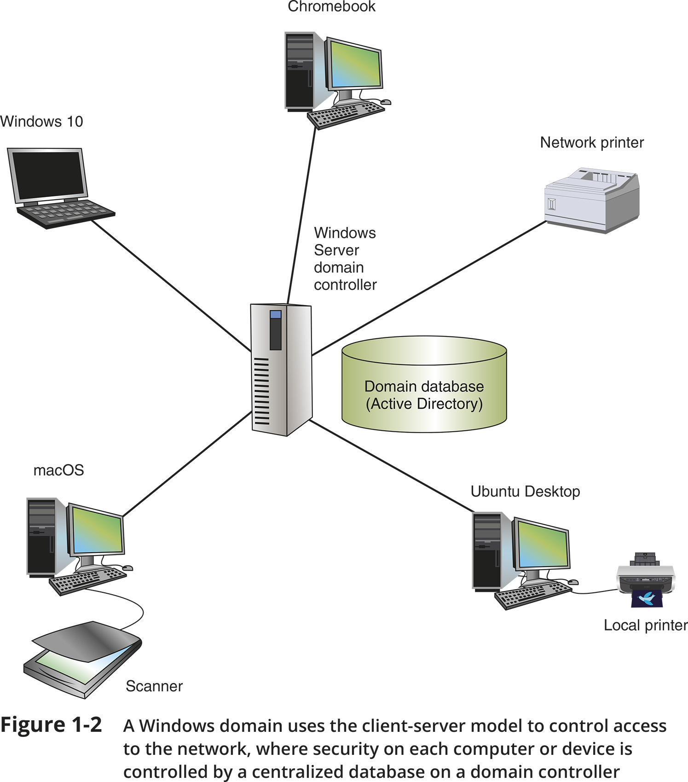
Client-Server Network Model (2 of 3)
Figure 1-2 A Windows domain uses the client-server model to control access to the network, where security on each computer or device is controlled by a centralized database on a domain controller

Slide 8
Client-Server Network Model (3 of 3)
The NOS is responsible for:
  Managing client data and other resources
  Ensuring authorized user access
  Controlling user file access
  Restricting user network access
  Dictating computer communication rules
  Supplying applications and data files to clients
Servers that have a NOS installed require:
  More memory, processing power, and storage capacity
  Equipped with special hardware to provide network management functions

Slide 9
Client-Server Applications (1 of 2)
Network services are the resources a network makes available to its users
  It includes applications and the data provided by these applications
In client-server applications:
  A client computer requests data or a service from a second computer, called the server

Slide 10
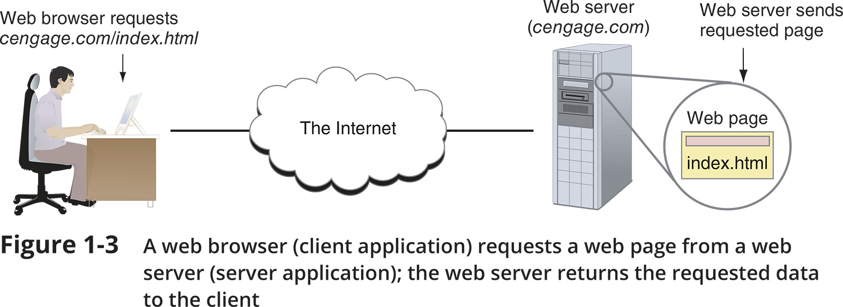
Client-Server Applications (2 of 2)
Figure 1-3 A web browser (client application) requests a web page from a web server (server application); the web server returns the requested data to the client

Slide 11
Network Services and Their Protocols (1 of 2)
Protocols are methods and rules for communication between networked devices
Two primary network protocols:
  TCP (Transmission Control Protocol)
  IP (Internet Protocol)
Popular client-server applications include:
  Web service
  Email services
  DNS service
  FTP service
  Database services
  Remote access service

Slide 12
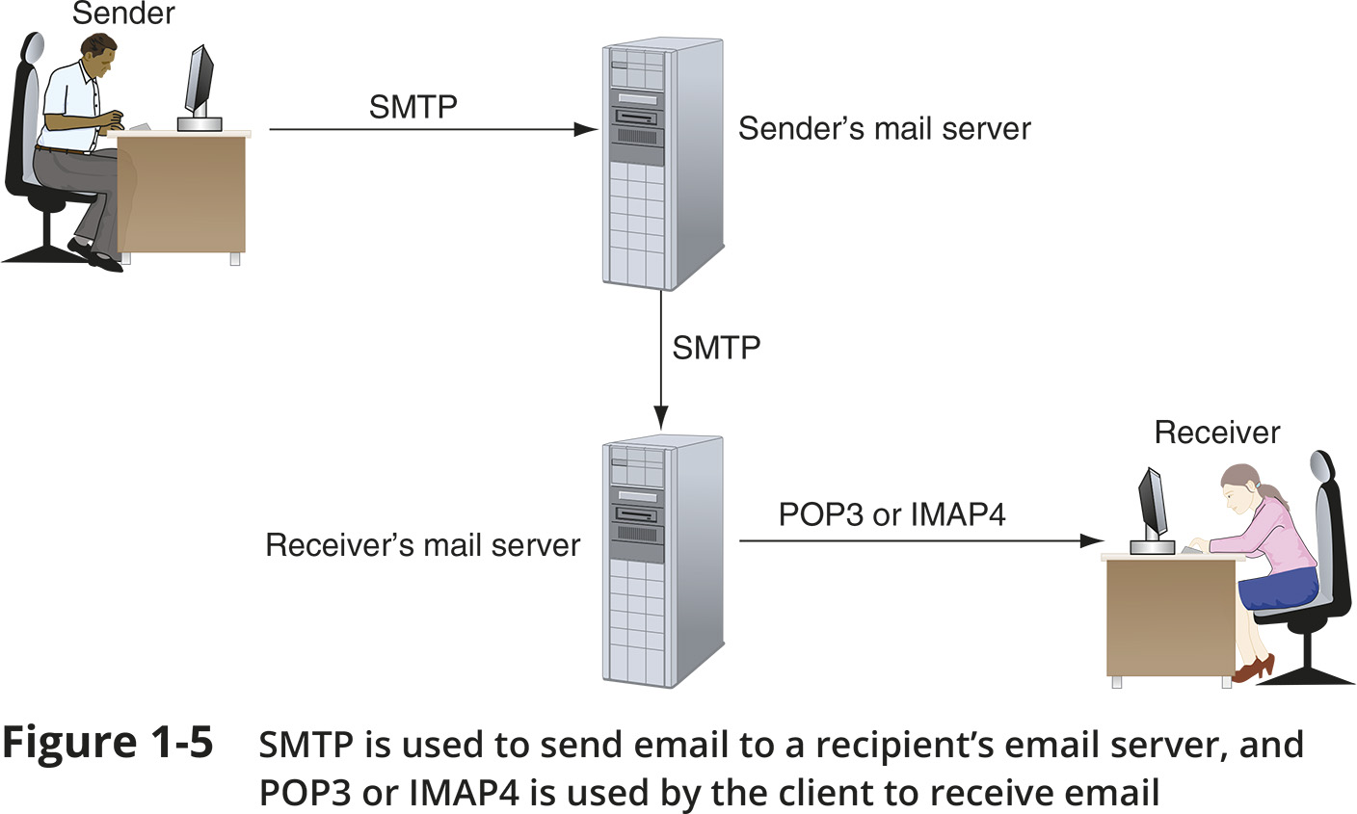
Network Services and Their Protocols (2 of 2)
Figure 1-5 SMTP is used to send email to a recipient’s email server, and POP3 or IMAP4 is used by the client to receive email

Slide 13
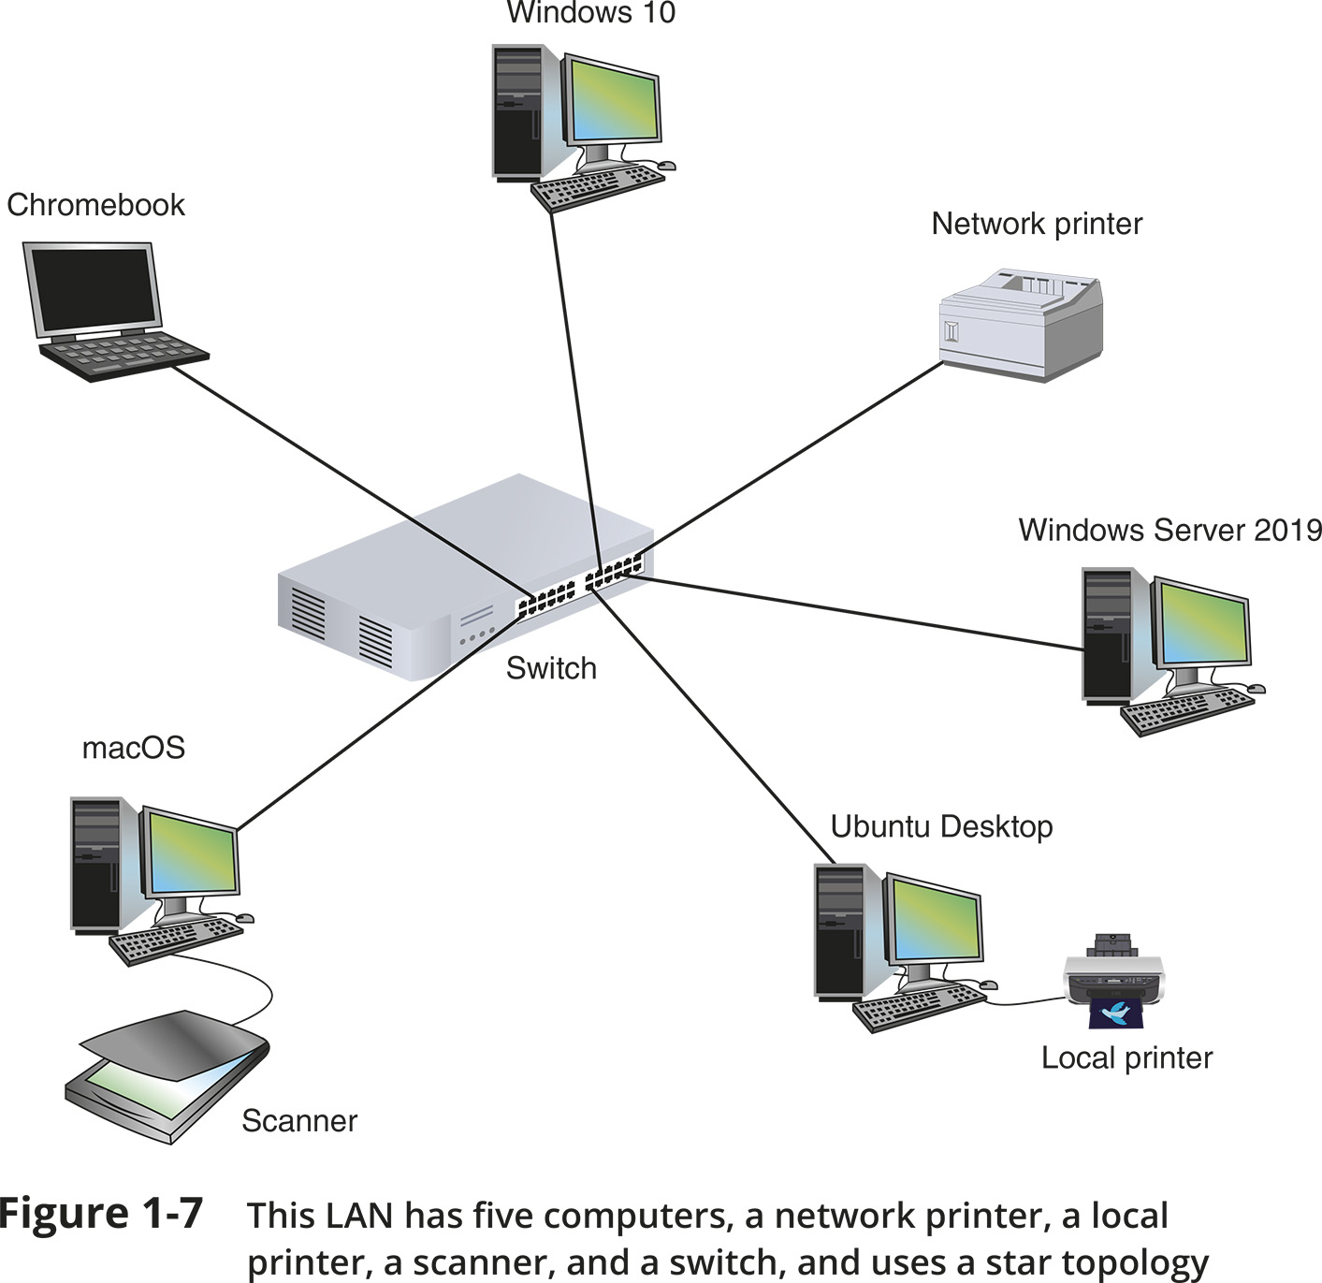
Network Hardware
Figure 1-7 This LAN has five computers, a network printer, a local printer, a scanner, and a switch, and uses a star topology

Slide 14
LANs and Their Hardware (1 of 4)
A LAN (local area network) is usually contained in a small space
A switch receives incoming data from one of its ports and redirects it to another port or multiple ports
  Will send the data to its intended destination
The physical topology used by this network is called a star topology
  All devices connect to one central device (usually a switch)
A NIC (network interface card) is a network port used to attach a device to a network
  Also called a network adapter
A LAN can have several switches
A backbone is a central conduit that connects the segments (pieces) of a network

Slide 15
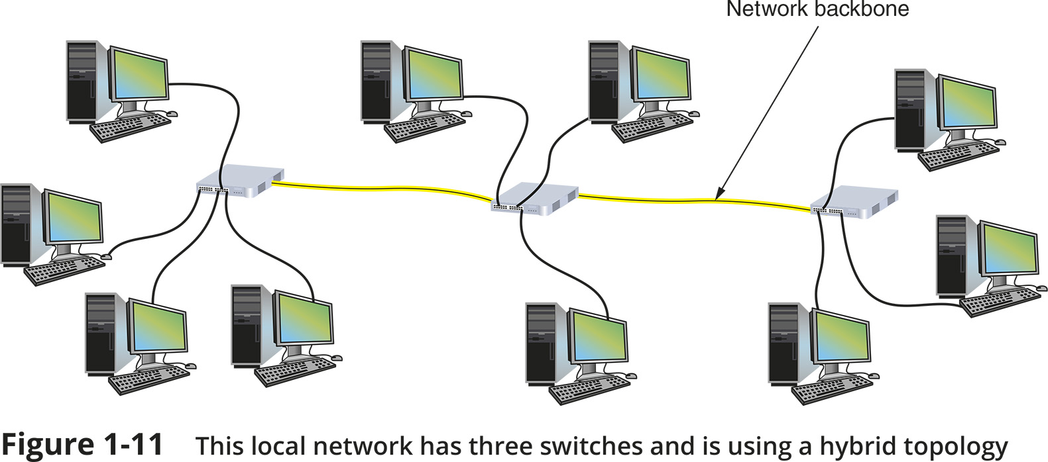
LANs and Their Hardware (2 of 4)
Figure 1-11 This local network has three switches and is using a hybrid topology

Slide 16
LANs and Their Hardware (3 of 4)
A router is a device that manages traffic between two or more networks
  Can help find the best path for traffic to get from one network to another
Routers can be used in small home networks to connect the home LAN to the Internet
  Called a SOHO (small office-home office) network
Industrial-grade routers can have several network ports, one for each network it connects to
Difference between router and switch:
  A router is like a gateway between networks and belongs to two or more local networks
  A switch belongs only to its local network

Slide 17
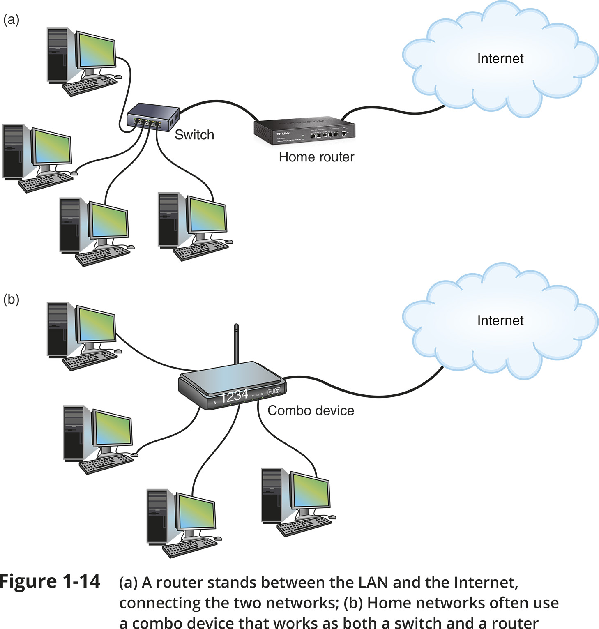
LANs and Their Hardware (4 of 4)
Figure 1-14 (a) A router stands between the LAN and the Internet, connecting the two networks; (b) Home networks often use a combo device that works as both a switch and a router

Slide 18
MANs and WANs (1 of 2)
A WAN (wide area network) is a group of LANs that spread over a wide geographical area
A MAN (metropolitan area network) is a group of connected LANs in the same geographical area
  Also known as a campus area network (CAN)
MANs and WANs often use different transmission methods and media than LANs
PAN (personal area network) is a much smaller network of personal devices
  A network of personal devices such as your smartphone and your computer
Other network types:
  BAN (body area network)
  SAN (storage area network)
  WLAN (wireless local area network)

Slide 19
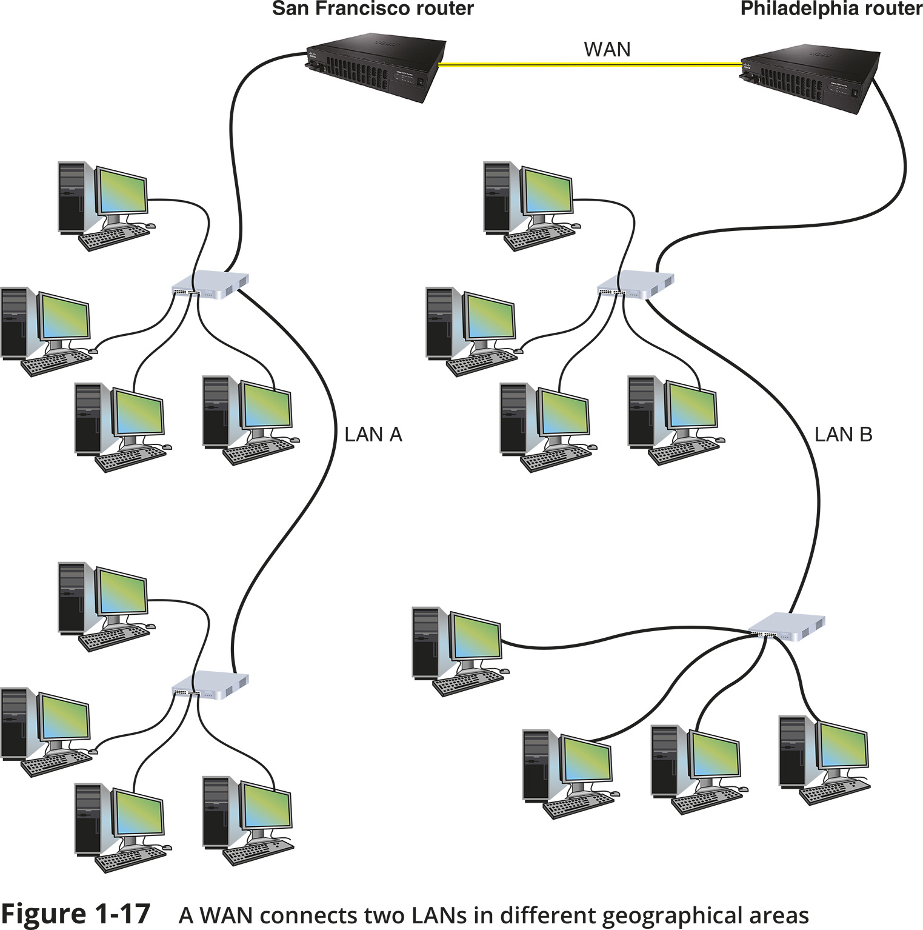
MANs and WANs (2 of 2)
Figure 1-17 A WAN connects two LANS in different geographical areas

Slide 20
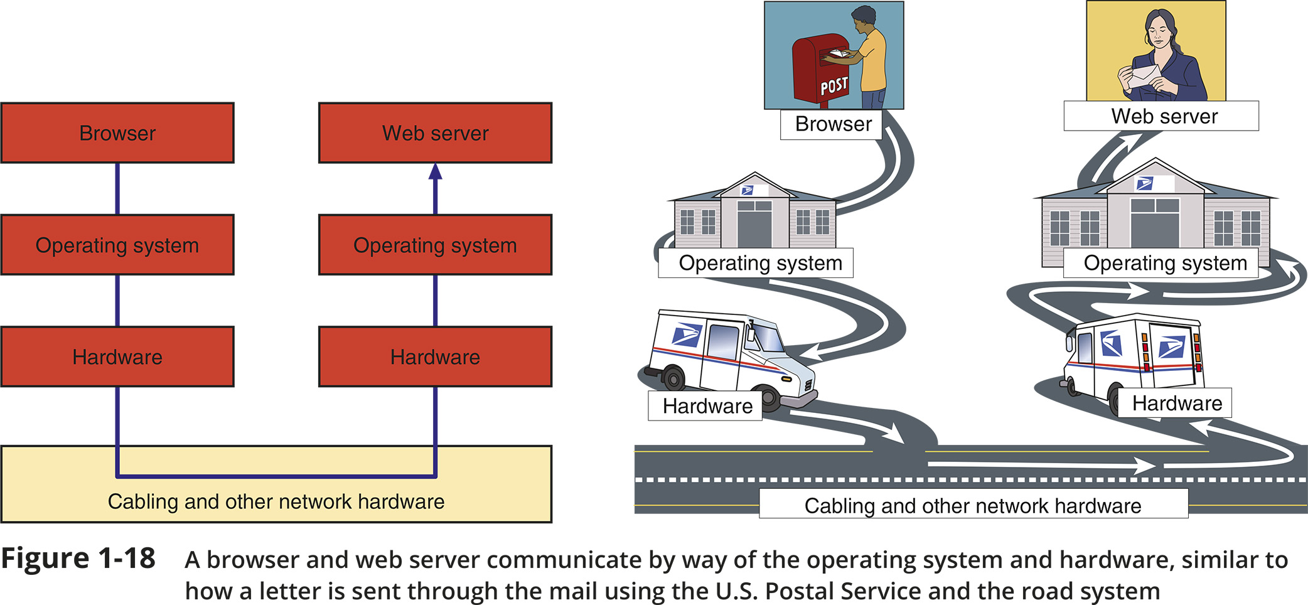
The Seven-Layer OSI Model (1 of 2)
Figure 1-18 A browser and web server communicate by way of the operating system and hardware, similar to how a letter is sent through the mail using the U.S. Postal Service and the road system

Slide 21
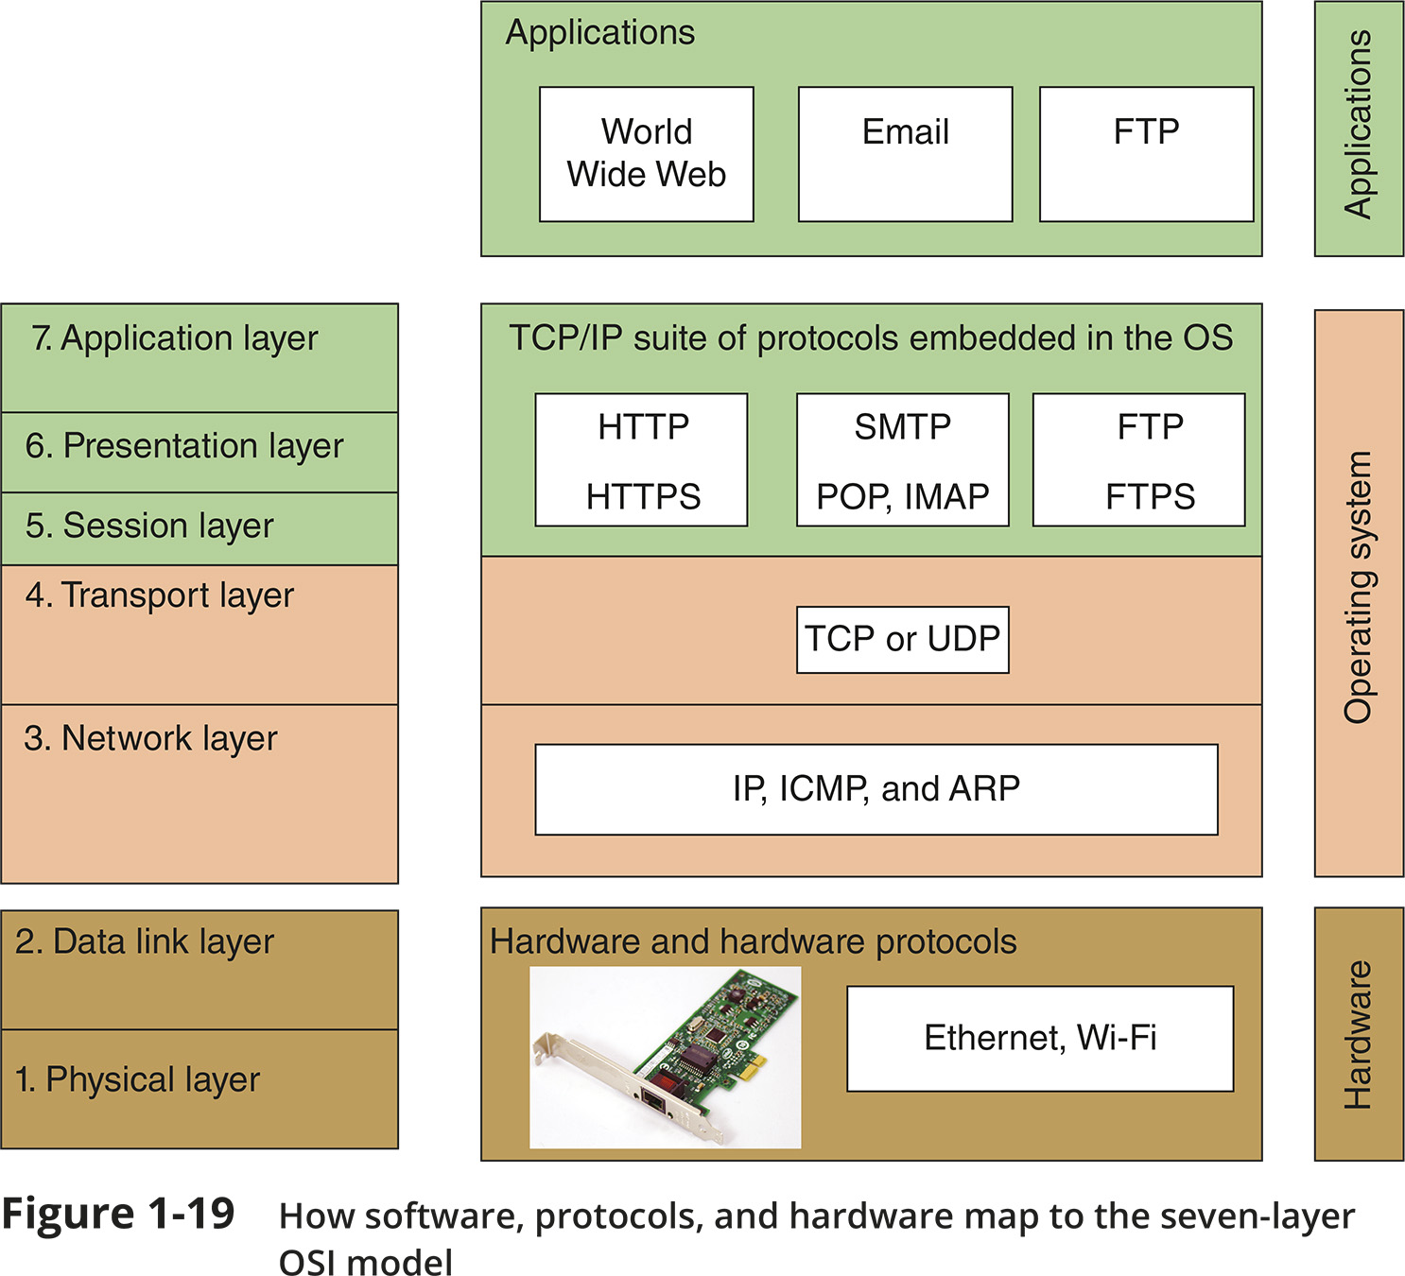
The Seven-Layer OSI Model (2 of 2)
Figure 1-19 How software, protocols, and hardware map to the seven-layer OSI model

Slide 22
Layer 7: Application Layer
The application layer describes the interface between two applications, on separate computers
Application layer protocols are used by programs that fall into two categories:
  Provide services to a user, such as a browser and Web server
  Utility programs that provide services to the system, such as SNMP (Simple Network Management Protocol) programs that monitor and gather information about network traffic
Payload is the data that is passed between applications or utility programs and the OS

Slide 23
Layer 6: Presentation Layer
The presentation layer is responsible for reformatting, compressing, and/or encrypting data in a way that the receiving application can read
Example:
  An email message can be encrypted at the Presentation layer by the email client or by the OS

Slide 24
Layer 5: Session Layer
The session layer describes how data between applications is synched and recovered if messages don’t arrive intact at the receiving application
The application, presentation, and session layers are intertwined
  It is often difficult to distinguish between them
Most tasks are performed by the OS when an application makes an API call to the OS
  An API (application programming interface) call is the method an application uses when it makes a request of the OS

Slide 25
Layer 4: Transport Layer
The transport layer is responsible for transporting Application layer payloads from one application to another
Two main Transport layer protocols are:
  TCP (Transmission Control Protocol) - makes a connection with the end host, checks whether data was received; called a connection-oriented protocol
  UDP (User Datagram Protocol) - does not guarantee delivery by first connecting and checking whether data is received; called a connectionless protocol
Protocols add control information in an area at the beginning of the payload (called header)
Encapsulation is the process of adding a header to the data inherited from the layer above
The Transport layer header addresses the receiving application by a number called a port
If a message is too large, TCP divides it into smaller messages called segments
  In UDP, the message is called a datagram

Slide 26
Layer 3: Network Layer
The network layer is responsible for moving messages from one node to another until they reach the destination host
The principal protocol used by this layer is IP (Internet Protocol)
IP adds its own network layer header to the segment or datagram
  The entire network layer message is called a packet
An IP address is an address assigned to each node on a network
  The network layer uses it to uniquely identify each host
IP relies on several routing protocols to find the best route for a packet to take to reach destination
  ICMP and ARP are examples
Network layer protocol will divide large packets into smaller packets in a process called fragmentation

Slide 27
Layer 2: Data Link Layer
Layers 2 and 1 are responsible for interfacing with physical hardware on the local network
  Protocols at these layers are programmed into firmware of a computer’s NIC and other hardware
Type of networking hardware or technology used on a network determine the data link layer protocol used
  Ethernet and Wi-Fi are examples
The data link layer puts control information in a data link layer header and at the end of the packet in a trailer
  The entire data link layer message is called a frame
A MAC (Media Access Control) address is also called a physical address, hardware address, or data link layer address
  It is embedded on every network adapter

Slide 28
Layer 1: Physical Layer
The physical layer is responsible for sending bits via a wired or wireless transmission
Bits can be transmitted as:
  Wavelengths in the air
  Voltage on a copper wire
  Light (via fiber-optic cabling)

Slide 29
Protocol Data Unit or PDU
Protocol data unit (PDU) is the technical name for a group of bits as it moves from one layer to the next and from one LAN to the next
  Technicians loosely call this group of bits a message or a transmission

Slide 30
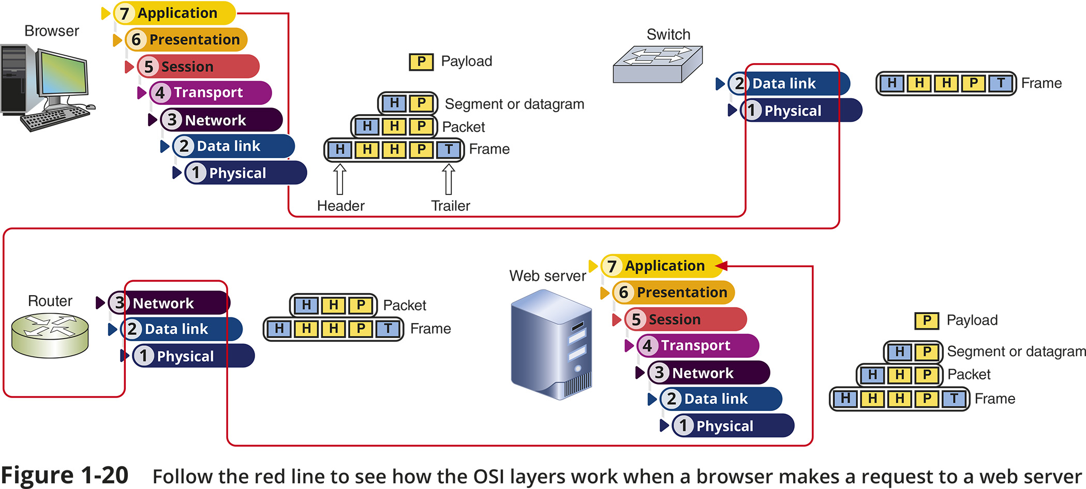
Summary of How the Layers Work Together
Figure 1-20 Follow the red line to see how the OSI layers work when a browser makes a request to a web server

Slide 31
Troubleshooting Network Problems
Troubleshooting steps used by most expert networking troubleshooters:
  Step 1: Identify the problem and its symptoms
  Step 2: Establish theory of probable cause
  Step 3: Test your theory to determine cause
  Step 4: Establish a plan for resolving the problem
  Step 5: Implement the solution or escalate the problem
  Step 6: Verify full functionality and implement preventative measures
  Step 7: Document findings, actions, outcomes

Slide 32
Self-Assessment
What networking hardware devices have you used in the past?
What type of network or computer safety issues have you (or a friend or another student) experienced? How did you troubleshoot those issues?
Notes:
Instructions:
Create a question(s) aligned with the learning objectives at the beginning of the module. Form questions based on the LOs for the module so that students can evaluate their progress on the goals for the course.
Try to form a question(s) that asks students to apply some of the knowledge they learned from this module and connects that knowledge to a personal experience they have had, an experience in school, a professional memory, etc.

Slide 33
Summary
Now that the lesson has ended, you should be able to:
Distinguish between peer-to-peer and client-server networks
Identify types of applications and protocols used on a network
Describe various networking hardware devices and the most common physical topologies
Describe the seven layers of the OSI model
Explain best practices for safety when working with networks and computers
Describe the seven-step troubleshooting model for troubleshooting network problems

