Slide 1
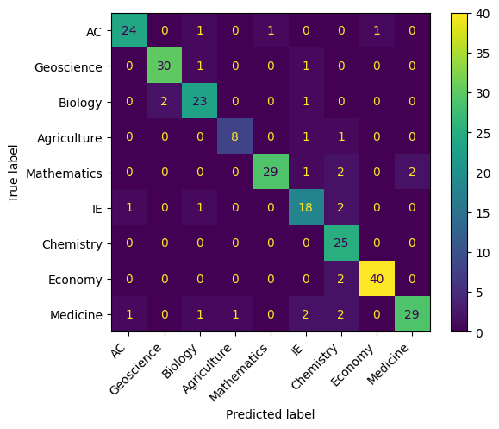
Text Classification for Serbian Science Journals
Author: Miloš Đurić
Introduction
Algorithms are used together with Count and TF-IDF Vectorizers
Text is filtered by removing insufficient characters and preprocessed with removing stop words, NLTK’s WordNetLemmatizer (English) and SrbAi’s Stemmer (Serbian) before classification
Metrics used for evaluation are Accuracy and Macro Average metrics
Confusion Matrix is made for visual representation of the results
Results and Discussion
The goal of the project is to see how different text classification algorithms classify text paragraphs from Serbian science journals into different categories, depending on their content.
Results show that predominantly SVM with TF-IDF Vectorizer show the best results, while KNN with Count Vectorizer the worst. In general TF-IDF Vectorizer shows greater success rate than Count Vectorizer for all algorithms except for Multinomial NB. Another good performance is shown by KNN with TF-IDF, perhaps because the TF-IDF Vectorizer maps words more adjustably to the KNNs classification than its counter-part. Multinomial NB also shows generally good performance, although its performance doesn’t seem to be greatly affected by the difference in Vectorizers. It seems the use of TF-IDF mapping alongside Support Machine Vectors brings the highest success rate with both accuracy and macro average metrics when it comes to classification of data of this size and vocabulary.
Data
Data used for this project was made using an online archive of scientific journals called “Srpski Citatni indeks”¹. It contains 1700 paragraphs split into 9 categories. Each paragraph is labeled whether it is in written in Serbian or English. Data is divided 70% in training set, 15% in validation set and 15% in test set
Confusion Matrix Example
Improving Algorithm Performance
We use fine-tuning to improve the algorithms results
Classifiers parameters can be changed, e.g. KNNs weights and SVMs kernel function
Use of transformers, e.g. PowerTransformer
Methodology
Data is classified using Multinomial Naive Bayes, K-Nearest Neighbors and Support Vector Machine algorithms
References
https://scindeks.ceon.rs/

