Slide 1





BREAST CANCER
DETECTION
Team 05 : Miloy Ajmera (majmera) and Samridhi Kochar (skochar)

Slide 2
AGENDA
01
WHAT IS BREAST CANCER?
03
MOTIVATION
05
KEY FINDINGS
07
DATASETS
09
ARCHITECTURE
11
CONCLUSION
02
VALUE
04
RESULTS
06
PROBLEM STATEMENT
08
DATA PROCESSING
10
METRICS
12
FUTURE SCOPE

Slide 3
A disease in which cells of the breast grow out of control
WHAT IS BREAST CANCER?

Slide 4
Early Detection
Potentially save lives by detection of breast cancer at early stages leading to timely diagnosis and treatment
VALUE
Improved Efficiency
Provides quicker results for testing and assist doctors in diagnosis avoiding unnecessary procedures
Reduced Costs
Breast cancer prediction through images in machine learning can potentially reduce the need for more expensive treatments

Slide 5
MOTIVATION
Globally, an estimated 684,996 women died of Breast Cancer in 2020. About 42,000 women and 500 men die each year in the U.S. alone from Breast Cancer
If detected at an early stage:
More treatment options and a better chance of survival
93% or higher survival rate in first five years
https://www.cancer.net/cancer-types/breast-cancer/statistics#
https://www.cdc.gov/cancer/breast/basic_info/index.htm
https://www.carolmilgardbreastcenter.org/for-patients/facts-myths/early-detection-is-key/#

Slide 6
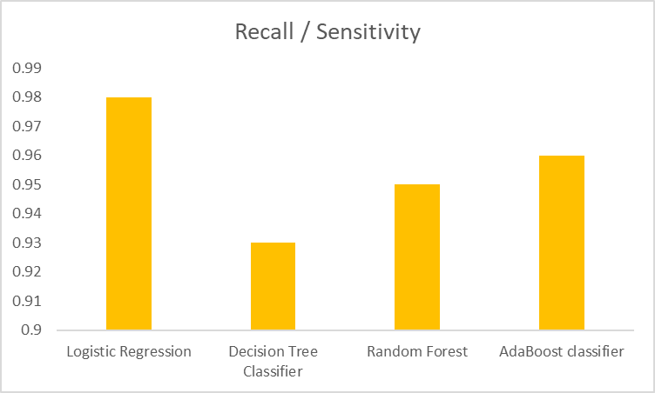
RESULTS
Our models can predict the presence of Breast Cancer with upto 98% accuracy.
With higher priority to Recall metric, Logistic Regression gives us 98% recall.

Slide 7
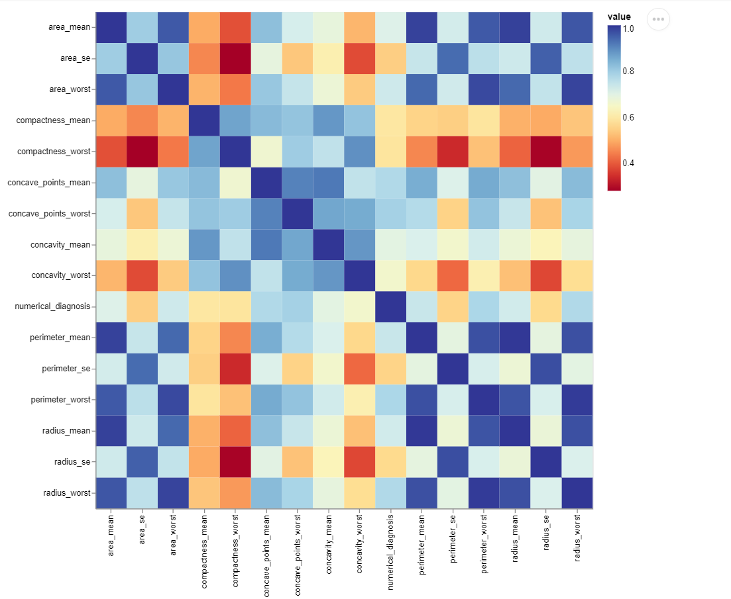
KEY FINDINGS
From the heatmap on the right, we can confirm that area, radius and perimeter features are significant for Breast Cancer identification.
Compactness features are anti-correlated with the features that show high chances of presence of breast cancer.

Slide 8
Problem Statement
P(T, E+ΔE) > P(T,E)
Task (T) -> Binary Classification of detecting Malignant or Benign Cancer
Performance Metric (P) -> Recall and Accuracy
Experience (E) -> Breast Cancer X-Ray reports

Slide 9
DATA SET
The goal of the project would be to classify the diagnosis as either benign or malignant based on the input features of the dataset.
Our dataset is taken from the Breast Cancer Dataset available on Kaggle which is collected and created by the University of Wisconsin, Clinical Sciences Center.
The dataset consists of 569 rows and 32 columns.
The field "diagnosis" contains 357 benign (B) and 212 malignant (M) cases.
Page 08 of 15

Slide 10
Data Processing

Slide 11
Steps:
Check for Nulls: Not Found
Check for Duplicates: Not Found
Check for Outliers: Not Found

Slide 12
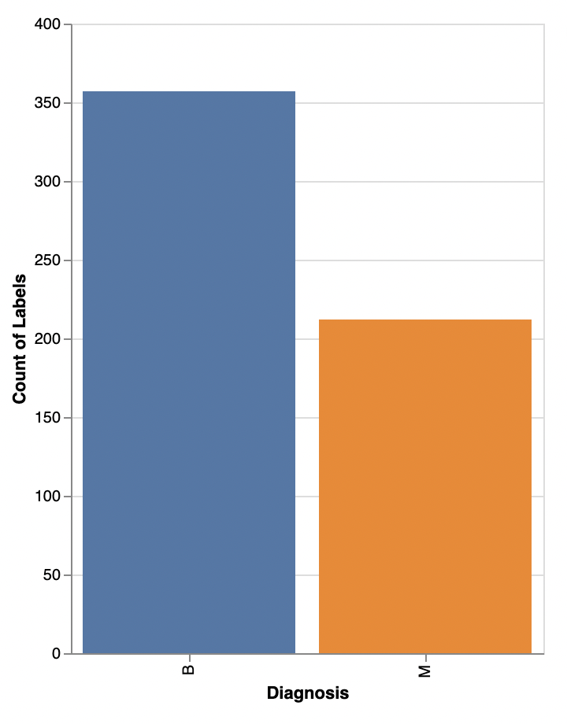
Steps (contd.):
Check for imbalance of data:
Finding: Approximately 63% records said the cancer is Benign (B) and 37% depicted Malignant (M)
Action: Used SMOTE to balance observations

Slide 13
Decision Tree
Base Pipeline
SMOTE
RepeatedStratifiedKFolds
Random Forest
Train Data
StandardScaler
Adaboost
GridSearch
Model Architecture
Logistic Regression

Slide 14
Key Metrics

Slide 15
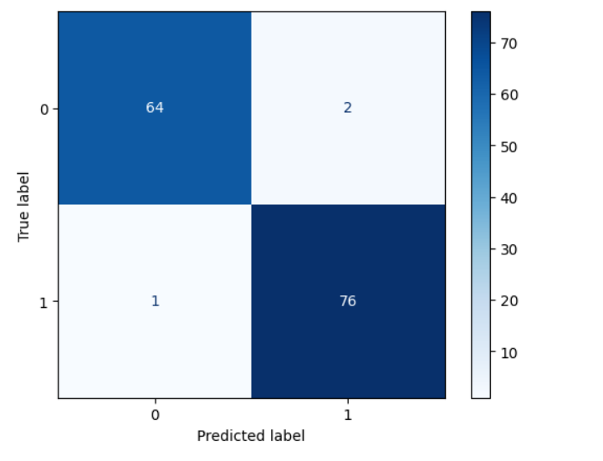
Logistic Regression
Accuracy : 0.96
Precision : 0.98
Recall : 0.98
F1 Score : 0.98

Slide 16
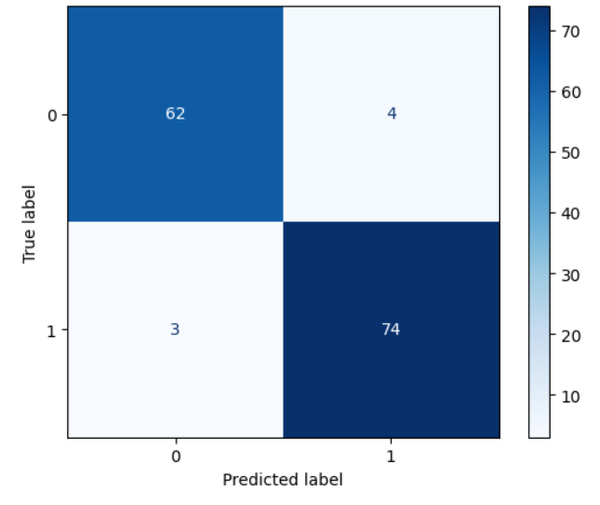
Decision Tree Classifier
Accuracy : 0.93
Precision : 0.95
Recall : 0.95
F1 Score : 0.95

Slide 17

Random Forest
Accuracy : 0.96
Precision : 0.95
Recall : 0.95
F1 Score : 0.95

Slide 18
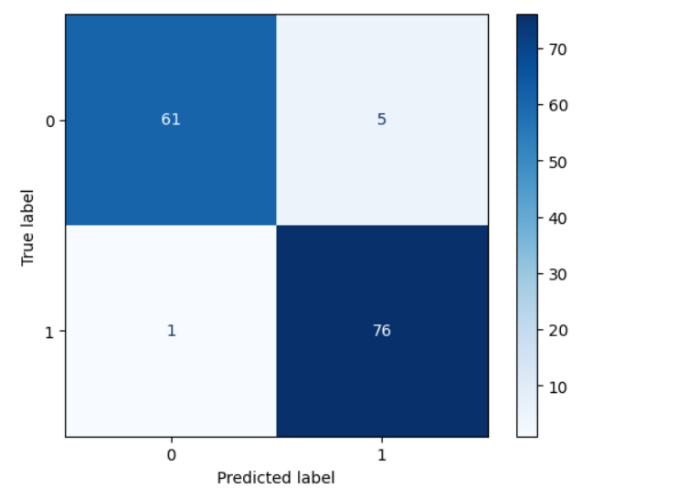
AdaBoost Classifier
Accuracy : 0.95
Precision : 0.96
Recall : 0.96
F1 Score : 0.96

Slide 19
CONCLUSION
We have understood the correlation between all the columns and realized that the columns indicating “Area” and “Perimeter” provide more relevance to the decision variable
We used Hyperparameter tuning improve Recall / Sensitivity of the Logistic Regression model to reduce false negatives.
Our best model is the Logistic Regression Model having a recall of 0.98.

Slide 20
FUTURE SCOPE
Hyperparameter tuning can be further explored to improve model accuracy and reduce false negatives.
Additional features like genetic data, patient history, or lifestyle factors can enhance model accuracy.
Integration of the model into clinical decision-making systems can assist medical professionals in diagnosis and treatment planning.
Collaborations with medical centers or research institutions can improve model accuracy by gathering more data.

Slide 21
THANK
YOU

