Slide 1
Smart Device Presentaion
Smart Wi-Fi LED Bulb
Milad Sabouri
Embedded Systems
Illinois Tech - Spring 2018

Slide 2
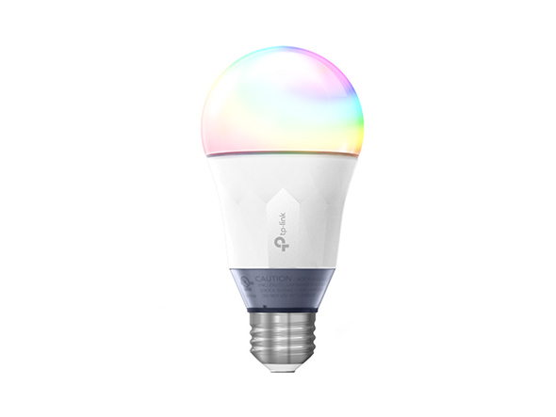
SMART LED

Slide 3
SMART LED
Screw in
turn on
sync up
Video Link: https://www.youtube.com/watch?v=JJ9NNbS9sYI

Slide 4
SMART LED
TP-Link LB130
Android
iOS
It uses its own built-in Wi-Fi radio to connect directly with your home's router.

Slide 5
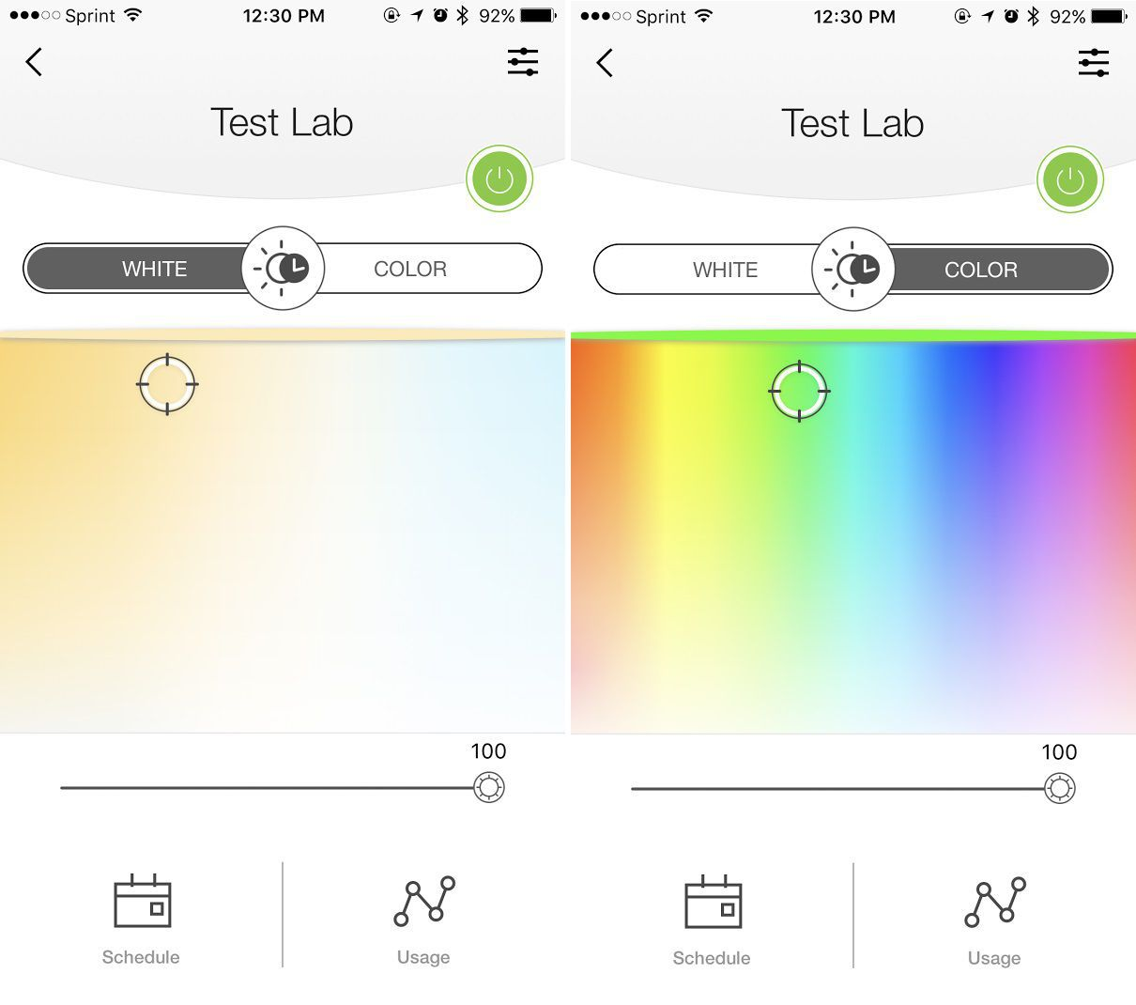

Slide 6
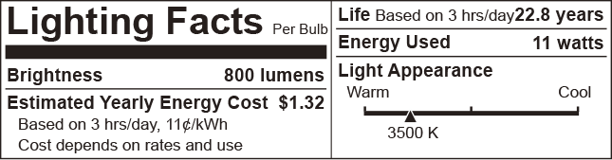
Specifications
NETWORK
Protocol | IEEE 802.11b/g/n
Wireless Type | 2.4GHz, 1T1R
System Requirements | Android 4.1 or higher, iOS 9.0 or higher

Slide 7
Specifications
GENERAL
Lighting Facts
Certification | RoHS, FCC, UL
Package Contents | Smart Wi-Fi LED Bulb LB130, Quick Installation Guide
Environment | • Operating Temperature: -20 ºC~ 40 ºC (-4°F ~ 104°F ) • Operating Humidity: 10%-90% RH NC min
Bulb Lifetime (to 50% brightness level) | 25000 Hrs min @Ta=25C
Lamp Base | E26
Weight | 180g
Packaging Dimensions | 6.7 x 4.1x 3.1 in. (171*104*79mm)

Slide 8
Specification
WORKING STATUS
Tunable | Yes (via app and cloud only)
Typical Lumen Output | 800lm
Input Power (Actual power draw in Watts) | 11W typical
Stand-by (Light off) power | 0.5W Max
Color Temperature | 2500K-9000K & RGB full color
Rated input Voltage | 120VAC 60Hz
Beam Angle | 180 Degree typical
Dimmable | Yes (via app and cloud only)
Color Changing Hue | Yes (via app and cloud only)

