Slide 1
bitcoin price ANALYSIS
Data analytic ( ITMD-527) - final project
Group 174: Milad Sabouri – Nastaran Ghane

Slide 2

Introduction
Credit: Techcrunch

Slide 3
Dataset
4/28/2013
1,793 Days
3/25/2018
$134.21
257 Weeks
$8,495.78
MIN | $ 68.43
MAX | $ 1,9497.4
MEAN | $ 1,635.309
MODE | $ 104
MEDIAN | $ 498.17
SD | 3132.144

Slide 4
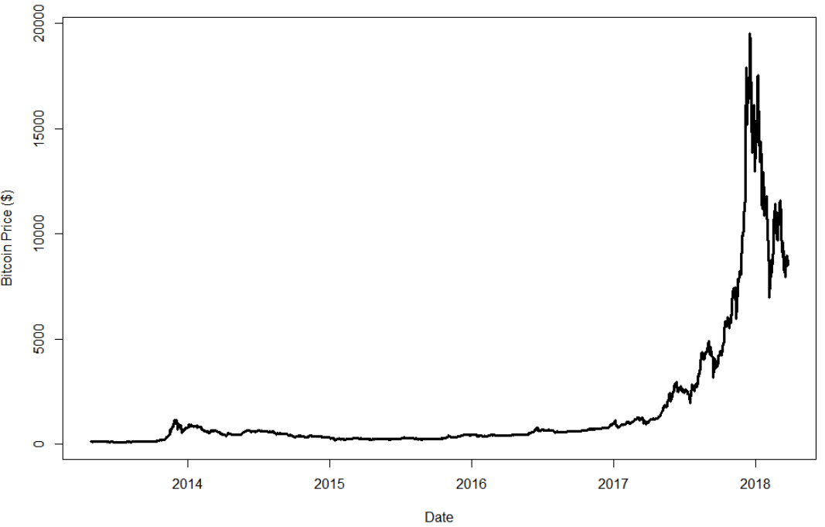
Time-series plot

Slide 5
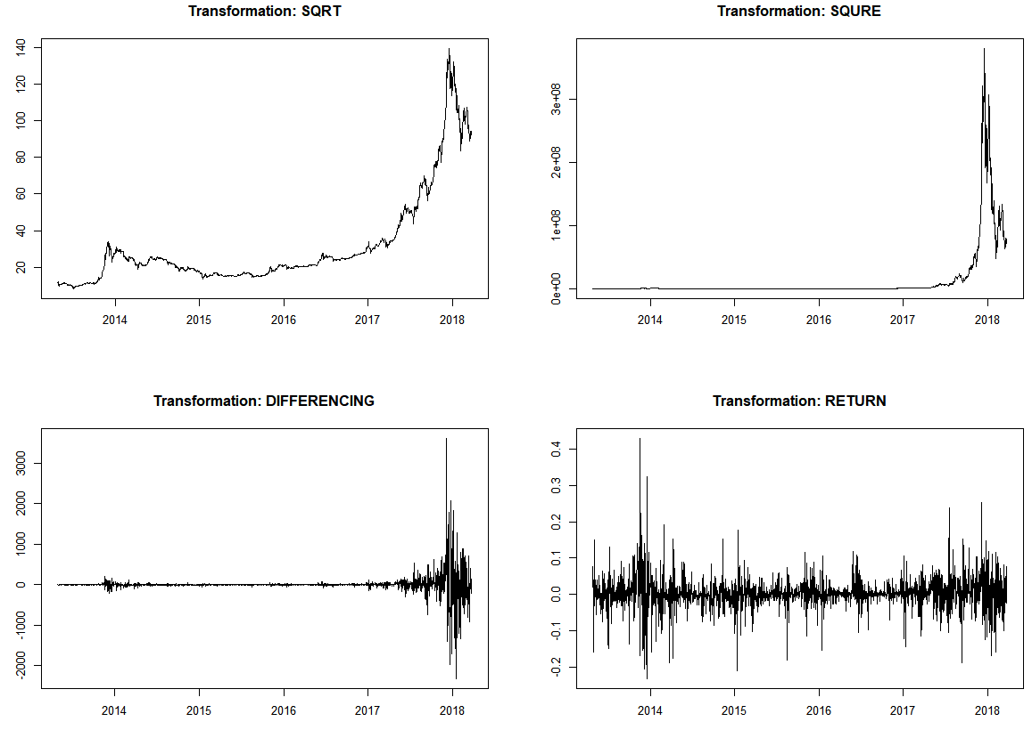
Data processing

Slide 6
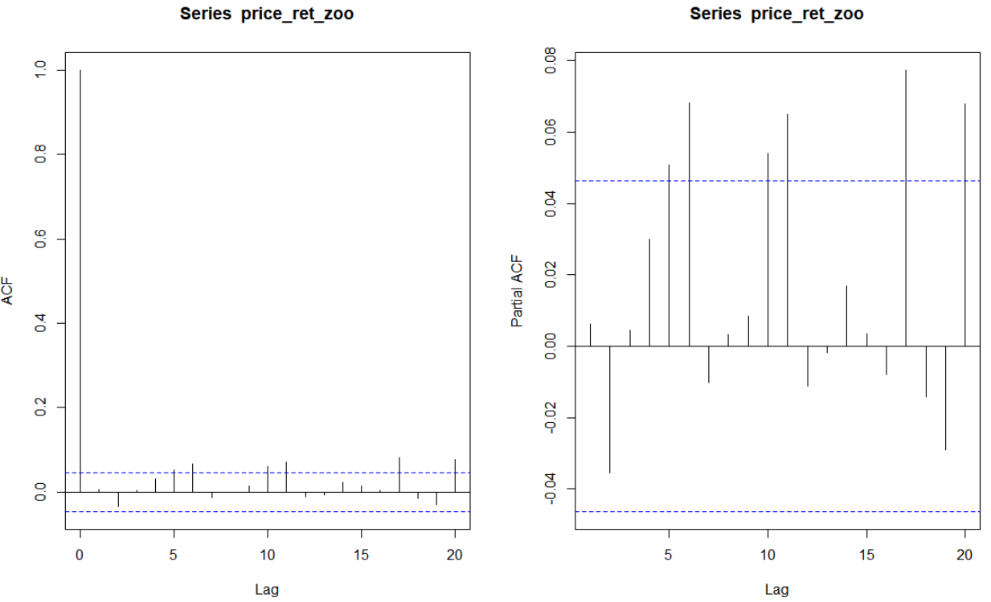
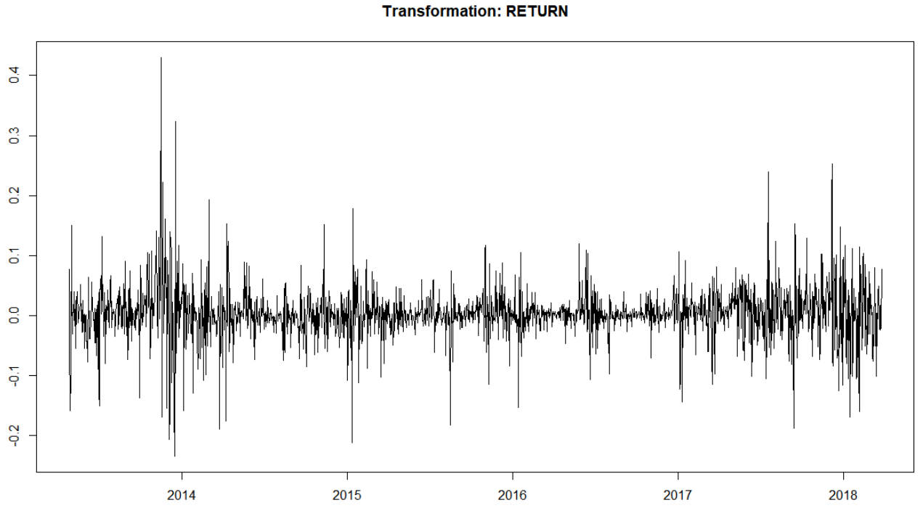
Data preprocessing - Daily data

Slide 7
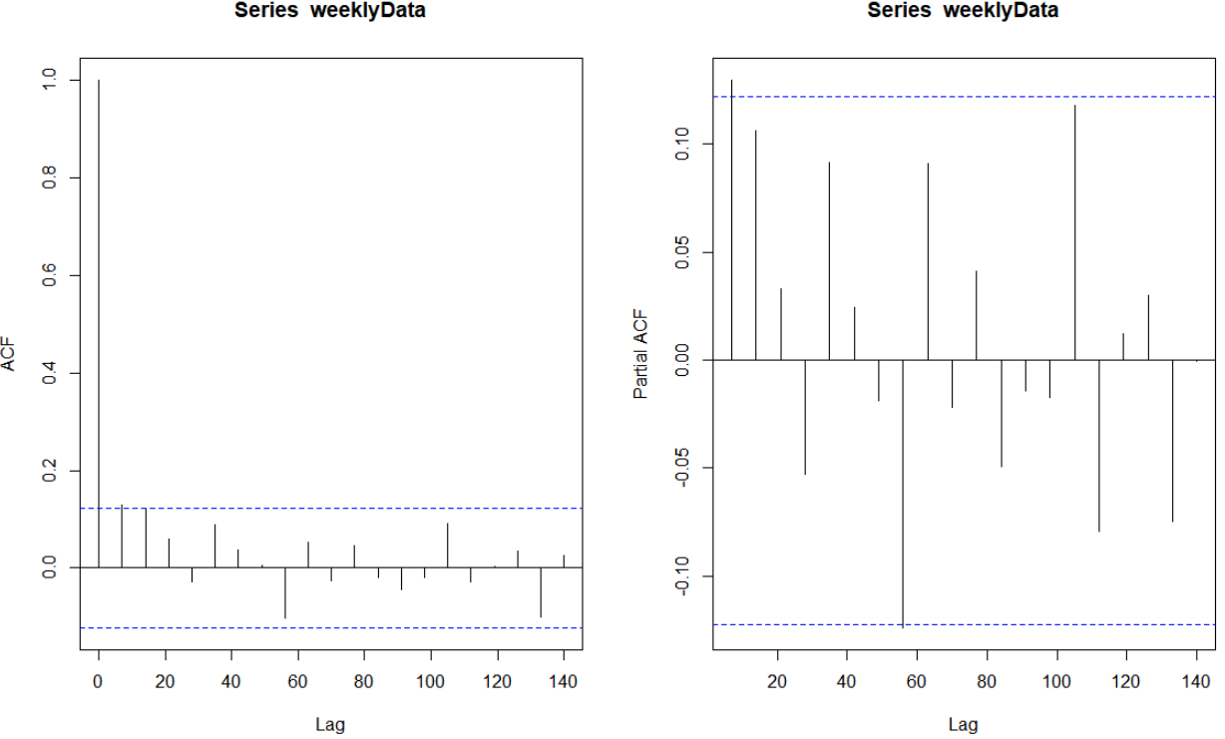
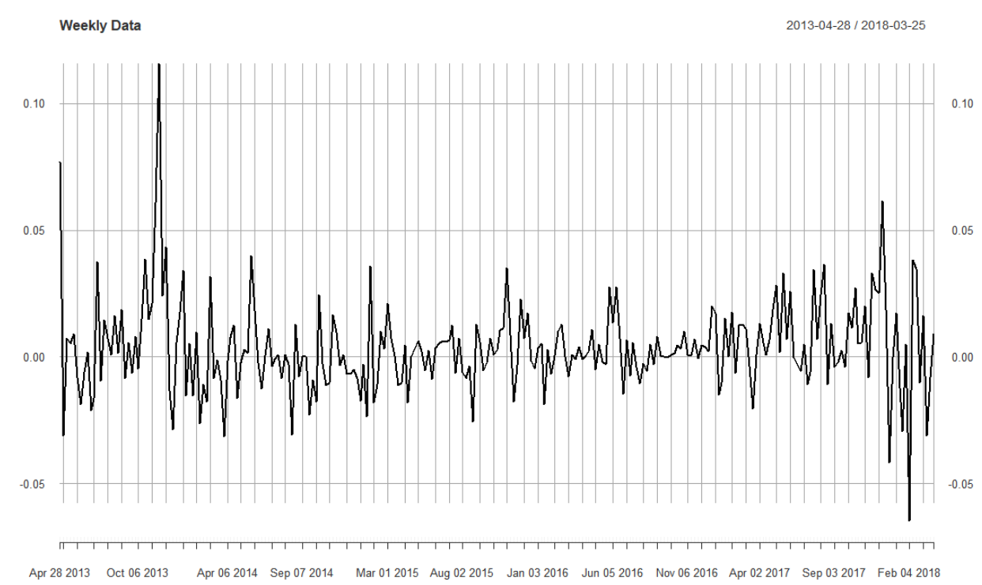
Data preprocessing - Weekly data

Slide 8
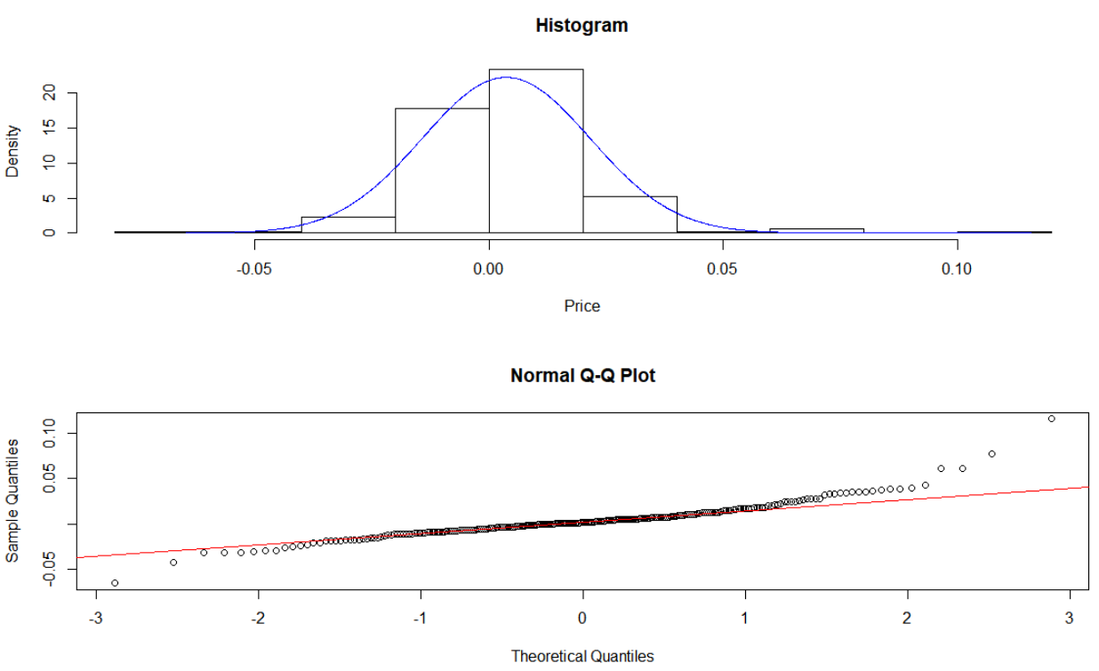
Normality

Slide 9
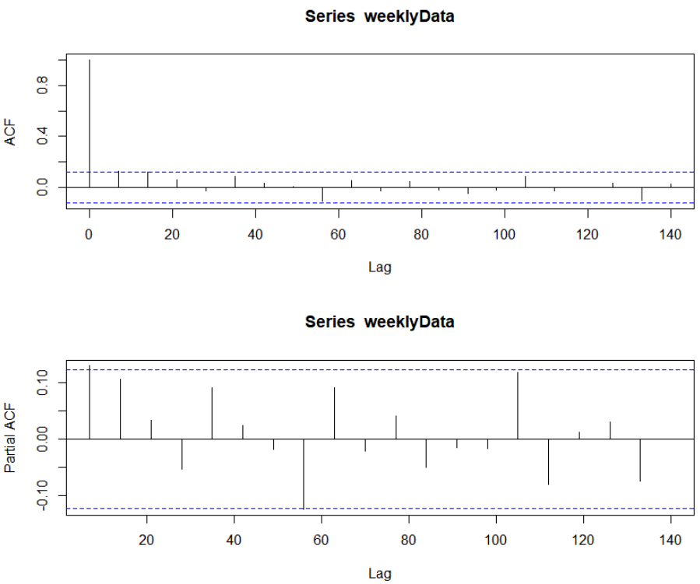
Make models
p=7
q=2
Manually
EACF
Auto.arima

Slide 10
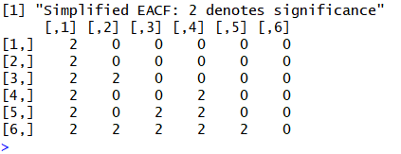
Make models
Manually
EACF
Auto.arima
p=1
q=2

Slide 11
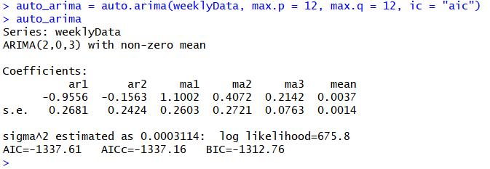
Make models
p=2
q=3
Manually
EACF
Auto.arima

Slide 12
Models selection
AR(7)
AIC: -1330.63
MA(2)
AIC: -1336.63
ARMA(1,2)
AIC: -1338.55
AIC: -1337.61
ARMA(7,2)
AIC: -1334.96
ARMA(2,3)
AR(7)
MA(2)
ARMA(1,2)
ARMA(2,3)
ARMA(7,2)

Slide 13
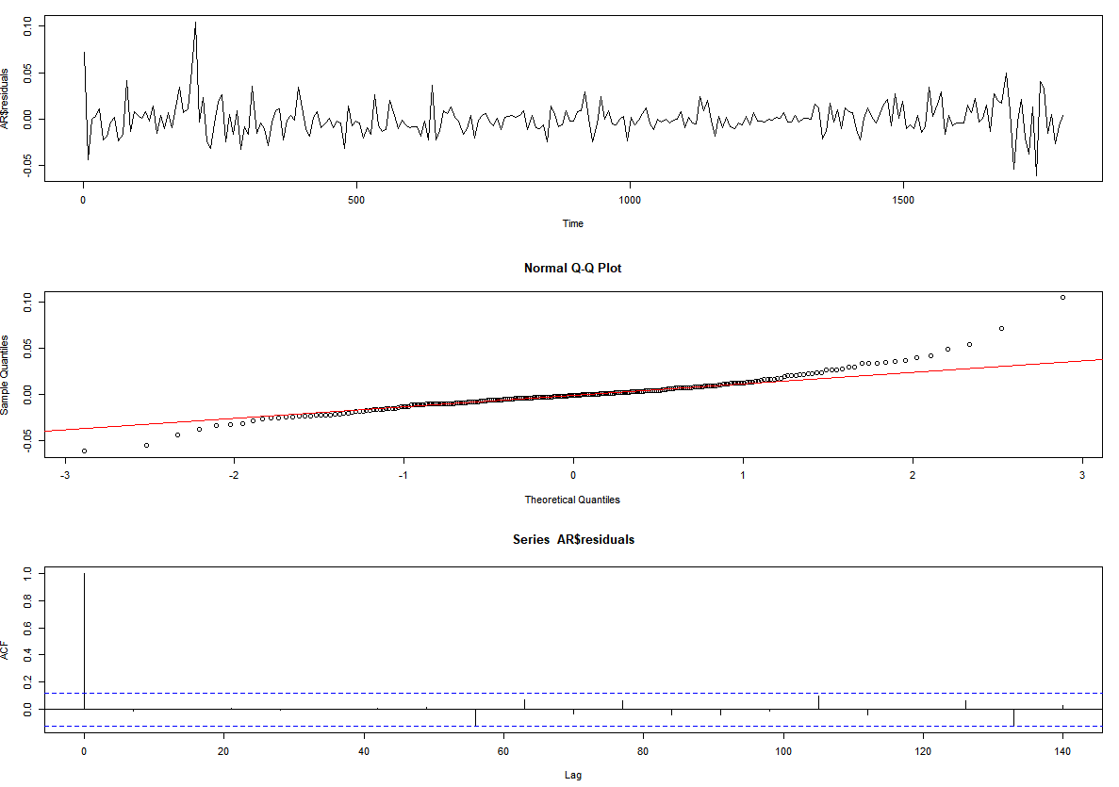
Residual Analysis
AR(7)
MA(2)
ARMA(7, 2)
ARMA(2,3)
ARMA(1,2)

Slide 14
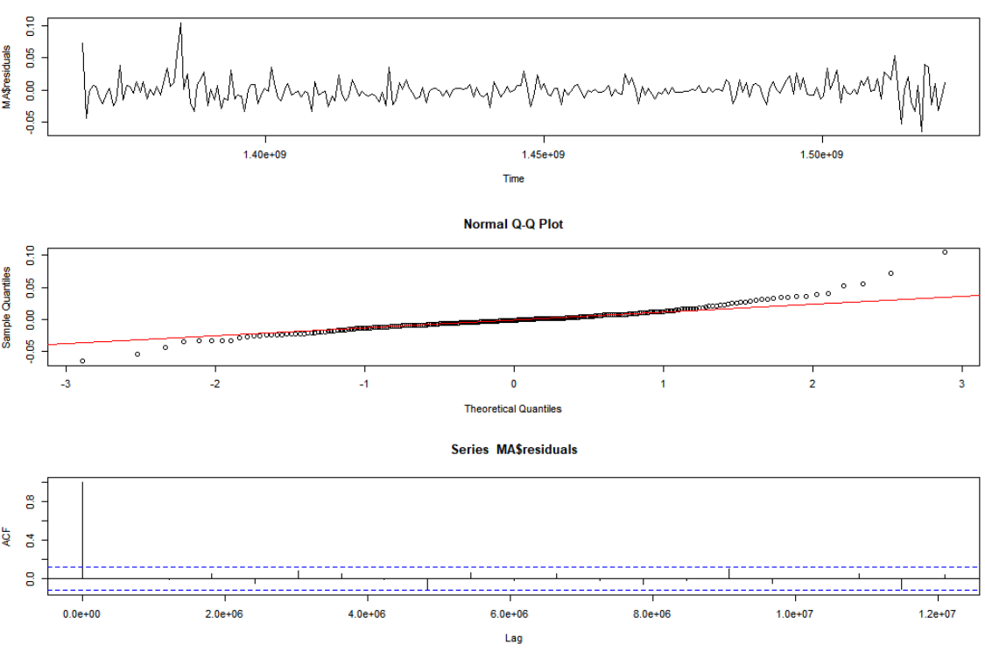
Residual Analysis
AR(7)
MA(2)
ARMA(7, 2)
ARMA(2,3)
ARMA(1,2)

Slide 15
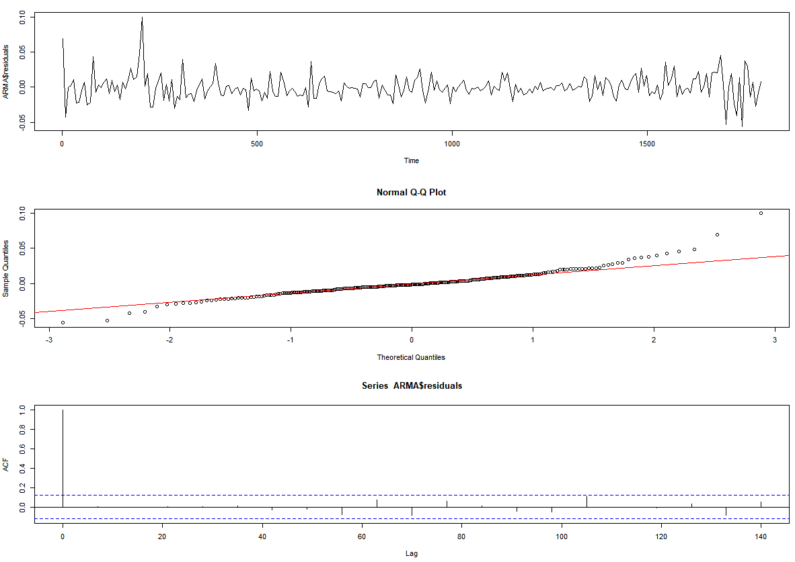
Residual Analysis
AR(7)
MA(2)
ARMA(7, 2)
ARMA(2,3)
ARMA(1,2)

Slide 16
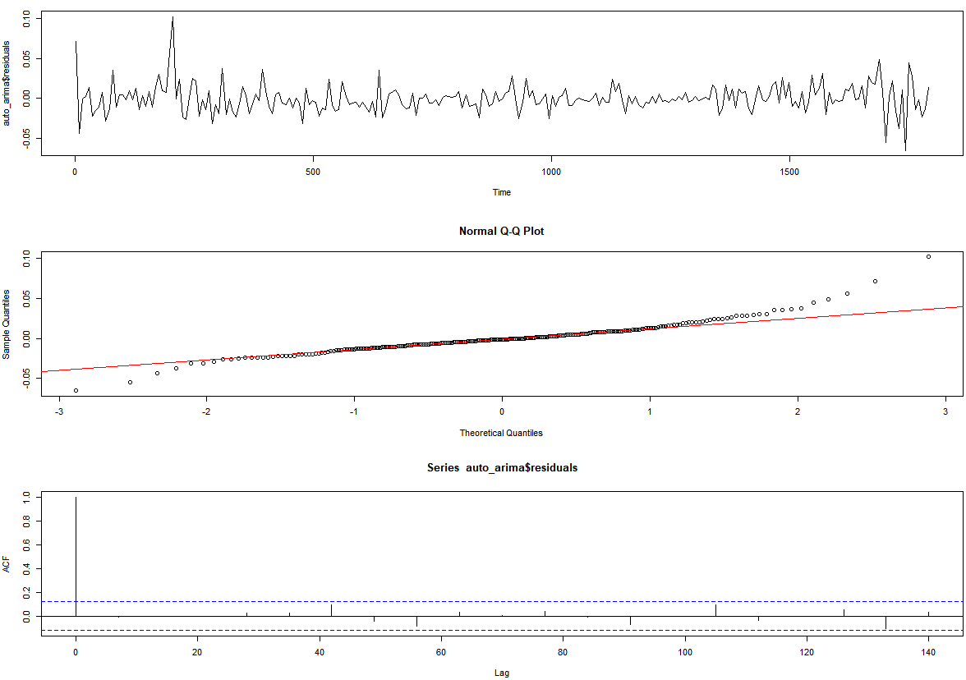
Residual Analysis
AR(7)
MA(2)
ARMA(7, 2)
ARMA(2,3)
ARMA(1,2)

Slide 17
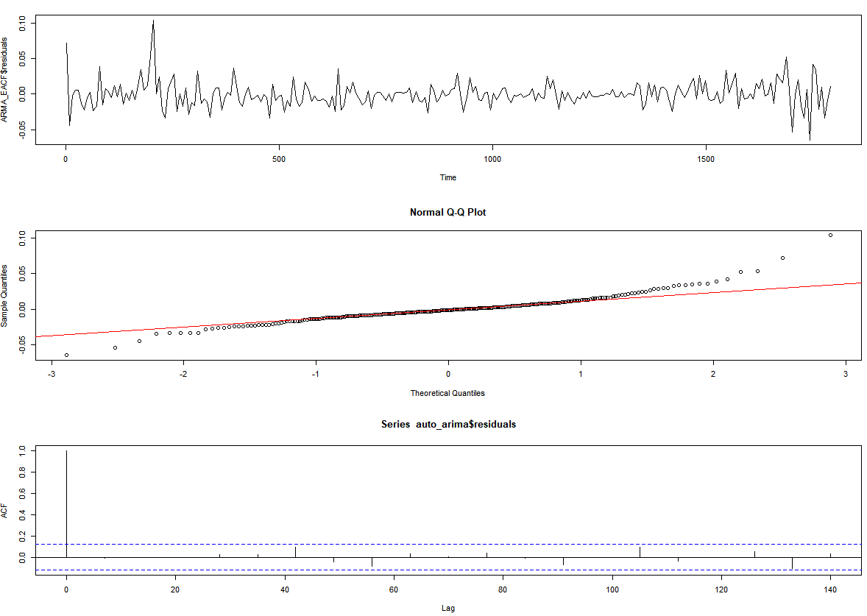
Residual Analysis
AR(7)
MA(2)
ARMA(7, 2)
ARMA(2,3)
ARMA(1,2)

Slide 18
Cross validation
1st Fold
1:217
218:225
5 Fold Cross Validation
2nd Fold
9:225
226:233
3rd Fold
17:233
234:241
4th Fold
25:241
242:249
5th Fold
33:249
250:257

Slide 19

Evaluation
AR(7)
MAE: 0.02670786
MA(2)
MAE: 0.02670700
ARMA(1,2)
MAE: 0.02649215
MAE: 0.02662835
ARMA(7,2)
MAE: 0.02670202
ARMA(2,3)
AR(7)
MA(2)
ARMA(1,2)
ARMA(2,3)
ARMA(7,2)

Slide 20
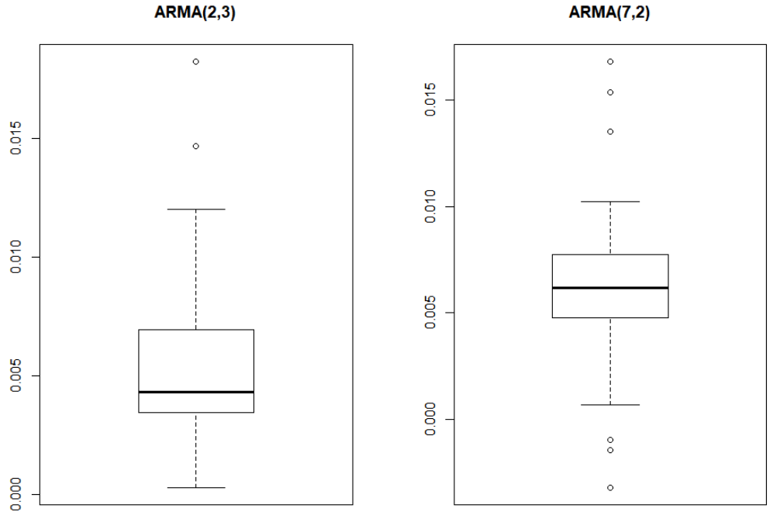
Hypothesis Testing
ARMA(2,3)
ARMA(7,2)

Slide 21
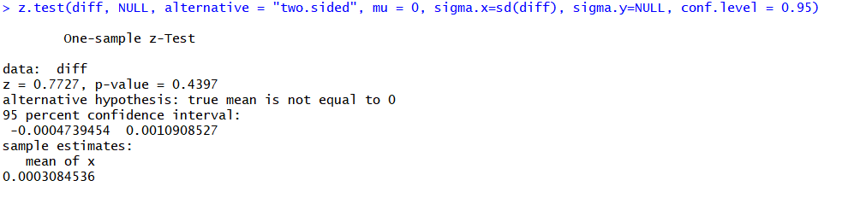
Hypothesis Testing
ARMA(2,3)
ARMA(7,2)

Slide 22
Conclusion & future work
ARMA(7,2) and ARMA(2,3) make better results rather than other models.
Applying GARCH Model to analyze variance of data
Applying Regression Model to find out the relations between prices and volume of the market
Analyzing the relations between Bitcoin price and other effective factors such as oil and gold prices

Slide 23
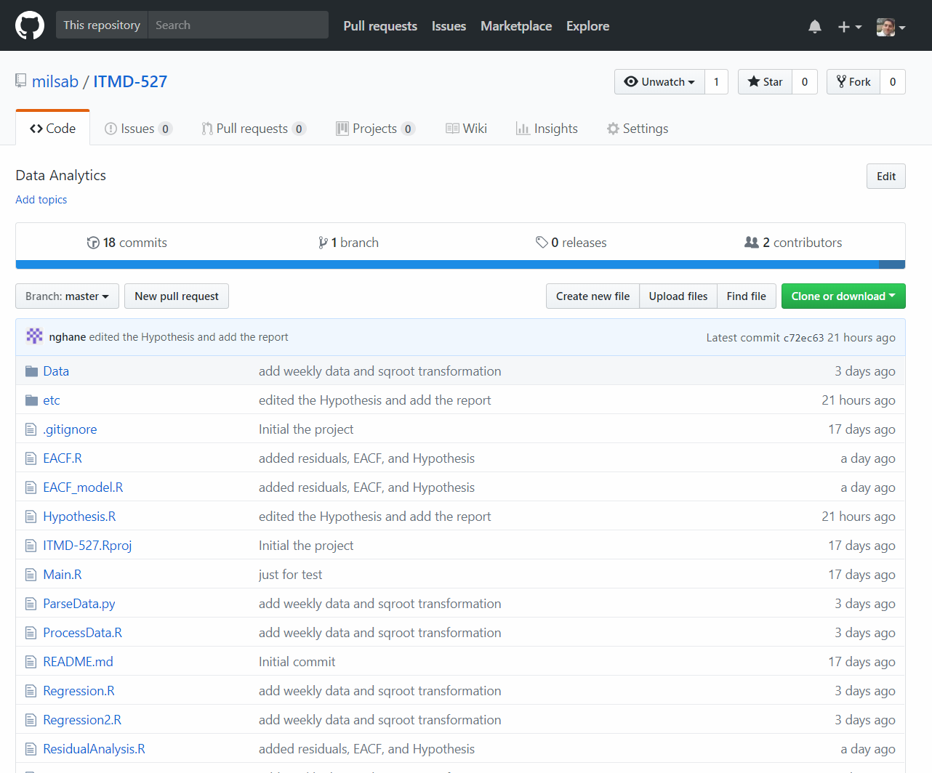
GITHUB
https://github.com/milsab/ITMD-527

Slide 24
Thank you
Credit: Techcrunch

