Slide 1
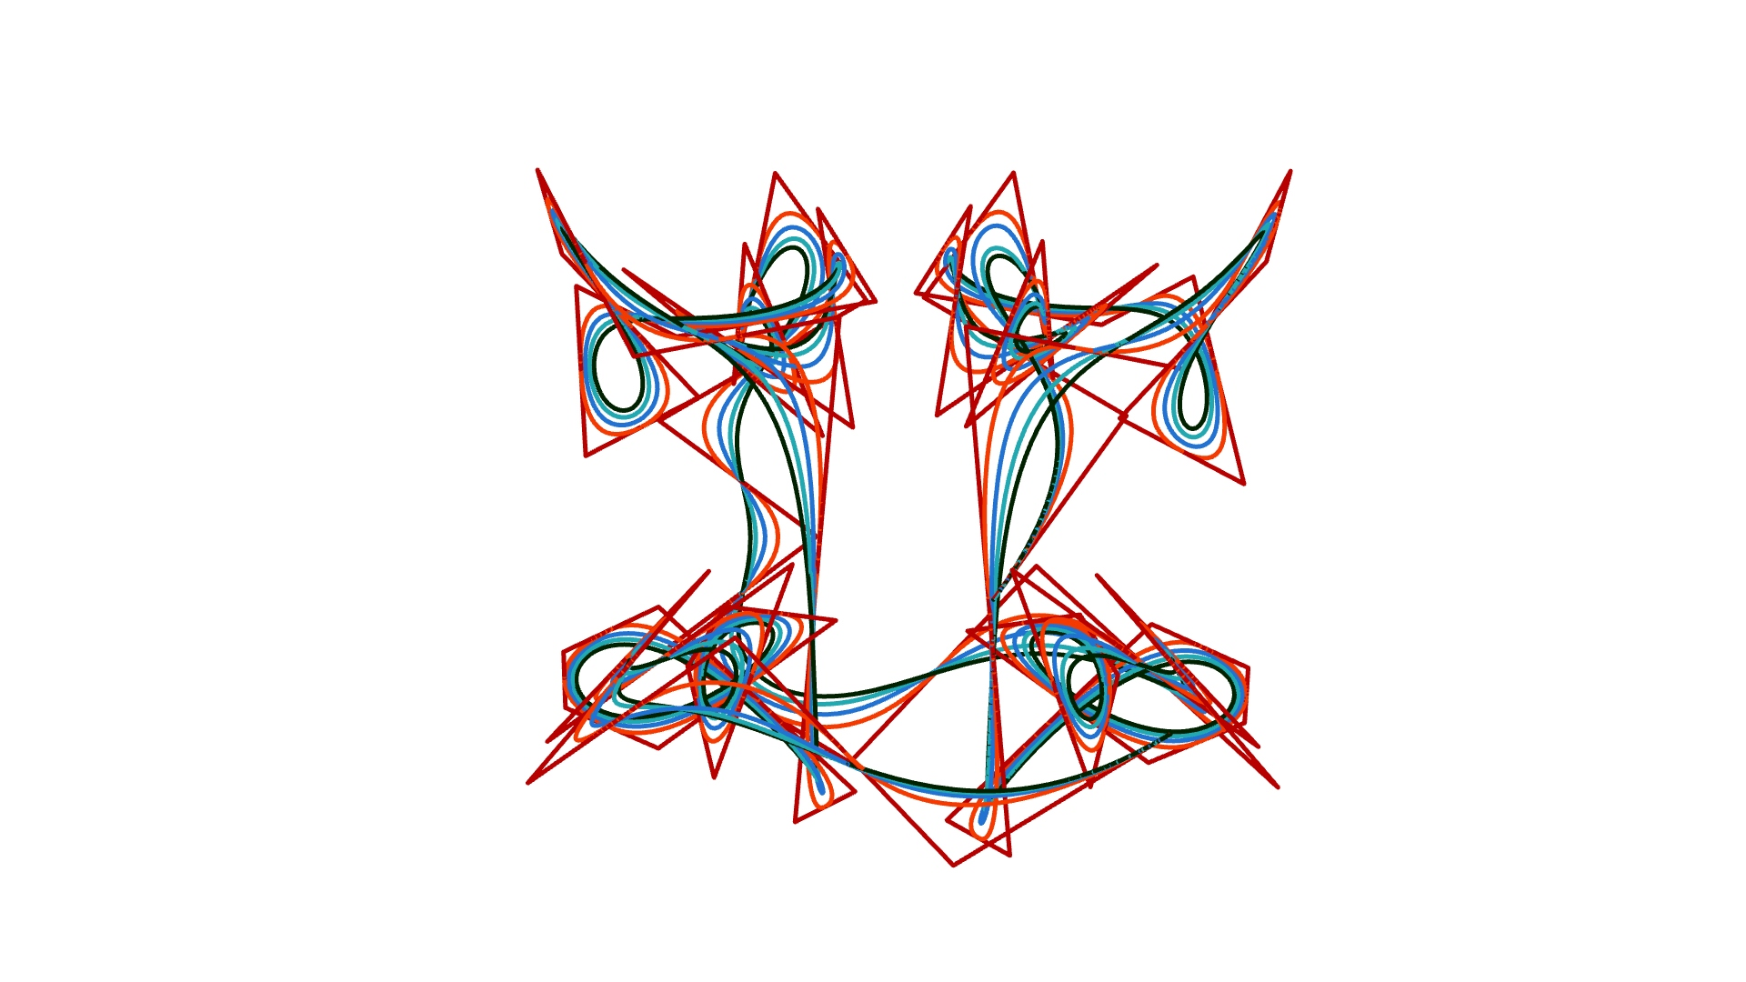
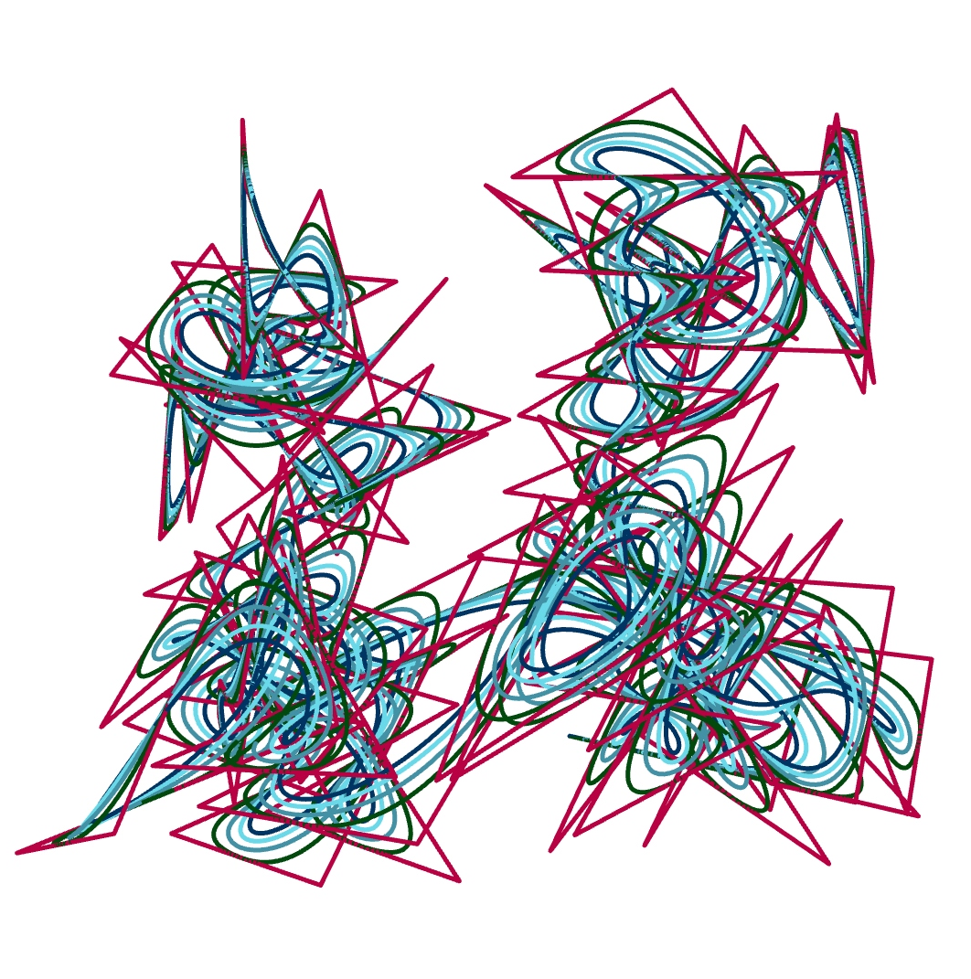
P#
<Computational Design Thinking>
<Generative Design>
P#
BEST PICTURE
Assignment
Context
Course
Date
Generative
Design
Freshmore
Term 1
Computational
Design Thinking
2020
Student
<Description>
Lim Thian Yew
1003158
A short description of your project. Please use formal, as opposed to colloquial language here. Explain briefly what was the main objective of the project, the sources of inspiration, the approach developed, key technical challenges and solutions.
This is not about generic unorganized thoughts, experiences blogging, lessons learned etc. It is a concise summary of the project. Think of it as if you are writing the headlines for a news article.
<Overview>
Please stay within the boundaries of this text box and picture frames. We aim to compile an annual booklet of the “best of” projects. Uniformity is thus critical. The template is designed so it can be also printed in A4 size.
<Formatting Rules>
Regarding text, keep the monospace format for all body text. If you need to include sections use the style <Section> with bold face. Avoid text styles such as italics, underlines etc.
The text in each page should not drop below here…
Instructor
Jason Lim

Slide 2
P#
<Computational Design Thinking>
<Generative Design>
P#
References
<Required Entries>
1. The front page shall be exactly as the first slide of this template. It shall contain a project description and the best picture of your project. If you need more text use this slide as a template or the next slide if your text does not require a full page text block.
2. Every page has an assignment title on the front page left side green slot as well as on every page at the top right side. Please update all instances with the official title of the assignment.
3. Fill the student name, student id as well as the instructor’s name and title fields in the first slide. The student id field is important for grading purposes. Some of you use names variations other than what is officially registered, which causes confusion during marking.
<Content Rules>
1. Add high quality pictures in either jpeg or png format. Do not use pixelated screen grabs or high compressed content. They will look terrible in both screen and print.
2. You may use animated gifs and/or videos. Make sure they are embedded and viewable. You may also link youtube or vimeo videos to avoid huge files. In case you use linked content, include a URL of the video for download in the side margin as in the top left corner of this page.
3. Stay within max 10MB total file size so we don’t overload the SUTD servers.
4. The minimum number of slides of a report is 5 and the maximum is 10. It is recommended that you to put more effort in better organizing a smaller number of slides instead of dumping information indiscriminately.
5. Respect the copyright of external sources used. Always use proper attribution to works by other people. Add the name of the author and date of the work in the side margin. Use a reference such as (Author, YYYY), using the last name of the author and year in the body text.
1/2
You may use this margin to link external sources used such as URLs, articles bibliography, footnotes, picture captions etc.
If you do not need to include any of the above then delete both the green text caption and this textbox.
1/2
Captions
01 Description
02 Description
01
02

Slide 3
P#
<Computational Design Thinking>
<Generative Design>
P#
<Layout Rules>
The template contains number of variations of content blocks eg. full, half, quarter and eighth. You may mix and match as long as the locations of the boxes stay consistent.
To best select layout consider the idea of visual information density. If the figure show too little information use a small box. If the figure is densely packed with information use a large box.
Add a one-liner description for each figure. You may adjust the captions section vertically to fit your descriptions. If you mix various layouts from different slides you will also need to adjust the figure layout key.
The template contains a wide range of content box variations to reduce effort on presentation and the potential for poorly executed manual edits. Delete the slides that are not needed.
Last line of text should not go below here
1/8
1/8
1/8
1/8
1/4
1/8
1/8
Captions
01 Description
02 Description
03 Description
04 Description
05 Description
06 Description
07 Description
08 Description
09 Description
1/8
1/8
02
03
04
05
01
06
07
08
09

Slide 4
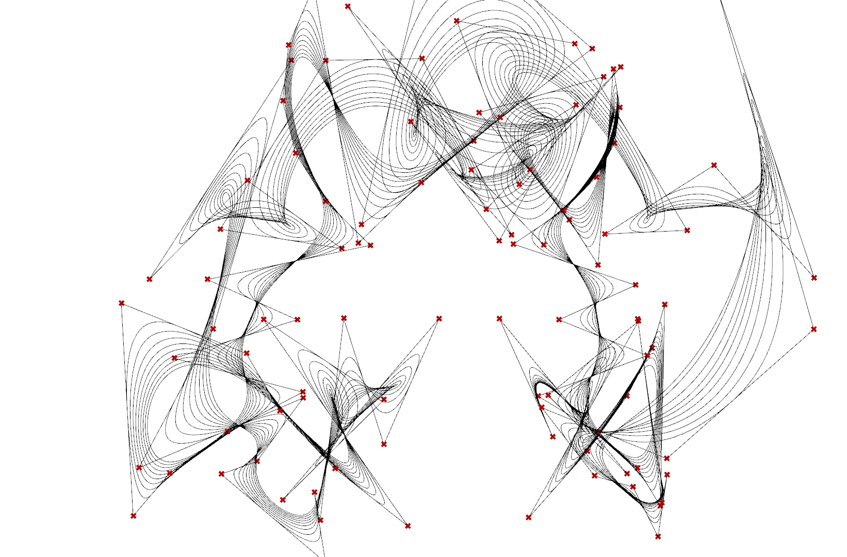
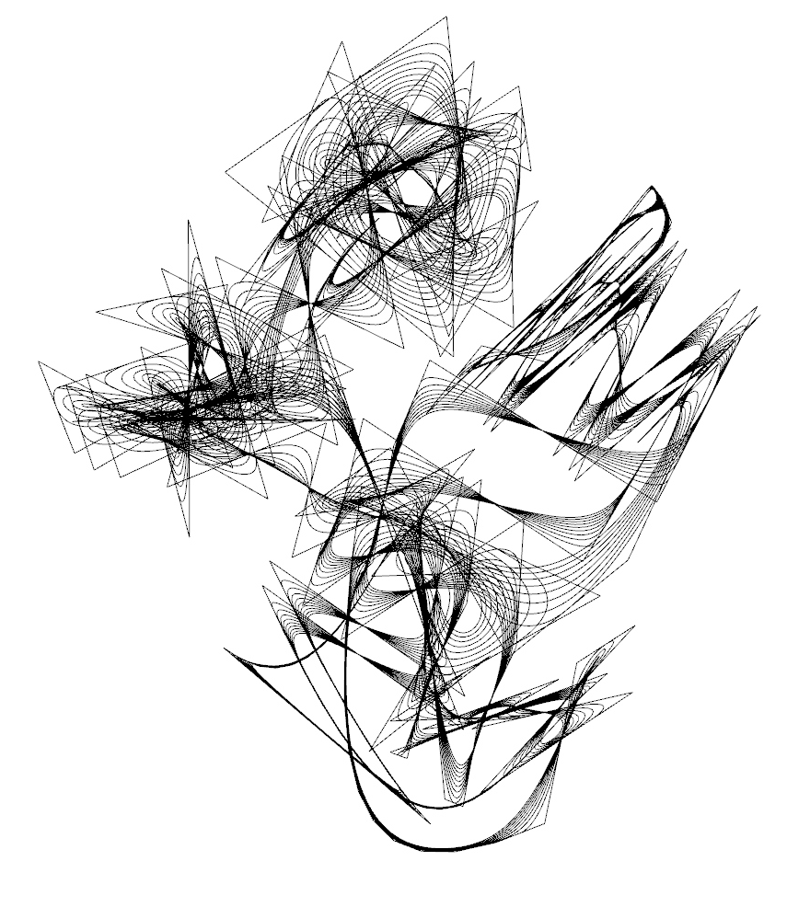
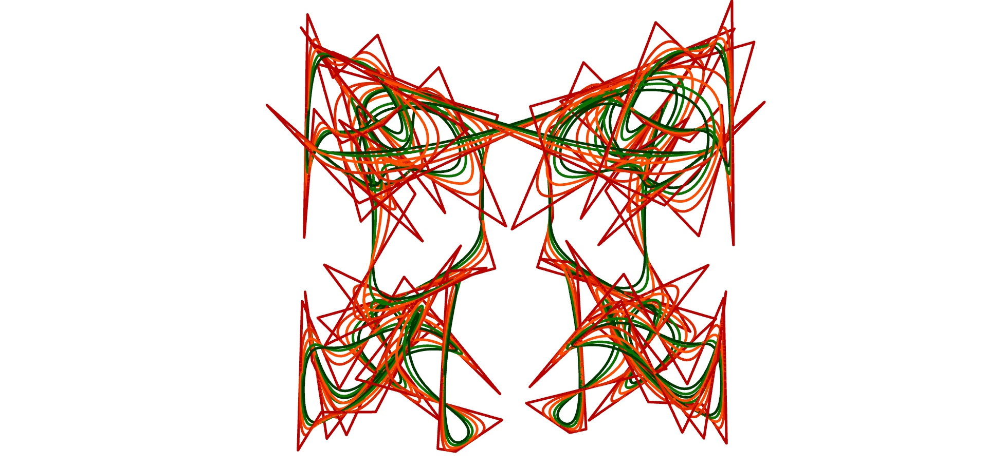

P#
<Computational Design Thinking>
<Generative Design>
P#
1/4
1/2
3/4
1/4
Captions
01 Description
02 Description
03 Description
04 Description
05 Description
1/4
01
03
02
04
05

Slide 5
P#
<Computational Design Thinking>
<Generative Design>
P#
4/4
1/2
1/2
Captions
01 Description
02 Description
03 Description
01
02
03

