Slide 1

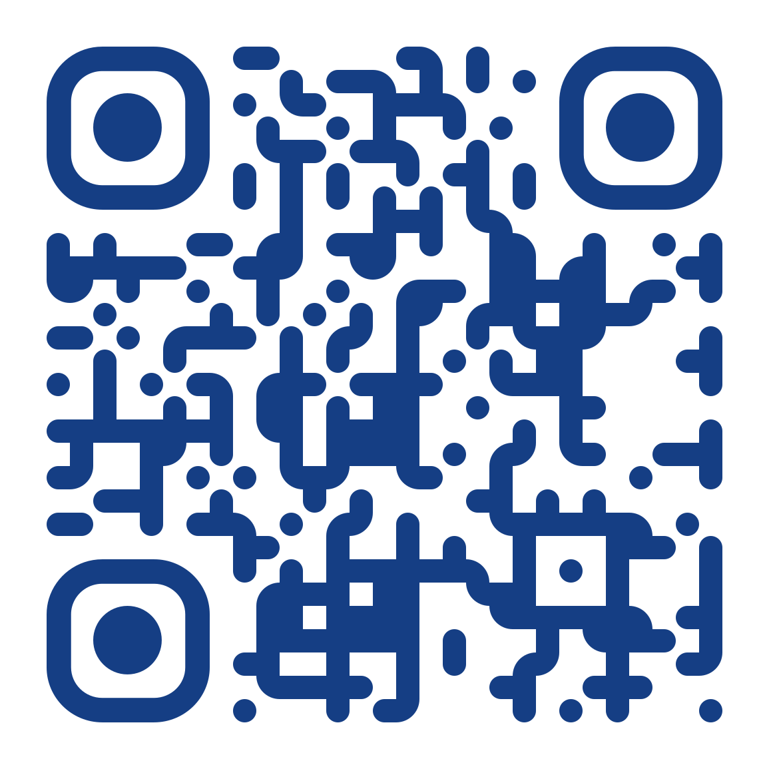














#OILS26 Conference
From Bit to Bench
Shaping sustAInable & ethical innovation in life sciences
20 OCTOBER 2026
SCAN TO REGISTER
UNIVERSITY OF ZURICH, SWITZERLAND
09:00
Opening Ceremony
09:30
KEYNOTE 1
Lizbé Koekemoer
Feeding the Models: Open Data for AI-Driven Drug Discovery
10:15
PANEL
Jilles Vreeken · Ellen Carbo · Fergus Imrie
Scientific AI: Data Quality, Limitations & the Future of Models That Understand Science
11:15
Coffee Break
11:45
WORKSHOP 1
Sebastian Kahlert · Pernilla Sörme
Sustainable Practice in the Lab
13:00
Lunch Break
14:00
WORKSHOP 2
Joseph Heng
Accessing & Using Open AI Tools, Pre-trained Models and Datasets for Life Sciences
15:15
Coffee Break
15:45
KEYNOTE 2
Nicoletta Iacobacci
The Missing Behavioral Layer in AI-Assisted Science
16:30
PITCHFEST
Emerging Voices: Early-career researchers
17:30
Closing Ceremony — Pitch Winner Awards
17:45
Networking Apéro
Sponsors & Partners:
www.biologists.com
Follow us on:
@OpenLifescience
b2match.com/e/oils2026

