Slide 1

CS 523 DE : Big Data Technology
Milton Gonzalez

Slide 2





Spark streaming
Next versión

Slide 3
Stack
.Net core 3.1
Windows 10
Kafka
Spark 3.01
Scala 2.12.10
Java 1.8

Slide 4
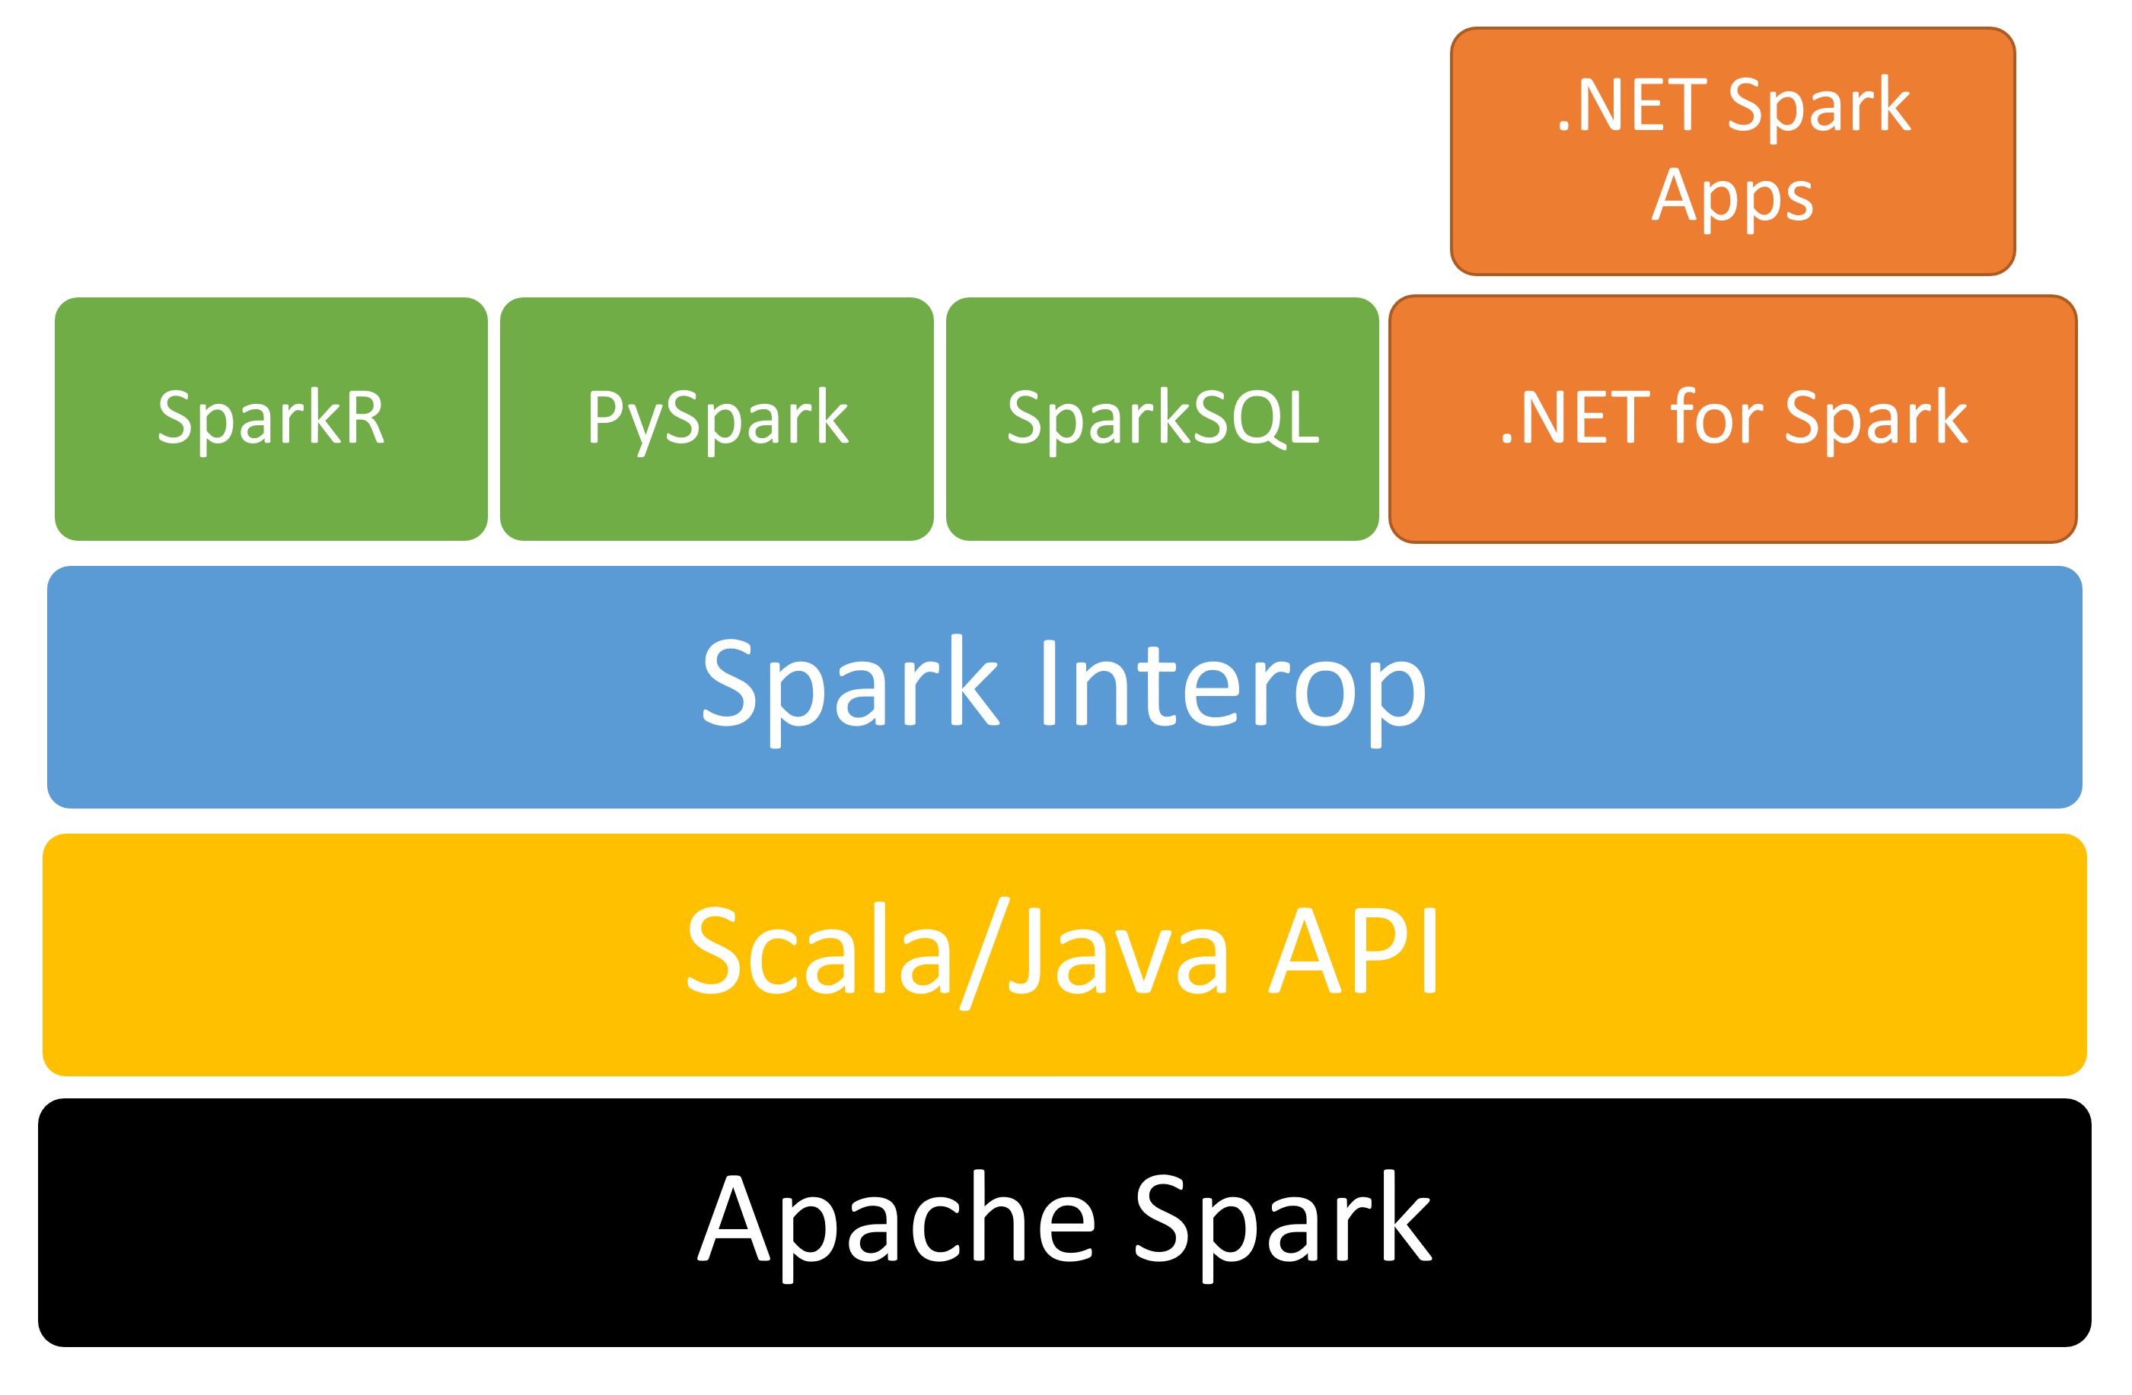
Why .Net??
When compared against Python and Scala using the TPC-H benchmark, .NET for Apache Spark performs well in most cases and is 2x faster than Python when user-defined function performance is critical. There is an ongoing effort to improve and benchmark performance.
To do your own benchmarking, see the benchmarks available on the .NET for Apache Spark GitHub.

Slide 5
Spark streaming
Next versión

Slide 6


Bonus Track
Next versión

Slide 7
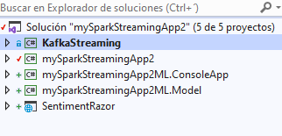
Code

Slide 8
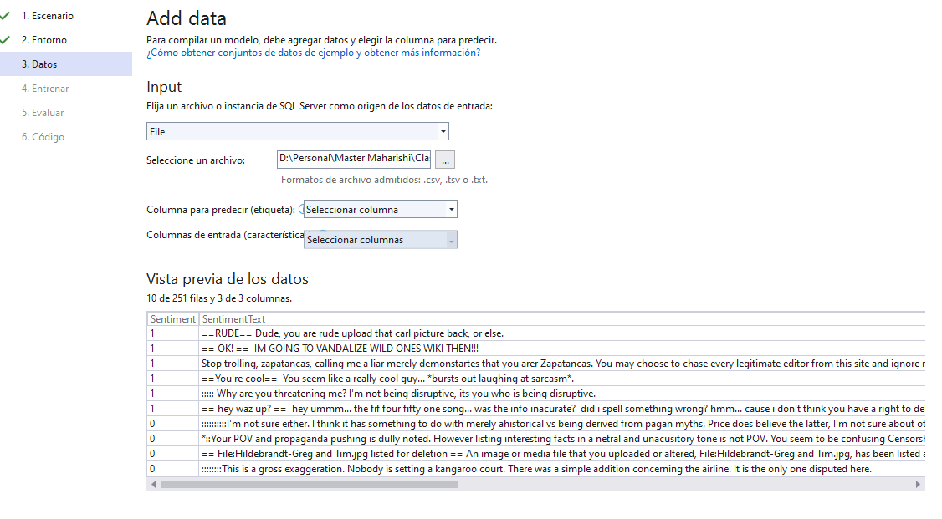
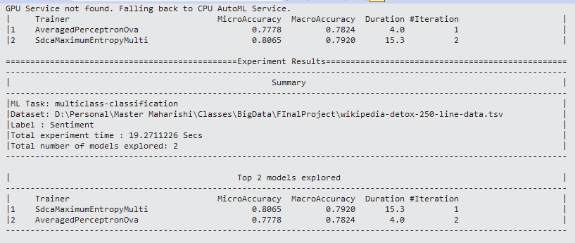
Train data
Data to train: https://raw.githubusercontent.com/dotnet/machinelearning/main/test/data/wikipedia-detox-250-line-data.tsv

