Slide 1

ReflectionAgents
Self-improving AI through Reflexion-style agentic loops
A declarative framework where agents plan, critique each other,
and learn — without updating model weights.
Mark Lubin · github.com/milubin/ReflectionAgents · May 2026

Slide 2
The big idea
AI agents that talk to each other,
critique their own work,
and get measurably better across rounds —
without retraining or updating any model weights.
0
11
1
model retraining
examples, CPU → GPU → Ray
DSL, every backend

Slide 3

The problem
Standard LLM calls answer once, then stop.
Single-pass generation
Reflective improvement
No self-correction. The model produces an answer, you read it, that's the run.
No mechanism to notice mistakes, refine reasoning, or build on prior work.
Hallucinations and shallow reasoning go unchecked unless a human catches them.
Generate. Critique. Improve. Repeat — until the agents agree the answer is good enough.
Multiple specialists work in parallel; a meta-agent picks the best ideas; critics validate before changes are applied.
All in natural language. No fine-tuning. No weight updates. Just better prompts and structured loops.

Slide 4



The foundation: Reflexion (Shinn et al., 2023)
"Language Agents with Verbal Reinforcement Learning"
Agents reflect on their own outputs in natural language and use those reflections to improve on the next pass — without changing model parameters.
Verbal reflection
Iterative learning
Self-terminating
Critique happens in plain English. The agent reads its prior answer and says what was wrong — no gradients, no weights.
Each round produces a better output than the last. The system has a memory of its own mistakes within a session.
Loops stop when the agents collectively agree the output is good — not after a fixed number of rounds.
arXiv:2303.11366 · Now considered foundational; built into LangGraph, AutoGen, CrewAI

Slide 5


The pattern
Generate → Critique → Improve, with a stop condition
Generate
Critique
Improve
Synthesize
Agents produce initial outputs in parallel
Other agents review for flaws and gaps
Refined outputs based on critiques
Final report when confidence is high
⟲ loop continues until average agent confidence ≥ threshold (e.g. 0.85)
Why this matters
Termination is intelligent, not arbitrary. The system runs as long as the agents say more thinking would help — and stops the moment they're confident the answer is good. This is the difference from "call the LLM 5 times and average."

Slide 6
The framework: one DSL, every backend
ParallelDSL(backend="cpu" | "ray" | "gpu" | "csl")
Same workflow code. Different hardware. No rewrites.
✓
✓
✓
Planned
CPU
Ray
GPU
Cerebras
ThreadPoolExecutor
Distributed
Triton kernel
WSE-3 CSL
Local parallel agents.
No dependencies.
Native parallelism
across cores or nodes.
CUDA path with CPU
fallback.
Wafer-scale hardware
target. Skeleton.
Backend dispatch happens in dsl/base_dsl.py — the workflow description never changes.

Slide 7
The agent pipeline
Planner → parallel specialists → reflection → synthesizer
Planner
Specialist
Specialist
Specialist
Specialist
analyze
analyze
analyze
analyze
Reflection round · agents critique each other if avg confidence < threshold
Synthesizer
Every agent returns structured JSON with a confidence score that drives loop termination.

Slide 8


Two real domains, same framework
The framework's claim: it works on real problems, not toy text tasks.
Quantum Error Correction
Adaptive Enemy AI
Examples 09, 10
Example 11 — the focus of this deck
Real physics simulation via Stim — a 3-qubit bit-flip repetition code.
A Navigator agent reasons in natural language about which noise levels to probe next, building a real error-rate curve adaptively.
Demonstrates the framework as an autonomous experimental scientist.
An enemy in a dungeon RPG that learns to beat the player across episodes.
Four specialist agents propose policy changes. A Navigator picks the best ones. Critics validate. Metrics confirm.
Same Reflexion pattern as QEC — but the domain is policy parameter optimization on a synthetic combat benchmark.
Output: log-log noise curve, agent graph, full JSON history
Output: learning curve, agent graph, complete run log

Slide 9
Example 11
The enemy learns to beat you
A 12×9 corridor dungeon. The enemy starts dumb — slow, weak attacks, no tactics. Six tunable policy parameters. Twelve simulation trials per policy evaluation. Five rounds of multi-agent reflection.
8%
92%
112s
baseline win rate
after 5 rounds
total runtime

Slide 10
The cast: six specialized agents
Each round, four analysts work in parallel; a Navigator chooses; critics validate.
Analyst
Analyst
Analyst
Tactician
Pathfinder
Predictor
Combat timing, crit chance, burst behavior
Movement: speed, flanking, retreat
Models player behavior, suggests counters
Analyst
Coordinator
Coordinator
Historian
Navigator
Critic
Reviews past episodes, identifies patterns
Picks best changes, decides when to stop
Validates each Navigator decision
Analysts and Navigator: Grok-3 via xAI. Critics: same. All run in parallel via Ray.

Slide 11
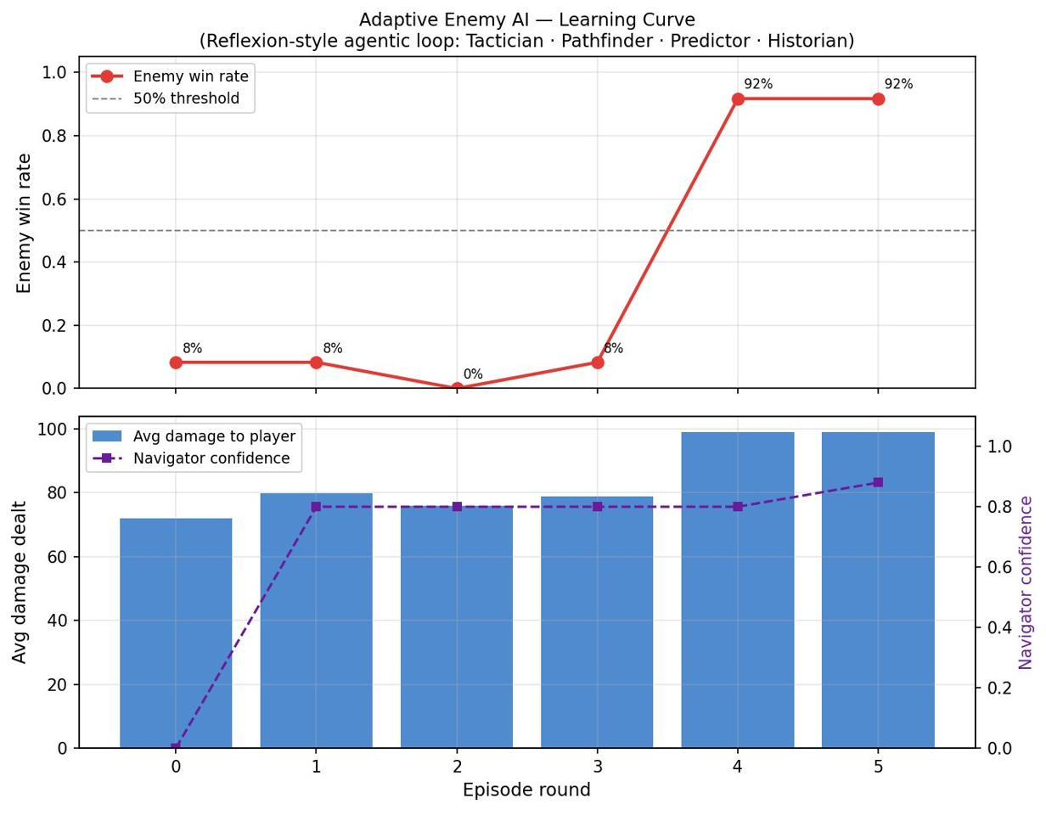
The result: 8% → 92% in five rounds
This is what self-improvement looks like — including the dip in Round 2.
Trajectory
R0
8%
baseline
R1
8%
flat — no critical params
R2
0%
regression
R3
8%
recovery
R4
92%
breakthrough
R5
92%
converged

Slide 12
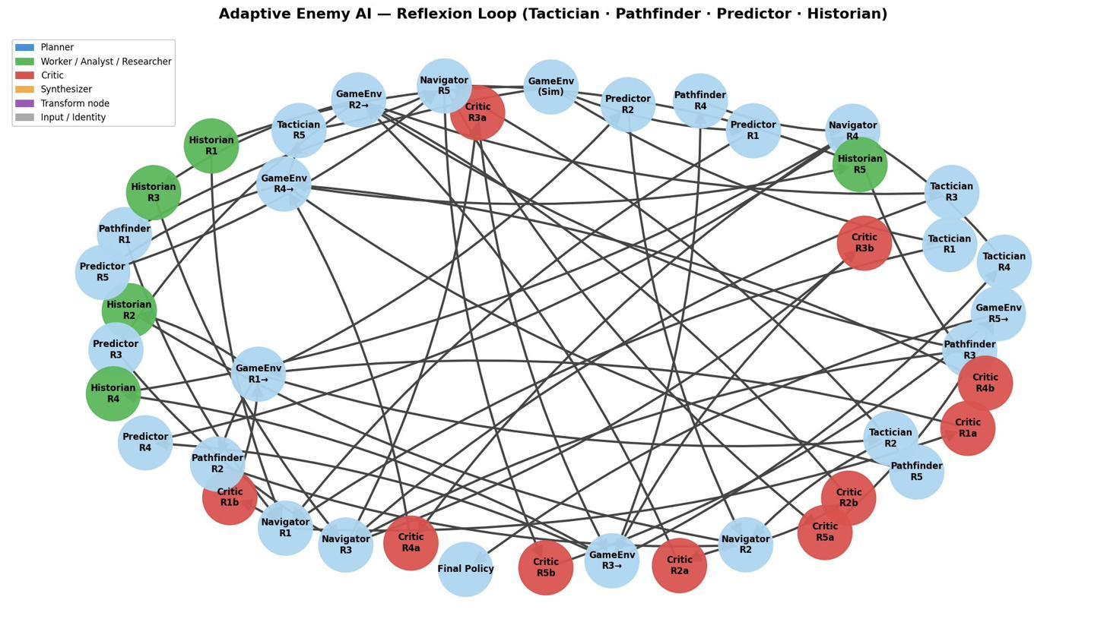
The agent network behind the curve
Every node is an LLM call. Every edge is a piece of information flowing between agents.
By the numbers
20
analyst calls
4 agents × 5 rounds
5
Navigator decisions
1 per round
7
critic validations
1 per applied change
6
GameEnv evaluations
baseline + 5 rounds
1
final report
synthesis at end
~39 LLM calls total — orchestrated declaratively, run in parallel via Ray, completed in 112 seconds.

Slide 13
What the curve actually shows
The dip is the most important data point.
The mistake
The recovery
The win
Round 2: regression to 0%
Round 3: self-correction
Round 4: breakthrough
The Navigator proposed two parameter changes. A critic deferred one (citing attribution risk). The remaining change made things worse — flank_weight matters less than burst_threshold on a corridor map.
Navigator proposed exactly ONE change (speed=2). Single critic approved cleanly. Win rate recovered to baseline. The agents had visibility into prior deferrals and adapted.
Single change again (attack_bonus=5). Win rate jumped 8% → 92%. Clean attribution: one variable changed, dramatic effect, no ambiguity about what caused it.

Slide 14
Why the dip matters
Earlier runs converged in two rounds with a clean monotonic curve.
Pretty for a slide. But it didn't show the framework actually doing anything beyond aggregating suggestions.
Monotonic 8% → 92% → 100%
Non-monotonic 8% → 0% → 92%
Demo material — looks great in a graph.
Honest material — demonstrates the value-add.
✗ Doesn't exercise critic deferral
✗ Doesn't show recovery from a wrong call
✗ Looks like the framework just got lucky
✓ Critic deferral mechanism actually fired
✓ Navigator self-limited to 1 change after deferral
✓ Clean attribution: each change tied to its outcome

Slide 15
Key insight #1
Disagreement is the signal, not the bug
When the four analysts proposed conflicting parameter changes, the Navigator picked the highest-leverage one based on cross-agent agreement. When critics disagreed with the Navigator, overrides got applied. The whole framework runs on disagreement.
Round 1 in the actual run
Why those two
Tactician: crit_chance + burst_threshold
Pathfinder: flank_weight + burst_threshold
Predictor: speed + crit_chance
Historian: attack_bonus + flank_weight
Navigator picked: crit_chance, burst_threshold
crit_chance was supported by Tactician AND Predictor AND Historian — strong cross-agent signal. burst_threshold was supported by Tactician AND Pathfinder. The Navigator's job was synthesis, not aggregation; it picked the changes that emerged from multiple independent perspectives.

Slide 16
Key insight #2
Critics need leverage, not just opinions
In early versions, critics could only override values — they could say "reduce crit_chance from 0.30 to 0.25" but they couldn't say "don't apply this change at all." That changed.
Approve
Modify
Defer
verdict: approve
verdict: modify + override
verdict: modify [DEFER]
Change lands as proposed. Used when the change is well-reasoned and isolated.
Change lands with a substituted value. Used when the direction is right but the magnitude is risky.
Change is dropped from this round. Used when too many parameters change simultaneously and attribution becomes impossible.

Slide 17
Key insight #3
Feedback loops have to actually close
In an earlier iteration, every critic flagged "attribution risk" — but the Navigator never saw those flags, so it kept proposing the same 3-change batches every round. The system stalled for 7 straight rounds with zero improvement.
Before: open loop
After: closed loop
Critics flagged risk. Navigator didn't read those flags. Navigator kept proposing the same 3-change batches. Critics kept flagging them. 7 rounds, 0% progress, full stalemate.
Deferral history is now passed to the Navigator. When critics defer, the Navigator sees it next round and self-limits to 1 change. Stalemate impossible.

Slide 18
Honest framing
What this framework is — and what it isn't.
It IS
It is NOT
✓ An educational framework for exploring agentic + parallel computing patterns
✓ A demonstration that the Reflexion pattern works on real (non-toy) workloads
✓ A clean starting point for anyone wanting to build agentic + Ray + structured-JSON systems
✓ Domain-grounded — Stim quantum simulations, not chat-with-Wikipedia toys
✗ A replacement for Bayesian optimization or other classical methods on well-defined problems
✗ A production system at CERN/Fermilab scale — built by one person with heavy AI assistance
✗ A playable game (example 11 is a synthetic combat benchmark, not a real-time game)
✗ Sample-efficient — LLM API calls are slow and expensive vs. numerical optimizers

Slide 19
Compared to other agentic frameworks
Most frameworks have some Reflexion. Few combine it with multiple backends + real domain grounding.
 | LangGraph | CrewAI | AutoGen | ReflectionAgents
Declarative DSL | Imperative | Imperative | Imperative | ✓
Reflection as primitive | Plugin | Plugin | Plugin | Core
Native parallelism | Limited | Limited | Limited | Ray
Multiple backends | Single-node | Single-node | Single-node | CPU/GPU/Ray/CSL
Domain grounding | Generic | Generic | Generic | Stim physics + game
Where ReflectionAgents differs: declarative + reflective + parallel + multi-backend in one place.

Slide 20
Takeaways
Reflection is no longer experimental
01
By 2026, every major agentic framework has Reflexion built in. The pattern is now standard practice for serious agent design.
The framework actually self-corrects
02
Five rounds, one regression, four parameter changes, clean attribution. The dip in Round 2 isn't a failure — it's evidence the system is exploring rather than memorizing.
Closed feedback loops matter
03
Critics who flag risk without affecting decisions are theatre. The structural fixes — deferral history feeding back to Navigator — are what made the framework work.
Best fit: exploratory science
04
Where understanding why matters as much as the answer itself. Quantum error correction, drug discovery, scheduling, biology. Not where pure sample efficiency wins.

Slide 21
Backup material
Technical depth
Architecture, JSON contracts, Ray patterns

Slide 22
Per-agent JSON contracts
Different agent roles return different shapes. The confidence field is the only constant.
Analyst
Navigator
{
"analysis": "<3-5 sentences>",
"suggestions": [...],
"confidence": 0.85
}
{
"apply": [{param, new_value, ...}],
"rationale": "...",
"confidence": 0.85,
"stop": true | false
}
Critic
Synthesizer
{
"verdict": "approve" | "modify" | "reject",
"comment": "...",
"override": {param, new_value} | null
}
{
"report": "<full report>",
"biggest_impact": "...",
"player_weakness": "..."
}
Parsing: every agent strips markdown code fences before json.loads(); fallback to default dict on parse failure.

Slide 23
Implementation patterns: Ray remotes
Three conventions worth knowing if you extend the framework.
Imports duplicated inside @ray.remote
Each remote re-imports os, time, json, re, OpenAI. Ray workers don't reliably inherit parent module imports on Replit. Don't "clean this up" — it will break.
Sometimes-Ray-sometimes-not simulations
Example 09 inlines the Stim simulation inside its Ray remote. Example 10 calls Stim directly outside Ray (because the loop is sequential). Pick the pattern that fits the dispatch.
Module-scope helpers vs inlined code
_grok_client() and _parse_json() at module scope serve the synchronous main loop. Inside Ray remotes, the same logic is inlined — same reason as #1.

Slide 24
README suggestions for Replit
Five concrete updates based on the latest run.
1
Use the latest run as the canonical example
Add the 8% → 0% → 92% trajectory and the new PNG to the README's example 11 section. The non-monotonic curve tells a more honest story than monotonic ones.
2
Document the critic's three modes
Approve, modify-with-override, defer. The README currently only describes generic critic-as-validator. The three-mode taxonomy is what makes the run trajectory legible.
3
Add an attribution-clarity section
Why single-change rounds matter. Right now the README says "reflection improves output" — which is fine but generic. The attribution-discipline angle is more specific to what the framework actually contributes.
4
Update example 11 numbers
Current README claims ~100% win rate at convergence. Add a "typical run" table showing 5-round trajectories with regression possible, since LLM stochasticity makes the path non-deterministic.
5
Honest framing of game scope
The README sometimes implies a playable 2D game. It's a synthetic combat benchmark. Be explicit: "policy parameter optimization on a corridor dungeon simulator, not a playable game."

Slide 25
Resources
Try it yourself
Source code
github.com/milubin/ReflectionAgents
Reflexion paper
arxiv.org/abs/2303.11366
Stim simulator
github.com/quantumlib/Stim
Mark Lubin · May 2026

