Slide 1
WORKFLOW
Import Data from:
Growth reading
Fluoresce reading
GC reading
4. Data partition
training 80%
testing 20%
Feature extraction:
GC peak area (target)
Induction OD
for each fluoresce wavelength:
slope
area
max
min
median
5. Train and tune machine learning models:
ordinary least square
lasso
partial least square
neural network
random forest
support vector machine
6. Select best model
using RMSE criteria
compute standard deviation using bootstrap
Data preprocessing
check
skewness
collinearity
perform
center
scale
remove high correlation columns

Slide 2
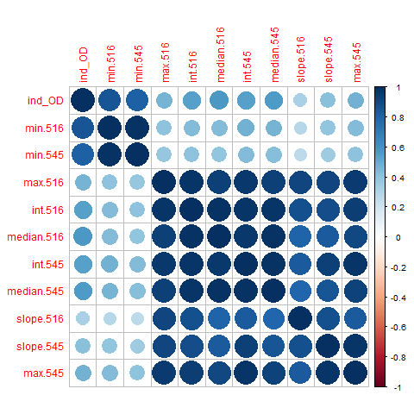
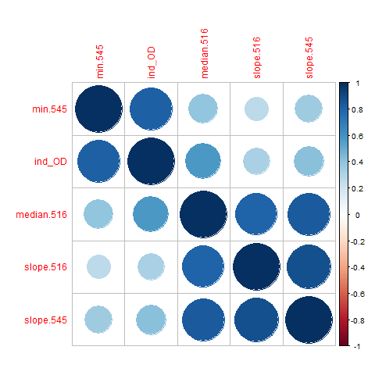
DATA PREPROCESSING
Many features appear to be highly correlated.
correlation plot before feature removal
correlation plot after
feature removal

Slide 3
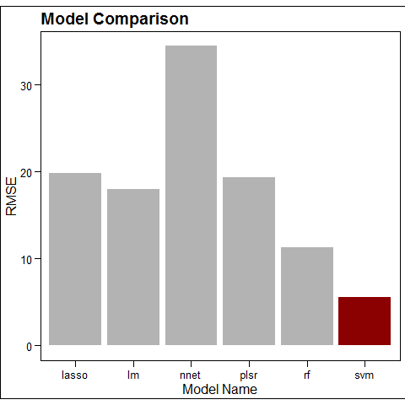
MODEL COMPARISON
lasso: lasso
lm: ordinary least square
nnet: neural network
plsr: partial least square
rf: random forest
svm: support vector machine

Slide 4
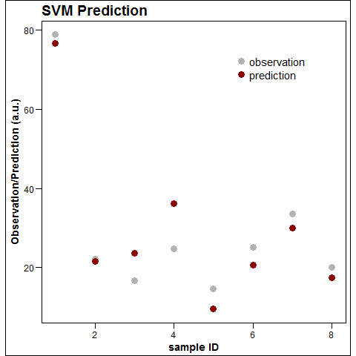
SVM PERFORMANCE
Prediction statistics from Bootstrapping (10 fold):
RMSE_{svm:}
4.36 ± 2.88

