Slide 1
MACHINE LEARNING · END-TO-END ML PIPELINE
Heart Disease Risk Prediction
Using technology to detect one of the world's leading causes of death, earlier.
Jhoselyn Miluska Pajuelo · Software Engineer → AI / ML Engineer
0.894 ROC-AUC
3 models compared
SHAP explainable
Notes:
~30s. Open warm: 'Heart disease is the world's number-one killer. I wanted to see if machine learning could help catch it earlier.' Set up that this is an end-to-end ML engineering project. Drop the headline: ROC-AUC 0.894, three models compared, fully explainable.

Slide 2
Why I built this
Two motivations drove the project
♥
⚙
Technology that serves people
A real engineering challenge
Heart disease is the world's leading cause of death. I wanted to apply ML to a problem that genuinely matters — supporting earlier screening so high-risk patients can be flagged before it's too late.
Not just training a model, but building the full workflow the way it's done in practice: clean structure, leakage prevention, model comparison, and explainability I can defend.
Notes:
~30s. The 'why'. Two reasons: (1) I wanted technology that actually serves people — early screening for a disease that matters. (2) I wanted a real engineering challenge, not a toy notebook. This dual motivation shaped every decision.

Slide 3
The problem, framed for ML
A binary classification task
Predict whether a patient is likely to have heart disease from routine clinical measurements (age, chest pain type, blood pressure, cholesterol, max heart rate, and more).
0
Target = 0
No heart disease
Why recall matters most
1
Target = 1
In a screening context, missing a sick patient (a false negative) is far more harmful than a false alarm. So the model is judged on recall — not just accuracy.
Heart disease
Notes:
~30s. Frame the ML problem: binary classification from routine clinical measurements. Key point — recall matters most: missing a sick patient is worse than a false alarm, so I optimize and judge on recall, not just accuracy.

Slide 4
An end-to-end pipeline
Built as reusable modules — not just notebooks
›
›
›
›
›
›
›
1
2
3
4
5
6
7
8
EDA
Split
Preprocess
Feature
Engineering
Train
Evaluate
SHAP
Select
Model
Split before preprocessing
Train / val / test separated first, so no test information leaks into scaling or imputation.
Modular source code
Logic lives in src/ modules with pytest tests — notebooks stay for exploration only.
Reproducible by design
Config-driven runs and saved artifacts make every result repeatable.
Notes:
~35s. Walk the pipeline left to right quickly. Emphasize three things: I split BEFORE preprocessing, the logic lives in tested modules (not just notebooks), and runs are reproducible. This is what makes it 'engineering', not just 'modeling'.

Slide 5
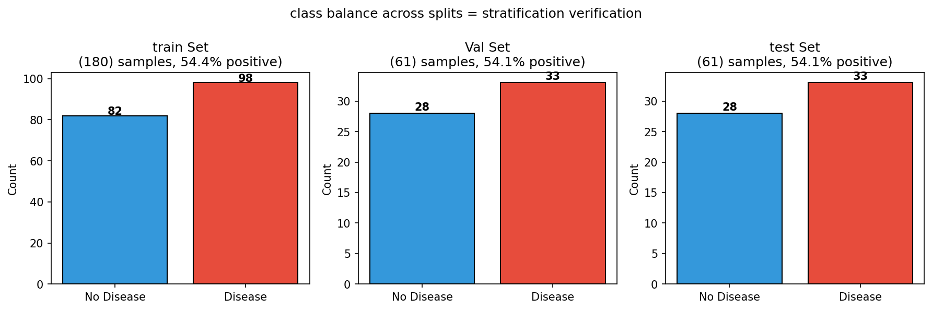
Engineering decisions that matter
1
Leakage prevention
Class balance preserved across splits
I split the data before any preprocessing or feature engineering, so validation and test sets never influence the transforms learned on training data.
2
Generalization gap analysis
Stratified split keeps the disease / no-disease ratio consistent in train, validation, and test.
Every model was checked with cross-validation AND held-out test performance. Random Forest showed the widest gap (0.063) — a sign of overfitting.
Notes:
~40s. Two decisions I'm proud of. Leakage prevention — split first so test data never leaks into the transforms. Generalization gap — I check CV vs test; Random Forest's wider 0.063 gap flagged overfitting. The figure shows class balance held across splits.

Slide 6
Domain-inspired feature engineering
Engineered features from clinical reasoning — then validated they actually added signal
Ischemia Score
Est. Stroke Volume
oldpeak + exang + (ca / 3)
(trestbps / thalach) × (age / 50)
Combines several indicators of cardiac stress into one composite signal.
A proxy for cardiovascular efficiency under stress.
Validated four ways
✓
Correlation with target
✓
Multicollinearity check
✓
Ablation tests
Both engineered features ranked in the top three predictors by SHAP — confirming the strategy paid off.
Notes:
~35s. I engineered two clinical features: an ischemia score and a stroke-volume proxy. Crucially I didn't just add them — I validated with correlation, VIF, multicollinearity, and ablation. Tease: they ended up in the top predictors.

Slide 7
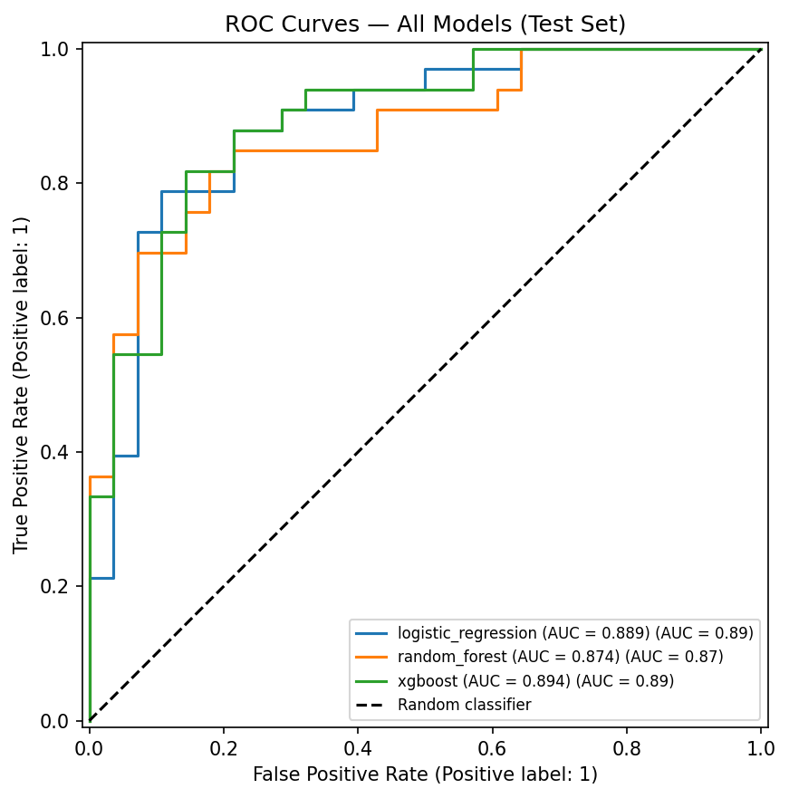
Results
XGBoost selected — best ROC-AUC with a healthy generalization gap
Model | Acc | ROC-AUC | Recall | CV Gap
XGBoost ★ | 81.97% | 0.894 | 0.788 | 0.050
Logistic Regression | 81.97% | 0.889 | 0.788 | 0.045
Random Forest | 81.97% | 0.875 | 0.818 | 0.063
0.894
ROC-AUC
78.8%
Recall (26/33 caught)
0.050
CV → test gap
ROC curves — all models
Caught 26 of 33 disease cases. The 7 missed (false negatives) remain the key limitation in a screening setting.
Notes:
~40s. Results. XGBoost won — best ROC-AUC 0.894 with a healthy 0.050 gap. Recall 78.8%: caught 26 of 33 disease cases. Be honest about the 7 missed — that's the real-world limitation in screening.

Slide 8
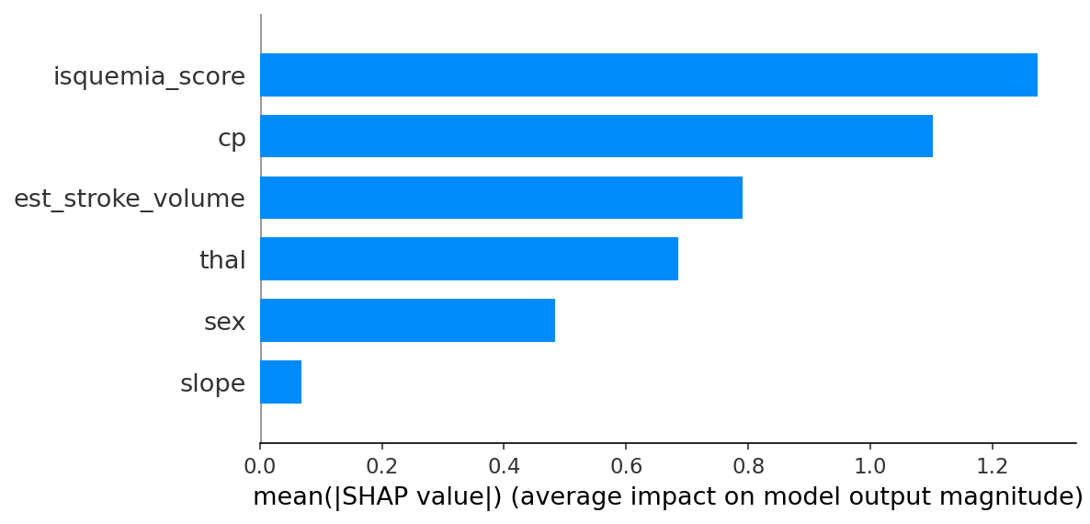
Explainable, not a black box
SHAP shows which features drive each prediction and the engineered ones earned their place
SHAP feature importance
Top drivers (by mean |SHAP|)
1
isquemia_score
engineered
2
cp
Chest pain type
3
est_stroke_volume
engineered
4
thal
Thalassemia
5
sex
Biological sex
6
slope
ST segment
Two engineered features landed in the top three.
Notes:
~30s. Explainability. SHAP shows what drives predictions. Payoff moment: my engineered ischemia_score is the single strongest driver and est_stroke_volume is also top-three — proof the feature engineering added genuine signal, not noise. Chest pain type (cp) follows close behind.

Slide 9
How I grew building this
1
Thinking like an ML engineer
2
Measuring what truly matters
Learned to design for leakage prevention, reproducibility, and a clean split between exploration and production code.
Moved beyond accuracy to recall, ROC-AUC, and generalization-gap analysis, metrics that fit the real problem.
3
Making models accountable
Adopted SHAP to explain predictions and to validate that my engineered features added genuine signal.
Notes:
~40s. The growth story — the heart of the talk. I went from code-that-runs to engineering models I can trust: thinking about leakage and reproducibility, measuring what matters, making models accountable with SHAP, and communicating limitations honestly.

Slide 10
Where it goes next
Limitations
Next steps
Small dataset — not clinically deployable
Create a UI
Limited demographic information
Evaluate SHAP results
False negatives still a concern
FastAPI endpoint
UV package management
Thank you · Jhoselyn Pajuelo
Notes:
~30s. Close. State limitations plainly (small data, not deployable). Then the roadmap: Optuna, calibration, FastAPI, Docker, CI/CD. End on the mission line: build technology that helps people — reliably and explainably. Thank you.

