Slide 1
Let’s build our own PyTorch
from scratch!
a
b
Let’s see how deep learning actually works under the hood!
×
calculus → graph → backprop → neural network
L
Adam Dendek
14.10.2026
01

Slide 2
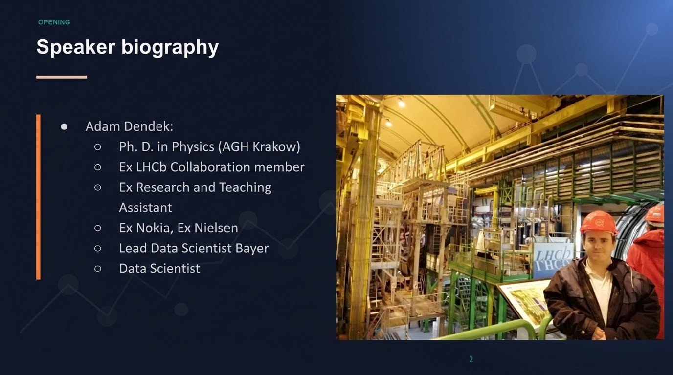

Slide 3
OPENING
Today's journey
01
02
03
04
05
06
Motivation
Forward graph
Backward pass (scalar)
Backward Pass Tensors
Neural nets
Beyond
Goal: understand the mechanism — not just the API.

Slide 4

opening
CODE TOUR
Project repository
The lecture is supported by the utorch repo
https://github.com/adendek/utorch
Each branch isolates one conceptual leap:
  feat/01-initial-repo-structure: Clean build system and environment sanity.
  feat/02-forward-graphs: Dynamic tape recording without gradients.
  feat/03-scalar-autograd: Reverse-mode chain rule on single numbers.
  feat/04-tensor-autograd: Matrix calculus, VJPs, and dimensional alignment.
  feat/05-nn-framework: Object-oriented building blocks and training loops.
  main: The integrated reference build.
Each branch builds strictly on the previous one.
Checkout the branch to follow the lecture live.
Documentaiont page: https://adendek.github.io/utorch/
Notes:
"Each branch builds strictly on the previous one. Checkout the branch to follow the lecture live."

Slide 5


Mootivation
Consider two papers from two different eras.
1997
2023
Long Short-Term Memory
Attention is all you need
Hochreiter & Schmidhuber
Pages 24–29 filled with grueling manual derivative algebra. Every gradient derived and wired by hand.
2017 / 2023: Attention & Transformers
Vaswani et al.
Zero pages of manual calculus derivations.
The entire backward pass is delegated to the autograd engine.

Slide 6
MOTIVATION
What changed?
Before
Now
• Derive local gradients
• Wire dependencies
• Propagate gradients
• Debug the bookkeeping
• Write the forward computation
• Call `backward()`
• Receive gradients
Autograd automates the repetitive application of the chain rule.

Slide 7

Let’s move to the branch: feat/02-forward-graphs

Slide 8
FORWARD PASS
Start with ordinary Python
PYTHON
Python remembers the value of d.
It does not remember how d was produced.
a = 2
b = 3
c = a*b
d = c+a
d
# print 8
For autograd, the history matters.
Side Quest: Is python interpreter or compiled languge?

Slide 9
FORWARD PASS
We Need a Smarter Number: (Tensor)
a = Tensor(2)
b = Tensor(3)
c = a * b
# c stores: parents=[a, b], op='mul’, value =6
Anatomy of an Autograd Node
1. data: numerical value (scalar or array)
2. parents: ancestors that produced this node
3. operation: which primitive ran (+, *, matmul)
4. gradient: sensitivity arriving from loss
Tensor
value
gradient
parents
operation

Slide 10
FORWARD PASS
Operator Overloading: The Magic Interception
The Two Jobs of Forward:
1. Compute numeric value:
c = a * b = 6
2. Record dependency graph: parents=[a, b], op='mul'
Expression | Dunder Method
c = a * b | a.__mul__(b)
c = a + b | a.__add__(b)
c = a @ b | a.__matmul__(b)
Tensor
value
gradient
parents
operation

Slide 11
FORWARD PASS
LIVE DEMO
The graph is a DAG
a
b
d
Directed + acyclic + shared dependencies
×
+
×2
A node can feed multiple downstream operations.
c

Slide 12
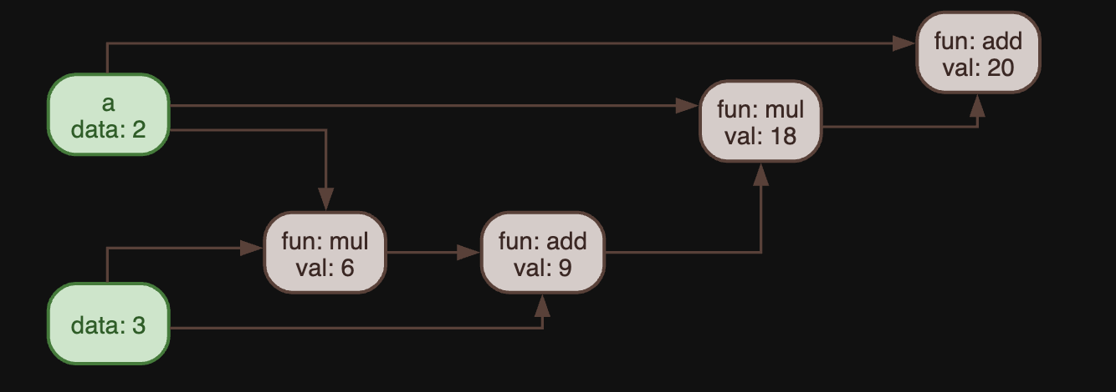


FORWARD PASS
LIVE CODE
Visualize the graph
draw_graph(c)
LIVE DEMO

Slide 13
Let’s move to the branch: feat/03-scalar-autograd

Slide 14

BACKWARD PASS
Forward vs. backward
Forward: “what is the value?”
Backward: “how sensitive is the loss?”
FORWARD
inputs
operations
loss
BACKWARD
gradients
operations
inputs
Calculus review
23

Slide 15
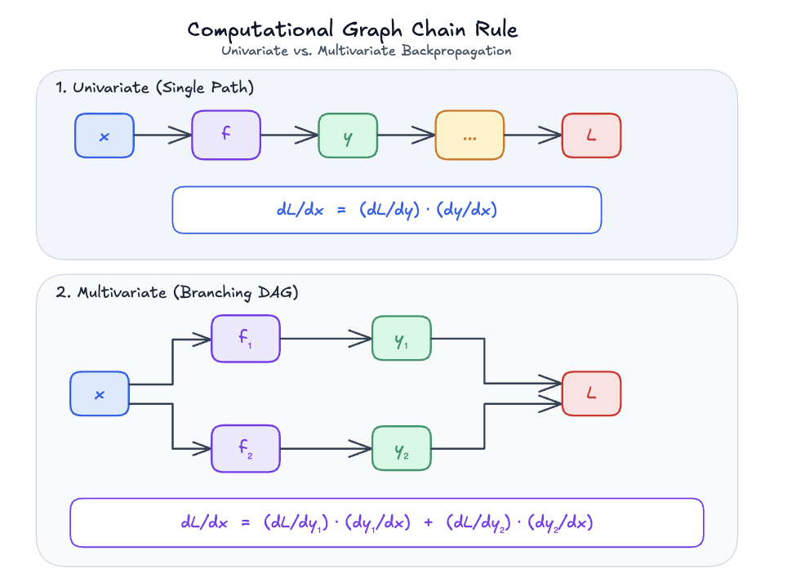
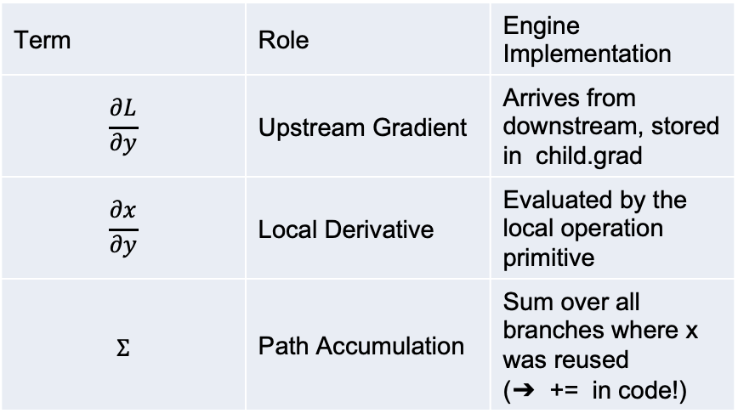
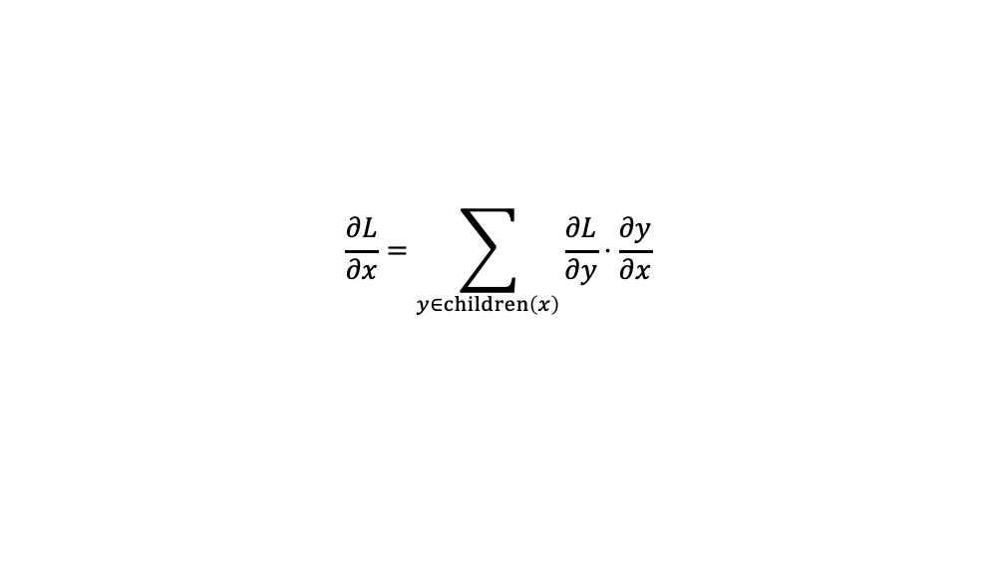
BACKWARD PASS
The Multivariate Chain Rule
How gradients flow from multiple downstream children back to a variable
$$\begin{matrix}\frac{∂L}{∂x}=\sum_{y∈children\left(x\right)}{\frac{∂L}{∂y}}⋅\frac{∂y}{∂x}\end{matrix}$$
Term | Role | Engine Implementation
$$\begin{matrix}\frac{∂L}{∂y}\end{matrix}$$ | Upstream Gradient | Arrives from downstream, stored in child.grad
$$\begin{matrix}\frac{∂x}{∂y}\end{matrix}$$ | Local Derivative | Evaluated by the local operation primitive
$$\begin{matrix}Σ\end{matrix}$$ | Path Accumulation | Sum over all branches where x was reused (➔ += in code!)
Every backpropagation step reduces to three simple actions: Receive upstream gradient → multiply by local derivative → accumulate (+=) across all downstream paths.

Slide 16

BACKWARD PASS
Start at the loss
L = f(x)
$$\begin{matrix}\frac{∂L}{∂L}=1\end{matrix}$$
Seed the backward pass with 1.
24

Slide 17
BACKWARD PASS
Local derivative rules
primitive
local derivative(s)
add
1 , 1
subtract
1 , −1
The engine is generic; primitives provide the calculus.
multiply
b , a
divide
1/b , −a/b²
exp
exp(x)
sin
cos(x)
cos
−sin(x)

Slide 18
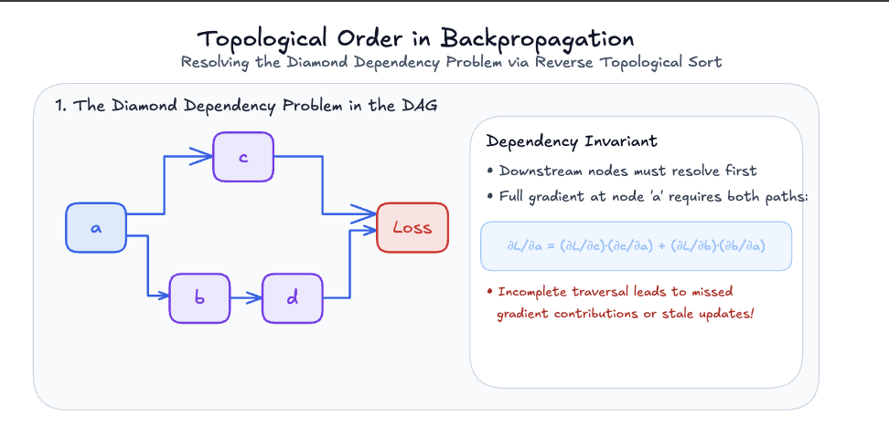
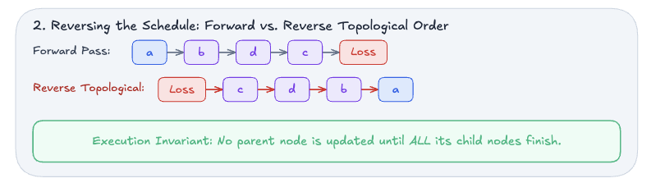
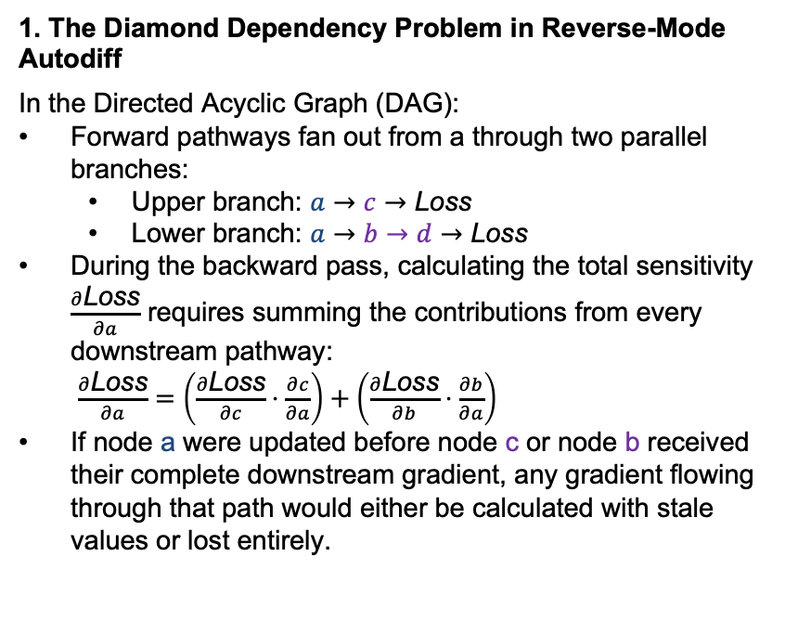
BACKWARD PASS
Topological order
1. The Diamond Dependency Problem in Reverse-Mode Autodiff
In the Directed Acyclic Graph (DAG):
Forward pathways fan out from a through two parallel branches:
  Upper branch: $a→c→\text{Loss}$
  Lower branch: $a→b→d→\text{Loss}$
During the backward pass, calculating the total sensitivity $\frac{∂\text{Loss}}{∂a}$ requires summing the contributions from every downstream pathway:
$\frac{∂\text{Loss}}{∂a}=\left(\frac{∂\text{Loss}}{∂c}⋅\frac{∂c}{∂a}\right)+\left(\frac{∂\text{Loss}}{∂b}⋅\frac{∂b}{∂a}\right)$
If node a were updated before node c or node b received their complete downstream gradient, any gradient flowing through that path would either be calculated with stale values or lost entirely.
29

Slide 19

BACKWARD PASS
The autograd engine
def backward(self):
nodes = topological_sort(self)
self.grad = ones_like(self.value)
for node in reversed(nodes):
# apply the primitive's local rule
# add contributions to parents
Graph traversal is generic.
Derivative rules are operation-specific.
Look for these ideas in the real implementation.
https://github.com/adendek/utorch/blob/feat/03-scalar-autograd/utorch/autograd/tensor.py#L389
31

Slide 20
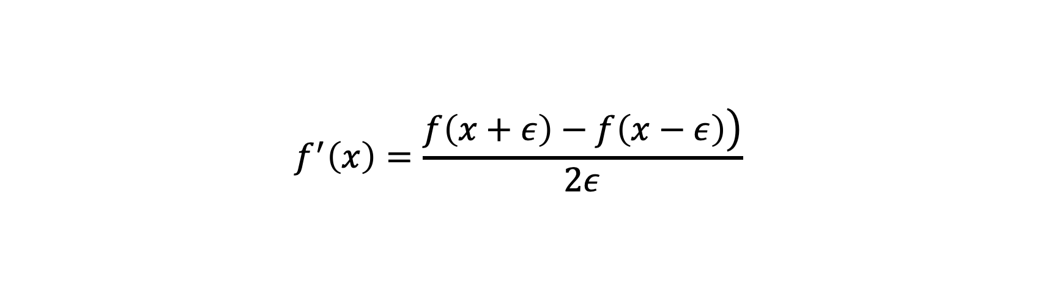
TESTING
Numerical gradient checking
$$\begin{matrix}f^{′}\left(x\right)=\frac{\left.f\left(x+ε\right)−f\left(x−ε\right)\right)}{2ε}\end{matrix}$$
Finite differences
useful for debugging
expensive for large models
Autograd gradient ≈ finite-difference gradient
38

Slide 21

Let’s move to the branch: feat/04-tensor-autograd
02

Slide 22
TENSORS
Our Engine Has a Problem: No Matrix Multpilication Primitive
Why neural networks break our scalar autograd engine
The Scalar Engine Limitation
So far, our PRIMITIVES dictionary only knows elementwise operations:
add, sub, mul, div, pow, sin, exp, relu
In scalar multiplication, d/da(a * b) = b . What is the derivative of a matrix with respect to another matrix?
Deep Learning Reality
Real deep learning is built on dense linear projections:
Y = X @ W + b
Without a primitive rule for @ (matmul) , our autograd engine crashes.
44

Slide 23

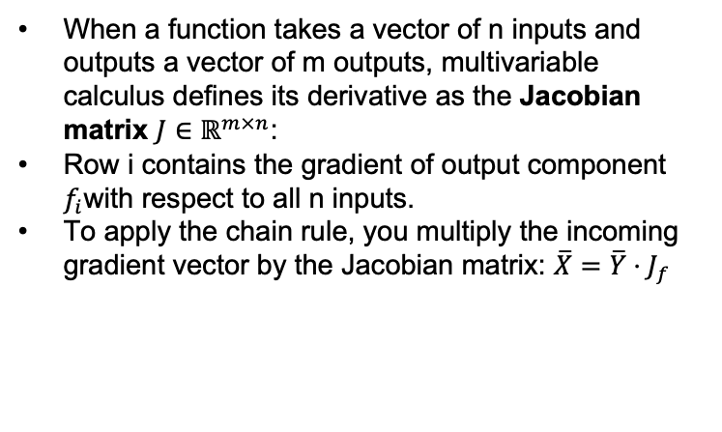

TENSORS: CALCULAUS THEORY
The Textbook Answer: The Jacobian Matrix
Multi-variable vector-to-vector mappings: f: ℝⁿ ➔ ℝᵐ
$$\begin{matrix}J=\left[\begin{matrix}\frac{∂f_{1}}{∂x_{1}} & \frac{∂f_{1}}{∂x_{2}} & ⋯ & \frac{∂f_{1}}{∂x_{n}} \\ \frac{∂f_{2}}{∂x_{1}} & \frac{∂f_{2}}{∂x_{2}} & ⋯ & \frac{∂f_{2}}{∂x_{n}} \\ ⋮ & ⋮ & ⋱ & ⋮ \\ \frac{∂f_{m}}{∂x_{1}} & \frac{∂f_{m}}{∂x_{2}} & ⋯ & \frac{∂f_{m}}{∂x_{n}}\end{matrix}\right]\end{matrix}$$
When a function takes a vector of n inputs and outputs a vector of m outputs, multivariable calculus defines its derivative as the Jacobian matrix $J∈ℝ^{m×n}$:
Row i contains the gradient of output component $f_{i}$with respect to all n inputs.
To apply the chain rule, you multiply the incoming gradient vector by the Jacobian matrix: $\overline{X}=\overline{Y}⋅J_{f}$
https://mml-book.github.io/book/mml-book.pdf Pages 149-158

Slide 24
TENSORS: THE REALITY CHECK
Why We CANNOT Compute the Jacobian
The memory catastrophe of explicit matrix calculus
Modest Linear Layer
Consider a realistic, modest linear layer:
• Batch size B = 64 , features D = 1,024 ==> n = 65,536 input numbers.
• Batch size B = 64 , features H = 1,024 ==> m = 65,536 output numbers.
The Memory Catastrophe
Entries in J = 65,536 × 65,536:
≈ 4.29 × 10⁹ floating-point numbers!
Memory required (4.29 × 10⁹ × 4 bytes): ≈ 17.2 Gigabytes of RAM for ONE layer, ONE mini-batch!
Calculating the full Jacobian is mathematically possible, but computationally expensive. We must find a shortcut.

Slide 25
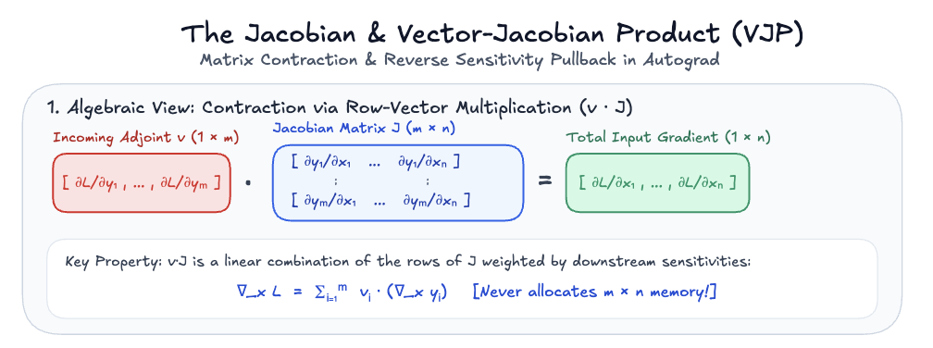
TENSORS: THE REALITY CHECK
We Don't Want the Matrix - We Want the Product!
The VJP Collapse
In deep learning, we never need the standalone Jacobian J .
We only ever need the product of the incoming loss gradient Ȳ with J : X̄ = Ȳ · J

Slide 26
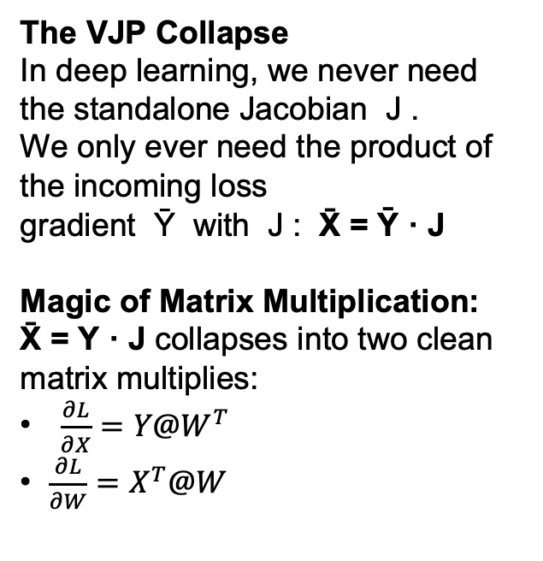
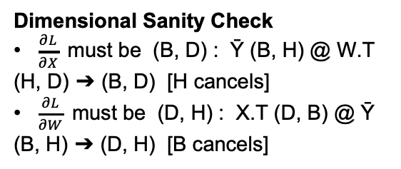
TENSORS: THE REALITY CHECK
We Don't Want the Matrix - We Want the Product!
The VJP Collapse
In deep learning, we never need the standalone Jacobian J .
We only ever need the product of the incoming loss gradient Ȳ with J : X̄ = Ȳ · J
Magic of Matrix Multiplication:
X̄ = Y · J collapses into two clean matrix multiplies:
$\begin{matrix}\frac{∂L}{∂X}=Y@W^{T}\end{matrix}$
• $\begin{matrix}\frac{∂L}{∂W}=X^{T}@W\end{matrix}$
Dimensional Sanity Check
• $\frac{∂L}{∂X}$must be (B, D) : Ȳ (B, H) @ W.T (H, D) ➔ (B, D) [H cancels]
• $\frac{∂L}{∂W}$must be (D, H) : X.T (D, B) @ Ȳ (B, H) ➔ (D, H) [B cancels]
Autograd Primitive Rule
"matmul": lambda grad, left, right, args: (grad @ right.T, left.T @ grad)

Slide 27
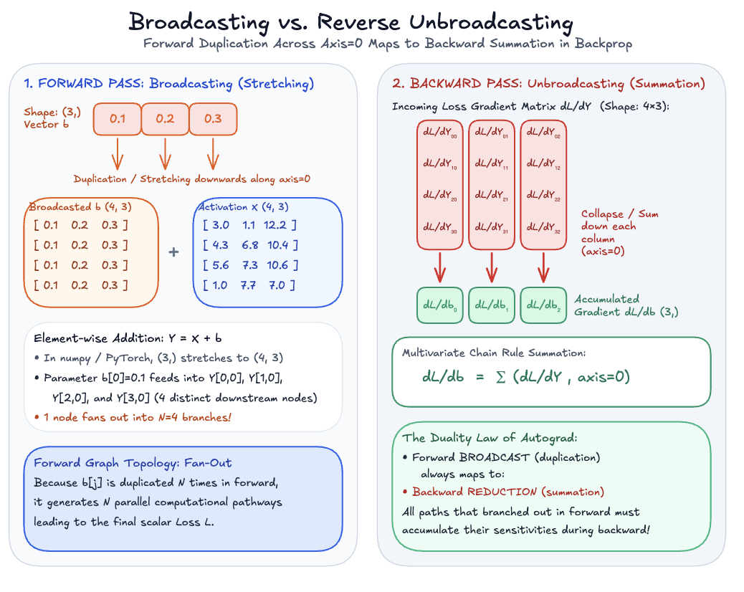

Slide 28
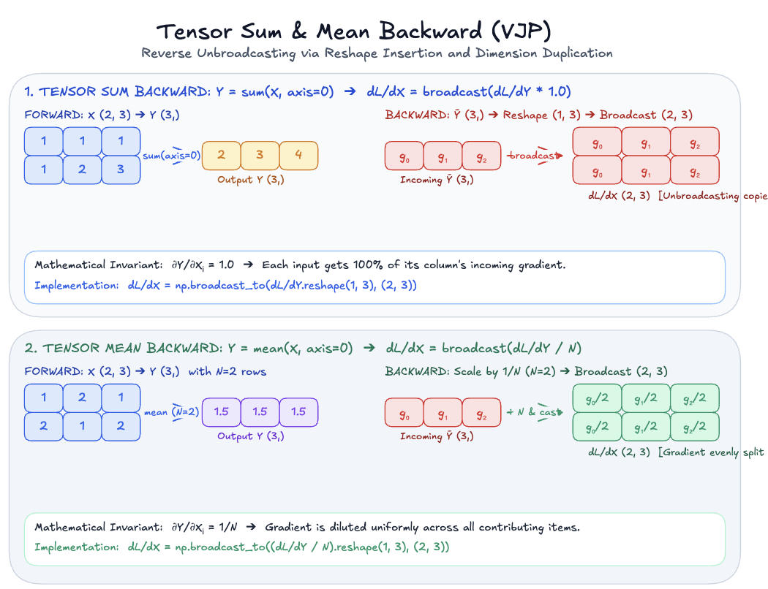

LIVE DEMO

Slide 29
Let’s move to the final branch: feat/05-nn-framework or main
02

Slide 30

[NEURAL NETWORKS] [CORE ABSTRACTIONS]
From Raw Tensors to Composable Blocks
Why we need higher-level abstractions?
The Solution: 5 Clean Pillars
Parameter ➔ Module ➔ Loss ➔ Optimizer ➔ Dataset ➔ Dataloader
Parameter: Distinguishes trainable weights from temporary activations.
Module: Encapsulates state, submodules, and forward logic.
Loss & Optimizer: Decouple objective evaluation and parameter update rules.
Dataset : Returns a single example
Dataloader: Combines dataset with sampler
The Scaling Bottleneck
What we have so far: Tensors, matrix multiplication ( @ ), and the backward() engine.
The Problem: Training a multi-layer network by manually managing loose arrays [W1, W2, W3] and [b1, b2, b3] , writing manual forward loops, and manually writing gradient descent steps is brittle and unscalable.
LIVE DEMO
Autograd provides the calculus.
The neural network framework provides the modular LEGO blocks to build architectures.

Slide 31
FUTURE?
What do we still missing?
More layers (Conv, attention)
Linear algebra taken for free (numpy)
Compiler
No hardware acceleration (CuDA)
Tensor Parallel
….

Slide 32
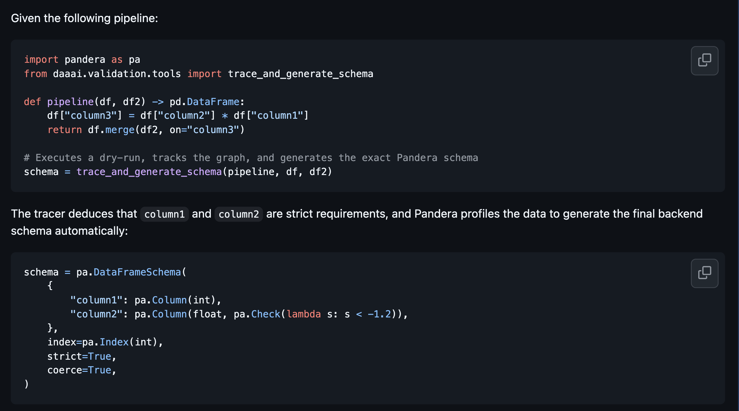
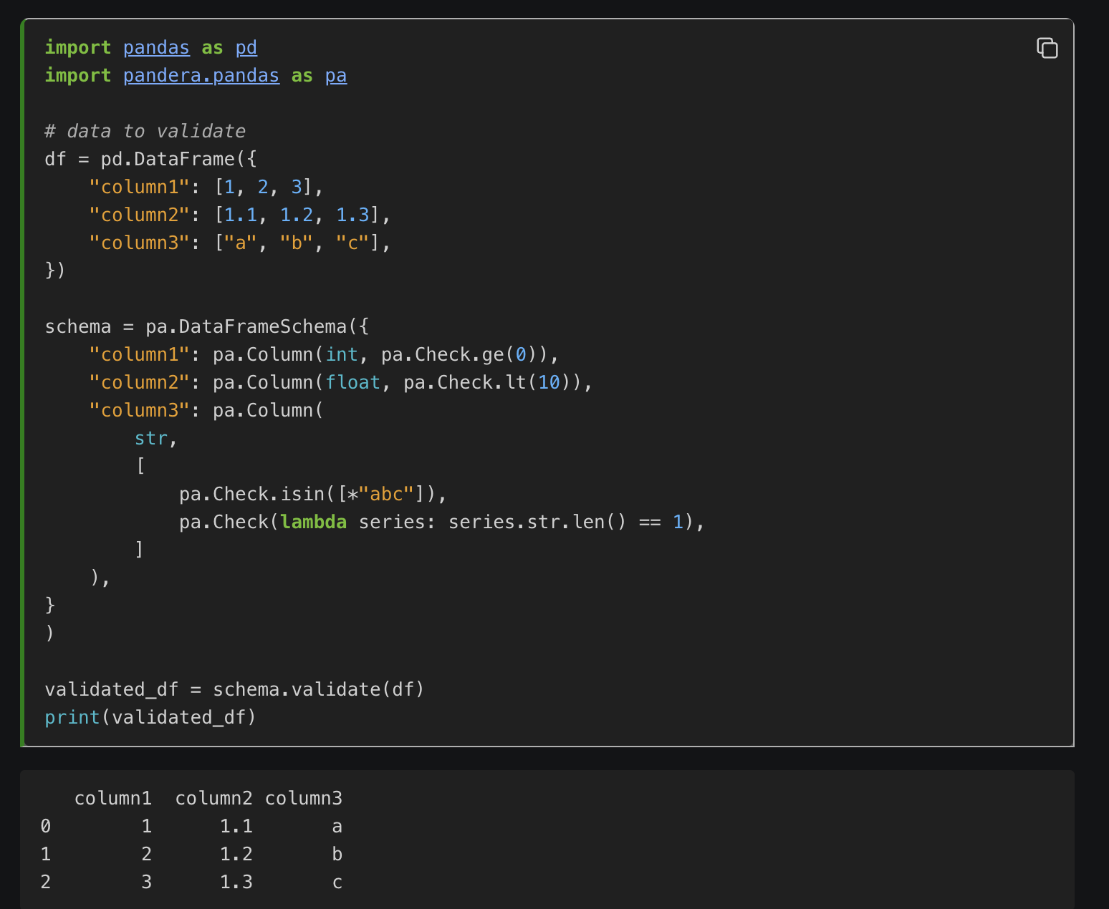
FUTURE?
Do you enjoy building computational graphs?
Idea for a thesis:
Auto generation of pandera validation rules based on the analysis of the graph.

Slide 33

CLOSING
$$\begin{matrix}\frac{softmax\left(Q@K^{T}\right)}{\sqrt{\left(d_{k}\right)}}@V\end{matrix}$$
Thank you for your

Slide 34
CLOSING
Feedback
Your Feedback is always welcome!!
tinyurl.com/mimuw-dnn-feedback
Anonymous, no login, three questions.

