Slide 1


Evaluating the Efficacy of Machine Learning Algorithms in Detecting DDoS Attacks Using the CIC-DDoS2019 Dataset
Group 2 :
Suchitra Kairi (212056)
Tahrima Arif Mim (220205)
Jessica Sen (220241)

Slide 2

Problem Definition & Motivation
DDoS Attacks Are Getting Worse, Faster
Financial platforms, healthcare portals, and government services are rendered unavailable [10], [12]
Signature/rule-based IDS cannot keep up with fast-evolving, multi-vector attacks; it only detects attack types it has seen before.
Why Machine Learning?
Adaptive, data-driven classification that can learn from data and detect new or previously unseen attack patterns, going beyond fixed attack signatures
Tree-based ensembles (DT, RF, XGBoost, LightGBM) show strong benchmark performance
But: most studies test one algorithm, skip feature selection, or never test generalization to new attack types
2

Slide 3


Objectives & Research Questions
OBJECTIVES
Data & Model Implementation
Select & Optimise
Generalise & Fine-Tune
Acquire & clean CIC-DDoS2019; implement DT, RF, XGBoost, LightGBM and compare accuracy, FPR, and training/inference time
Apply a feature selection process, Filter→Wrapper→Embedded pipeline; evaluate accuracy vs. training time, inference time & memory usage
Train the best classifier on known attacks, test on an unseen attack type, then fine-tune with 10–20% stratified target data
RESEARCH QUESTIONS
RQ1
How do Decision Tree, Random Forest, XGBoost, and LightGBM compare in accuracy, false-positive rate, training time, and computational overhead on CIC-DDoS2019?
RQ2
How does a three-stage (Filter → Wrapper → Embedded) feature selection pipeline affect detection accuracy and computational efficiency versus the full feature set?
RQ3
How well does the best classifier generalise to an unseen DDoS attack type, and how much does fine-tuning with a small amount of target data improve detection?
3

Slide 4




Literature Review and Research Gap
Limitations of Existing Approaches
Saluja et al. [1], Al-Eryani et al. [2]
Sakr et al. [6]
Cantone et al. [7]
Tree-based models achieve high accuracy, but no feature selection or evaluate efficiency metrics
Hybrid feature selection,filter+wrapper cut features 79→35, but never benchmarked cross-attack generalisation
Cross-dataset accuracy collapsed to near-random — and no fine-tuning was attempted to recover it
The Gap This Study Addresses
No single study combines all three:
(1) a 4-algorithm comparison,
(2) a structured 3-stage feature selection pipeline, and
(3) cross-attack-type generalisation with fine-tuning recovery.
4

Slide 5
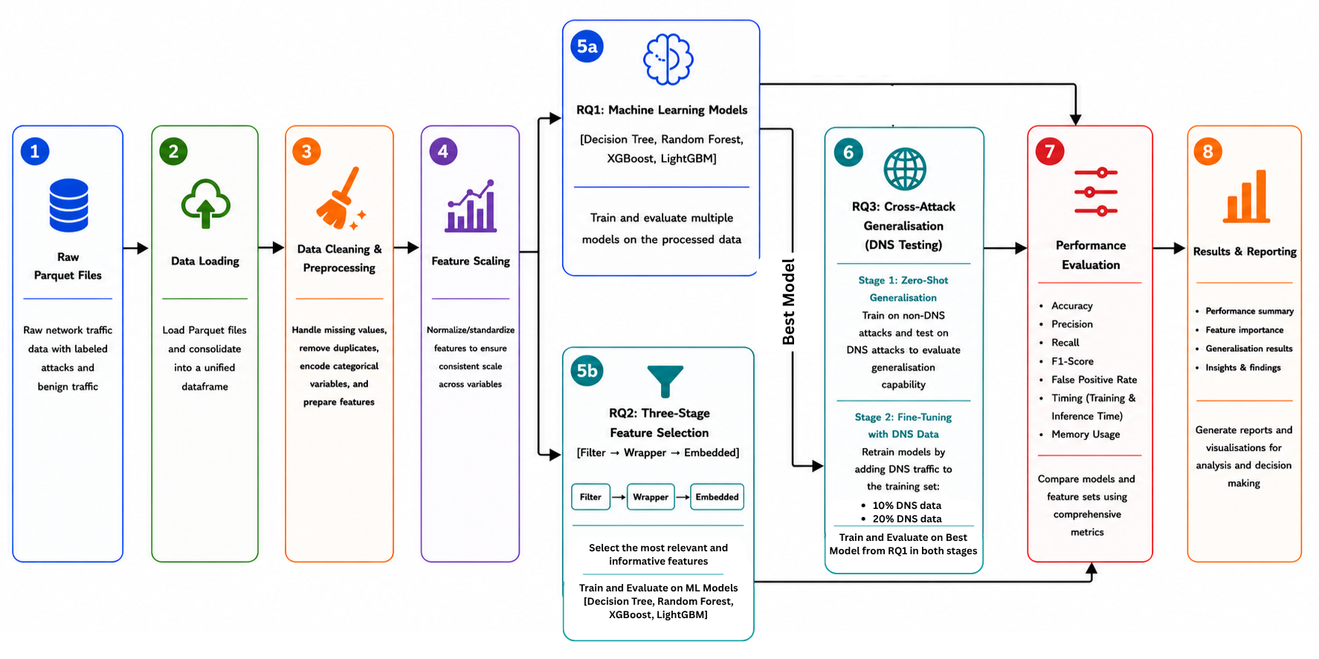
System Architecture
5

Slide 6

Methodology & Experimental Setup
Data Ingestion
Data Cleaning (inf/Nan, duplicates)
Label Preparation & Scaling
RQ1
Baseline Training
RQ2
Feature Selection and Retrain
RQ3
Zero-shot + Fine-tuning
1
2
3
4
5
6
Dataset
Environment
Key Settings
CIC-DDoS2019 (Kaggle) — LDAP, MSSQL, NetBIOS, Syn, UDP,
UDP-Lag (known) + DNS (held-out, unseen)
Google Colab
Python 3
scikit-learn, XGBoost, LightGBM, pandas, psutil, matplotlib
random_state=42 · 200 estimators (DT/RF/XGBoost/LightGBM)
77→40→25→15 features
10%/20% fine-tuning
6

Slide 7
Technical Implementation
One Reproducible Notebook, Three Experiments
Single Notebook
Shared Artefacts
Live Demonstration
Sectioned into Setup → Cleaning → RQ1 → RQ2 → RQ3, so every reported number traces to one cell
RQ2 reuses RQ1's fitted scaler & encoder; RQ3 fits its own since it's a disjoint binary task
Data loading, Data cleaning, model training, and evaluation end-to-end
Fine-tuning = full retrain, not incremental: each stage retrains the Decision Tree from scratch on the combined dataset (scikit-learn has no partial-fit for it) — still practical since only 10–20% new data was needed to recover performance.
Switch to Colab — live execution
7

Slide 8

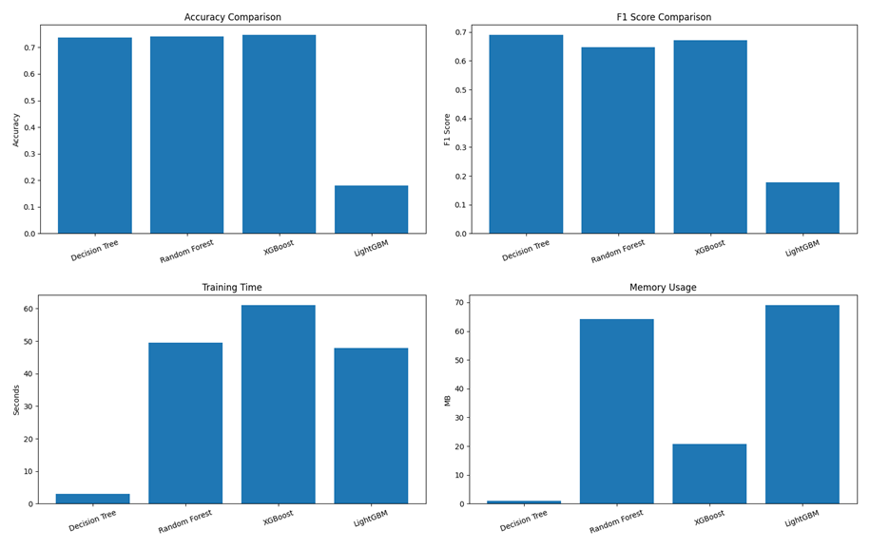
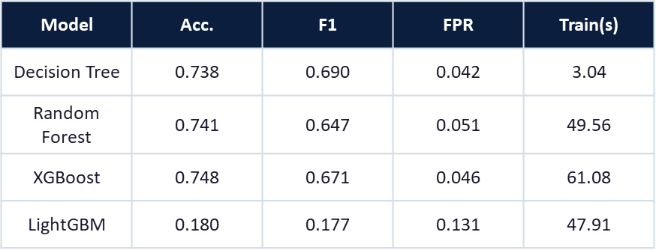


Results & Analysis — RQ1
Baseline Comparison: Four Classifiers, Full Feature Set
DT / RF / XGBoost cluster around 0.74 accuracy; DT is fastest with the lowest false-positive rate.
LightGBM underperforms sharply (0.18) under default settings
Fig. RQ1 — (a) accuracy, (b) F1, (c) training time, (d) memory across models
16–20×
faster training for Decision Tree vs. Random Forest / XGBoost — for 0.3–1.0 points less accuracy
8

Slide 9

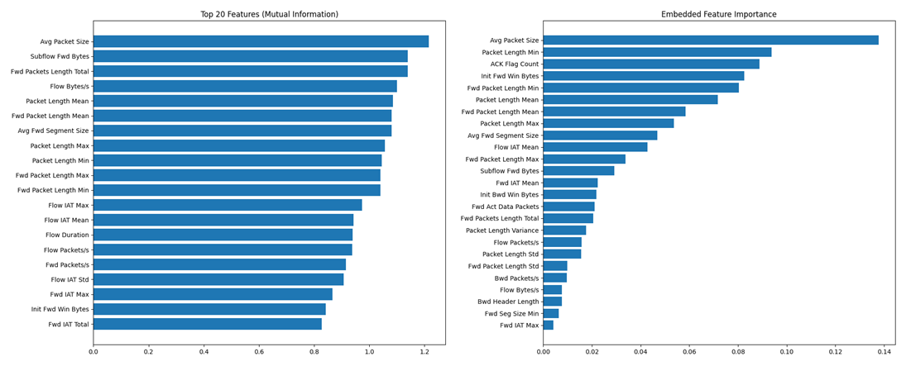

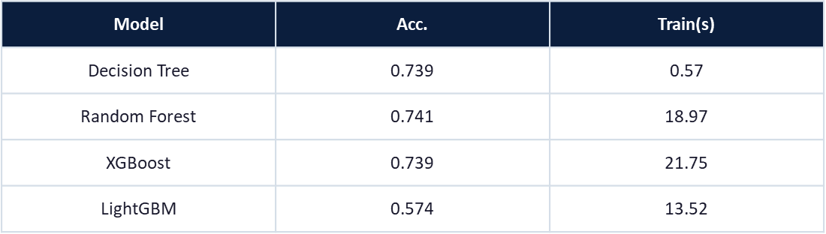
Results & Analysis — RQ2
Three-Stage Feature Selection: 77 → 15 Features
Filter → Wrapper → Embedded
77 → 40 → 25 → 15 features (81% reduction)
Accuracy
Essentially unchanged for DT/RF/XGBoost
Random Forest time
49.6s → 19.0s (–62%)
XGBoost time
61.1s → 21.7s (–64%)
LightGBM
0.180 → 0.574 accuracy
Why it matters?
Packet/window size fingerprints scripted flood tools — real users show natural variability, floods don't
9

Slide 10

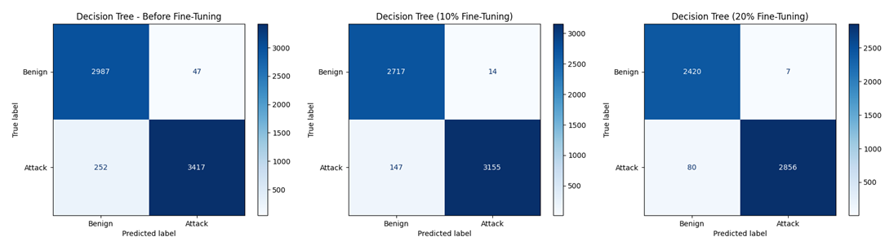
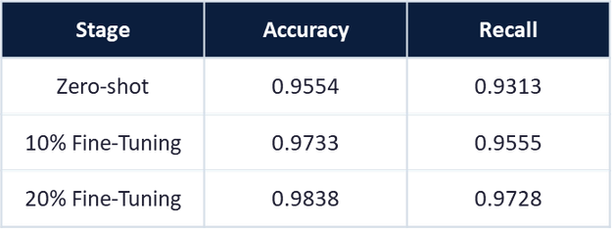


Results & Analysis — RQ3
Generalisation to an Unseen Attack & Fine-Tuning
95.5% accuracy zero-shot on a fully unseen DNS attack.
Confusion matrices — zero-shot → 10% → 20% fine-tuned (Decision Tree, held-out DNS traffic)
+3.95 pts
≥98.6%
Fine-tuning with just 20% of target data pushes accuracy to 98.4% without sacrificing precision.
Recall gained from zero-shot to 20% fine-tuning (93.1% → 97.3%)
Precision held throughout — the recall gain isn't bought with false alarms
10

Slide 11





Results & Analysis
Addressing the Research Questions
RQ1
DT, RF, and XGBoost perform comparably (~0.74 accuracy); DT offers the best speed/FPR trade-off. LightGBM needs tuning to compete — its leaf-wise growth struggles to find valid splits for minority classes in a high-dimensional, imbalanced space.
RQ2
An 81% feature reduction preserves accuracy while cutting training time by over 60%, because DDoS flow features are highly redundant — the retained features already captured what the models were actually using. Confirms and extends Sakr et al.'s [6] finding.
RQ3
The classifier generalises well zero-shot (95.5%) and improves further with fine-tuning — directly countering Cantone et al.'s [7] near-random collapse, and meaning defenders could realistically respond to a new attack within hours, not after collecting a whole new dataset.
11

Slide 12
Limitations & Future Work
What Limits This Study
Where This Goes Next
LightGBM underperformance
Binary framing for RQ3
Single-model fine-tuning
Dataset scale
Tune LightGBM
Multi-Class Generalisation
Extend Fine-Tuning
Expand the Dataset
18.0% → 57.4% after feature selection; further tuning needed (class weight, num_leaves)
class_weight, min_child_samples, num_leaves to close the accuracy gap
Tests “is this malicious?”, not full DNS-attack sub type identification
Test full attack-sub-type identification, not just binary Benign/Attack
Only Decision Tree fine-tuned so far, to keep the experiment tractable
Repeat the RQ3 fine-tuning experiment for RF, XGBoost, and LightGBM
Some attack types (NTP, SNMP, SSDP…) lacked complete train/test files and were excluded
Incorporate NTP, SNMP, SSDP and other attack types as data becomes available
12

Slide 13
Conclusion
Decision Tree, Random Forest, and XGBoost achieved similar detection accuracy of around 74%, while LightGBM required further tuning to improve its performance.
The three-stage feature selection pipeline reduced the number of features from 77 to 15—an 81% reduction—while maintaining accuracy and reducing training time by up to 64%.
Finally, the best-performing model successfully detected a previously unseen DNS attack with 95.5% zero-shot accuracy, which improved to 98.4% after fine-tuning using only 20% of the new attack data.
13

Slide 14


Our
We
14

Slide 15
References
[1] K. Saluja et al., “Exploring Robust DDoS Detection: A Machine Learning Analysis with the CICDDoS2019 Dataset,” Proc. 2024 IEEE 5th India Council Int’l Subsections Conf. (INDISCON), 2024, pp. 1–6.
[2] A. M. Al-Eryani, E. Hossny, and F. A. Omara, “Efficient Machine Learning Algorithms for DDoS Attack Detection,” Proc. 2024 6th Int’l Conf. on Computing and Informatics (ICCI), 2024, pp. 174–181.
[6] N. H. Sakr, A. Hikal, et al., “A Hybrid Approach for Efficient Feature Selection in Anomaly Intrusion Detection for IoT Networks,” The J. of Supercomputing, vol. 80, pp. 26942–26984, 2024.
[7] M. Cantone, C. Marrocco, and A. Bria, “Machine Learning in Network Intrusion Detection: A Cross-Dataset Generalization Study,” IEEE Access, vol. 12, pp. 144489–144510, 2024.
[10] T. F. Deressu, A. M. Beyene, and A. Y. Gemechu, “A Survey of Application Layer Distributed Denial of Service Detection: Approaches, Models, and Datasets,” Artificial Intelligence Review, Springer, vol. 59, no. 6, 2026.
[12] B. Bouyeddou et al., “A Systematic Literature Review on the Accuracy of Machine Learning-Based DDoS Detection Techniques in Software Defined Networking,” Information Retrieval Journal, Springer, 2026.
15

