Slide 1


International University of Business Agriculture and Technology
DEVELOPING THE NETWORK SYSTEM AND LOAD BALANCING FOR RADIAL INTERNATIONAL LTD.
Prepared for
Practicum Board of IUBAT
Prepared by
Jannatul Ferdus Mim
ID: 15103117
Program: BCSE
Supervised by
Dr. Hasibur Rashid Chayon
Assistant Professor
Dept. of CSE

Slide 2
CONTENTS
Introduction
Objectives
Company Overview
Existing network of RADIAL INTERNATIONAL LTD.
Proposed network
Comparison
Conclusion

Slide 3
INTRODUCTION

Slide 4
Specific objectives
Redesigning the Network System.
Dynamic IP allocation.
Redundancy implementation.
Load Balancing.

Slide 5
COMPANY OVERVIEW

Slide 6
RADIAL INTERNATIONAL LTD.
A Garment Manufacturer Company.
Established in 1991.
Composite knitwear company with knitting, dyeing, cutting, sewing and finishing.
Oekotex certified company.

Slide 7
EXISTING NETWORK

Slide 8
Branch Offices:
Gazipur Branch Office (Concern Office).
Baridhara Main Office.

Slide 9
Three−tier (three layer) Hierarchical Network Model

Slide 10
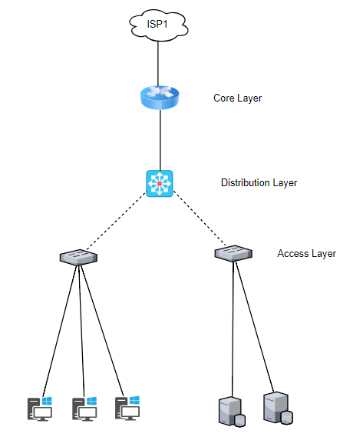

Slide 11
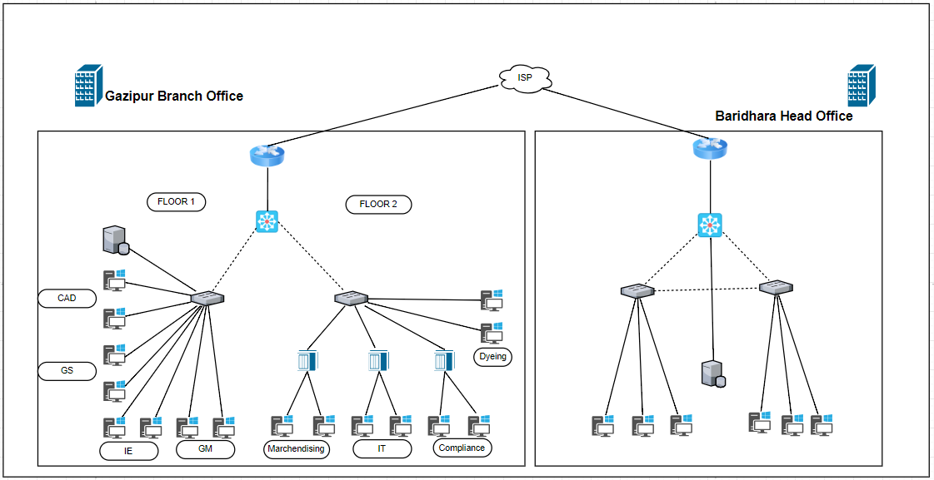

Slide 12
Departments in Existing System
General Manager (GM).
CAD Department.
Garments Store (GS) Department.
Industrial Engineering Department (IE).
Information Technology (IT) Department.
Dyeing Department
Marchendising Department.
Compliance Department.

Slide 13
Communication Structure between Departments

Slide 14
Leased Line

Slide 15
Limitation of Existing Network
Use of old devices
No backup path for instant solution.
No load balancing method.
No separation of different departments.
No dynamic IP allocation system.

Slide 16
PROPOSED NETWORK

Slide 17
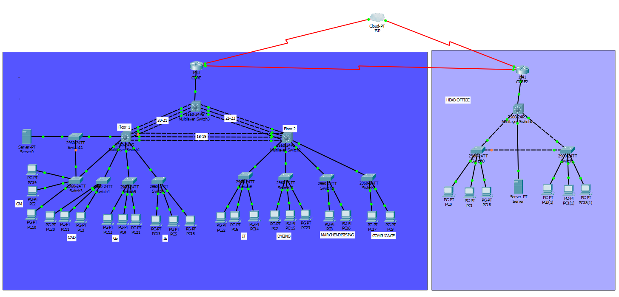

Slide 18
Redesigning the Network System.
Replacing the network device HUB with Cisco catalyst switches.
Separating the departments from each other.
Providing switches for individual department.
Controlling access.
Configuration: VLAN, Inter VLAN, Access Control List.

Slide 19
Dynamic IP Allocation.
Separate IP series for different departments.
Automatic Private IP Addressing (APIPA) feature.
Automatic IP configuration.
Dynamic IP allocation.
Configuration: Dynamic Host Configuration Protocol.

Slide 20
Redundancy Implementation.
In place of one multi-switch total three multi-switches are used.
Multiple paths are configured as a single group channel.
Providing backup path for the server.
Configuration: STP (Spanning tree protocol), Ether-Channel.

Slide 21
Load Balancing
By providing multiple links between multilayer switches the data transmission load between department has been balanced.
Fast data transmission
Configuration: Ether-Channel

Slide 22
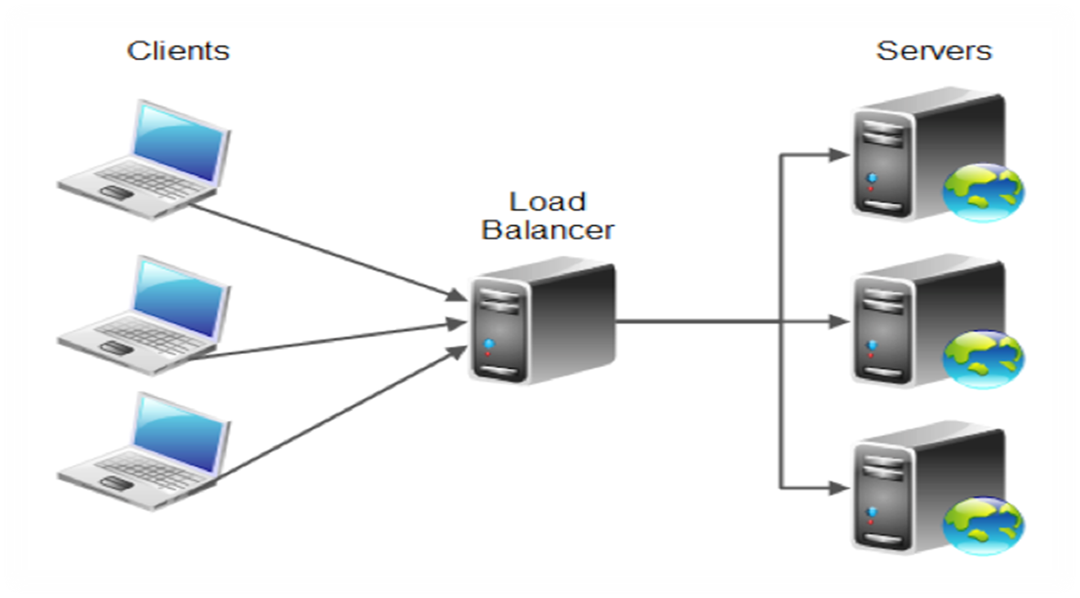
Load Balancing Features with SNAT (Secure NAT) with the Help of Load Balancer

Slide 23
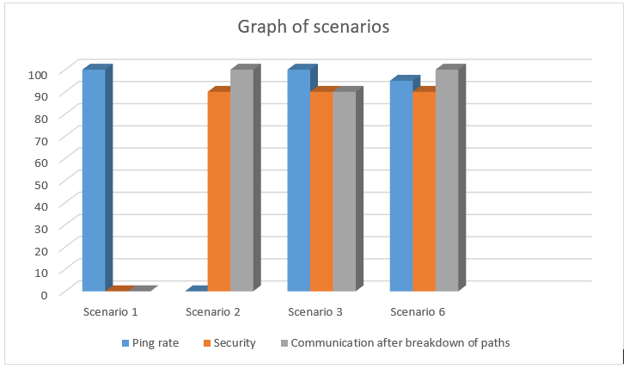
COMPARISON

Slide 24
Significance of Proposed Network
Dividing the departments by redesigning the network system.
Controlling the access permission.
Providing dynamic IP configuration.
Providing redundant path to make the communication faster.
Load balancing of data transmission between the departments.

Slide 25
DEMONSTRATION

Slide 26
CONCLUSION

Slide 27


