Slide 1
REVOLUTIONILIZING MENTAL HEALTH SUPPORT: THE ROLE OF CHATBOT TECHNOLOGY

Slide 2
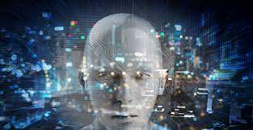
INTRODUCTION
Welcome to the presentation on Revolutionizing Metal health support:
The role of chatbot technology. Today we will explore how chatbots are transforming The way we provide mental health support. We will discuss their benefits ,Challenges, and future potential. Lets dive in!

Slide 3

UNDERSTANDING MENTAL HEALTH CHALLENGES
Mental health challenges affect
Millions worldwide. Depression,
Anxiety, and stress are prevalent. However, access to support remains limited. Chatbot technology offers a promising solution to bridge this gap. With their 24/7 availability, anonymity, and personalized assistance, chatbots Can provide immediate support to Those in need.

Slide 4

THE POWER OF CHATBOT TECHNOLOGY
Chatbots utilize natural
language processing and
machine learning to
understand and respond to
user queries.They can offer
Empathetic guidance, coping
Strategies, and even crisis
Intervention.Additioally,
Chatbots can collect valuable
Data for research and improve
Mental health services.Their
Potential to reach a wider
Audience and reduce stigma is
Truly revolutionary.

Slide 5
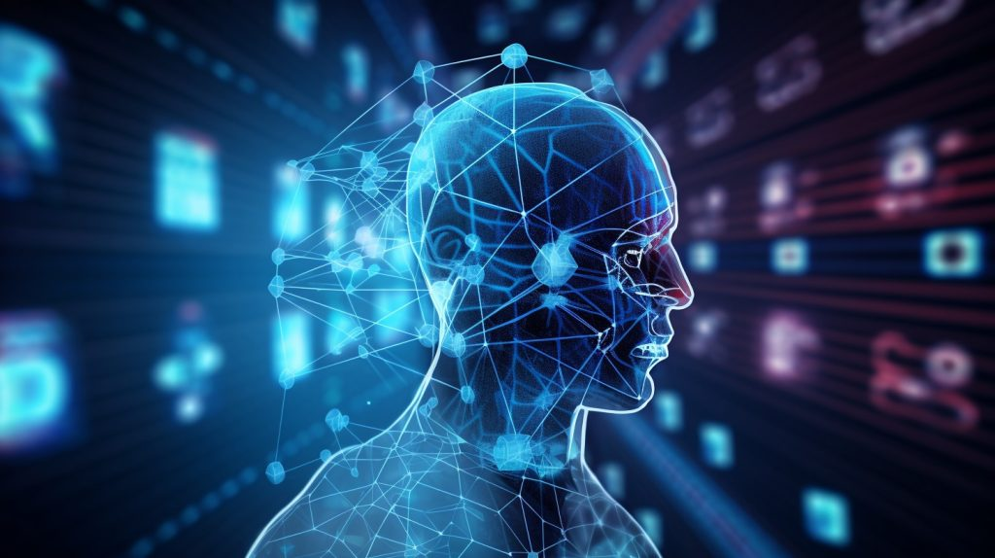
FUTURE IMPLICATIONS AND CHALLENGES
The future of chatbot technology in mental health support is promising. However, challenges exist. Ethical considerations, privacy concerns, and the need for continuous improvement in accuracy and empathy are important areas to address. By overcoming these challenges, chatbots can play a pivotal role in revolutionizing mental health support for a better future.

Slide 6
CONCLUSION
In conclusion, chatbot technology has the power to revolutionize mental health support. By providing accessible, personalized, and stigma-free assistance, chatbots can address the growing demand for mental health services. However, it is crucial to navigate the challenges and ensure ethical implementation. Let's embrace this transformative technology to create a future where mental health support is readily available to all.

Slide 7
THANKS

