Slide 1
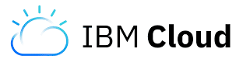






Cloud
Functions
8
2
PDA Server
Streaming Analytics
1
Event Streams
6
7
6
5
3
Kafka Connect Weather Connector
4

