Slide 1
Music Genre Classification from Audio Features
Mudassir Imam
Juan Leonhardt
Yu Wang

Slide 2

Introduction
This project aimed to explore the effectiveness of machine learning models in predicting music genres from audio features extracted from Spotify tracks. By leveraging a comprehensive dataset of 114,000 tracks spanning 114 genres, collected and cleaned from the Spotify API, we investigate the following research questions:
How well can audio features from the Spotify data predict a track's genre?
Are there specific genres that are more accurately classified by machine learning models compared to others?

Slide 3
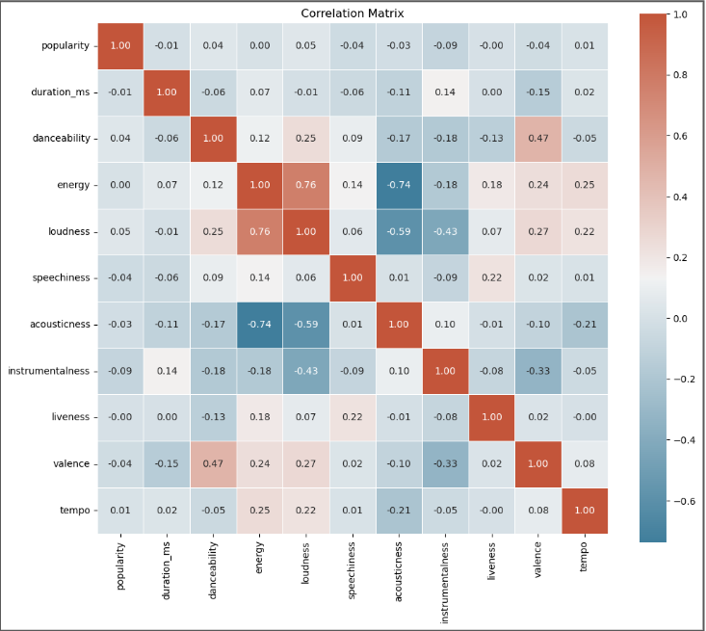
Exploratory Data Analysis
No significant correlation was found among the numerical features.
The dataset comprises 15 explanatory features: 4 categorical and 11 numeric features.
Preliminary EDA indicated minimal correlation between audio features and song popularity, leading us to focus on the challenge of genre classification across 114 genres.

Slide 4
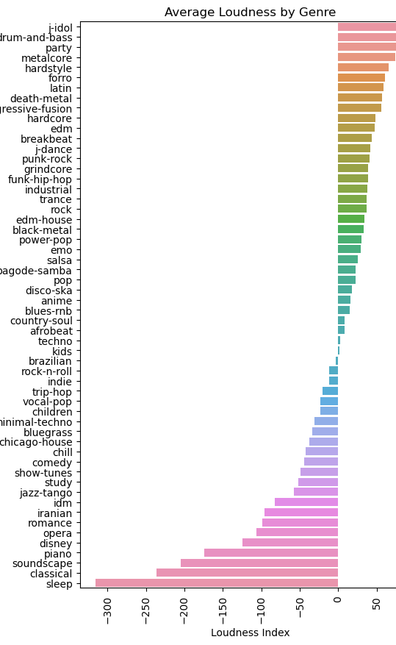

Exploratory Data Analysis
”
We found that there are significant differences in various musical attributes between different most of the music genres. For example, genres such as comedy, salsa, and electronic dance music are often high-energy and danceable in nature, while classical music and sleep music are more calm and relaxing.
However, it is important to mention that there are groups or pairs of genres that are extremely similar to each other, for example: Rock & Roll and Rockabilly, or Dub and EDM.

Slide 5
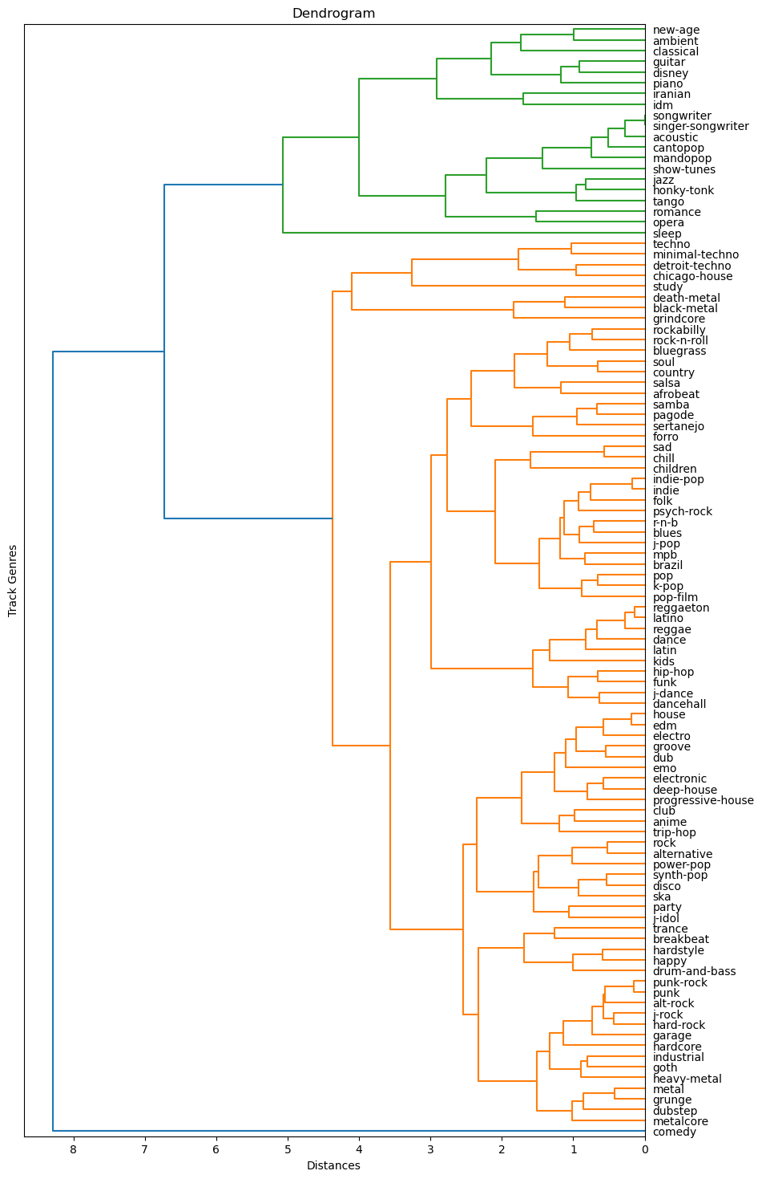
Data Preparation
1. Removed non-sound based genres
2. Removed non-explanatory features
3. Performed one-hot encoding in categorical variables
4. Scaled numerical features using standard scaling
5. Consolidated 114 genres into 56 by using hierarchical clustering:
a. Grouped the dataframe by genre and calculated the mean for each variable.
b. Performed hierarchical clustering, and supported it with a dendrogram
c. Chose a distance threshold and obtained 56 genres. Thus, merging those that had similar characteristics.
6. Label Encoding of the Target Variable: Transform the genres of the songs from string to integer.
7. We chose to not to drop explanatory features due to the low correlation between features. And more importantly, given that this classification problem has more categories than explanatory features, retaining all features is necessary for capturing the task's complexity and interactions.

Slide 6
Performance Metric Selection
Genre classification is challenging due to songs often blending elements from multiple genres. For this project:
All models will predict the probability of a song belonging to each genre, not just one.
As our target metric, we will choose top-k categorical accuracy considers a song correctly classified if its true genre is among the top 3 (k = 3) predicted genres.
In music streaming services, this metric is valuable for ensuring relevant song recommendations. This approach recognizes the complex nature of song genres and focuses on practical relevance in music applications.
Example with K = 3
Real Genre: Black Metal
Predicted Genre | Probability
Metal | 30%
Black Metal | 25%
Rock | 10%
EDM | 5%
Industrial | 2%

Slide 7
Machine Learning Models
In this project, we compare three models—Neural Network, XGBoost, and KNN—for predicting song genres across various characteristics and metrics:
Model | Characteristics | Goal and Output | Metric
Neural Network | 4 hidden layers (256, 128, 64, 32 neurons) Adam optimizer with learning rate of 0.001 30 epochs and 128 batch size ReLu activation function in hidden layers Softmax activation function in output | Goal: To predict the probability of a song belonging to each of the 56 genres Output: Numpy array of shape (n , 56) | Top-K Categorical Accuracy
XGBoost | Softmax objective |  | Top-K Categorical Accuracy
KNN | Number of Neighbors: 10 |  | Top-K Categorical Accuracy

Slide 8
Model Selection
XGBoost performs best in terms of the observed metrics.
KNN offers a compelling balance between accuracy and efficiency.
Genres that have very unique sound features are easily recognizable by the models
All models have difficulty predicting genres that have a more broad definition
Model | Top-3 Categorical Accuracy | Accuracy | Best predicted genres (Accuracy) | Worst predicted genres (Accuracy)
Neural Network | 69.46% | 44.54% | Grindcore (86%), Study (80%), Comedy (78%) | Emo (5%), Blues - R&B (11%), Techno (18%)
XGBoost | 73.74% | 47.47% | Grindcore (87%), Sleep (85%), Study (81%) | Techno (13%), Emo (16%), Blues - R&B (16%)
KNN | 70.36% | 40.99% | Comedy (77%), Grindcore (75%), Sleep (70%) | Techno (10%), Trip - Hop (8%), Emo (5%)

Slide 9
Ensemble Model
We built an ensemble model, including 4 weak learners. This is a voting classifier, using soft voting to obtain probabilities of a song belonging to each of the 56 genres.
Weak Learner | Individual result | Characteristics | Voting | Final Result
Logistic Regression Model | Top-3 categorical accuracy: 54.09% Accuracy: 31.01% | Solver: LBFGS Multinomial | Soft Voting | Top-3 categorical accuracy: 64.78% Accuracy: 39.53%
KNN Classifier | Top-3 categorical accuracy: 70.36% Accuracy: 40.99% | Number of Neighbors: 10
SVM Classifier | Top-3 categorical accuracy: 56.9% Accuracy: 33.14% | Linear Kernel
Decision Tree Classifier | Top-3 categorical accuracy: 98.94% Accuracy: 39.49% | Gini Index Criterion Best split instead of best random split

Slide 10
Conclusions
Explored effectiveness of ML models in classifying music genres from Spotify audio features:
Models performance: XGBoost showed highest Top-3 Categorical Accuracy (73.74%), followed by Neural Network (69.54%) and KNN (70.36%)
Performance by Genre: Genres that have very unique sound features are easily recognizable by the models
Ensemble model: Didn't outperform individual models, possibly due to logistic regression and SVM components.
Ensemble model high training time: Very computationally expensive SVM.
Feature Importance: The decision tree model consider features like "popularity," "danceability," and "duration_ms" more important for predictions rather than factors like "explicit" and "mode".
With this project we were able to demonstrate a high potential in genre classification for a target variable with a large number of classes, with KNN, XGBoost and Neural Networks showing promising results.
For future work we consider:
Explore better ensemble strategies such as different components or a stacking classifier.
Lyrics and other non-sound based parameters can improve the prediction accuracy of our models.
Multi-label classifiers could enhance the predictive power of our models

