Slide 1

Team 7: Fintech giants
Notes:
Hello,everyone. today, I’m glad to introduce our product xxx here. First, Our team named fintech giants. To create this excellent product , we divided this task into two different parts:

Slide 2
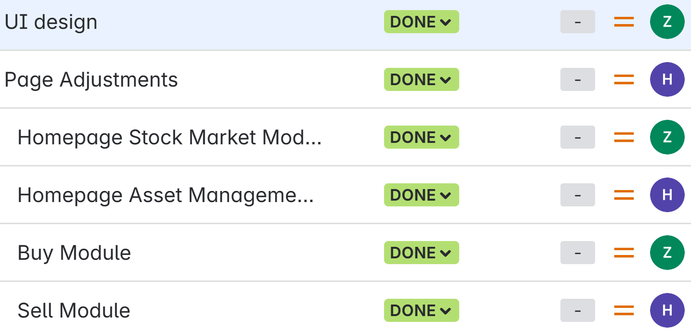


Team 7: Fintech giants
Project Topics: PortfolioManage Pro
Presentation Dates: July 30, 2025
Zinnia Zhang | Zero Zhu
Notes:
On one side, Zinnia and zero were responsible for the front-end, designing and presenting all the functionalities in UI

Slide 3
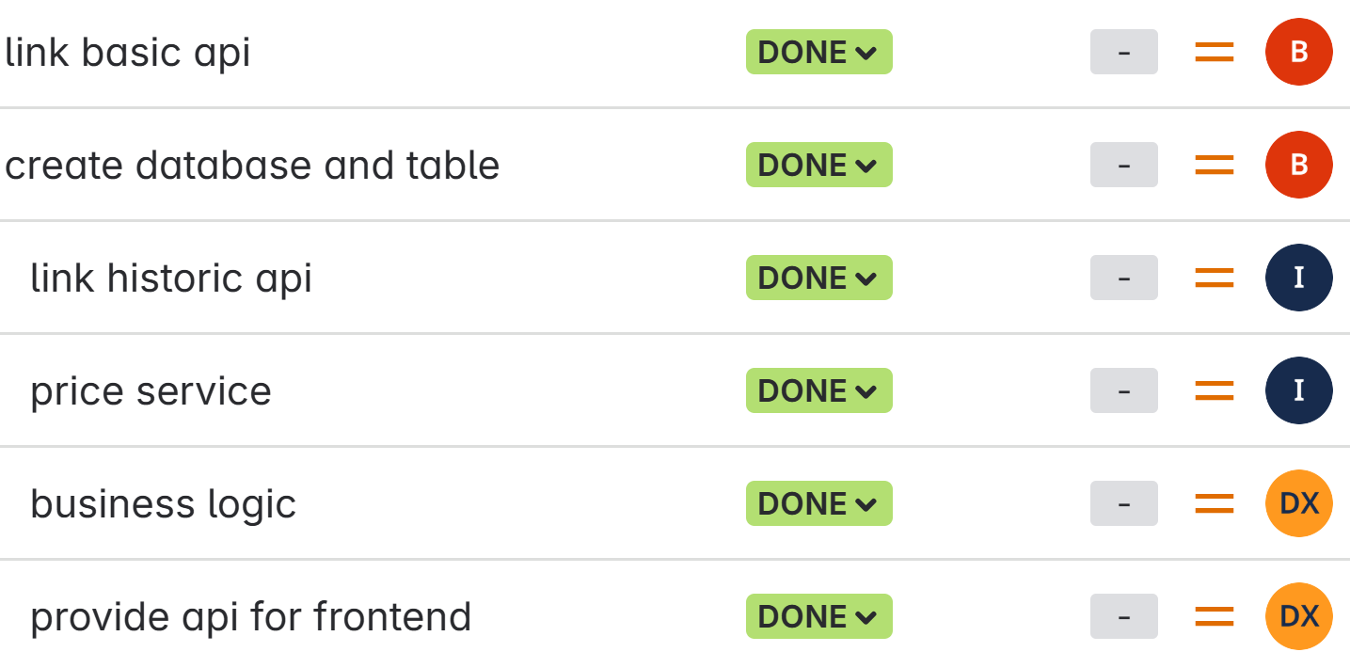



Team 7: Data Crafters
Project Topics: Portfolio Asset Manager
Presentation Dates: July 30, 2025
Benjie Zhao | Ivan Zhao
Diana Xu
Notes:
On other side, Ivan, Benjie and I handled the back-end, focusing on the external API and database interfaces throughout the task allocation and completion process, we used Jira for task management. You can see the tasks assigned to each team member and its status. It record our work progress and show every teammates’ duty.

Slide 4
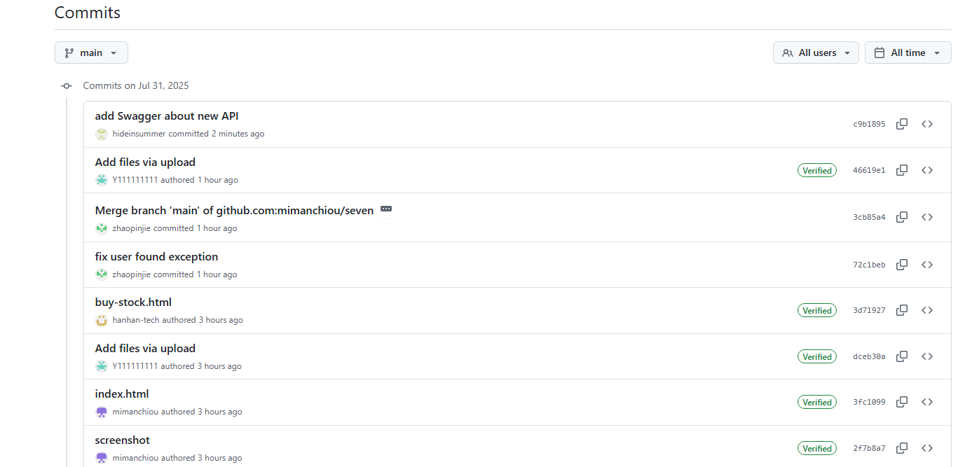
Notes:
There are our submission records, where you can see that everyone has committed their code. In addition, we utilized github for version control and merging code to ensure smooth interaction between the fronted end and back-end. In cases of conflicts, we can roll back to previous version or compare them against historical versions. It is very beneficial to our work.Next, here’s our system workflow diagram.

Slide 5
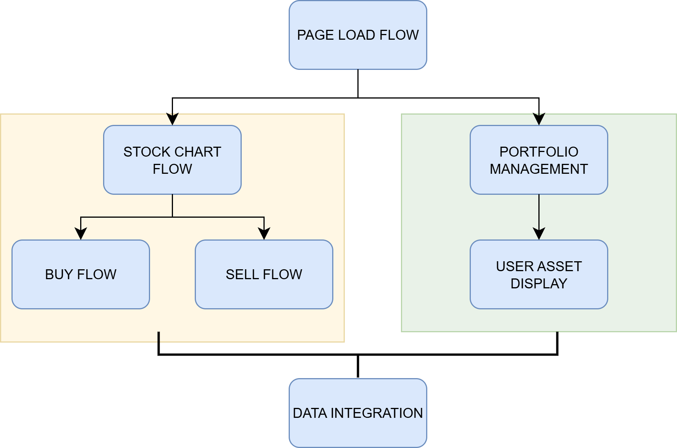
System Flow Diagram
Notes:
This diagram shows our six core business processes. The PAGE LOAD FLOW automatically fetches user funds and displays account overview. STOCK CHART FLOW lets users select stocks and view real-time charts via Yahoo Finance API. BUY FLOW verifies funds and executes purchases. SELL FLOW checks holdings and processes sales. PORTFOLIO MANAGEMENT handles performance tracking and record management. DATA INTEGRATION ensures seamless API connectivity and data processing across all components.

Slide 6
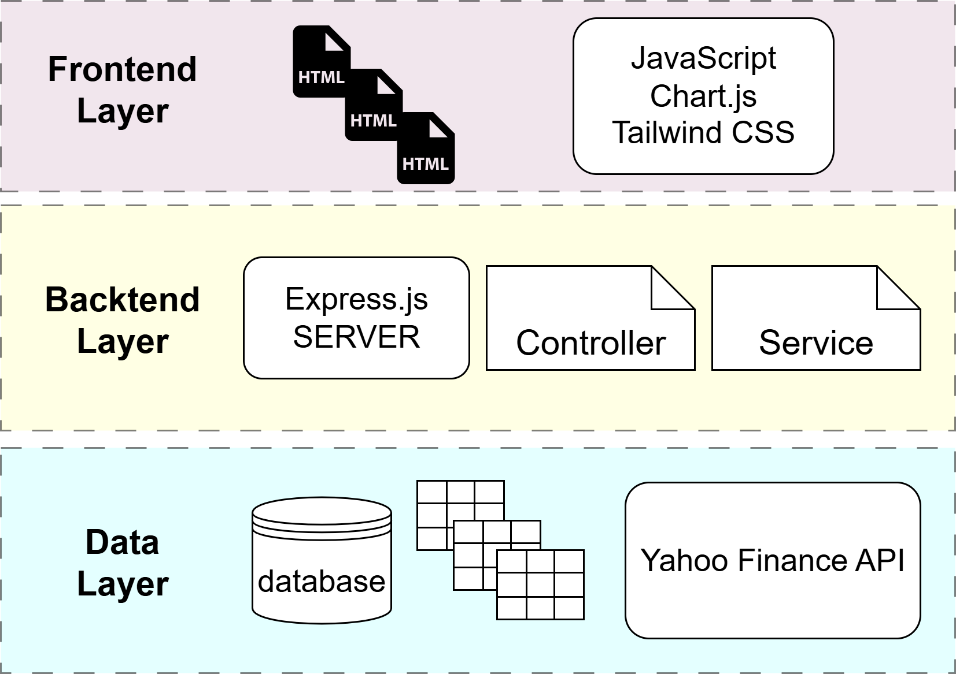
System Architecture
Notes:
Our system follows a three-tier architecture. The FRONTEND LAYER includes our main dashboard, buy/sell pages, built with JavaScript, Chart.js, and Tailwind CSS. The BACKEND LAYER runs on Express.js with four controllers handling different business functions, supported by service layers for business logic. The DATA LAYER contains our database with Users, Portfolio, and Stock tables, plus Yahoo Finance API integration for real-time market data. This design ensures scalability, maintainability, and clear separation of concerns.Now I’ll pass it over to benjie to introduce the database’s tasks he was responsible for.

Slide 7
Database & CRUD APIs
Three Core Database Systems managing all application data
User Management APIs
Portfolio Management APIs
Stock Details APIs
Database architecture with three normalized tables
Users table
Portfolio_items table
Stock_details table
Complete CRUD operations for all entities

Slide 8
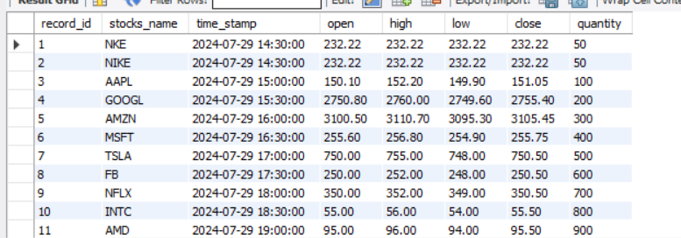

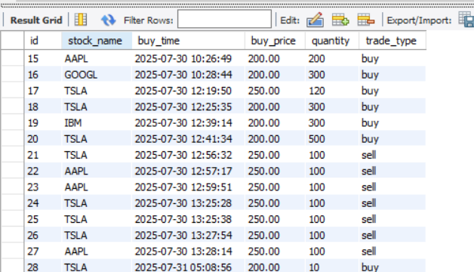
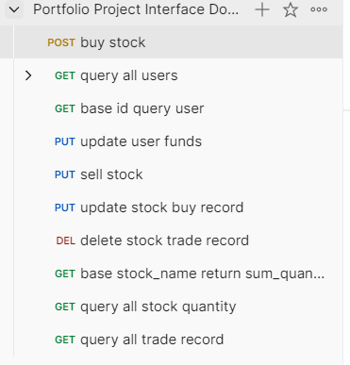
Database & CRUD APIs
stocks_detail Table
user_info Table
user_portfolio_items

Slide 9
Stock Data APIs
Technical foundation using Yahoo Finance API
Reliability solutions implemented
Notes:
I developed four core APIs that handle all stock market data. The Historical Price Chart API provides 1, 3, or 5-day price data with up to 600 data points for smooth charts. The Current Stock Price API delivers real-time OHLC data, volume, and market value. I also built a Stock Search API for finding companies by name, and a Company Information API for detailed business backgrounds.
For our technical foundation, I chose Yahoo Finance API because it's provides high-quality data with 2-15 minute update intervals.
To ensure reliability, I implemented an automatic retry system. When Yahoo Finance fails, our system waits and retries up to 3 times, keeping the service running smoothly despite external issues.
Testing shows excellent results. All APIs respond quickly and accurately with major stocks like Apple, Microsoft, and Tesla. We get smooth charts with hundreds of data points and real-time updates during market hours.

Slide 10
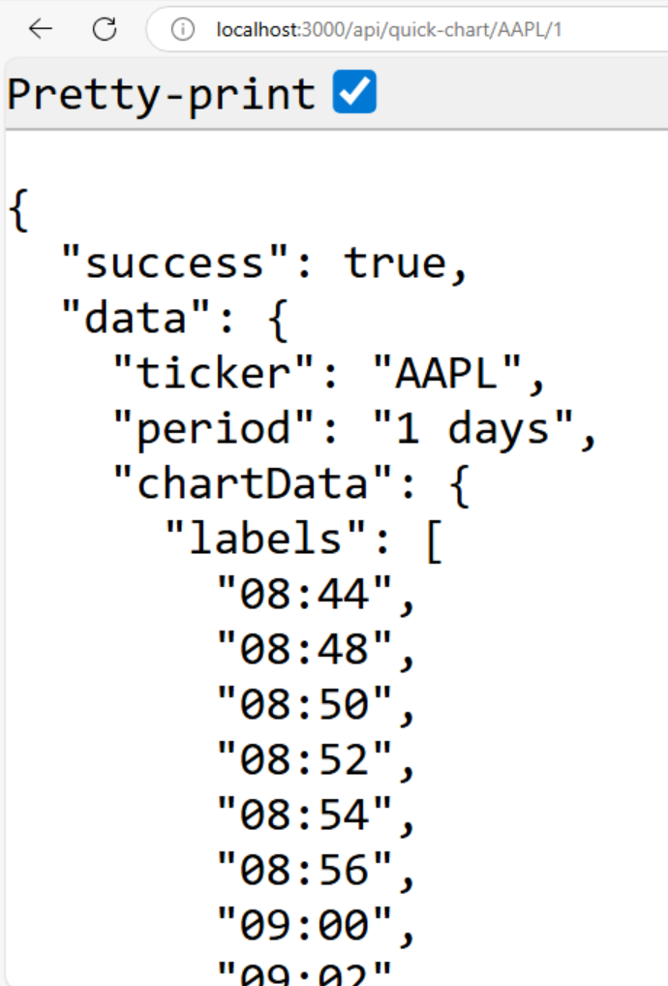
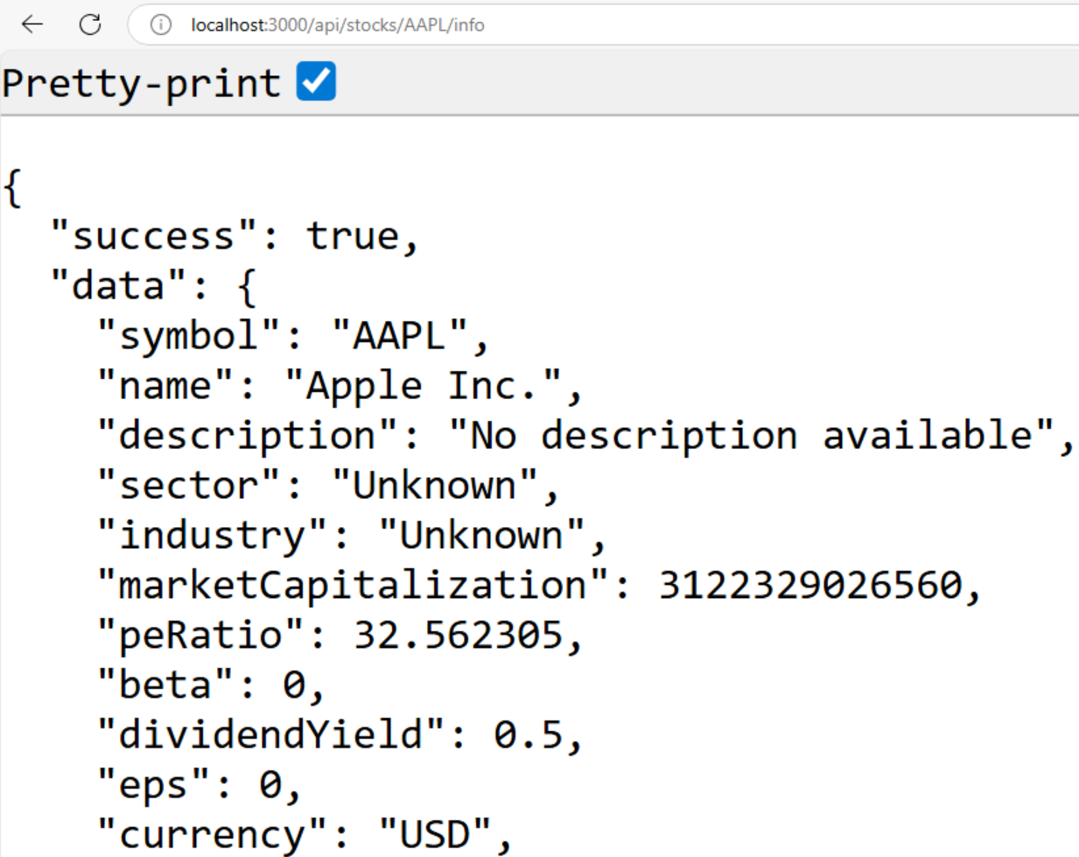
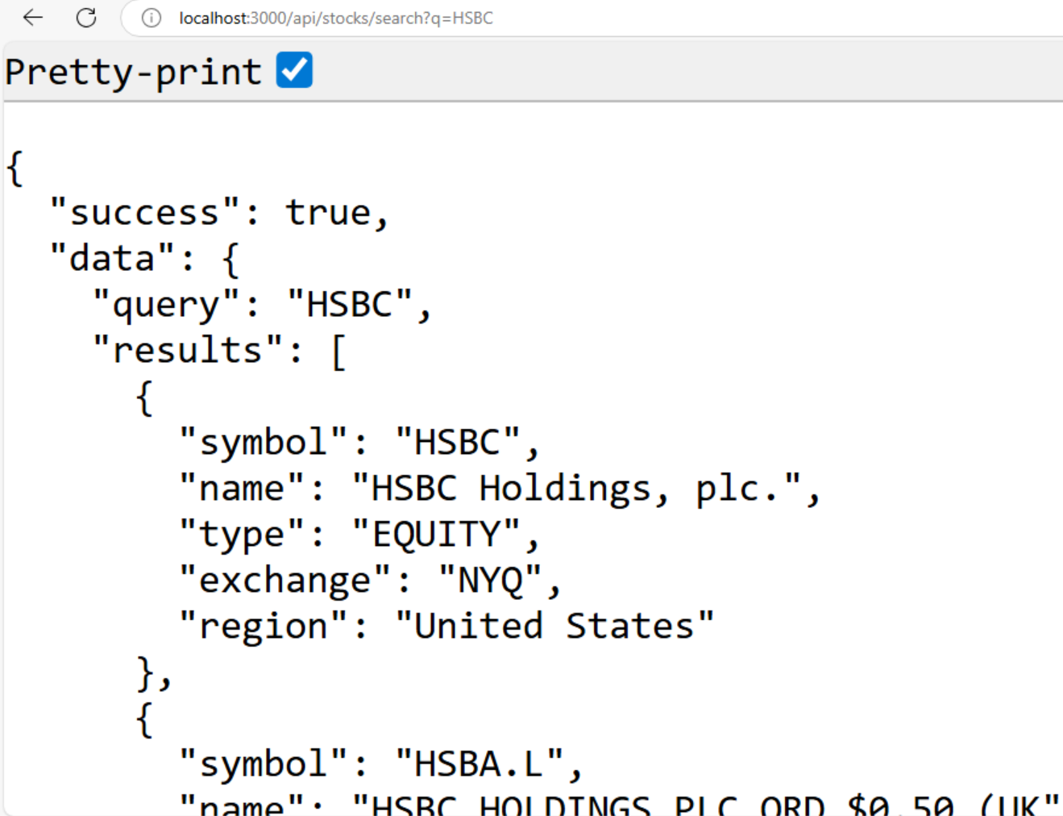
Stock Data APIs
Four Core APIs built for complete stock data services
Notes:
I developed four core APIs that handle all stock market data. The Historical Price Chart API provides 1, 3, or 5-day price data with up to 600 data points for smooth charts. The Current Stock Price API delivers real-time OHLC data, volume, and market value. I also built a Stock Search API for finding companies by name, and a Company Information API for detailed business backgrounds.
For our technical foundation, I chose Yahoo Finance API because it's provides high-quality data with 2-15 minute update intervals.
To ensure reliability, I implemented an automatic retry system. When Yahoo Finance fails, our system waits and retries up to 3 times, keeping the service running smoothly despite external issues.
Testing shows excellent results. All APIs respond quickly and accurately with major stocks like Apple, Microsoft, and Tesla. We get smooth charts with hundreds of data points and real-time updates during market hours.

Slide 11
API Integration & Project Management
Frontend-Backend API Integration ensuring seamless connectivity
GitHub repository management and version control
Comprehensive API documentation using Swagger UI

Slide 12
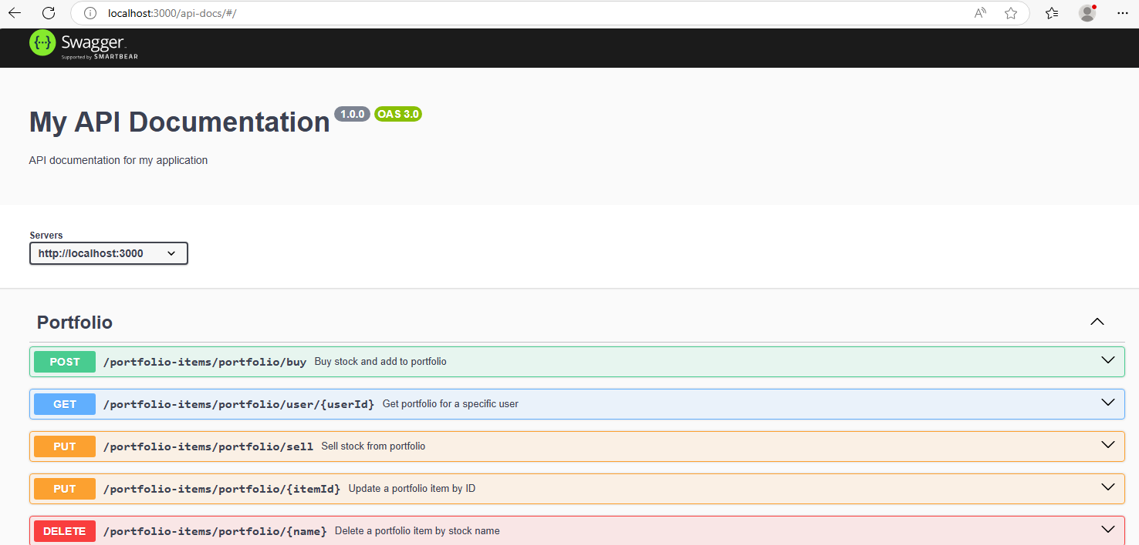
Notes:
It is my swagger documentation. you can see all API we developed in this project. In the future, we can use it to improve our system. In my view , we can add other advanced function like stocks recommendation. It will be very useful for our development.

Slide 13
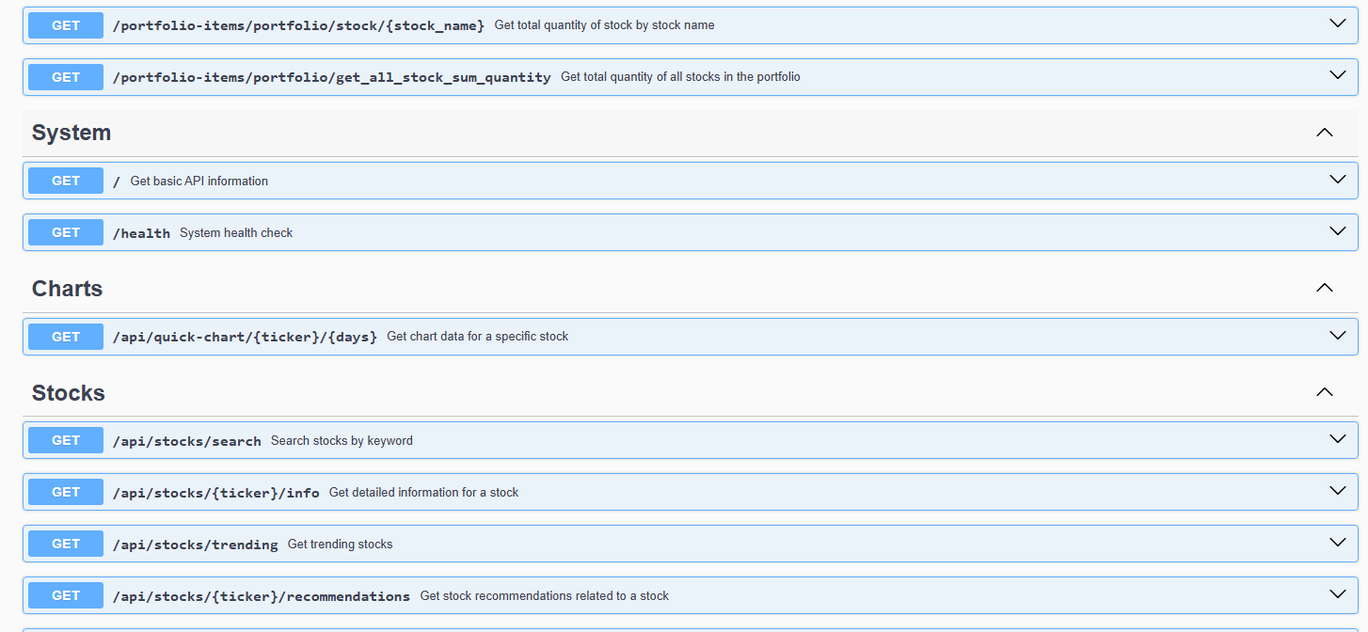

Slide 14
Frontend Development
Three Main User Interfaces for complete trading experience
Dashboard (index.html)
Buy Page (buy-stock.html)
Sell Page (sell-stock.html)
Interactive data visualization using Chart.js
Modern responsive design with Tailwind CSS
User experience optimization and form validation

Slide 15
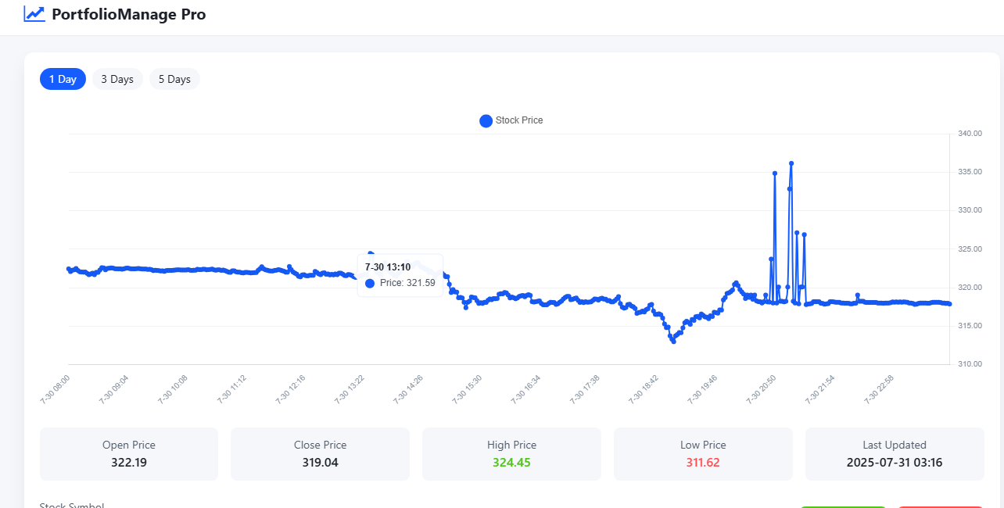

Slide 16
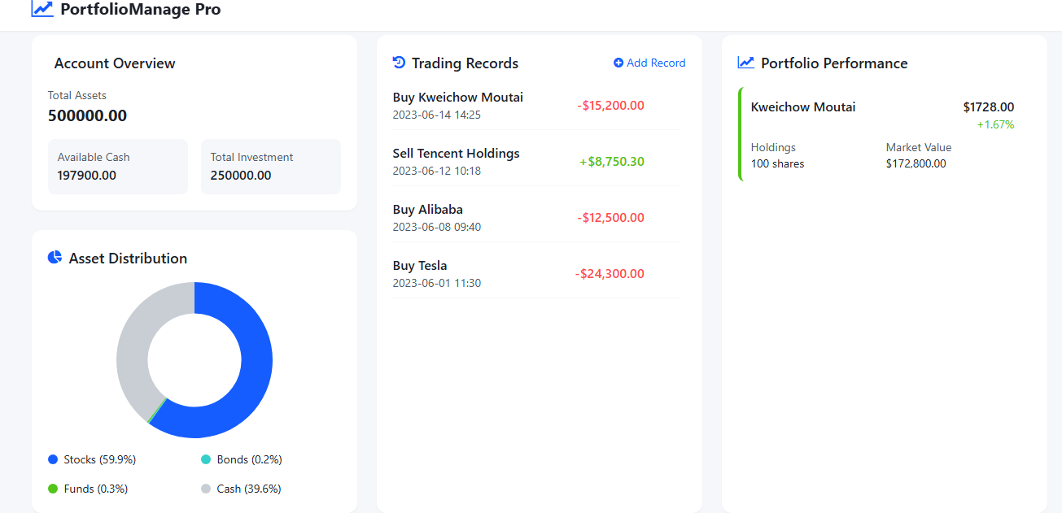

Slide 17
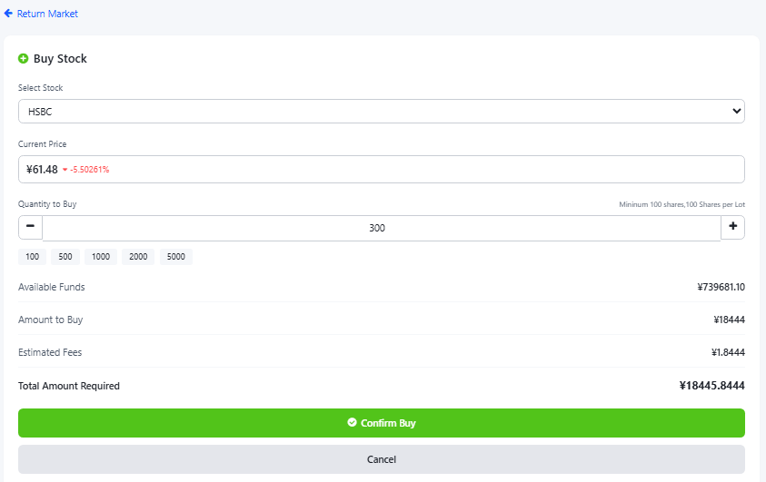
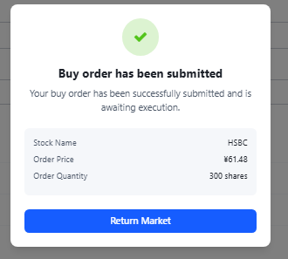

Slide 18
DEMO MOMENT

