Slide 1

Portfolio Asset Manager

Slide 2





Team 7: Data Crafters
Project Topics: Portfolio Asset Manager
Presentation Dates: July 30, 2025
Zinnia Zhang | Zero Zhu | Benjie Zhao | Ivan Zhao
Tech Lead | Team Coordinator | Co-researcher | Presentation Lead
Diana Xu
Tech Lead

Slide 3
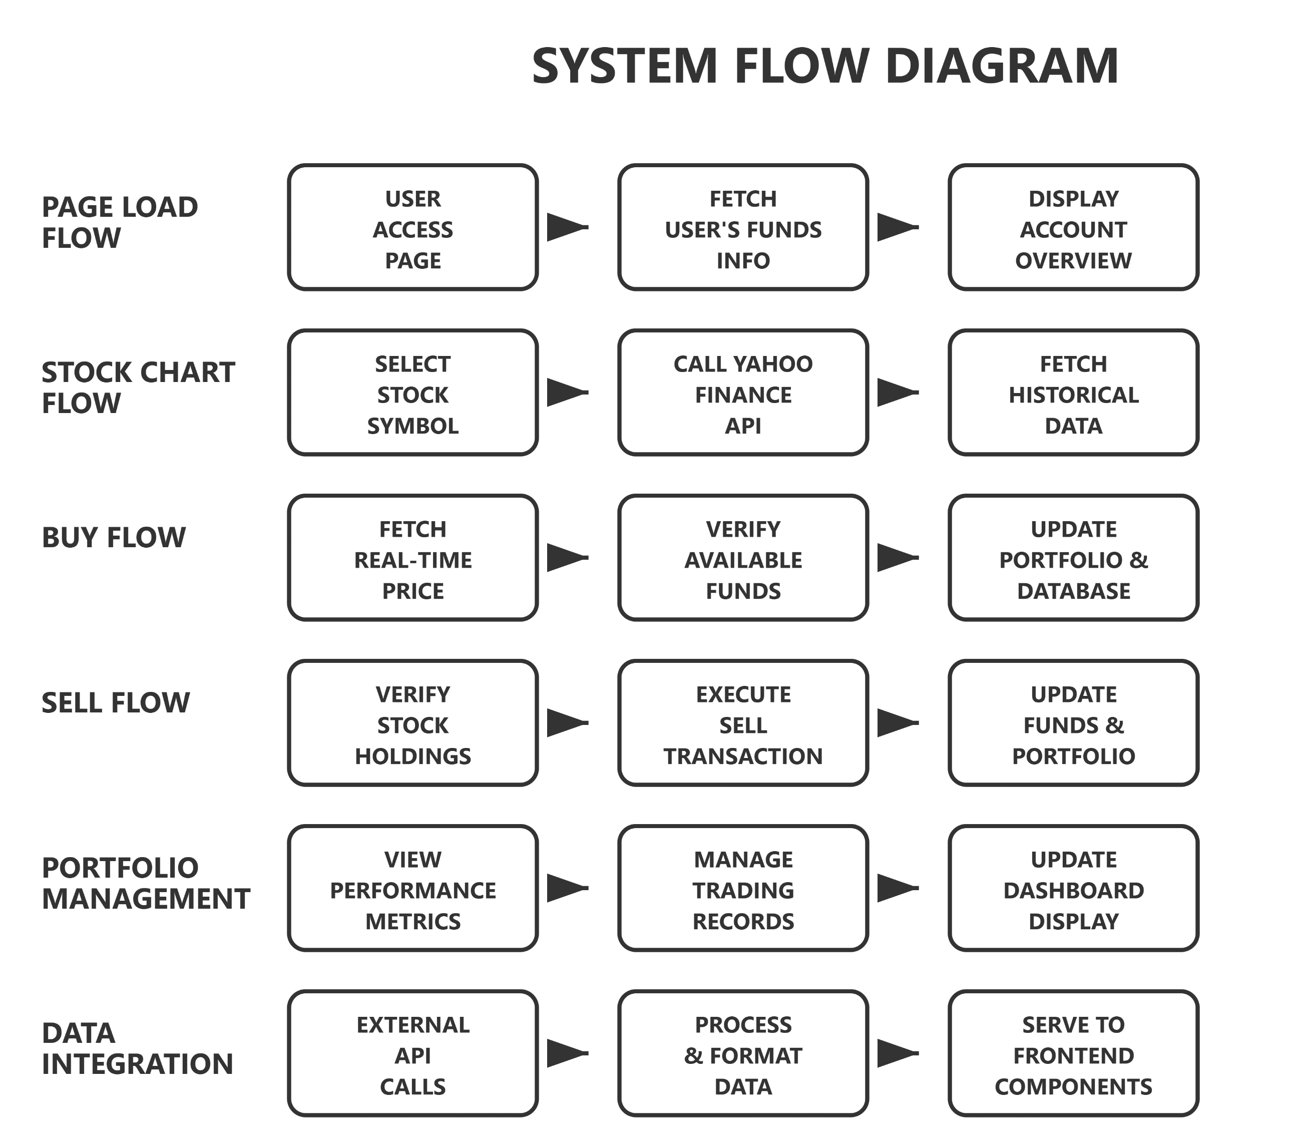
Notes:
This diagram shows our six core business processes. The PAGE LOAD FLOW automatically fetches user funds and displays account overview. STOCK CHART FLOW lets users select stocks and view real-time charts via Yahoo Finance API. BUY FLOW verifies funds and executes purchases. SELL FLOW checks holdings and processes sales. PORTFOLIO MANAGEMENT handles performance tracking and record management. DATA INTEGRATION ensures seamless API connectivity and data processing across all components.

Slide 4
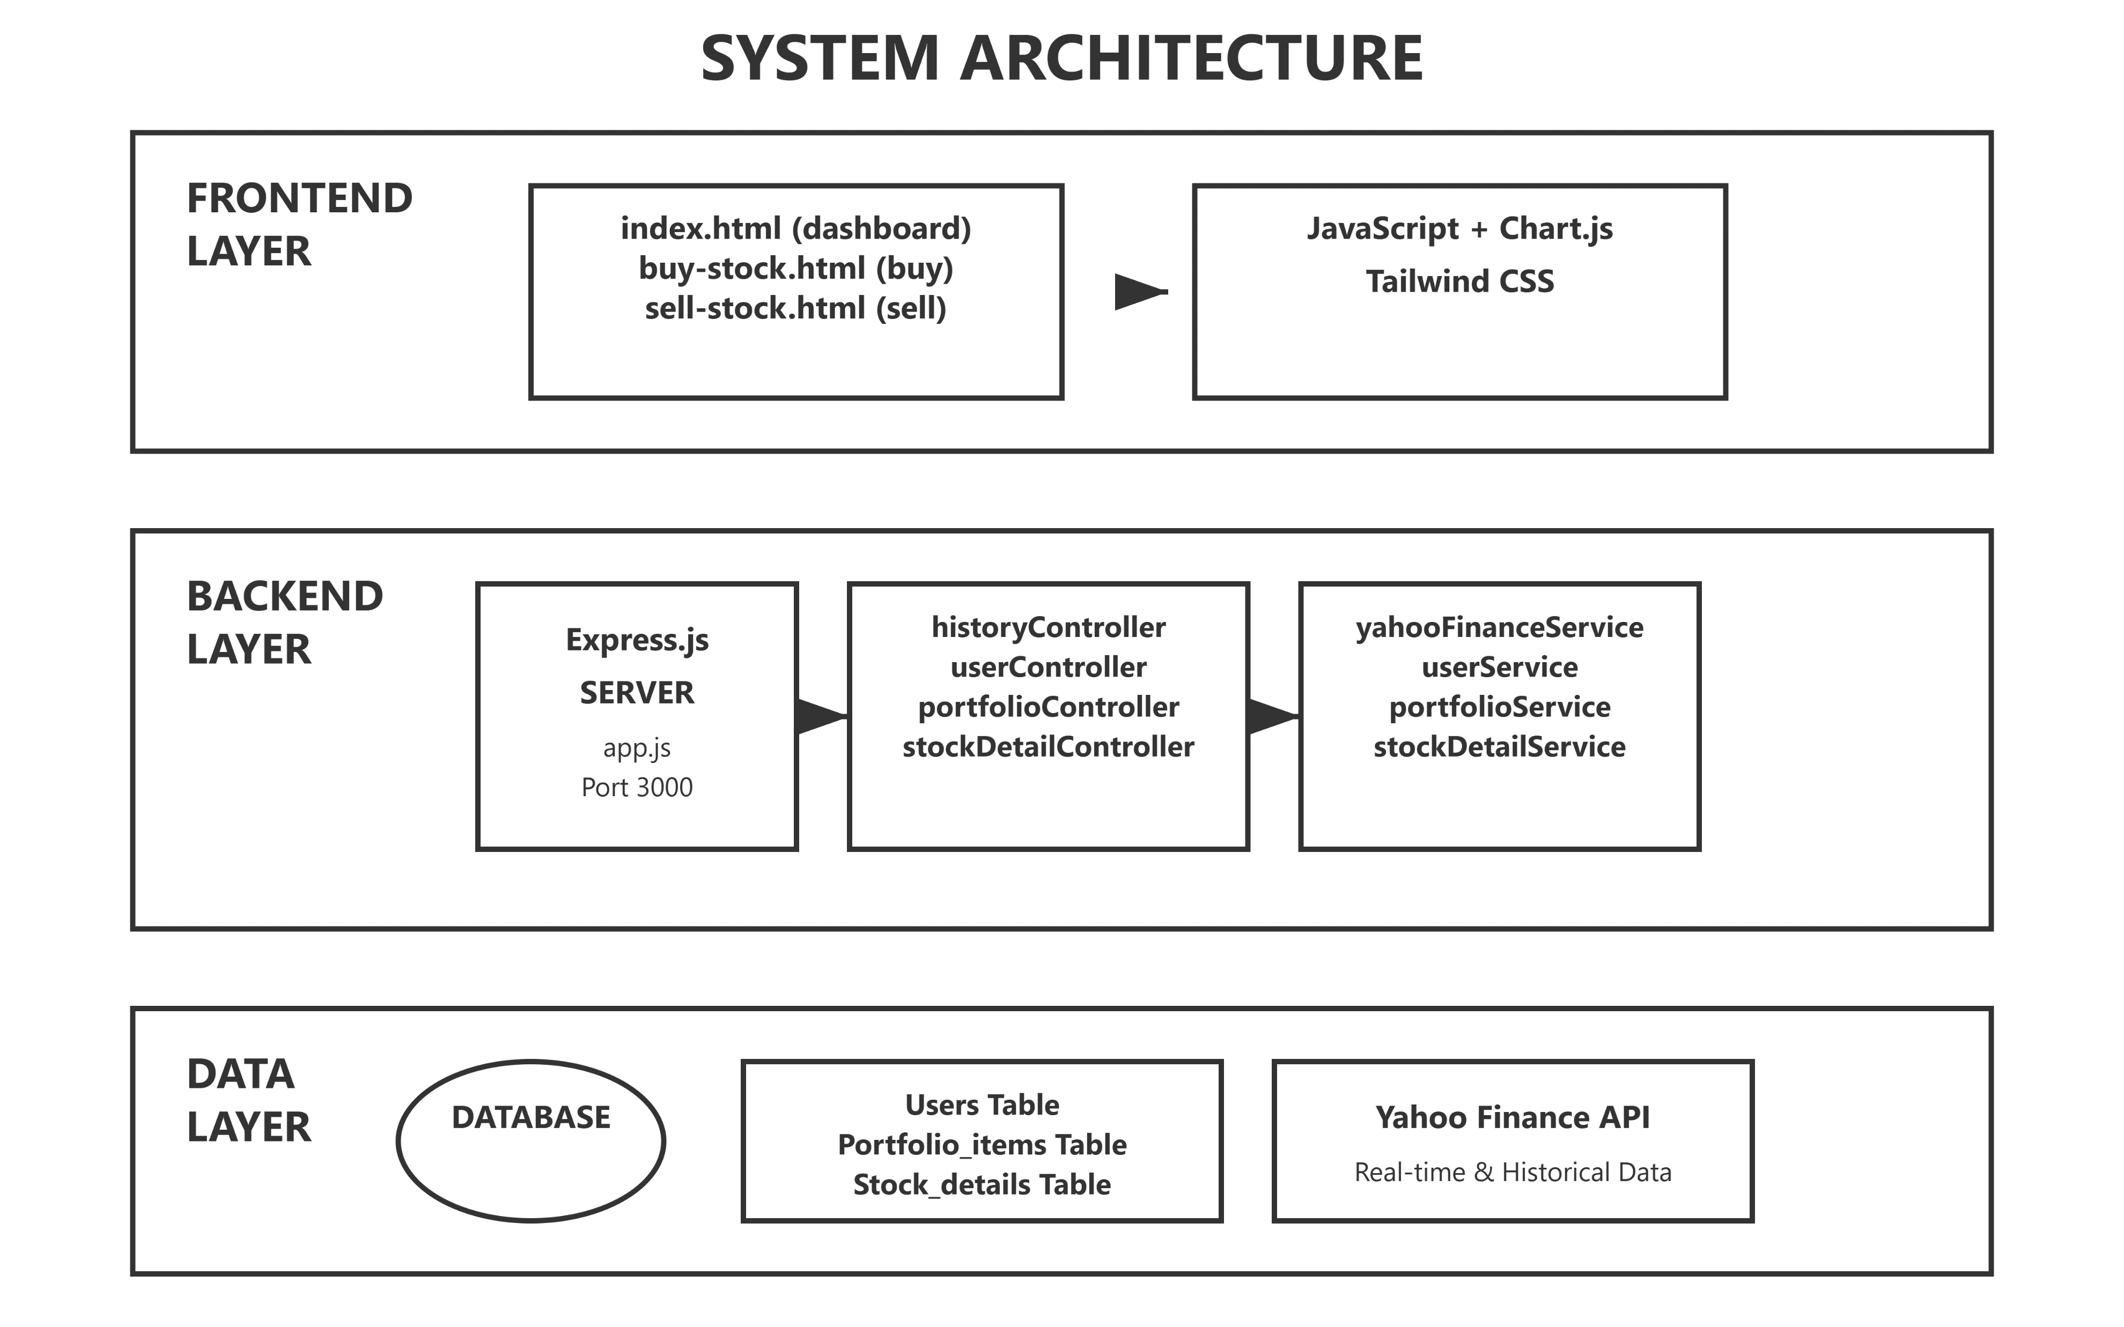
Notes:
Our system follows a three-tier architecture. The FRONTEND LAYER includes our main dashboard, buy/sell pages, built with JavaScript, Chart.js, and Tailwind CSS. The BACKEND LAYER runs on Express.js with four controllers handling different business functions, supported by service layers for business logic. The DATA LAYER contains our database with Users, Portfolio, and Stock tables, plus Yahoo Finance API integration for real-time market data. This design ensures scalability, maintainability, and clear separation of concerns.

Slide 5
Database & CRUD APIs
Three Core Database Systems managing all application data
User Management APIs - Account creation, authentication, fund tracking
Portfolio Management APIs - Buy/sell transactions, holdings tracking
Stock Details APIs - Trading records, historical data storage
Database architecture with three normalized tables
Users table - stores account information and available funds
Portfolio_items table - tracks stock holdings and transactions
Stock_details table - maintains trading history and stock records
Complete CRUD operations for all entities
Create - User registration, portfolio purchases, trading records
Read - Account queries, portfolio retrieval, transaction history
Update - Fund management, portfolio modifications, record updates
Delete - Account removal, portfolio cleanup, record deletion

Slide 6
Stock Data APIs
Four Core APIs built for complete stock data services
Historical Price Chart API - 1, 3, 5 day periods with up to 600 data points
Current Stock Price API - Real-time OHLC, volume, market value
Stock Search API - Find companies by name or symbol
Company Information API - Detailed business background
Technical foundation using Yahoo Finance API
Completely free with unlimited access
High-quality data with 2-15 minute update intervals
Reliability solutions implemented
Automatic retry system for failed requests
Up to 3 retry attempts with intelligent waiting
Smooth service operation despite external issues
Notes:
I developed four core APIs that handle all stock market data. The Historical Price Chart API provides 1, 3, or 5-day price data with up to 600 data points for smooth charts. The Current Stock Price API delivers real-time OHLC data, volume, and market value. I also built a Stock Search API for finding companies by name, and a Company Information API for detailed business backgrounds.
For our technical foundation, I chose Yahoo Finance API because it's provides high-quality data with 2-15 minute update intervals.
To ensure reliability, I implemented an automatic retry system. When Yahoo Finance fails, our system waits and retries up to 3 times, keeping the service running smoothly despite external issues.
Testing shows excellent results. All APIs respond quickly and accurately with major stocks like Apple, Microsoft, and Tesla. We get smooth charts with hundreds of data points and real-time updates during market hours.

Slide 7
API Integration & Project Management
Frontend-Backend API Integration ensuring seamless connectivity
CORS configuration - Enable cross-origin requests for frontend access
RESTful endpoints - Standardized API routes for all frontend operations
Error handling middleware - Consistent error responses across all APIs
GitHub repository management and version control
Branch management strategy with main, development, and feature branches
Pull request reviews and merge conflict resolution
Release tagging and deployment coordination
Comprehensive API documentation using Swagger UI
Interactive API documentation with live testing capabilities

Slide 8
Frontend Development
Three Main User Interfaces for complete trading experience
Dashboard (index.html) - Portfolio overview, charts, trading records
Buy Page (buy-stock.html) - Stock selection, price display, purchase interface
Sell Page (sell-stock.html) - Holdings view, quantity selection, sale execution
Interactive data visualization using Chart.js
Real-time stock price charts with 1, 3, 5-day timeframes
Portfolio asset distribution pie charts with dynamic updates
Performance metrics and mini-charts for individual stocks
Modern responsive design with Tailwind CSS
Mobile-first approach ensuring cross-device compatibility
Professional UI components with hover effects and animations
Consistent color scheme and typography throughout the application
User experience optimization and form validation
Real-time form validation for buy/sell operations
Success/error modal dialogs for transaction feedback
Intuitive navigation flow and loading states for smooth interactions

Slide 9
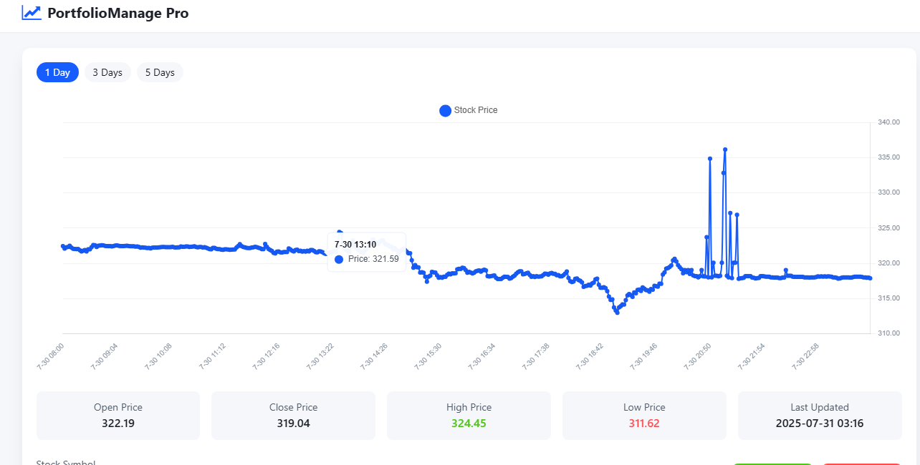

Slide 10
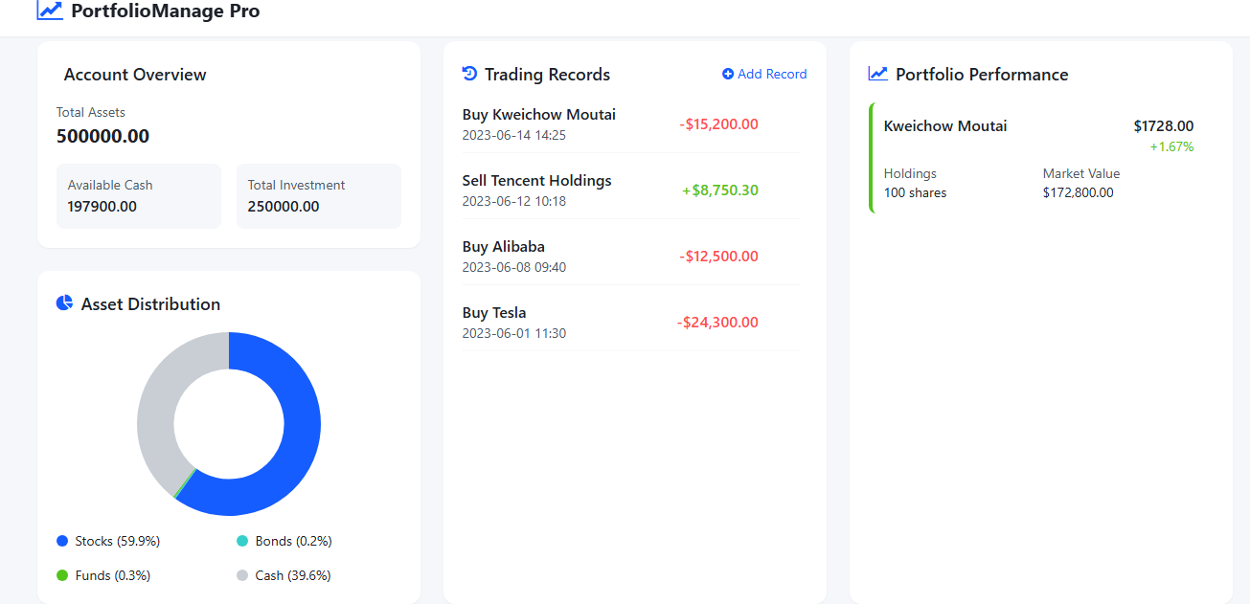

Slide 11
Conclusion
What have we learned?
Modern web development requires seamless integration between frontend, backend, and external APIs
Real-time financial data presents unique challenges in reliability and performance optimization
What could have been done if given more time
Advanced portfolio analytics with machine learning predictions and risk assessment algorithms
Mobile app development, advanced charting features, and AI-powered investment recommendations
How could this be useful to your work at your company
Demonstrates full-stack development skills, API integration expertise, and ability to build scalable financial applications
Showcases team collaboration - coordinated frontend/backend development with Git version control
Proves problem-solving abilities - implemented error handling and reliability solutions under pressure
Notes:
In conclusion, this project taught us that modern financial applications require seamless integration between frontend, backend, and external APIs. We also learned that real-time financial data presents unique challenges in reliability and performance optimization.
Given more time, we could have implemented machine learning algorithms for investment predictions and comprehensive risk assessment tools.
For future enhancements, we plan to develop a mobile app, advanced charting features, and AI-powered investment recommendations.
This project demonstrates valuable workplace skills. It showcases our full-stack development capabilities and API integration expertise. We proved our team collaboration abilities by coordinating frontend and backend development with Git version control. Most importantly, we demonstrated strong problem-solving skills by implementing reliable error handling systems under pressure.

Slide 12


