Slide 1
Efficient Representations of Information Flows in System Security
Ji Kaihang Advised by: A/P Liang Zhenkai

Slide 2
Information Flows in Security Tasks
Information-flow-based techniques are popular in system security.
mov eax, [r12+18h]
mov [r11+8], eax
cmp eax, 1
jz 0x161
1:path
Secrect.txt
gzip
if fgets():
F
T
7:Exception
2:msg
ls
cat
tar
4:socket
sshd
bash
Secrect.tar.gz
9:ret
Taint Tracking
in Binary Analysis
Provenance Tracking
in System Auditing
Program Dependency Graph
in Code Analysis

Slide 3
Representations in Information Flows - Graph
Common representation: Directed Graph
In Program:
Data flow graph (DFG) or Program dependency graph
Nodes: Functions, basic blocks, variables, etc.
Edges: Data flows or control flows
In System Auditing:
Provenance graph
Nodes: System entities (processes, sockets, files)
Edges: System call events
1:path
if fgets():
F
T
7:Exception
2:msg
4:socket
9:ret
Secrect.txt
gzip
ls
cat
tar
sshd
bash
Secrect.tar.gz
Notes:
Despite the general representation…

Slide 4
Challenges in Information Flow Analysis
Information flow analysis incurs significant performance costs:
1. Heavy Performance Overhead: Instrumentation and tag propagation bring 8 to 40 times slowdown to dynamic binary taint analysis.
2. Massive Amount of Data: Overwhelming TBs of real-world data makes dependency queries taking hours to execute in provenance-based system audit analysis.
3. Large Searching Space <- Undecidability: In static code analysis of large codebases, the number of possible execution paths increases exponentially due to the lack of concrete execution decisions.

Slide 5
Information Flows on Graphs
Challenge - Significant Performance Cost
Original on-graph tasks involve high complexity
Unnecessary for particular sub-tasks
Our Goal
To improve the efficiency and scalability of information flow analysis in a range of security tasks
Notes:
The original task high complexity, which is unnecessary for sub-tasks…
By focusing on the key sub-features/semantics

Slide 6
In this thesis
By deeply understanding the individual features and internal structure of problems, we investigate new representations and algorithms for complexity reduction, aimed at enhancing information-flow reasoning over the system.
Notes:
By understanding the internal structure of problems, we investigate new representations and algorithms aimed at enhancing information-flow reasoning over the system.

Slide 7
Complexity Reduction in Information Flows
From specific to broader data structures in information flow tasks:
[1: Sequence] How to accelerate information flow tracking by identifying linear order?
[2: Partial Order Graph] How to streamlining information flow identification in partial order graphs?
[3: Proposed Work – General Digraph] How to optimize analysis with information flows in direct graphs for specified task?
1. Sequence (Linear Order)
2. Partial Order Graph
3. General Digraph
Notes:
By focusing on the key sub-features/semantics -> internal structure; on different complexity level
The original task high complexity, which is unnecessary for sub-tasks…
3) Subgraph matching

Slide 8
Complexity Reduction in Information Flows
From specific to broader data structures in information flow tasks:
[1: Sequence] How to accelerate information flow tracking by identifying linear order?
[2: Partial Order Graph] How to streamlining information flow identification in partial order graphs?
[3: Proposed Work – General Digraph] How to optimize analysis with information flows in direct graphs for specified task?
1. Sequence

Slide 9


Dynamic Information Flow Tracking (DIFT)
DIFT: An important program analysis technique in security
Track information flows in a program: Taint state transforms between sources and sinks of interest
Vulnerable Program
162.66.239.75
/etc/passwd
Data Leakage Example
Notes:
Auto-play animations
What could be sources and sinks

Slide 10

Dynamic Information Flow Tracking (DIFT)
DIFT: An important program analysis technique in security
Track information flows in a program: Taint state transforms between sources and sinks of interest
Security applications: Vulnerability analysis, Configuration diagnosis, etc.
fp = fopen(path, "r");
while(fgets(msg, maxLength-1, fp)) {
strcat(msg, "\n");
send(socket, msg, strlen(msg), 0);
}
Sink
162.66.239.75
/etc/passwd
Source
Data Leakage Example
Notes:
Auto-play animations
What could be sources and sinks

Slide 11

Dynamic Information Flow Tracking (DIFT)
Challenge: Users often need to check multiple information flows ​
Calls for efficient DIFT Query: Rapidly DIFT with different given sources and sinks​
DIFT is expensive: 8~40 times performance overhead​
One way to support DIFT query: Heavy computing support (OSDI’16)
Another way is to speed up DIFT itself…
?
fp = fopen(path, "r");
while(fgets(msg, maxLength-1, fp)) {
strcat(msg, "\n");
send(socket, msg, strlen(msg), 0);
}
Malicious Input
?
Sink
/opt/secret
162.66.239.75
/etc/passwd
Source
Data Leakage Example
Notes:
Auto-play animations
What could be sources and sinks

Slide 12
Complexity of DIFT Operation Rules
Existing work of accelerating DIFT
Program Execution
Instrumentation
Taint Propagation
Decoupling
Decoupled Analysis
(CCS’13,Security’15)
Fast Path
Partial Instrumentation
(Micro’06,RAID’19)
Hot Path
Popular Path Summary
(PLDI’10)
Normal Execution
Traditional DIFT
Lack of speeding up propagation operation itself.
Notes:
The second technique is called fast path and slow path, that will reduce instrumentation for not interesting execution paths.
Another mechanism is hot path, that will summarize the taint propagation logic for popular paths.
They focus on reducing the invocation of taint propagation logic but not on speeding up propagation operation itself
To understand why propagation operation is hard to speed-up, let’s take a look at the current implementation of existing taint tools

Slide 13
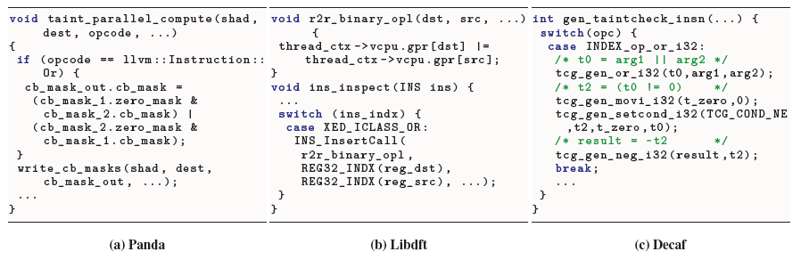
Complexity of DIFT Operation Rules
Taint propagation logics in current DIFT mechanisms are
Implemented in high-level programming languages with if and loops
Unnecessarily complex
Challenging to be computationally speeded-up
Different implementations of taint propagation rule of or instruction in Panda, libdft and DECAF.

Slide 14
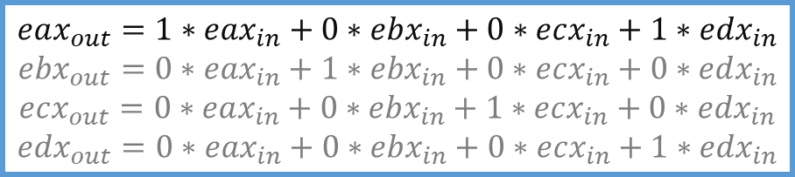

Our Insight: Linearity
DIFT propagation logic is data dependency (TaintInduce NDSS’19)
Example: DIFT operations for x86 instructions
eax
ebx
ecx
edx
Input State
$$eax_{out}=1∗eax_{in}+1∗edx_{in}$$
$$ebx_{out}=1∗ebx_{in}$$
$$ecx_{out}=1∗ecx_{in}$$
$$edx_{out}=1∗edx_{in}$$
eax
ebx
ecx
edx
Output State
DIFT operations for instruction
OR eax, edx
Dependencies in Boolean space
$$eax_{out}=1∗eax_{in}+0∗ebx_{in}+0∗ecx_{in}+1∗edx_{in}$$
$$ebx_{out}=0∗eax_{in}+1∗ebx_{in}+0∗ecx_{in}+0∗edx_{in}$$
$$ecx_{out}=0∗eax_{in}+0∗ebx_{in}+1∗ecx_{in}+0∗edx_{in}$$
$$edx_{out}=0∗eax_{in}+0∗ebx_{in}+0∗ecx_{in}+1∗edx_{in}$$
Dependencies in a verbose form
Notes:
For simplicity, assume we only have four registers in the CPU state
Other registers carry their old data

Slide 15

Our Insight: Linearity
DIFT propagation logic is data dependency (TaintInduce NDSS’19)
Example: DIFT operations for x86 instructions
eax
ebx
ecx
edx
Input State
$$eax_{out}=1∗eax_{in}+1∗edx_{in}$$
$$ebx_{out}=1∗ebx_{in}$$
$$ecx_{out}=1∗ecx_{in}$$
$$edx_{out}=1∗edx_{in}$$
eax
ebx
ecx
edx
Output State
DIFT operations for instruction
OR eax, edx
Dependencies in Boolean space
$$eax_{out}=1∗eax_{in}+0∗ebx_{in}+0∗ecx_{in}+1∗edx_{in}$$
$$ebx_{out}=0∗eax_{in}+1∗ebx_{in}+0∗ecx_{in}+0∗edx_{in}$$
$$ecx_{out}=0∗eax_{in}+0∗ebx_{in}+1∗ecx_{in}+0∗edx_{in}$$
$$edx_{out}=0∗eax_{in}+0∗ebx_{in}+0∗ecx_{in}+1∗edx_{in}$$
Dependencies in a verbose form
Notes:
For simplicity, assume we only have four registers in the CPU state
Other registers carry their old data

Slide 16
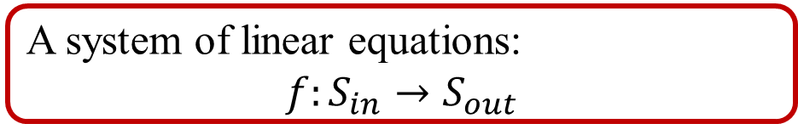
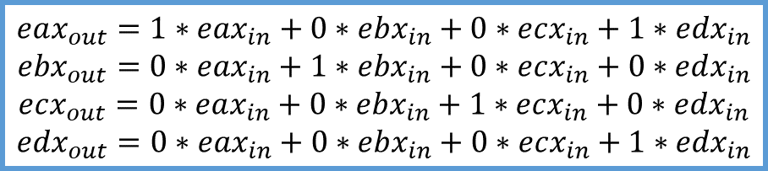
Our Insight: Linearity
We identify the linearity in DIFT:
The DIFT operation between input states and output states is a linear relationship.
DIFT propagation logic is data dependency (TaintInduce NDSS’19)
Example: DIFT operations for x86 instructions
eax
ebx
ecx
edx
Input State
$$eax_{out}=1∗eax_{in}+1∗edx_{in}$$
$$ebx_{out}=1∗ebx_{in}$$
$$ecx_{out}=1∗ecx_{in}$$
$$edx_{out}=1∗edx_{in}$$
eax
ebx
ecx
edx
Output State
DIFT operations for instruction
OR eax, edx
A system of linear equations:
$${f:S_{in}→S}_{out}$$
Dependencies in Boolean space
$$eax_{out}=1∗eax_{in}+0∗ebx_{in}+0∗ecx_{in}+1∗edx_{in}$$
$$ebx_{out}=0∗eax_{in}+1∗ebx_{in}+0∗ecx_{in}+0∗edx_{in}$$
$$ecx_{out}=0∗eax_{in}+0∗ebx_{in}+1∗ecx_{in}+0∗edx_{in}$$
$$edx_{out}=0∗eax_{in}+0∗ebx_{in}+0∗ecx_{in}+1∗edx_{in}$$
Dependencies in a verbose form
Notes:
For simplicity, assume we only have four registers in the CPU state
Other registers carry their old data

Slide 17
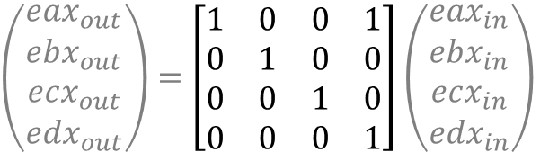
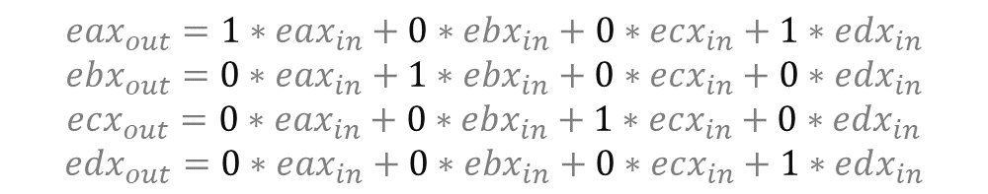
DIFT Operations as Matrix Transformations
FlowMatrix: a new matrix-based representation of DIFT propagation rule
$$eax_{out}=1∗eax_{in}+0∗ebx_{in}+0∗ecx_{in}+1∗edx_{in}$$
$$ebx_{out}=0∗eax_{in}+1∗ebx_{in}+0∗ecx_{in}+0∗edx_{in}$$
$$ecx_{out}=0∗eax_{in}+0∗ebx_{in}+1∗ecx_{in}+0∗edx_{in}$$
$$edx_{out}=0∗eax_{in}+0∗ebx_{in}+0∗ecx_{in}+1∗edx_{in}$$
$\left(\begin{matrix}eax_{out} \\ \begin{aligned}ebx_{out} \\ ecx_{out} \\ edx_{out}\end{aligned}\end{matrix}\right)=\left[\begin{matrix}1 & 0 & 0 & 1 \\ 0 & 1 & 0 & 0 \\ 0 & 0 & 1 & 0 \\ 0 & 0 & 0 & 1\end{matrix}\right]$ $\left(\begin{matrix}eax_{in} \\ \begin{aligned}ebx_{in} \\ ecx_{in} \\ edx_{in}\end{aligned}\end{matrix}\right)$
The coefficient matrix, the dependencies between $S_{in}$ and $S_{out}$

Slide 18
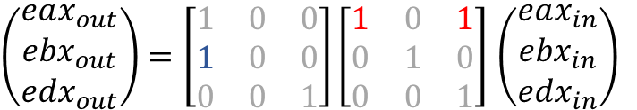
Propagation Summary as Matrix Multiplication
Example: DIFT propagation of two x86 instructions
eax
ebx
edx
Init State
$\left(\begin{matrix}eax_{out} \\ \begin{aligned}ebx_{out} \\ edx_{out}\end{aligned}\end{matrix}\right)=\left[\begin{matrix}1 & 0 & 0 \\ 1 & 0 & 0 \\ 0 & 0 & 1\end{matrix}\right]\left[\begin{matrix}1 & 0 & 1 \\ 0 & 1 & 0 \\ 0 & 0 & 1\end{matrix}\right]$ $\left(\begin{matrix}eax_{in} \\ \begin{aligned}ebx_{in} \\ edx_{in}\end{aligned}\end{matrix}\right)$
OR eax,edx
eax
ebx
edx
State 1
MOV ebx,eax
“OR” Matrix
eax
ebx
edx
State 2
“MOV” Matrix

Slide 19
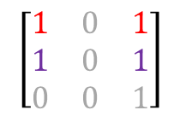
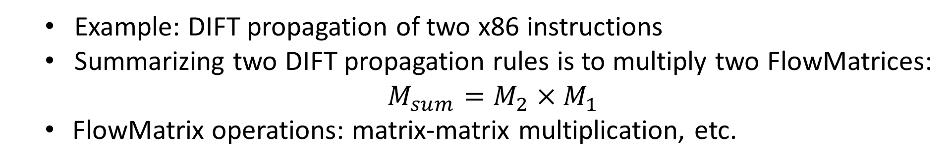
Propagation Summary as Matrix Multiplication
Example: DIFT propagation of two x86 instructions
Summarizing two DIFT propagation rules is to multiply two FlowMatrices:
$M_{sum}=M_{2}×M_{1}$
FlowMatrix operations: matrix-matrix multiplication, etc.
eax
ebx
edx
Init State
$\left(\begin{matrix}eax_{out} \\ \begin{aligned}ebx_{out} \\ edx_{out}\end{aligned}\end{matrix}\right)=\left[\begin{matrix}1 & 0 & 0 \\ 1 & 0 & 0 \\ 0 & 0 & 1\end{matrix}\right]\left[\begin{matrix}1 & 0 & 1 \\ 0 & 1 & 0 \\ 0 & 0 & 1\end{matrix}\right]$ $\left(\begin{matrix}eax_{in} \\ \begin{aligned}ebx_{in} \\ edx_{in}\end{aligned}\end{matrix}\right)$
OR eax,edx
eax
ebx
edx
State 1
MOV ebx,eax
$$\left[\begin{matrix}1 & 0 & 1 \\ 1 & 0 & 1 \\ 0 & 0 & 1\end{matrix}\right]$$
eax
ebx
edx
State 2
Summarized Matrix
Notes:
associative law of matrix multiplication

Slide 20
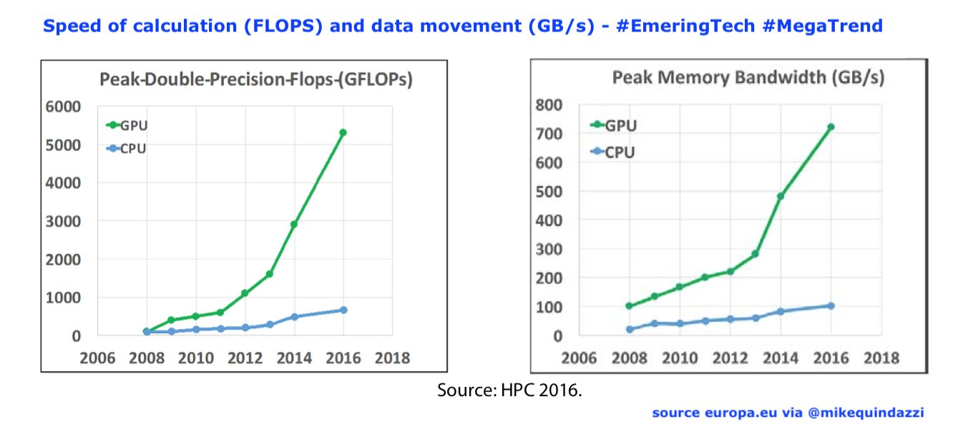
GPU-assisted DIFT Operations
GPUs are suitable for highly parallel applications such as matrix and vector computations.
FlowMatrix operations are accelerated by GPUs!
Notes:
CPU->GPU gap: CPU too slow

Slide 21
GPU-assisted FlowMatrix-based DIFT Query
How can GPUs and FlowMatrix support efficient DIFT queries?
Answer a query by propagating each instruction sequentially? ☹ Query too slow
Prepare queries by pre-computing every possible query? ☹ Too much to prepare
Goal: Reasonable pre-processing cost and rapid query response
?
fp = fopen(path, "r");
while(fgets(msg, maxLength-1, fp)) {
strcat(msg, "\n");
send(socket, msg, strlen(msg), 0);
}
Malicious Input
?
/opt/secret
162.66.239.75
?
/etc/passwd
Source
Sink
DIFT Query Motivating Example
Notes:
Title: too general
Naïve way: instr by instr

Slide 22
Trace-based Repeated DIFT Query
Offline DIFT query on instruction execution traces
(Segment-tree-like) Query Tree
Leaf nodes: FlowMatrix for a single instruction
Non-leaf nodes: Summarized FlowMatrices of two child nodes
Pre-processing (Tree Construction): Linear time complexity

Slide 23
Trace-based Repeated DIFT Query
Offline DIFT query on instruction execution traces
(Segment-tree-like) Query Tree
Leaf nodes: FlowMatrix for a single instruction
Non-leaf nodes: Summarized FlowMatrices of two child nodes
Pre-processing (Tree Construction): Linear time complexity
Query: Logarithmic time complexity
DIFT Query

Slide 24
Evaluation
Evaluation Aspects
Performance
How fast is FlowMatrix-based DIFT query?
How much improvement is achieved by GPU assistance?
Throughput
What is the throughput of FlowMatrix-based DIFT queries?
Comparison
How does FlowMatrix-based DIFT query compare with existing taint tools and DIFT query systems?
Date Set
15 CVEs and 7 common applications
Notes:
Detailed
Accuracy
Setup

Slide 25
Evaluation
Question: How fast is FlowMatrix-based DIFT query?
Answer:
Most DIFT query requests can be answered in less than 0.5 sec.
Notes:
Titles with details

Slide 26

Evaluation
Performance improvement enabled by GPU:
5.6 times faster than our CPU version
Throughput:
Over 5,000,000 dataflows per second on average
Compared with others on throughput:
Our throughput is three orders of magnitude larger than LibDFT
Comparable with server-cluster-based solution JetStream (achieved by 128 CPU cores)
Notes:
Titles with details

Slide 27
Summary
FlowMatrix: a Matrix-based DIFT Representation
We recognize linearity of trace-based information flow operations
We propose a matrix-based representation for DIFT operations
GPU-assisted DIFT
FlowMatrix enables GPU as co-processors for efficient DIFT operations
DIFT Query
We design an efficient DIFT query with high throughput
Notes:
Matrix … DIFT
GPU-assisted DIFT

Slide 28
Complexity Reduction in Information Flows
From specific to broader data structures in information flow tasks:
[1: Sequence] How to accelerating information flow tracking in sequential data?
[2: Partial Order Graph] How to streamlining information flow identification in partial order graphs?
[3: Proposed Work – General Digraph] How to optimize analysis with information flows in direct graphs for specified task?
Partial Order Graph

Slide 29
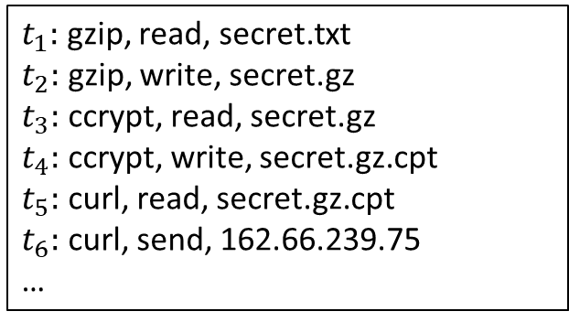
Cyber Threat Analysis with System Auditing
Audit records are a valuable source for analyzing cyber threats:
Low level view of interactions among system entities
Represented as a provenance graph for system’s historical contexts
$t_{1}:$ gzip, read, secret.txt
$t_{2}:$ gzip, write, secret.gz
$t_{3}:$ ccrypt, read, secret.gz
$t_{4}:$ ccrypt, write, secret.gz.cpt
$t_{5}:$ curl, read, secret.gz.cpt
$t_{6}:$ curl, send, 162.66.239.75
…
secret.txt
secret.gz
secret.gz.cpt
read
write
read
write
read
gzip
ccrypt
curl
send
162.66.239.75
(1) Compress
(2) Encrypt
(3) Send-to-Remote
Audit Records
Provenance Graph

Slide 30
Cyber Threat Analysis with System Auditing
Cornerstone: Dependency tracking on provenance graphs
Rule-based intrusion detection system(IDS)
…
secret.gz
secret.gz.cpt
secret.txt
Sensitive Files
Externals
read
write
read
write
read
Sensitive files should never be exfiltrated to any external entities.
gzip
ccrypt
curl
send
Security Policy for Rule-based IDS*
162.66.239.75
Provenance Graph
*: SP’19

Slide 31
Cyber Threat Analysis with System Auditing
Cornerstone: Dependency tracking on provenance graphs
Rule-based intrusion detection system(IDS)
…
The key is to identify the dependency in a provenance graph.
secret.txt
secret.gz
secret.gz.cpt
Sensitive Files
Externals
read
write
read
write
read
Sensitive files should never be exfiltrated to any external entities.
gzip
ccrypt
curl
send
Security Policy for Rule-based IDS*
162.66.239.75
Provenance Graph
*: SP’19

Slide 32
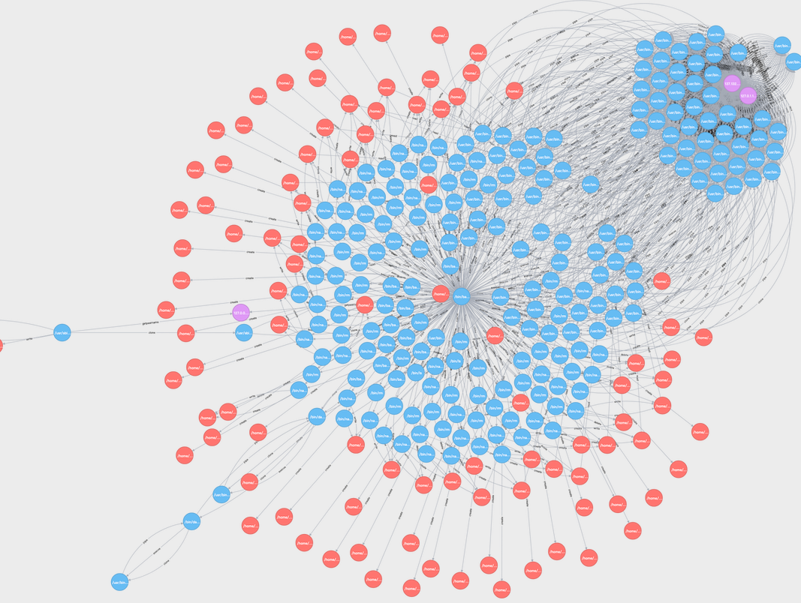
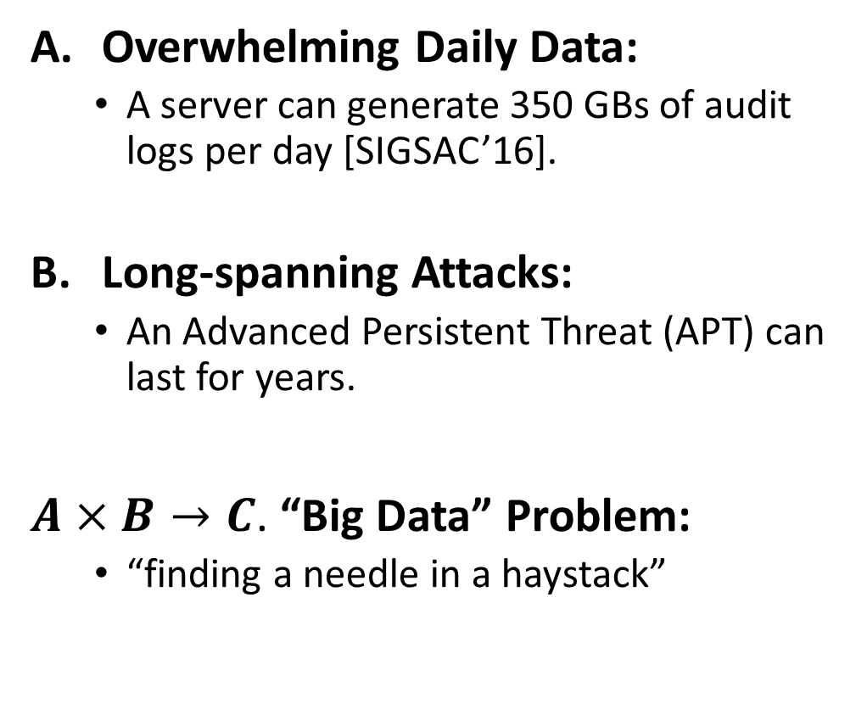
Dependency Identification is Not Easy
Overwhelming Daily Data:
A server can generate 350 GBs of audit logs per day [SIGSAC’16].
Long-spanning Attacks:
An Advanced Persistent Threat (APT) can last for years.
$A×B→C$. “Big Data” Problem:
“finding a needle in a haystack”
Provenance Graph in Real Life

Slide 33
Dependency Identification is Not Easy
Backend of Research Work in System Auditing
Relational databases [NDSS’21, SP’22, Security’23…], graph database and NoSQL tools [Software Impacts’21…]
Lack domain-specific design; Fail to satisfy all query type
Hours of query response time in a long-span attack investigation [ATC’18]
Optimization for Behavior Identification [ATC’18, Security’18]
SQL-style query language for finding a particular behavior from audit records
No acceleration for dependency tracking
Lack of supporting existing threat detection mechanism
Can we achieve efficient dependency tracking
while supporting existing detection techniques?

Slide 34

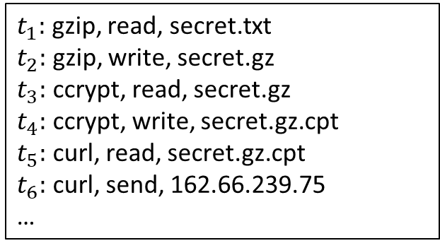





Observation: Orders in Cluttered Audit Records
Audit Records are Chronicles of System Interactions
Each audit record contains temporal information
$t_{1}:$ gzip, read, secret.txt
$t_{2}:$ gzip, write, secret.gz
$t_{3}:$ ccrypt, read, secret.gz
$t_{4}:$ ccrypt, write, secret.gz.cpt
$t_{5}:$ curl, read, secret.gz.cpt
$t_{6}:$ curl, send, 162.66.239.75
…
secret.txt
secret.gz
secret.gz.cpt
$t_{1}$:read
$t_{2}:$write
$t_{3}:$read
$t_{4}:$write
$t_{5}:$read
gzip
ccrypt
curl
$t_{6}:$send
162.66.239.75
Temporal Information in Records
Provenance Graph with Temporal Information
Notes:
Why this is good:

Slide 35



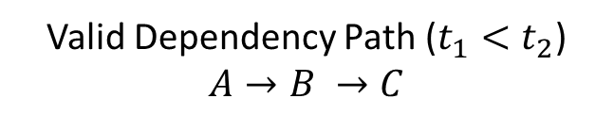






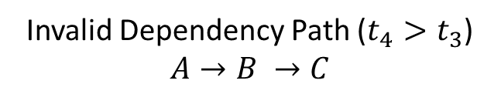








What does “Time” enable: Partial-Order Graphs
Temporal Provenance Graphs
A dependency path must adhere to the temporal order
Convert to Partial-Order Graphs on Temporal Dimension
System entity gets a new version once affected by others (E.g. Writes to a file)
Methodology: Creating cloned nodes for each in-degree edge
$$t_{1}$$
$$t_{2}$$
$$t_{4}$$
$$t_{3}$$
$$A$$
$$B$$
$$C$$
$$A$$
$$B$$
$$C$$
Valid Dependency Path ($t_{1}<t_{2}$)
$$A→B →C$$
Invalid Dependency Path ($t_{4}>t_{3}$)
$$A→B →C$$
$$t_{3}$$
$$B$$
$$C$$
$$t_{4}$$
$$t_{4}$$
$$A$$
$$B′$$
Partially Ordered Structure

Slide 36
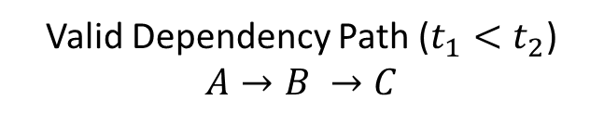
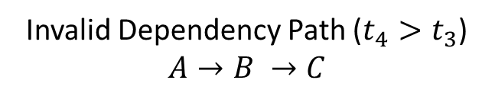
What does “Time” enable: Partial-Order Graphs
Temporal Provenance Graphs
A dependency path must adhere to the temporal order
Convert to Partial-Order Graphs on Temporal Dimension
System entity gets a new version once affected by others (E.g. Writes to a file)
Methodology: Creating cloned nodes for each in-degree edge
$$t_{1}$$
$$t_{2}$$
$$t_{4}$$
$$t_{3}$$
$$A$$
$$B$$
$$C$$
$$A$$
$$B$$
$$C$$
Following Direction of Edges = Following Order of Time
Valid Dependency Path ($t_{1}<t_{2}$)
$$A→B →C$$
Invalid Dependency Path ($t_{4}>t_{3}$)
$$A→B →C$$
$$t_{3}$$
$$B$$
$$C$$
$$t_{4}$$
$$t_{4}$$
$$A$$
$$B′$$
Partially Ordered Structure

Slide 37









What does “Time” enable: Graph Partition
Temporal Graph Partition: Vertex-cutting
Each system call is partitioned into a subgraph (instead of cross-subgraph)
Clone outgoing nodes from previous subgraph as incoming boundaries
gzip
secret.gz
secret.gz.cpt
$t_{3}:$read
$t_{1}$:read
$t_{5}:$read
$t_{2}:$write
ccrypt
secret.gz
$t_{4}:$write
curl
162.66.239.75
secret.txt
secret.gz.cpt
$t_{6}:$send
Destination
Source
$G_{1}$: $t_{1}\sim t_{2}$
$G_{2}$: $t_{3}\sim t_{4}$
$G_{3}$: $t_{5}\sim t_{6}$

Slide 38
Tracking on Large Graphs
Recall: IDS Rule Example
Specified sensitive file lists and external entities
No specification for intermediate dependency routines
…
Sensitive Files
Externals
Sensitive files should never be exfiltrated to any external entities.
IDS Rule

Slide 39




Tracking on Large Graphs
Recall: IDS Rule Example
Specified sensitive file lists and external entities
No specification for intermediate dependency routines
secret.txt
secret.gz
secret.gz.cpt
…
$t_{1}$:read
$t_{2}:$write
$t_{3}:$read
$t_{4}:$write
$t_{5}:$read
gzip
ccrypt
curl
Sensitive Files
Externals
$t_{6}:$send
Sensitive files should never be exfiltrated to any external entities.
162.66.239.75
IDS Rule
Provenance Graph

Slide 40
Tracking on Large Graphs
Recall: IDS Rule Example
Specified sensitive file lists and external entities
No specification for intermediate dependency routines
Source
For intermediate subgraphs, we only pay attention to
its dependency transmission rather than internal structure
secret.txt
secret.gz
secret.gz.cpt
$t_{1}$:read
$t_{2}:$write
?
$t_{4}:$write
$t_{5}:$read
…
$t_{3}:$read
gzip
ccrypt
curl
Sensitive Files
Externals
$t_{6}:$send
Sink
Sensitive files should never be exfiltrated to any external entities.
162.66.239.75
IDS Rule
Provenance Graph

Slide 41
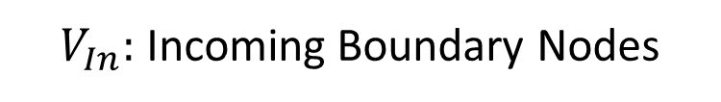
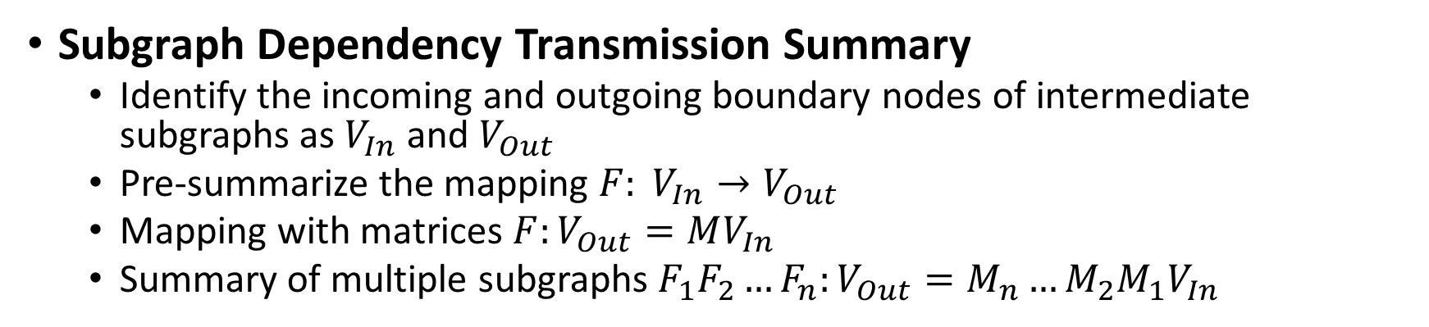

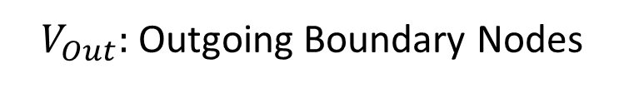
Subgraph Summary
Subgraph Dependency Transmission Summary
Identify the incoming and outgoing boundary nodes of intermediate subgraphs as $V_{In}$ and $V_{Out}$
Pre-summarize the mapping $F: V_{In}→V_{Out}$
Mapping with matrices $F:V_{Out}=MV_{In}$
Summary of multiple subgraphs $F_{1}F_{2}…F_{n}:V_{Out}=M_{n}…M_{2}M_{1}V_{In}$
$$M=\left[\begin{matrix}1 & 0 & 0 \\ 1 & 1 & 0 \\ 1 & 1 & 1\end{matrix} \right]$$
$V_{In}:$Incoming Boundary Nodes
$V_{Out}:$Outgoing Boundary Nodes

Slide 42

Behavior Query
Query with a behavior / multiple behaviors
A behavior of interest is a subgraph of provenance graphs
Virtual nodes linked with subgraphs
Convert behavior query to node query:
Behavior 1:
Initial Compromise
Behavior 2:
Establish Foothold
Behavior 3:
Exfiltration

Slide 43
Query Optimizations
GPU-assisted: Performance Speed-up
Pre-summary and Query Handling with Tree Structure

Slide 44
Query Optimizations
GPU-assisted: Performance Speed-up
Pre-summary and Query Handling with Tree Structure
O(log n) complexity in query, O(n) extra storage overhead
Time interval: 15 minutes, 1 hour, 4 hours, 1 day, 1 week, 1 month…
Flexibility: O(log n) for leaf update, such as marking a behavior
Month 1
Month 2
Week 1
…
Week 5
…
Week 4
…
…
Day 1
Day 2
Day 7
Day 29
Query: Src@Day1 -> Dest@Day 29

Slide 45

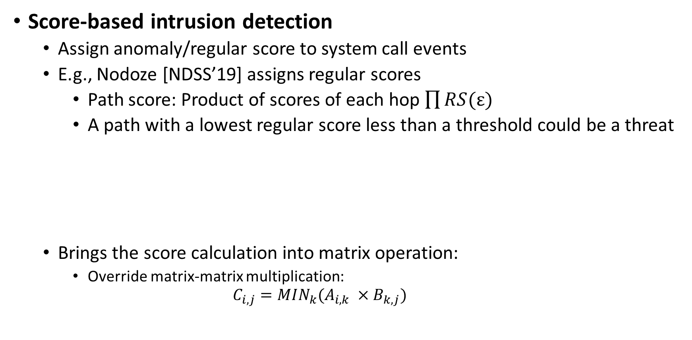
Intrusion Detection Integration
Score-based intrusion detection
Assign anomaly/regular score to system call events
E.g., Nodoze [NDSS’19] assigns regular scores
Path score: Product of scores of each hop $\prod{RS(\text{ε})}$
A path with a lowest regular score less than a threshold could be a threat
Brings the score calculation into matrix operation:
Override matrix-matrix multiplication:
$$C_{i,j}=MIN_{k}(A_{i,k} ×B_{k,j})$$
0.6
0.4
Path Score: 0.24
0.8
0.7
Path Score: 0.56

Slide 46
Evaluation
Experimental datasets:
APT attacks from the DARPA Transparent Computing (TC) dataset
Extension Backdoor, Firefox Backdoor, Pine Backdoor, and Phishing Executable
Evaluation aspects:
How efficient our approach is when executing behavior query in performance and storage?
What is the performance improvement of our query engine compared to other tools?
What is the slowdown for introducing scored-based detection approaches?

Slide 47
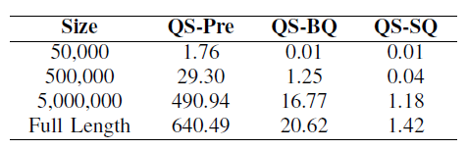
Evaluation 1: How efficient?
Single node query (SQ): less than 1.5 seconds
Behavior query (BQ): less than half a minute
Preparation time (Pre): 0.88 seconds for logs of 15 minutes on average

Slide 48
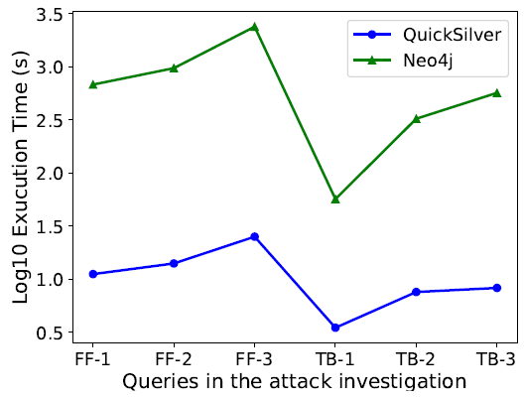
Evaluation 2: Compared with other tool
Two orders of magnitude faster than graph database (Neo4j)
FF: Firefox
TB: Thunderbird
Notes:
Log10-transformed query times for QUICKSILVER and Neo4j. FF-1, FF-2, and FF-3 represent three queries over FireFox. TB-1, TB-2, and TB-3 represent three queries over Thunderbird. The other query targets for FF-1, FF-2, and TB-1 are behaviors, while the other query targets for FF-3, TB-2, and TB-3 are files and/or sockets.

Slide 49
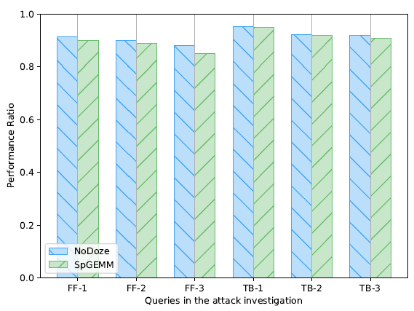
Evaluation 3: Performance of Detection Integration
Around 10% slowdown by integrating Nodoze
Where does the performance slowdown come from?
Intrusion detection integration? Not using CUDA library?
Replace matrix multiplication provided by CUDA: 11% slowdown

Slide 50
Summary
Temporal Order
We convert provenance graphs to partially-ordered graphs with partitions by recognizing the temporal order inside provenance graphs
Query Engine
An efficient GPU-assisted provenance query engine
Intrusion Detection
Integrate score-based threat detection mechanisms with provenance tracking
Notes:
Matrix … DIFT
GPU-assisted DIFT

Slide 51
Complexity Reduction in Information Flows
From specific to broader data structures in information flow tasks:
[1: Linear Order] How to accelerating information flow tracking in sequential data?
[2: Partial Order Graph] How to streamlining information flow identification in partial order graphs?
[3: Proposed Work – General Digraph] How to optimize analysis with information flows in directed graphs for specified tasks?
General Digraph

Slide 52
Implementation Inconsistency in Source Code
Discrepancies from two programs despite common specifications
Brings security risks
E.g., Unexpected crashes, undefined behavior, specification gaps…
Common in fast-evolved communities
E.g., Ahead-of-specification implementation in WebAssembly

Slide 53
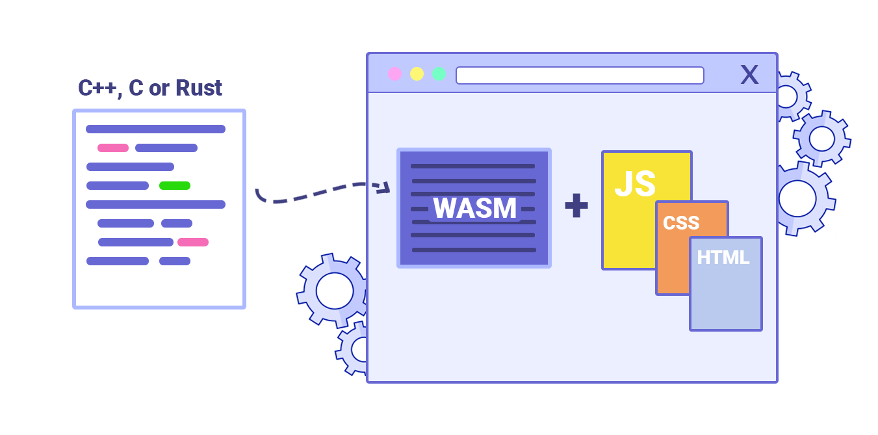
WebAssembly
WebAssembly (WASM)
A new binary instruction format
Compiled from high-level programming languages
Efficiently executed by runtimes on various platforms
Specification-related Inconsistencies in Compilers and Runtimes
Cause: Ahead-of-specification implementation, unrefined features, high-level language feature-related porting, etc.
Target: On the information flow paths of opcodes and operands
By marking the opcodes and operands as data flow sources/sinks, the generated program dependency subgraphs with the aligned root should also align to each other

Slide 54
Motivating Example: SIMD
SIMD vector type handling as a return type in function calls:
bool selectCall(...) {
if (!IsDirect && <ConstantExpr>CalledOperand())
return false;
if (ReturnType->isVector())
if (!hasSIMD128())
// Failed to select a call instr
return false;
// Further convert to a detailed MVT
switch(ReturnType):
...
}
auto parseExpression() {
switch (op) {
case Call:
if (returnType.isV128()) {
// No architecture checking
expressionStack.Append(returnType);
}
} }
Call instruction parser in WebKit Runtime
Call instruction generation in LLVM Compiler

Slide 55
Motivating Example: SIMD
SIMD vector type handling as a return type in function calls:
bool selectCall(...) {
if (!IsDirect && <ConstantExpr>CalledOperand())
return false;
if (ReturnType->isVector())
if (!hasSIMD128())
// Failed to select a call instr
return false;
// Further convert to a detailed MVT
switch(ReturnType):
...
}
auto parseExpression() {
switch (op) {
case Call:
if (returnType.isV128()) {
// No architecture checking
expressionStack.Append(returnType);
}
} }
Specification-related Inconsistency:
Is hardware feature required?
Call instruction parser in WebKit Runtime
Call instruction generation in LLVM Compiler

Slide 56
Motivating Example: SIMD
Document: WASM-SIMD
“WebAssembly aims to take advantage of common hardware capabilities for near-native speed.”
Hardware Required!
Verify: WebKit triggers a segmentation fault
Patch: Add platform checking for WebKit
auto parseExpression() { // Patched
switch (op) {
case Call:
if (returnType.isV128())
if (!Context::tierSupportsSIMD)
addCrash();
expressionStack.Append(returnType);
}
}
WebKit (Patched)

Slide 57
Problem
Specification-Related Implementation Inconsistency Identification
Target: Specification feature checking in opcode&operand selection/parsing
Code: Code generation phase (compilers), parser and validator (runtimes)
bool selectCall(...) {
if (!IsDirect && <ConstantExpr>CalledOperand())
return false;
if (ReturnType->isVector())
if (!hasSIMD128())
// Failed to select a call instr
return false;
// Further convert to a detailed MVT
switch(ReturnType):
...
}
auto parseExpression() {
switch (op) {
case Call:
if (returnType.isV128()) {
// No architecture checking
expressionStack.Append(returnType);
}
} }
Cross
Check
Parser (WasmFunctionParser) in WebKit Runtime
Code generation (WebAssemblyFastISel) in LLVM Compiler
Notes:
Instead of focusing

Slide 58
Related Work
Implementation inconsistency in WASM
Differential testing [ASE’23, arXiv’23], fuzzing [FASE’21]
Substantial analysis time due to large searching space without heuristic guidance
Inconsistency checking for compilers & runtimes other than WASM
Formal verification [CC’92,*], Symbolic execution [TACAS’03]
Difficult to scale due to the path explosion problem
Previous work focus on semantic correctness rather than specification-feature-checking
*: “Introduction to Runtime Verification”, Lectures on Runtime Verification, 2018

Slide 59
Program Dependency Graph (PDG)
Capturing control flows and data flows in one graph
Control flows (solid arrows) and data flows (dash arrows)
Unnecessary complexity: Some nodes unrelated to our problem
bool selectCall(...) {
if (!IsDirect && <ConstantExpr>CalledOperand())
return false;
if (ReturnType->isVector())
if (!hasSIMD128())
// Failed to select a call instr
return false;
// Further convert to a detailed MVT
switch(ReturnType):
...
}
Entry
!isDirect()
IR Instrunction
T
F
T
Ret false
Const Operand()
F
ReturnType
isVector()
F
T
T
!hasSIMD128()
Ret false
F
switch()
…
v128
Program dependency graph of selectCall
Code generation (simplified) from LLVM compiler

Slide 60
Program Dependency Graph (PDG)
Capturing control flows and data flows in one graph
Control flows (solid arrows) and data flows (dash arrows)
Unnecessary complexity: Some nodes unrelated to our problem
bool selectCall(...) {
if (!IsDirect && <ConstantExpr>CalledOperand())
return false;
if (ReturnType->isVector())
if (!hasSIMD128())
// Failed to select a call instr
return false;
// Further convert to a detailed MVT
switch(ReturnType):
...
}
Entry
!isDirect()
IR Instrunction
T
F
T
Ret false
Const Operand()
F
ReturnType
isVector()
F
T
T
!hasSIMD128()
Ret false
F
switch()
…
v128
Program dependency graph of selectCall
Code generation (simplified) from LLVM compiler

Slide 61
Searching Space Reduction: Graph Deduction
Deducted DPGs for reducing searching space:
Data flows: IR instructions/expressions – opcodes/operands as sources and sinks
Control flows: Specification-checking constraints
What’s next: To identify the unmatched paths of specification checking
IR Instr.
Expression
!hasSIMD128
T
IsVector()
…
F
F
…
IsV128()
F
IsI64()
T
T
Return false
rtype
rtype
…
Opcode
Opcode
Deducted Graph – LLVM Compiler
Deducted Graph – WebKit Runtime (Unpatched)

Slide 62
Searching Space Reduction: Constraint Alignment
Subgraph matching with heuristics:
Aligned “Anchor” Constraints: Checking the same specification feature
E.g., IsVector and IsV128 both check whether their data types are 128-bit vector
IR Instr.
Expression
!hasSIMD128
T
IsVector()
…
F
F
…
IsV128()
F
IsI64()
T
T
Return false
rtype
rtype
…
Opcode
Opcode
Deducted Graph – LLVM Compiler
Deducted Graph – WebKit Runtime (Unpatched)

Slide 63

Searching Space Reduction: Constraint Alignment
Principle in constraint alignment
Without alignment, number of paths to be matched:
$$"p×q"\sim "m×n“$$
Number of paths to be matched after alignment: $"p"\sim "m"+"q"\sim "n"$
#path from upper subgraph: p
#path from upper subgraph: m
…
…
…
…
#path from lower subgraph: q
#path from upper subgraph: n

Slide 64
Effectiveness Improvement in Path Matching
Verification of unmatched sub-paths
Is this specification-feature-checking performed in the other subgraphs?
…
…
Unmatched path from other subgraphs
…
…
…
…

Slide 65
Code Comprehension Component
Tasks in two-step searching space reduction
Specification-related constraint identification
Cross-project constraint alignment
Challenge
Specification-checking in different projects: differences in naming, code structure, etc.
// LLVM
if (!hasSIMD128())
// WebKit
if (!Context::tierSupportsSIMD)

Slide 66
Learning-based Code Comprehension
Traditional learning models
Inputs could be code text, program dependency graph, code property graph, etc.
Such models require massive amounts of high-quality training data
Training data not enough for compiler and runtime code alignment ☹
Pre-trained models:
E.g., generative pre-trained transformers (GPTs)
Trained on extensive and diverse datasets
No necessary requirements for massive amounts of training data ☺
Able capture a broad range of code patterns

Slide 67


Effectiveness Improvement
Inherent problems
E.g., hallucination
It checks whether a variable is empty.
What does isVoid() mean?
// Check whether a function has a return
if (!ReturnType->isVoid())
Notes:
Omission

Slide 68
Effectiveness Improvement
Input (Prompt)
Conditions: E.g., the full if statement
Context: E.g., located function names, nearby codes
Define: Included function definitions
Background: Project name, file name
Extra Knowledge (Retrieval-augmented generation, RAG)
Project Documents (if applicable)
SPEC Documents (if applicable)
Prompt Skills
E.g., Few shot learning, chain-of-thought prompting, structure prompting, etc.
Notes:
Omission

Slide 69
Proposed Goals
Problem formulation
First to formulate the problem of implementation inconsistency of WebAssembly specification in compilers and runtimes
Matching
Deduce program dependency graph for searching space reduction
Leverage node alignment as heuristic guidance for subgraph matching
Utilize GPT as code comprehension component
Engine
Propose an intelligent source code cross-checking system for detecting WASM specification implementation inconsistencies
Notes:
Omission

Slide 70
In Summary
We improve the efficiency and scalability of security analysis with information flows by reducing the complexity towards different data structures of problems.
We accelerate binary DIFT query with a novel matrix representation utilized on GPUs.
We perform efficient GPU-assisted provenance dependency query for system auditing by identifying the partial-order relationship.
We propose an efficient identification approach for WebAssembly specification implementation inconsistency via graph deduction and heuristic node matching.
Thanks!
Notes:
We did A,B,C

Slide 71
Evaluation - Performance
Question: How much improvement achieved by GPU assistance?
Answer:
Our prototype outperforms CPU-based DIFT tool over 5 times in performance on average.

Slide 72
Evaluation - Throughput
Question: What is the throughput of the DIFT query operations?
Answer:
Over 5,000,000 dataflows per second on average

Slide 73

Evaluation - Comparison
Question: Is FlowMatrix comparable to existing taint engines and DIFT query systems?
Answer:
Our throughput is three orders of magnitude larger than LibDFT
Comparable with JetStream (achieved by 128 CPU cores)

Slide 74
Prompt Flow for Constraint Alignment
You are an expert for code comprehension in Web Assembly specification implementation from compilers and runtimes. Please help me…
For example: [Few Cases Provided]
For the first specification checking, please explain the code: [if statement]
Background: [Project Name] [File Name] [Code Context]…
Please refer to [Project Document] for extra information.
[Explain the code]
For the second specification checking…
[Explain the code]
Please make a judgement whether these two constraints perform the same checking, answering with “Yes” and “No” only. If unsure, answer “No”.
Please refer to [SPEC Document] for potential extra information.
Yes/No

Slide 75

Support Under/Over-tracking in DIFT queries
Improper tracking policy may lead under/over-tracking
E.g., Common under-tracking cases: dependencies between pointers and values, between condition and in-branch variables
How to mutate tracking policy with FlowMatrix?
Directly patch DIFT rule matrix
eax
ebx
MOV eax, [ebx]
eax
ebx
$$\left[\begin{matrix}0 & 0 \\ 0 & 1\end{matrix}\right]→\left[\begin{matrix}0 & 1 \\ 0 & 1\end{matrix}\right]$$
Rule Patching
Notes:
Simplify
Over-tainting+under-tainting: policy
How to mutate policy with flowMatrix

Slide 76

Support Under/Over-tracking in DIFT queries
Improper tracking policy may lead under/over-tracking
E.g., Common under-tracking cases: dependencies between pointers and values, between condition and in-branch variables
How to mutate tracking policy with FlowMatrix?
Directly patch DIFT rule matrix
Add a temporary variable to bridge information flows
eax
ebx
JNE <branch1>
branch1:
XOR ebx, ebx
MOV eax, ebx
eax
ZF
MOV eax, [ebx]
tmp
eax
ebx
eax
ZF
$$\left[\begin{matrix}0 & 0 \\ 0 & 0\end{matrix}\right]→\left[\begin{matrix}0 & 0 & 1 \\ 0 & 0 & 0 \\ 0 & 0 & 0\end{matrix}\right]×\left[\begin{matrix}0 & 0 & 0 \\ 0 & 0 & 0 \\ 0 & 1 & 0\end{matrix}\right]$$
$$\left[\begin{matrix}0 & 0 \\ 0 & 1\end{matrix}\right]→\left[\begin{matrix}0 & 1 \\ 0 & 1\end{matrix}\right]$$
Rule Patching
Temporary Variable Bridging
Notes:
Simplify
Over-tainting+under-tainting: policy
How to mutate policy with flowMatrix

Slide 77
Cyber Threat Analysis with System Auditing
Cornerstone: Dependency tracking on provenance graphs
Rule-based intrusion detection system(IDS)
Security Query for Forensic Analysis
…
…
The key is to identify the dependency in a provenance graph.
secret.txt
secret.gz
secret.gz.cpt
Sensitive Files
Operations
Externals
read
write
read
write
read
Someone remotely accesses our HR’s desktop, compresses a sensitive file, encrypts it and then sends data to a remote server.
gzip
ccrypt
curl
send
162.66.239.75
Security Query*
Provenance Graph
*: VLDB’15, ATC’18, Security’18

Slide 78
Cyber Threat Analysis with System Auditing
Cornerstone: Dependency tracking on provenance graphs
Rule-based intrusion detection system(IDS)
Security Query for Forensic Analysis
…
…
secret.txt
secret.gz
secret.gz.cpt
Sensitive Files
Operations
Externals
read
write
read
write
read
Someone remotely accesses our HR’s desktop, compresses a sensitive file, encrypts it and then sends data to a remote server.
gzip
ccrypt
curl
send
162.66.239.75
Security Query*
Provenance Graph
*: VLDB’15, ATC’18, Security’18

Slide 79
Cyber Threat Analysis with System Auditing
Cornerstone: Dependency tracking on provenance graphs
Rule-based intrusion detection system(IDS)
Security Query for Forensic Analysis
…
…
secret.txt
secret.gz
secret.gz.cpt
Sensitive Files
Operations
Externals
read
write
read
write
read
Someone remotely accesses our HR’s desktop, compresses a sensitive file, encrypts it and then sends data to a remote server.
gzip
ccrypt
curl
send
162.66.239.75
Security Query*
Provenance Graph
*: VLDB’15, ATC’18, Security’18

Slide 80
Cons in Information Flow Analysis
Information flow analysis incurs significant costs:
1. Heavy Performance Overhead: Instrumentation and tag propagation bring 8 to 40 times slowdown to dynamic binary taint analysis.
; Application instruction
mov eax, [ebp+8]
; Instrumented code for tainting
push eax
lea eax, [ebp+8]
push eax
call TagPropagation
pop eax
Simplified example for instrumentation
Notes:
Challenge

Slide 81
Cons in Information Flow Analysis
Information flow analysis incurs significant costs:
2. Massive Amount of Data: Overwhelming TBs of real-world data makes dependency queries taking hours to execute in provenance-based system audit analysis.
$ strace ls
execve("/usr/bin/ls", ["ls"], 0x7ffde2c6ee40 /* 24 vars */) = 0
brk(NULL) = 0x55993d854000
arch_prctl(0x3001 /* ARCH_??? */, 0x7ffc68fd71e0) = -1 EINVAL (Invalid argument) <…144 system calls in total…>
One command could generate hundreds of audit records
Notes:
0x3001 ARCH_CET_STATUS, which checks Control-flow Enforcement Technology (CET) Shadow Stack

Slide 82
Cons in Information Flow Analysis
Information flow analysis incurs significant costs:
3. Large Searching Space: In static code analysis of large codebases, the number of possible execution paths increases exponentially due to the lack of concrete execution decisions.
1: if x>0:
2: if y>0:
3: if z>0:
Dynamic: (x,y,z) = (1,3,5)
Static: (x,y,z) = (int,int,int)
Notes:
0x3001 ARCH_CET_STATUS, which checks Control-flow Enforcement Technology (CET) Shadow Stack

Slide 83

Representations in Information Flows - Graph
Pros: Universal Representation
Cons: significant performance cost due to heavy computation and large scale of data
Goals:
What are the individual features of data structures in different problems?

Slide 84
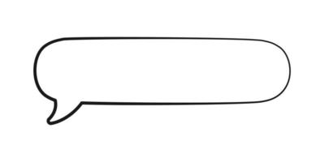
Dependency Identification Optimizations
Prioritized Dependency Tracking [NDSS’18, Security’21]
In forensic analysis, first check subgraphs that are more likely to be abnormal
Ad-hoc optimization for threat detection
Optimization for Behavior Identification [ATC’18, Security’18]
SQL-style query language for finding a particular behavior from audit records
No acceleration for dependency tracking
Lack of supporting existing threat detection mechanism
Can we achieve efficient dependency tracking while integrated with detection techniques?

Slide 85



Popular Security Tasks for information flows
All these tasks requires information-flow-based techniques
Data Leak Prevention
Intrusion Detection
Static Application
Security Testing
Notes:
They can all be modeled as information flow graphs

Slide 86
Cons in Information Flow Analysis
Information flow analysis incurs significant costs:
3. Path Explosion: In static code analysis of large codebases, the number of possible execution paths increases exponentially due to the lack of concrete execution decisions.
Notes:
0x3001 ARCH_CET_STATUS, which checks Control-flow Enforcement Technology (CET) Shadow Stack

Slide 87


Our goal in this thesis
To improve the efficiency and scalability of information flow analysis in a range of security tasks
Hours
Optimize to
Seconds ~ Minutes

Slide 88
Cons in Information Flow Analysis
Information flow analysis incurs significant costs:
3. Path Explosion: In static code analysis of large codebases, the number of possible execution paths increases exponentially due to the lack of concrete execution decisions.
1: if x>0:
Dynamic: (x,y,z) = (1,3,5)
2: if y>0:
3: if z>0:
Notes:
0x3001 ARCH_CET_STATUS, which checks Control-flow Enforcement Technology (CET) Shadow Stack

Slide 89
Subgraph Summary
Pre-summary is efficient for later query, but…
We are unable to pre-summarize intermediate subgraph for each possible source-destination pair
Pre-summarize for time intervals and combine in queries as need
Insight from human’s organization: In the first hour; the second hour; …
Q1: How to cut provenance graphs with time intervals?
Q2: How to combine the summary results?

Slide 90




Representation of Mappings
Boundary Vector Space
Summarized mapping for a subgraph $F:V_{In}^{}→V_{Out}^{}$
Mapping with matrices $F:v_{out}=Mv_{in}$
Summary of multiple subgraphs $F_{1}F_{2}…F_{n}:v_{out}=M_{n}…M_{2}M_{1}v_{in}$
$$M=\left[\begin{matrix}1 & 0 & 0 \\ 1 & 1 & 0 \\ 1 & 1 & 1\end{matrix} \right]$$
$$v_{in}$$
$$v_{out}$$

Slide 91



Partitioned Subgraph Summary
Summarized Mapping
$$V_{In}^{G_{1}}→V_{Out}^{G_{1}}$$
$$V_{In}^{G_{2}}→V_{Out}^{G_{2}}$$
$$V_{In}^{G_{3}}→V_{Out}^{G_{3}}$$
gzip
secret.gz
secret.gz
$t_{3}:$read
$t_{1}$:read
$t_{5}:$read
$t_{2}:$write
ccrypt
secret.gz
$t_{4}:$write
curl
162.66.239.75
secret.txt
secret.gz.cpt
$t_{6}:$send
Destination
Source
$G_{1}$: $t_{1}\sim t_{2}$
$G_{2}$: $t_{3}\sim t_{4}$
$G_{3}$: $t_{5}\sim t_{6}$

Slide 92

Partitioned Subgraph Summary
Summarized Mapping
The incoming boundary node vector space $V_{In}^{G_{i+1}}$ is the clone of the outgoing vector space from the previous subgraph $V_{Out}^{G_{i}}$
$$V_{In}^{G_{1}}→V_{Out}^{G_{1}}$$
$$V_{In}^{G_{2}}→V_{Out}^{G_{2}}$$
$$V_{In}^{G_{3}}→V_{Out}^{G_{3}}$$
gzip
secret.gz
secret.gz
$t_{3}:$read
$t_{1}$:read
$t_{5}:$read
$t_{2}:$write
ccrypt
secret.gz
$t_{4}:$write
curl
162.66.239.75
secret.txt
secret.gz.cpt
$t_{6}:$send
Destination
Source
$G_{1}$: $t_{1}\sim t_{2}$
$G_{2}$: $t_{3}\sim t_{4}$
$G_{3}$: $t_{5}\sim t_{6}$

Slide 93


Partitioned Subgraph Summary
Summarized Mapping
The incoming boundary node vector space $V_{In}^{G_{i+1}}$ is the clone of the outgoing vector space from the previous subgraph $V_{Out}^{G_{i}}$
$$V_{In}^{G_{1}}→V_{Out}^{G_{1}}$$
$$V_{Out}^{G_{1}}→V_{Out}^{G_{2}}$$
$$V_{Out}^{G_{2}}→V_{Out}^{G_{3}}$$
gzip
secret.gz
secret.gz
$t_{3}:$read
$t_{1}$:read
$t_{5}:$read
$t_{2}:$write
ccrypt
secret.gz
$t_{4}:$write
curl
162.66.239.75
secret.txt
secret.gz.cpt
$t_{6}:$send
Destination
Source
$G_{1}$: $t_{1}\sim t_{2}$
$G_{2}$: $t_{3}\sim t_{4}$
$G_{3}$: $t_{5}\sim t_{6}$

Slide 94

Summary Combination
Dependency Tracking through Subgraphs
Dependency Existence Query $Q(Src, Dest)$can be addressed with:
$Src→V_{In}^{G_{1}}→V_{Out}^{G_{1}}$ $→V_{Out}^{G_{2}}→V_{Out}^{G_{3}}→Dest$
gzip
secret.gz
secret.gz
$t_{3}:$read
$t_{1}$:read
$t_{5}:$read
$t_{2}:$write
ccrypt
secret.gz
$t_{4}:$write
curl
162.66.239.75
secret.txt
secret.gz.cpt
$t_{6}:$send
Destination
Source
$G_{1}$: $t_{1}\sim t_{2}$
$G_{2}$: $t_{3}\sim t_{4}$
$G_{3}$: $t_{5}\sim t_{6}$

Slide 95
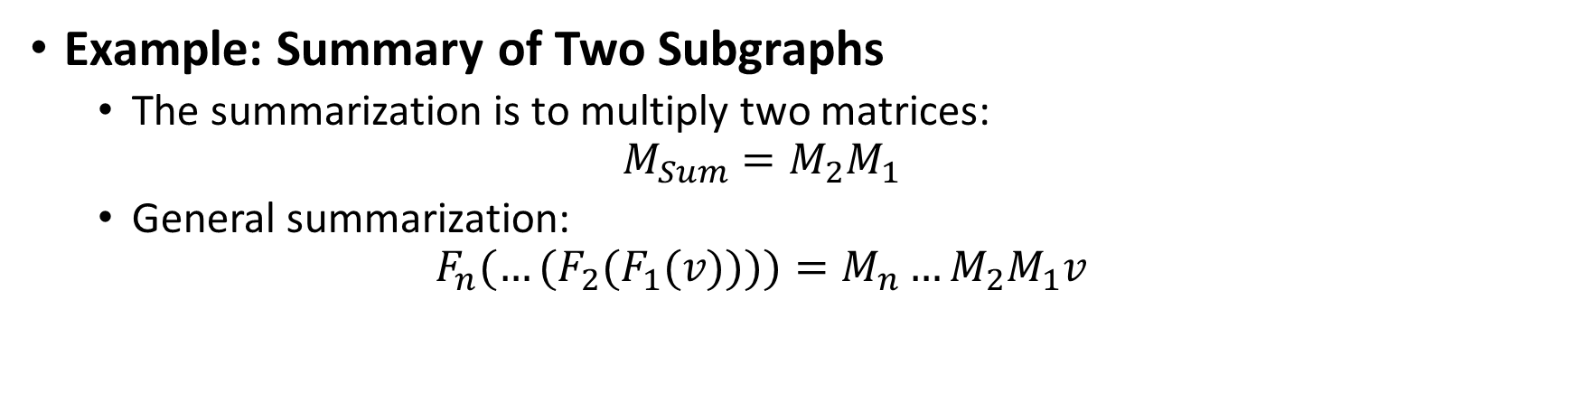
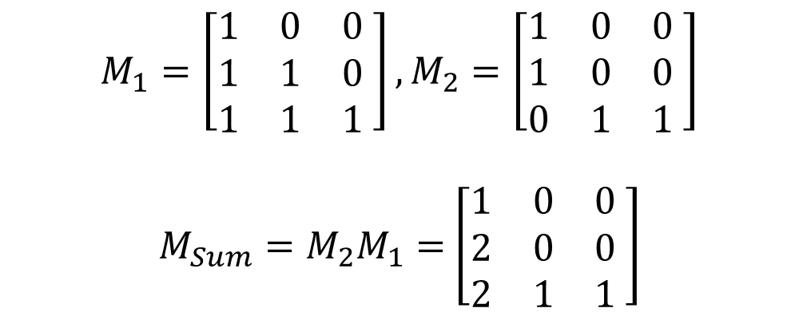
Combination with Matrices
Example: Summary of Two Subgraphs
The summarization is to multiply two matrices:
$$M_{Sum}=M_{2}M_{1}$$
General summarization:
$${{F_{n}(…(F}_{2}(F}_{1}(v))))=M_{n}…M_{2}M_{1}v$$
$$M_{1}=\left[\begin{matrix}1 & 0 & 0 \\ 1 & 1 & 0 \\ 1 & 1 & 1\end{matrix} \right],M_{2}=\left[\begin{matrix}1 & 0 & 0 \\ 1 & 0 & 0 \\ 0 & 1 & 1\end{matrix} \right]$$
$M_{Sum}=M_{2}M_{1}=$ $\left[\begin{matrix}1 & 0 & 0 \\ 2 & 0 & 0 \\ 2 & 1 & 1\end{matrix} \right]$
Summary of two subgraphs

Slide 96
Cons in Information Flow Analysis
Information flow analysis incurs significant costs:
3. Path Explosion: In static code analysis of large codebases, the number of possible execution paths increases exponentially due to the lack of concrete execution decisions.
1: if x>0:
Dynamic: (x,y,z) = (1,3,5)
2: if y>0:
3: if z>0:
Notes:
0x3001 ARCH_CET_STATUS, which checks Control-flow Enforcement Technology (CET) Shadow Stack

Slide 97

Tracking on Large Graphs
For intermediate subgraphs, we only pay attention to
its dependency transmission rather than internal structure
secret.txt
secret.gz
secret.gz.cpt
$t_{1}$:read
$t_{2}:$write
?
$t_{4}:$write
$t_{5}:$read
$t_{3}:$read
gzip
ccrypt
curl
$t_{6}:$send
…
secret.txt
162.66.239.75
162.66.239.75
Source
Destination
Provenance Graph
$G_{Intermediate}$:Black Box
Dependency Path Finding: $Source→G_{Intermediate}→Destination$

Slide 98
Motivating Example: SIMD
Vector type handling in call instruction:
Source
v128
auto parseExpression() {
switch (op) {
case Call:
if (returnType.isV128()) {
// No architecture checking
expressionStack.Append(returnType);
}
} }
ReturnType is
128-bit Vector?
Y
WebKit Runtime
Expression

Slide 99
Motivating Example: SIMD
bool selectCall(...) {
if (!IsDirect && <ConstantExpr>CalledOperand())
return false;
if (ReturnType->isVector() && !hasSIMD128())
// Failed to select a call instr
return false;
// Further convert to a detailed MVT
switch(ReturnType):
...
}
Vector type handling in call instruction:
Source, Forward Tracking
Expression
v128
Platform
supports SIMD?
LLVM Compiler
&&
Discrepancy:
Is hardware feature required?
auto parseExpression() {
switch (op) {
case Call:
if (returnType.isV128()) {
// No architecture checking
expressionStack.Append(returnType);
}
} }
N
ReturnType is
128-bit Vector?
ReturnType is
128-bit Vector?
End
Y
Y
Sink
v128
Expression
LLVM Compiler
WebKit Runtime
WebKit Runtime

Slide 100
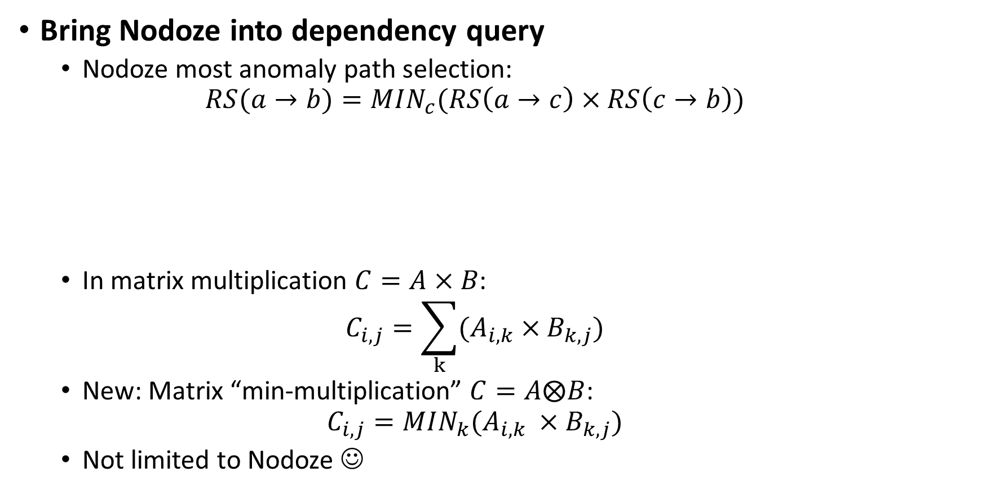
Score Computation with Matrix
Bring Nodoze into dependency query
Nodoze most anomaly path selection:
$$RS(a→b)=MIN_{c}(RS\left(a→c\right)×RS\left(c→b\right))$$
In matrix multiplication $C=A×B$:
$$C_{i,j}=\sum_{k}{{(A}_{i,k} ×B_{k,j})}$$
New: Matrix “min-multiplication” $C=A⨂B$:
$$C_{i,j}=MIN_{k}(A_{i,k} ×B_{k,j})$$
Not limited to Nodoze ☺
0.6
0.4
Path Score: 0.24
0.8
0.7
Path Score: 0.56

Slide 101

Principle in Constraint Alignment
Possible paths to be matched:
$$"p×q"\sim "m×n"$$
Paths to be matched after node alignment:
$$"p"\sim "m"+"q"\sim "n"$$
#path from upper subgraph: p
#path from lower subgraph: m
#path from lower subgraph: q
#path from lower subgraph: n

Slide 102
Identification via Path Cross-matching
Cross-check compilers and runtimes at path level
Extract all the instruction-generation/parser-related paths from program dependency graphs
Cross-match paths and looking for mismatches
Observations of specification checking
Observation 1: Single or continuous if statements
Observation 2: Logical order
// Common
if (returnType.isV128())
if (!Context::tierSupportsSIMD)
// Uncommon
if (!Context::tierSupportsSIMD)
if (returnType.isV128())
// Checking with in a single if statement
if (!hasSIMD128() && ReturnType->isVector())
// Checking with in continuous if statements
if (returnType.isV128())
if (!Context::tierSupportsSIMD)

Slide 103
Mismatched Path
A potential inconsistency
Append to a task queue for verification
Is this SPEC check performed in the other subgraphs?
Queue the discrepancy over other mismatched sub-paths from other sub-paths

Slide 104
Mismatched Path
A potential inconsistency
Append to a task queue for verification
Is this SPEC check performed in the other subgraphs?
Queue the discrepancy over other mismatched sub-paths from other sub-paths

